Slide 1
Effects of hadronic rescatterings in small system
Tetsufumi Hirano
Sophia Univ.
Ultra-RelatIvistiCH Heavy IoNZ 2016
18-20 July 2016, CERN

Slide 2
Contents
1. My early career and collaboration with Ulrich
2. Integrated dynamical model
3. Initial longitudinal structure
4. Results in d+Au
5. Hydro +
mini-jet model
6. Summary

Slide 3
Ulrich’s paper triggered one of my first studies
Proceedings of QM97 at Tsukuba
(My very first QM attendance)

Slide 4
T_{ch f.o.} > T_{th f.o.}

Slide 5
Idea of partial chemical equilibrium in hydro
Yield and slope of p_{T} spectra at once within hydro
Similar ideas:
D.Teaney (2002)
P.Kolb and R.Rapp (2003)
P.Huovinen (2008)

Slide 6
Slope of v₂(p_{T})?
Upper: Chem. Eq.
Lower: Partial Chem. Eq.
PCE spoils success of hydro!
Most people: Why is v₂ sensitive to final stage? Simply wrong!
It seemed to me Ulrich was at least interested in these results.

Slide 7
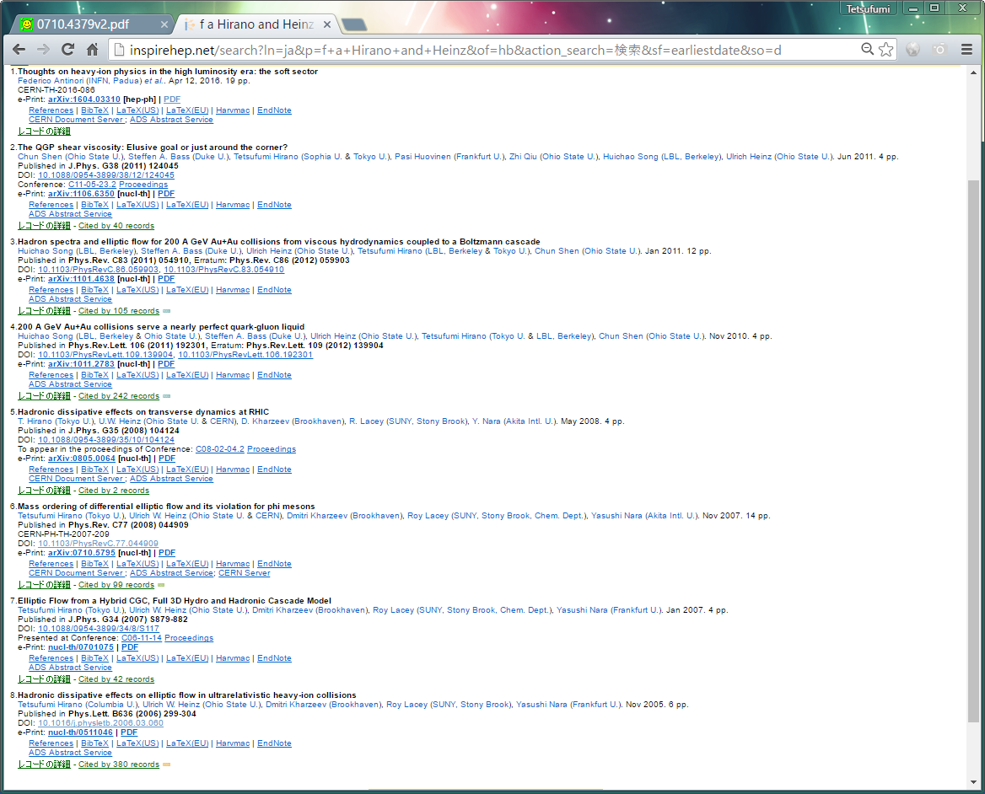
8 papers with Ulrich

Slide 8
Very first full 3D hydro + cascade

Slide 9

Main results
$$ε_{2,CGC}>ε_{2,Glauber}$$
Initial condition:
CGC vs. Glauber
v2(eta): Crucial roll played by hadronic rescatterings
These ideas survive in recent hydro analysis

Slide 10
Contents
1. My early career and collaboration with Ulrich
2. Integrated dynamical model
3. Initial longitudinal structure
4. Results in d+Au
5. Hydro +
mini-jet model
6. Summary

Slide 11
Integrated dynamical model
Hadronic cascade model
Microscopic description of
Hadron gases (JAM)
time
Relativistic hydrodynamics
Space-time evolution of
QGP+hadronic fluids
Lattice EOS
collision axis
0
Monte-Carlo Glauber/KLN model
Initial profile of matter
Hirano, Huovinen, Murase, Nara (2013)
Takeuchi, MHHN (2015)

Slide 12
Contents
1. My early career and collaboration with Ulrich
2. Integrated dynamical model
3. Initial longitudinal structure
4. Results in d+Au
5. Hydro +
mini-jet model
6. Summary

Slide 13
Rapidity triangle/trapezoid of (dN_{dAu}/deta)/(dN_{pp}/deta)
Figures from
Adil and Gyulassy (2005)

Slide 14


Modified BGK model
Original BGK: Brodsky, Gunion, Kuhn (1977)
Formation of hadronic strings
${−Y}_{beam}$← rapidity → $Y_{beam}$
Number of participants
from MC-Glauber model
Parametrization of entropy density dist.

Slide 15










Rapidity dependence of initial entropy density
$$s_{0}\left(τ_{0}, η_{s}, x_{⊥}\right)∝$$
$$f^{pp}(η_{s})$$
$$1$$
$$N_{A}$$
$$⨂$$
$$N_{B}$$
$$η_{s}$$
$$η_{s}$$
$${−Y}_{b}$$
$$Y_{b}$$
Rapidity profile in pp collisions
→ Boost inv. near midrapidity
Rapidity triangle/trapezoid

Slide 16
Integrated dynamical model for small systems
time
Hadronic cascade model
Microscopic description of
Hadron gases
Relativistic hydrodynamics
Space-time evolution of
QGP+hadronic fluids
collision axis
0
Monte-Carlo Glauber + modified BGK + PYTHIA
Initial profile of matter
NEW
d
Au
Kawaguchi, Murase, Hirano (work in progress)

Slide 17
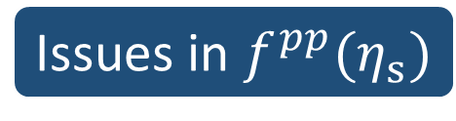
New version of Modified BGK Model
Issues in $f^{pp}(η_{s})$
No multiplicity fluctuation
  Multiplicity does not fluctuate in pp collisions.
No longitudinal fluctuation
  Smooth profile in longitudinal direction
PYTHIA8.1
Multiplicity fluctuation even in pp collisions
Fluctuation of longitudinal matter profile
→New baseline initial condition based on Glauber picture

Slide 18
Contents
1. My early career and collaboration with Ulrich
2. Integrated dynamical model
3. Initial longitudinal structure
4. Results in d+Au
5. Hydro +
mini-jet model
6. Summary

Slide 19
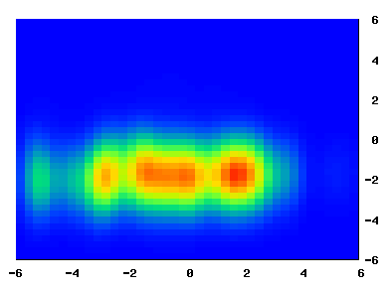
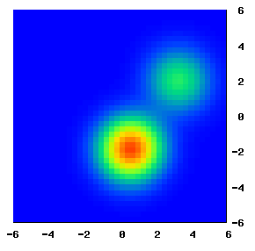







Matter Profile in d+Au Collision
Longitudinal profile
$$(x=0)$$
Transverse profile
$$(η_{s}=0)$$
$$y [fm]$$
$$y [fm]$$
Au-going side
$$η_{s}$$
d-going side
$$x [fm]$$
Smearing parameters
$$δ_{x}=δ_{y}=0.3 \left[fm\right], δ_{η_{s}}=0.3$$

Slide 20
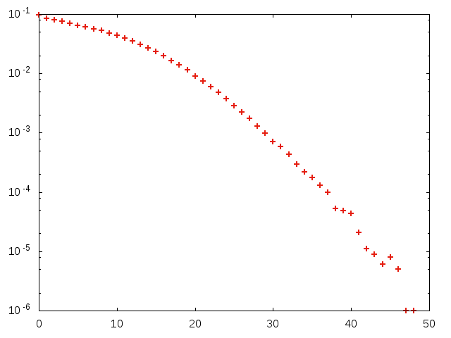

Multiplicity distribution in d+Au collisions
Event fraction
$$N_{ch}(−3.9<η<−3.0)$$
Au-going side
Utilize for centrality cut

Slide 21
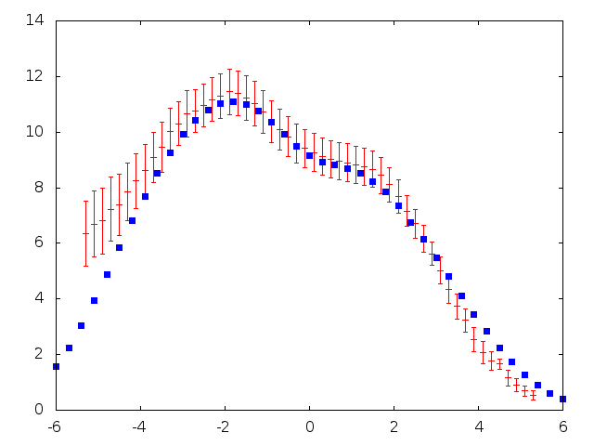
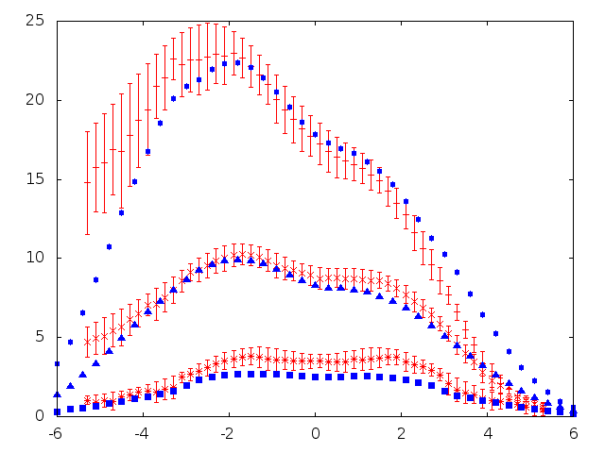



Pseudorapidity distribution in d+Au collisions
PHOBOS
Model
0-20%
$$\frac{dN_{ch}}{dη}$$
40-60%
80-100%
min. bias
$$η$$
$$η$$
Reasonable description of pseudorapidity and centrality dependences in d+Au collisions
PHOBOS, PRC83, 024913 (2011)

Slide 22
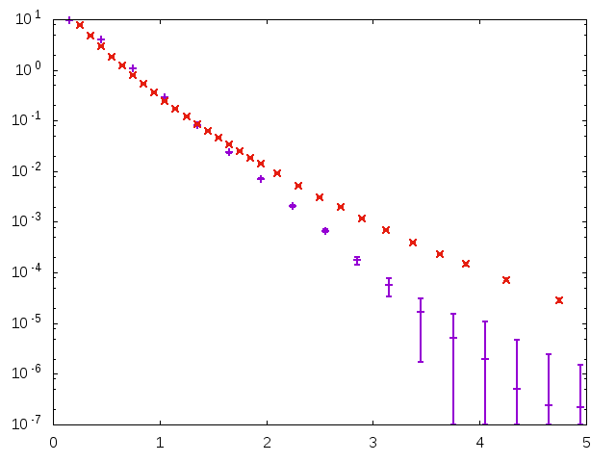
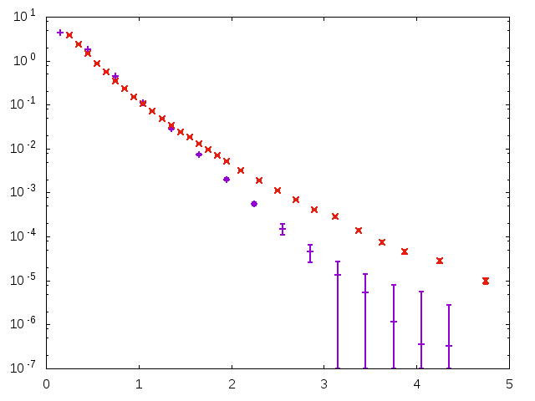







p_{T} spectra of charged hadrons
$$0.2<η<1.4$$
PHOBOS
Model
$${\left(2πp_{T}\right)}^{−1}{d^{2}N}/{dηdp_{T}} {\left({GeV}/c\right)}^{−2}$$
0-$20\%$
40-$70\%$
$$p_{T} ({GeV}/c)$$
$$p_{T} ({GeV}/c)$$
Low $p_{T}$ well described by this model
PHOBOS, PRL91, 072302 (2003)

Slide 23
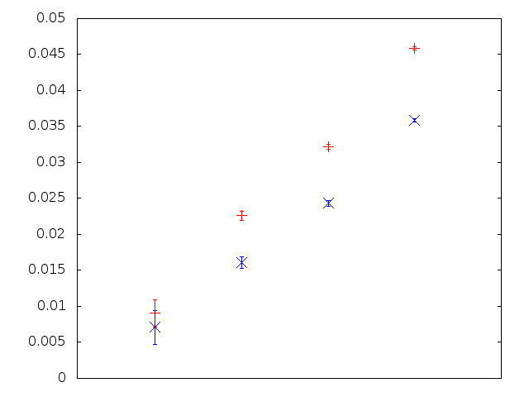
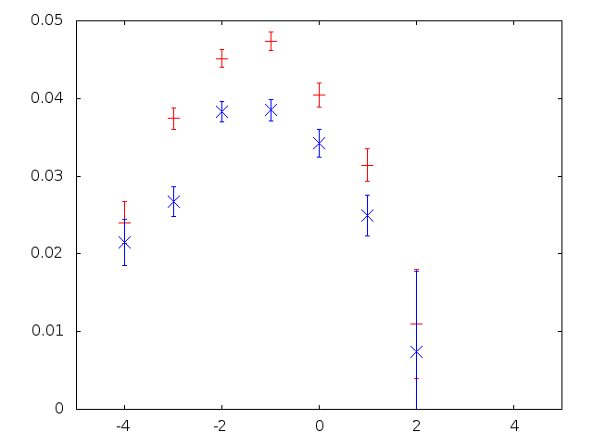










Effects of hadronic rescatterings on v₂ in d+Au collisions
Centrality dependence
Pseudorapidity dependence
0-$20\%$
$$\left|η\right|<6$$
$$0−40\%$$
20-$40\%$
$$v_{2}\{2\}$$
40-$60\%$
$$v_{2}\{2\}$$
60-$80\%$
RED: w. rescatterings
BLUE: w.o. rescatterings
$$η$$
~80% of total $v_{2}$ from fluid-dynamical stage
→ Similar to AA collisions

Slide 24
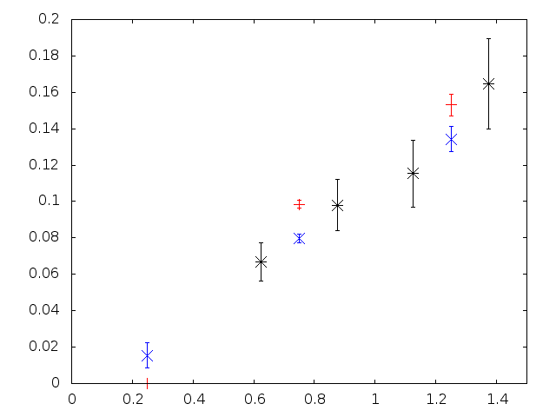






Comparison with PHENIX data
PHENIX, PRL114, 192301 (2015)
BLACK: PHENIX
RED: w. rescatterings
BLUE: w.o. rescatterings
$$v_{2}\{2\}$$
$$0−5\%$$
$$\left|η\right|<0.35$$
$$p_{T} ({GeV}/c)$$
Not significant effects of rescatterings on $v_{2}(p_{T})$ slope
→Partly canceled by increase of mean $p_{T}$
Analysis of $v_{2}\{EP\}$: work in progress

Slide 25
Contents
1. My early career and collaboration with Ulrich
2. Integrated dynamical model
3. Initial longitudinal structure
4. Results in d+Au
5. Hydro +
mini-jet model
6. Summary

Slide 26
New source of higher harmonics?
Fluctuations appear everywhere!
Initial state fluctuations
  Fluctuations of transverse position of nucleons in colliding nuclei
  Multiplicity fluctuations
Hydrodynamic fluctuations
  Thermal noises
  Critical fluctuations
Disturbance by (mini-)jet propagation
Schulk, Tomášik(2014)

Slide 27
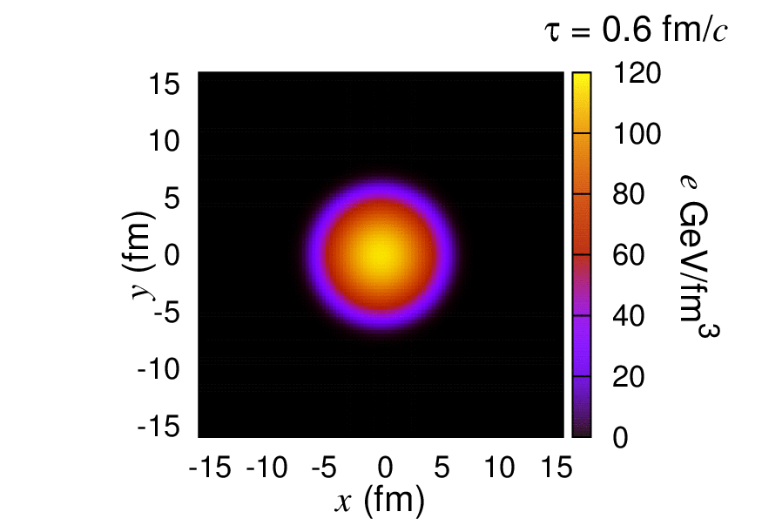
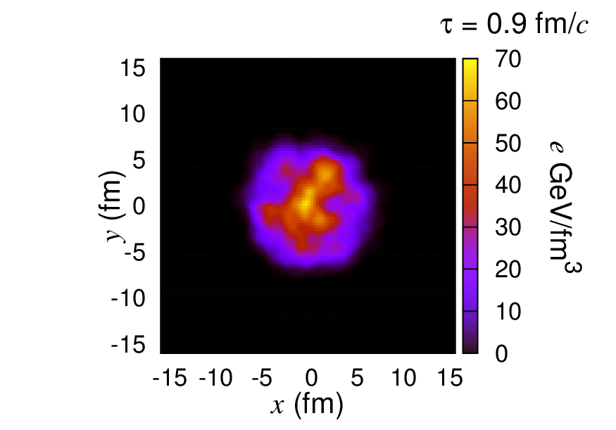

Jet propagation in $γ$-jet event
Full 3D ideal hydrodynamics
+ energy-momentum deposition by a parton
Smooth profile case
Bumpy profile case
Without linearization
Chaudhuri, Heinz (2006), Betz, Noronha, Torrieri, Gyulassy, Rischke (2010),
Tachibana, Hirano (2014, 2016), …
Movies: Courtesy of Y. Tachibana

Slide 28
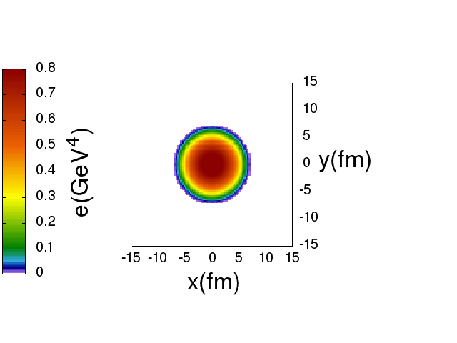



Many mini-jet propagation
$$Pb+Pb 2.76 TeV$$
$$b=0 fm$$
$N_{coll}: 1983$, $N_{part}: 411$
# of mini-jet ($p_{T}>2GeV$):
$\sim 600$ (at midrapidity)
Smooth initial condition (optical Glauber)
Bumpy freezeout hypersuface
Higher harmonics?
Okai, Tachibana, Hirano (work in progress)

Slide 29
Contents
1. My early career and collaboration with Ulrich
2. Integrated dynamical model
3. Initial longitudinal structure
4. Results in d+Au
5. Hydro +
mini-jet model
6. Summary

Slide 30

Summary
Happy 60th Birthday to Ulrich!
Effects of hadronic rescatterings (Calibration of a lens to look at the QGP) investigated together with Ulrich must be always important in high-energy nuclear collisions towards extracting transport properties of the QGP

Slide 31
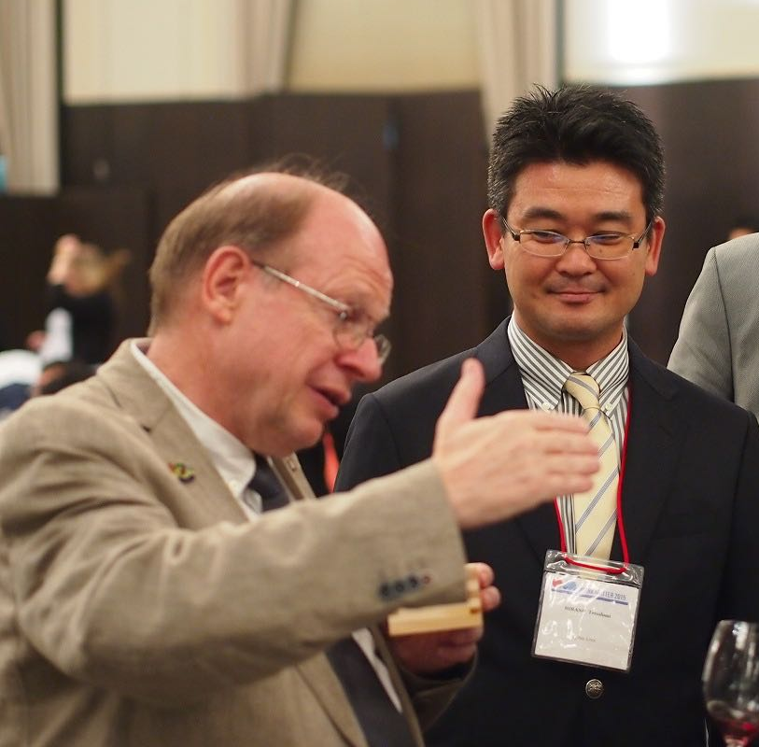
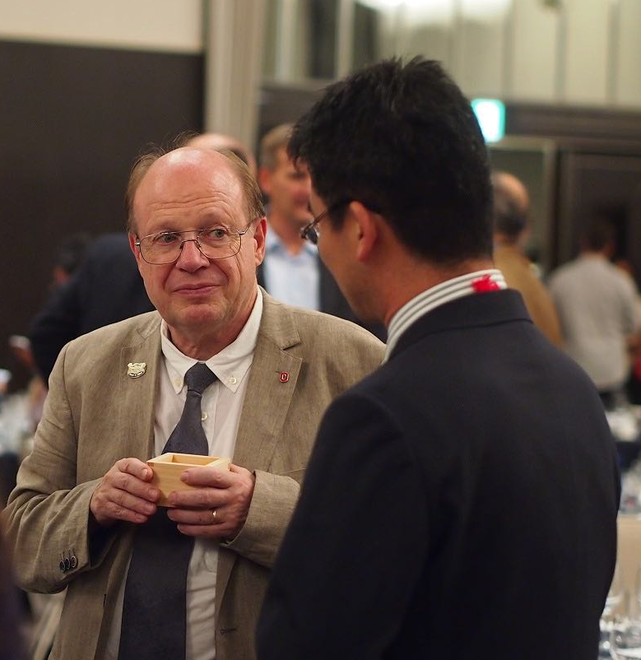
Photos taken in
QM2015 at Kobe
To successful
QM2017 at Chicago!

Slide 32
Backups

Slide 33
Violation of mass ordering in v₂(p_{T})

Slide 34
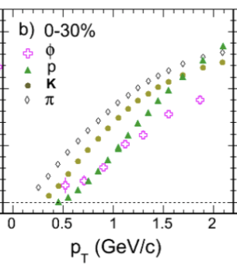
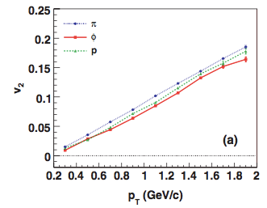
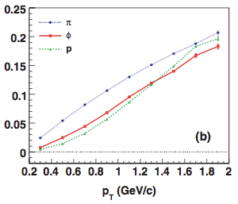
Observed!
mass ordering
at T=155 MeV
Prediction
of violation
Md. Nasim [STAR Collaboration],
Nucl. Phys. A 904-905 (2013) 413c
Quantitatively?

Slide 35
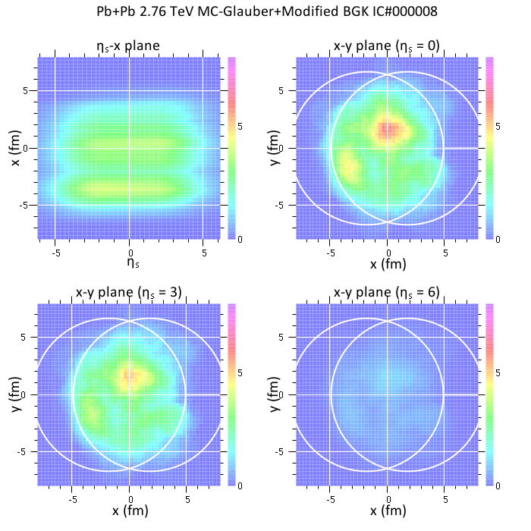

MC-Glauber to hydro
Initial time: $τ_{0}=0.6 fm$
Soft/hard fraction: $α=0.18$
+ overall normalization
+ rapidity shape in $pp$
Entropy density
The other thermodynamic
variables through equation of state
One example of initial condition

Slide 36






Relativistic hydrodynamics
Hydrodynamic equations
Equation of state
$$∂_{μ}T^{μν}=0$$
$$T^{μν}=\left(e+p\right)u^{μ}u^{ν}$$
$$−pg^{μν}$$
$e$: energy density
$p$: pressure
High $T$
→ Lattice result (hot QCD)
Low $T$
→ Hadron resonance gas
$u^{μ}$: four flow velocity
*No dissipation in this study
See also, P.Huovinen and P.Petreczky,
NPA837, 26 (2010)

Slide 37






Hydro to cascade
One-particle distribution from a fluid element
F.Cooper, G.Frye (1974)
$$E\frac{d^{3}ΔN}{d^{3}k}=\frac{g}{{\left(2π\right)}^{3}}\frac{k⋅Δσ}{exp\left[k⋅u/T_{sw}\right]±1}$$
$$Σ:T\left(x\right)=T_{sw}$$
$${Δσ}^{μ}$$
$$T_{sw}=155 MeV$$
$$N^{μ}$$
Thermal dist. in switching hypersurface $Σ$
boosted by fluid velocity $u^{μ}$
Output from hydro as initial condition for cascade

Slide 38


Hadronic cascade model (JAM)
Incoherent convolution of hadron-hadron scattering and resonance decays
Some remarks on strangeness sector
$\overline{K}N$ and $KN$ incoming channel
$$\overline{K}N→πY,\overline{K}N→Y^{∗}, KN→K^{∗}N$$
*Inverse process through detailed balance
Other processes → Additive quark model
$$σ_{tot}=σ_{NN}\frac{n_{1}}{3}\frac{n_{2}}{3}\left(1−0.4\frac{n_{s1}}{n_{1}}\right)\left(1−0.4\frac{n_{s2}}{n_{2}}\right)$$
See also, Y.Nara et al., PRC61, 024901 (2000),
TH and Y.Nara, PTEP 01A203 (2012).

Slide 39


Some details of initial conditions in longitudinal direction
$$s_{0}\left(τ_{0}, η_{s}, x_{⊥}\right)=\frac{dS}{τ_{0}dη_{s}d^{2}x_{⊥}}$$
$$=\frac{C}{τ_{0}}f^{pp}(η_{s})\left[\frac{1−α}{2}\left(\frac{Y_{b}−η_{s}}{Y_{b}}ρ_{A}\left(x_{⊥}\right)+\frac{Y_{b}+η_{s}}{Y_{b}}ρ_{B}(x_{⊥})\right)+αρ_{coll}(x_{⊥})\right]$$
Triangle/Trapezoid
$$f^{pp}\left(η_{s}\right)=exp\left[−θ(\left|η_{s}\right|−Δη)\frac{{\left(\left|η_{s}\right|−Δη\right)}^{2}}{σ_{η}^{2}}\right]$$
RHIC energy:
$$C=15.0, α=0.18, τ_{0}=0.6 fm, Δη=1.3, σ_{η}=2.1$$

Slide 40







Rejection sampling
$N_{A}×N_{B}$ strings
One AA event
→ $N_{A}×N_{B}$ PYTHIA events
Weight in one PYTHIA event
$$w\left(η\right)$$
$$=\frac{1}{2}\left(\frac{Y_{b}+η}{Y_{b}}\frac{1}{N_{A}}+\frac{Y_{b}−η}{Y_{b}}\frac{1}{N_{B}}\right)$$
$$N_{A}$$
$$N_{B}$$
$$N_{A}N_{B}w\left(η\right)=\left\{\begin{matrix}N_{A} (η=−Y_{b}) \\ N_{B} (η=Y_{b})\end{matrix}\right.$$
${−Y}_{b}$ ← $η$ → $Y_{b}$

Slide 41







p_{T} dependent option in rejection sampling
$$w\left(η, p_{T}\right)=w\left(η\right)×\frac{1}{2}\left(1−\tanh{\frac{p_{T}−p_{T0}}{Δp_{T}}}\right)$$
$$+ 1×\frac{1}{2}\left(1+\tanh{\frac{p_{T}−p_{T0}}{Δp_{T}}}\right)$$
$$N_{A}N_{B}w(η=0,p_{T})$$
$$N_{coll}$$
$$N_{part}/2$$
$$Δp_{T}$$
$$p_{T}$$
$$p_{T0}$$

