Slide 1


Building the Standard Model for Relativistic Heavy-ion Collisions
Chun Shen
McGill University
July 20, ULtra-RelatIvistiCH Heavy IoNZ 2016

Slide 2
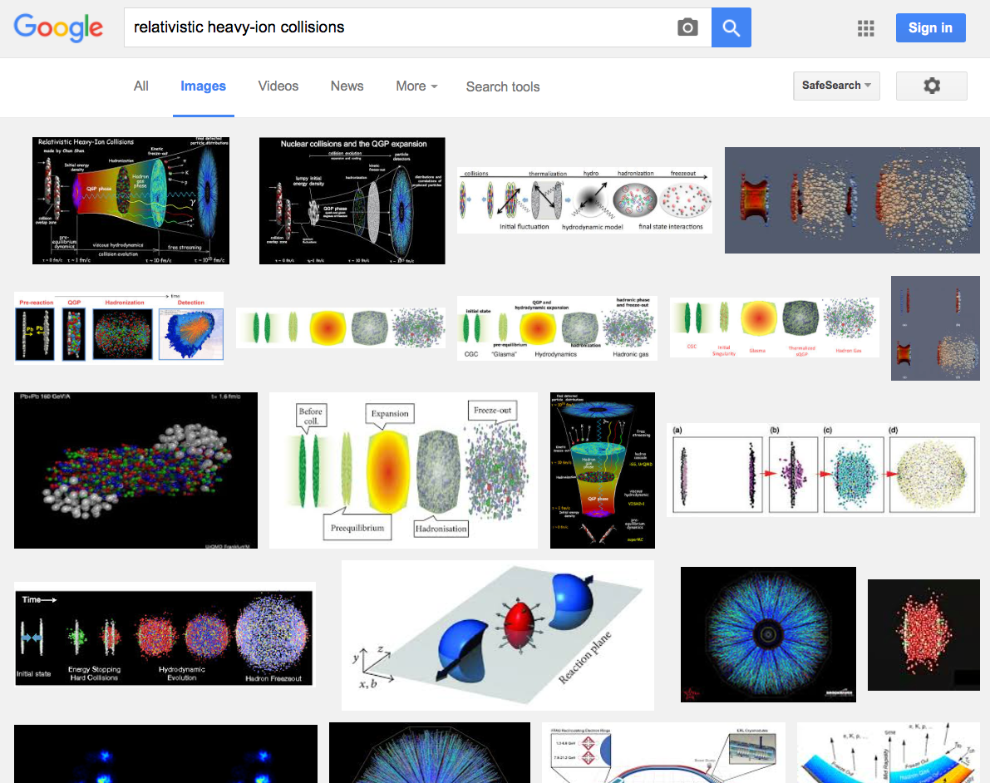

Slide 3
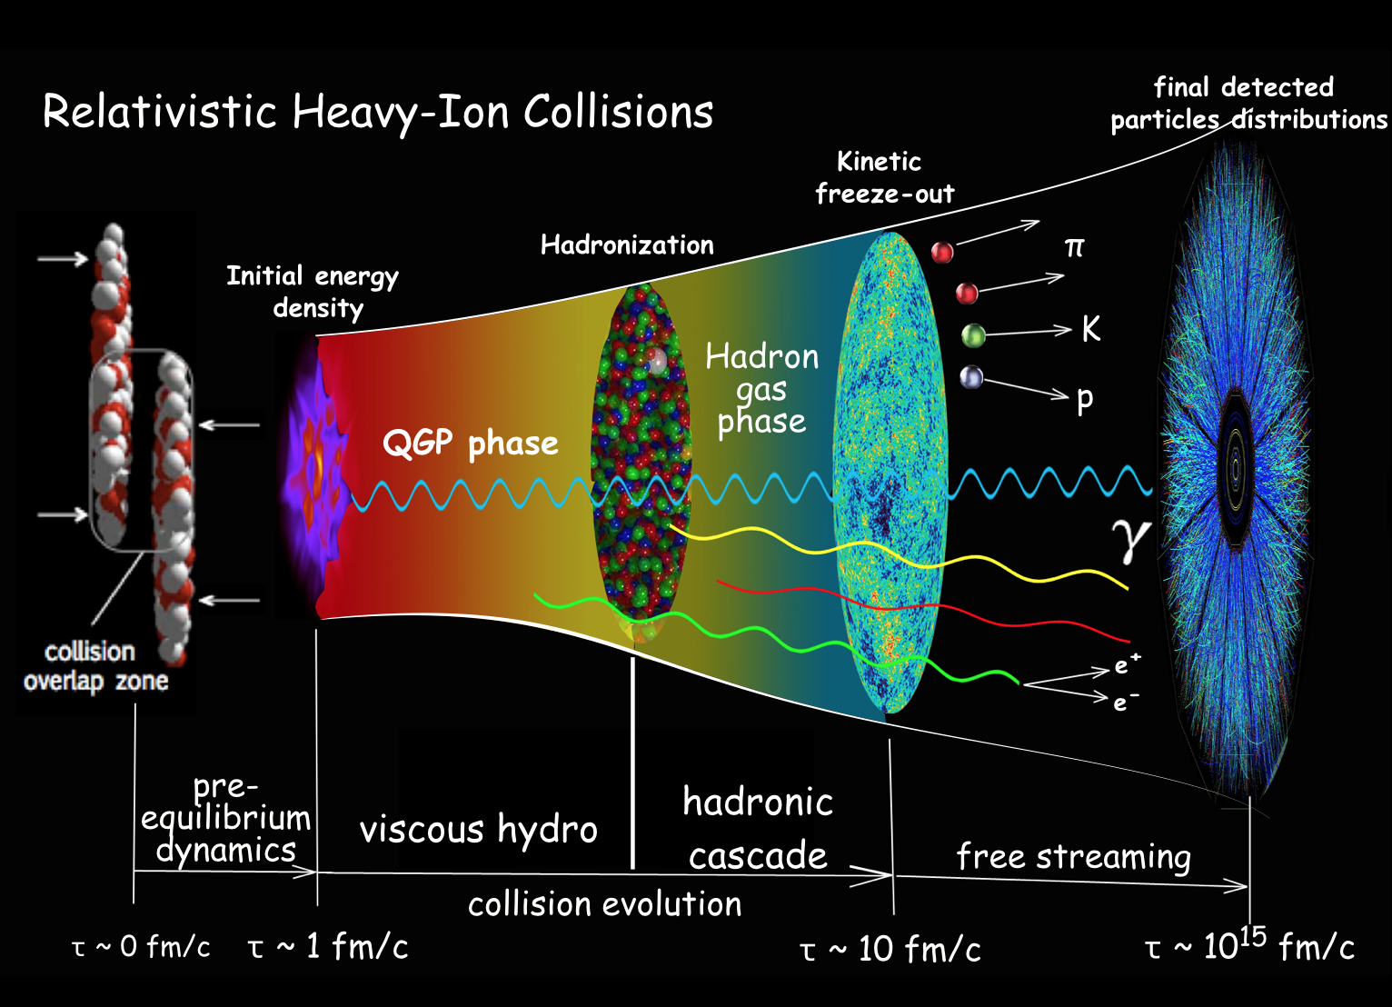

Slide 4
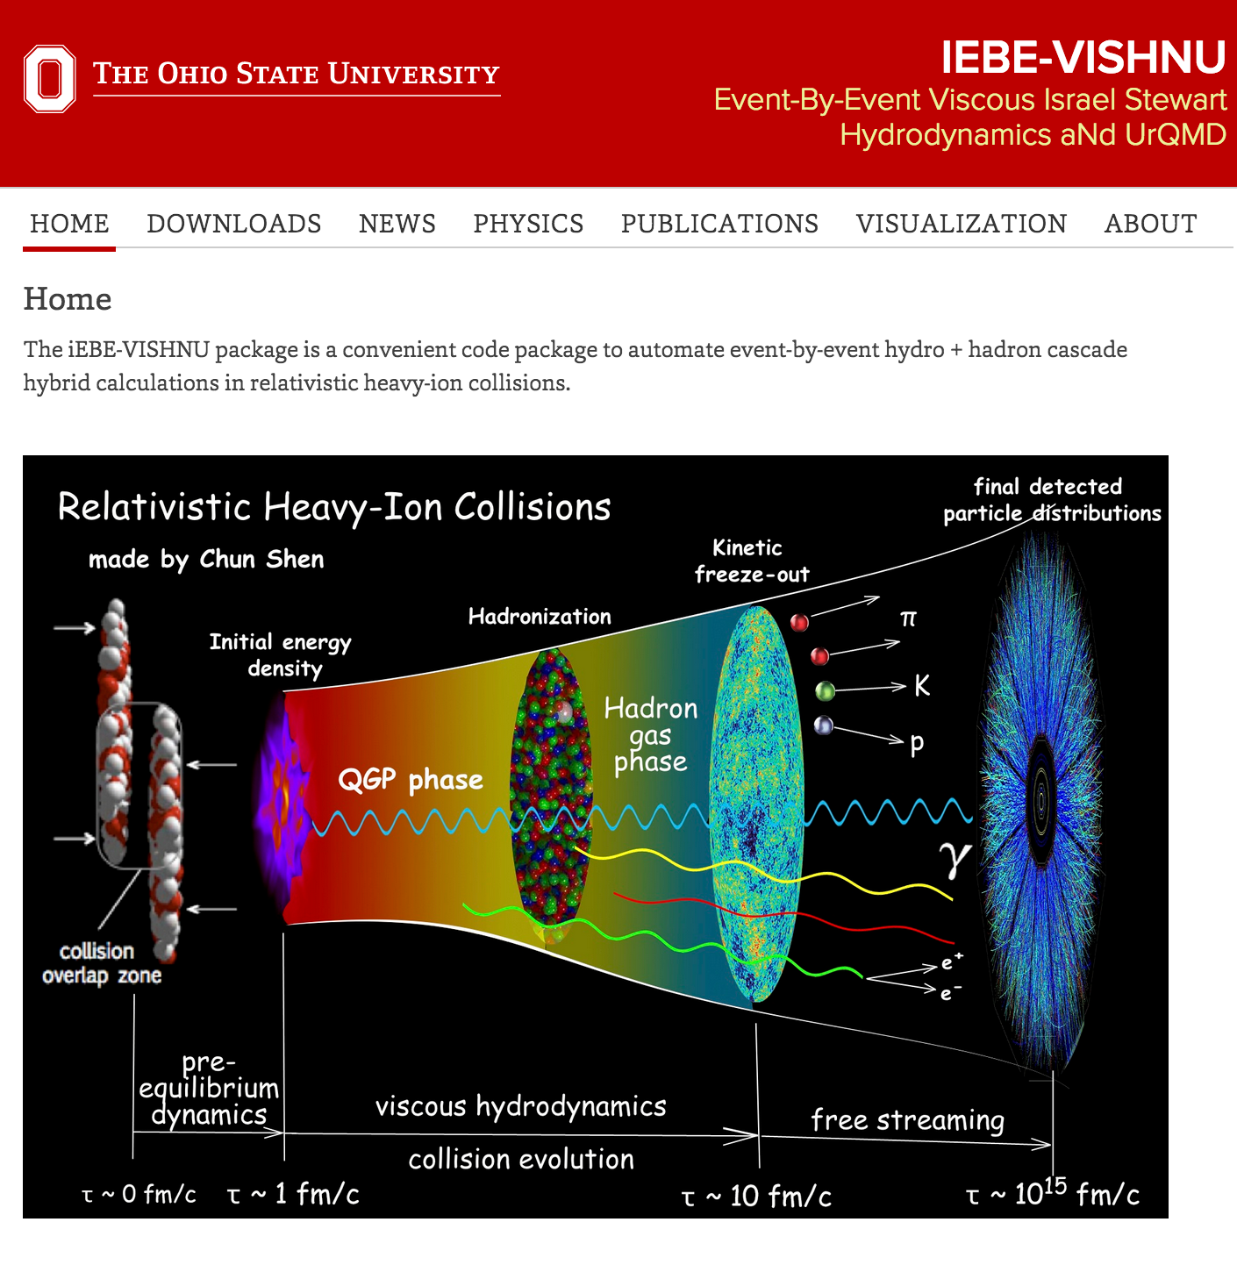


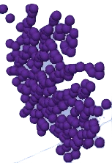
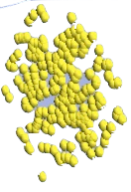
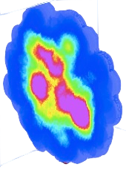
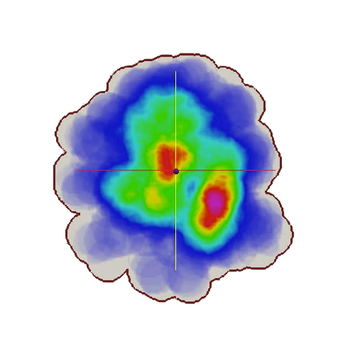
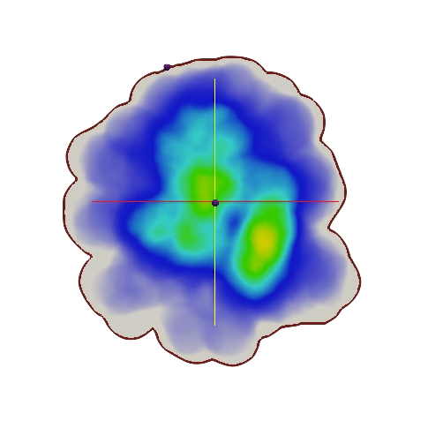
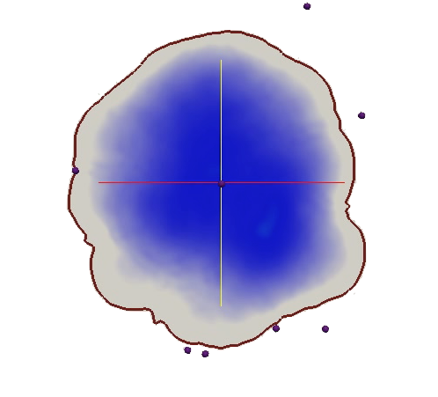
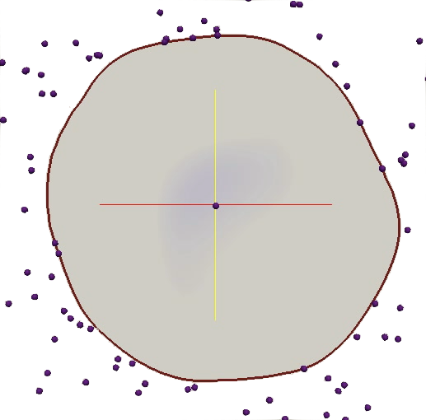
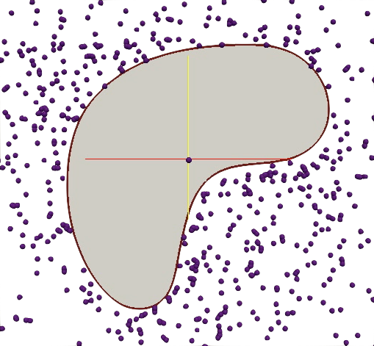
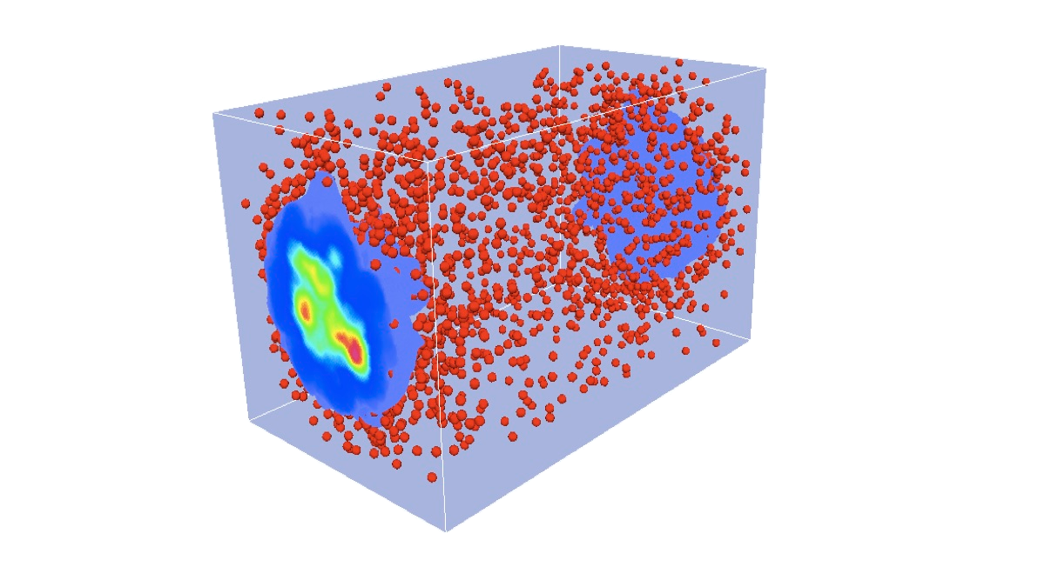
IEBE simulation work flow
http://u.osu.edu/vishnu/
Initial Condition
Ω
+
=
Generate Initial Conditions
superMC
(C++)
Hydrodynamics
Hydrodynamic simulations
VISHNew
(FORTRAN)
Flow of time
Cascade
iSS
(C++)
Particle emission
Hadron re-scattering
UrQMD
(FORTRAN)
Collect particle information into observables
binUtilities
(Python)
3
3

Slide 5
IEBE simulation work flow
http://u.osu.edu/vishnu/
Initial Condition
Ω
+
=
Generate Initial Conditions
superMC
(C++)
Hydrodynamics
Hydrodynamic simulations
VISHNew
(FORTRAN)
Flow of time
Cascade
15,000,000 events
have been simulated!
iSS
(C++)
Particle emission
Hadron re-scattering
UrQMD
(FORTRAN)
Collect particle information into observables
binUtilities
(Python)
3

Slide 6
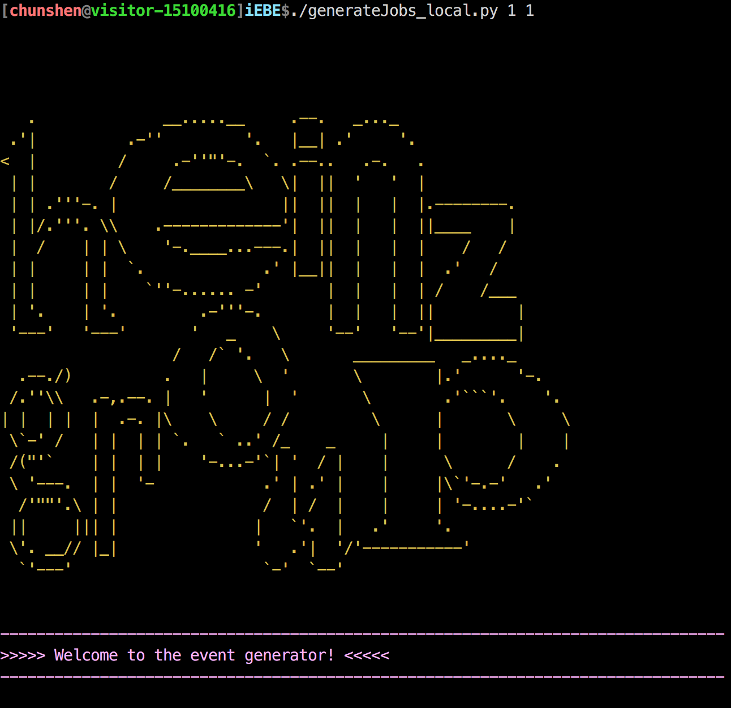
IEBE simulation work flow
http://u.osu.edu/vishnu/
Initial Condition
Ω
+
=
Generate Initial Conditions
superMC
(C++)
Hydrodynamics
Hydrodynamic simulations
VISHNew
(FORTRAN)
Flow of time
Cascade
15,000,000 events
have been simulated!
iSS
(C++)
Particle emission
Hadron re-scattering
UrQMD
(FORTRAN)
Collect particle information into observables
binUtilities
(Python)
3

Slide 7
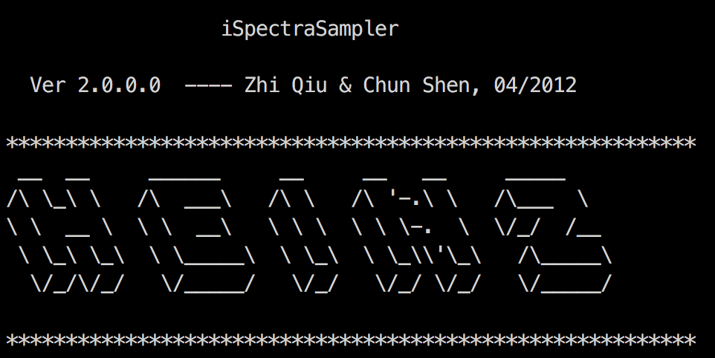
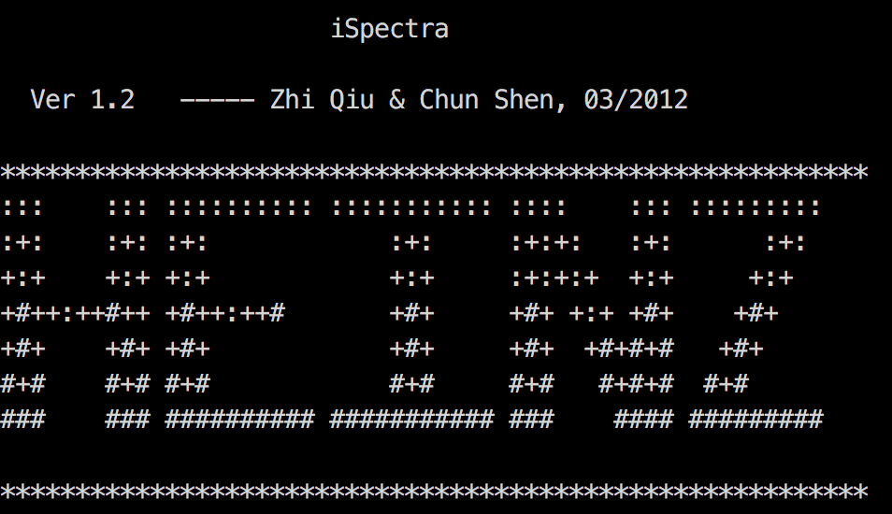
IEBE simulation work flow
http://u.osu.edu/vishnu/
Initial Condition
Ω
+
=
Generate Initial Conditions
superMC
(C++)
Hydrodynamics
Hydrodynamic simulations
VISHNew
(FORTRAN)
Flow of time
Cascade
15,000,000 events
have been simulated!
iSS
(C++)
Particle emission
Hadron re-scattering
UrQMD
(FORTRAN)
Collect particle information into observables
binUtilities
(Python)
From Zhi Qiu:
3

Slide 8
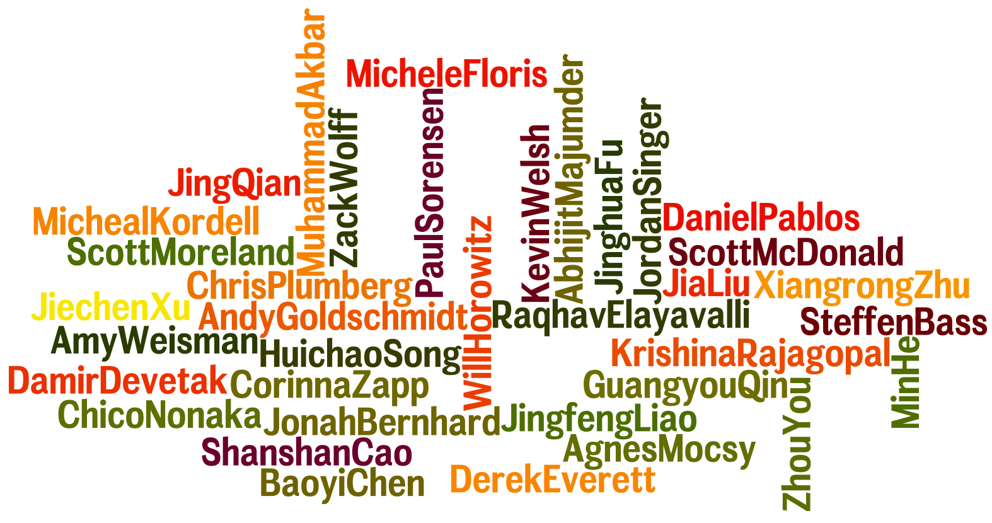
A Healthy User Community
Keep growing …

Slide 9
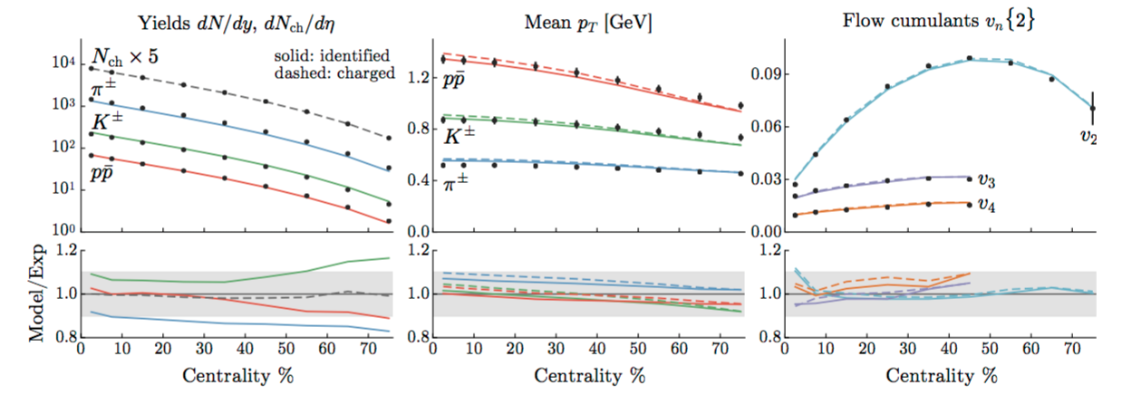
Highlights of iEBE-VISHNU
Trento+iEBE-VISHNU
J. E. Bernhard, J. S. Moreland, S. A. Bass, J. Liu and U.Heinz, arXiv:1605.03954 [nucl-th].
4

Slide 10
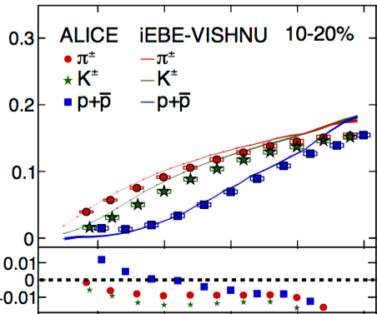
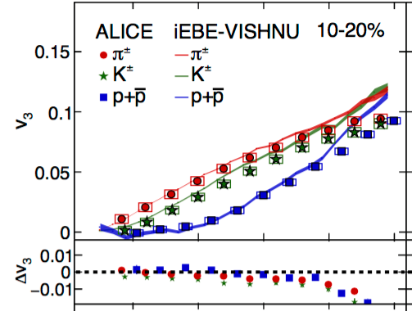
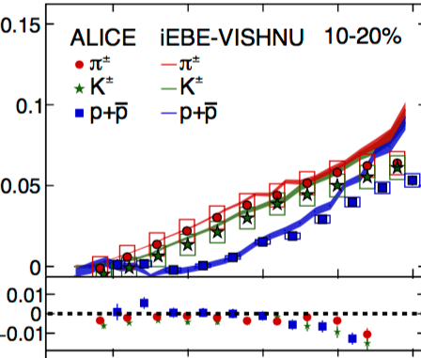

Highlights of iEBE-VISHNU
Trento+iEBE-VISHNU
AMPT+iEBE-VISHNU
v2
v3
v4
J. E. Bernhard, J. S. Moreland, S. A. Bass, J. Liu and U.Heinz, arXiv:1605.03954 [nucl-th].
H. j. Xu, Z. Li and H. Song, Phys. Rev. C 93, 064905 (2016)
J. Adam et al. [ALICE Collaboration], arXiv:1606.06057 [nucl-ex].
4

Slide 11
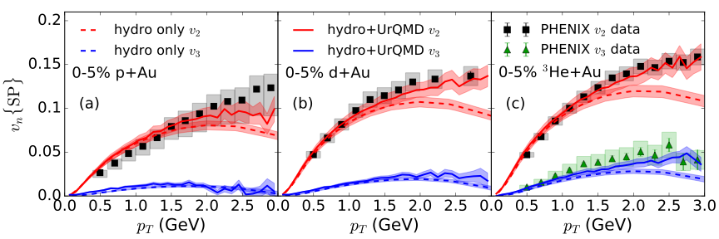
Highlights of iEBE-VISHNU
Trento+iEBE-VISHNU
AMPT+iEBE-VISHNU
v2
v3
v4
iEBE-VISHNU
J. E. Bernhard, J. S. Moreland, S. A. Bass, J. Liu and U.Heinz, arXiv:1605.03954 [nucl-th].
H. j. Xu, Z. Li and H. Song, Phys. Rev. C 93, 064905 (2016)
J. Adam et al. [ALICE Collaboration], arXiv:1606.06057 [nucl-ex].
C. Shen, J. F. Paquet, G. Denicol, S. Jeon, and C. Gale, in preparation
3
4

Slide 12
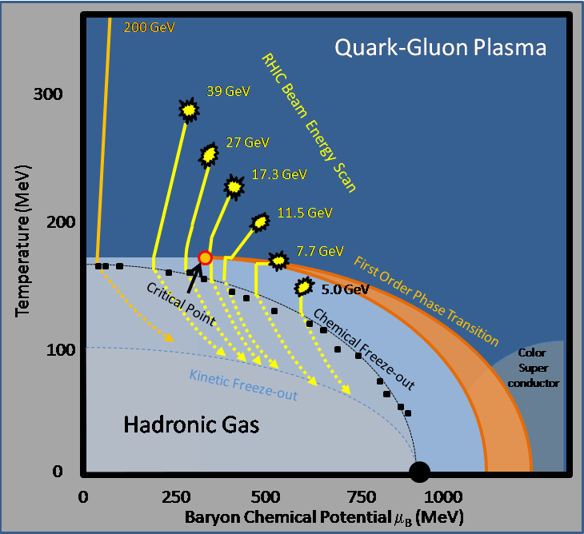
Exploring the phases of QCD
5

Slide 13
Exploring the phases of QCD
Event-by-event fluctuating initial conditions
(AMPT, UrQMD,
MCGlb*, …)
(3+1)-d dissipative hydrodynamic modelling of the QGP
MUSIC
Microscopic description for hadronic phase
UrQMD/JAM
5

Slide 14
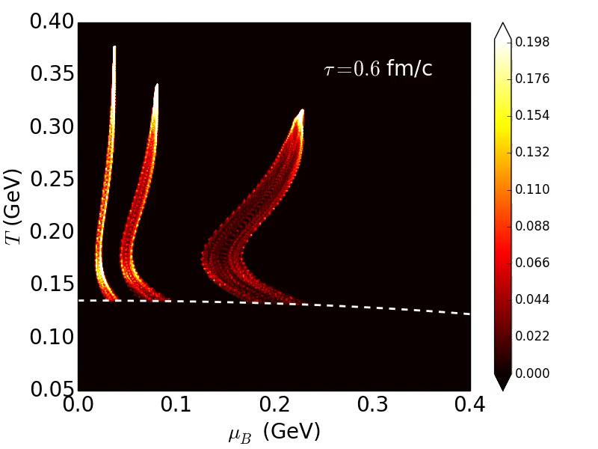

Compass for the QCD phase diagram
0-5%
200
19.6
62.4
e = 0.1 GeV/fm³
6

Slide 15
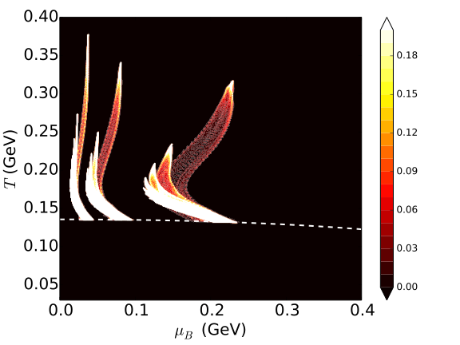
Compass for the QCD phase diagram
0-5%
200
19.6
62.4
e = 0.1 GeV/fm³
6

Slide 16










Dissipative hydrodynamics
Energy momentum tensor
Conserved currents
Equations of motion
Dissipative quantities are evolved with 2nd order Israel-Stewart type of equations
At Navier-Stokes limit,
7
Notes:
\begin{eqnarray*}\Delta^{\mu\nu}_{\alpha\beta} D \pi^{\alpha \beta} &=& - \frac{1}{{\color[rgb]{0.000000,0.000000,1.000000}\tau_\pi}} (\pi^{\mu\nu} - 2 {\color[rgb]{1.000000,0.000000,0.000000}\eta} \sigma^{\mu\nu}) - \frac{\delta_{\pi \pi}}{{\color[rgb]{0.000000,0.000000,1.000000}\tau_\pi}} \pi^{\mu\nu} \theta -\frac{\tau_{\pi\pi}}{{\color[rgb]{0.000000,0.000000,1.000000}\tau_\pi}} \pi^{\lambda \langle \mu} \sigma^{\nu \rangle}\,_\lambda \\
&& + \frac{\phi_7}{{\color[rgb]{0.000000,0.000000,1.000000}\tau_\pi}} \pi^{\langle \mu}_\alpha \pi^{\nu \rangle \alpha} \end{eqnarray*}
\Delta^{\mu\nu} D q_\nu = - \frac{1}{{\color[rgb]{0.000000,0.000000,1.000000}\tau_q}} (q^\mu - {\color[rgb]{1.000000,0.000000,0.000000}\kappa} \nabla^{\mu} \frac{\mu_B}{T}) - \frac{\delta_{qq}}{{\color[rgb]{0.000000,0.000000,1.000000}\tau_q}} q^\mu \theta - \frac{\lambda_{qq}}{{\color[rgb]{0.000000,0.000000,1.000000}\tau_q}} q_\nu \sigma^{\mu\nu}
nonlinear coupling terms:
+ \frac{l_{\pi q}}{\tau_\pi} \nabla^{\langle \mu} q^{\nu \rangle} + \frac{\lambda_{\pi q}}{\tau_\pi} q^{\langle \mu} \nabla^{\nu \rangle} \frac{\mu_B}{T}
+ \frac{l_{q \pi}}{\tau_q} \Delta^{\mu\nu} \partial_\lambda \pi^\lambda_\nu - \frac{\lambda_{q \pi}}{\tau_q} \pi^{\mu\nu} \nabla_{\nu} \frac{\mu_B}{T}

Slide 17






Switching to hadronic cascade
Afterburner toolkit:
Particle sampler
(iSS)
Hadronic
cascade
Final
analysis
Hyper-surfaces
particle
spectra
finite μ
UrQMD
JAM
VISH2+1
MUSIC
HBT radii
Efficient, well-tested, and open source
https://github.com/chunshen1987/HBTcorrelation_MCafterburner
8

Slide 18

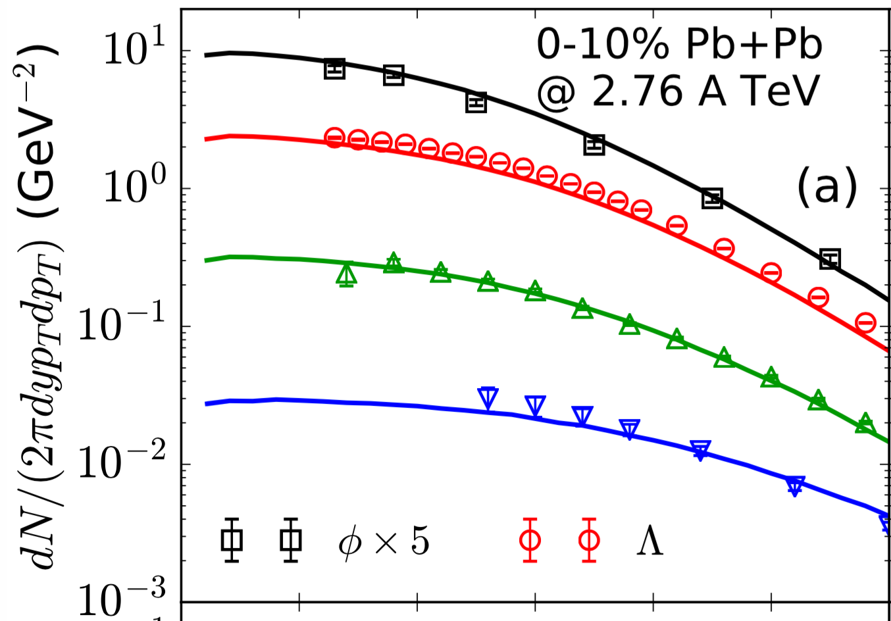
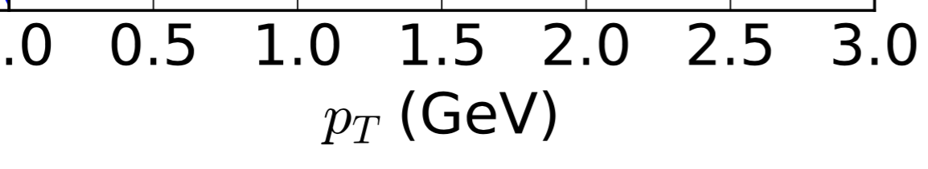
Switching to hadronic cascade
Afterburner toolkit:
Particle sampler
(iSS)
Hadronic
cascade
Final
analysis
Hyper-surfaces
particle
spectra
finite μ
UrQMD
JAM
VISH2+1
MUSIC
HBT radii
In collaboration with
Scott McDonald
Efficient, well-tested, and open source
https://github.com/chunshen1987/HBTcorrelation_MCafterburner
8

Slide 19
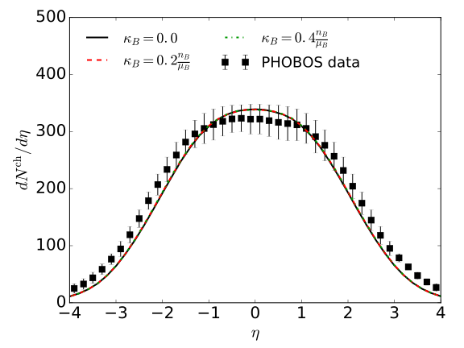

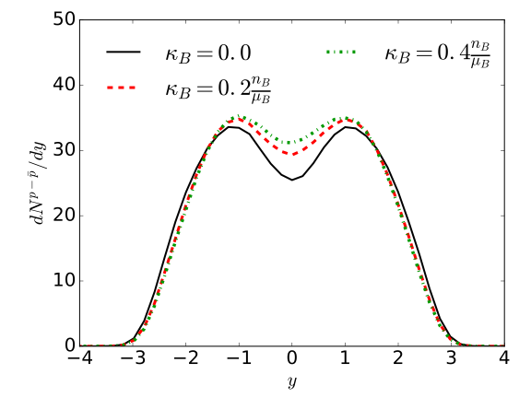
Effects of net baryon diffusion on particle yields
Au+Au
0-5%
0-5%
Net baryon diffusion has little effects on charged hadron pseudo-rapidity distribution
More net baryon numbers are transported to mid-rapidity with a larger diffusion constant
Constraints on net baryon diffusion?
9

Slide 20
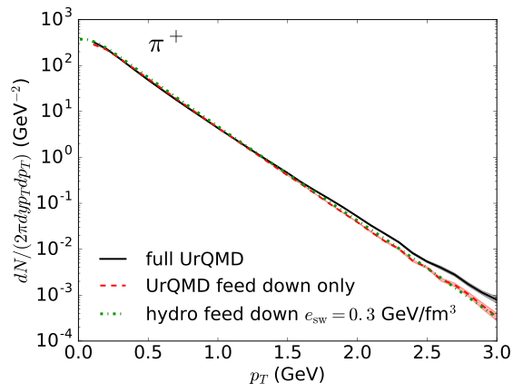
Effects of hadronic afterburner on pid spectra
Au+Au
0-5%
Hadronic afterburner hardens pion spectra at high pT
11

Slide 21
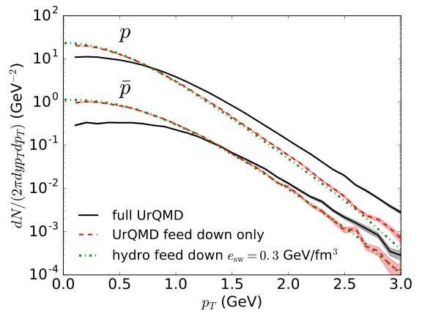
Effects of hadronic afterburner on pid spectra
Au+Au
0-5%
0-5%
Hadronic afterburner hardens pion spectra at high pT
Heavy baryon spectra are largely affected
hadronic afterburner is essential for baryon spectra
11

Slide 22


Effects of hadronic afterburner on pid spectra
Au+Au
0-5%
0-5%
annihilation
Hadronic afterburner hardens pion spectra at high pT
Heavy baryon spectra are largely affected
hadronic afterburner is essential for baryon spectra
11

Slide 23


Effects of hadronic afterburner on pid spectra
Au+Au
0-5%
0-5%
annihilation
hadronic
rescatterings
Hadronic afterburner hardens pion spectra at high pT
Heavy baryon spectra are largely affected
hadronic afterburner is essential for baryon spectra
11

Slide 24
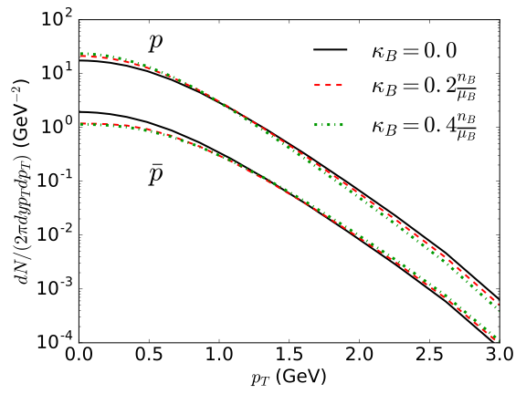
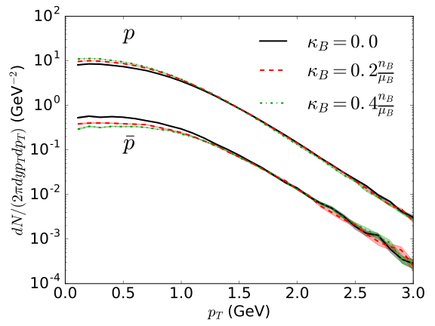

Effects of net baryon diffusion on pid spectra
pure hydro
hydro + UrQMD
Au+Au
0-5%
Hadronic scatterings erase the diffusion effects at high pT
12

Slide 25





Effects of net baryon diffusion on pid spectra
pure hydro
hydro + UrQMD
0-5%
Hadronic scatterings erase the diffusion effects at high pT
 | 0.042 | 0.108 | 0.162
(GeV)
12

Slide 26

Effects of net baryon diffusion on pid spectra
pure hydro
hydro + UrQMD
0-5%
Hadronic scatterings erase the diffusion effects at high pT
set constraints on
net baryon diffusion
 | 0.042 | 0.108 | 0.162
(GeV)
12

Slide 27
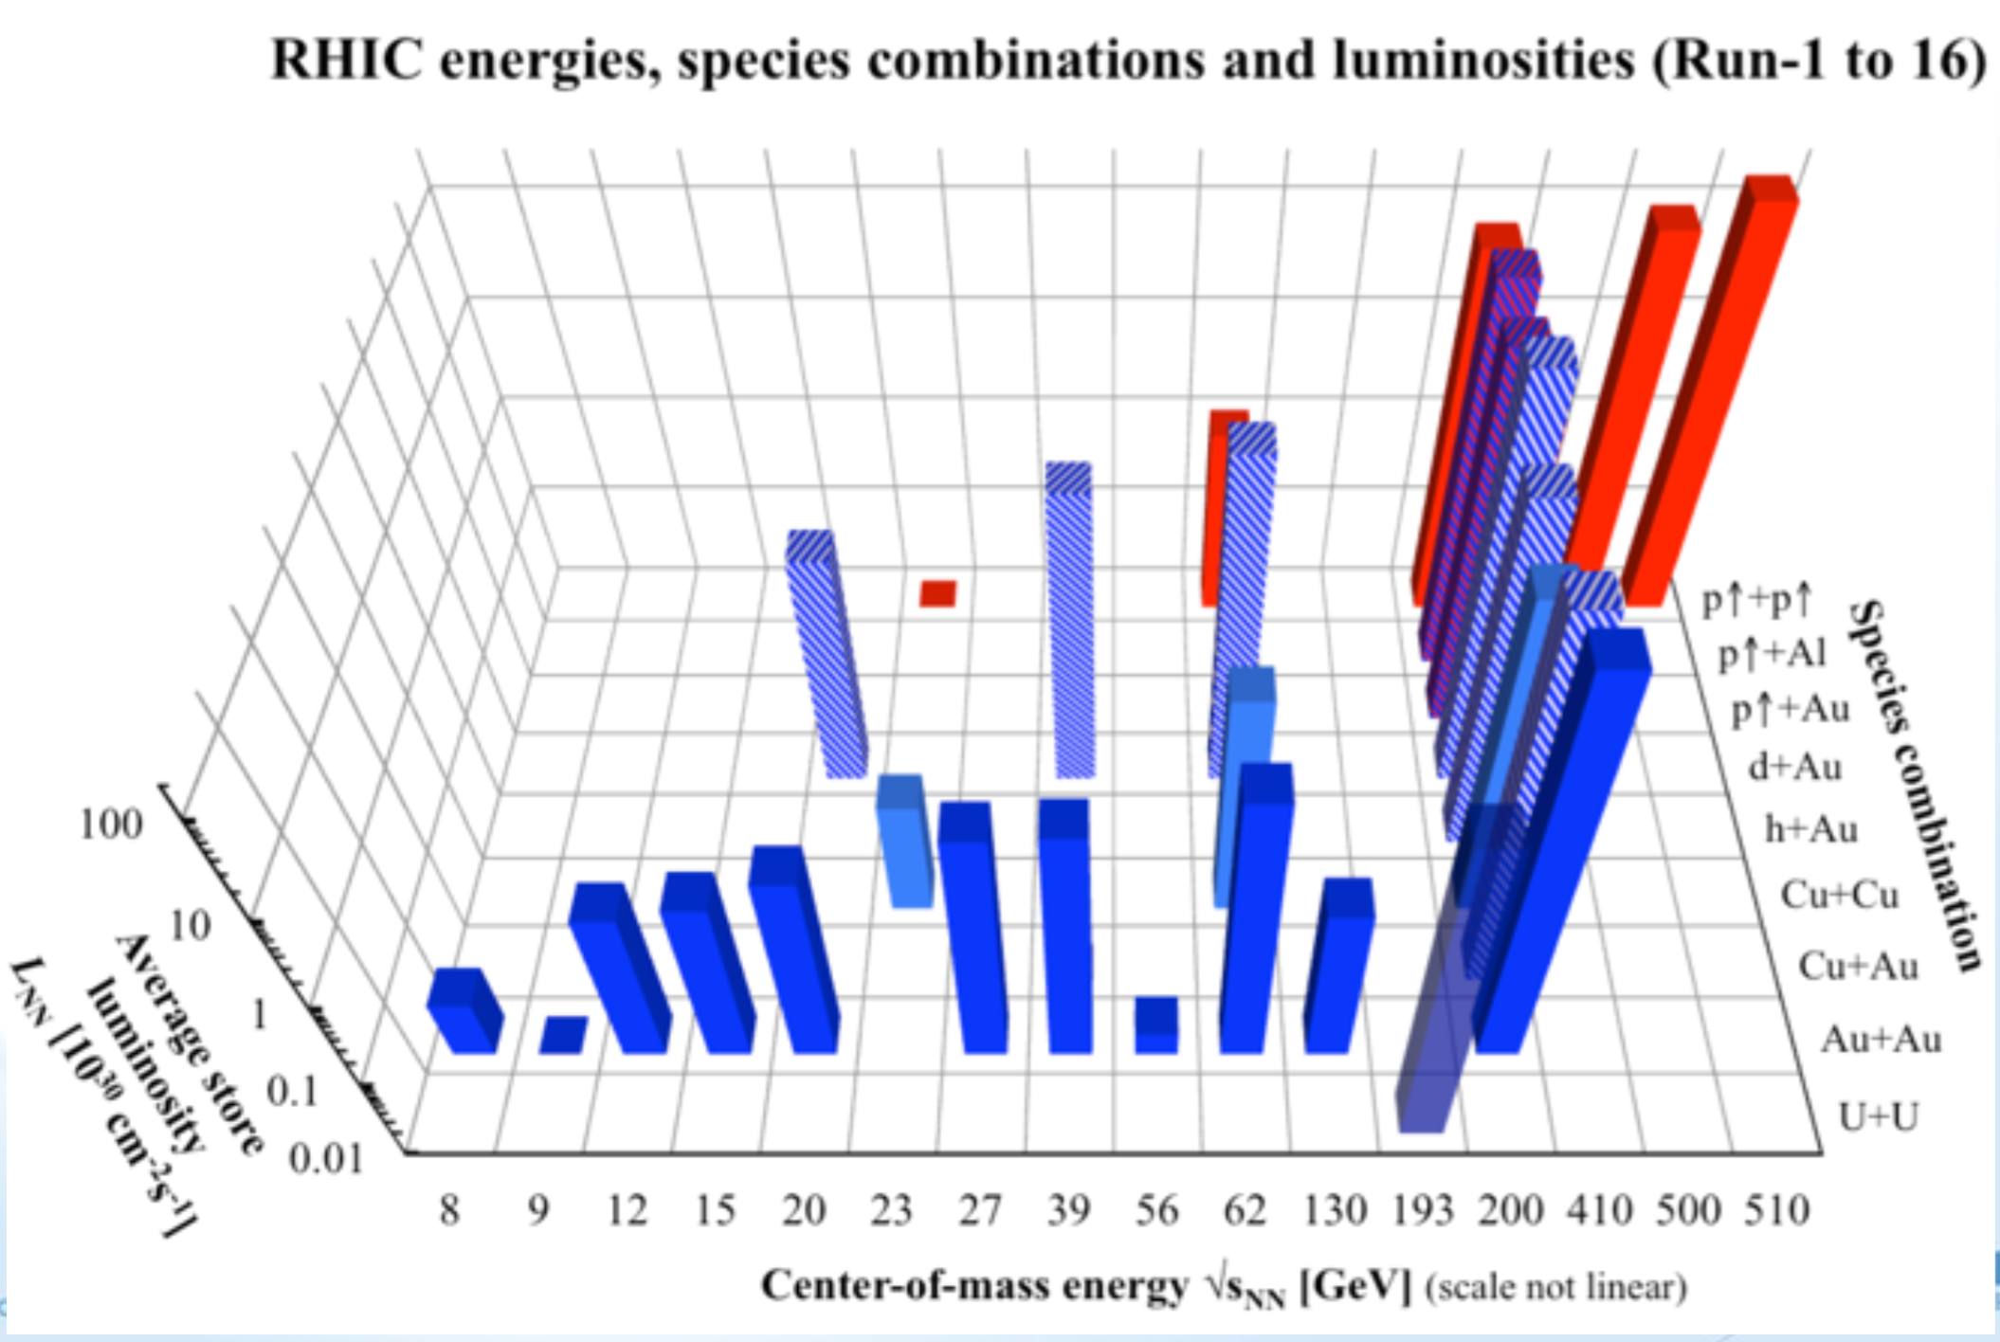
d+Au collisions at BES energies…
d+Au
Picture from
Berndt Muller’s talk

Slide 28
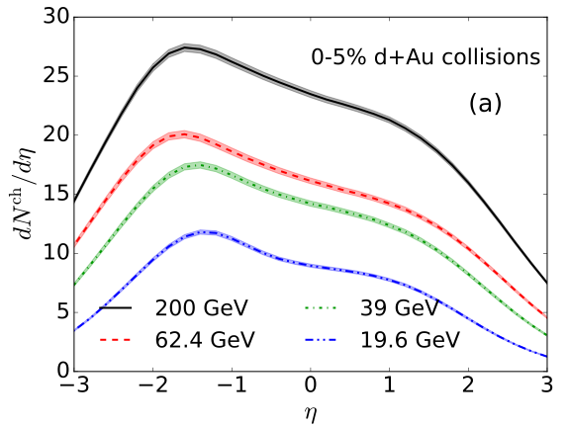
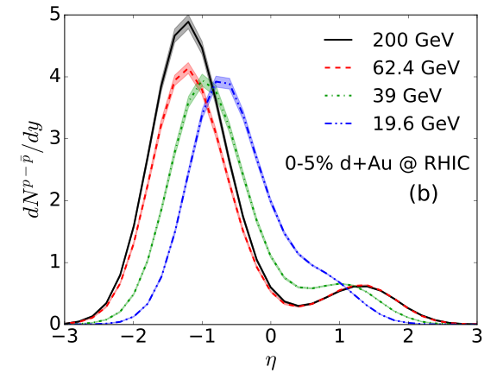
Doping baryons in small QGP droplets
The ratios of s/n in the small collisions systems are as large as those in Au+Au collisions
14

Slide 29

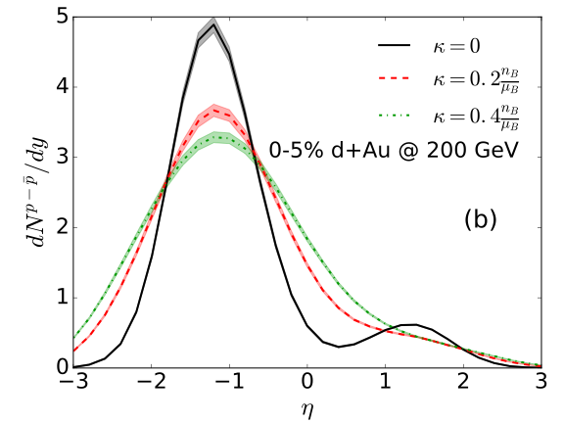
Doping baryons in small QGP droplets
The ratios of s/n in the small collisions systems are as large as those in Au+Au collisions
The effect of net baryon diffusion on the net proton rapidity distribution is more pronounced in small system
more baryon transport in small systems
14

Slide 30

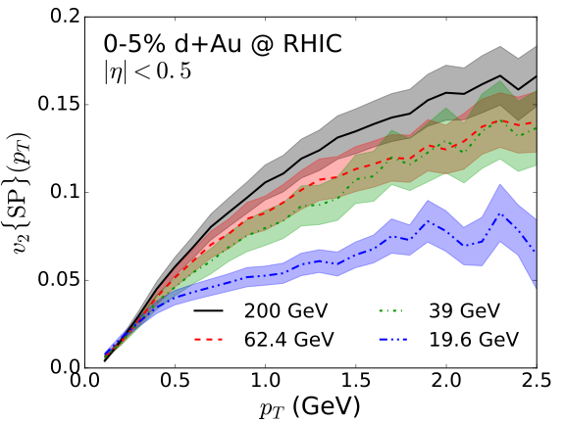
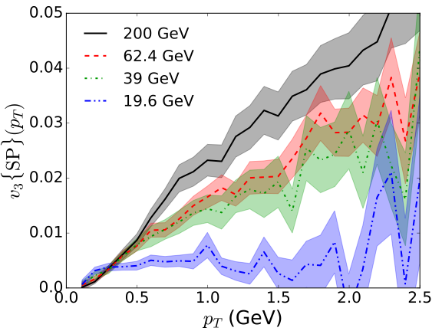
Charged hadron vn(pT) at different
Sizeable charged hadron v2 is found at all 4 collision energies
Charged hadron v3 is very small at 19.6 GeV
strong collision energy dependence
15

Slide 31
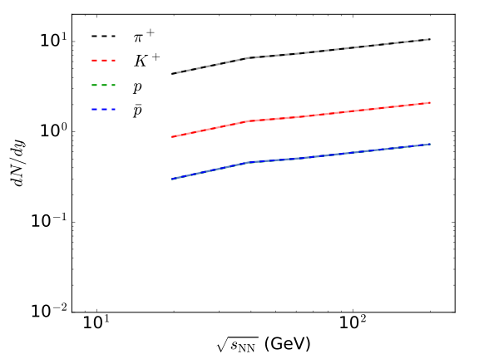
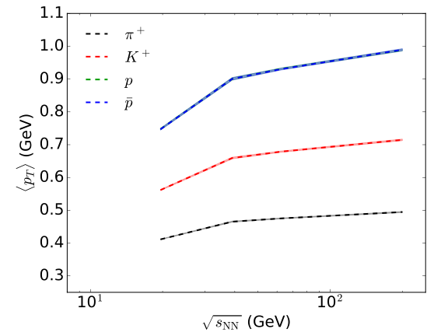


Collision energy dependence of pid observables
yields
mean pT
16

Slide 32
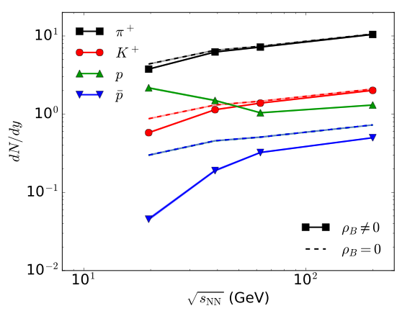
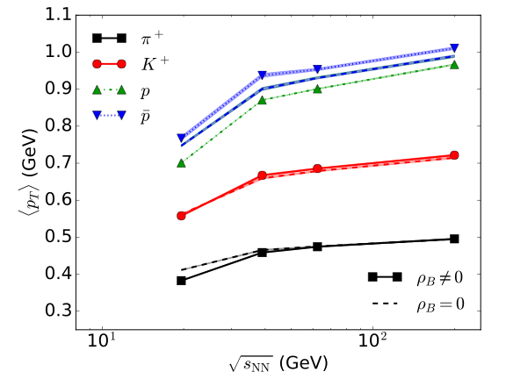
Collision energy dependence of pid observables
yields
mean pT
More protons than kaons at low collision energies
Identified particle mean-pT drops rapidly at 19.6 GeV
strong collision energy dependence
16

Slide 33

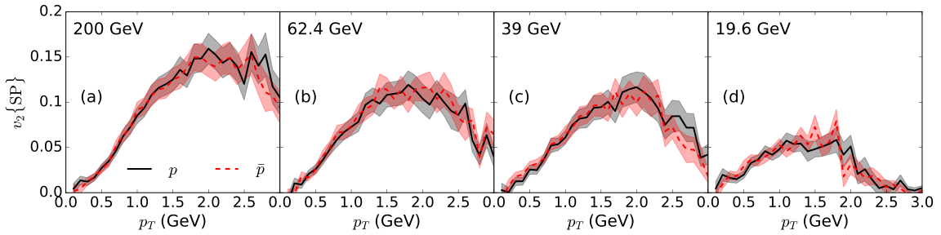
17

Slide 34

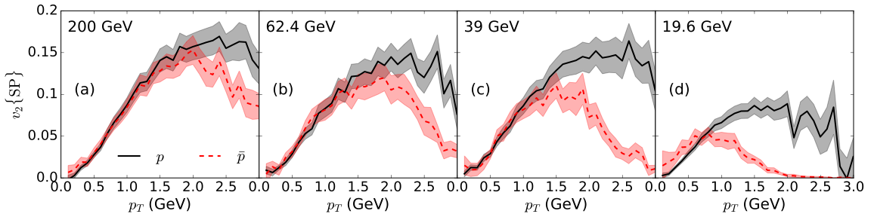
Proton v2 deviates from anti-proton v2 at pT > 1.5 GeV
17

Slide 35

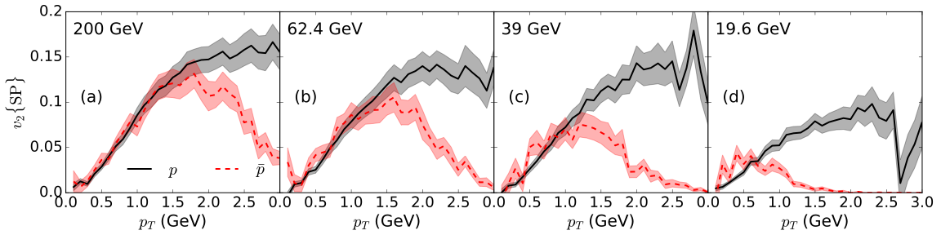
Proton v2 deviates from anti-proton v2 at pT > 1.5 GeV
A non-zero baryon diffusion enlarges the difference at high pT
17

Slide 36
A non-zero baryon diffusion enlarges the difference at high pT
Predictions for d+Au beam energy scan
17

Slide 37


Conclusions
The efficient numerical modelling of relativist heavy-ion collisions has opened the doorway to an era of precision physics
Aiming at heavy-ion collisions in the RHIC BES program, a hybrid hydrodynamics + hadronic cascade framework is developed
full (3+1)-d event-by-event with net baryon diffusion
We identified a few experiment observables that could constrain the net baryon diffusion
Soft hadronic observables in d+Au collisions at BES energies will shed new lights on understanding the collectivity of QGP droplets
18

Slide 38
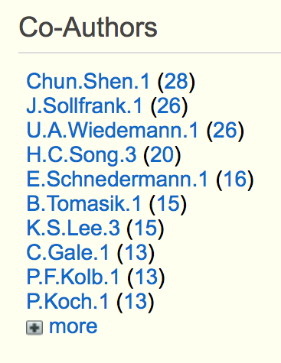
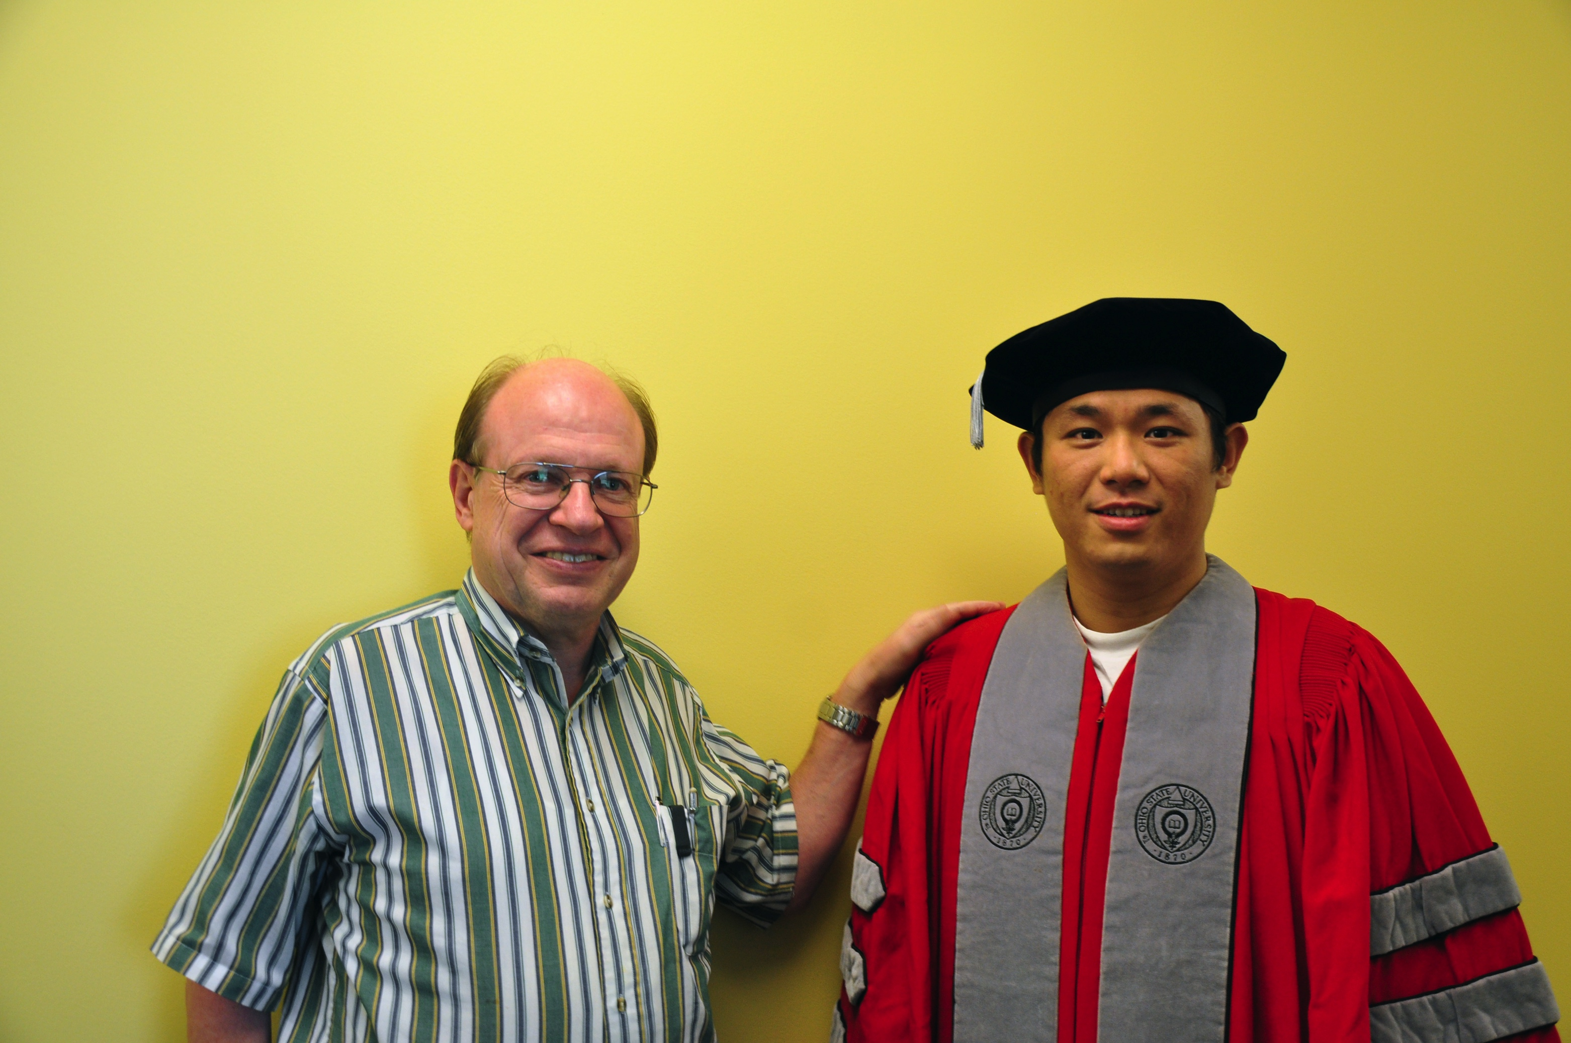
Uli and I
I am the top 1 in Uli’s Co-Authors list on inSPIRES
I was the graduate student who caused the most Visa problems for Uli
My most memorable experience with Uli is our first road trip to the Argonne National Lab for the Mid-West Theory Get Together in 2010
Happy birthday!
19

Slide 39
back ups

Slide 41

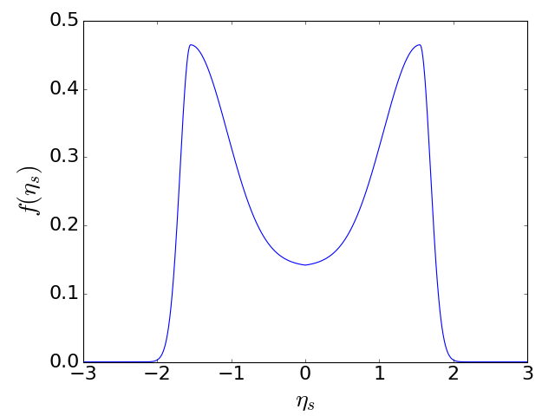


Initialize MUSIC with net baryon density
In every event, the net baryon number is
For Glauber initial conditions, we assume
A
B
4
Notes:
\rho_B({\bf x}_\perp, \eta_s) = f_L(\eta_s) T_A({\bf x}_\perp) + f_R(\eta_s) T_B({\bf x}_\perp)
f_{L,R}(\eta_s) = \left(1 \pm \frac{\eta_s}{y_\mathrm{beam}}\right) f(\eta_s)

Slide 42
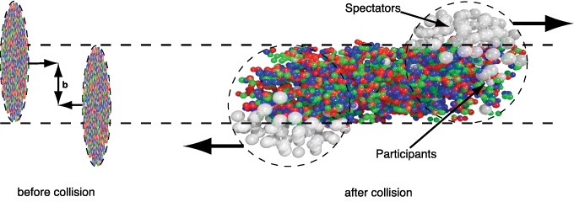

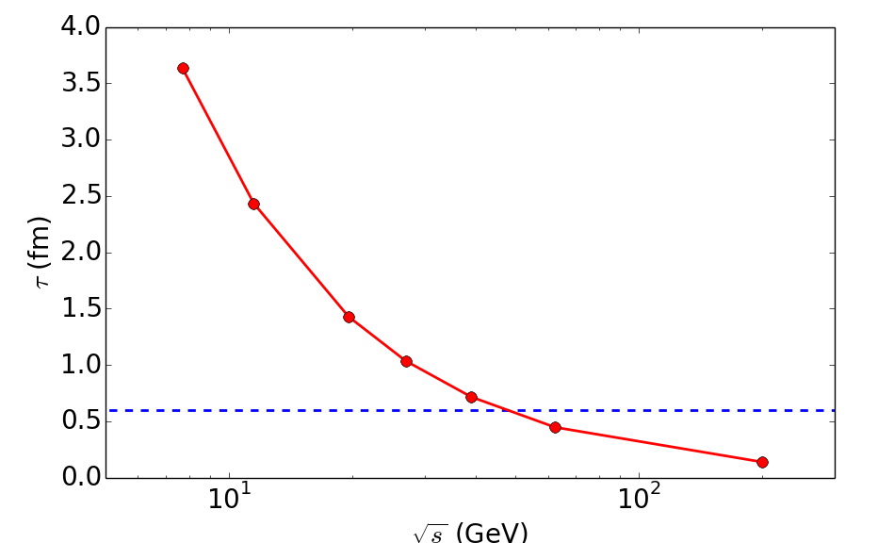

When to start hydrodynamics?
Two nuclei overlapping time
Nuclei overlapping time is large at low collision energy
Pre-equilibrium dynamics can play an important role
5

Slide 43






Dissipative hydrodynamics
Energy momentum tensor
Conserved currents
Dissipative part:
G. S. Denicol et al., Phys. Rev. D 89, 074005 (2014)
6
Notes:
\begin{eqnarray*}\Delta^{\mu\nu}_{\alpha\beta} D \pi^{\alpha \beta} &=& - \frac{1}{{\color[rgb]{0.000000,0.000000,1.000000}\tau_\pi}} (\pi^{\mu\nu} - 2 {\color[rgb]{1.000000,0.000000,0.000000}\eta} \sigma^{\mu\nu}) - \frac{\delta_{\pi \pi}}{{\color[rgb]{0.000000,0.000000,1.000000}\tau_\pi}} \pi^{\mu\nu} \theta -\frac{\tau_{\pi\pi}}{{\color[rgb]{0.000000,0.000000,1.000000}\tau_\pi}} \pi^{\lambda \langle \mu} \sigma^{\nu \rangle}\,_\lambda \\
&& + \frac{\phi_7}{{\color[rgb]{0.000000,0.000000,1.000000}\tau_\pi}} \pi^{\langle \mu}_\alpha \pi^{\nu \rangle \alpha} \end{eqnarray*}
\Delta^{\mu\nu} D q_\nu = - \frac{1}{{\color[rgb]{0.000000,0.000000,1.000000}\tau_q}} (q^\mu - {\color[rgb]{1.000000,0.000000,0.000000}\kappa} \nabla^{\mu} \frac{\mu_B}{T}) - \frac{\delta_{qq}}{{\color[rgb]{0.000000,0.000000,1.000000}\tau_q}} q^\mu \theta - \frac{\lambda_{qq}}{{\color[rgb]{0.000000,0.000000,1.000000}\tau_q}} q_\nu \sigma^{\mu\nu}
nonlinear coupling terms:
+ \frac{l_{\pi q}}{\tau_\pi} \nabla^{\langle \mu} q^{\nu \rangle} + \frac{\lambda_{\pi q}}{\tau_\pi} q^{\langle \mu} \nabla^{\nu \rangle} \frac{\mu_B}{T}
+ \frac{l_{q \pi}}{\tau_q} \Delta^{\mu\nu} \partial_\lambda \pi^\lambda_\nu - \frac{\lambda_{q \pi}}{\tau_q} \pi^{\mu\nu} \nabla_{\nu} \frac{\mu_B}{T}

Slide 44






Transport coefficients
Dissipative part:
With non-zero μ, we choose
In the relaxation time approximation, the net baryon diffusion
constant can be related to shear viscosity as,
(in the massless and small μ/T limits)
To study the effects of diffusion, we choose the constant C independent of η
G. S. Denicol et al., Phys. Rev. D 89, 074005 (2014)
7
Notes:
\begin{eqnarray*}\Delta^{\mu\nu}_{\alpha\beta} D \pi^{\alpha \beta} &=& - \frac{1}{{\color[rgb]{0.000000,0.000000,1.000000}\tau_\pi}} (\pi^{\mu\nu} - 2 {\color[rgb]{1.000000,0.000000,0.000000}\eta} \sigma^{\mu\nu}) - \frac{\delta_{\pi \pi}}{{\color[rgb]{0.000000,0.000000,1.000000}\tau_\pi}} \pi^{\mu\nu} \theta -\frac{\tau_{\pi\pi}}{{\color[rgb]{0.000000,0.000000,1.000000}\tau_\pi}} \pi^{\lambda \langle \mu} \sigma^{\nu \rangle}\,_\lambda \\
&& + \frac{\phi_7}{{\color[rgb]{0.000000,0.000000,1.000000}\tau_\pi}} \pi^{\langle \mu}_\alpha \pi^{\nu \rangle \alpha} \end{eqnarray*}
\Delta^{\mu\nu} D q_\nu = - \frac{1}{{\color[rgb]{0.000000,0.000000,1.000000}\tau_q}} (q^\mu - {\color[rgb]{1.000000,0.000000,0.000000}\kappa} \nabla^{\mu} \frac{\mu_B}{T}) - \frac{\delta_{qq}}{{\color[rgb]{0.000000,0.000000,1.000000}\tau_q}} q^\mu \theta - \frac{\lambda_{qq}}{{\color[rgb]{0.000000,0.000000,1.000000}\tau_q}} q_\nu \sigma^{\mu\nu}
nonlinear coupling terms:
+ \frac{l_{\pi q}}{\tau_\pi} \nabla^{\langle \mu} q^{\nu \rangle} + \frac{\lambda_{\pi q}}{\tau_\pi} q^{\langle \mu} \nabla^{\nu \rangle} \frac{\mu_B}{T}
+ \frac{l_{q \pi}}{\tau_q} \Delta^{\mu\nu} \partial_\lambda \pi^\lambda_\nu - \frac{\lambda_{q \pi}}{\tau_q} \pi^{\mu\nu} \nabla_{\nu} \frac{\mu_B}{T}

Slide 45






Convert to particles
The conversion hyper surface is determined using Cornelius algorithm
P. Huovinen and H. Petersen, Eur. Phys. J. A 48, 171 (2012)
From the relaxation time approximation,
is calculated using hadron resonance gas model
8

Slide 46





Diffusion δf is essential
is conserved
With diffusion, is essential to ensure net baryon number conservation
8

Slide 47

Diffusion δf is essential
Conservation laws (net baryon number and total energy) are checked at every time step; the relative violation is below 1x10⁻⁵
is conserved
With diffusion, is essential to ensure net baryon number conservation
8

Slide 48



Effects of net baryon diffusion on particle yields
On the switching hyper-surface,
 | 0.23 | 0.25 | 0.26
 | 0.076 | 0.062 | 0.06
(GeV)
0-5%
(GeV)
The diffusion changes net proton number
Larger diffusion constant results a ~20 MeV larger averaged chemical potential on the switching hyper-surface; It reduces the standard deviation of μB by ~15%
mapping the QCD phase diagram in precision
10

Slide 49



Effects of hadronic afterburner on pid v2
10-40%
10-40%
Momentum anisotropy keeps developing in the UrQMD phase
hadronic afterburner is essential
15

Slide 50

Effects of hadronic afterburner on pid v2
10-40%
10-40%
Momentum anisotropy keeps developing in the UrQMD phase
Low pT proton v2 is blue shifted because of the pion “wind”
hadronic afterburner is essential
15

Slide 51


Effects of net baryon diffusion on pid v2
pure hydro
hydro + UrQMD
10-40%
10-40%
Hadronic scatterings wash out most of the diffusion effects on pid v2
16

Slide 52


Effects of net baryon diffusion on pid v2
pure hydro
hydro + UrQMD
10-40%
10-40%
Hadronic scatterings wash out most of the diffusion effects on pid v2
Splitting between π and p v2 in the STAR measurement is better reproduced with hybrid simulations
16

Slide 53

Is hadronic cascade under control?
JAM
UrQMD

Slide 54


Quantify uncertainties in hadronic cascade
Charged hadrons
Net protons
0-5%
0-5%
UrQMD and JAM produce very close results for particle rapidity distributions
Only some small noticeable differences in net proton rapidity distribution
differences in cross sections/resonances?
17

Slide 55


Quantify uncertainties in hadronic cascade
0-5%
0-5%
Light meson spectra are very close from the two cascade simulations
Baryon spectra have some small noticeable differences
differences in cross sections/resonances?
18

Slide 56


Quantify uncertainties in hadronic cascade
10-40%
10-40%
Pid v2 from the two hadronic cascade simulations are close to each other
differences in cross sections/resonances?
19

Slide 57





hydro + UrQMD
AMPT
arXiv:1509.08397
10-40%
Theory simulations give , which is opposite compared to the STAR data
mean field effects in the hadronic phase?
17

Slide 58

pure hydro
10-40%
18

Slide 59


pure hydro
10-40%
Hydrodynamic simulations with initial flow and a lower decoupling energy density can give positive
sensitive to pre-equilibrium flow and late stage dynamics
18

Slide 60

pure hydro
hydro + UrQMD
10-40%
10-40%
Hydrodynamic simulations with initial flow and a lower decoupling energy density can give positive
Current statistics is still not enough for anti-proton in the hybrid approach
sensitive to pre-equilibrium flow and late stage dynamics
18

Slide 61


Explore the pre-equilibrium dynamics
A transport approach:
Feed into a transport simulation
Freeze out particles at a constant tau surface and build T^{μν}
MC-Glauber
EoS: T, μB
Sample partons until the total energy of system is reached
19

Slide 62


Explore the pre-equilibrium dynamics
Elastic scatterings with a constant cross section
20

Slide 63


Preliminary results for v1
Hadronic afterburner does not affect charged hadron v1(y) much
A lower switching energy density results a larger v1 signal

Slide 64


Preliminary results for v1
Baryon diffusion does not affect the charge hadron v1
Charged hadron v1 shows little sensitivity to pre-equilibrium flow

Slide 65


Will a lower decoupling temperature fix this?
By evolving the fireball with hydrodynamics to a lower energy density,
pion spectrum is too flat
hadronic chemistry changes a lot — need PCE EoS
hadronic afterburner is essential

Slide 66


Will a lower decoupling temperature fix this?
By evolving the fireball with hydrodynamics to a lower energy density,
The blue shift in proton v2 can not be reproduced with hydro
hadronic afterburner is essential

Slide 67

Will a lower decoupling temperature fix this?
By evolving the fireball with hydrodynamics to a lower energy density,
esw = 0.1 GeV/fm³

Slide 68

Will a lower decoupling temperature fix this?
esw = 0.3 GeV/fm³
esw = 0.1 GeV/fm³
A more viscous phase from UrQMD compared to hydro

Slide 69


When to switch from hydro to cascade?
Different switching energy density can result different chemical contents in hadronic phase
Hadronic chemistry determines the

Slide 70


When to switch from hydro to cascade?
Different switching energy density can result different chemical contents in hadronic phase
Hydrodynamics generates more radial flow than hadronic cascade
Hadronic chemistry determines the

Slide 71


Effects of net baryon diffusion on pid spectra
Net baryon diffusion has negligible effects on light meson spectra

Slide 72


Effects of net baryon diffusion on pid spectra
hydro
hydro + UrQMD
Diffusion δf shows larger effects on proton and anti-proton spectra than shear δf

Slide 73


δf effects on pid v2
Net baryon diffusion δf has negligible effects on pid v2

Slide 74


δf effects on pid v2
The shear δf corrections to pid v2 are smaller once hadronic scatterings are included

Slide 75

Quantify uncertainties in hadronic cascade
Identical pion HBT radii:
differences in cross sections/resonances?
25

Slide 76

Quantify uncertainties in hadronic cascade
Identical pion HBT radii:
out direction

Slide 77

HBT correlation functions (UrQMD)

Slide 78

HBT correlation functions (JAM)

Slide 79

HBT correlation functions (UrQMD vs JAM)
Out direction:

Slide 80


Code Check
1+1D cross check:
MUSIC results agree very well with Akihiko’s results

Slide 81



Code Check
MUSIC with baryon propagation passed ideal Gubser flow test for the transverse dynamics

Slide 82



Dynamic evolution of net baryon current with diffusion
solid: with diffusion dashed: no diffusion
With diffusion, is larger in the center of the transverse plane

Slide 83


Dynamic evolution of net baryon current with diffusion
solid: with diffusion dashed: no diffusion
With diffusion, is larger in the center of the transverse plane
The dynamics of is driven by the evolution of and

Slide 84

Dynamic evolution of net baryon current with diffusion
solid: with diffusion dashed: no diffusion
With diffusion, is larger in the center of the transverse plane
The dynamics of is driven by the evolution of and

Slide 85

Dynamic evolution of net baryon current with diffusion
solid: with diffusion dashed: no diffusion
With diffusion, is larger in the center of the transverse plane
The dynamics of is driven by the evolution of and

Slide 86

Dynamic evolution of net baryon current with diffusion
solid: with diffusion dashed: no diffusion
With diffusion, is larger in the center of the transverse plane
The dynamics of is driven by the evolution of and

Slide 87

Dynamic evolution of net baryon current with diffusion
solid: with diffusion dashed: no diffusion
With diffusion, is larger in the center of the transverse plane
The dynamics of is driven by the evolution of and

Slide 88

Dynamic evolution of net baryon current with diffusion
solid: with diffusion dashed: no diffusion
With diffusion, is larger in the center of the transverse plane
The dynamics of is driven by the evolution of and

Slide 89

Dynamic evolution of net baryon current with diffusion
solid: with diffusion dashed: no diffusion
With diffusion, is larger in the center of the transverse plane
The dynamics of is driven by the evolution of and

Slide 90

Dynamic evolution of net baryon current with diffusion
solid: with diffusion dashed: no diffusion
With diffusion, is larger in the center of the transverse plane
The dynamics of is driven by the evolution of and

Slide 91








Stabilizing MUSIC with diffusion
We implement quest_revert for to stabilize the hydro evolution with diffusion,
The size of
If

Slide 92


Stabilizing MUSIC with diffusion
We implement quest_revert for to stabilize the hydro evolution with diffusion,
most of the modifications are at the edges of the fireball

