Slide 1
Status of User Accounting

Slide 2
User Accounting
Technical Status
Policy Status
Deployment Status
What Now?

Slide 3
Technical Status
The APEL client has had the ability for some time to collect and publish UserDN and FQAN information.
  UserDN information is encrypted when published to the central APEL respository
  Publishing is set off by default
OSG and DGAS (and probably NGDF) collect FQAN and UserDN
  Technically they could publish summaries to the central APEL repository.
  This has been tested with DGAS when they were using RGMA to publish.
Documentation on configuring publication is available
  http://goc.grid.sinica.edu.tw/gocwiki/ApelFaq#head-69f1753f985897a37902df00734f2480220250b0
CESGA Portal allows people to see information according to their status
  User can see own jobs, site admin see site’s, VO Member sees roles/groups for VO, VO Resource Manager sees UserDN
  https://www2.egee.cesga.es/gridsite/accounting/CESGA/dev/user/vomem_view.html

Slide 4
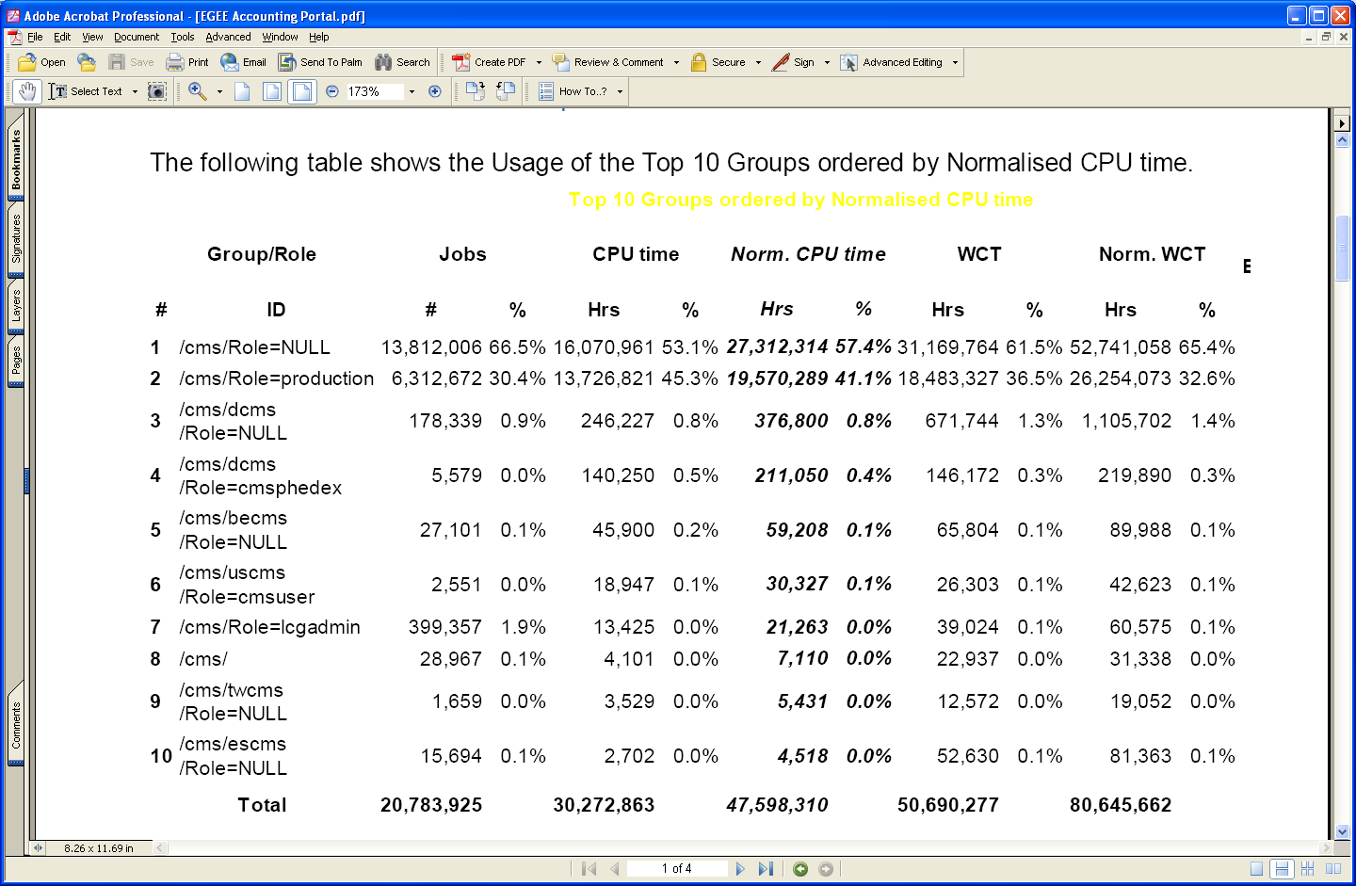

Slide 5
Policy Status
Updated draft distributed on 12 Feb, presented to GDB on 11th March
Grid Policy on the Handling of User-Level Job Accounting Data
V0.7, 23 Jan 2009
http://www.jspg.org/wiki/Grid_Policy_on_the_Handling_of_User-Level_Job_Accounting_Data
Request for comment from GDB. Will be tidied up and presented to MB for approval soon.
Believed to be ready for approval

Slide 6
Deployment Status
234 sites publishing data into APEL Central Repository
197 (84%) publishing FQAN
47 (20%) publishing UserDN
Despite MB request for sites supporting ATLAS to publish to allow their evaluation

Slide 7
Sites publishing UserDN in 2009
| ExecutingSite |
+--------------------+
| BIFI |
| CESGA-EGEE |
| CIEMAT-LCG2 |
| DESY-HH |
| DI-UMinho |
| e-ca-iaa |
| ESA-ESAC |
| ESA-ESRIN |
| FZK-LCG2 |
| GR-01-AUTH |
| GR-04-FORTH-ICS |
| GR-06-IASA |
| GR-07-UOI-HEPLAB |
| HG-01-GRNET |
| HG-02-IASA |
| HG-03-AUTH |
| HG-04-CTI-CEID |
| HG-05-FORTH |
| HG-06-EKT |
| IEETA |
| ifae |
| IFCA-LCG2 |
| IFIC-LCG2 |
| IFJ-PAN-BG |
| ITEP |
| JINR-LCG2 |
| JP-KEK-CRC-01 |
| Kharkov-KIPT-LCG2 |
| KR-KISTI-GCRT-01 |
| KR-KISTI-HEP |
| LCG_KNU |
| LIP-Coimbra |
| LIP-Lisbon |
| PDC |
| pic |
| PSNC |
| RUG-CIT |
| Taiwan-IPAS-LCG2 |
| TOKYO-LCG2 |
| UAM-LCG2 |
| UB-LCG2 |
| UMinho-CP |
| UNICAN |
| UOGRID |
| UPorto |
| USC-LCG2 |
| VGTU-gLite |
+--------------------+
47 rows in set (0.50 sec)

Slide 8
What Now?
Policy is mature enough. Speak up if a country is not happy.
Sites supporting WLCG should be ‘encouraged’ to switch on publishing of UserDN
Portal should be evaluated to see if people are happy with the functionality

