Slide 1
The LBNF Beamline
Alfons Weber
(University of Oxford & STFC/RAL)
European Neutrino Meeting LBNF/DUNE
CERN, CH
7-8 April 2016

Slide 2
Content
Overview
  Experimental Setup
Beamline
  Primary beamline
  Target Hall
  Decay Pipe
  Absorber
Neutrino Beam optimisation (preliminary!)
  target, horn, p beam
Summary

Slide 3
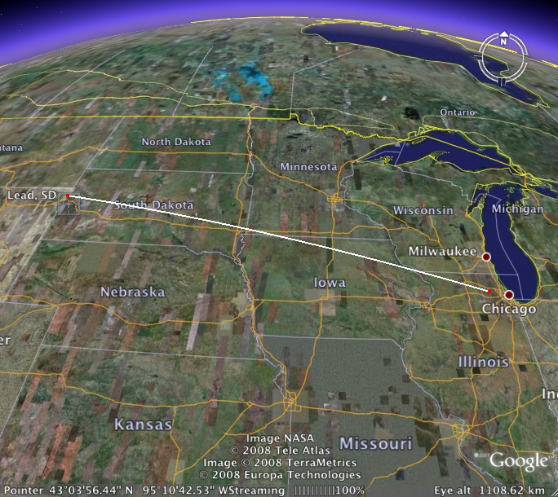
LBNF
SURF
Fermilab

Slide 4

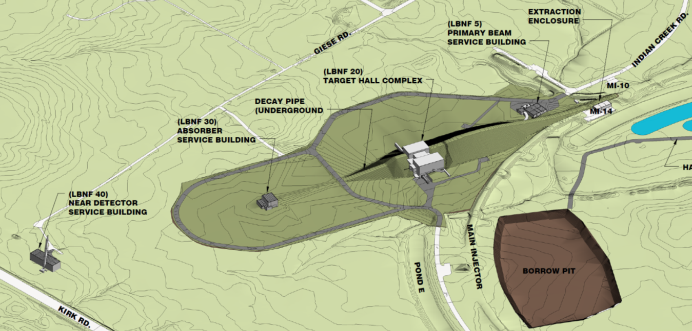
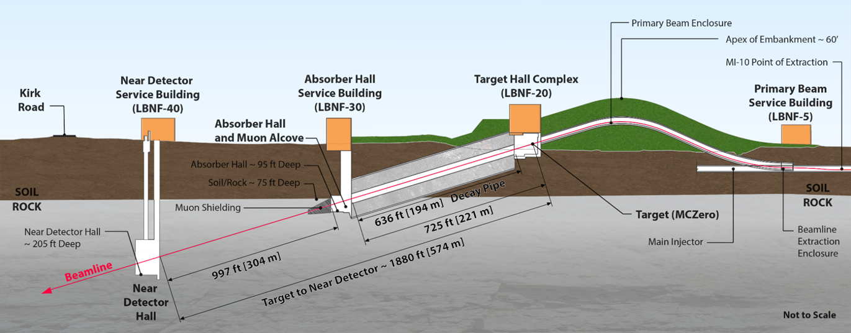
The Near Facilities
To SURF

Slide 5
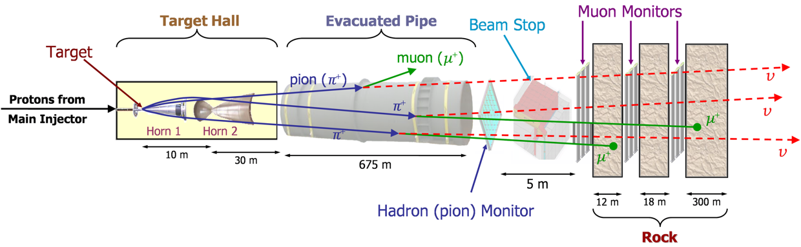
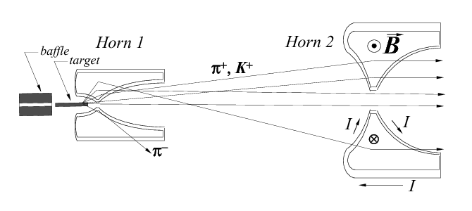
How to make a neutrino beam
NuMI

Slide 6
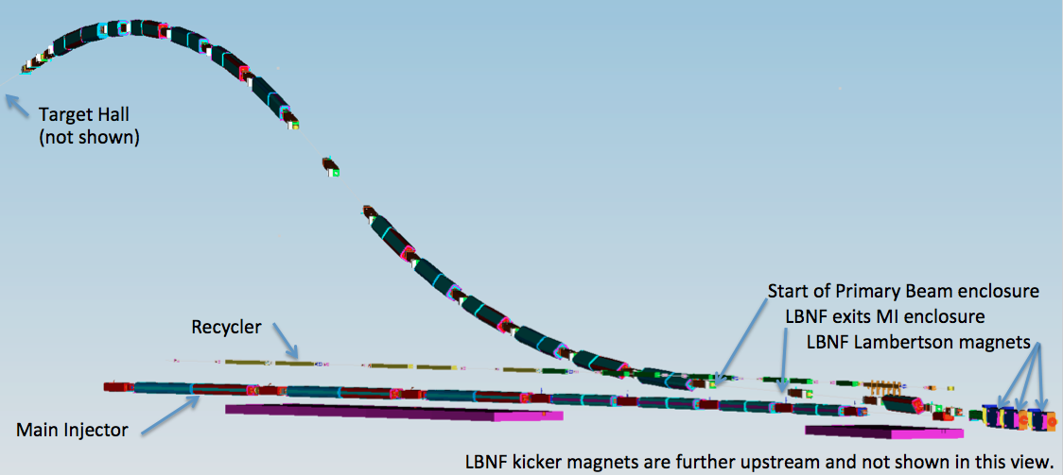
Primary Beam Line
Protons/cycle @60-120 GeV
1.2 MW era: 7.5x10¹³
2.4 MW era: (1.5-2.0)x10¹⁴
0.7 – 1.2 sec rep. rate
3D model of the primary proton beamline
The beam lattice
25 dipoles
21 quadrupoles
23 correctors
6 kickers
3 Lambertsons
1 C magnet
Beam size at target tunable between 1.0-4.0 mm
MI-10

Slide 7
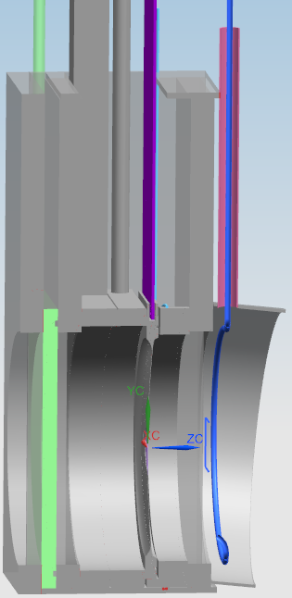
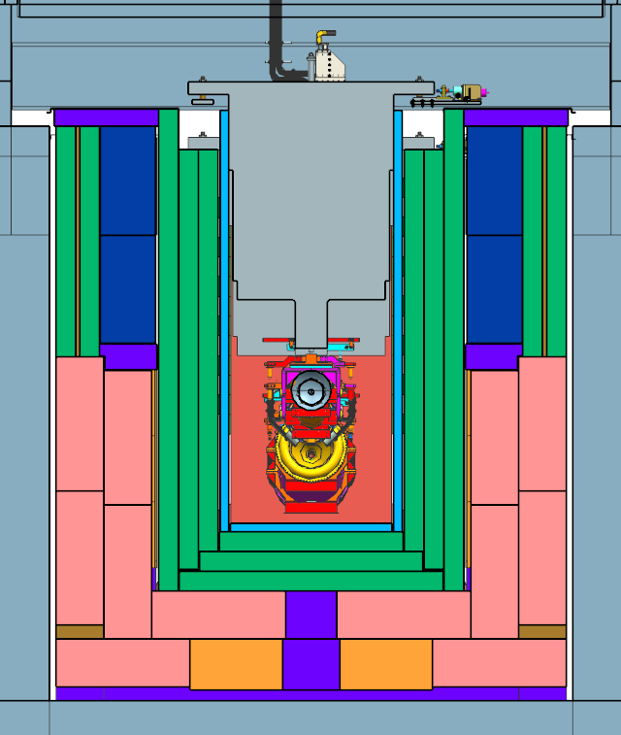
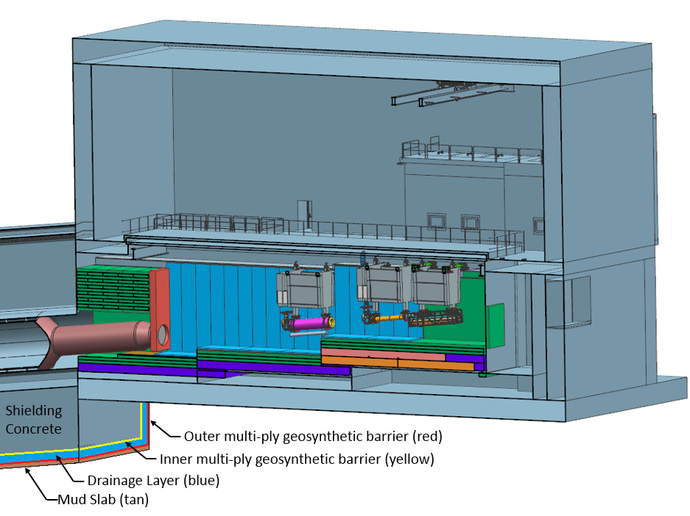
Target Hall
Here
2 horns
Graphite target
Air atmosphere
50 TON CRANE
DECAY PIPE
UPSTREAM
WINDOW
WORK CELL
Cooling panels
DECAY
PIPE
SNOUT
Design principle
flexibility
2.4 MW
(when needed)

Slide 8
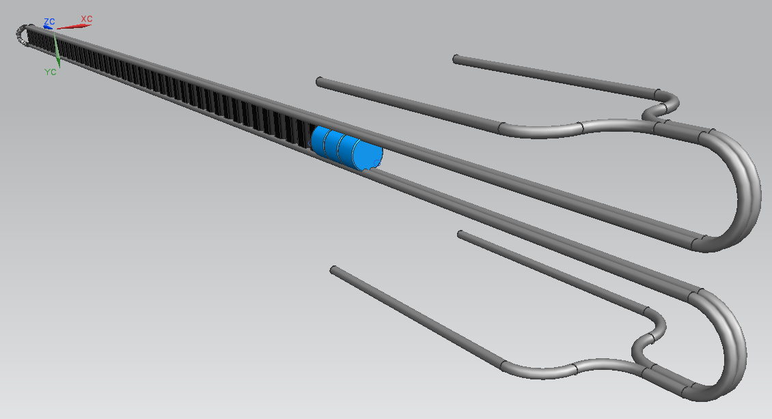
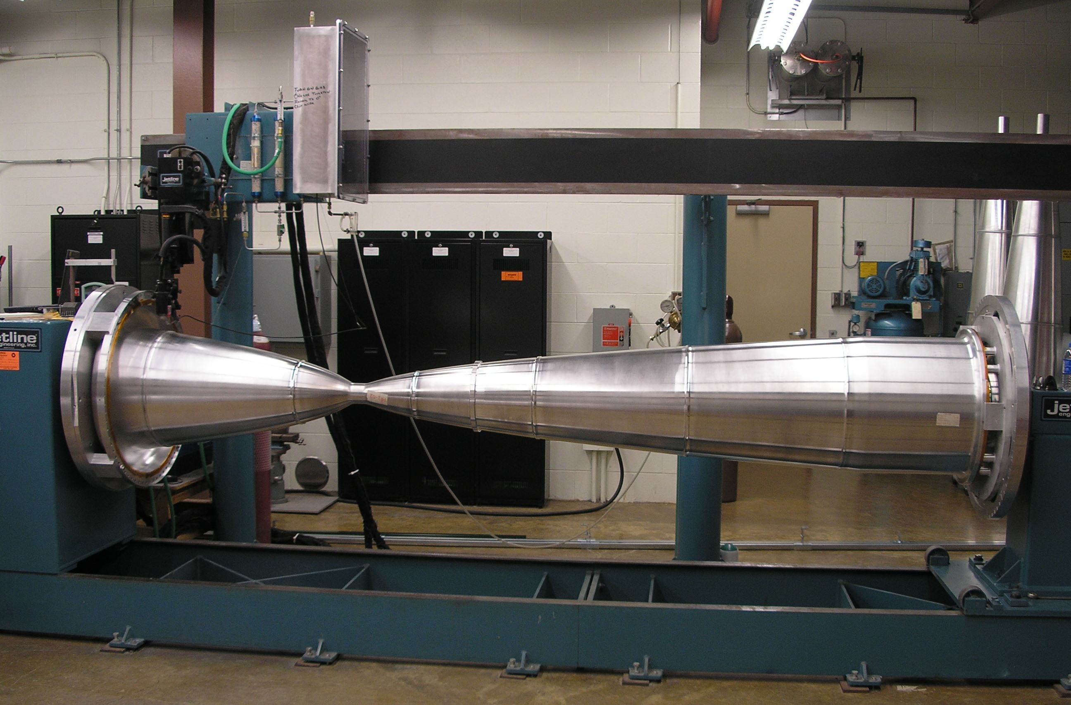
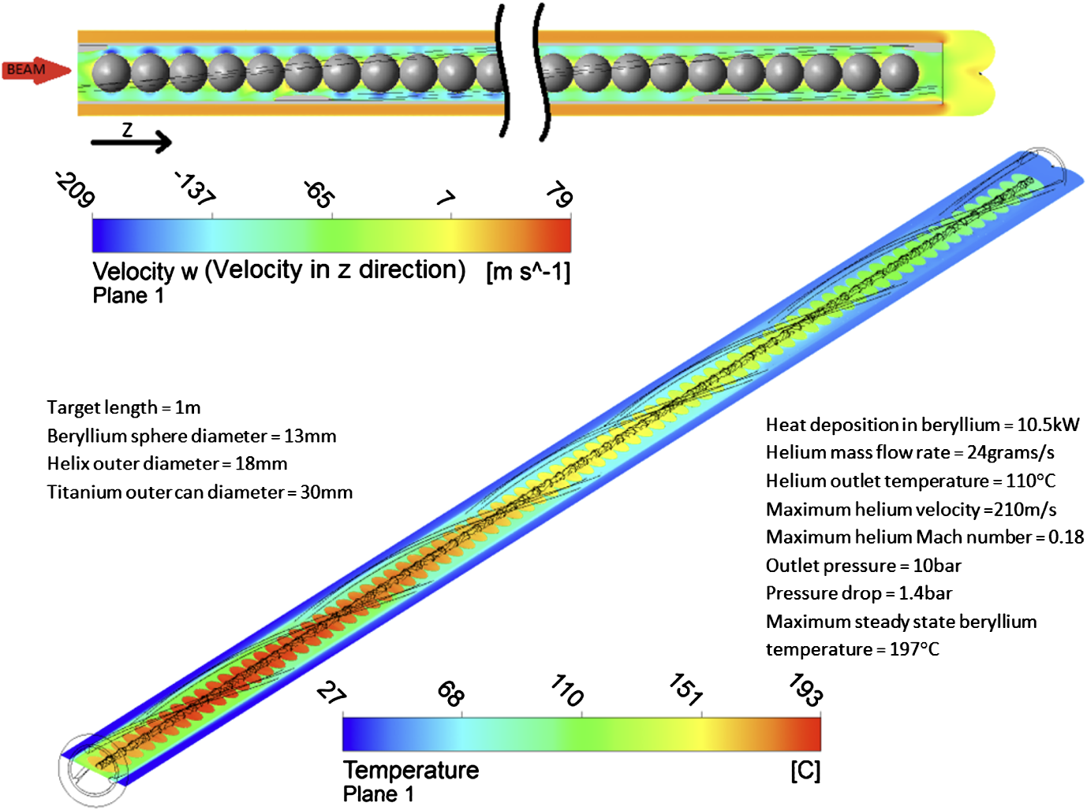
Target and Horns
NuMI-like (low energy) target and horns with modest modifications
47 graphite segments, each 2 cm long
Strong R&D program in place
0.2 mm spacing
Inner Conductor of NuMI Horn
Two interaction lengths, 95 cm
Operated at 230 kA for LBNF
New Horn power supply needed to reduce the pulse width to 0.8 ms.

Slide 9
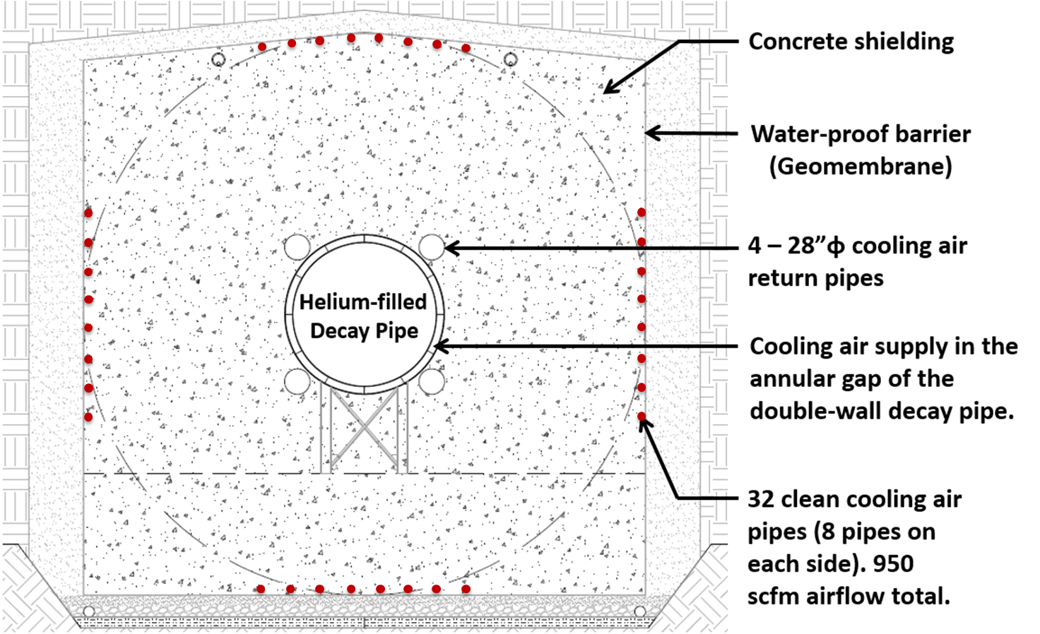
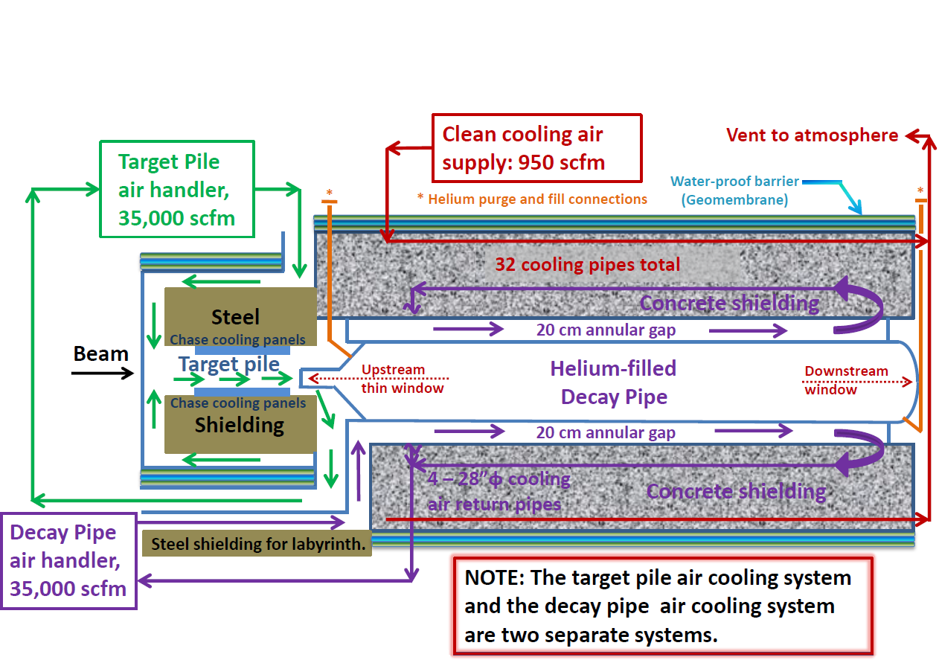
Decay Pipe
Porous cellular
concrete drainage
layer
194 m long, 4 m inside diameter
Helium filled
double-wall decay pipe, 20 cm annular gap
5.6 m thick concrete shielding
It collects ~30% of the beam power, removed by an air cooling system

Slide 10
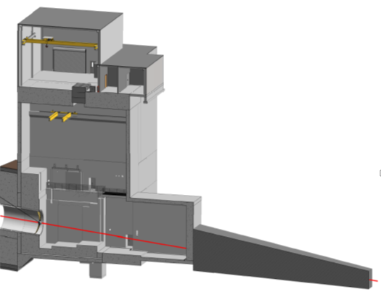
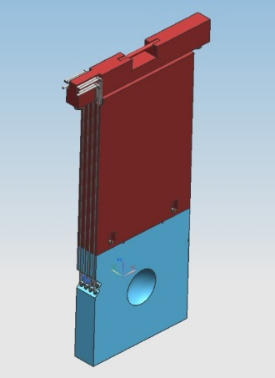
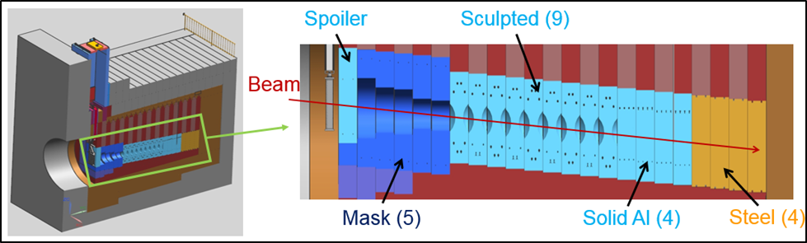
Hadron Absorber Hall
Cooling
Core: water
Shielding: forced air
Modular design
Designed for 2.4 MW
Core blocks replaceable (each 1 ft thick)
Muon Alcove
Beam
Beam
Muon Shielding (steel)

Slide 11
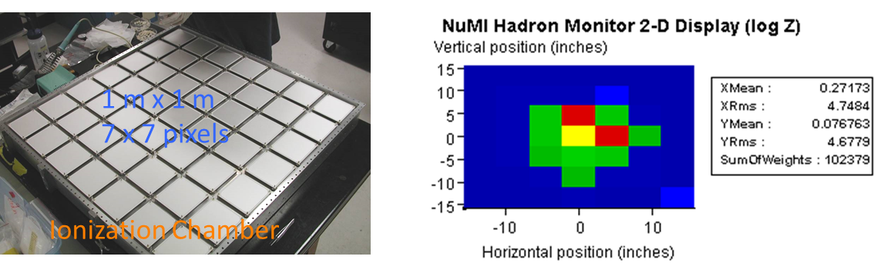
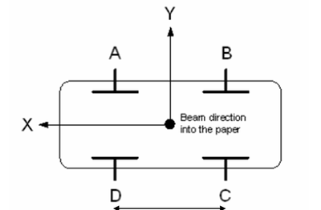
Instrumentation
Beam instrumentation is essential safety and physics
Target/Absorber
  Hadron/muon Monitor
  Info 2nd beam alignment
  ➔horns & target
Primary Beamline
  Beam Position/Profile Monitor
  Current Monitor

Slide 12
Neutrino Production System
Original (CDR, CD1R)
  2 horns (NuMI-like)
  1 m target
    Graphite fins
  Target chase atmosphere
    Air as default
  Hadron Absorber
    Sculptured core blocks
Optimised (under study for CD2)
  3 horns (new design)
  ~2 m target
    Graphite fins or rod
    Beryllium spheres
  Target chase atmosphere
    N₂ or He or air
  Hadron Absorber
    simplified

Slide 13
Beam Optimisation
Neutrino flux and spectrum and detector define physics reach
  Optimize neutrino flux for the physics
Handles
  Proton beam power and energy
  Target material and shape
  Focussing elements (horns)
  Decay volume
Use genetic algorithm to optimize CP-sensitivity
  Choose parameters at random
  Evaluate fitness (CP-sensitivity)
  Pick best configurations and mate them
  Generate new configuration derived from parent configuration

Slide 14
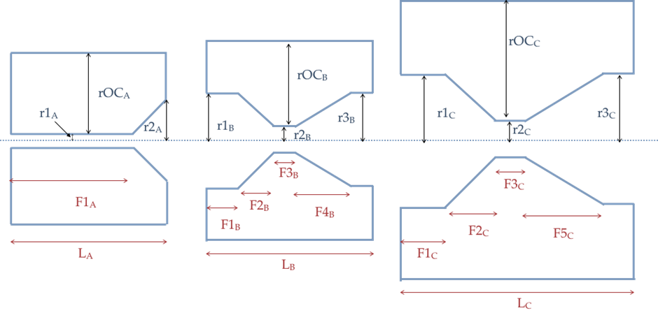
Horn Parameters
  Optimisation with 3 horn system

Slide 15
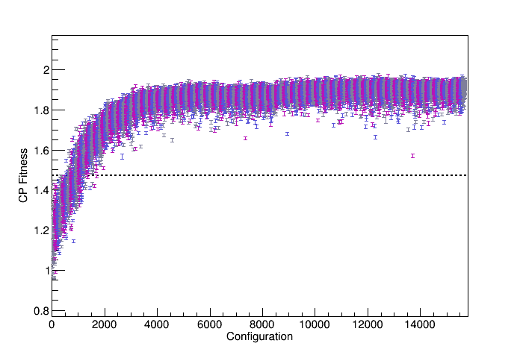
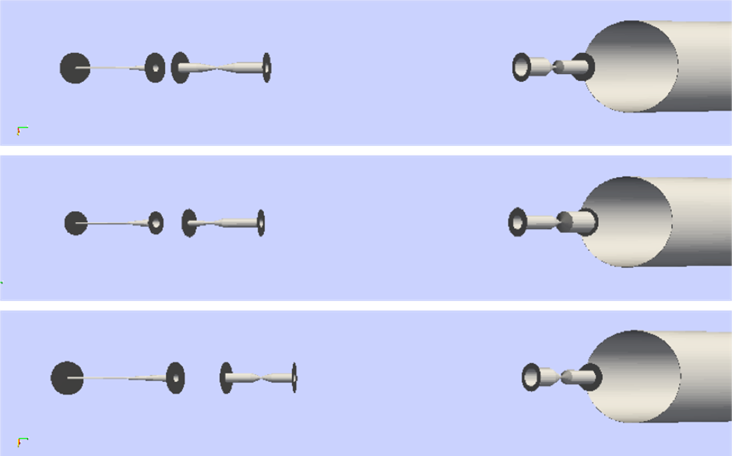
Beam Optimization (preliminary)
Best fitness: 1.97
Compared to 1.47 reference
CP Fitness: fraction of 3σ CP coverage
Significant number of iterations
  Each with O(100k) events

Slide 16

Optimization Result
Parameter | Lower Lim | Upper Lim | Unit | Early Optimum | Final Optimum
Horn A: LA | 1000 | 4500 | mm | 2612 | 2815
Horn A: F1A | 1 | 99 | % | 81 | 65
Horn A: r1A | 20 | 50 | mm | 38 | 34
Horn A: r2A | 20 | 200 | mm | 109 | 145
Horn A rOCA | 200 | 650 | mm | 563 | 630
Horn B: LB | 2000 | 4500 | mm | 2361 | 3229
Horn B: F1B | 0 | 100 | % | 29 | 20
Horn B: F2B | 0 | 100 | % | 18 | 21
Horn B: F3B | 0 | 100 | % | 1 | 1
Horn B: F4B | 0 | 100 | % | 20 | 22
Horn B: R1B | 50 | 200 | mm | 163 | 191
Horn B: R2B | 20 | 50 | mm | 48 | 47
Horn B: R3B | 50 | 200 | mm | 189 | 204
Horn B: ROCB | 200 | 650 | mm | 628 | 630
HornB: Z position | 2000 | 17000 | mm | 4269 | 3637
Horn C: LC | 2000 | 4500 | mm | 2723 | 2816
Horn C: F1C | 0 | 100 | % | 45 | 36
Horn C: F2C | 0 | 100 | % | 13 | 16
Horn C: F3C | 0 | 100 | % | 1 | 3
Horn C: F4C | 0 | 100 | % | 16 | 5
Horn C: R1C | 50 | 550 | mm | 365 | 398
Horn C: R2C | 20 | 50 | mm | 49 | 45
Horn C: R3C | 50 | 550 | mm | 277 | 310
Horn C: ROCC | 550 | 650 | mm | 637 | 643
Horn C: Z Position | 4000 | 19000 | mm | 17440 | 17478
Target Length | 0.5 | 2.0 | m | 2.0 | 2.00
Beam spot size | 1.6 | 2.5 | mm | 1.68 | 1.62
Target Fin Width | 9 | 15 | mm | 12.6 | 13.4
Proton Energy | 60 | 120 | GeV | 64 | 62
Horn Current | 150 | 300 | kA | 298 | 296

Slide 17
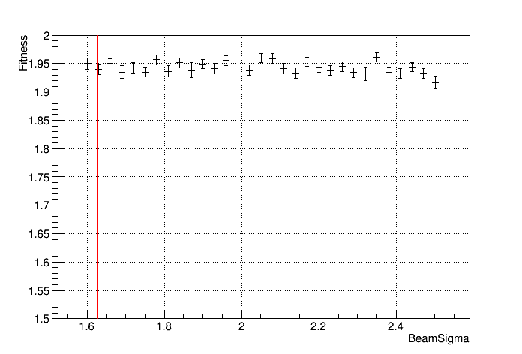
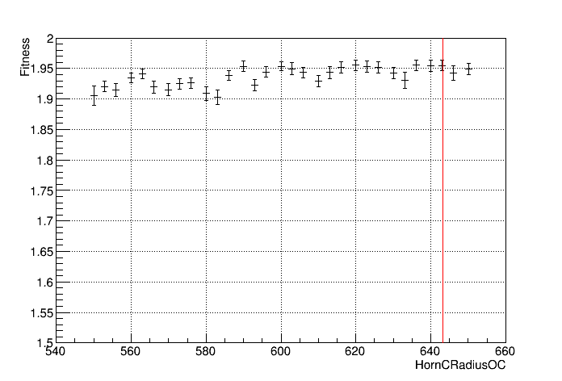
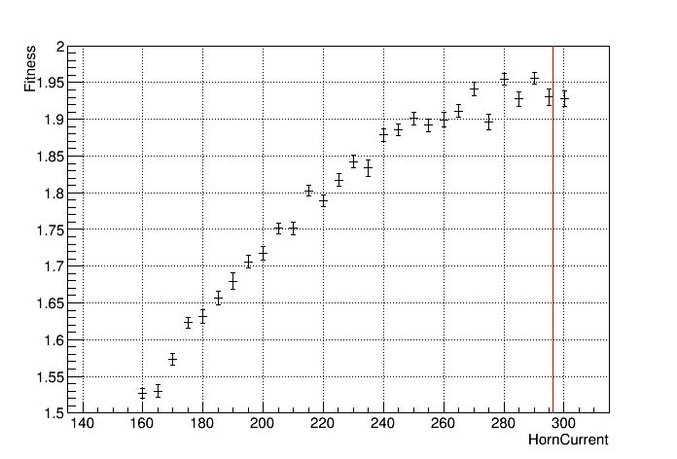
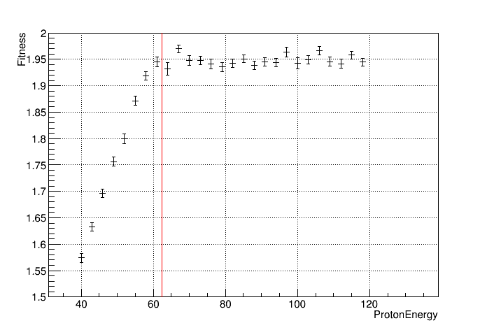
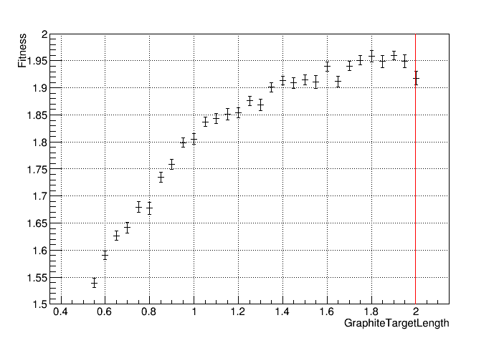
Parameter Scan

Slide 18
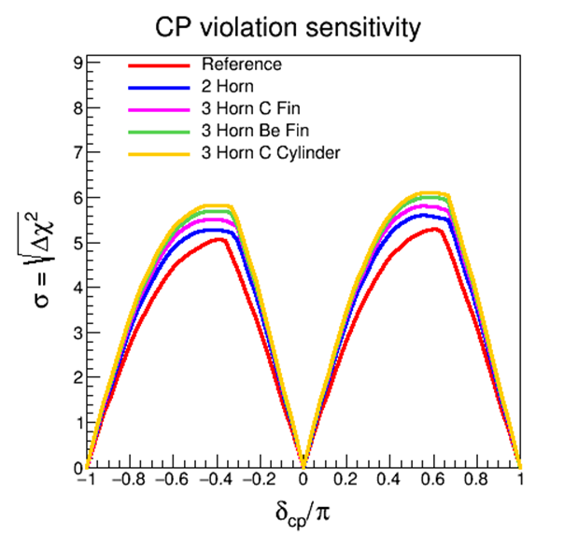
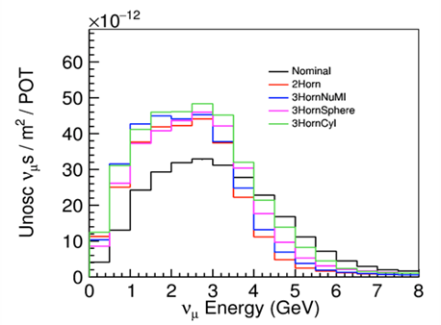
Conclusion
Flux can be substantially improved
3 horns, long target
Largely independent of target details

Slide 19
Target & Hadron Absorber
Hadron Absorber and Target design are closely coupled
  Larger target length
    More protons interact ➔ lower peripheral energy deposition
  Larger target radius
    More beam “halo” protons interact ➔ lower central energy deposition

Slide 20
Particle Flux at Absorber

Slide 21
Hadron Absorber Energy Dep.
2 horns, short target
3 horns, long target, wings
Additional neutrino production target/decay volume
1% ND neutrinos
Peak energy deposition reduced by factor 10-20
Simplified absorber design
Also reduced muon flux after absorber
  Reduced radiological impact

Slide 22
Simulations
Simulation are an important tool to design the LBNF facility
Beam optimisation
  Define the optimal placement, shape and form of components
  GEANT4 based toolset available
  FLUKA under development
Energy depositions
  Need to understand cooling requirements
  Based around MARS (could be GEANT or FLUKA)
Radiological impacts
  High radiation environment, need to understand where radiation is produced and how to deal with activation

Slide 23
Opportunities for Collaboration
non-DOE contribution essential
Ample opportunities depending on interest and capabilities
  Design, R&D, eventual construction
Examples
  Primary beam
    Dipole and corrector magnets, PS, beam monitors, …
  Neutrino beam
    Target, instrumentation, hadron/muon monitor, shielding, cooling, horns, horn PS, remote handling, support modules, beam windows, absorber, …
  Infrastructure
    hot cell, cooling, atmosphere, …
  Simulations
    Energy depositions, radiological implications, beam optimisation

Slide 24
Summary
LBNF beamline
  Highest power (neutrino) beam world wide
Variety of important tasks
  Simulation, engineering, production
  Scope from k$ to several M$
  Something for everybody
  You have an idea how to contribute or take a lead?
    Almost anything can be accommodated
Critical to success of LBNF/DUNE
  Physics ~ flux * detector

Slide 25
The End

Slide 26
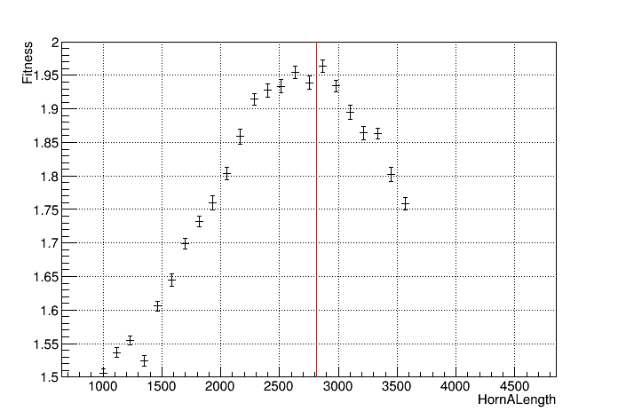
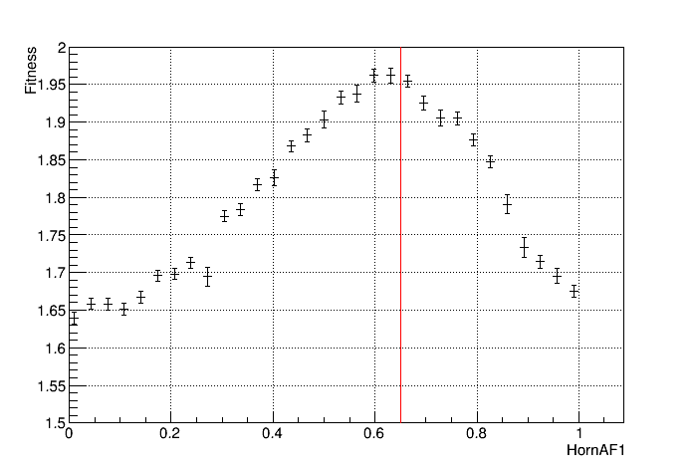
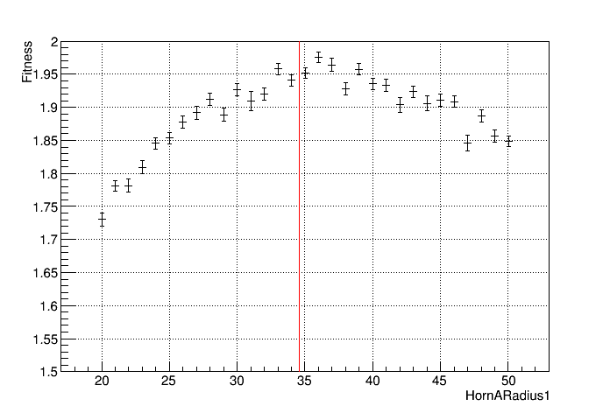
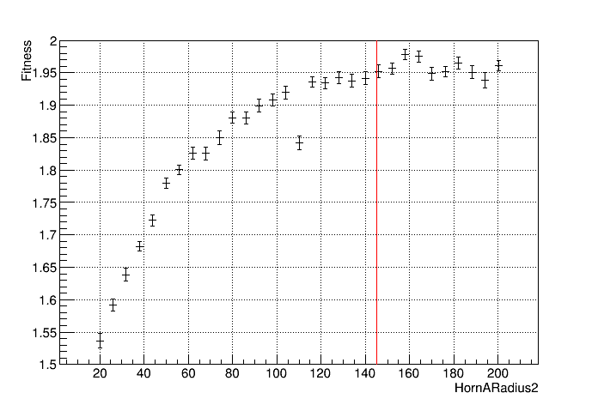
NuMI-style Parameter Scan

Slide 27
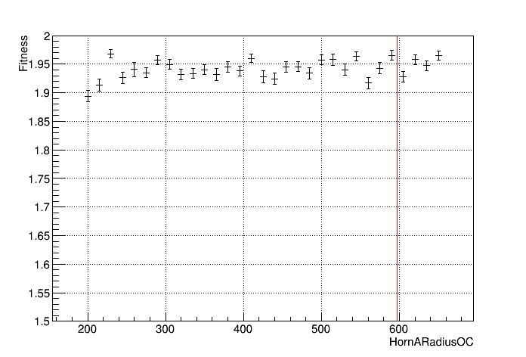
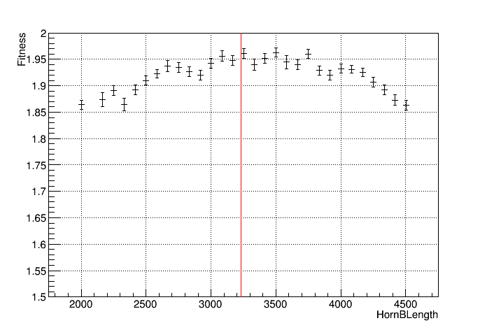
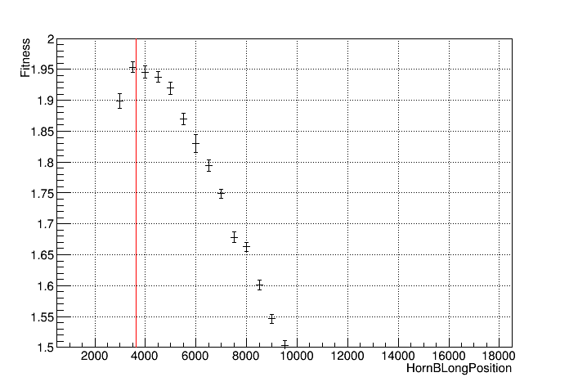
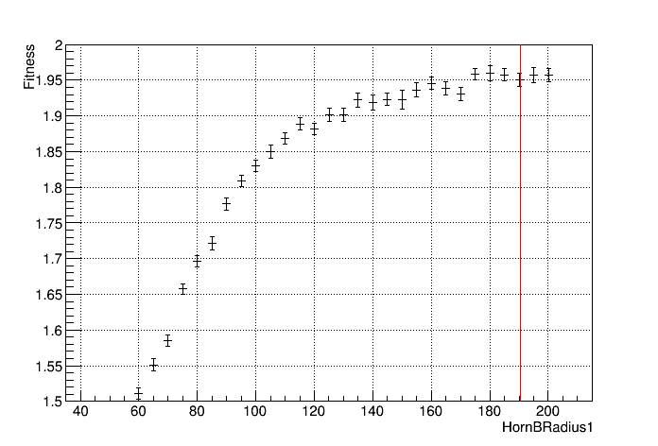
NuMI-style Parameter Scan

Slide 28
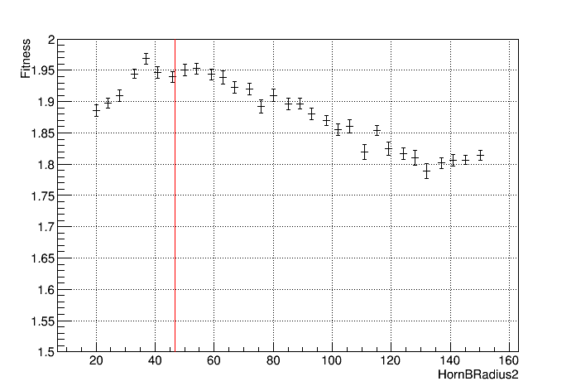
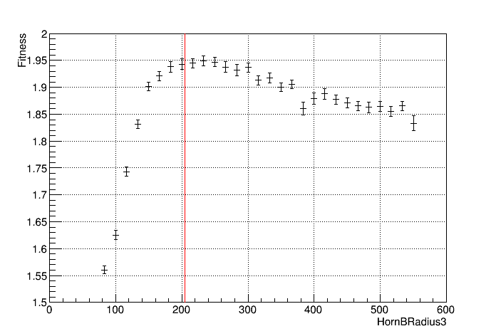
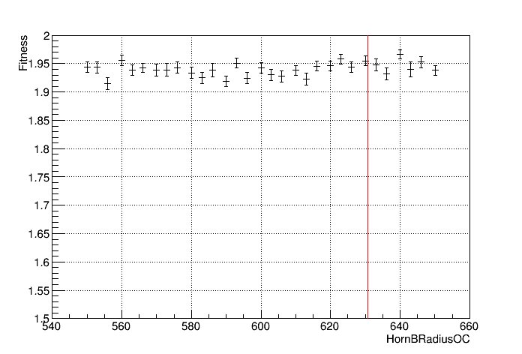
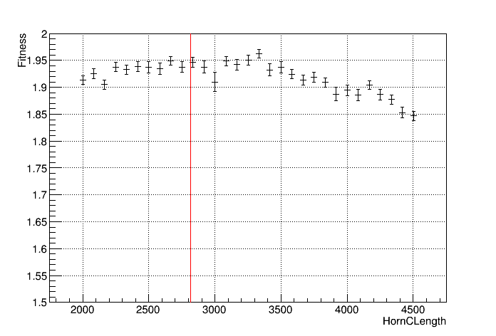
NuMI-style Parameter Scan

Slide 29
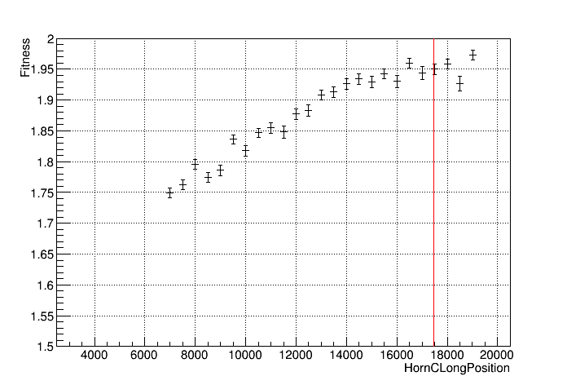
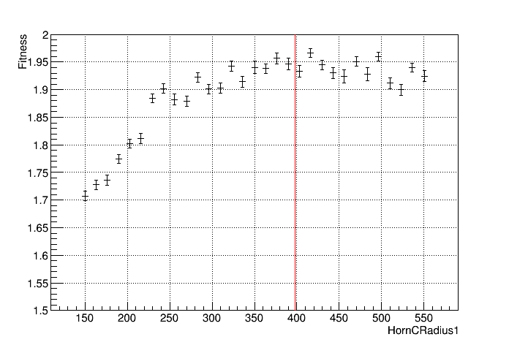
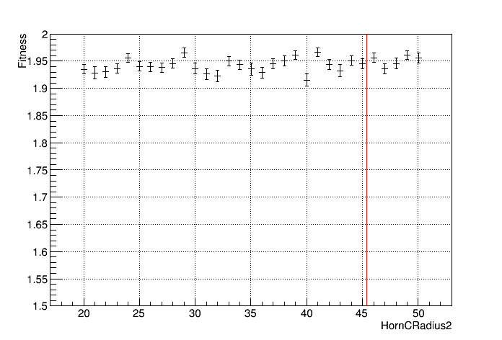
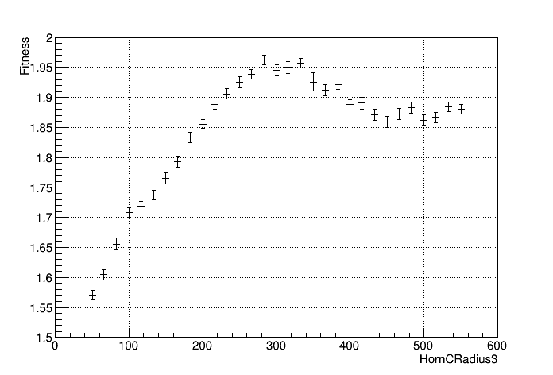
NuMI-style Parameter Scan

Slide 30
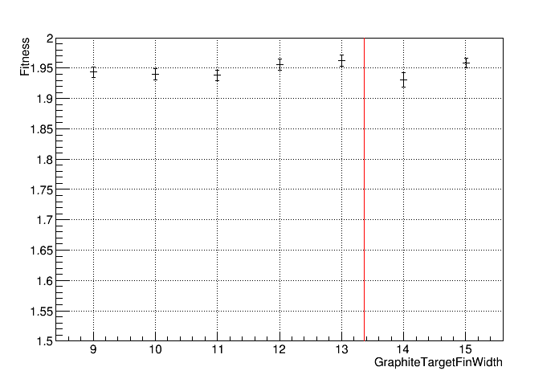
NuMI-style Parameter Scan

