Slide 1
The LBNF/DUNE projects
LBNF
DUNE
Near and Far detector Civil Engineering
Conventional facilities (infra., utilities, ..)
Cryostats
Cryogenics
Safety
…...
Detectors construction
Detectors installation
Detectors operation
Computing
Physics
…...

Slide 2
The LBNF/DUNE projects
LBNF
DUNE
International project, hosted and directed by FNAL
Under the responsibility of Fermilab
In partnership with various external Laboratories and Funding Agencies
Sanford Lab, CERN, ….
Model similar to the LHC machine project
International Collaboration
… with Fermilab as Host Lab
governed by its own management and a resource review board
Many Institutions and Funding Agencies involved
Model similar to the LHC experiments

Slide 3
The LBNF/DUNE projects
Conventional Utilities
Cryostats
Cryogenics
Overall Schedules
Logistics Coordination
All safety aspects
Neutrino Beam
LBNF
Director : Christopher J. Mossey (FNAL)
Overall scope: design, procurement, construction and installation

Slide 4
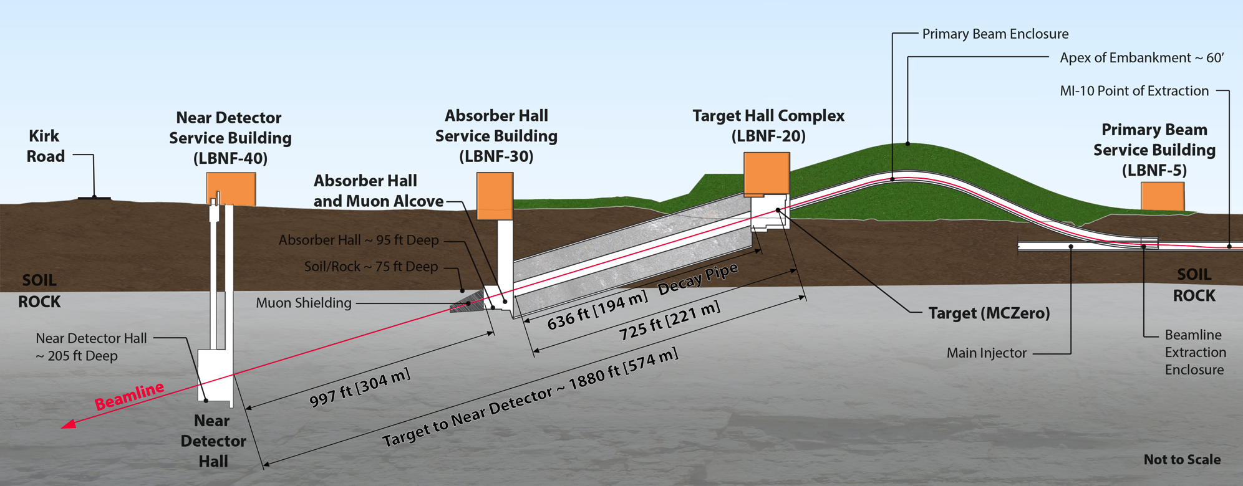
“Near Site” – LBNF at Fermilab, Batavia, IL
Primary proton beam @ 60-120GeV extracted from Main Injector
Initial 1.2 MW beam power, upgradable to 2.4 MW
Embankment allows target complex to be at grade and
neutrino beam to be aimed to Lead, SD
Decay region followed by absorber
Four surface support buildings
Near Detector facility

Slide 5
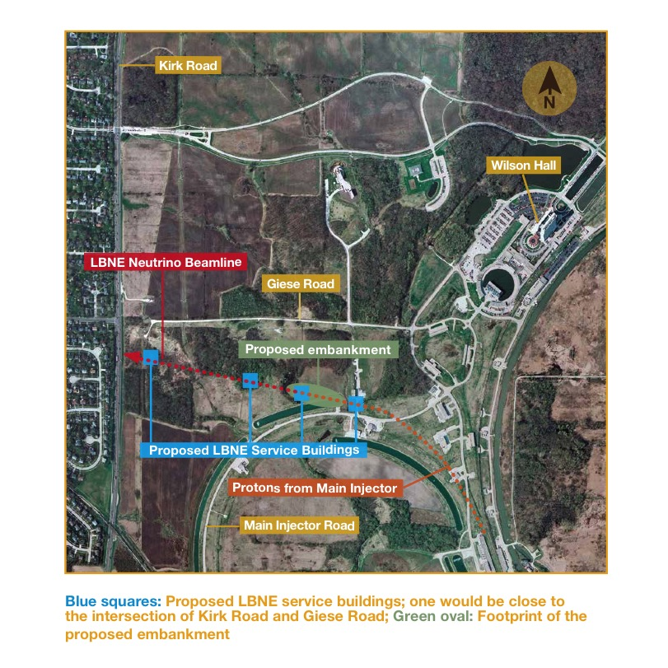
“Near Detector facility” – LBNF at Fermilab, Batavia, IL

Slide 6
Near Neutrino Detector Hall & Service Building (LBNF-40)
1’300 m²
Approximately 30m by 17m wide detector cavern
14m by 41m service building with truck bay, bridge crane, and support rooms
6.7m diameter primary shaft with septum dividing primary personnel access elevator from equipment/utility access.
5.2m diameter secondary shaft for emergency egress.
Roof hatch over primary shaft for large crawler-type crane needed for the Near Detector assembly

Slide 7
Near Neutrino Detector Hall
Embedded rail system for detector assembly, placement
Sump for optional LAr detector containment
Plan

Slide 8
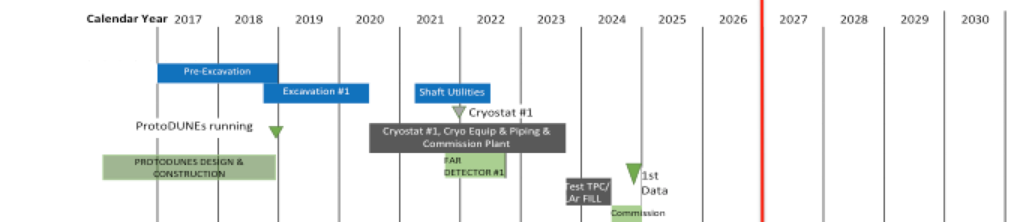
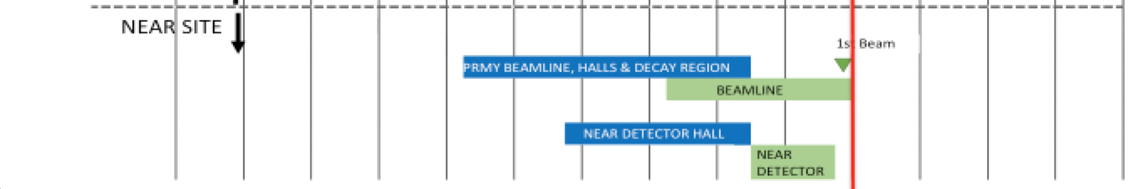
Near Neutrino Detector Hall
Embedded rail system for detector assembly, placement
Sump for optional LAr detector containment
Plan

Slide 9
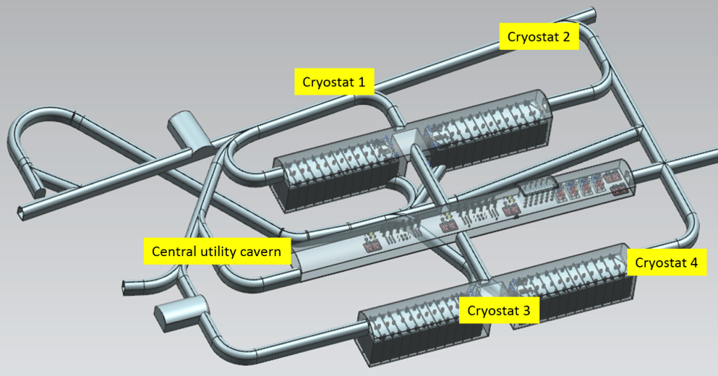
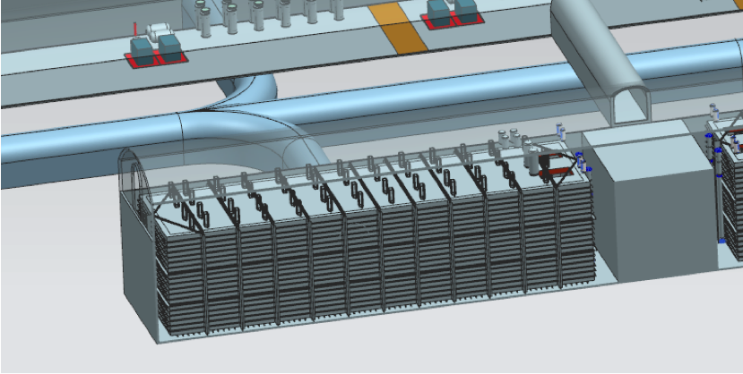
“Far Site” – LBNF at Sanford Lab, Lead, SD
Conventional Facilities:
  Surface and shaft Infrastructure including utilities
  Drifts and two caverns for detectors
  Central utility cavern for conventional and cryogenic equipment
Cryostats:
  Four membrane cryostats supported
  by external steel frames
Cryogenic Systems:
  LN2 refrigeration system for cooling
  and re-condensing gaseous Argon
  Systems for purification and
  recirculation of LAr
Argon: 70kt LAr (~40kt “fiducial” mass)
4850L cavern and drift layout
Single cryostat

Slide 10
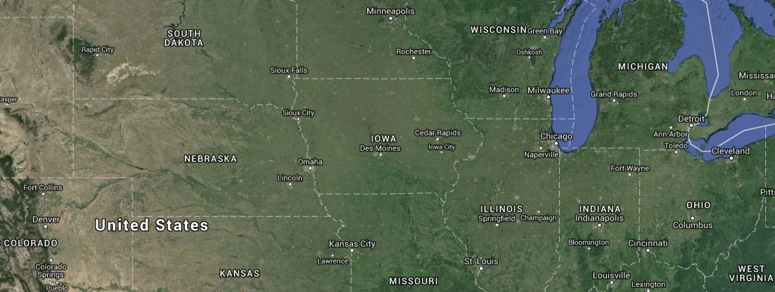
“Far Site” – LBNF at Sanford Lab, Lead, SD
Next International airports
Regional airport

Slide 11
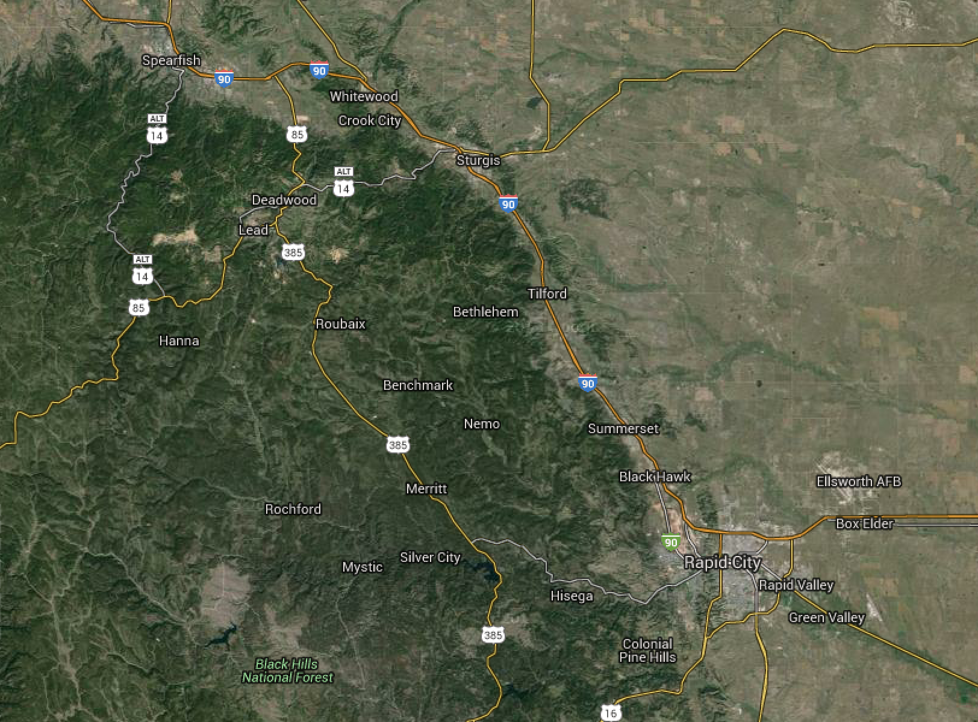
“Far Site” – LBNF at Sanford Lab, Lead, SD
~ 45’ car driving

Slide 12
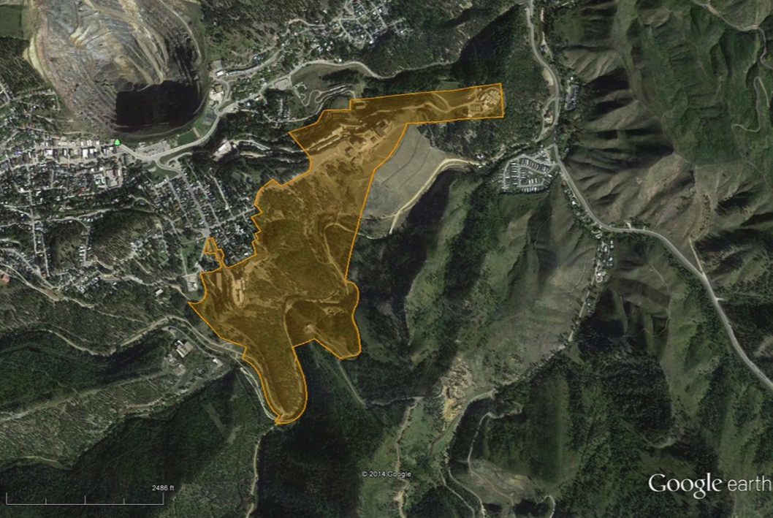
Far Site Overview – Sanford Lab in Lead, SD
Lead, SD
Yates Complex
Ross Complex
Property Summary
186 acres (surface)
7700 acres (underground)

Slide 13
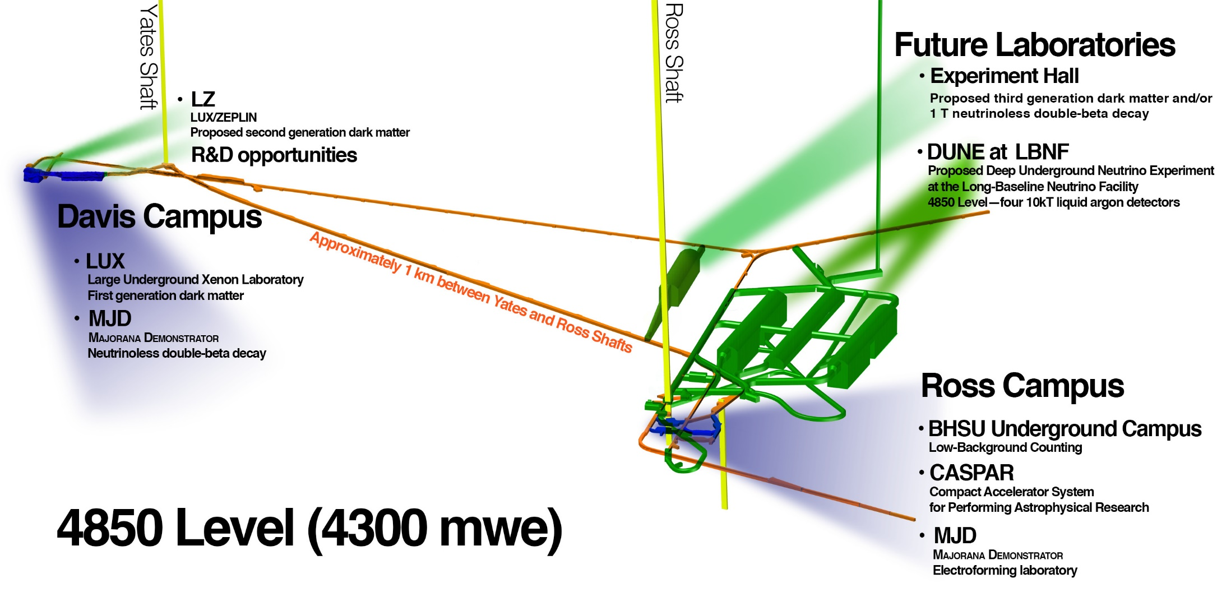
Far Site Context – part of an Underground Campus
Existing facilities
Proposed facilities

Slide 14
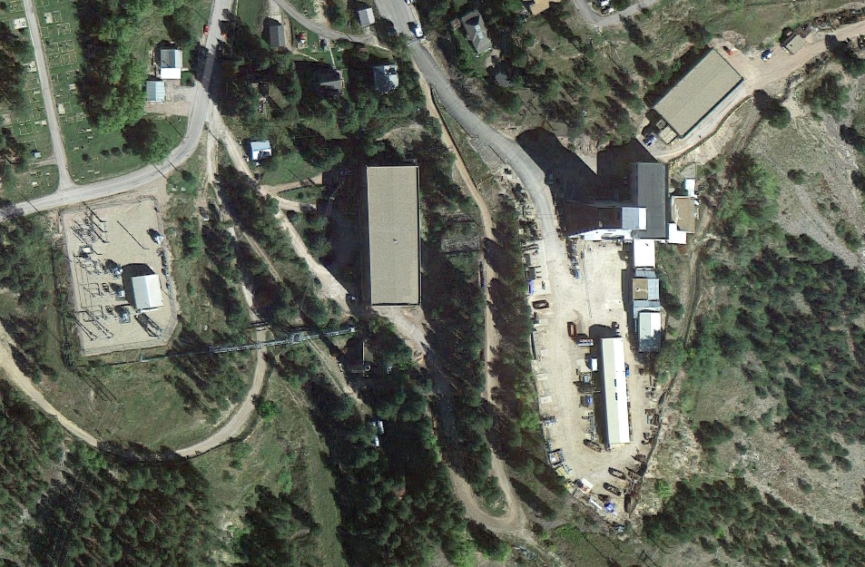

Design Scope – Surface (Ross Complex)
(LBNF Scope in White)
Ross Dry
Control
Room
Ross
Substation
Ross
Hoist
Bldg
Ross Headframe
and Crusher Bldg
Excavated Rock
Handling System
12kV Power Feed and
Transformer Upgrade
Cryogenic
Compressor
Building
and
Cryogenic Systems
(LAr and LN2)

Slide 15
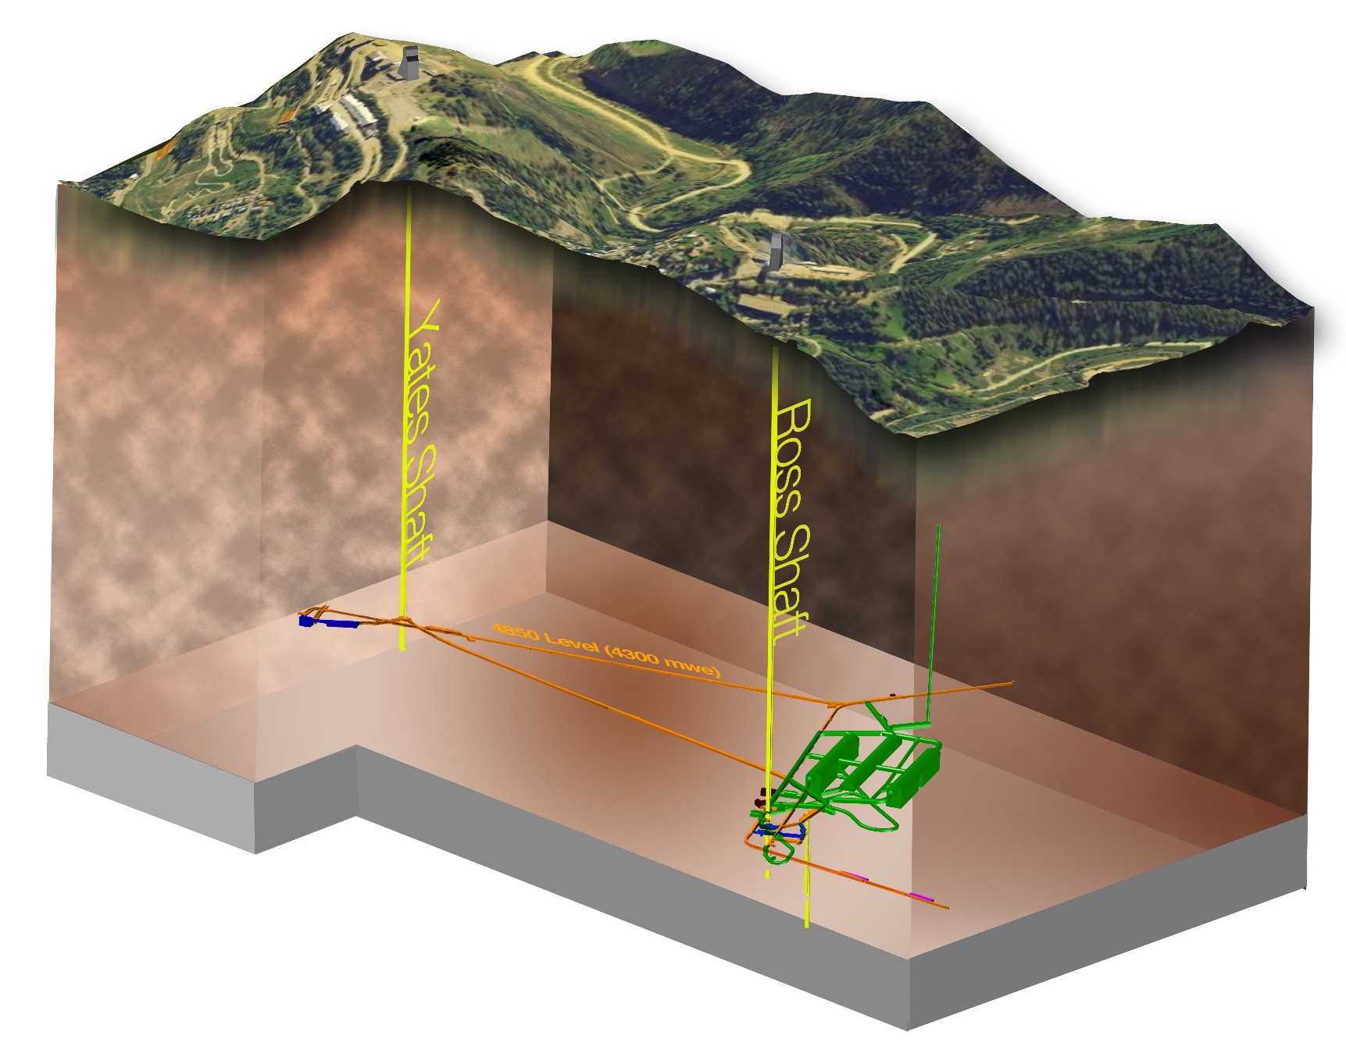
Far Site Scope – Overview of Phases of Work
Sanford Lab Reliability
Projects
FY16 – 18
  Ross shaft rehab
  Hoist motor
  rebuilds, more…
Pre-Excavation
FY17 - 20
  Rock disposal
  systems
  Ross brow
  expansion, more…
Excavation/
Construction
FY18 – 22
  Caverns/Drifts/Utilities/Surface building
Cryostats/Cryogenic Systems FY20 – 25

Slide 16
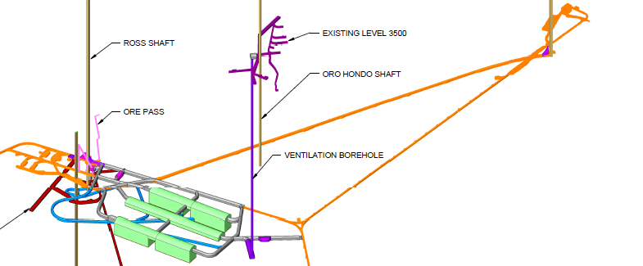

Slide 17
Scope – Shafts
Completion of the Ross Shaft rehabilitation from the 3200L to the 5000L
Utilities in the Ross Shaft
  Electrical power
  Fiber optics for experiment data and control and fire alarm
  Pipes in Ross Shaft for gaseous nitrogen and argon transport
  Fire water pipe from 4100L sump to 4850L

Slide 18
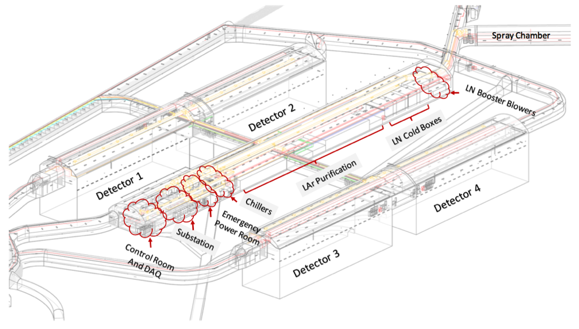
Scope – Detector Caverns
4 Detector Chambers ( 69.6m x 27.4m x 19.8m)

Slide 19
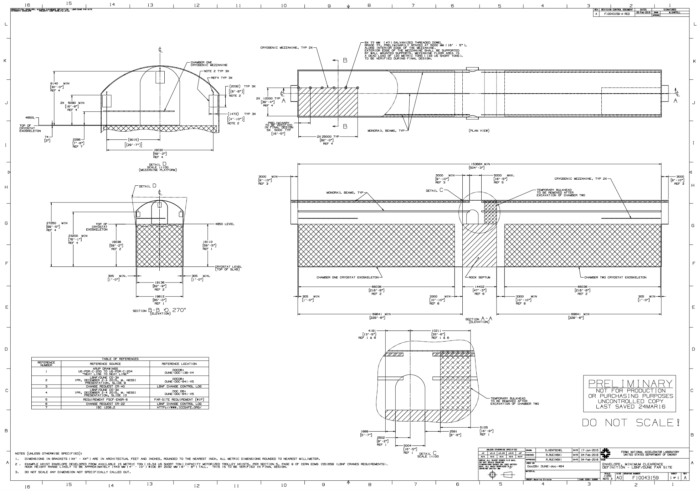
Scope – Detector Caverns

Slide 20
Scope – Central Utility Cavern

Slide 21
Cryostats Requirements
Four large cryostats capable of hosting a new generation of neutrino detectors based on Liquid Argon Time Projection Chamber techniques (TPC).
Each cryostat capable of hosting a fiducial active detector mass of at least 10’000 tons of Liquid Argon (LAr).
Cryostat system thermally and electrically neutral to the external environment.
The cryostat and cryogenic systems shall provide a stable liquid argon environment for the detector.
The cryostat and cryogenic systems shall be designed to maintain a single phase in the entire liquid argon volume at a stable temperature. The chosen temperature is 88.3 K +/- 1 K.
The cryostat design shall be capable of handling all need services, cryogenics and detector signal penetrations from the outside to the inside of the cold volume.
It shall be possible to install the cryostat in the foreseen SURF environment.
The cryostat shall host on its surface all services, proximity cryogenics, front-end electronic racks and feed-throughs.
Same cryostat design for both TPCs technologies.
Notes:
This is the list of the requirements that have an impact of the CF work.
READ.
Full list is available here.

Slide 22
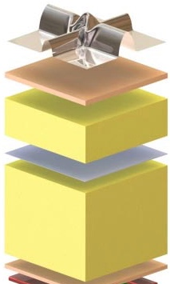
Cryostats Design Requirements
Cold cryostats technology based on LNG transport techniques
Insulation : reinforced polyurethane foam (5-7 W/m²)
Warm structure : support structure
SS 1.2 mm primary membrane in contact with the liquid (primary containment)
secondary membrane : composite laminated material (secondary containment)
Notes:
This is the list of the requirements that have an impact of the CF work.
READ.
Full list is available here.

Slide 23
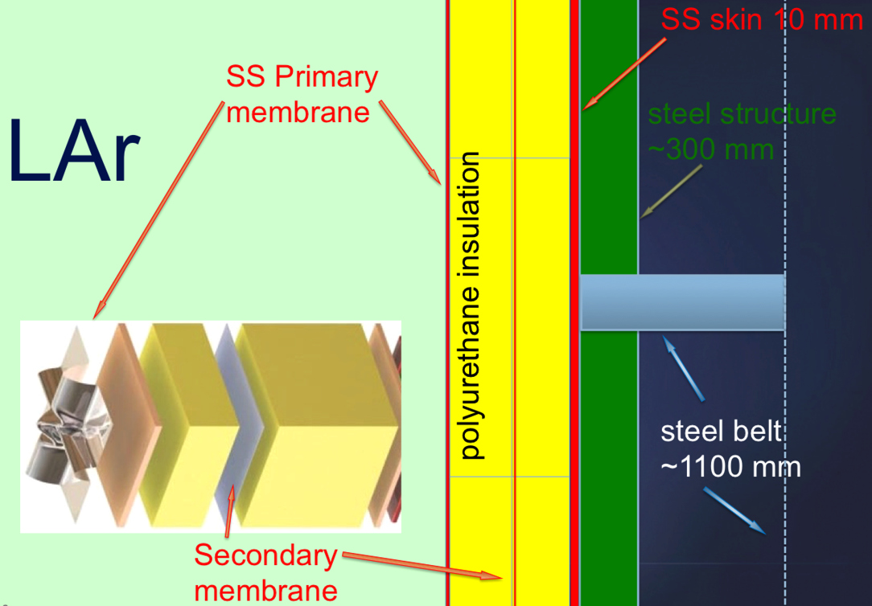
Cryostats Design Requirements
Gas containment
Warm cryostats : Fe support structure
Notes:
This is the list of the requirements that have an impact of the CF work.
READ.
Full list is available here.

Slide 24
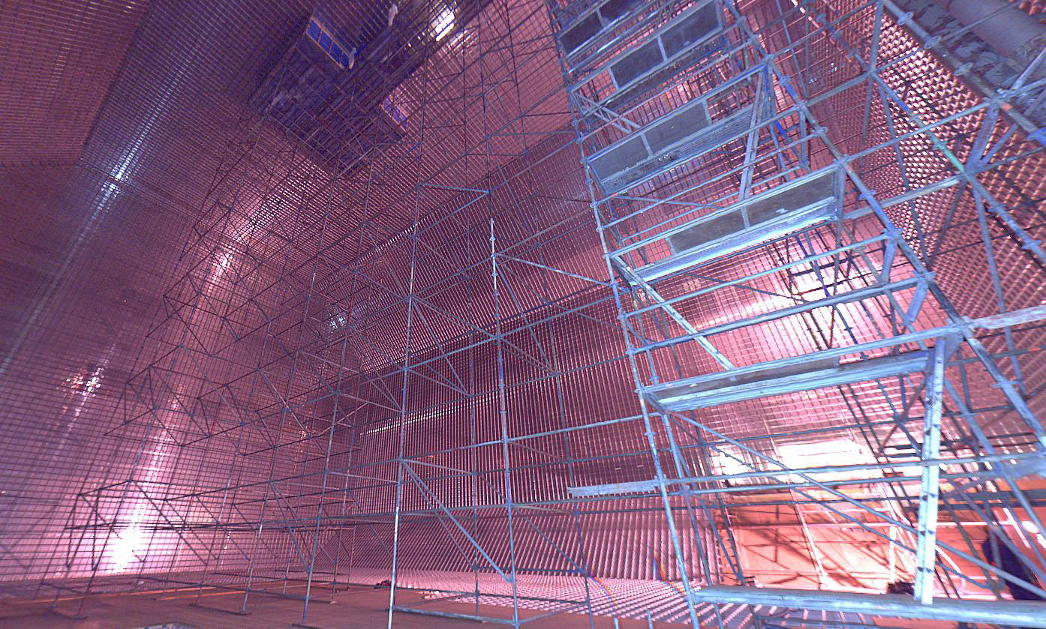
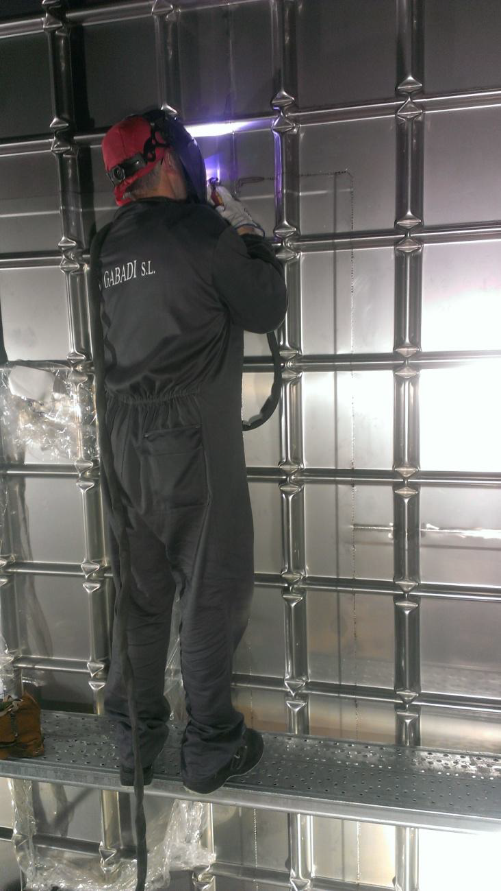
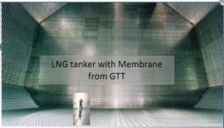
Membrane cryostats (LNG licence)

Slide 25
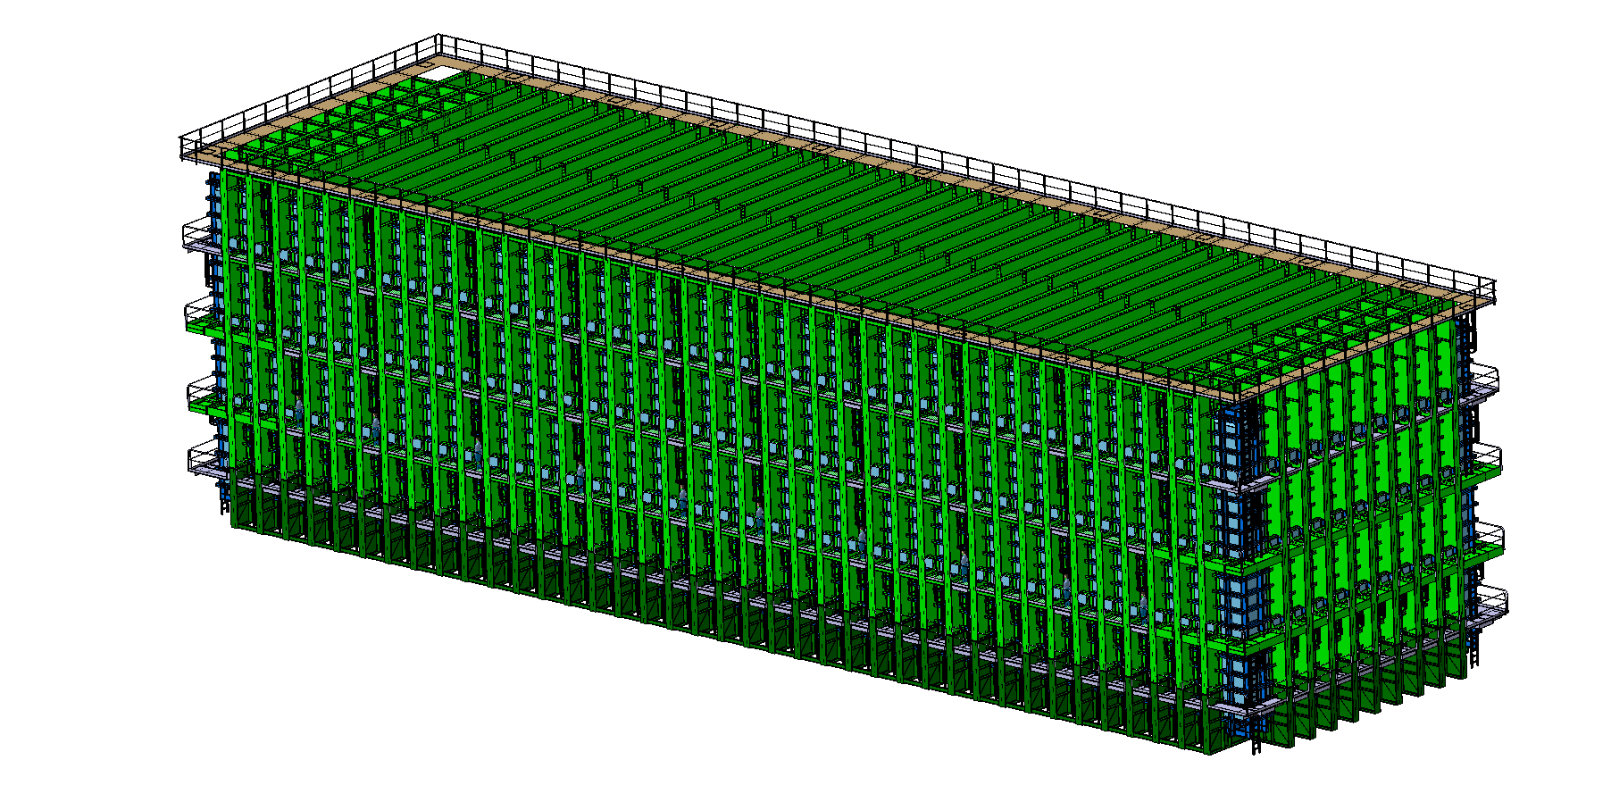
Warm Support Structure
Inner dimension (liquid+gas):
  L = 62.00 m
  W = 15.10 m
  H = 14.00 m
Notes:
This is the list of the requirements that have an impact of the CF work.
READ.
Full list is available here.

Slide 26
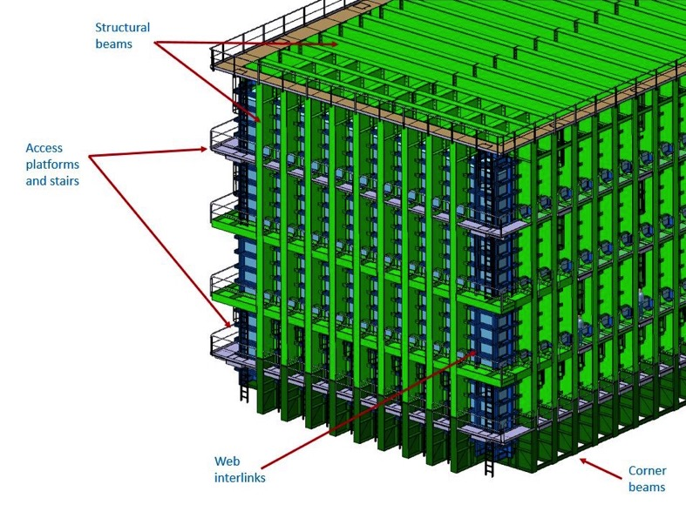
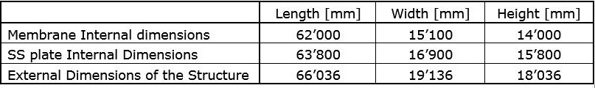
Design and dimensions
Notes:
This is the list of the requirements that have an impact of the CF work.
READ.
Full list is available here.

Slide 27
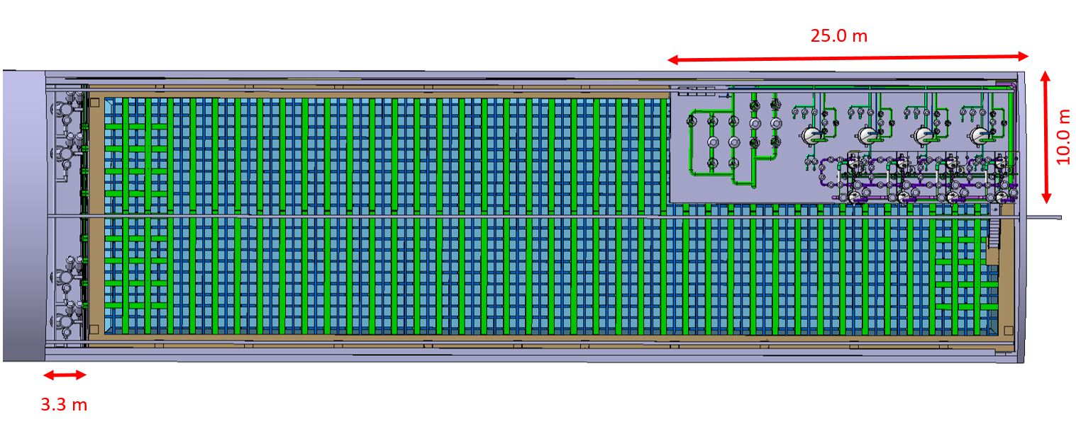
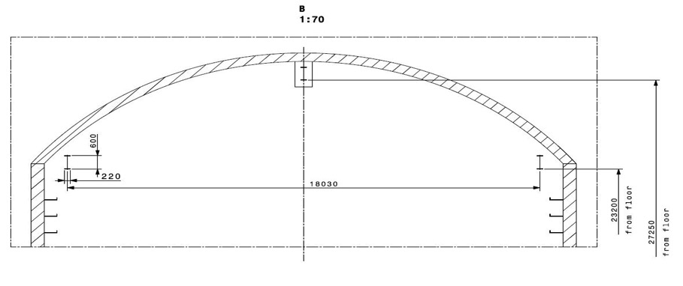
Design and dimensions
Notes:
This is the list of the requirements that have an impact of the CF work.
READ.
Full list is available here.

Slide 28
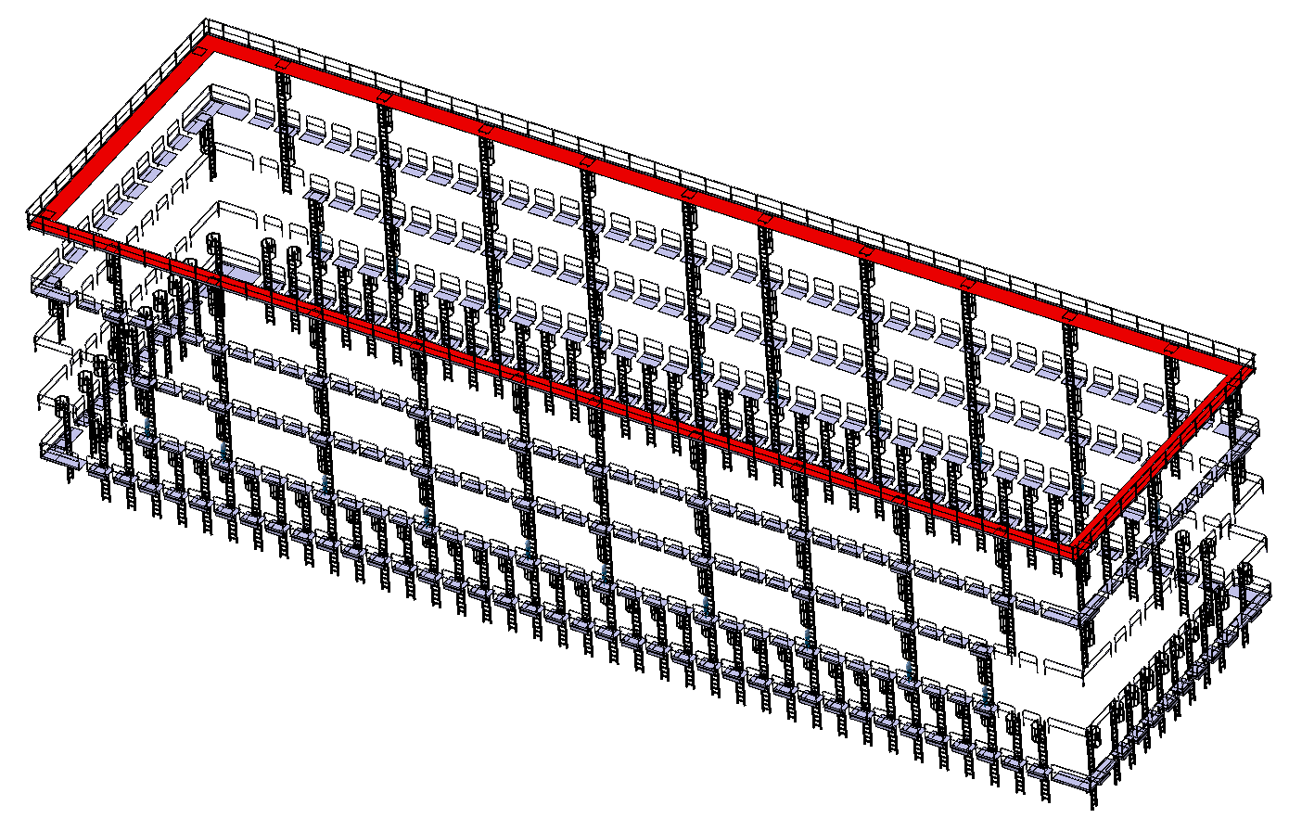
Access structure during assembly and operation
~ 900 m of gangways
~ 600 m of stairs
access platforms to the electronics racks and feed-throughs not yet designed
Notes:
This is the list of the requirements that have an impact of the CF work.
READ.
Full list is available here.

Slide 29
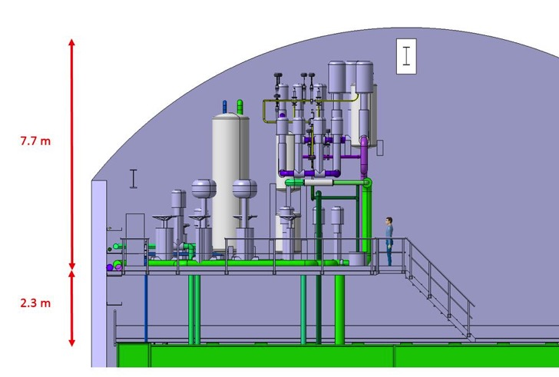
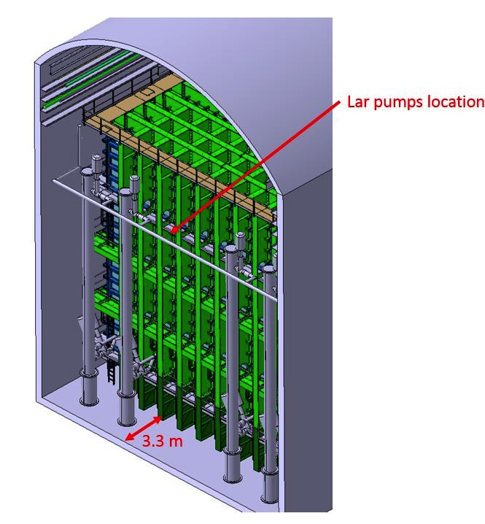
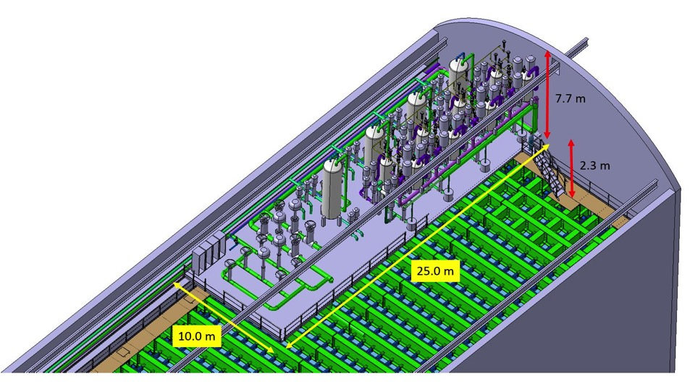
Design
Proximity cryogenics mezzanine
Notes:
This is the list of the requirements that have an impact of the CF work.
READ.
Full list is available here.

Slide 30
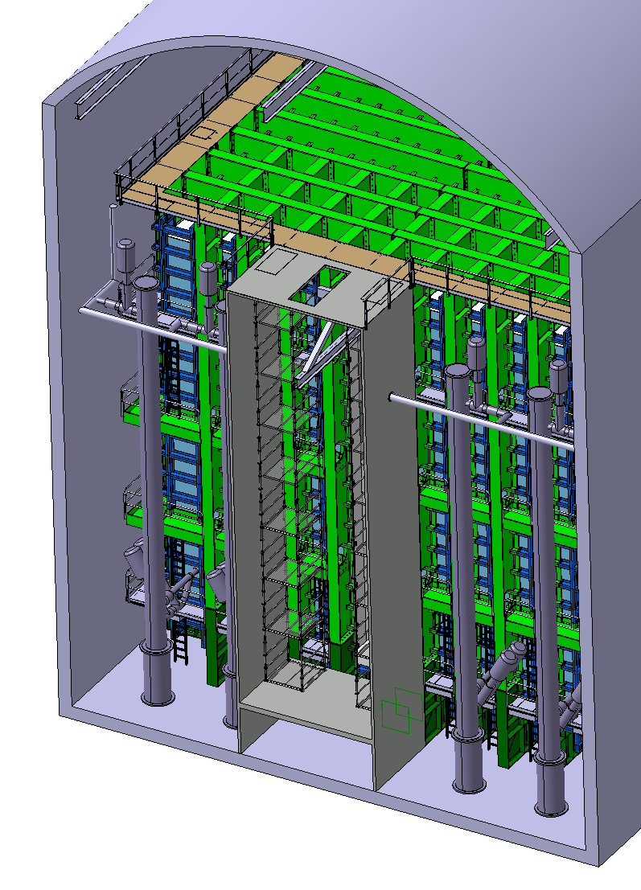
Detector installation : clean room and cryostat opening
Notes:
This is the list of the requirements that have an impact of the CF work.
READ.
Full list is available here.

Slide 31
LBNF Cryogenics
The LBNF Cryogenics is composed by three main parts: Proximity, Infrastructures/External, and Internal Cryogenics.
The Proximity Cryogenics is split between the detector cavern and the Central Utility Cavern (CUC). Its scope is to circulate and purify the LAr, to achieve and maintain the LAr purity, and to recondense and purify the boil off GAr.
The main items are: the LAr circulation pumps (detector cavern), the GAr and LAr purification filters with regeneration system (CUC), the condensers for the boil off GAr, the LAr/LN2 phase separators (detector cavern), and interconnecting piping, buffer tanks, valves, instrumentation, etc. (detector cavern + CUC).
The Infrastructures/External Cryogenics is split between the detector cavern and the Central Utility Cavern. Its scope is to receive the cryogens (LAr/LN2), to transport the Argon to cavern, and the full LN2 refrigeration system (compressors, cold boxes, LN2/GN2 distribution system).
The main items of the Infrastructure/External Cryogenics are: the cryogens receiving stations (surface), the GN2/GAr piping in the shaft, the full LN2 refrigeration system (surface and underground), the LN2 storage dewars (underground), and interconnecting piping, buffer tanks, valves, instrumentation, etc. (surface and underground).
The Internal Cryogenics is located inside the cryostat. Its scope is to distribute the LAr/GAr for the various modes of operations (Purge, Cool-down, Fill, Normal operations).
The main items are the manifolds for the purge, cool down and LAr return and the LAr withdrawal for the LAr continuous purification.
Notes:
READ.

Slide 32
Cryogenics Process Flow Diagram
Infrastructure
NO cryogenics in the shaft.
Proximity
Internal

Slide 33
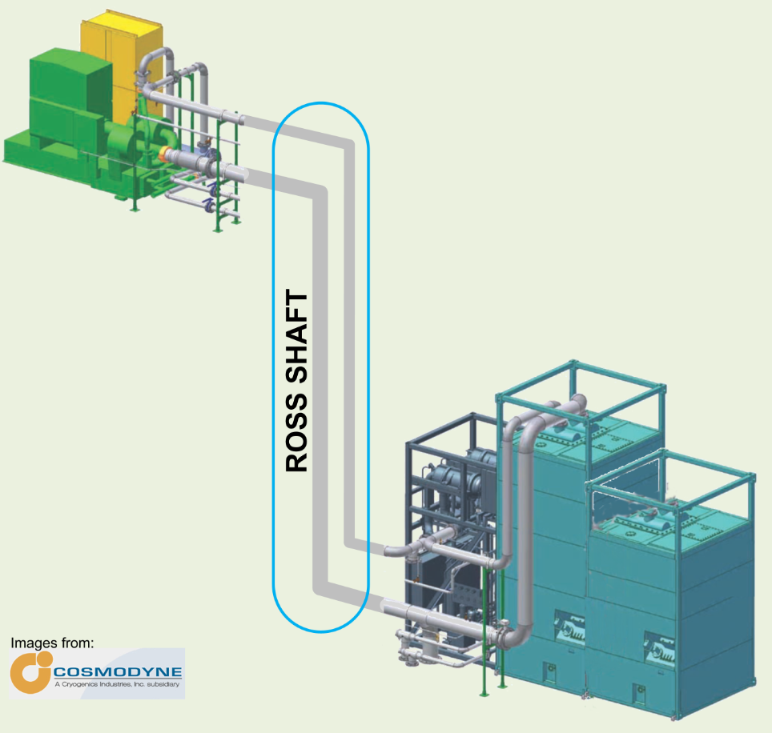
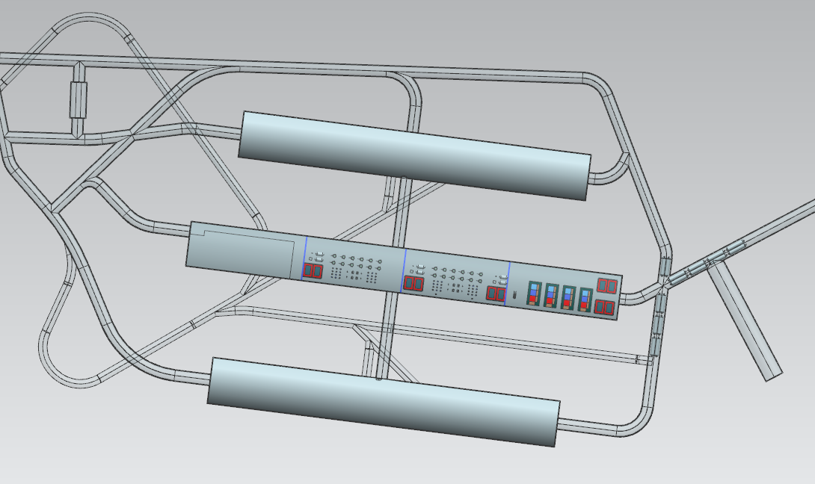
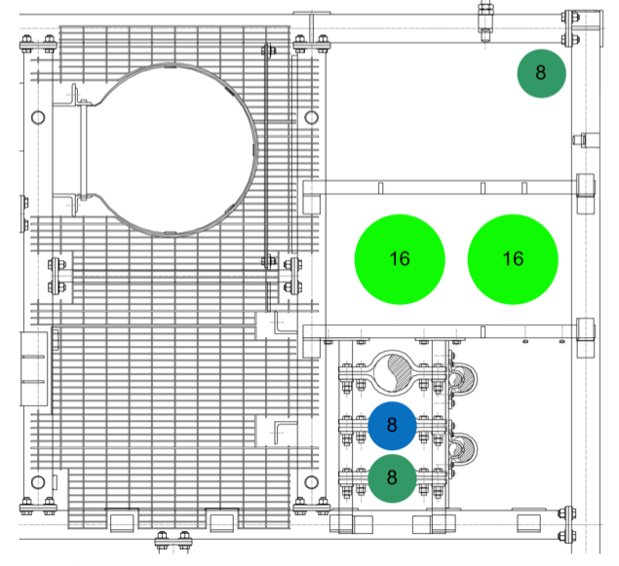
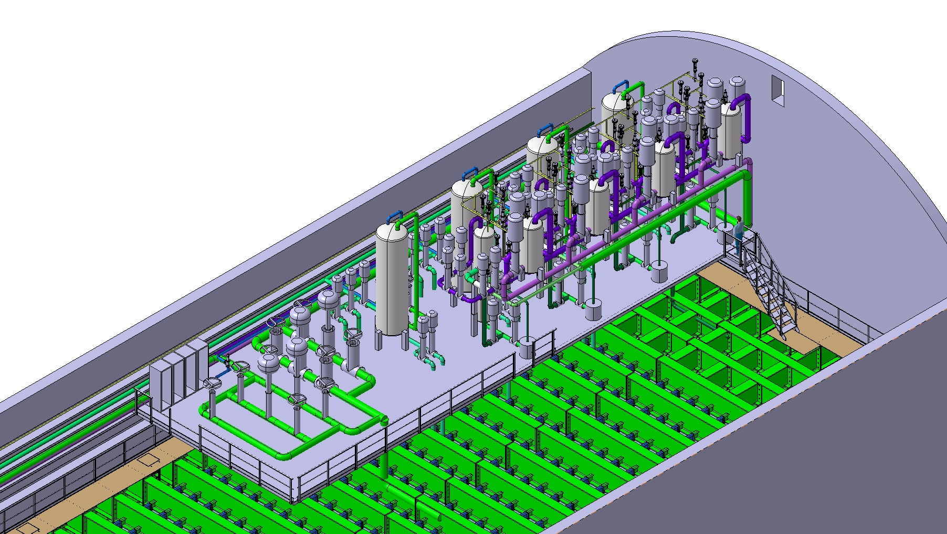
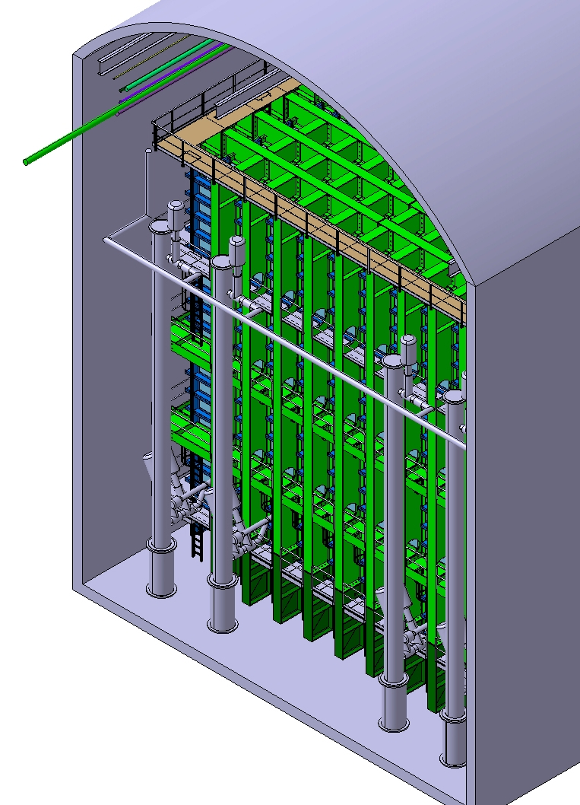
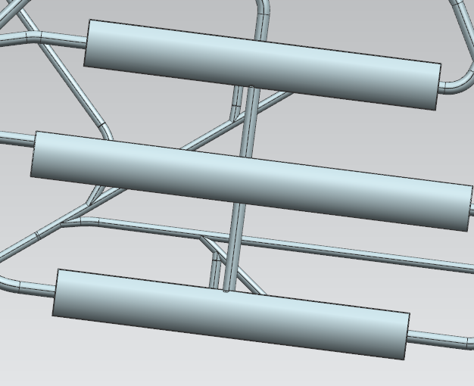
Views
Big compressors on surface
Central Utility Cavern
LN2 System (underground)
Cold boxes
& Expanders
Underground
4 Commercial units
GN2 Piping in shaft
Caverns 1&2
Caverns 3&4
LAr/GAr Filtration For Cryostats 3 & 4
LAr/GAr Filtration For Cryostats 1 & 2
LN2 Refrigeration System
7.7 m
Proximity Cryogenics in Detector Cavern
25 m
3.3 m
10 m
Not to scale

Slide 34
Relevant Cryogenics Parameters
Parameter | Value | Note
GAr Purge Flow rate | 1,123 m³/hr | From 1.2 m/hr
Condensers size | 4 x 97 kW = 388 kW | 3 LN2 units for cryostats 1 & 2, 4th unit for 3 & 4
LAr filling flow rate | 145 / 208 days | 1st /2nd Cryostats only (with 3 LN2 refrigeration units)
LAr filling flow rate | 179 / 287 days | 3rd/4th Cryostats only (with 4 LN2 refrigeration units)
Cryostat static heat leak | 28.8 kW | Each cryostat
Electronics heat leak | 23.7 kW | Each cryostat
Total estimated heat leak | 66.5 / 76.9 kW | Each cryostat with 2/4 LAr pumps in operation
Maximum LAr circulation speed (assuming 5 days turnover) | 1.73 m³/m (40 kg/s) | All 4 LAr pumps in operation
Nominal LAr circulation | 0.43 m³/m (10 kg/s) | Only 1 LAr pump in operation

Slide 35
Far Site Facilities Scope and Requirements
Scope Element | Funding Source
Excavation of 4850L detector and utility caverns and drifts | DOE
Surface buildings, utility infrastructure, cavern outfitting | DOE
LN2 cryogenic systems | DOE
Four 10kt fiducial cryostats | Non-DOE
LAr cryogenic systems | Non-DOE
LAr and LN2 cryogenic fluids procurement | DOE and Non-DOE
CD-3a Scope
Overall scope: Design, procurement, construction, and installation of conventional facility improvements, cryogenic systems, and cryostats to support the DUNE Far Site detectors.

Slide 36
LBNF/DUNE – Construction Summary

Slide 37
Far Site Facilities Scope and Requirements
Scope Element | Funding Source
Excavation of 4850L detector and utility caverns and drifts | DOE
Surface buildings, utility infrastructure, cavern outfitting | DOE
LN2 cryogenic systems | DOE
Four 10kt fiducial cryostats | Non-DOE
LAr cryogenic systems | Non-DOE
LAr and LN2 cryogenic fluids procurement | DOE and Non-DOE
CD-3a Scope
LNG Membrane cryostat is an European technology.
CERN has now a frame contract with the French firm holding the main IP.
The support structure requires many mechanical items (beams, flanges, plates, …) easely available in Europe, which can also be prefabricated.
Europe with ICARUS and ATLAS has the main knowledge of LAr cryogenic technologies. Several firms available in Europe and interested.

Slide 38
Far Site Facilities Scope and Requirements
Scope Element | Funding Source
Excavation of 4850L detector and utility caverns and drifts | DOE
Surface buildings, utility infrastructure, cavern outfitting | DOE
LN2 cryogenic systems | DOE
Four 10kt fiducial cryostats | Non-DOE
LAr cryogenic systems | Non-DOE
LAr and LN2 cryogenic fluids procurement | DOE and Non-DOE
CD-3a Scope
CERN is doing the final design of the cryostats, in contact with the LNG industrial community. We are constructing large prototypes (-> ProtoDUNEs).
CERN has accepted to finance the first cryostat construction.
We have the opportunity to build a consortium with several FAs for cryostat number 2. Several EU firms can be involved.
There are plenty of opportunities to participate in the engineering of the cryostats, in particular for all the penetrations to the liquid.
Same for the LAr cryogenics. We could effectively use the EU knowledge and market.

