Slide 1
Whizard2 test
Akiya Miyamoto
KEK
22 February 2016
LC Generator Group Meeting

Slide 2
Beam-spectrum
Circe2 problem:
  Circe2 file, which was created by GuinePig file with energy spread, did not work with Pythia hadronization.
  ➔ Reported to Whizard authors and waiting their reply.
Directly read GuineaPig
  lumi.ee.out ( used for DBD ) has to be randomized, but it works.
  See the next slide
  eγ and γγ spectrum have to be prepared.
    The latest guineapig++(1.1.1) does not output lumi.eg.out/lumi.gg.out.
    Did do_lumi=7, files were created by they were empty.
    How to create lumi data by Breit-Wigner γ ?
    It seems that user.f90 in Whizard1.95 used not lumi.xx.out, but photon/beam data after bunch crossing. ?

Slide 3
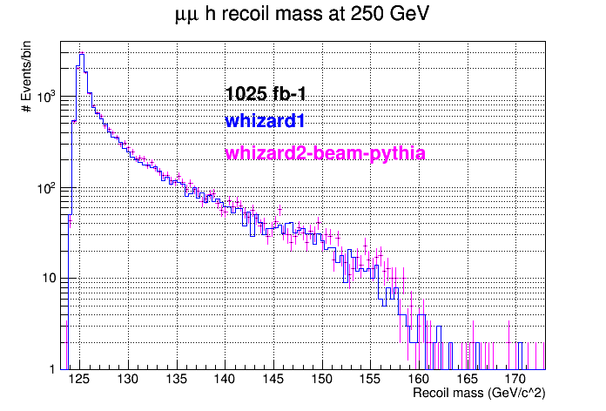
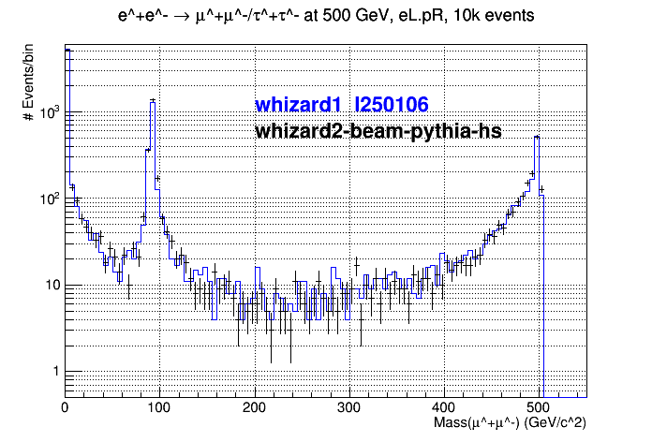
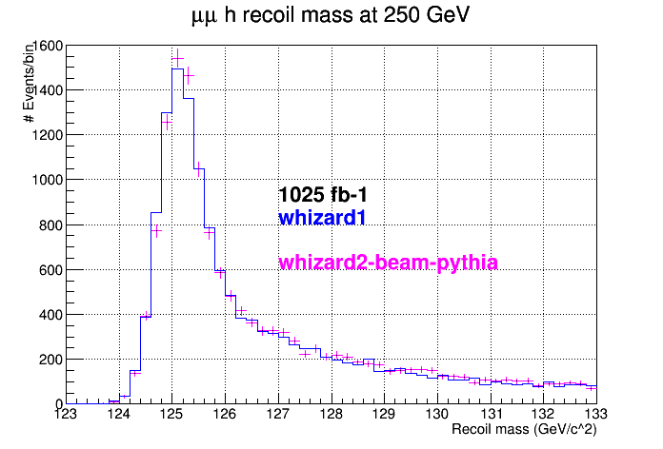

Slide 4
Tauola
Daniel Jeans noticed the longitudinal spin correlation in H→ tau+ tau-
was not correct.
➔ Fixed.
➔ But, phi-correlation ?
Need more check in another channels.
My tau code have been sent to the Whizard author.
Had a meeting with whizard author to discuss issues for
the implementation of tauola in Whizard2

Slide 5
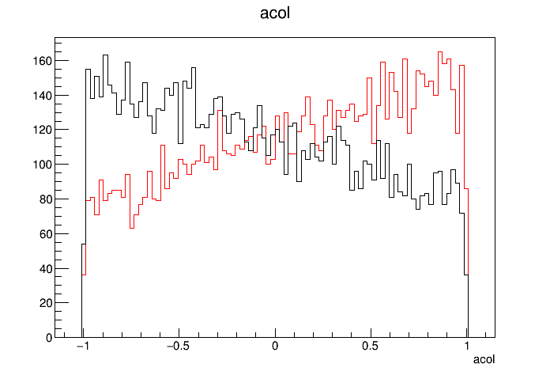
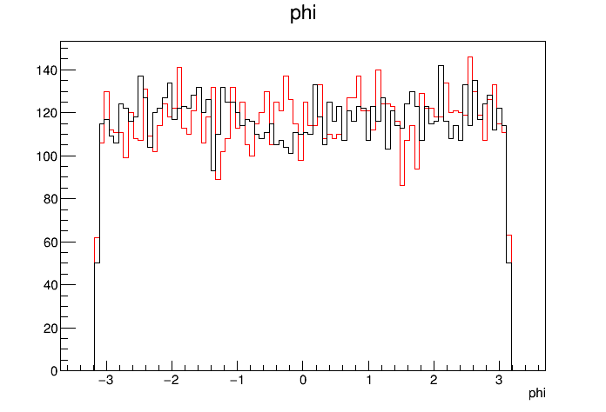
Red(ZH): e+e- → nu_mu nu_mu H, H → tau+tau-
Black(ZZ): e+e- → nu_mu nu_mu tau+ tau- ( mH=2TeV)
tau → pi nu decay only
angle between pi+-nu plain and
pi- -nu-bar plain in the rest frame
of tau+ and tau-, respectively
Acollinearity of pi+@tau+ rest f.
and pi-@tau- rest f.
Should have correlation !?
Definition of azim

Slide 6
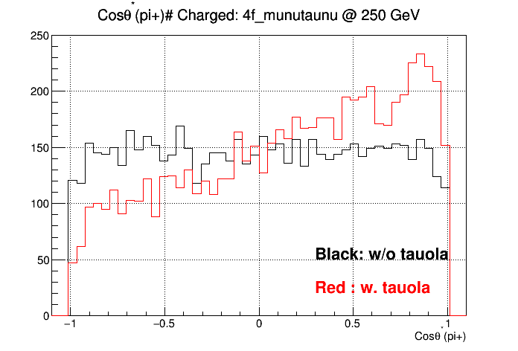
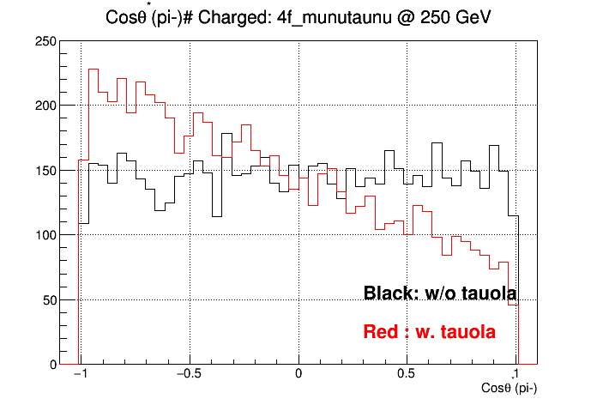
e+e- → mu nu tau nu , @ 250 GeV, with eL.pR
tau decays to pi nu only.
Pion decay angle in the tau rest frame
pi+
pi-

Slide 7
Hadronization
e+e- → qq and qqqq @250 and 500 GeV have been compared to DBD samples, with α_{S}=0 and using LEP Tuned hadronization parameter.
➔ See next slides
Test of shower matching with α_{S}!=0
  New process classification, with new kinematical condition
    qq → qq, qqj, qqjj j=u,d,s,c,g
    qqqq → qqqq, qqqqj, qqqqjj, …
    Is there no double counting ?
  4f_w_h ( e+e- → qqqq, qqqqj, qqqqjj ), j=u,d,s,c,g, 500 GeV
  - need to generate 6f final states → CPU time issues
  - Kinematical cuts needed for jet definition.
  It would be hard to prepare “a general purpose” SM samples.

Slide 8
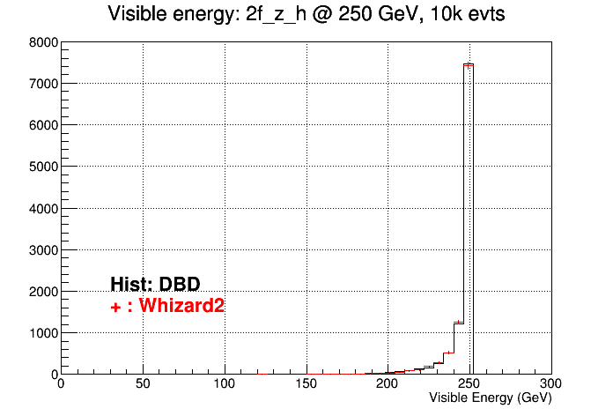
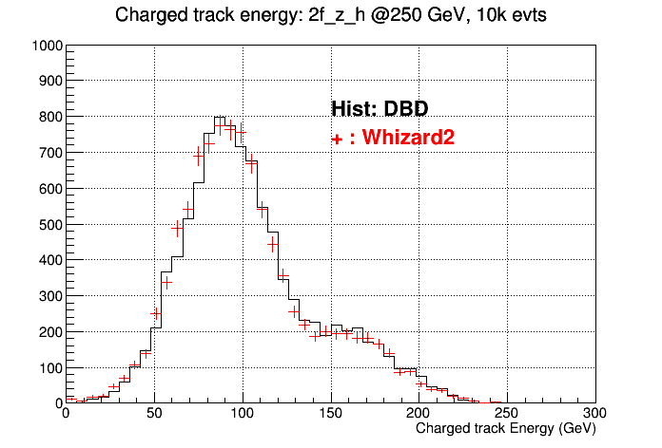
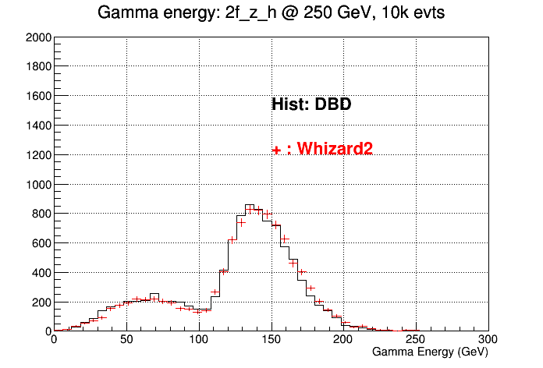
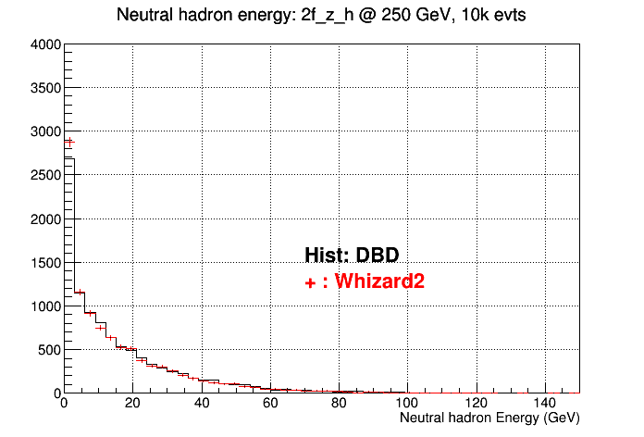
2f_z_h.eL.pR @ 250 GeV
Energy, 2q, 250 GeV

Slide 9
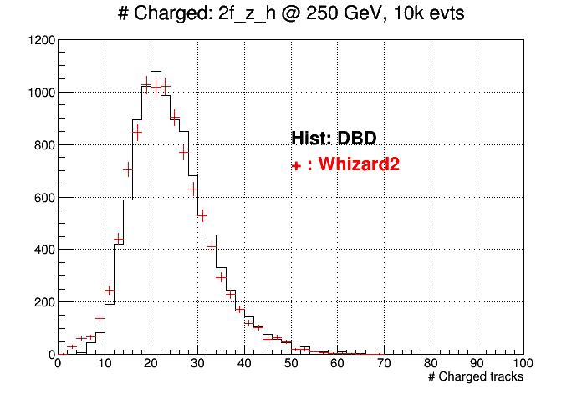
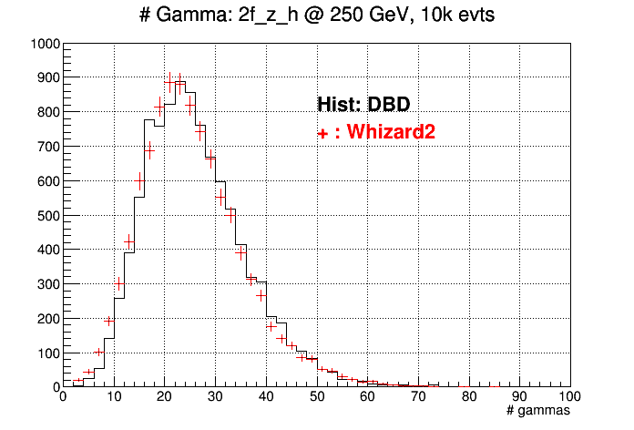
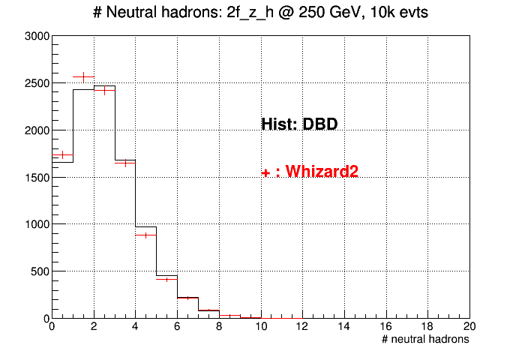
#particles, 2q, 250 GeV

Slide 10
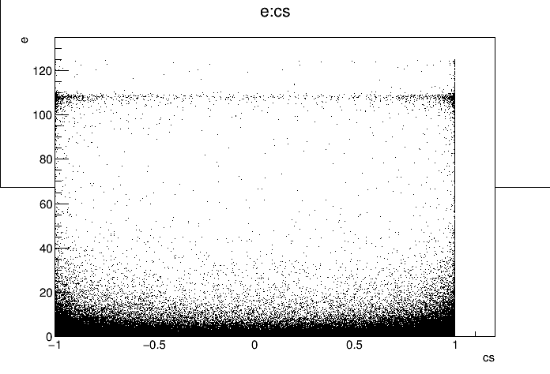
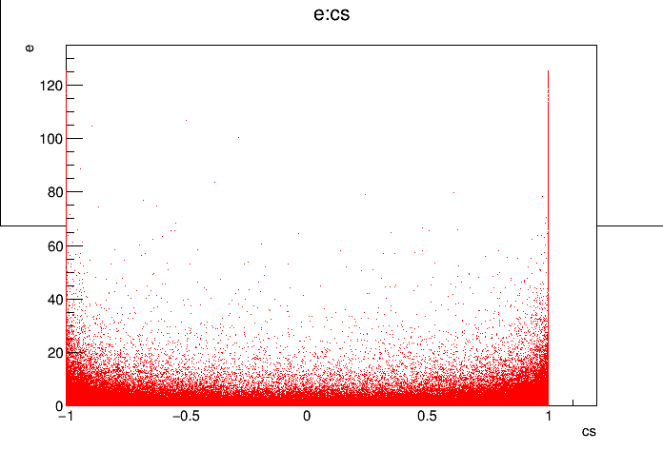
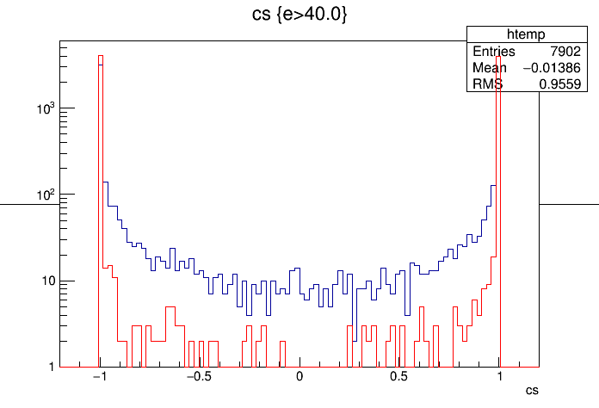
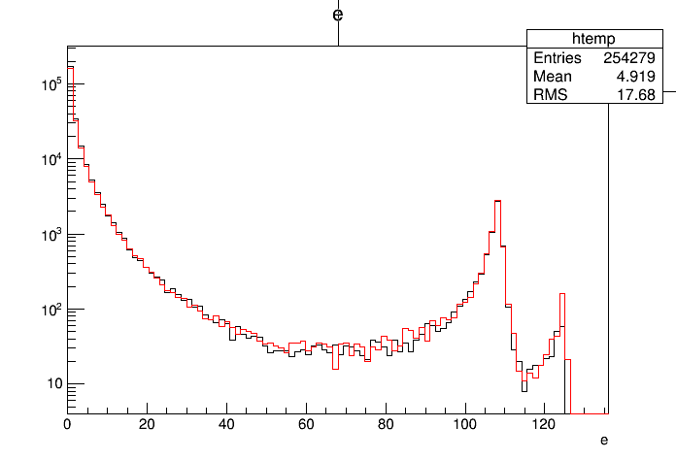
P2f_z_h.eL.pR @ 250 GeV
γ; 2q, 250 GeV
DBD
Whizard2
Different ISR photon distr.?
E_{γ}
➔ forgot to set a proper
flag ?
Cosθ_{γ}

Slide 11
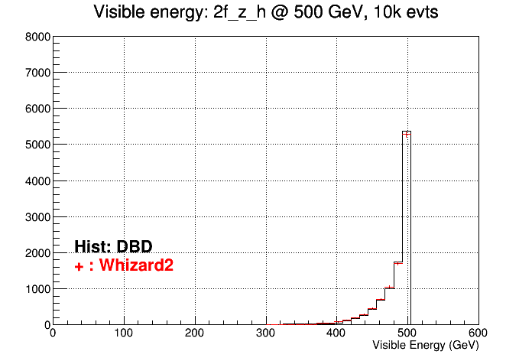
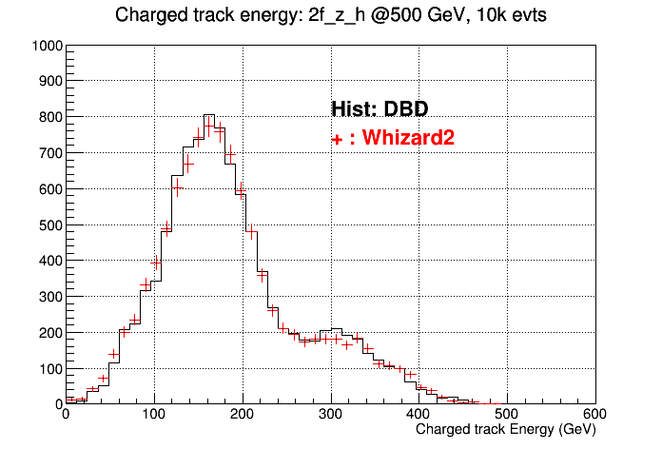

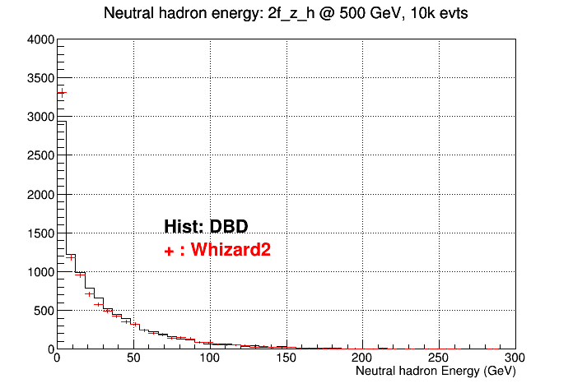
Energy: 2q, 500 GeV

Slide 12
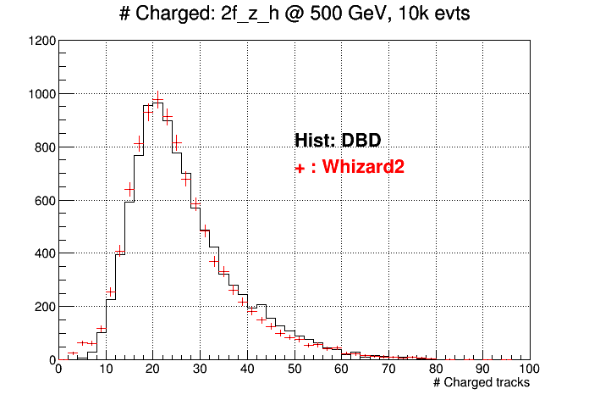
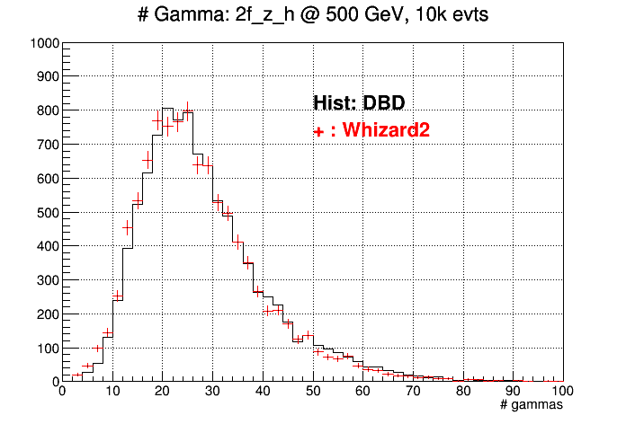
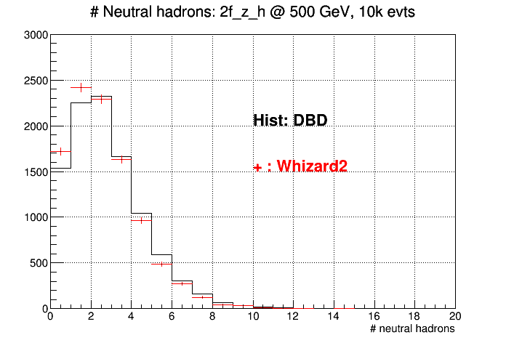
2q, 500 GeV

Slide 13
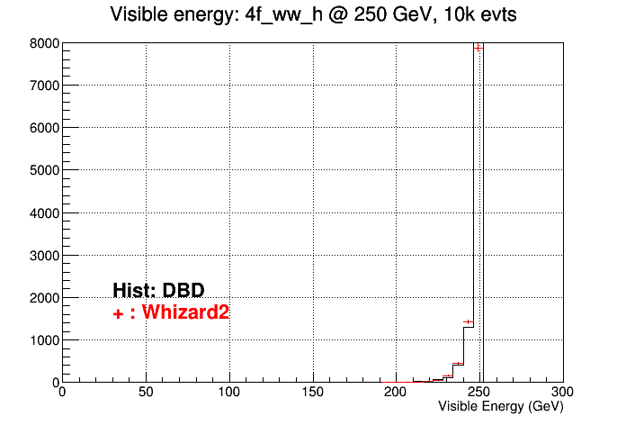
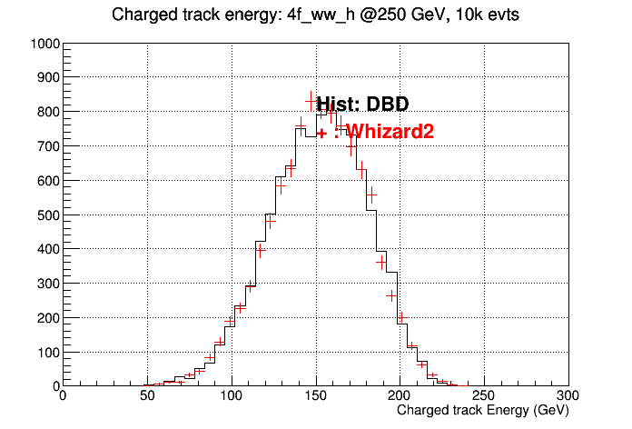
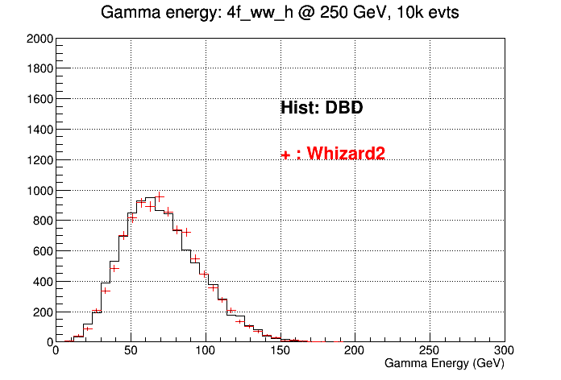

4q, 250 GeV

Slide 14
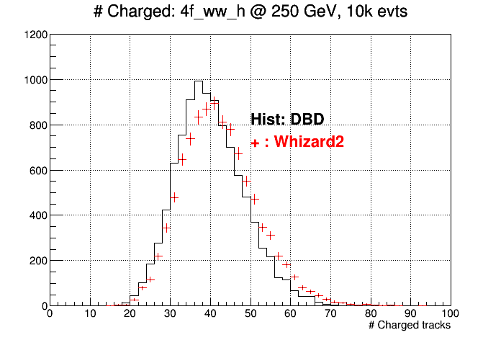
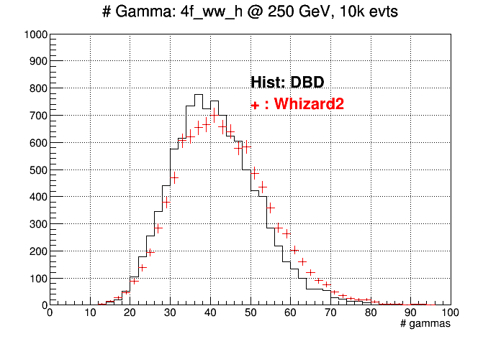
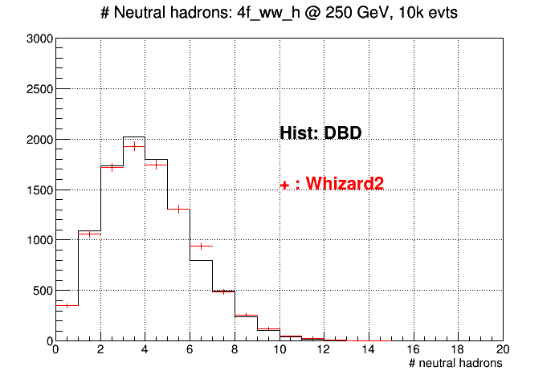
#particles, 4q, 250 GeV

Slide 15
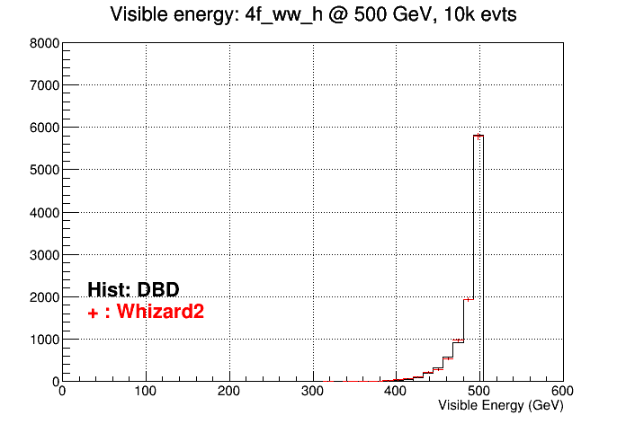
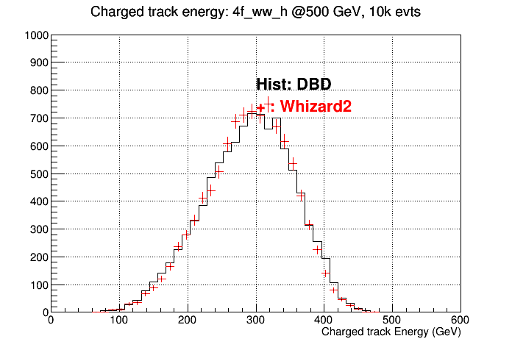
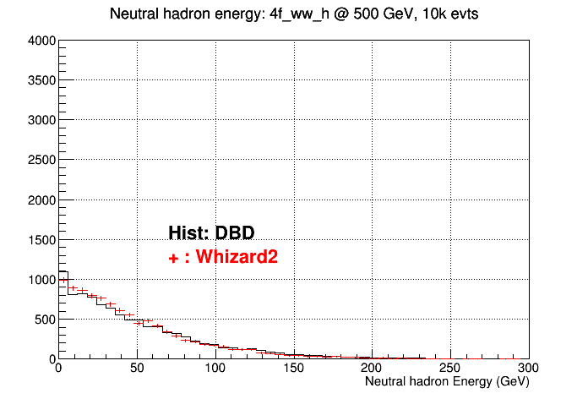

Energy, 4q, 500 GeV

Slide 16
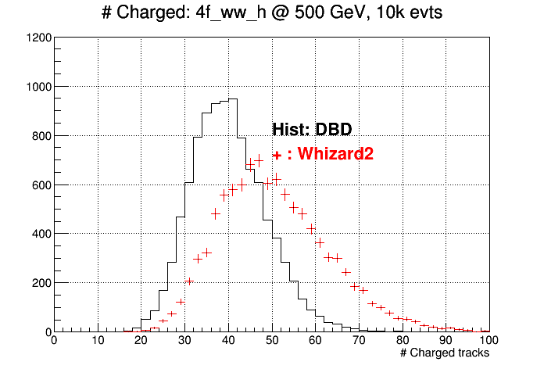
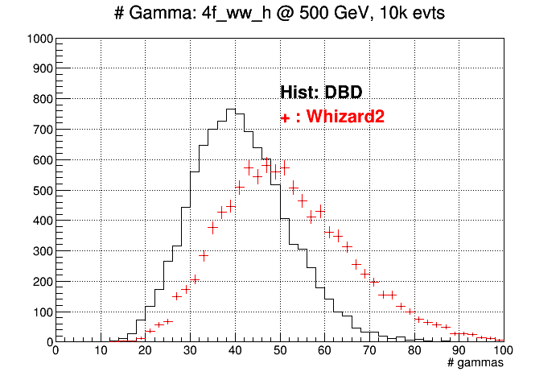
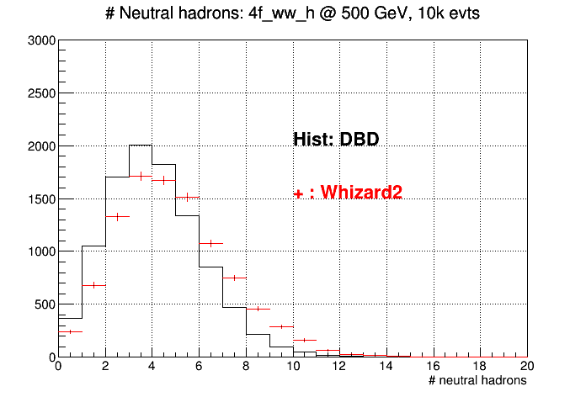
#particles, 4q, 500 GeV

