Slide 1

Activities with the quadrupole resonator at HZB
O. Kugeler, S. Keckert, R. Kleindienst, J. Knobloch
Master thesis
Start of PhD thesis
Done most of the work
PhD thesis
EuCARD-2
3rd Annual WP12 Meeting at STFC Daresbury Laboratory
April 4th and 5th 2016

Slide 2
Contents
Motivation
QPR measurement principle
Commissioning results
Alternative sample chambers
Example measurements
Outlook

Slide 3
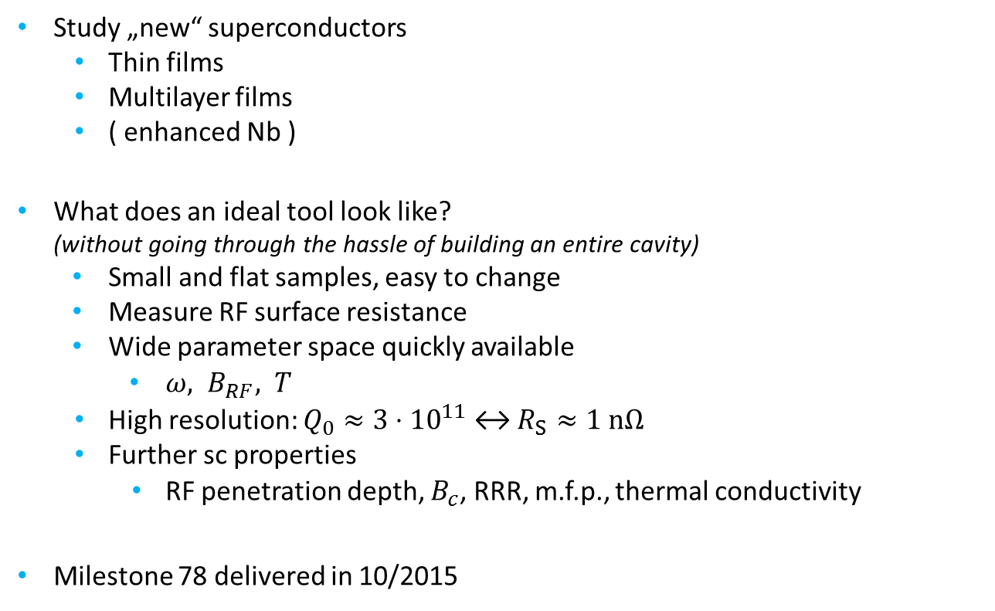
Motivation
Characterization of superconducting samples
Study „new“ superconductors
  Thin films
  Multilayer films
  ( enhanced Nb )
What does an ideal tool look like?
(without going through the hassle of building an entire cavity)
  Small and flat samples, easy to change
  Measure RF surface resistance
  Wide parameter space quickly available
    $ω, B_{RF}, T$
  High resolution: $Q_{0}≈3⋅{10}^{11}$ ↔ $R_{S}≈1 nΩ$
  Further sc properties
    RF penetration depth, $B_{c}$, RRR, m.f.p., thermal conductivity
Milestone 78 delivered in 10/2015
Notes:
turn key sytem: cryo plant, operation temperature
further sc properties: -> full characterization

Slide 4
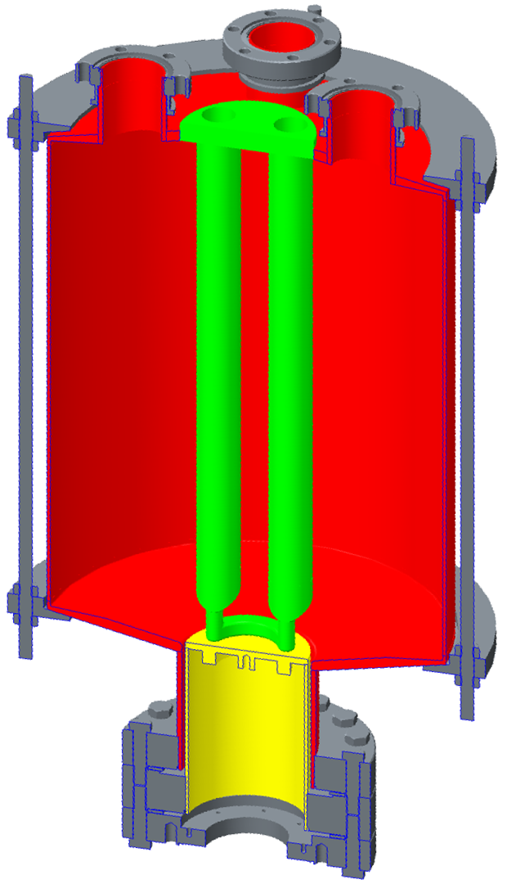
The Quadrupole Resonator (QPR)
LHe
Pumping ports
Coupler ports
System based on CERN design
EPAC ´98, Rev. Sci. Instrum. 74, 3390-3393 (2003)
Optimized RF parameters
Cavity and 4 hollow rods
made of Nb RRR 300
433 MHz or harmonics excited with loop antenna
Cavity (Nb)
4 hollow
rods (Nb)
Pole shoes
Sample
Coaxial gap
Frame
(SS, Ti)
Calorimetry chamber
(large domain Nb)
Notes:
4 rods, connected pairwise, transmission line

Slide 5
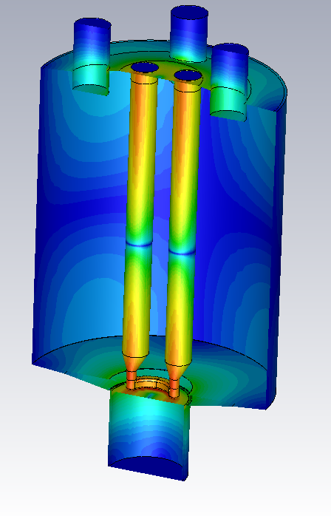
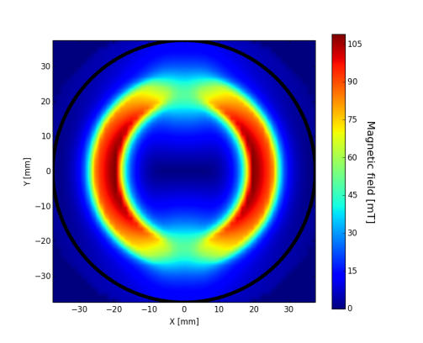
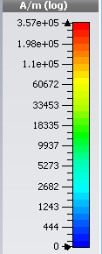
The Quadrupole Resonator (QPR)
LHe
Pumping ports
Coupler ports
Pole shoes focus magnetic field
on sample
Cavity (Nb)
4 hollow
rods (Nb)
Pole shoes
Sample
Ring shaped region of sample illuminated
Obtain geometry factor from simulation
Coaxial gap
Frame
(SS, Ti)
Calorimetry chamber
(large domain Nb)
420 MHz
Notes:
4 rods, connected pairwise, transmission line

Slide 6
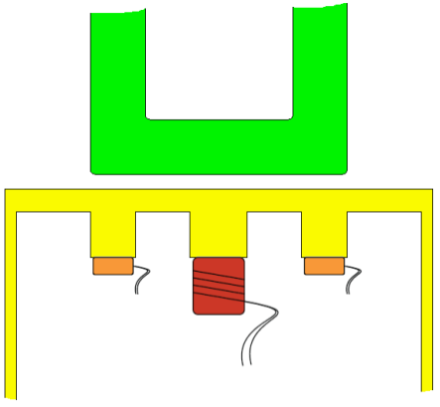
The Quadrupole Resonator (QPR)
LHe
Pumping ports
Coupler ports
Sample thermally decoupled
from cavity and LHe bath
LHe bath at constant temperature
Quadrupole modes at
420, 850, 1300 MHz
B_{Sample, max} = 125 mT
4 hollow
rods (Nb)
Cavity (Nb)
Pole shoes
Gap
Cavity
Vacuum
Sample
Coaxial gap
Cavity (Nb)
Frame
(SS, Ti)
LHe
Calorimetry chamber
(large domain Nb)
T-Sensor
Heater
Notes:
4 rods, connected pairwise, transmission line

Slide 7

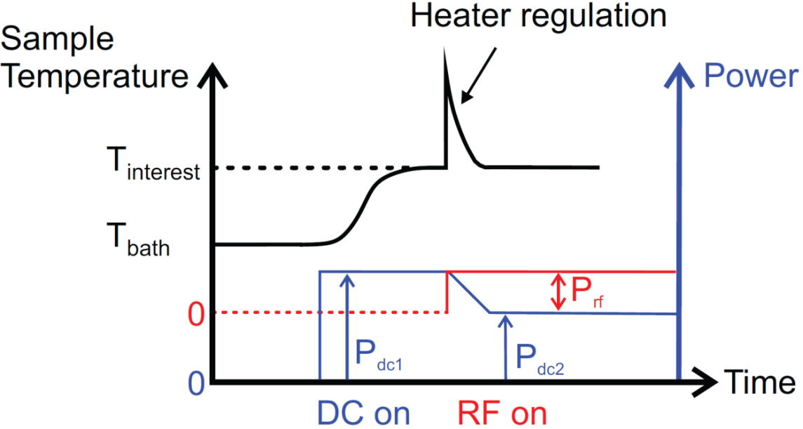
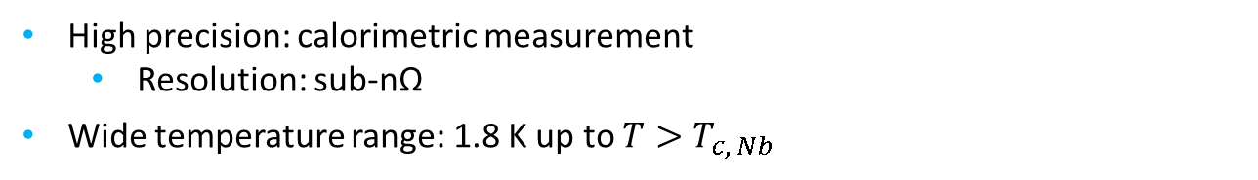
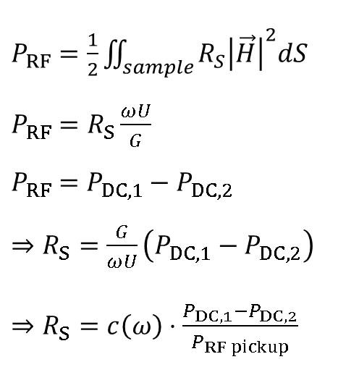
Surface resistance measurement
RF-DC compensation technique
High precision: calorimetric measurement
  Resolution: sub-nΩ
Wide temperature range: 1.8 K up to $T>T_{c, Nb}$
$P_{RF}=\frac{1}{2}\iint_{sample}{R_{S}{\left|\vec{H}\right|}^{2}dS}$
$P_{RF}=R_{S}\frac{ωU}{G}$
$P_{RF}=$ $P_{DC,1}−P_{DC,2}$
$⇒R_{S}=\frac{G}{ωU}\left(P_{DC,1}−P_{DC,2}\right)$
$⇒R_{S}=c\left(ω\right)⋅\frac{P_{DC,1}−P_{DC,2}}{P_{RF pickup}}$
[S. Aull, „High Resolution Surface Resistance Studies“, SRF 2013]
Notes:
Resolution: 0.5nOhm @ 100mT = 1mW
P_pickup ~ U
B_sample ~ sqrt U ~ sqrt P_t
Opposed to other sample test systems: low frequency

Slide 8
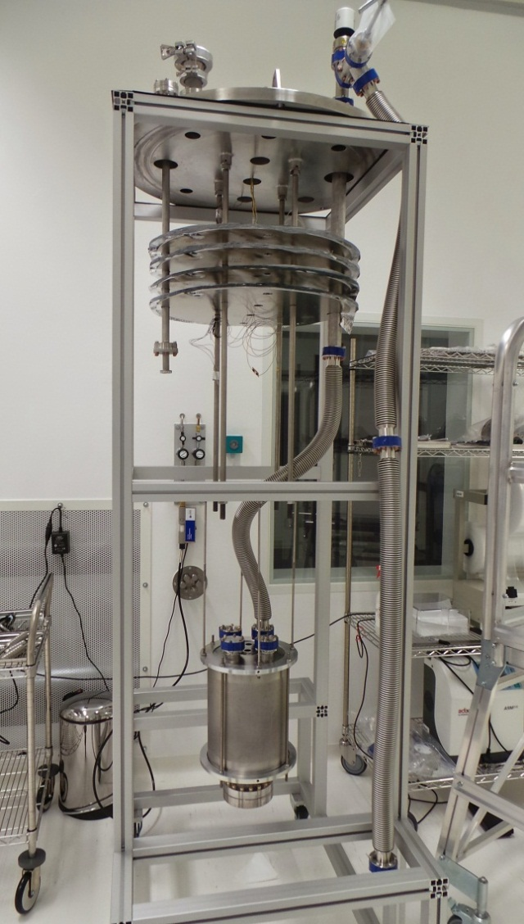
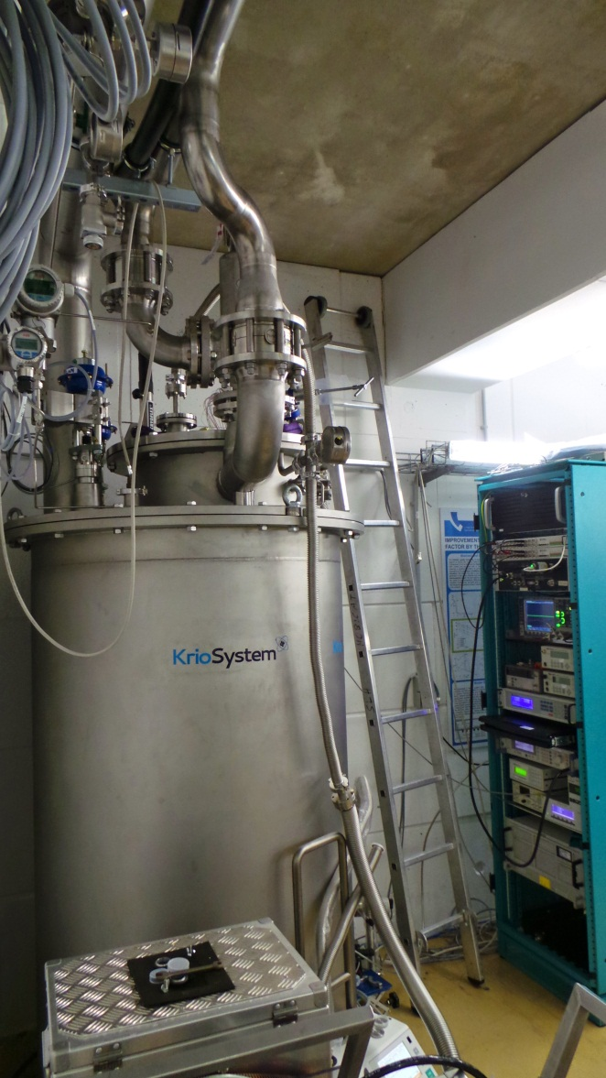
Cryostat and insert with QPR
Clean room
assembly
Mounting in the vertical test stand in the HoBiCaT bunker

Slide 9
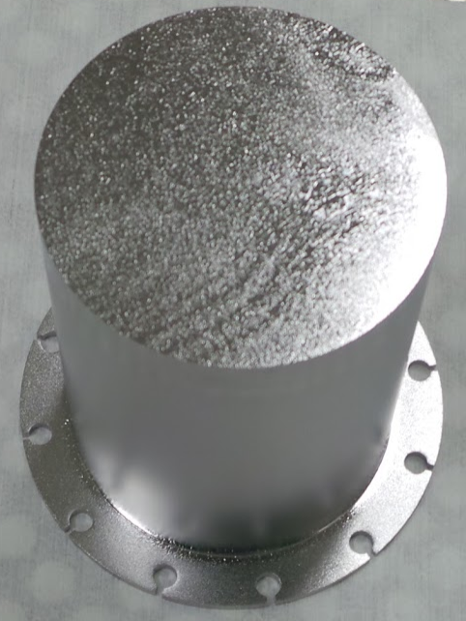
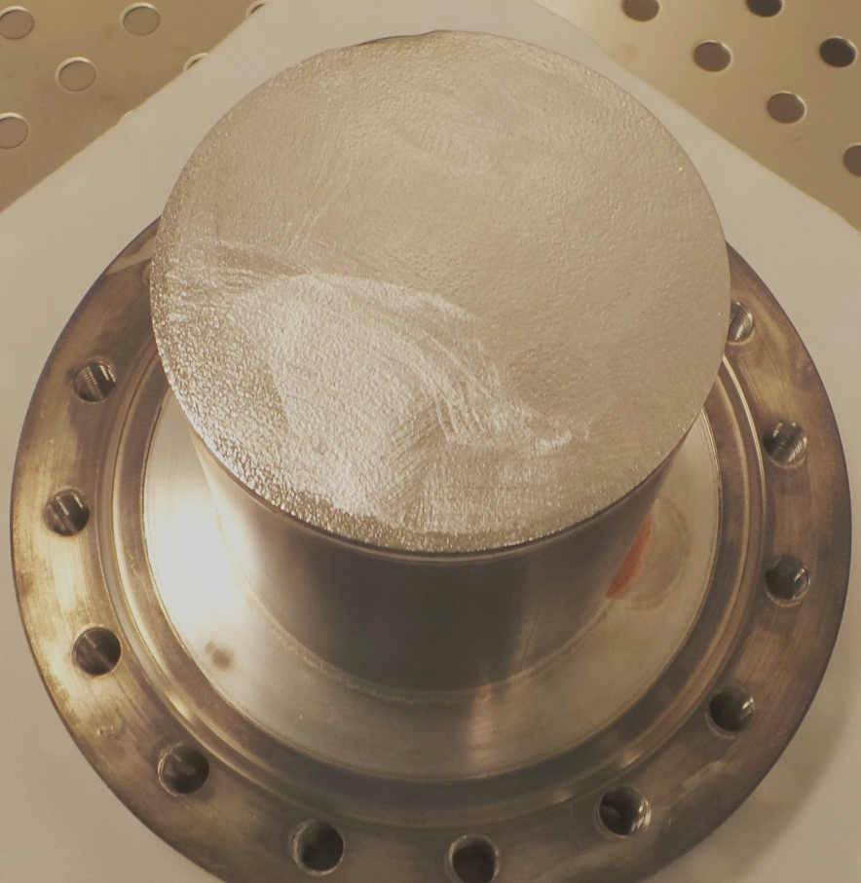
Niobium samples
Nb: Polychristalline RRR 300
BCP
+ High Temperature bake
Nb: Large Grain RRR 300
BCP
+ High Temperature bake
+ 120°C bake

Slide 10
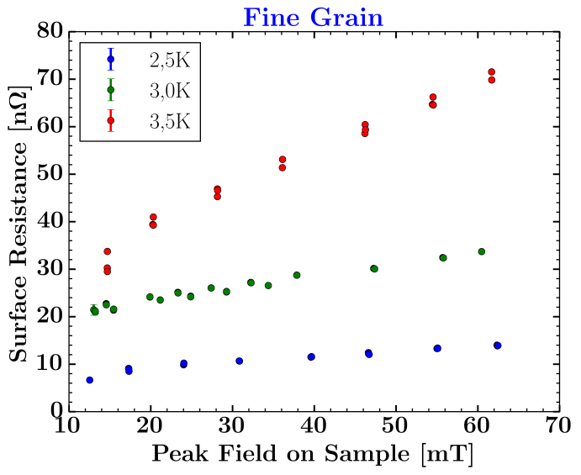
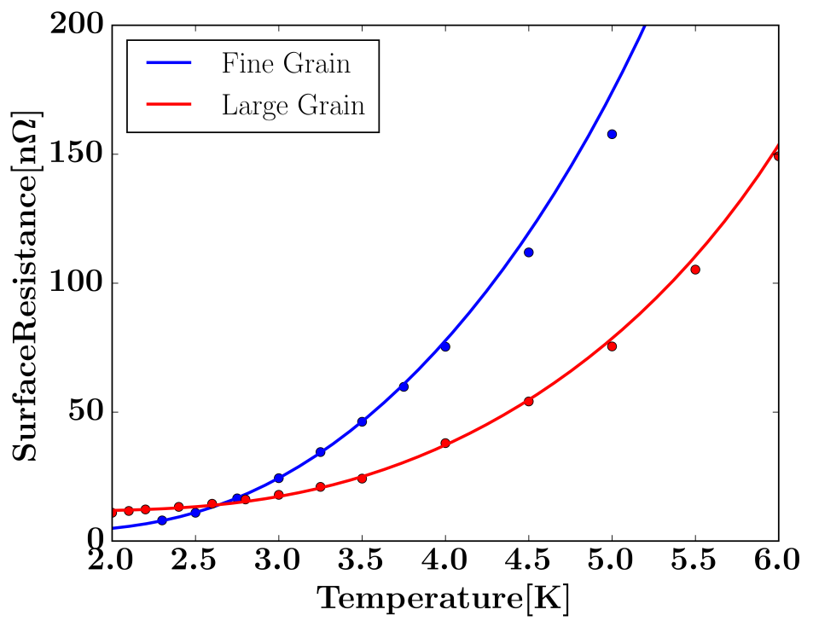
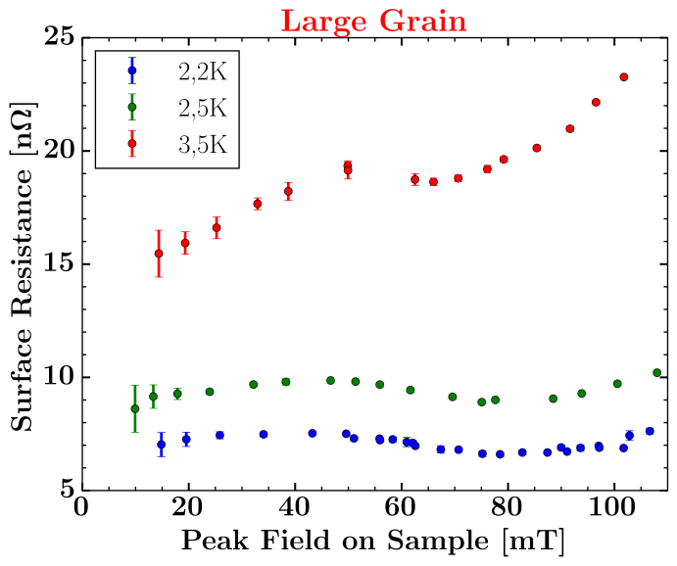
Commissioning results
Results
 | Fine Grain BCP + HT | Large Grain BCP + HT +120°C
Energy gap | 1.8 k_{B}T_{C} | 2.1 k_{B}T_{C}
Electron m.f.p | 68 nm | 15 nm
Residual Res. | 3.1 nΩ | 7.6 nΩ

Slide 11
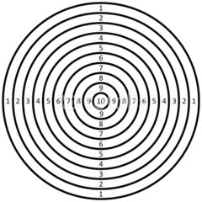
Status of the apparatus
low precision
low accuracy
low resolution
high precision
low accuracy
low resolution
low precision
low accuracy
high resolution
high precision
low accuracy
high resolution
low precision
high accuracy
low resolution
high precision
high accuracy
low resolution
low precision
high accuracy
high resolution
high precision
high accuracy
high resolution
Systematic errors still unresolved
Parallelity of gap critical
Concentricity of rods and sample inportant

Slide 12
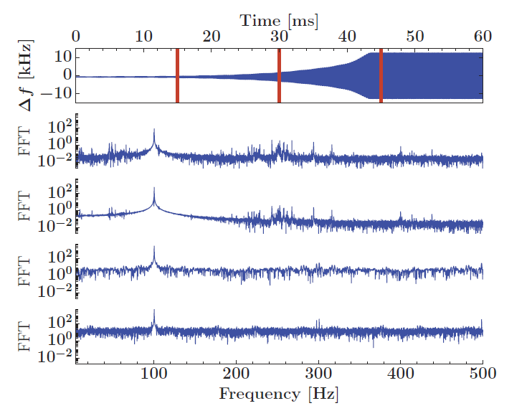
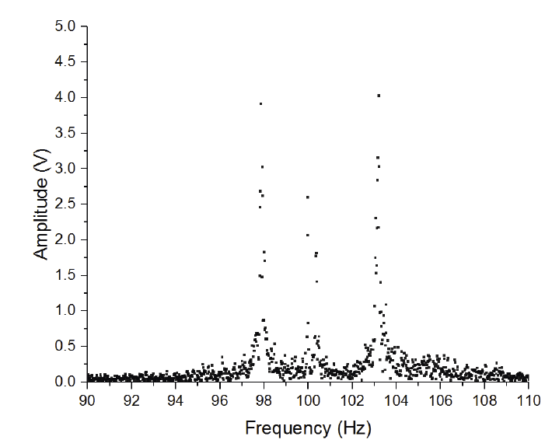
Microphonics
PLL feedback signal
Microphonics is an issue
Ponderomotive excitations observed
Oscillation of the rods has resonance
at 100 Hz (double mains frequency)
Mode is always excited and needs
to be compensated by PLL
Complications, esp in pulsed OP
Countermeasures
done: increased bandwidth of input antenna
better: passive damping or piezo tuning
measured with geophones
at warm resonator

Slide 13
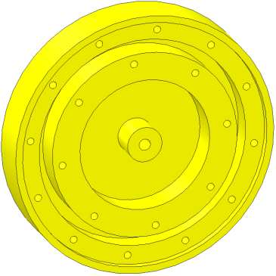
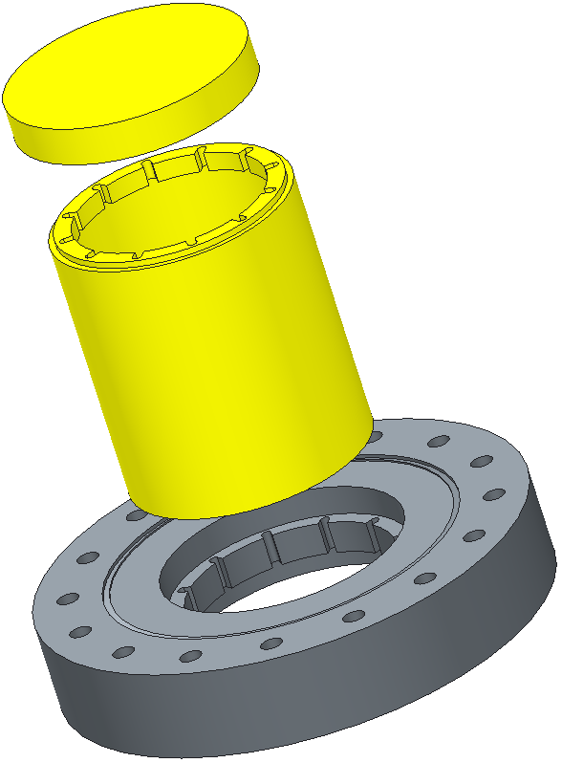
Alternative calorimetry chamber I
Helicoil
Cernox sensors
Motivation
Ohmic heater
Short sample holder for coating
h = 12 mm
Easier to handle
No welding required
Height adjustment possible
→ sensitivity on distance between rods and sample
Sample surface
Matching
surfaces
Risks
Indium wire
  Volumes of resonator and calorimetry chamber are connected
  Cleanliness
  Indium wire gaskets create
  additional risk: low quench field
Thermal contact ?
Impact on RF ?
Double sided
CF100 flange

Slide 14
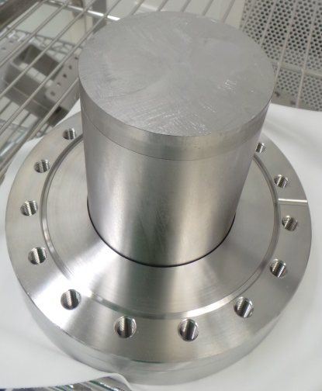
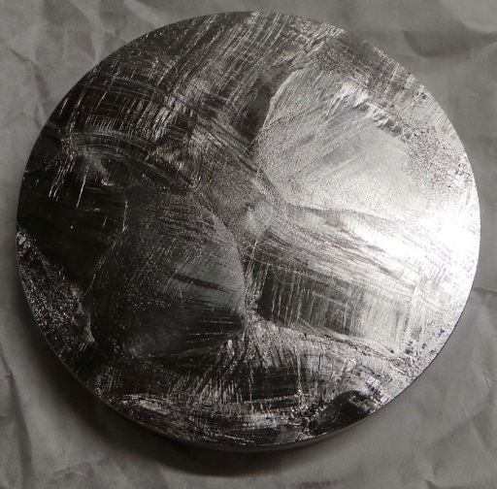
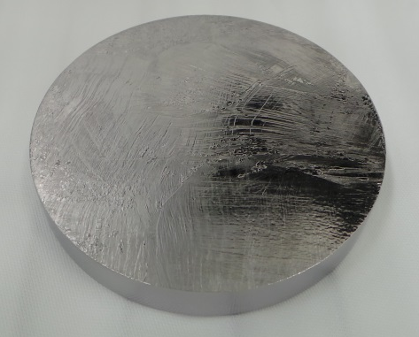
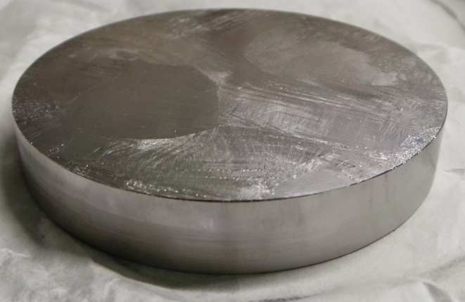
Alternative calorimetry chamber I
milled from large-grain bulk
Nb RRR 300
150 µm chemical etch (BCP)
Surface roughness
  max: 10 µm peak-to-peak
  typ: 2 µm
baked at 850°C / 240 min
150 µm BCP

Slide 15
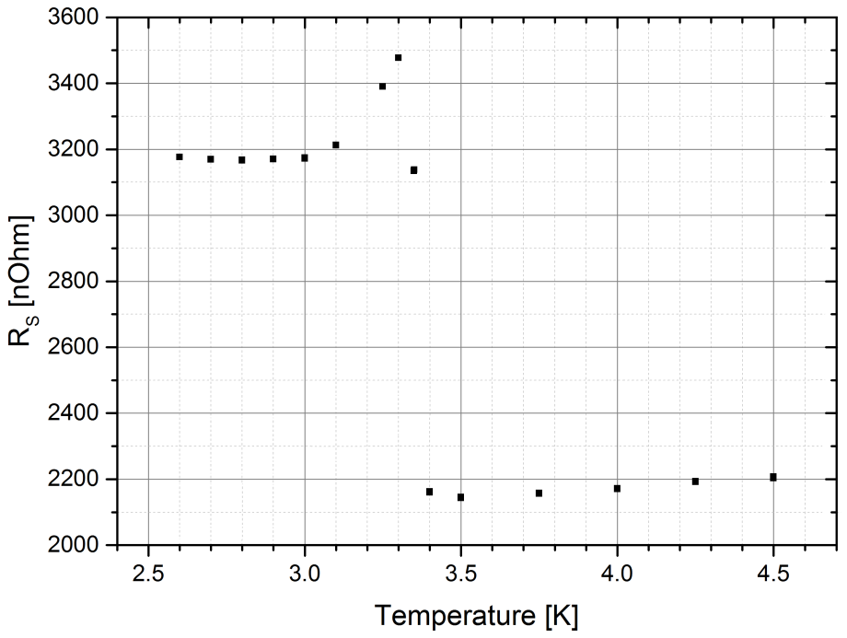
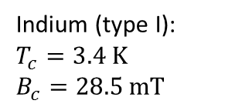
Surface resistance measurement
First sample: with indium gasket
(Too) high surface resistance
Influence of indium at upper gasket visible
Decrease of Rs at transition to nc Indium
Second sample: no indium
850 °C bake before BCP
Indium peak gone
Rs still too high
Indium (type I):
$$T_{c}=3.4 K$$
$$B_{c}=28.5 mT$$
Notes:
suspect currents crossing the gap

Slide 16
Possible causes ruled out
Multipacting
  possible electron paths too short
Paschen discharge
  pressure times distance value too low
Resistivity change at superconducting transition of Indium
  does not explain increased surface resistance after sc transition
Discontinuous thermal conductivity of Indium at Tc (Indium)
  does not explain increased surface resistance after sc transition
B-Field enhancement at interface sample/cylinder
  maximum conceivable enhanced field too low
Local quench
  should exhibit different temperature dependence of Rs
Q-disease
  sample baked after BCP
Mechanical stress in sample (new manufacturer REUTER from a Heraeus ingot)
  should have been relaxed upon 850°C bake
Anisotropy of RF currents in gap

Slide 17
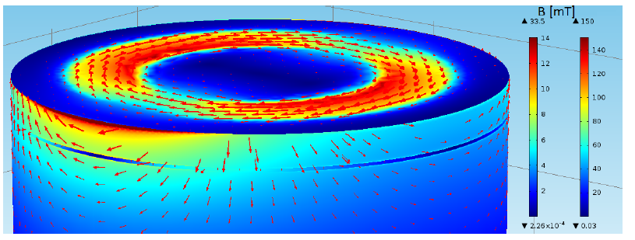
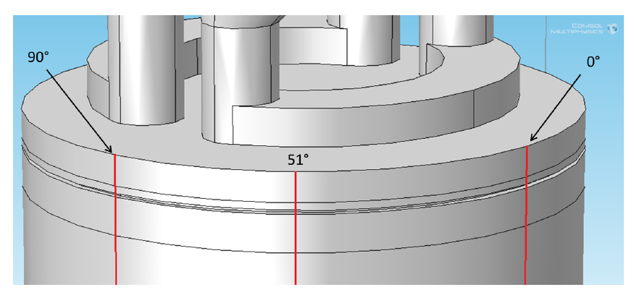
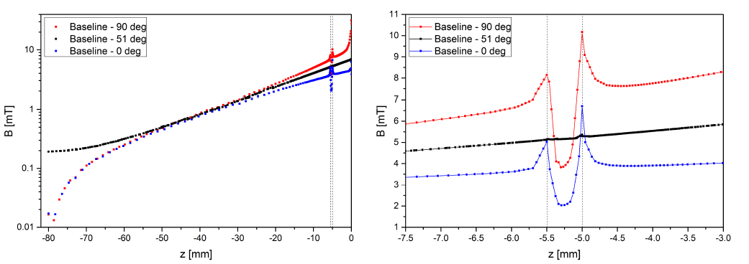
Simulations of the coaxial gap
RF currents passing Indium in gap vertically
magnetic field in gap (150mT at sample)
Notes:
looking for a reason why indium gasket did not work properly.
hypothesis: from simulations
stray currents in coaxial gap may play a role

Slide 18
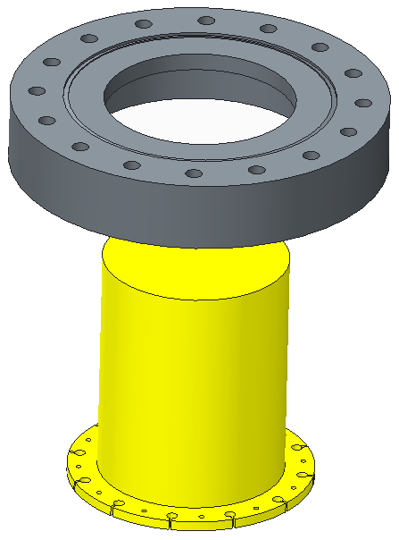
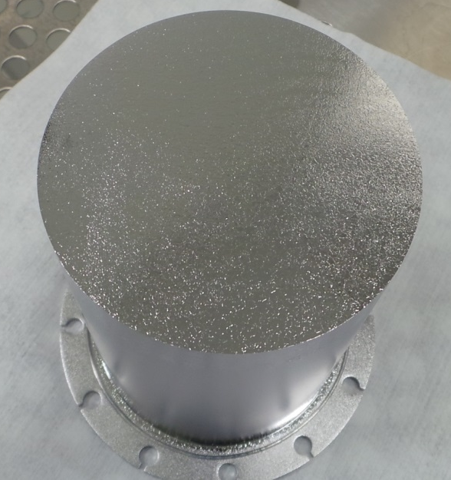
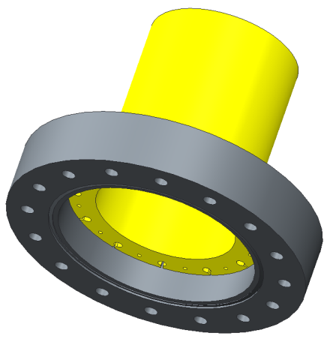
Alternative calorimetry chamber II
Pure Nb sample
→ high temperature treatments possible
  Baking
  N-doping
  Diffusion coating (e.g. Nb₃Sn)
UHV tight system
→ Indium wire gasket
Height adjustment possible
Short sample holder?
→ Electron beam welding required
Double sided
CF100 flange
gap omitted
Indium wire
additional Cernox sensors
Indium wire

Slide 19
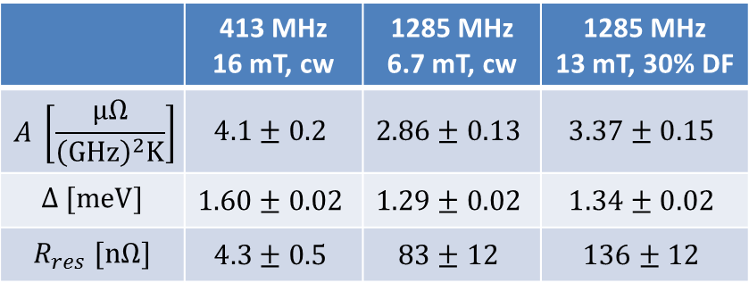
Surface resistance vs. Temperature
$R_{S}=R_{BCS}+R_{res}=\frac{Aω^{2}}{T}\exp\left(−\frac{Δ}{k_{B}T}\right)+R_{res}$
 | 413 MHz 16 mT, cw | 1285 MHz 6.7 mT, cw | 1285 MHz 13 mT, 30% DF
$$A \left[\frac{μΩ}{{\left(GHz\right)}^{2}K}\right]$$ | $$4.1±0.2$$ | $$2.86±0.13$$ | $$3.37±0.15$$
$$Δ [meV]$$ | $$1.60±0.02$$ | $$1.29±0.02$$ | $$1.34±0.02$$
$$R_{res} [nΩ]$$ | $$4.3±0.5$$ | $$83±12$$ | $$136±12$$
Notes:
chose B to measure at high T

Slide 20
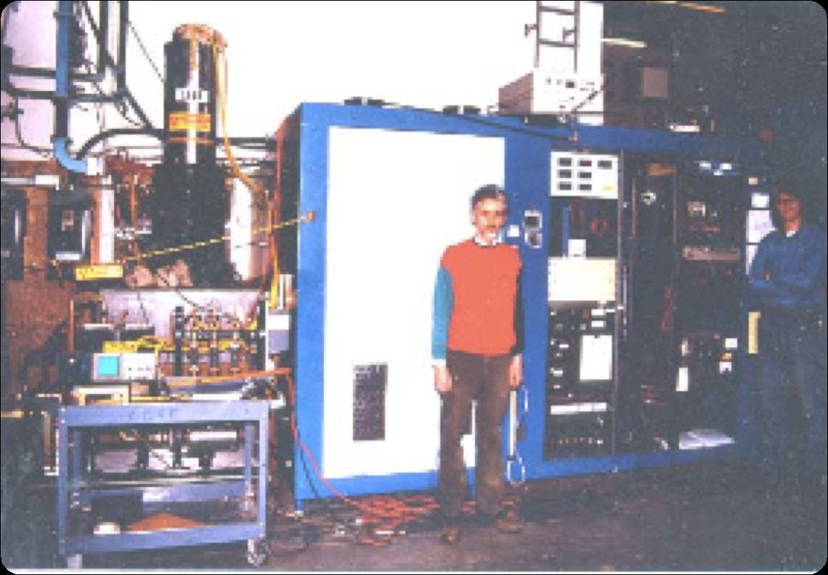
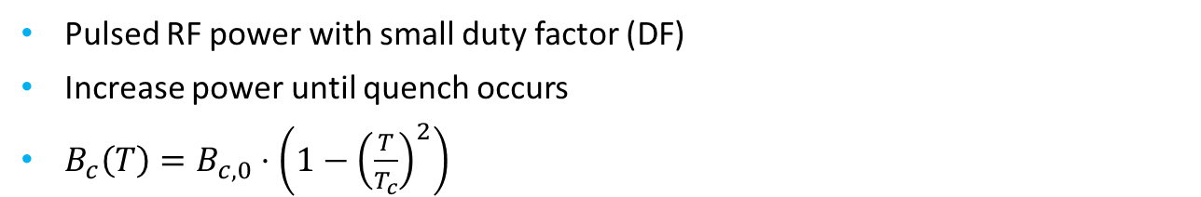
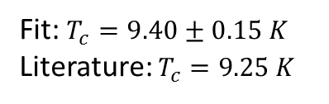
RF critical field
Pulsed RF power with small duty factor (DF)
Increase power until quench occurs
$B_{c}\left(T\right)=B_{c,0}⋅\left(1−{\left(\frac{T}{T_{c}}\right)}^{2}\right)$
Cavity: 1 MW klystron,
3 years of work
Fit: $T_{c}=9.40±0.15 K$
Literature: $T_{c}=9.25 K$
Notes:
1 MW klystron, 3 years of work

Slide 21
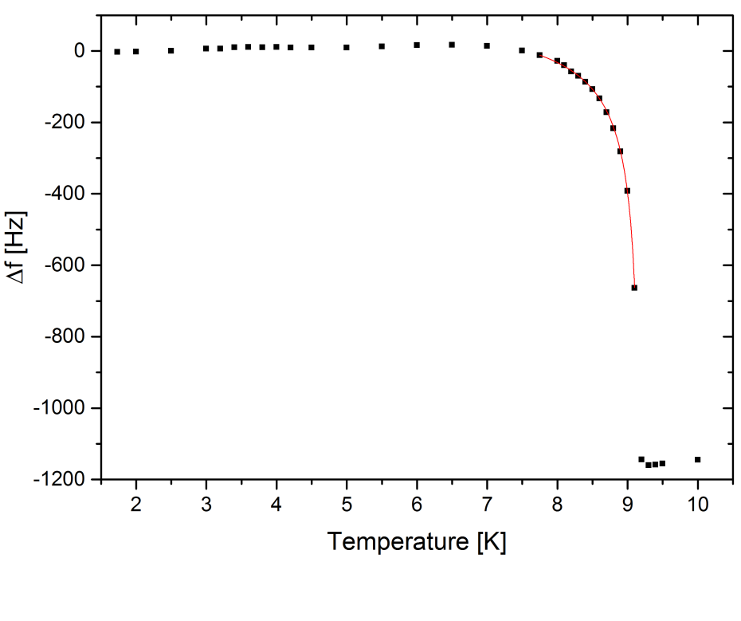
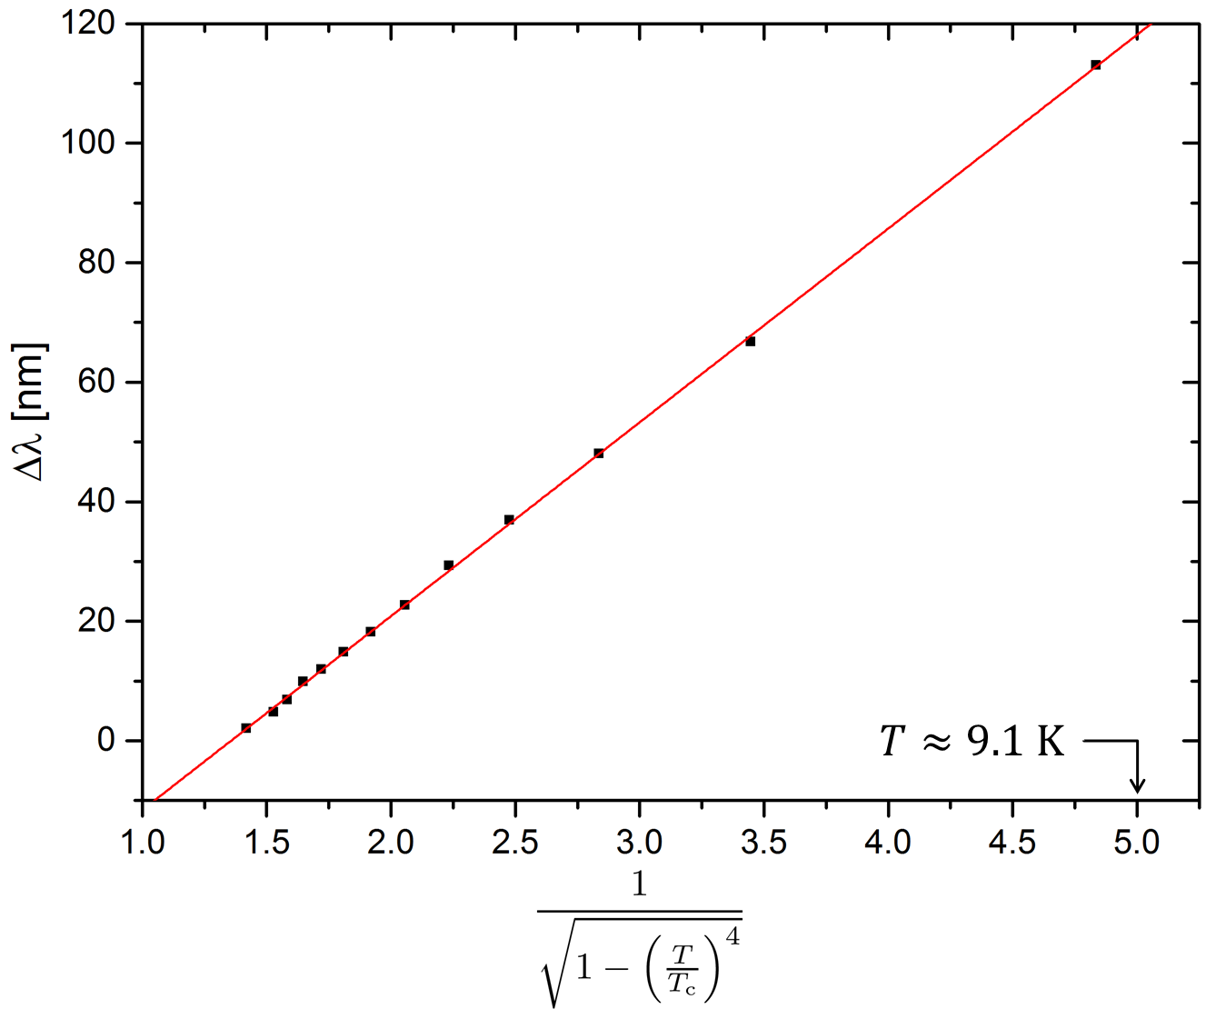
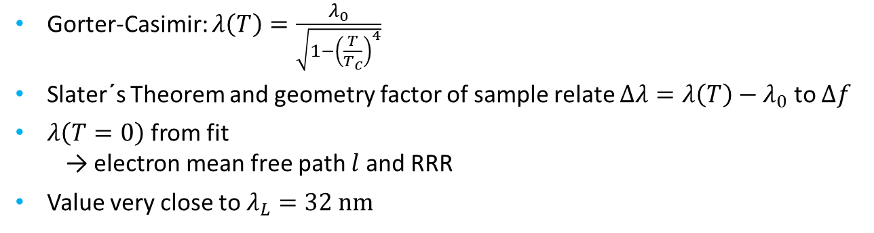

RF penetration depth
Gorter-Casimir: $λ\left(T\right)=\frac{λ_{0}}{\sqrt{1−{\left(\frac{T}{T_{c}}\right)}^{4}}}$
Slater´s Theorem and geometry factor of sample relate $Δλ=λ\left(T\right)−λ_{0}$ to $Δf$
$λ\left(T=0\right)$ from fit
  → electron mean free path $l$ and RRR
Value very close to $λ_{L}=32 nm$
$$λ_{0}=32.5±0.7 nm$$
Notes:
RRR= 720 (-420)
mfp = 1945 (-1140) nm

Slide 22
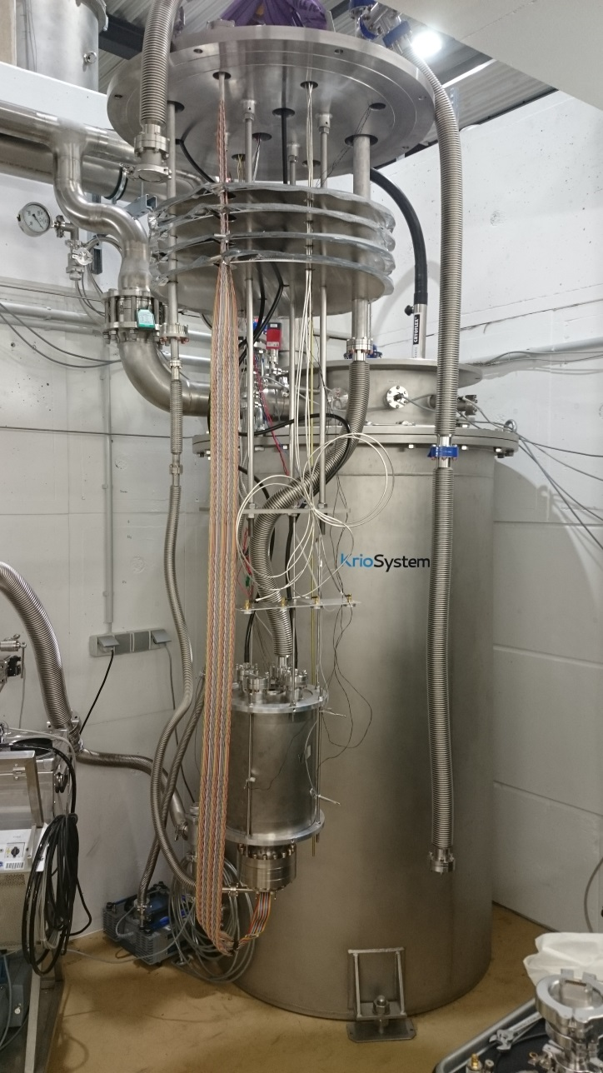

Summary & Outlook
QPR commissioned successfully
  RF measurements up to 125 mT possible
  Accuracy issues
Simplified sample geometries investigated (ongoing)
  Issues with Indium gasket
Take part in followup projects:
  ARIES (EuCARD3)
  ANR-DFG proposal
  EASITrain
ToDo beyond Milestones and Deliverables:
Test first non-Nb sample
( if possible within last year of EuCARD2 )
Notes:
short sample holder

Slide 23
B A C K U P S L I D E S

Slide 24
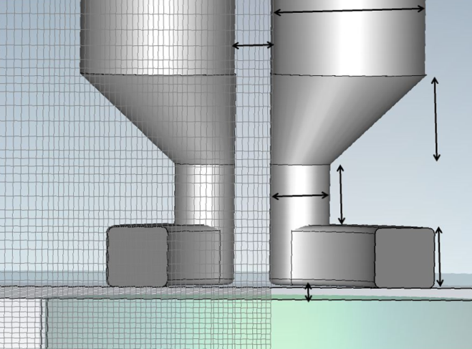
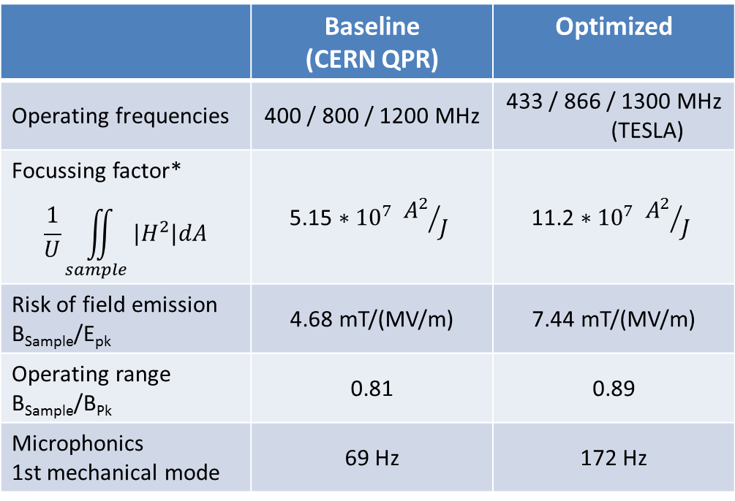
Optimization of HZB design
Optimization criteria
  Phase space: Frequency, field strength, temperature
  High resolution
Full parameterization with CST
  Maximizing figures of merit
 | Baseline (CERN QPR) | Optimized
Operating frequencies | 400 / 800 / 1200 MHz | 433 / 866 / 1300 MHz (TESLA)
Focussing factor* $$\frac{1}{U}\iint_{sample}{|H^{2}|dA}$$ | $$\text{5.15 ∗ }{10}^{7} {A^{2}}/J$$ | $$\text{11.2 ∗ }{10}^{7} {A^{2}}/J$$
Risk of field emission B_{Sample}/E_{pk} | 4.68 mT/(MV/m) | 7.44 mT/(MV/m)
Operating range B_{Sample}/B_{Pk} | 0.81 | 0.89
Microphonics 1st mechanical mode | 69 Hz | 172 Hz
Radius of rods increased
8 mm → 13 mm
Gap reduced
(pole shoes ↔ sample)
1 mm → 0.5 mm
[R. Kleindienst, „Development
of an Optimized Quadrupole
Resonator at HZB“, SRF 2013]
* fraction of field exposure between sample and resonator

Slide 25
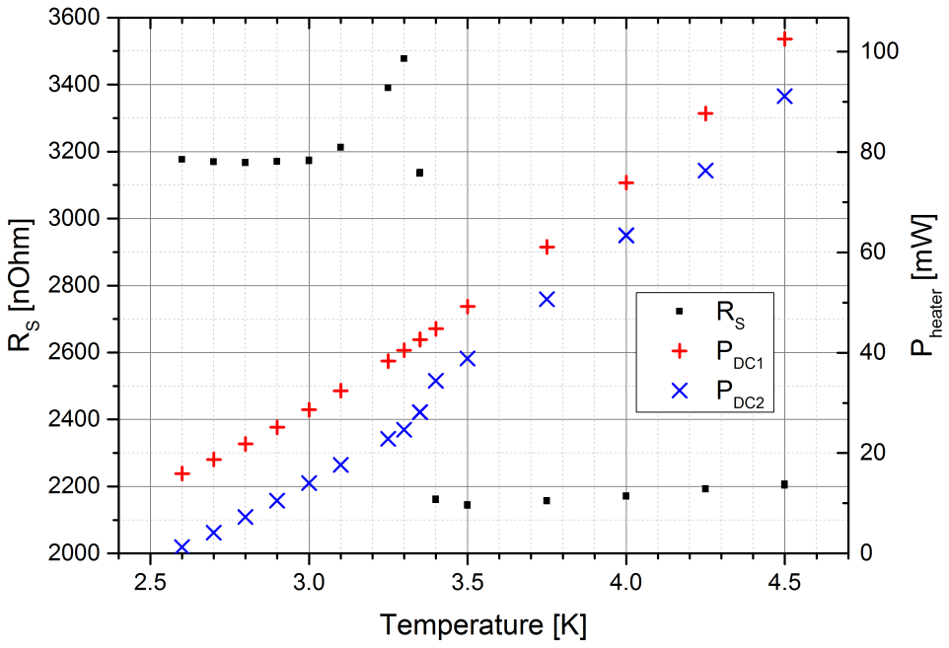

Surface resistance measurement
First sample: with indium gasket
High surface resistance
Influence of indium at upper gasket visible
Second sample: no indium
850 °C bake before BCP
Indium: $T_{c}=3.4 K$

Slide 26
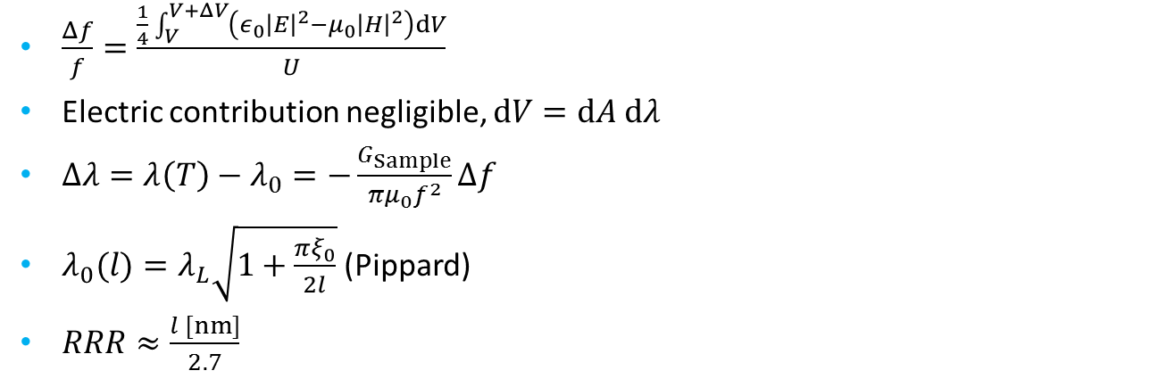
RF penetration depth
$\frac{Δf}{f}=\frac{\frac{1}{4}\int_{V}^{V+ΔV}{\left(ε_{0}{\left|E\right|}^{2}−μ_{0}{\left|H\right|}^{2}\right)dV}}{U}$
Electric contribution negligible, $dV=dA dλ$
$Δλ=λ\left(T\right)−λ_{0}=−\frac{G_{Sample}}{πμ_{0}f^{2}}Δf$
$λ_{0}(l)=λ_{L}\sqrt{1+\frac{πξ_{0}}{2l}}$ (Pippard)
$RRR≈\frac{l [nm]}{2.7}$

Slide 27
