Slide 2


A15 materials thin films and HiPIMS progress at CERN for SRF cavities
G. Rosaz, K. Ilyina, S. Calatroni, W. Vollenberg, A. Sublet, F. Leaux, D. Richter
CERN

Slide 3
Outline
HiPIMS
  Principle
  Setup
  Latest results
  Next steps
A15
  Goal
  Setup
  Results
  Next steps
Conclusion

Slide 4
HiPIMS coatings progress

Slide 5
Principle
HIgh Power Impulse Magnetron Sputtering
  Pulsed power supply (~100μs pulses, 1% duty cycle up to 1kHz)
  Power density
    DC: 12 W.cm⁻²
    HiPIMS: ~1kW.cm⁻²
  Ionization of sputtered species up to 90%
  Better coating conformity
  Lower substrate heat-up
  Lower coating rate : ions captured at the cathode
  Very sensitive to cathode surface state (roughness) → arcing

Slide 6
Motivation
Systematic Q-slope degradation when lowering cavity beta value
C. Benvenuti et al, Production and test of 352 MHz niobium sputtered reduced beta cavities, 1997

Slide 7
Motivation
Encouraging first coating (G. Terenziani)
HiPIMS performs close to the best ever achieved magnetron coated cavities.
How to go farther?

Slide 8
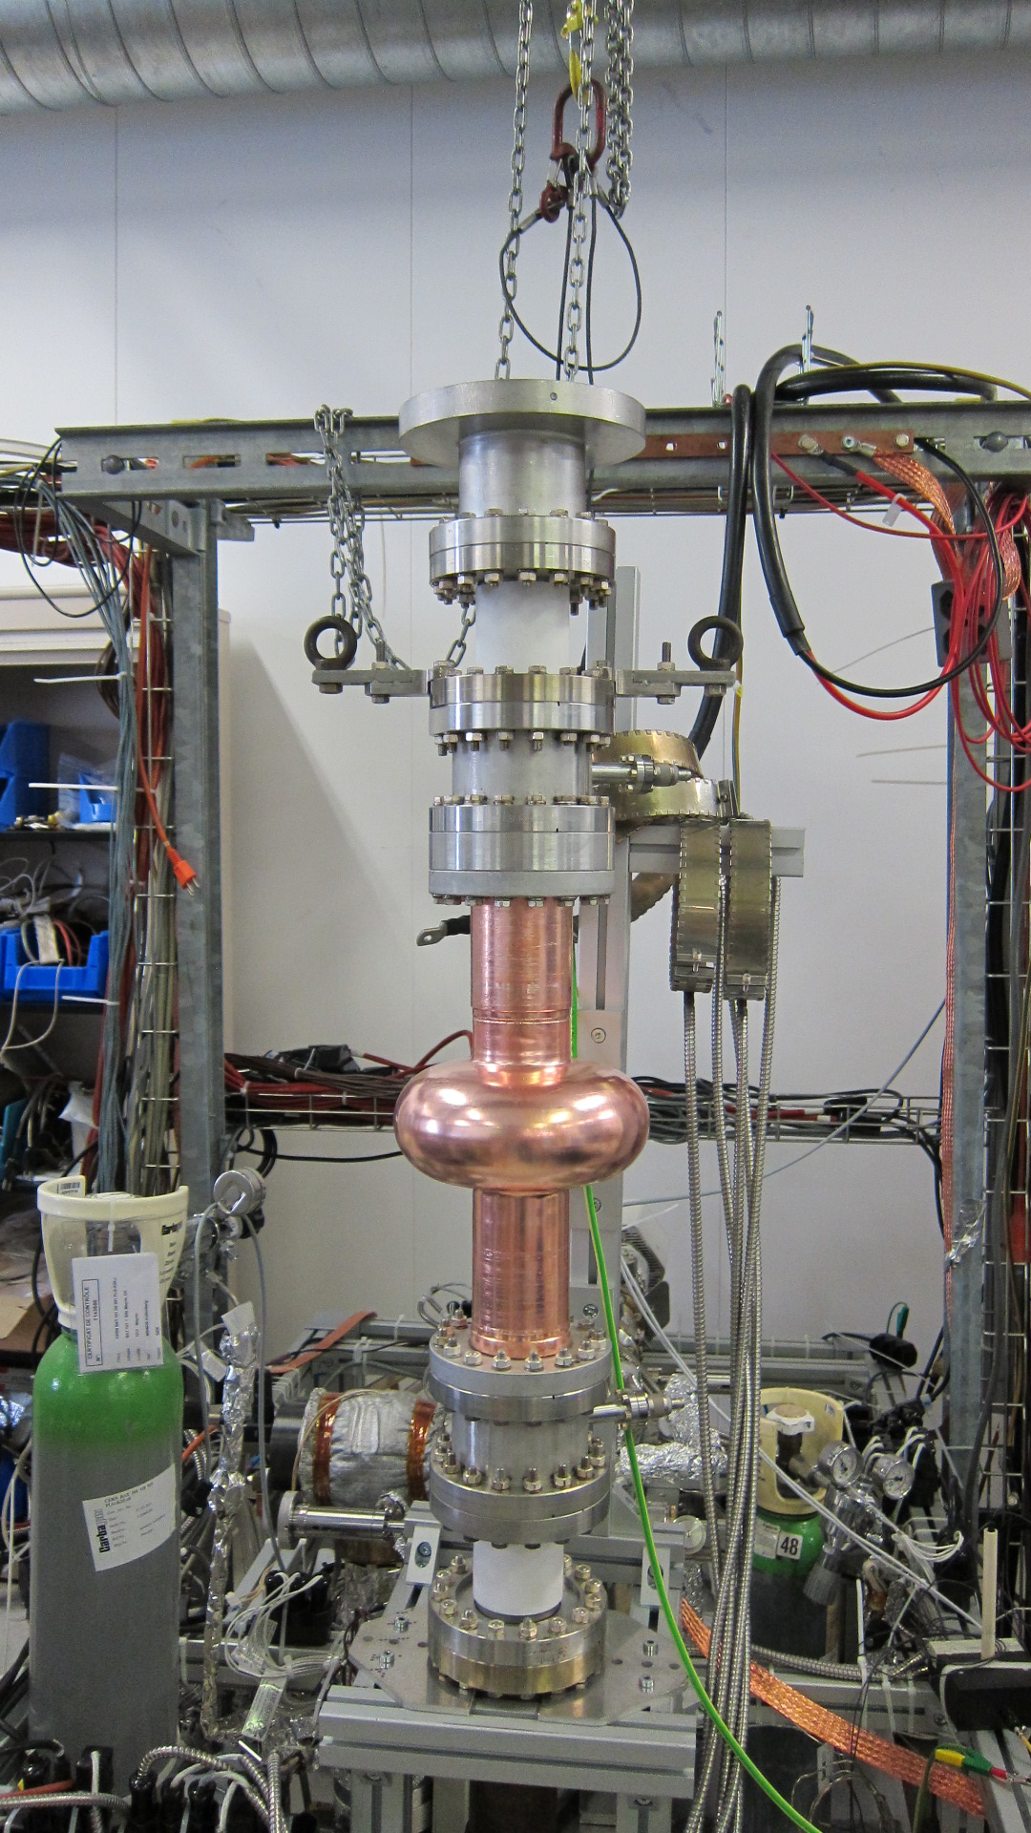
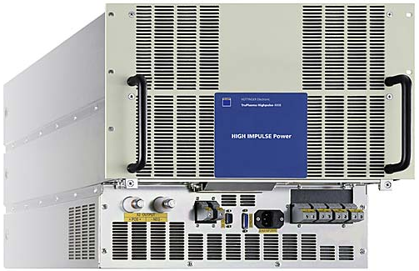
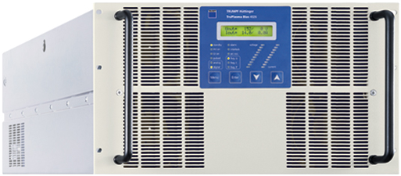
CERN Setup
Kr process gas
Differential pumping RGA (process quality control and leak detection)
Bakeout system (base pressure ~ 5.10⁻¹⁰ mbar)
Controlled venting: Dry Air
HiPIMS Power supply + capacitors bank
Bias power supply

Slide 9
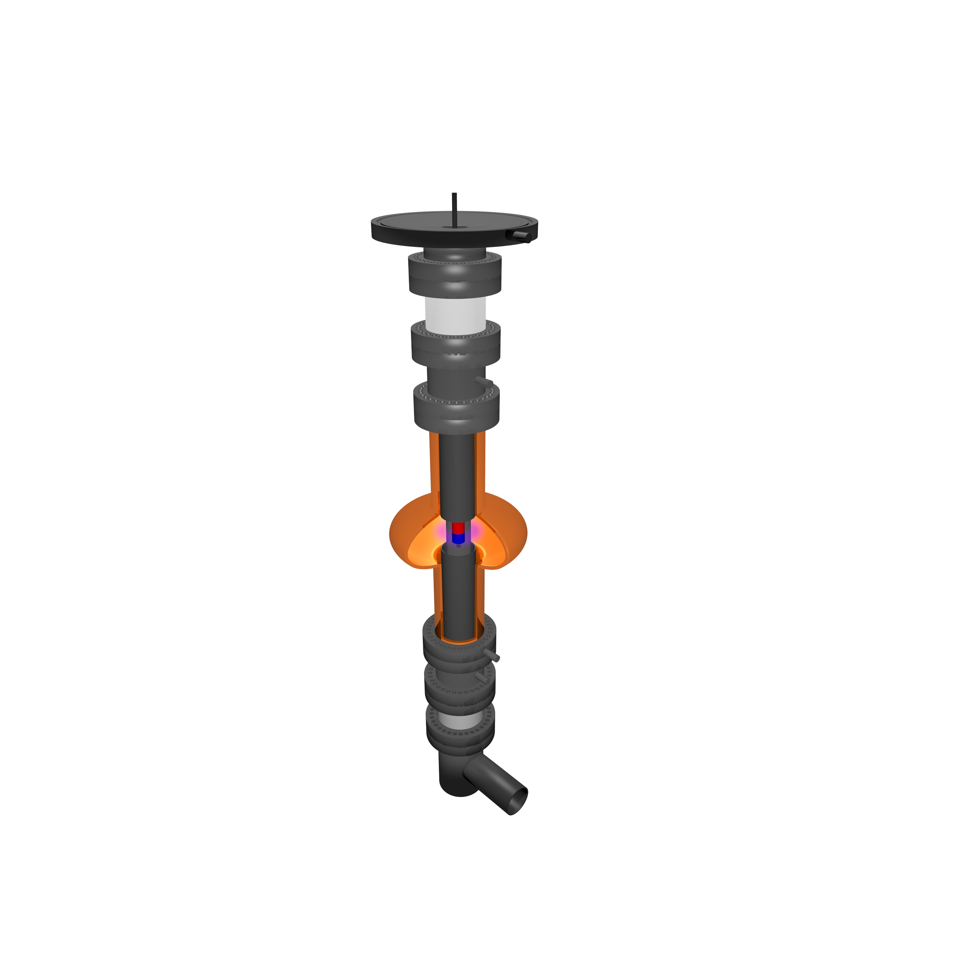
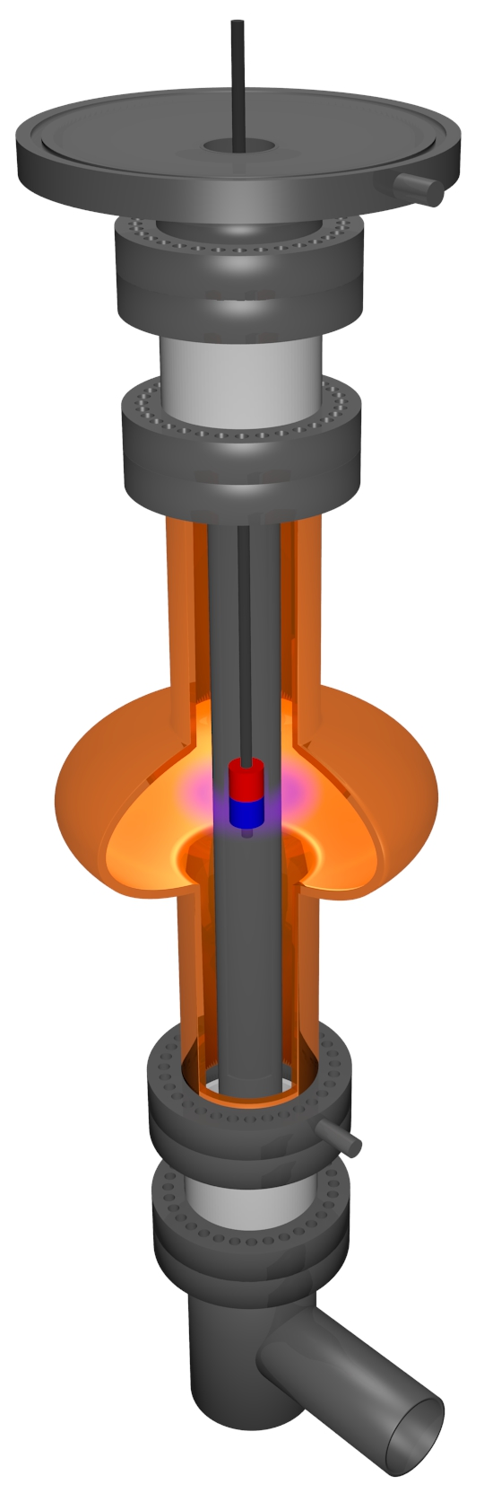
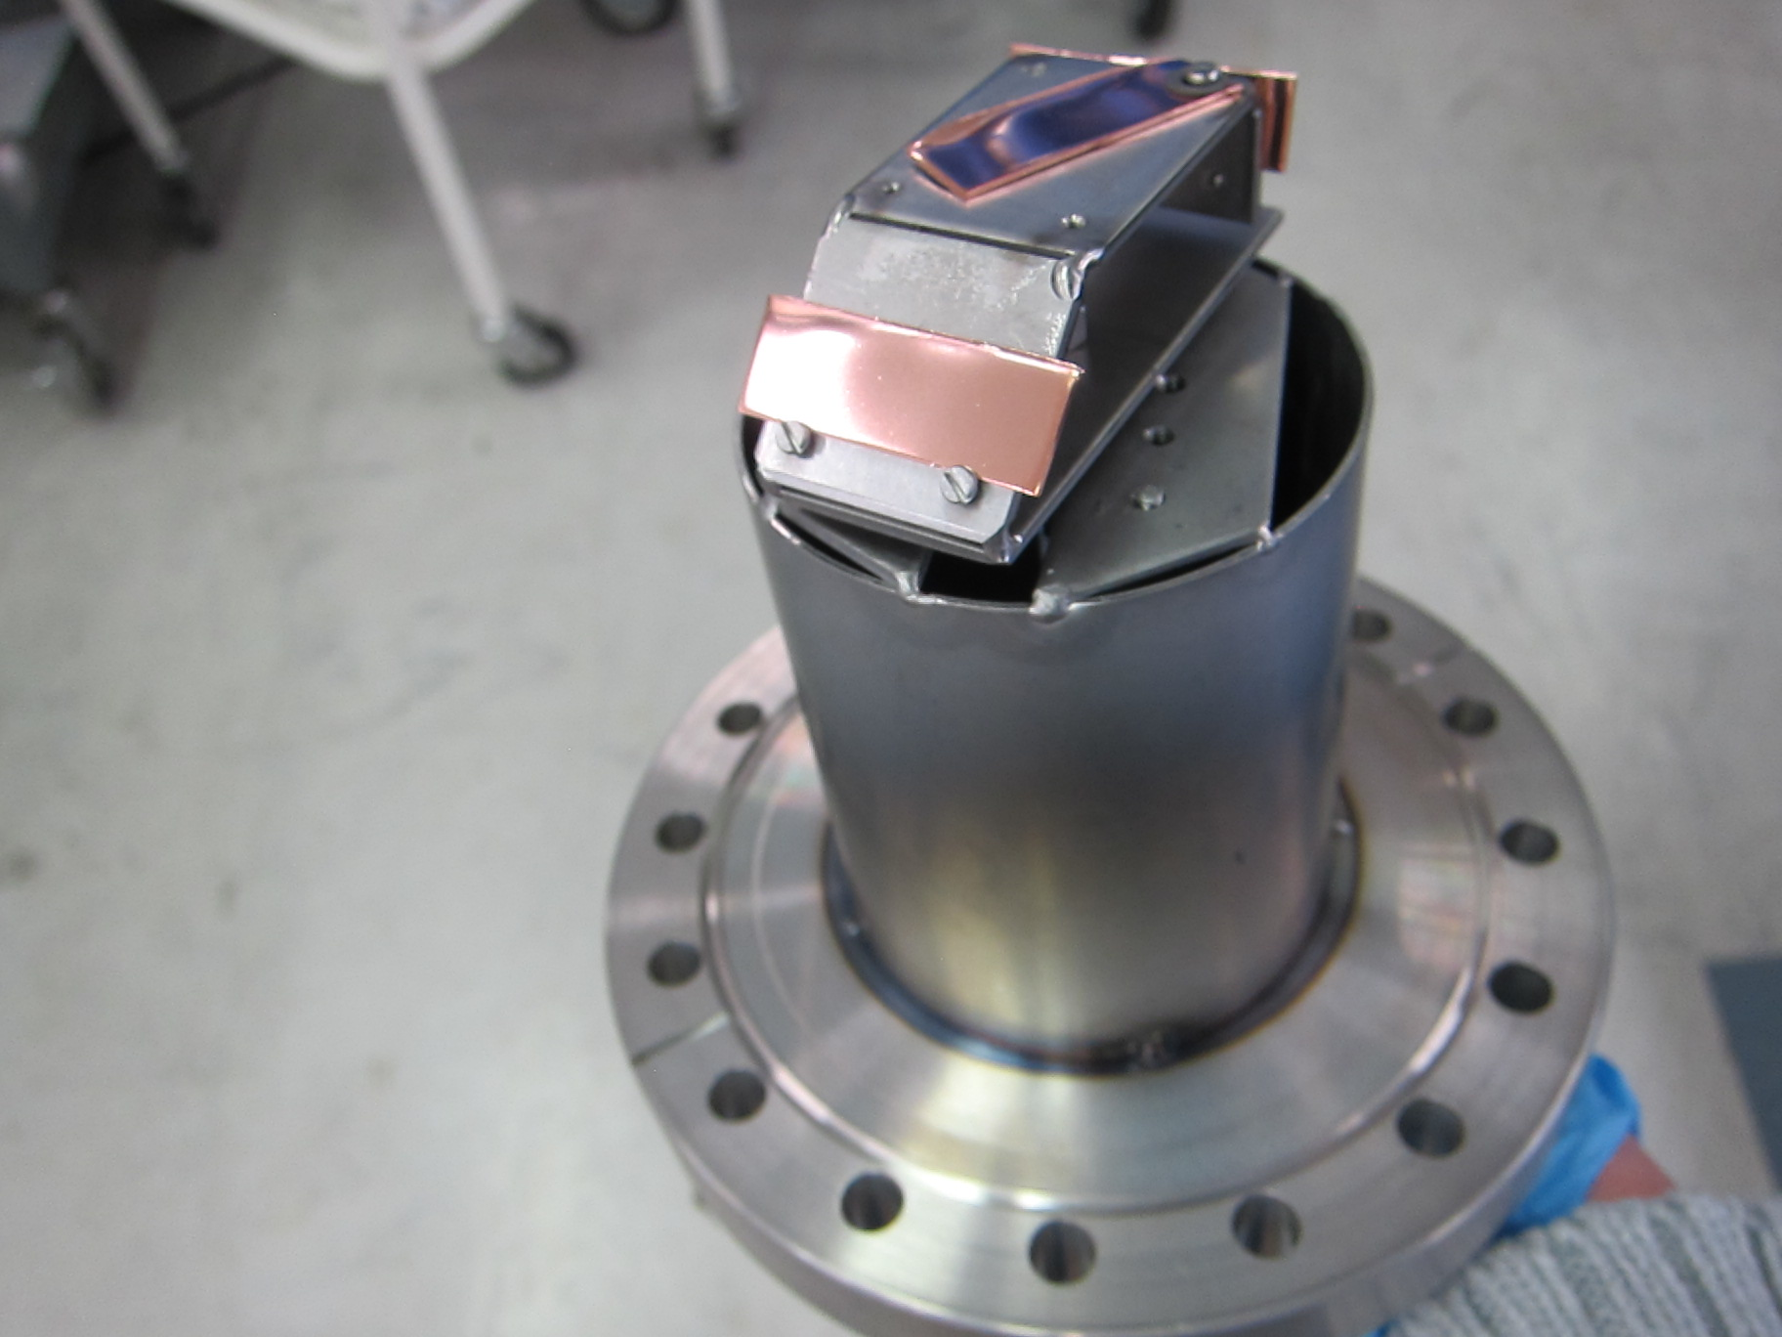
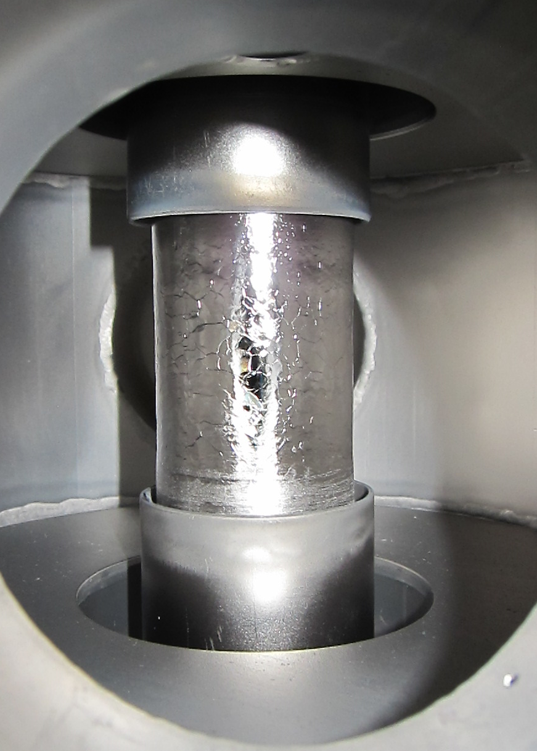
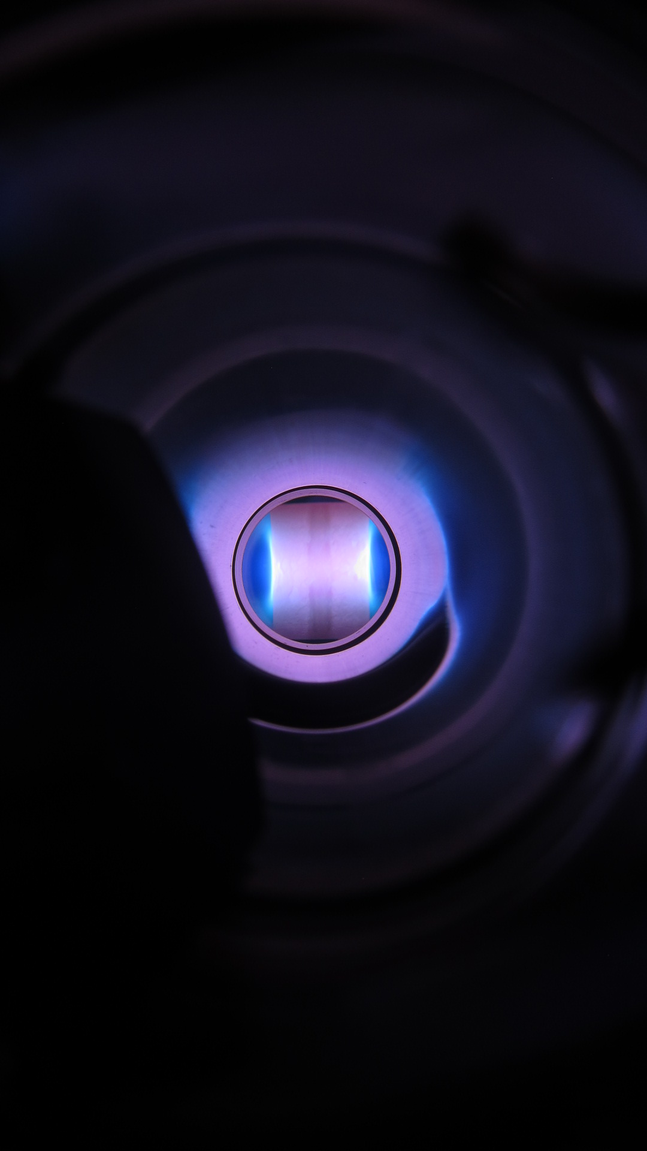
CERN Setup
Standard
  Single Nb cathode
  Cavity grounded
  LHC-like coating setup
Bias
  Three Nb electrodes
    Can be used as anode or cathode
  Coating in cut-offs: cavity grounded
  Cell coating: cavity can be biased
anode
anode
Sample Holder
90°
0°
45°

Slide 10
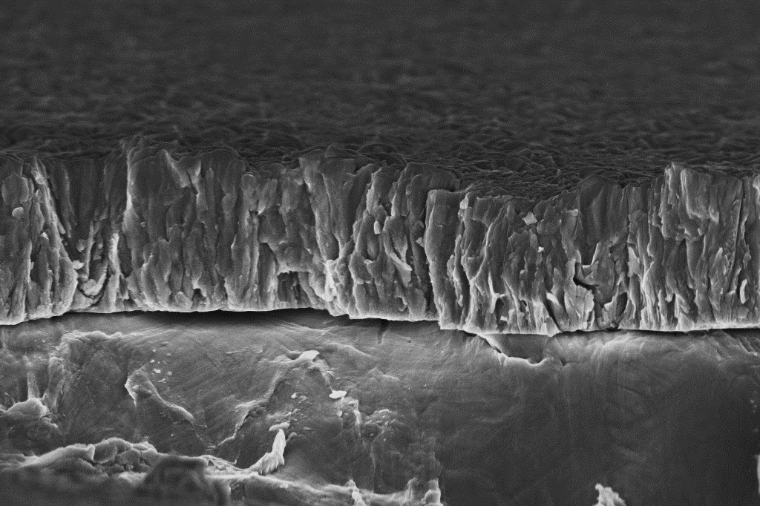
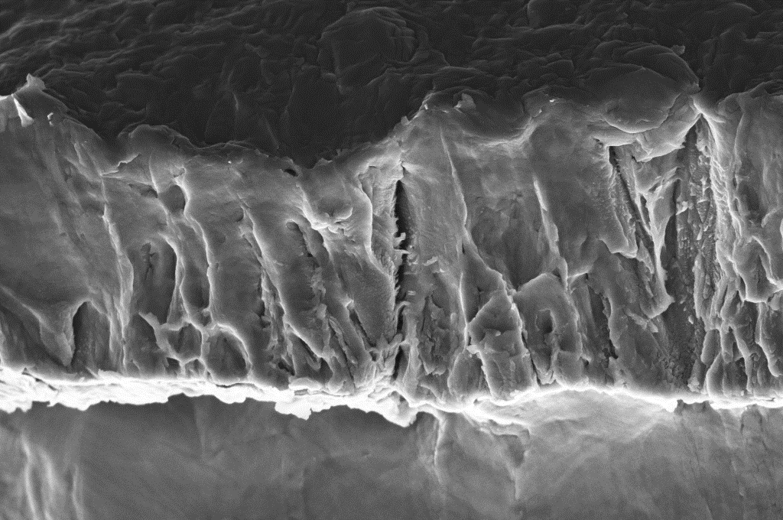
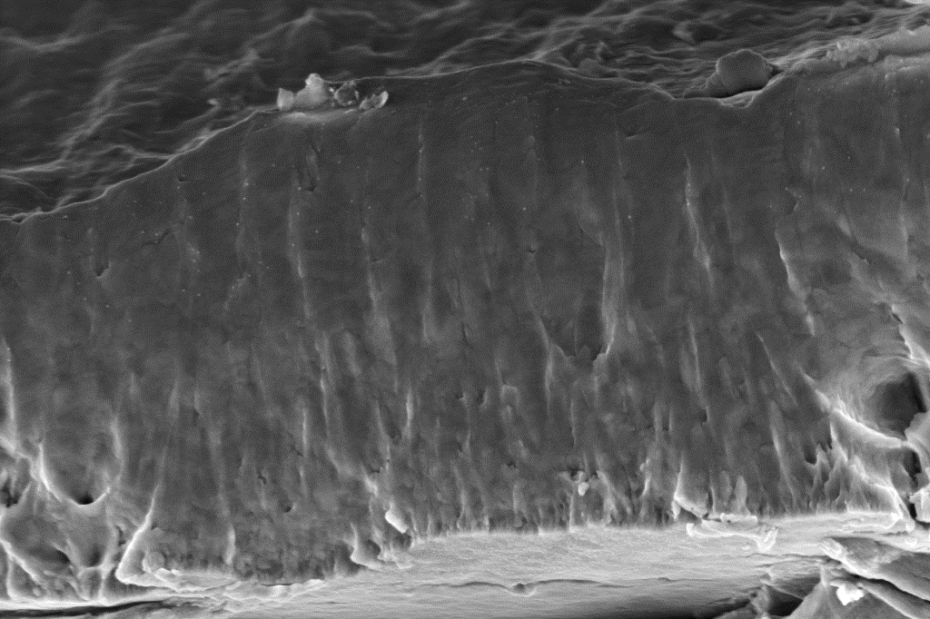
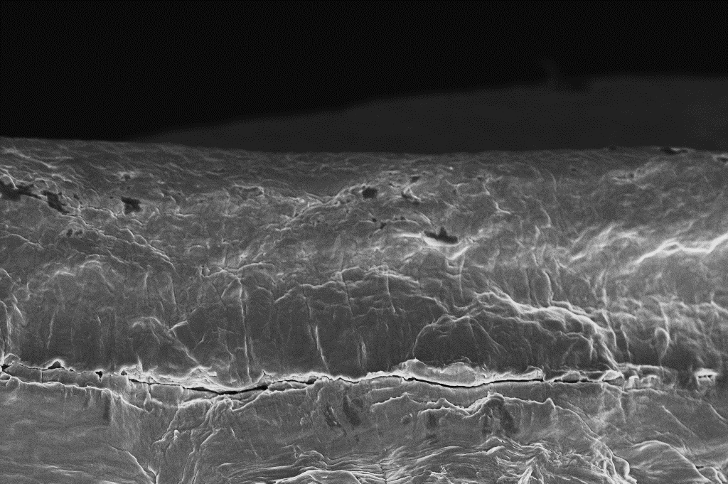
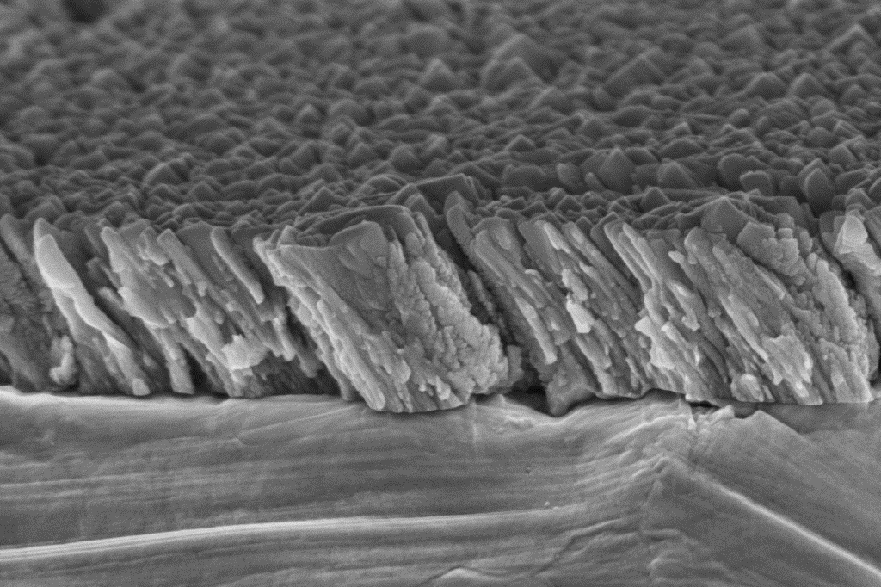
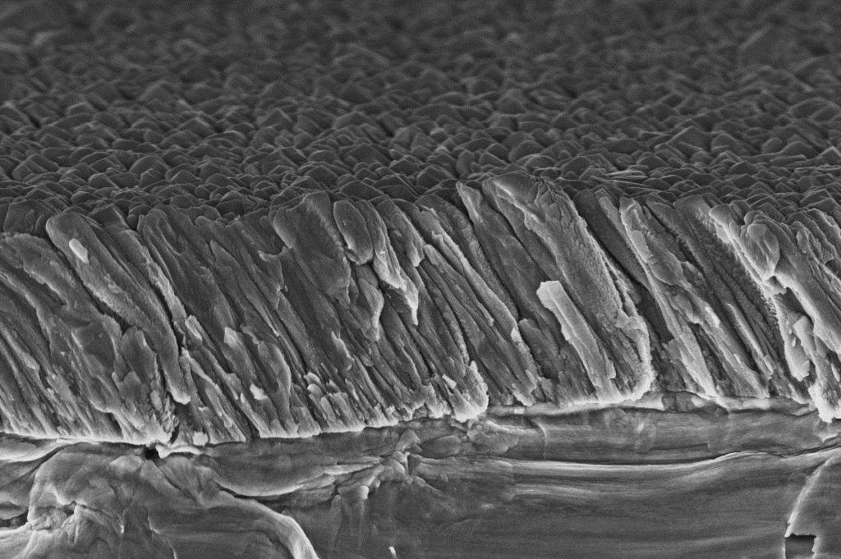
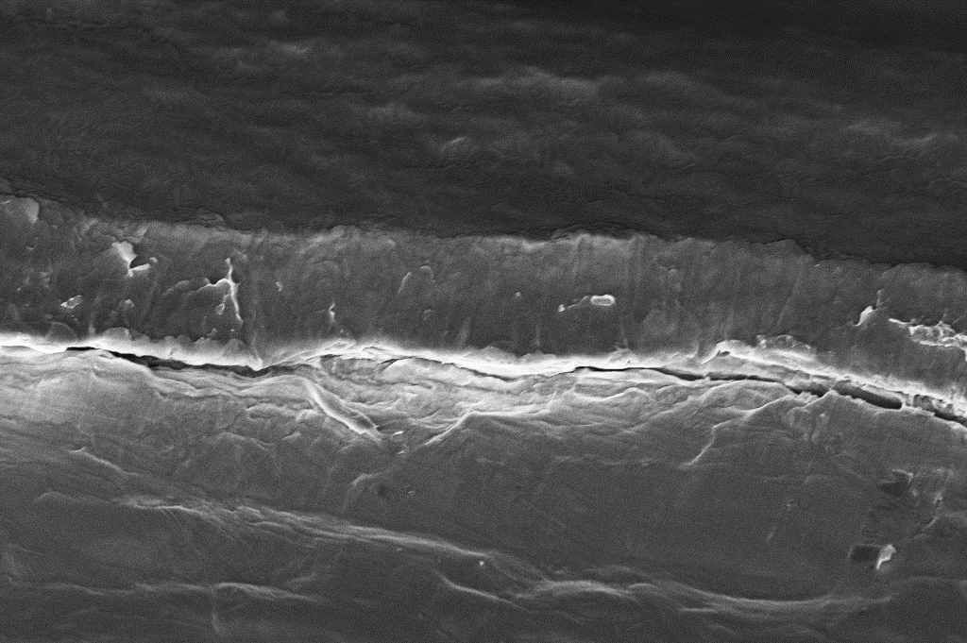
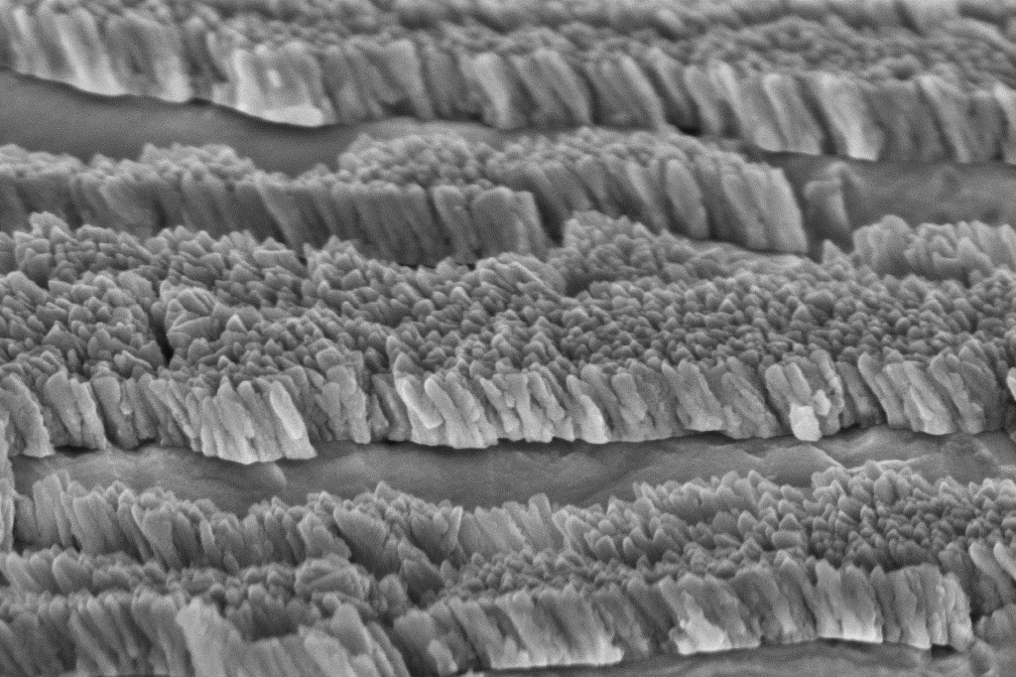
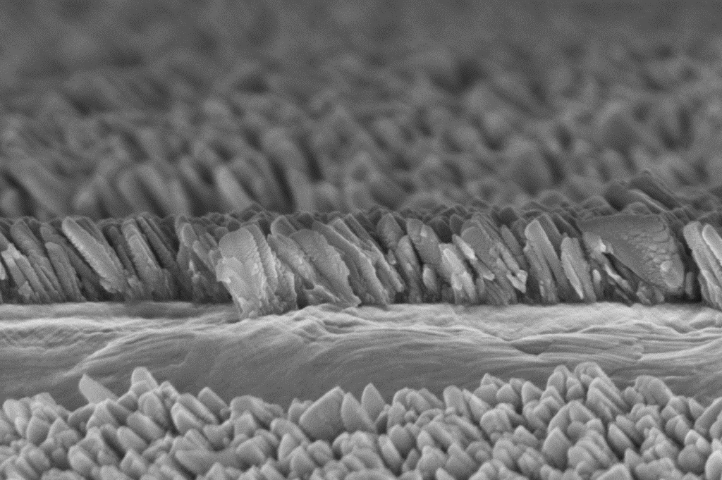
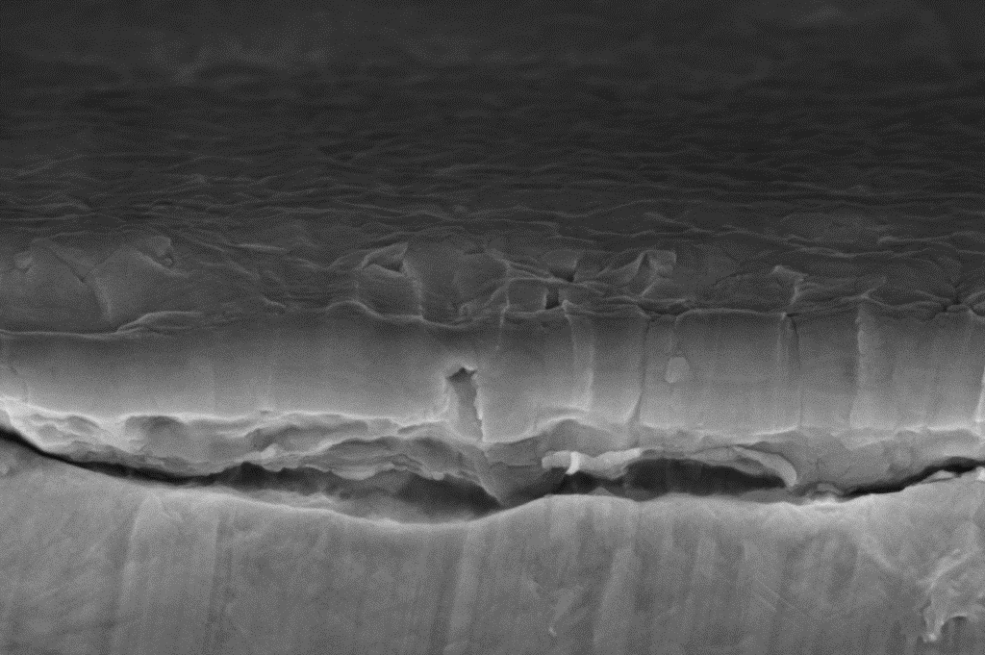
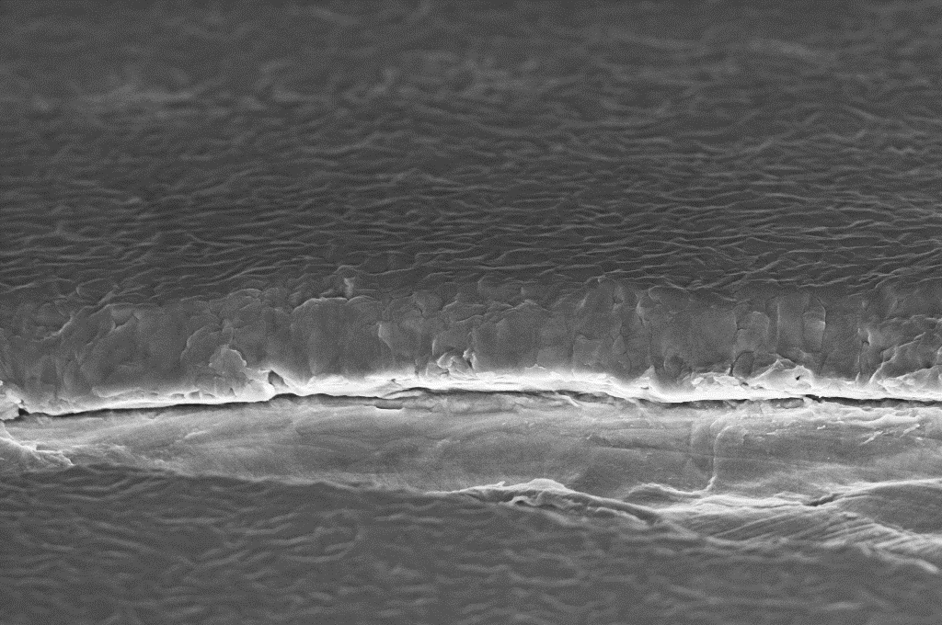
Latest results as function of coating angle
DCMS COATINGS
HiPIMS COATINGS
Grounded
-50V
Grounded
-50V
-100V
0°
0°
0°
0°
0°
45°
45°
45°
45°
45°
90°
90°
90°
90°
90°
All scale bars are 400μm
No major improvement from grounded to biased DCMS
Grounded HiPIMS equivalent to DCMS
Biased HiPIMS shows densification of the layer no matter the orientation

Slide 11
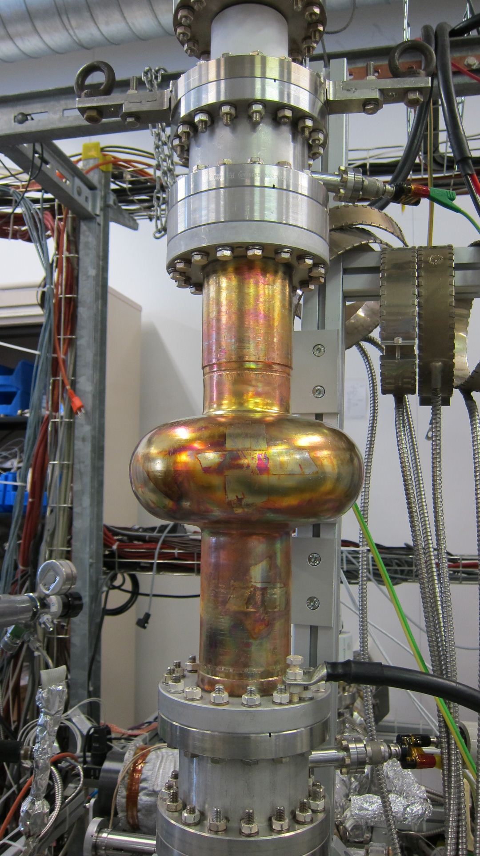
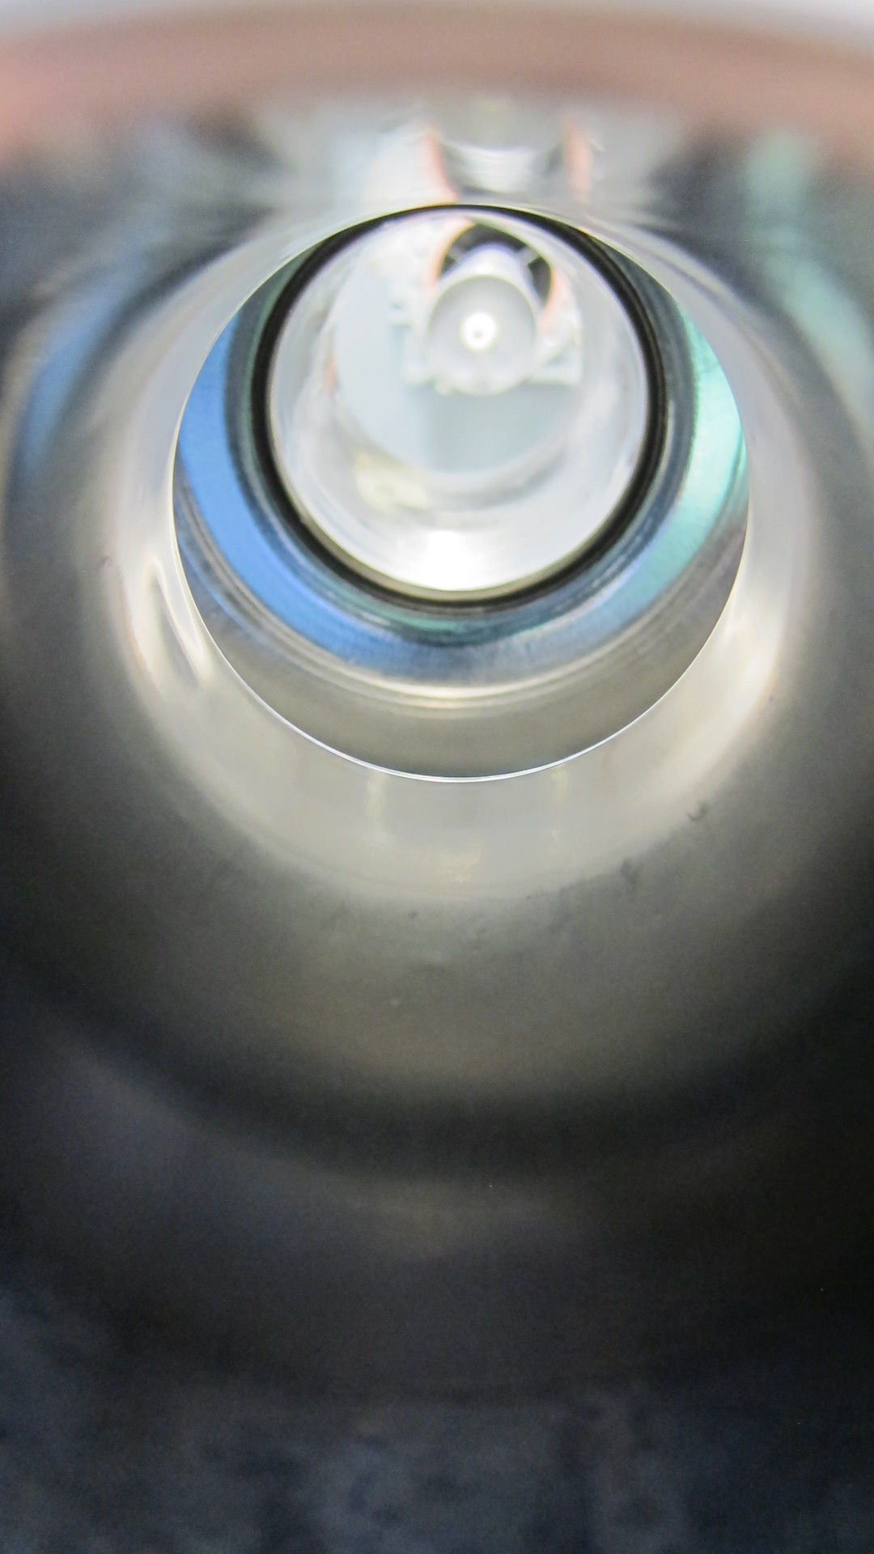
Next steps
M2.10 (1.3 GHz) coated with HiPIMS/-100V bias. RF characterization pending.
Samples FIB preparation and analysis on going : Substrate/Nb layer interface, porosity evaluation…
Pursue HiPIMS coatings to validate/exclude technological approach by end 2016.
Propose new magnetic configurations to enhance Nb ions flux at the substrate.
QPR to investigate the superconductive RF properties.
Exploration of SC DC properties (magnetometer, T_{C} …)

Slide 12
A15 Materials

Slide 13
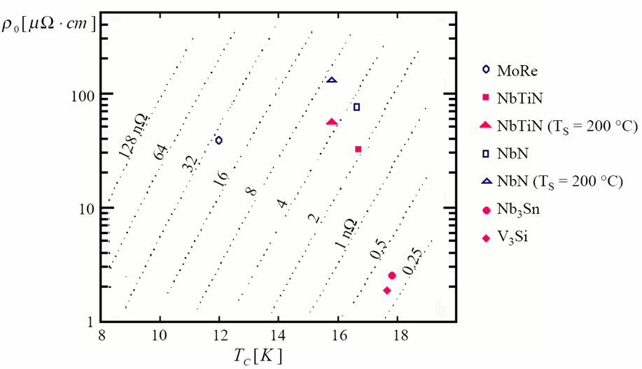
Goal
Propose an alternative to Nb films for SRF accelerating cavities
Candidates should have:
Low resistivity
Low surface resistance
“High” T_{C}
Single SC gap
Nb

Slide 14
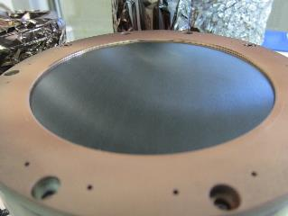
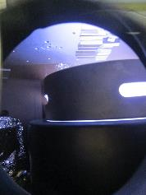
Coating Setup
Planar DC magnetron sputtering
150mm Nb/Sn and V/Si targets at 3:1 at. Ratio.
Ar sputtering gas
200W sputtering power
1.10⁻³ mbar up to 5.10⁻² mbar working pressure
Alloyed target → possible scale-up to cavity size coatings
B lines
e⁻ path

Slide 15
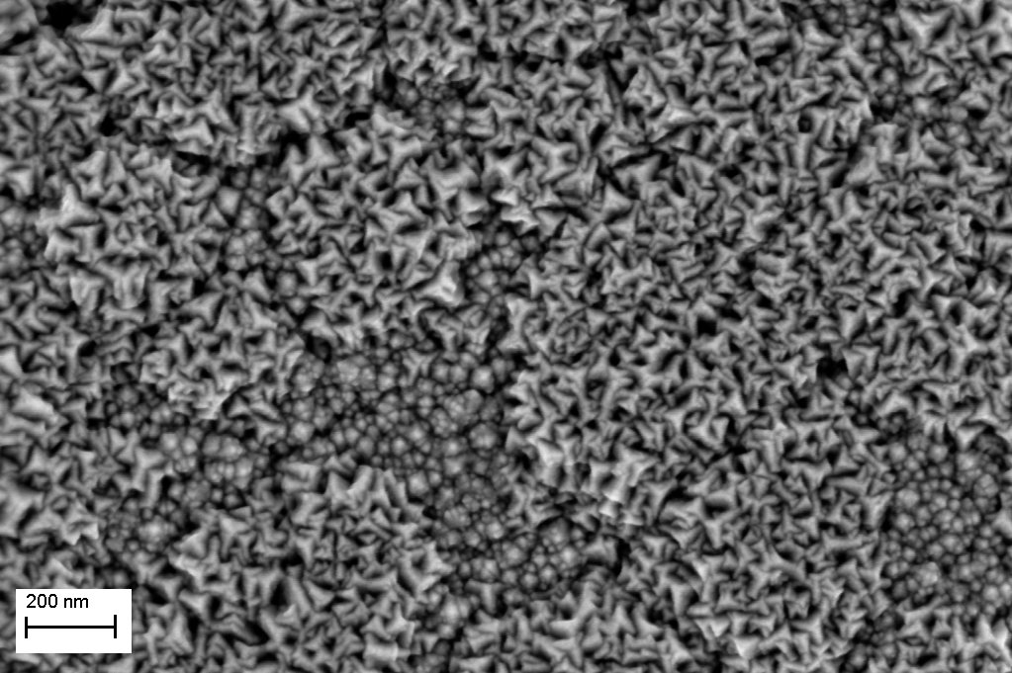
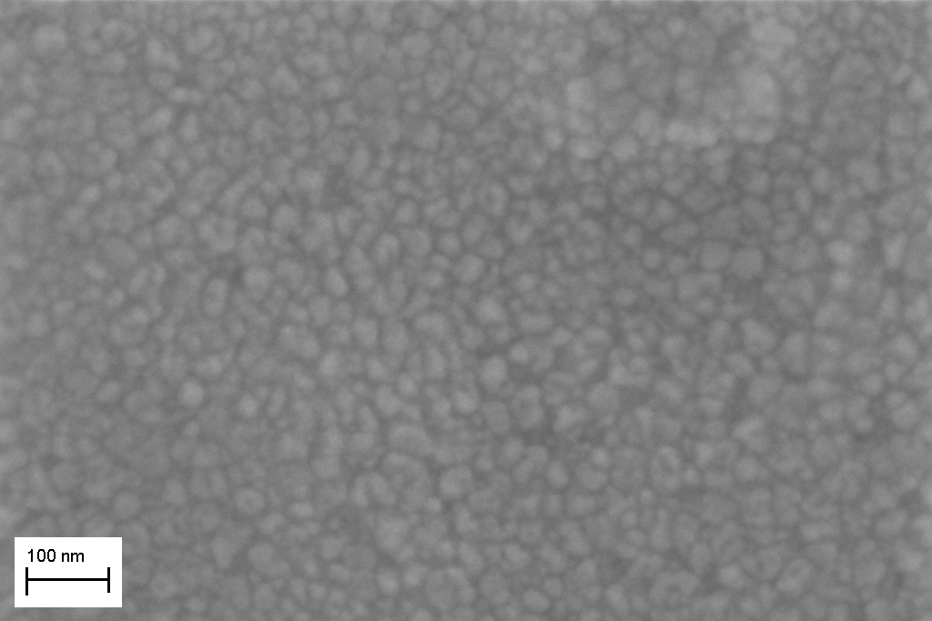
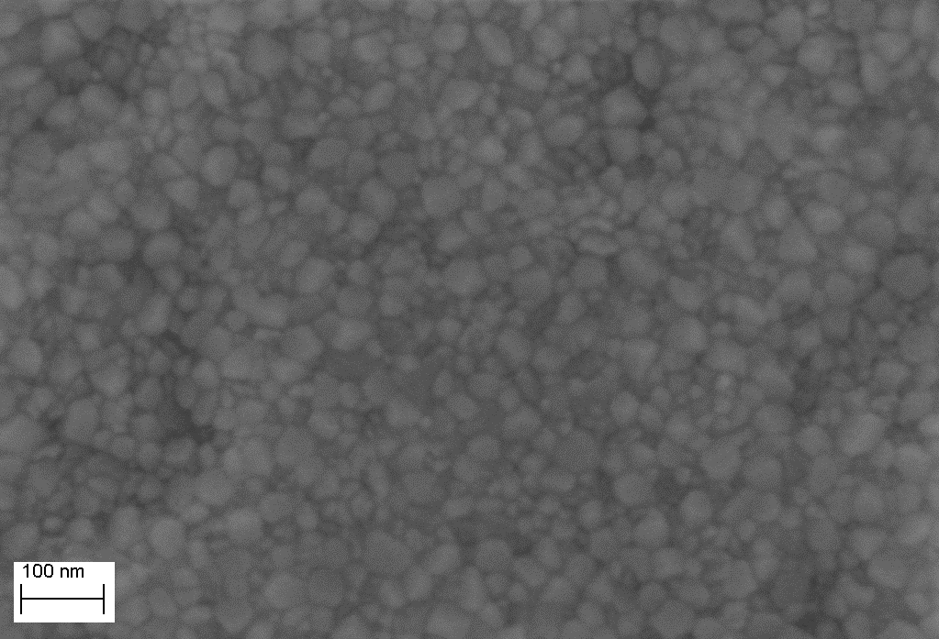
Results
Nb₃Sn Room temperature coatings + annealing
As deposited layer: nanocrystal but mainly amorphous
After annealing: A15 phase obtained even after annealing at low temperature.
DC measures confirm the obtention of a superconducting phase
Strong hysteresis suggests flux pinning

Slide 16
Next steps
EUCARD-2 deliverable D12.5: Postponed to Aug 2016 because of QPR system repair.
Understand the effect of surface preparation (surface energy measurements, roughness …)
Recommissioning of the T_{C} measurement setup (induction)
First promising results from high temperature coatings : to be investigated in depth.
V₃Si coatings already started:
  Stoichiometry issue : process gas?
  XRD on going
DC properties interpretation

Slide 17
Communications
2015
Poster at HiPIMS 2015, Braunschweig: BIASED HiPIMS TECHNOLOGY FOR SUPERCONDUCTING RF ACCELERATING CAVITIES COATING
DEVELOPMENT OF Nb3Sn COATINGS BY MAGNETRON SPUTTERING FOR SRF CAVITIES , G. Rosaz et al, SRF 2015 proceedings + POSTER
2016
Poster at FCC week, Rome : Superconducting sputtered Nb₃Sn films for SRF applications

Slide 18
CONCLUSION
HiPIMS
  Demonstrated very promising film morphology
  First biased cavity coated – RF measures on-going
  Study RF performances vs parameters (pulse duration, peak power, frequency…)
  Plasma characterization
A15
  Nb3Sn
    A15 phase obtained after annealing. Superconductivity confirmed
    High temperature coatings promising
  V3Si
    First coatings done and under characterization
  QPR coating by end Aug 2016
  T_{C} measurement bench to be requalified

