Slide 1
CLIC News

Slide 2
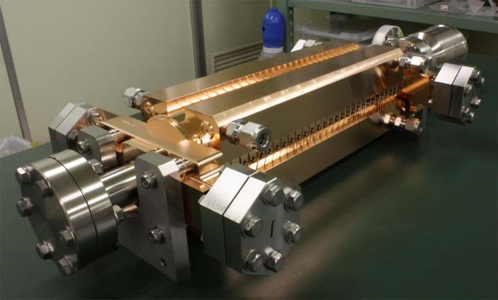
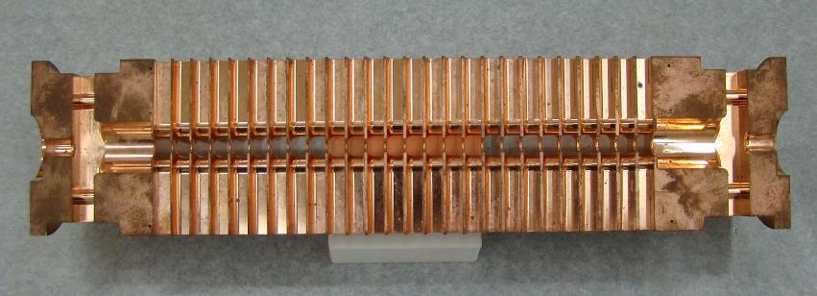
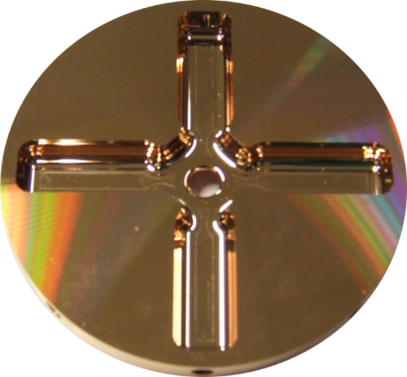
CLIC accelerating structure
Outside
11.994 GHz X-band
100 MV/m
Input power ≈50 MW
Pulse length ≈200 ns
Repetition rate 50 Hz
HOM damping
waveguide
Inside
Micron–precision disk
25 cm
6 mm diameter beam aperture

Slide 3
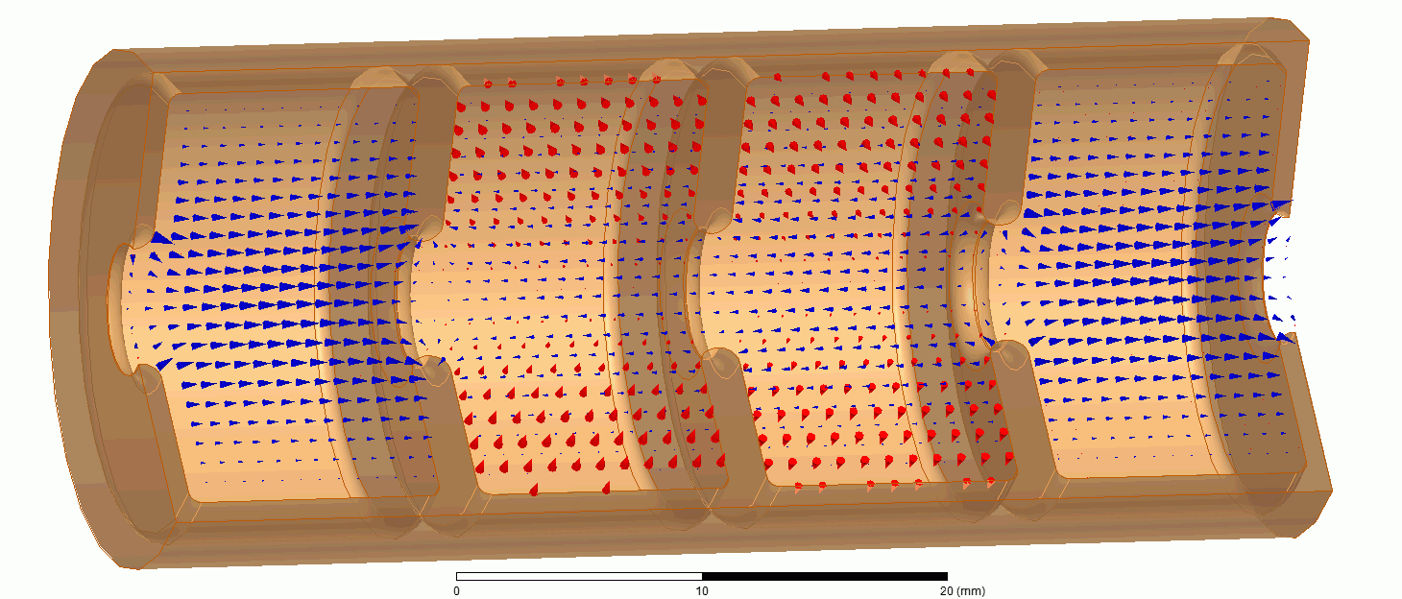

Breakdown rate
CLIC accelerating structure specifications include:
a gradient 100 MV/m,
a pulse length 180 ns,
and breakdown rate, BDR, 3x10⁻⁷/pulse/m.
BDR is the fraction of pulses which have a vacuum arc. Breakdown currents and lost acceleration result in lost luminosity on that pulse.
The three quantities are related to each other:
$$BDR∝E^{30}τ^{5}$$

Slide 4
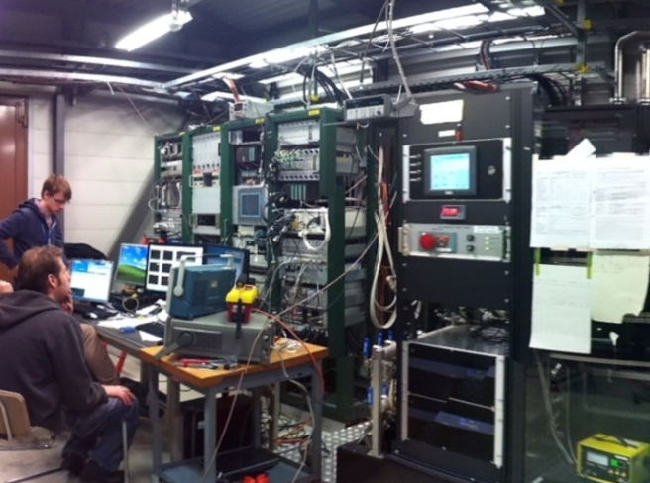
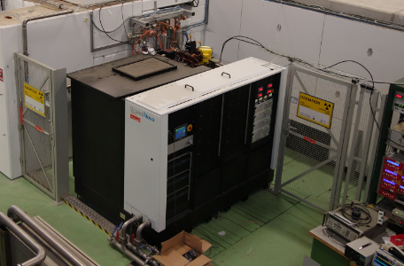
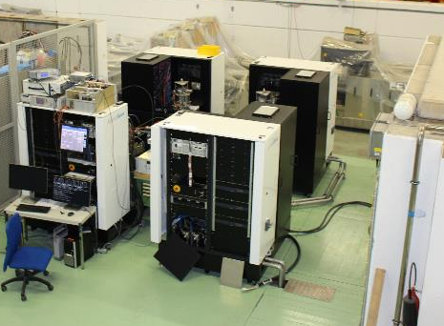
Testing Capability at CERN
Xbox-1
Xbox-2
Xbox-3
OPERATIONAL
OPERATIONAL
COMMISSIONING February 2016
CPI 50MW 1.5us klystron
Scandinova Modulator
Rep Rate 50Hz
Beam test capabilities
CPI 50MW 1.5us klystron
Scandinova Modulator
Rep Rate 50Hz
4x Toshiba 6MW 5us klystron
4x Scandinova Modulators
Rep Rate 400Hz
Previous tests:
2013 TD24R05 (CTF2)
2013 TD26CC-N1 (CTF2)
2014-15 T24 (Dogleg)
Previous tests:
2014-15 CLIC Crab Cavity
Medium power tests (Xbox-3A):
2015 3D-printed Ti waveguide
2015 X-band RF valve
Ongoing test:
Aug2015- TD26CC-N1 (Dogleg)
Ongoing test:
Sep2015- T24OPEN
Major increase in testing capacity!

Slide 5
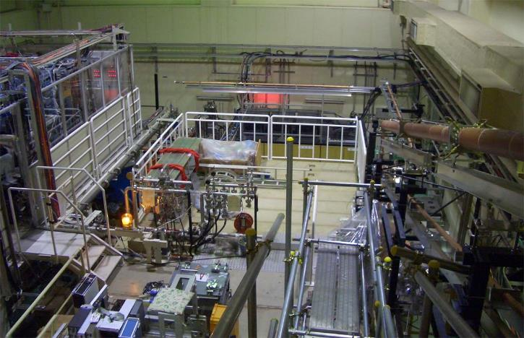
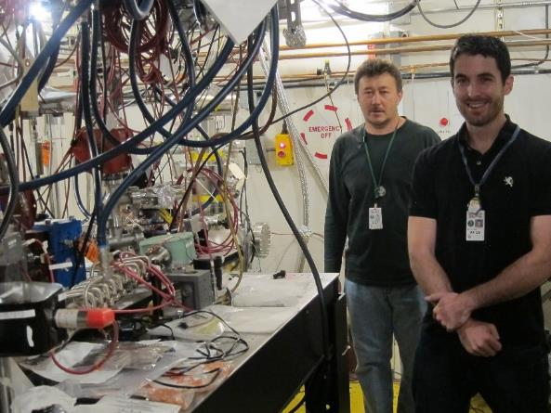
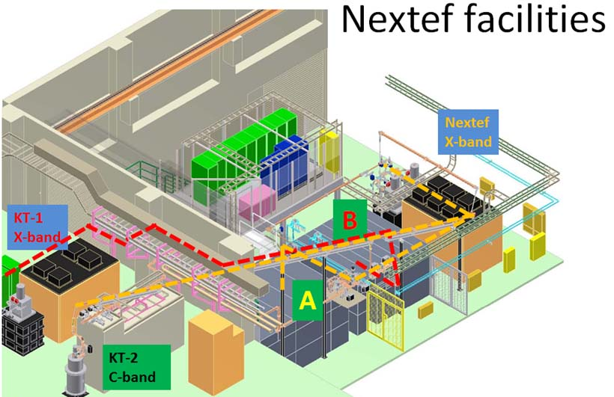
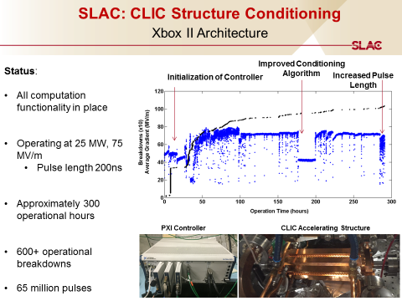
X-band test stands at KEK and SLAC
Nextef at KEK
ASTA at SLAC
Tsinghua University and SINAP have both ordered 50 MW X-band klystrons.

Slide 6
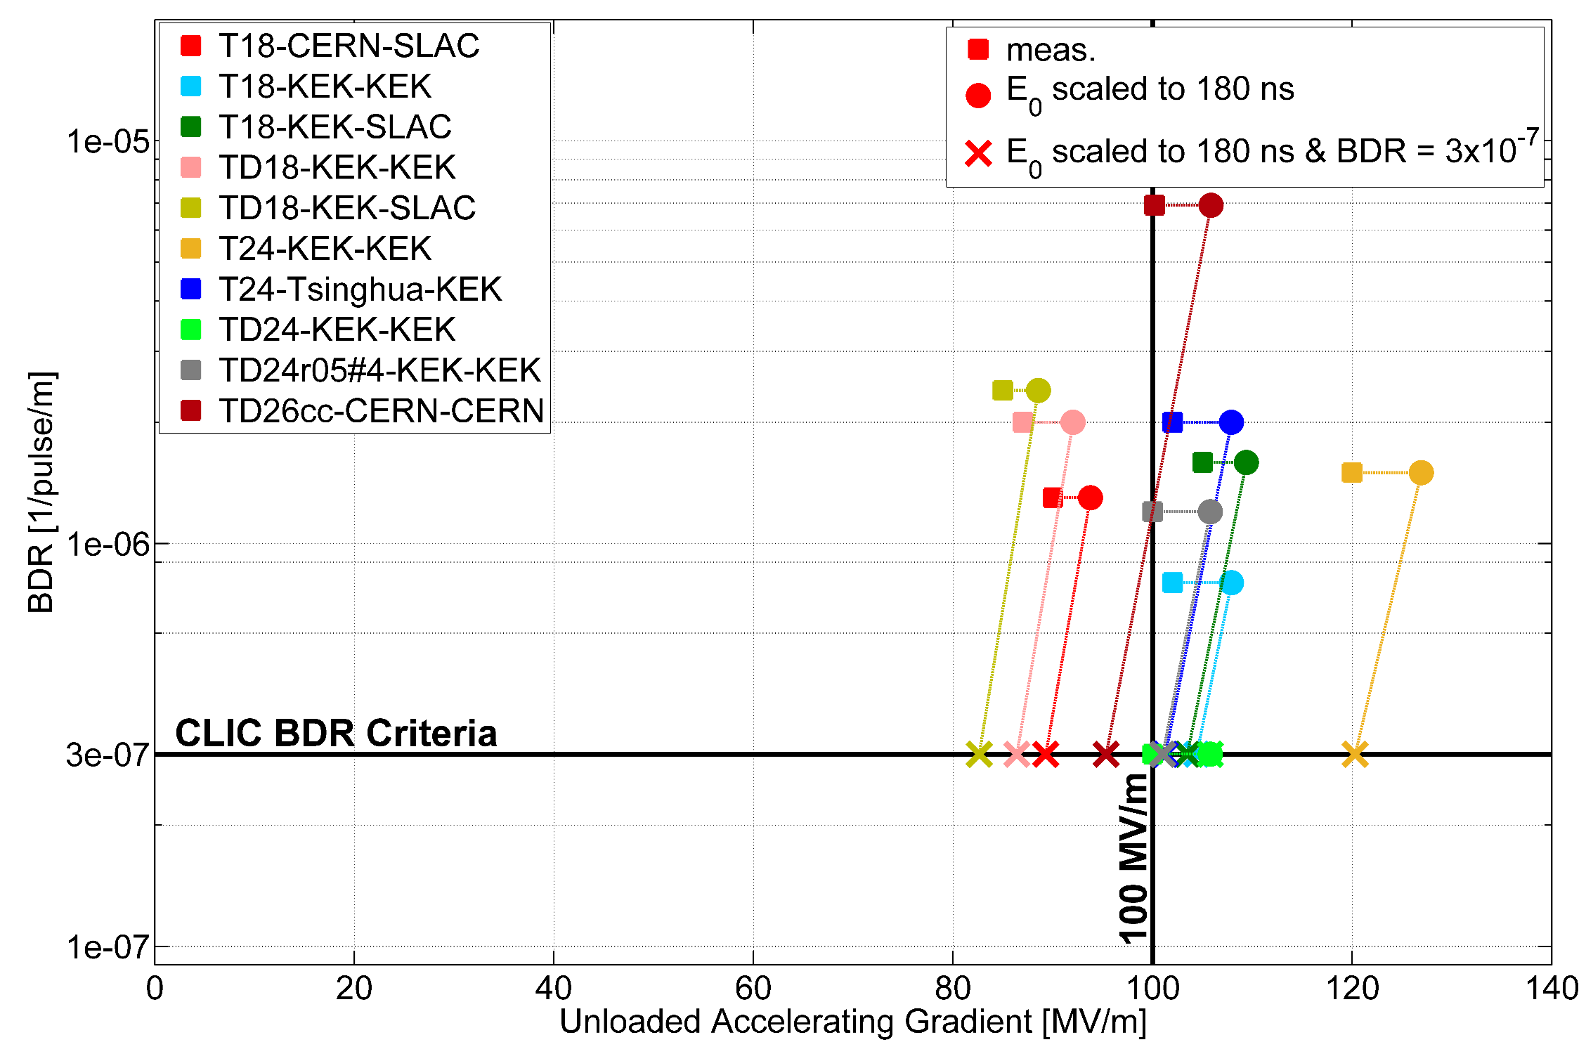

Performance summary at CLIC specifications
$$BDR∝E^{30}τ^{5}$$

Slide 7
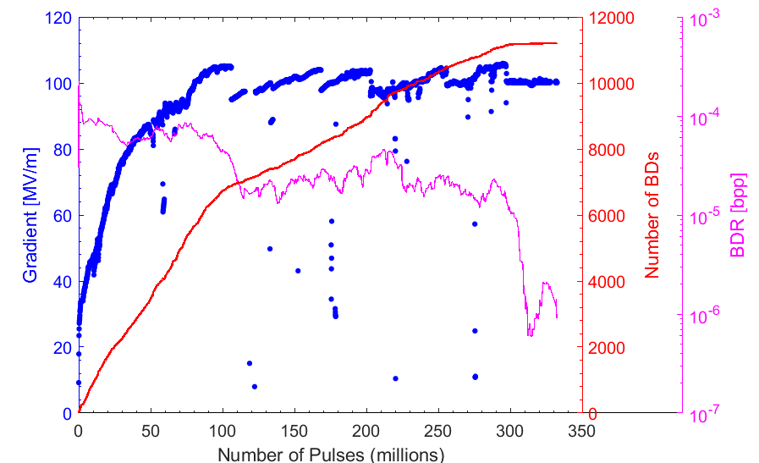
Conditioning
Accelerating structures do not run right away at full specification – pulse length and gradient need to be gradually increased while pulsing. Typical behaviour looks like this:
Pulse length steps
BDR falls during flat E run
4 million pulses per day at 50 Hz

Slide 8
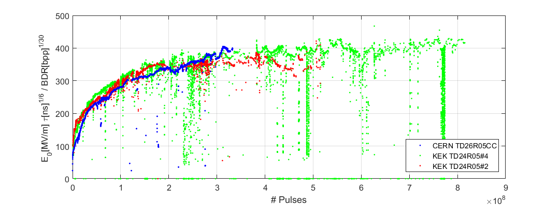
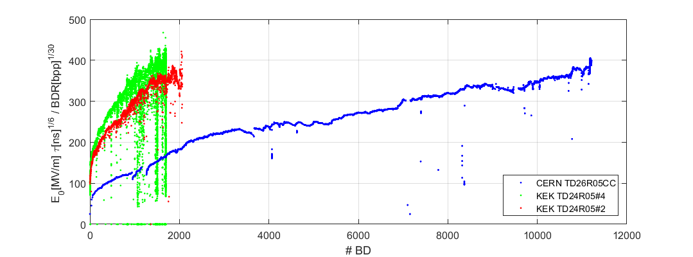

Comparing conditioning
Scaled gradient vs cumulative number of PULSES
Pulses
$$BDR∝E^{30}τ^{5}$$
Scaled gradient vs cumulative number of BREAKDOWNS
Breakdowns
Comparison of the conditioning of high gradient accelerating structures
Alberto Degiovanni, Walter Wuensch, and Jorge Giner Navarro
Phys. Rev. Accel. Beams 19, 032001 (2016) - Published 4 March 2016

Slide 9
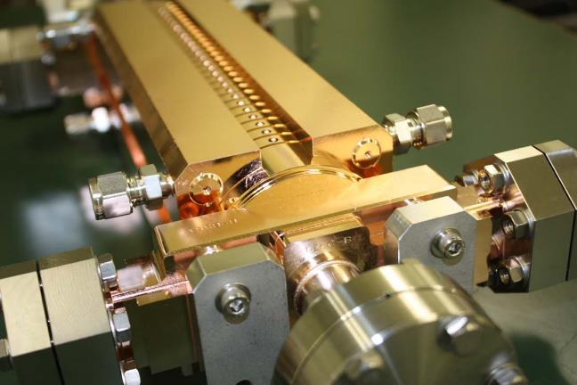
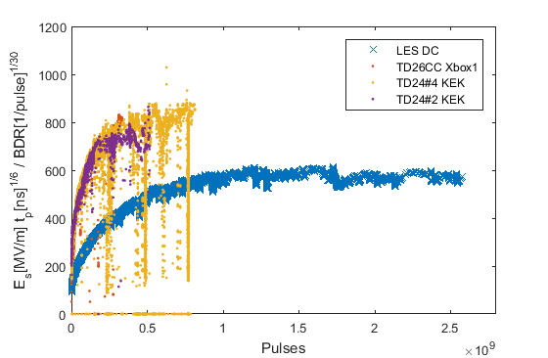
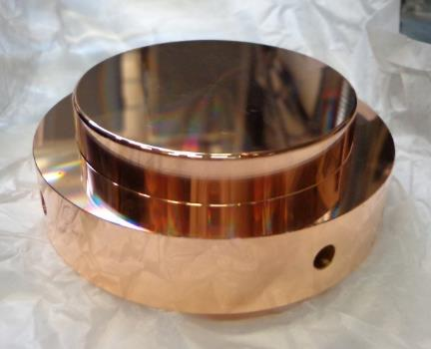
Longer term operation
7 months @ 50 Hz
rf
pulsed dc
30 days @ 1 kHz

Slide 10
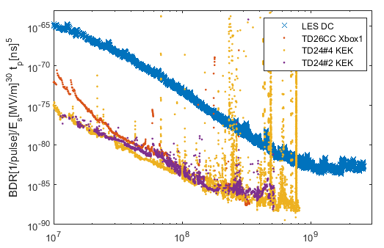
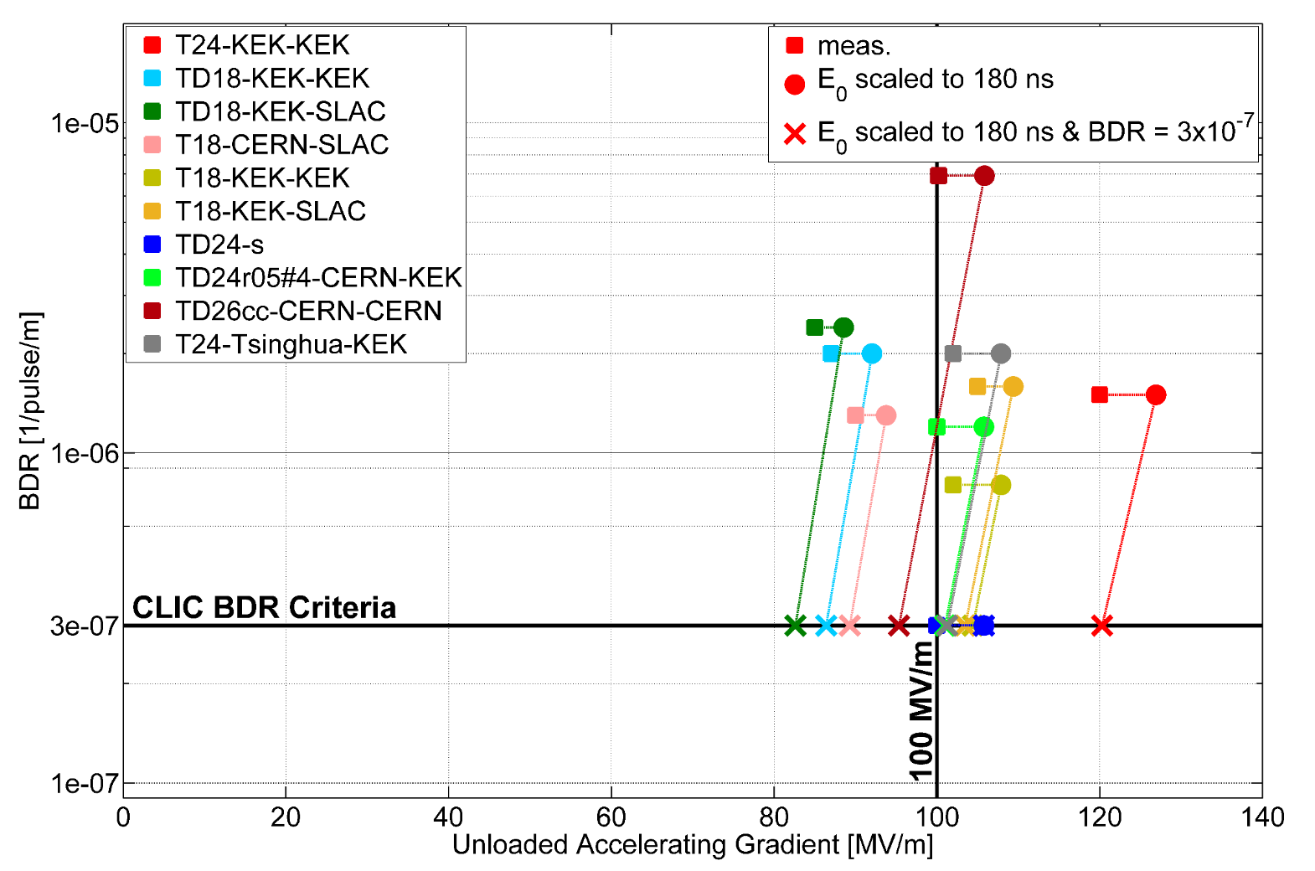
Long term evolution of BDR
pulsed dc
rf
Pulses

Slide 11

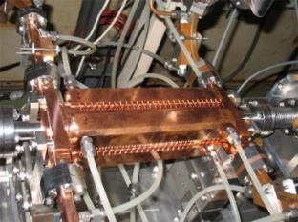
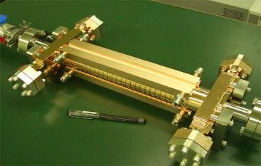

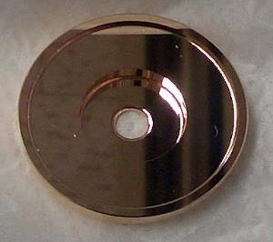
Gradient Perspectives
damped (mostly)
un-damped

Slide 12
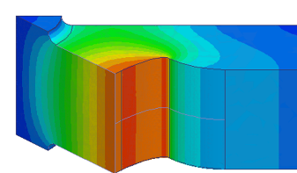
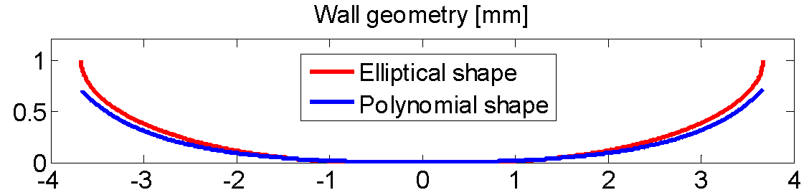
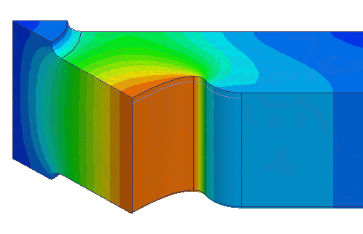
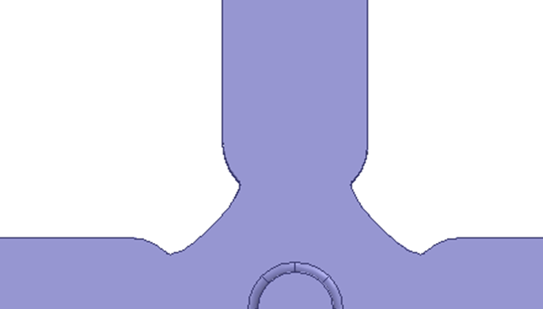
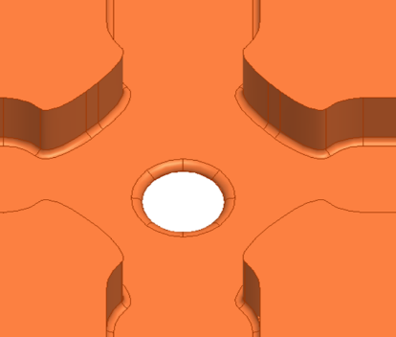
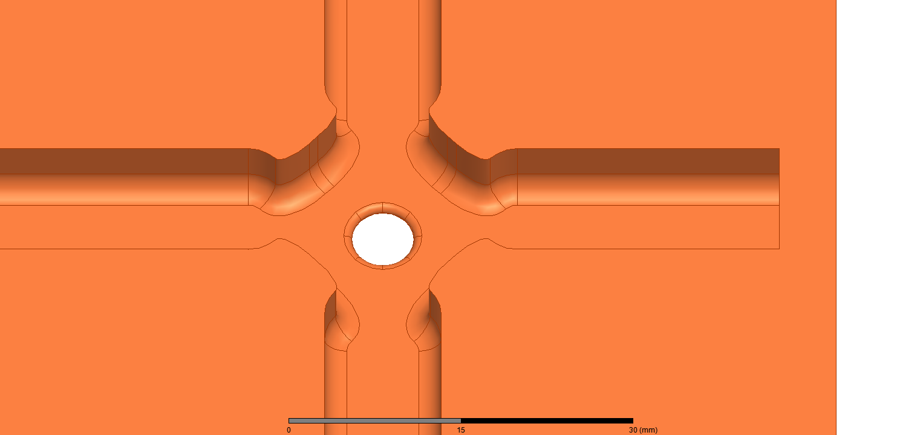
New baseline structure: major objective
Analysing results and re-optimizing CLIC, we have a new baseline structure.
We expect to get to 120 MV/m unloaded, closing the gap we expect from beam loading.
Mechanical design done. To be built and tested.
Width=11mm ->10.1mm
R = 0.5mm
R = 2.5mm
Opening=8mm->7.8mm

Slide 13
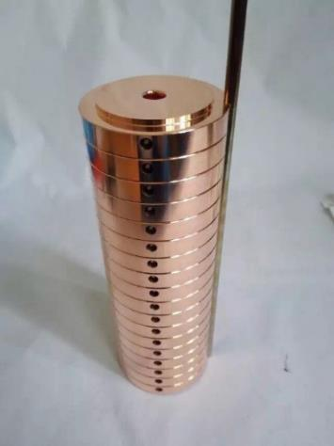
Symmetry plane structures
vs.
Structures in parts along symmetry planes have significant potential advantages - cost, joining, heat and chemical treatment, materials. Does require 3-D micron precision milling which is now possible.
Early tries with quadrants yielded unsatisfactory results, but don’t believe this was end of story. We’re back!

Slide 14
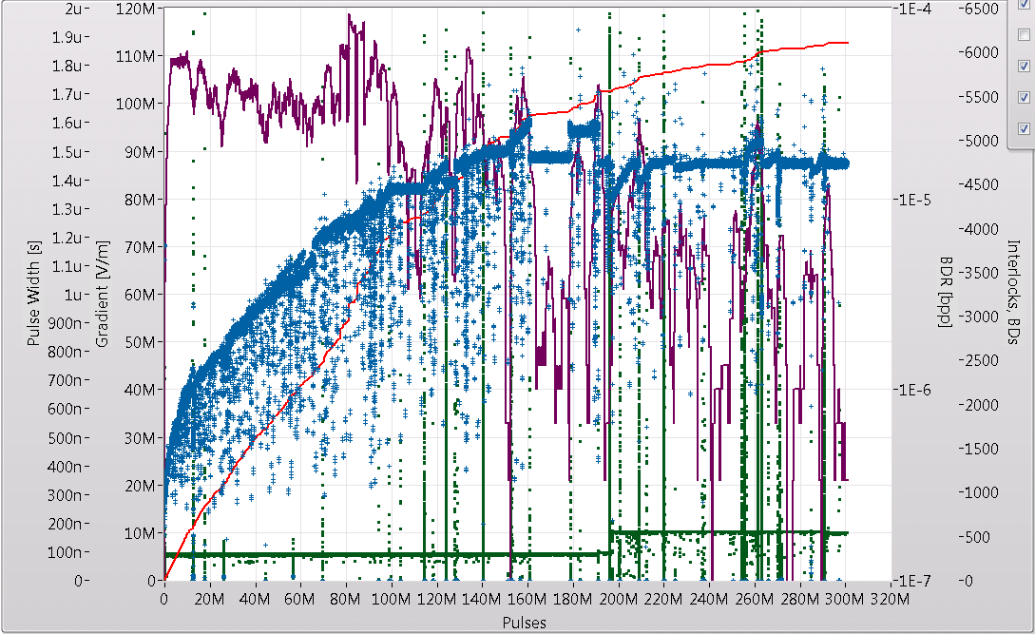
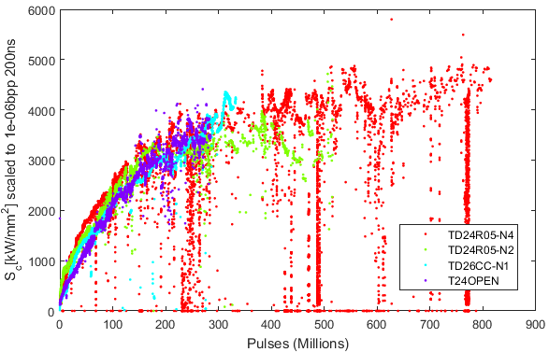
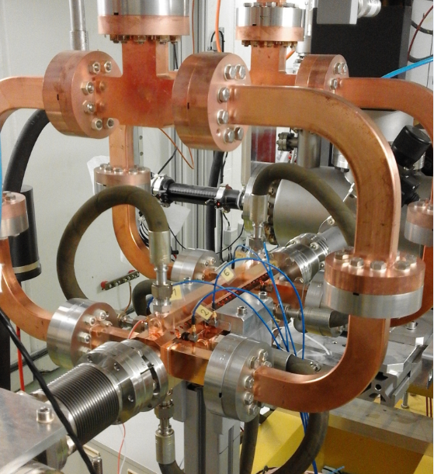
Structure in halves – testing in XBox-2
CERN design and high-gradient testing, SLAC fabrication.
Hard copper version under preparation.

Slide 15
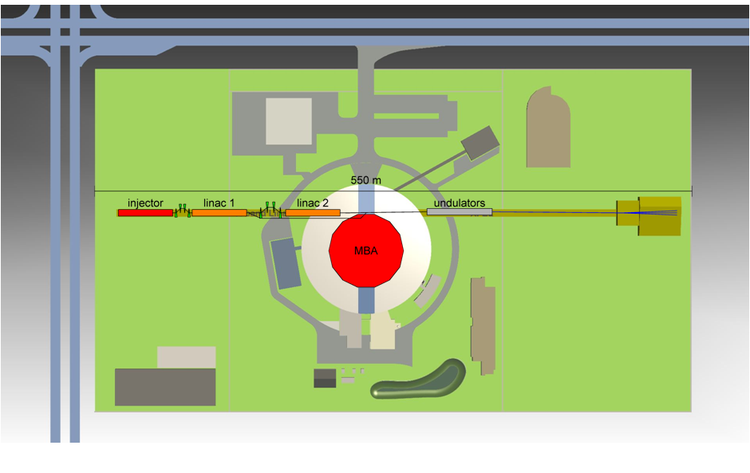
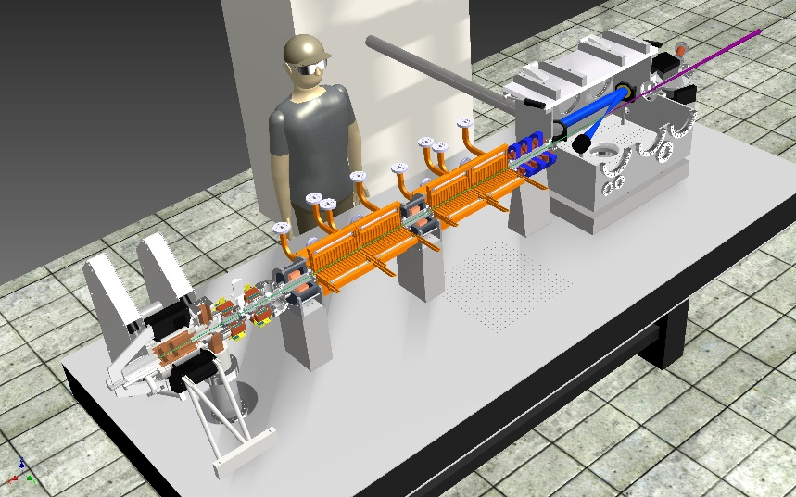
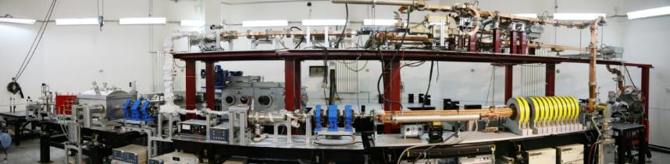
Applications of X-band acceleration
CLIC
Australian Light Source
Linear collider - TeV
XFEL – 1 to 10 GeV
https://indico.cern.ch/event/358352/session/7/contribution/40
Thompson/Compton
source – few 100s MeV
50MW
Smart*Light, NL
Compact Compton source
few 10s MeV
Tsinghua, China

Slide 16
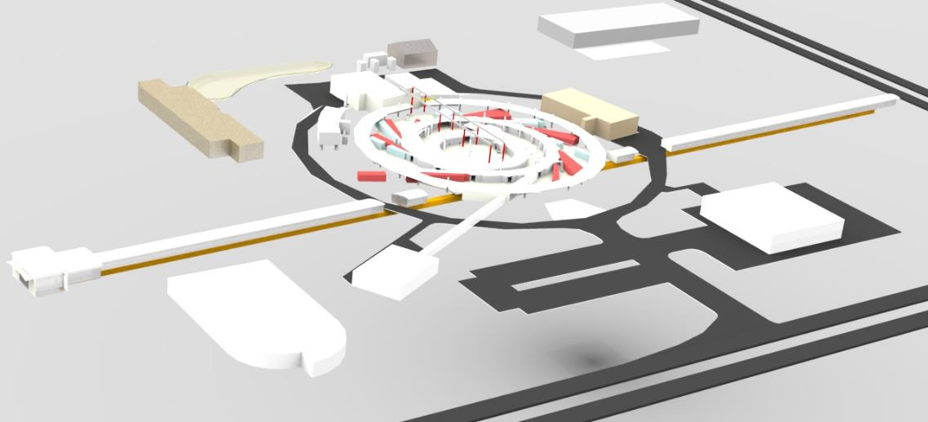
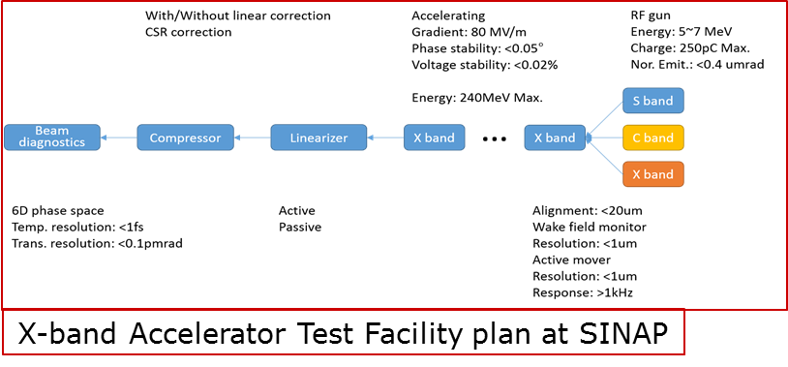
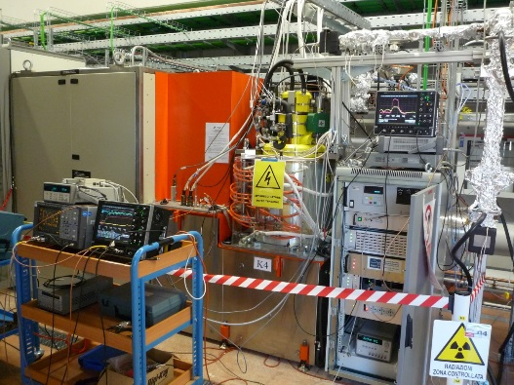
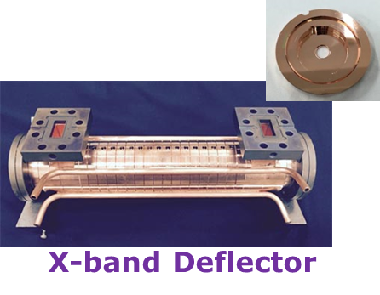
Selected collaborations on applications of X-band and high-gradient
XbFEL H2020 design study to be resubmitted in 2017.
XBox3-B to Australian light source, Monash University proposal.
X-band deflector and accelerating structure testing for X-band option for XFEL at SINAP.
X-band linearizer system with Fermi@Trieste and SwissFEL

Slide 17
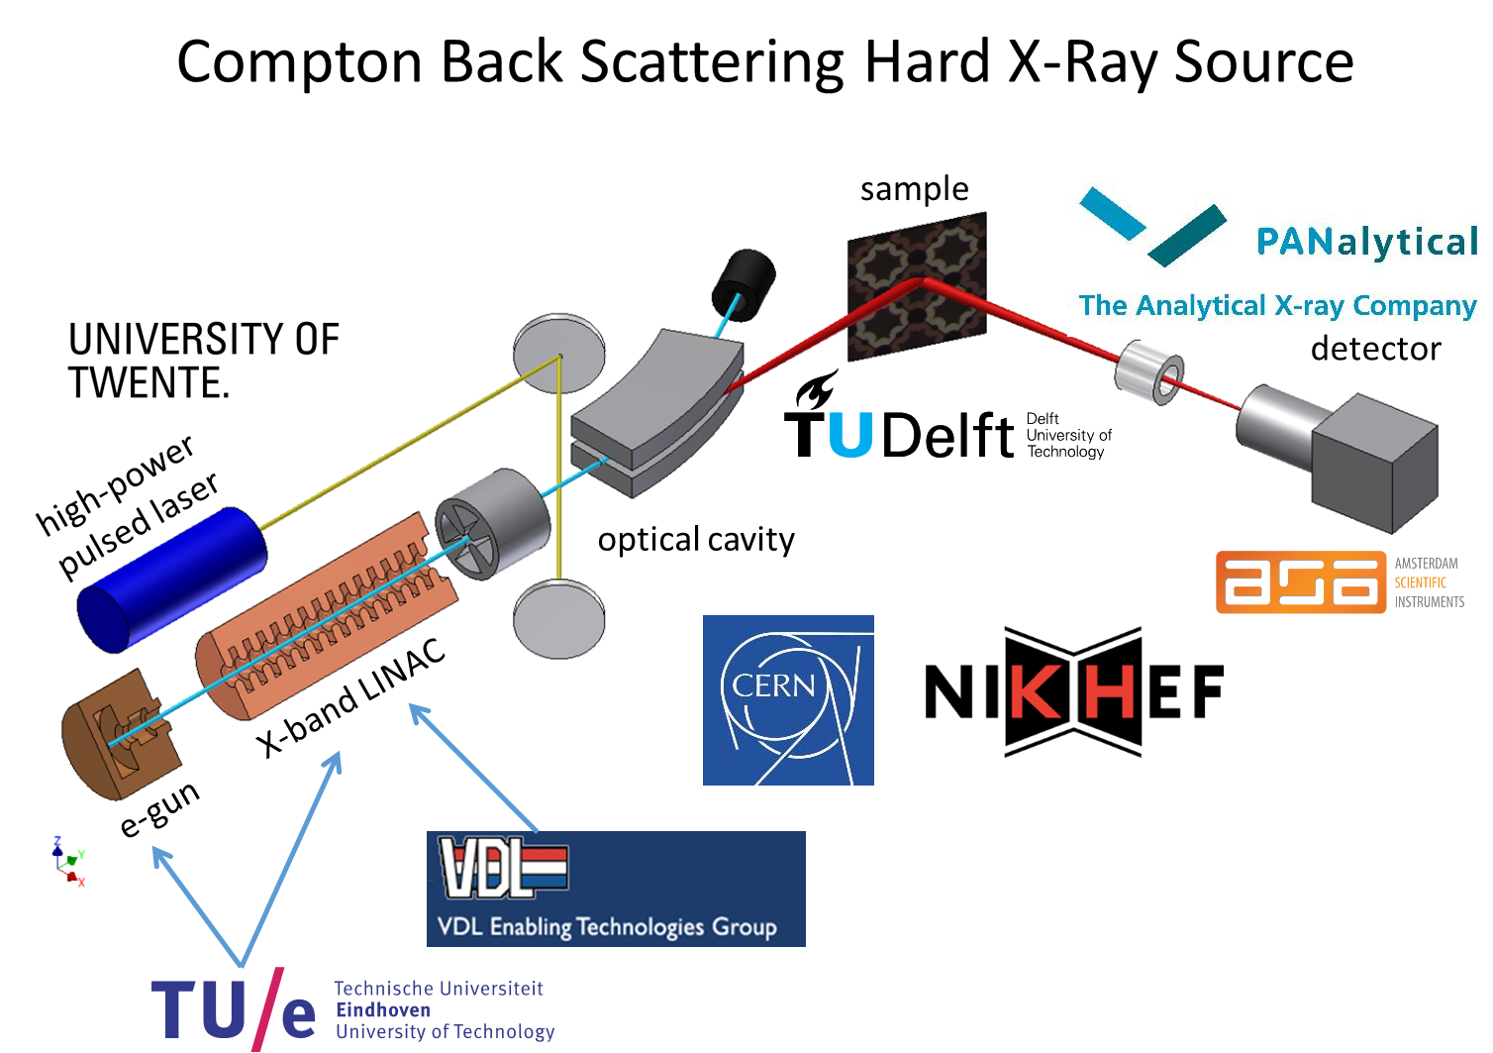
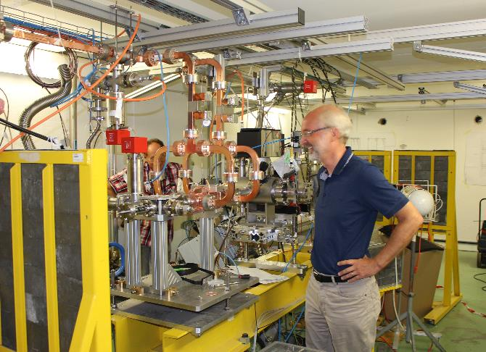
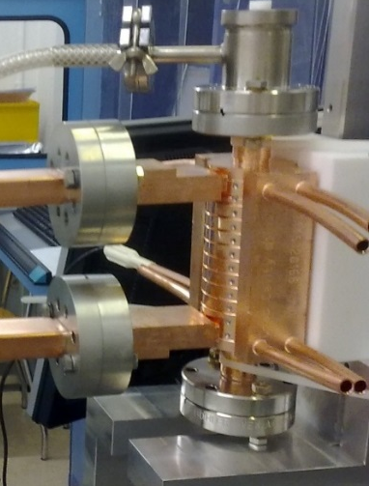
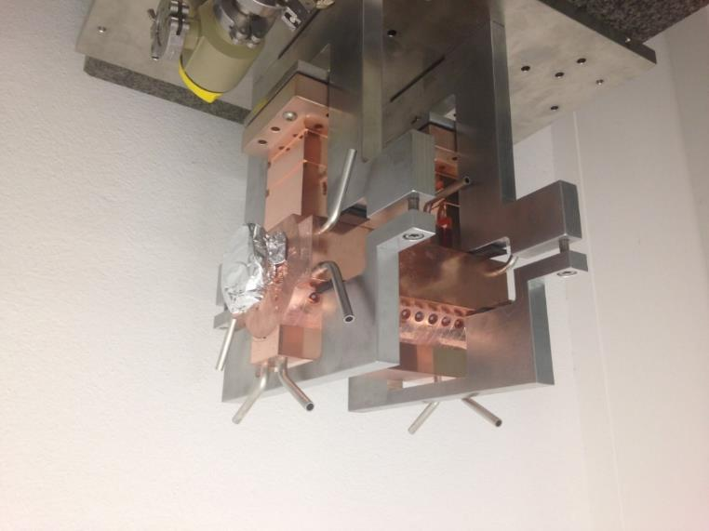
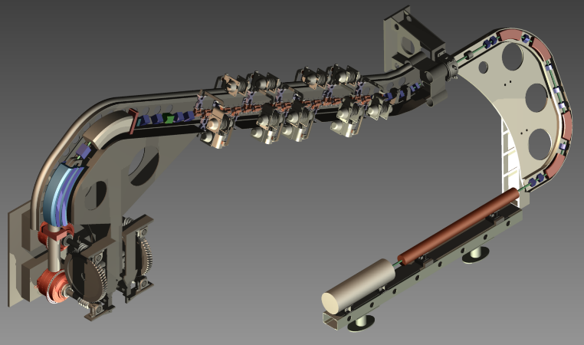
Selected collaborations on applications of X-band and high-gradient - continued
Trans-National Access for Xboxes in Aries (EUCARD3) proposal.
SMART*Light, Dutch proposal for compact Compton X-ray source.
Transverse deflector based on 50 MW klystron for SINBAD at DESY.
X-Band Thompson source energy upgrade at Tsinghua University.
Medical linac structures – TERA/KT and Lancaster/Cockcroft.
We gain experience with help and resources of other projects! For example XFEL-type accelerating structures are similar in gradient and iris aperture to CLIC 380 GeV structures.

Slide 18
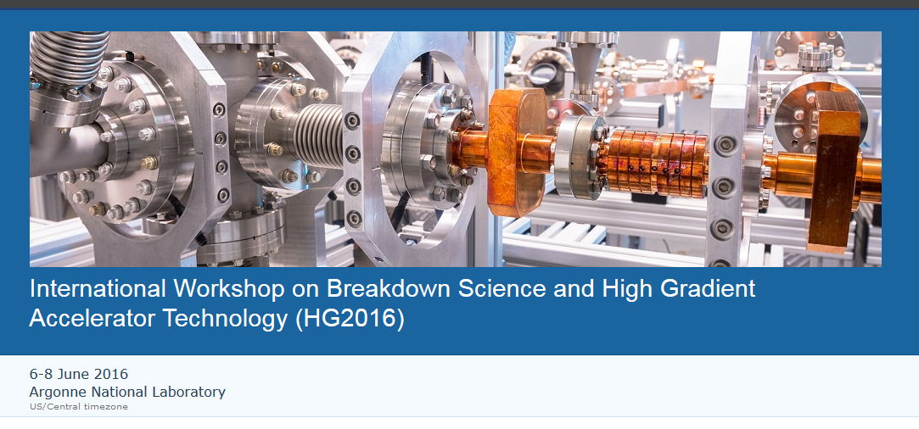
HG2016
https://indico.hep.anl.gov/indico/conferenceDisplay.py?ovw=True&confId=963

