Slide 1
Task 12.3.2
What modifications would be required for certain existing modulator models to have compatibility with different klystron models?
What would be required to support around 25% adjustment in klystron voltage and perveance?
Some modulator components are fixed as a function of required voltage and current, these would need to be either adjustable or easily replaceable
What would be the cost of the proposed changes?

Slide 2
Ongoing Activities
Discussions with modulator manufacturer regarding the required changes
Investigation in what modulator parameters which would potentially be deteriorated in order to support a larger range of klystrons
Currently mainly focusing on the following models:
Name Manufacturer Freq. [MHz] kV A Pmax Pavg
CPI VKX-8311A 11994.2 410 310 50 MW 5 kW
Thales TH2100C 2998 304 335 45 MW 20 kW
XL-5+ High Efficiency version of XL-5, Parameters Still Partly Unknown

Slide 3
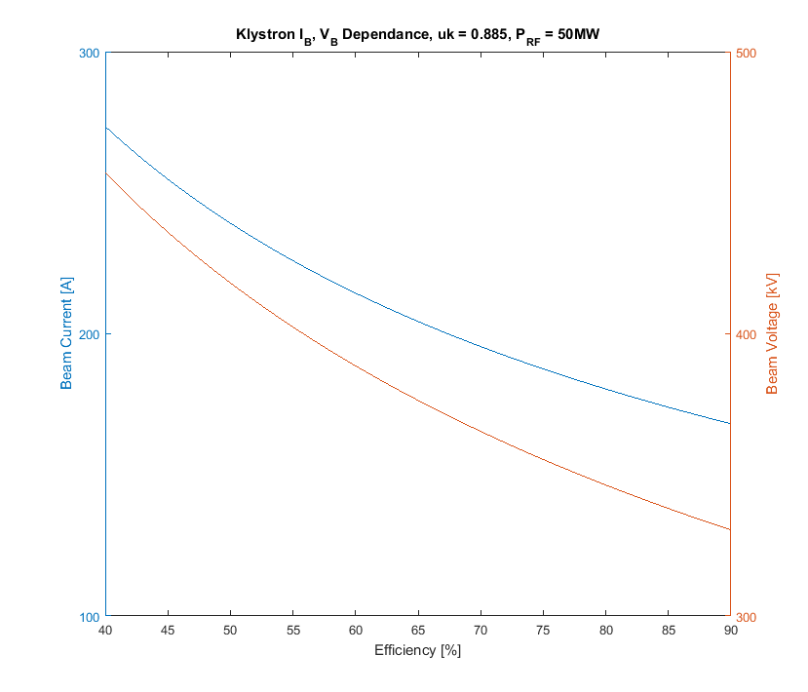
Parameter Uncertainty
High Efficiency version of the XL-5
Perveance will be lowered
Efficiency target is to raise by 25% to 90-95% from 65-70%
X-Box 2 uses the 50 MW XL-5 tube, what would the drive requirements be for 50 MW output if preveance is lowered?
How does this effect the modulator requirements?

