Slide 1

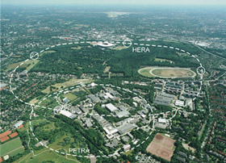





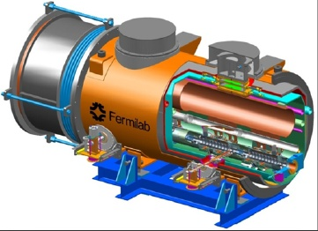
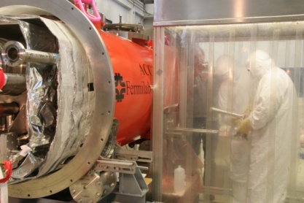
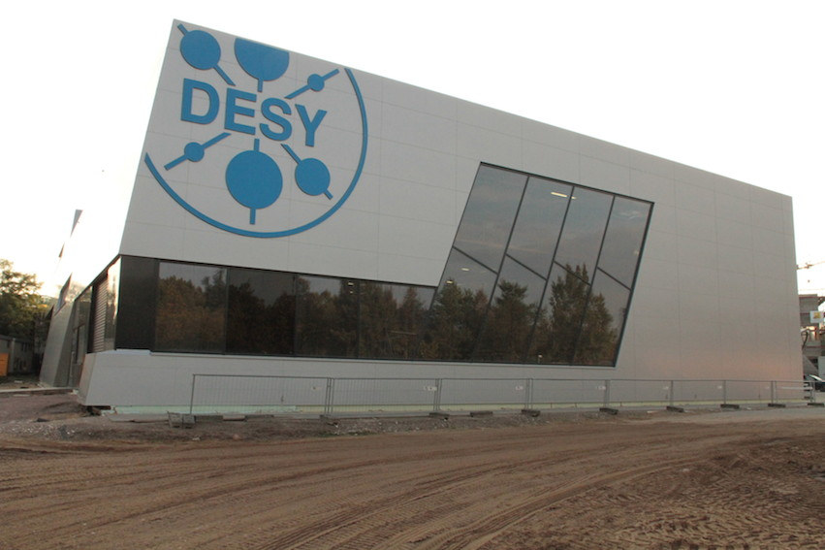
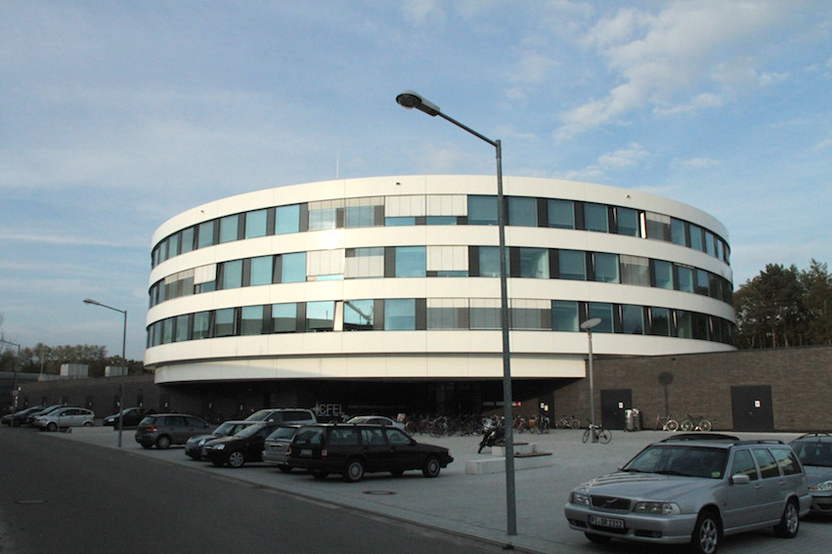

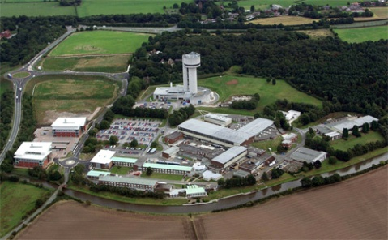
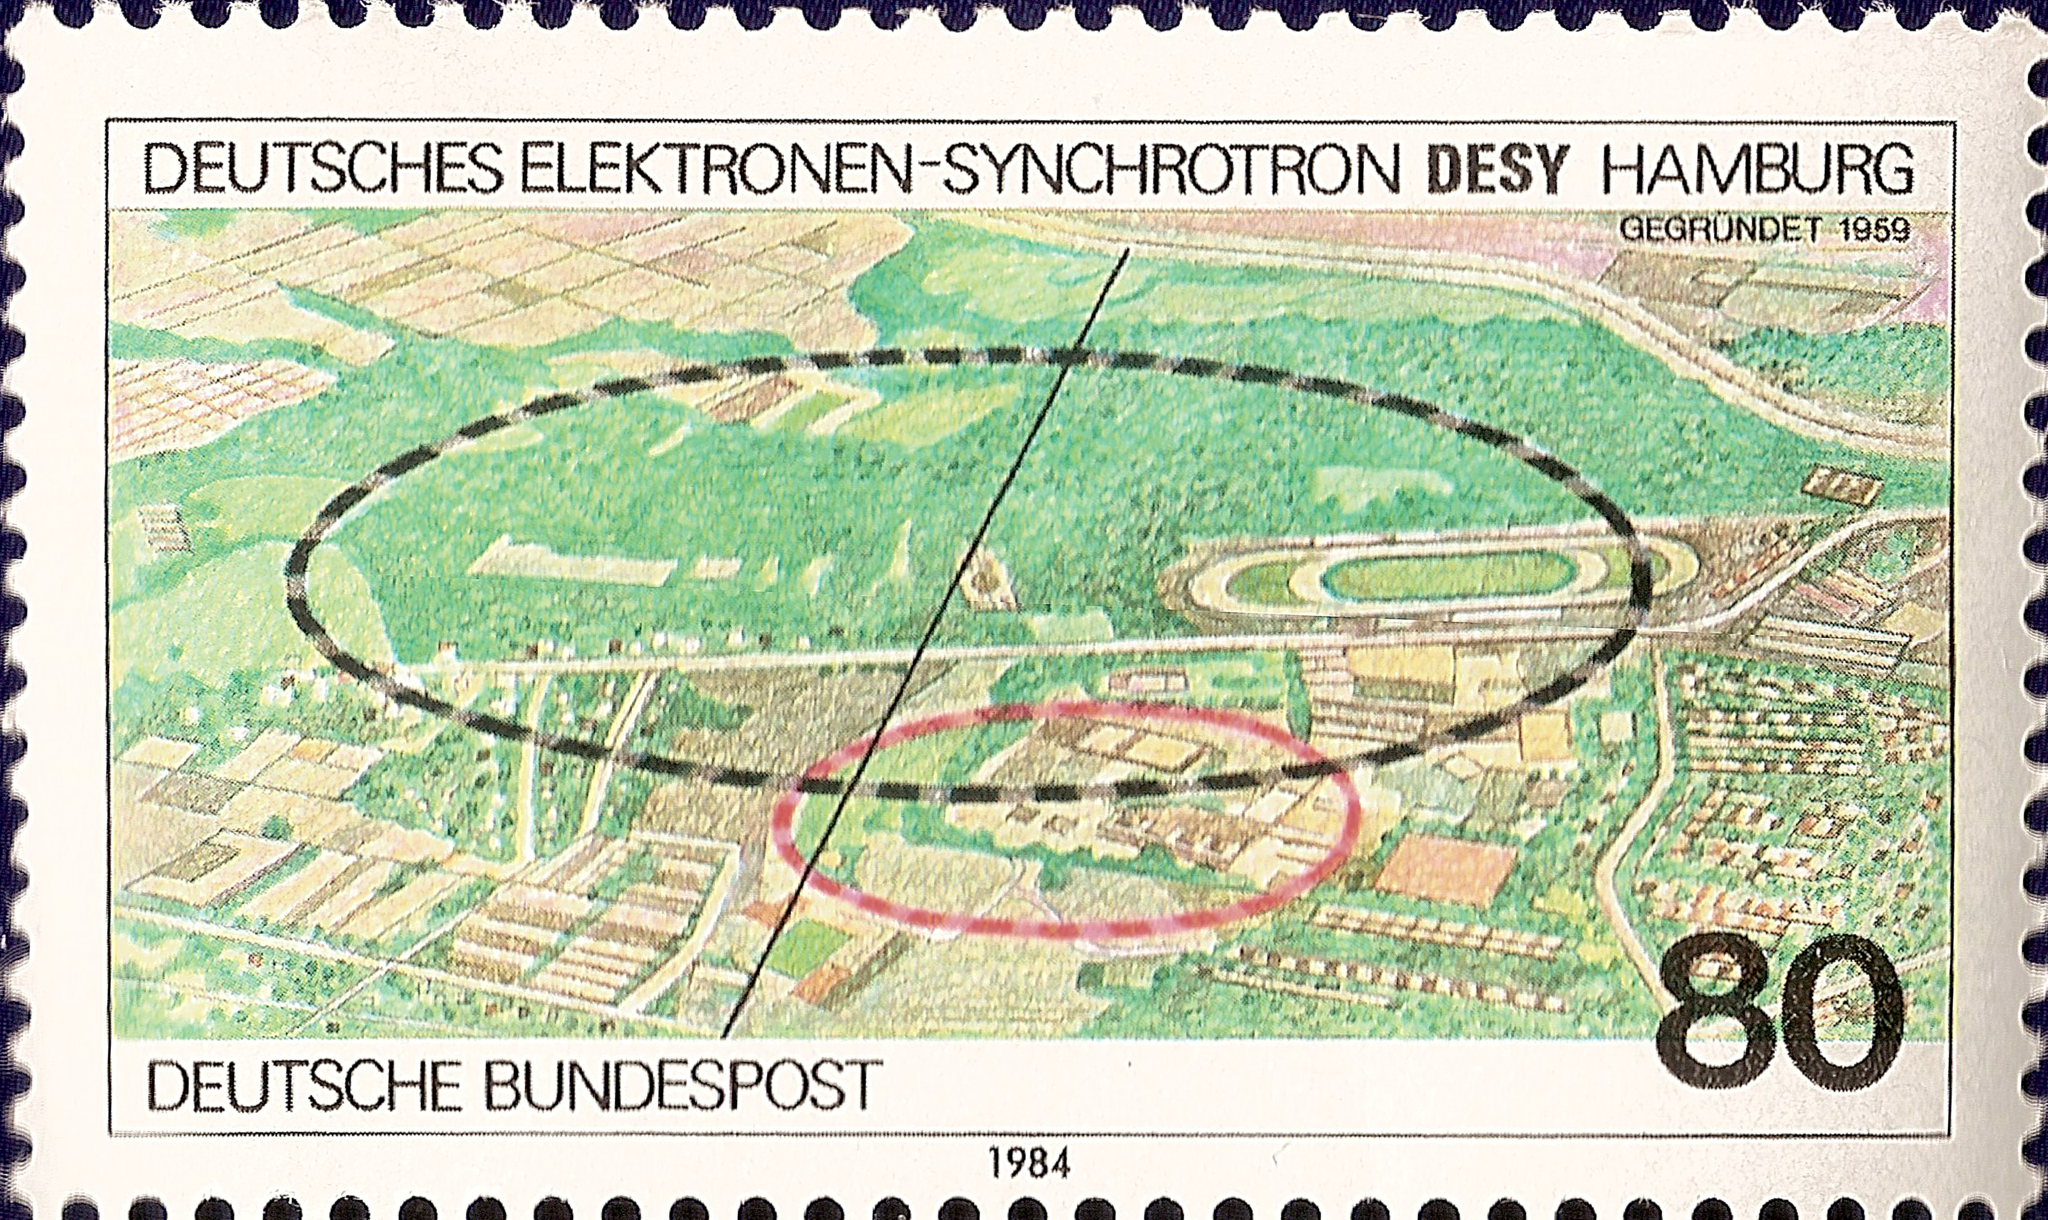
SRF HOM Diagnostics
for the European XFEL
Nicoleta Baboi, Ursula van Rienen
Roger M. Jones
DESY, Univ. of Rostock, Univ. of Manchester/ Cockcroft Inst.
https://indico.cern.ch/event/494553/overview

Slide 2
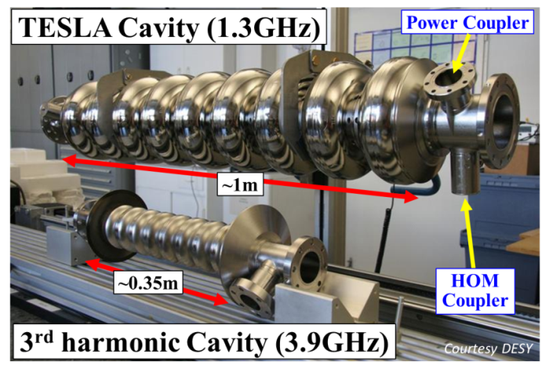
WP 12.4 SRF HOM Diagnostics for for European XFEL
TASK 12.4 | HOM Distribution | R.M. Jones
Sub-Task | Name | Coordinating Institute/Univ.
12.4.1 | HOMBPM | DESY
12.4.2 | HOMCD | Cockcroft/Univ. Manchester
12.4.3 | HOMGD | Univ. Rostock
Overall Aim
Beam phase (w.r.t. R.F.) and position within both 3.9 GHz and 1.3 GHz cavities
Potentially provides remote structure alignment
Transverse wakes are an issue! (~ ω³)
Four-year task due to staff resources commuted to Three years
N. Joshi, PDRA (grad. RHUL)

Slide 3


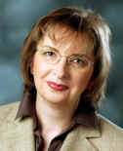
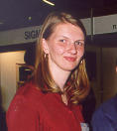
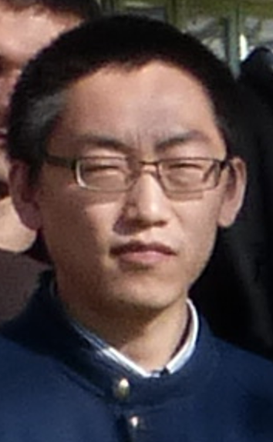
Task 12.4 HOM Diagnostics
in SC Accelerator Cavities -Staff
Sub-task leaders: Nicoleta Baboi (DESY), Ursula van Rienen (Univ. Rostock), Roger M. Jones (CI/Univ. Manchester).
P.D.R.A.s: N. Joshi (CI/Univ. of Manchester), Thomas Flisgen (Univ. of Rostock)
Ph.D.s: Liangliang Shi (DESY/Univ. of Manchester),
WP 12.4.1
WP 12.4.2
WP 12.4.3
N. Baboi,
DESY
L. Shi ,
Univ. of Manchester/DESY
N. Joshi,
CI/Univ. of Manchester
T. Flisgen,
Univ. of Rostock
U. Van Rienen,
Univ. of Rostock
Notes:
Samer Bou Habib (Poland) –Electronics for XFEL, Thomas Wamsat (DESY) -3.9 GHz electronics FLASH

Slide 4
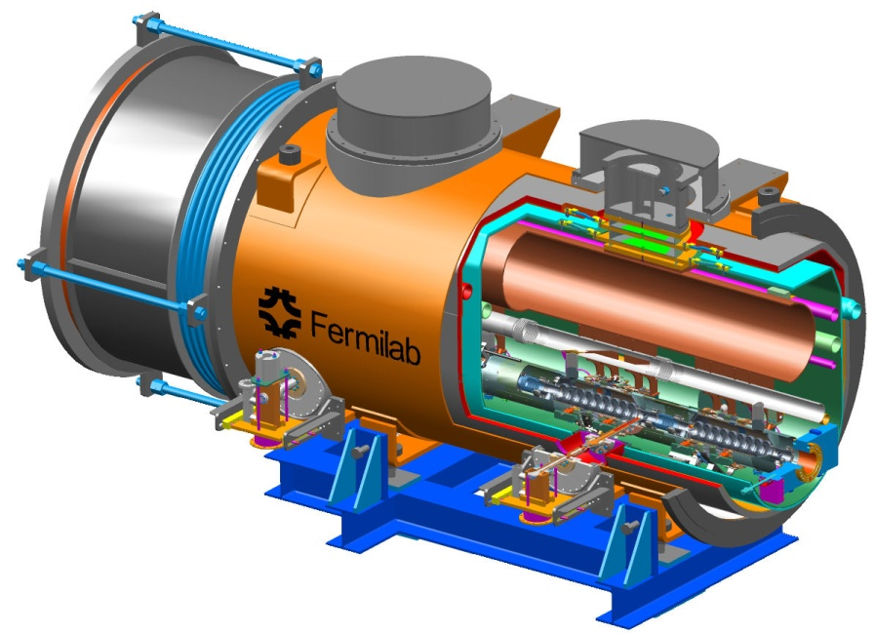
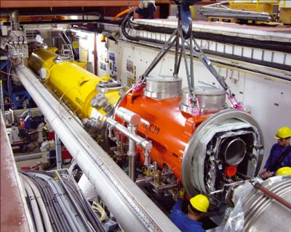
12.4 FLASH Third Harmonic Cavities
Fermilab has constructed a third harmonic accelerating (3.9GHz) superconducting module and cryostat for a new generation high brightness photo-injector.
This system will compensate the nonlinear distortion of the longitudinal phase space due to the RF curvature of the 1.3 GHz TESLA cavities prior to bunch compression.
The cryomodule, consisting of four 3.9GHz cavities, has been installed in the FLASH photoinjector downstream, of the first 1.3 GHz cryomodule (consisting of 8 cavities).
Four 3.9 GHz cavities provide the energy modulation, ~20 MV, needed for compensation.
Eight cavities are required per module for XFEL

Slide 5
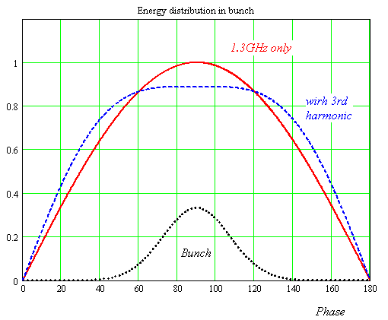
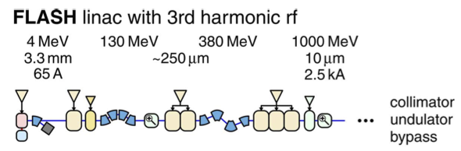

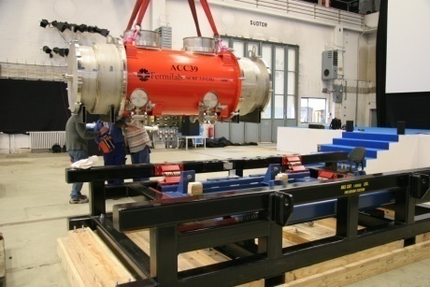
WP 12.4 FLASH 3.9 GHz Parameters
Illustrative energy (not to scale)
Number of Cavities | 4
Active Length | 0.346 meter
Gradient | 14 MV/m
Phase | -179º
R/Q [=U²/(wW)] | 750 Ω
E_{peak}/E_{acc} | 2.26
B_{peak} (E_{acc} = 14 MV/m) | 68 mT
Q_{ext} | 1.3 X 10⁶
BBU Limit for HOM, Q | <1 X 10⁵
Total Energy | 20 MeV
Beam Current | 9 mA
Forward Power, per cavity | 9 kW
Coupler Power, per coupler | 45 kW
Adding a harmonic ensures the 2nd derivative at the max is zero for total field (could use any of the harmonics in the expansion, but using the lowest freq. ensures the transverse wakefields ~ ω³ are minimised).
The third harmonic system (3.9GHz) compensates for the nonlinear distortion of the longitudinal phase space due to cosine-like voltage curvature of 1.3 GHz cavities.
It linearises the energy distribution upstream of the bunch compressor thus facilitating a small normalized emittance ~1.10⁻⁶ m.rad.

Slide 6
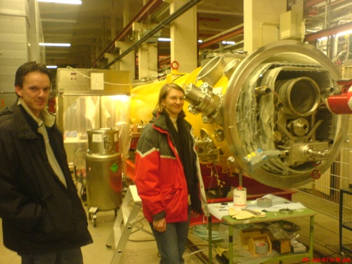
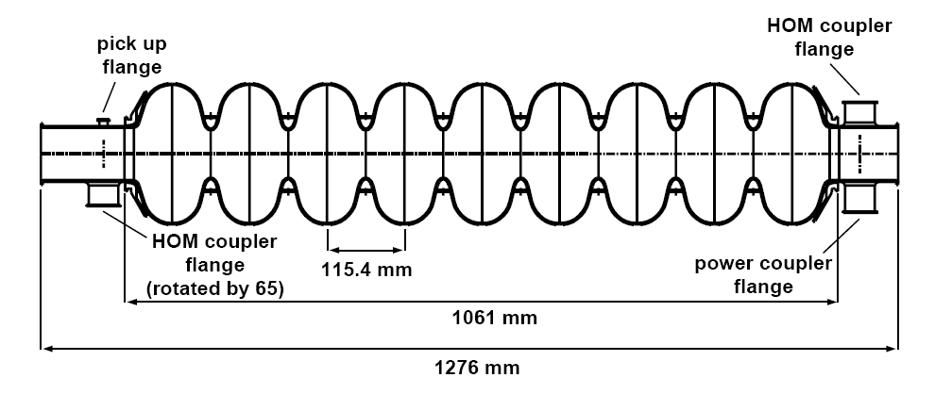
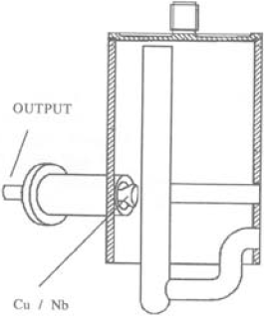
bunch compressors
bypass line
gun
undulators
FEL beam
ACC39
4 cavities within
3.9GHz Module
collimator section
dump
5 accelerating modules
with 8 cavities each
1.3GHz SC, typically 450-700MeV, 1 nC charge for FLASH/XFEL
HOMs generated in accelerating cavities must be damped.
Monitored HOMs facilitate beam/cavity info
Forty cavities exist at FLASH.
-Couplers/cables already exist.
-Electronics enable monitoring of HOMs (wideband and narrowband response).
Based on 1.3 GHz (SLAC/FNAL/DESY) Diagnostics –
The HOMS electronics were redesigned for ACC39 within FLASH as part of EuCARD
New diagnostics required for E-XFEL (EuCARD2)

Slide 7
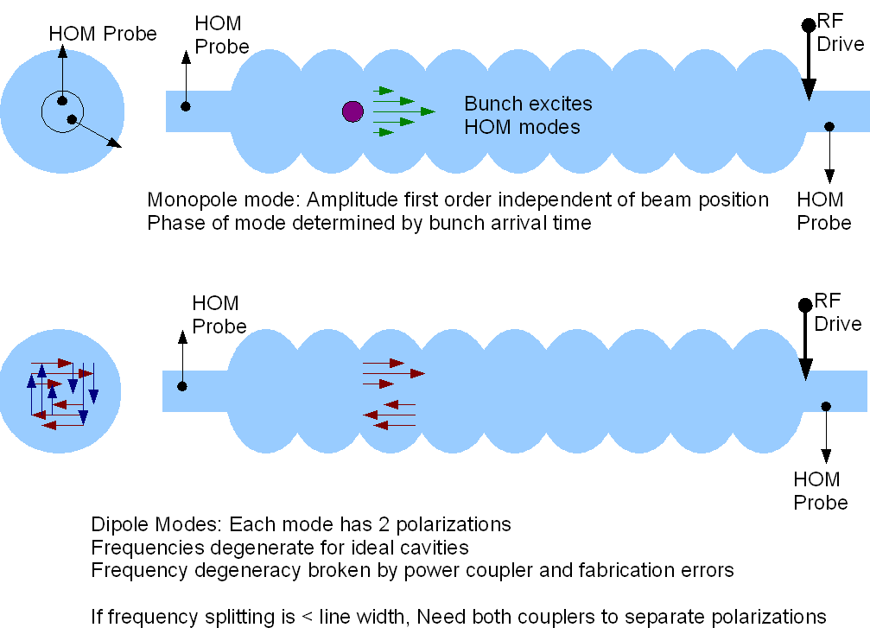
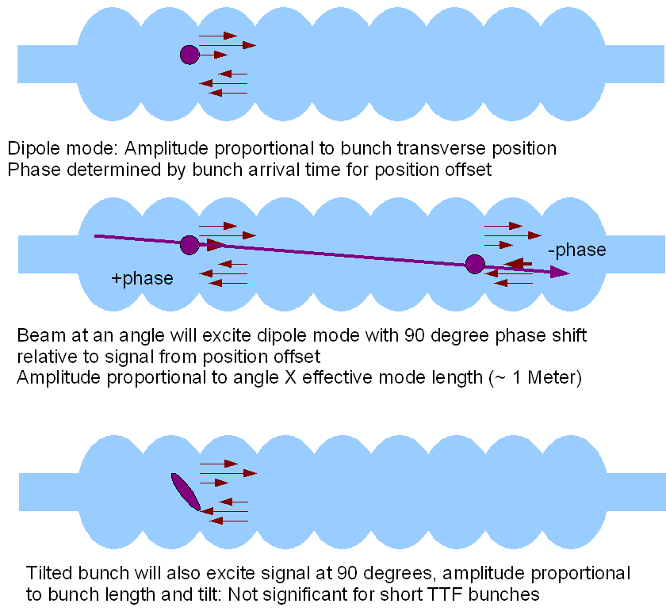
WP 12.4 Response of HOM
modes to beam

Slide 8
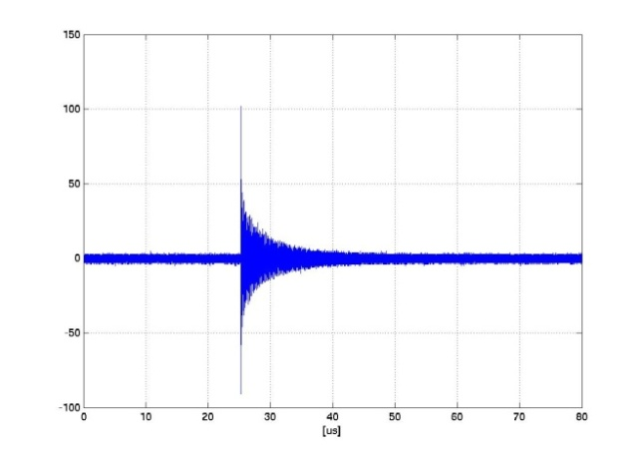
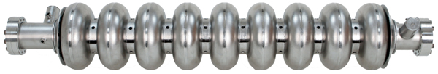
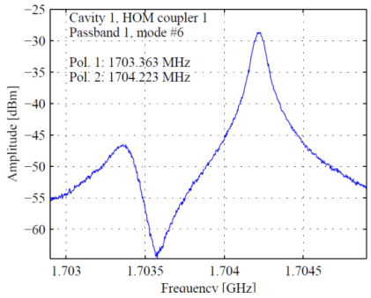
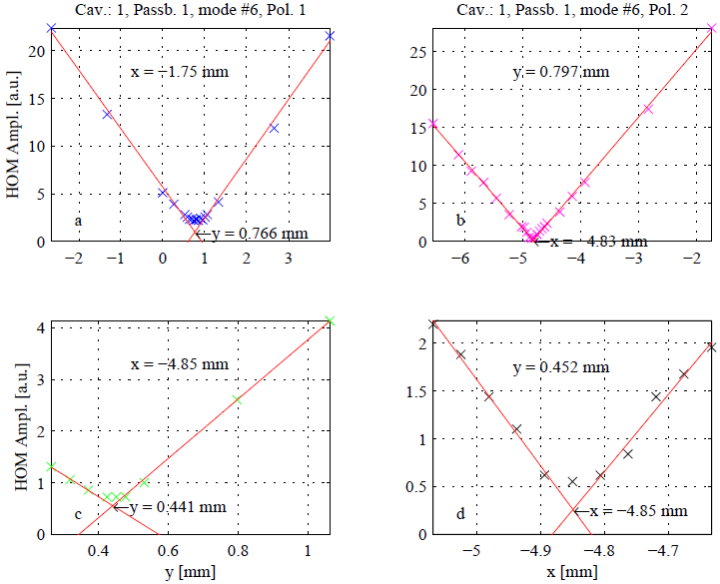
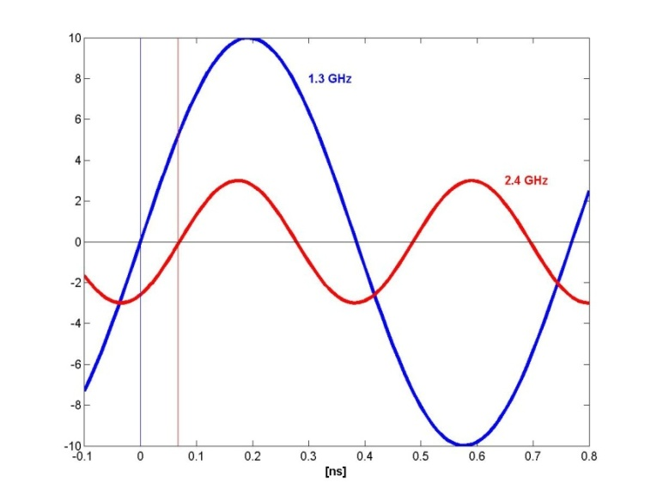
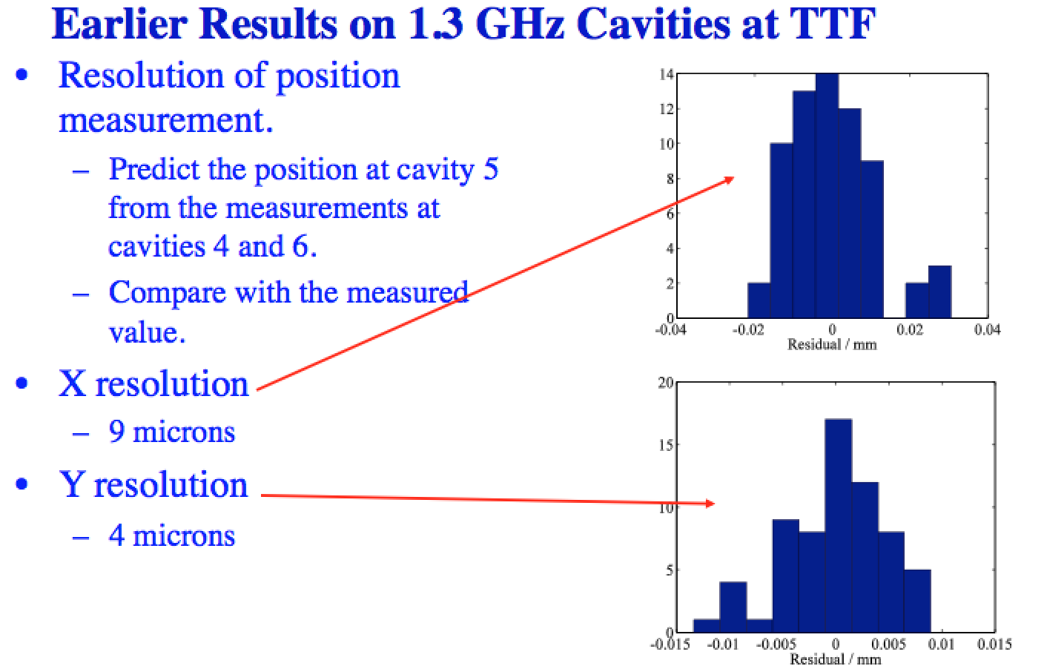
Principle: HOM-based Beam Position and Phase
WP 12.4 Analysis of Narrowband Signals – Beam Position and Beam Phase
e⁻
e⁻
Filter higher dipole mode for
beam position
Filter higher monopole mode for beam phase
×
Beam offset [mm]
Phase difference
Beam Position
Monitor (BPM)
Beam Phase Monitor (BPhM)

Slide 9
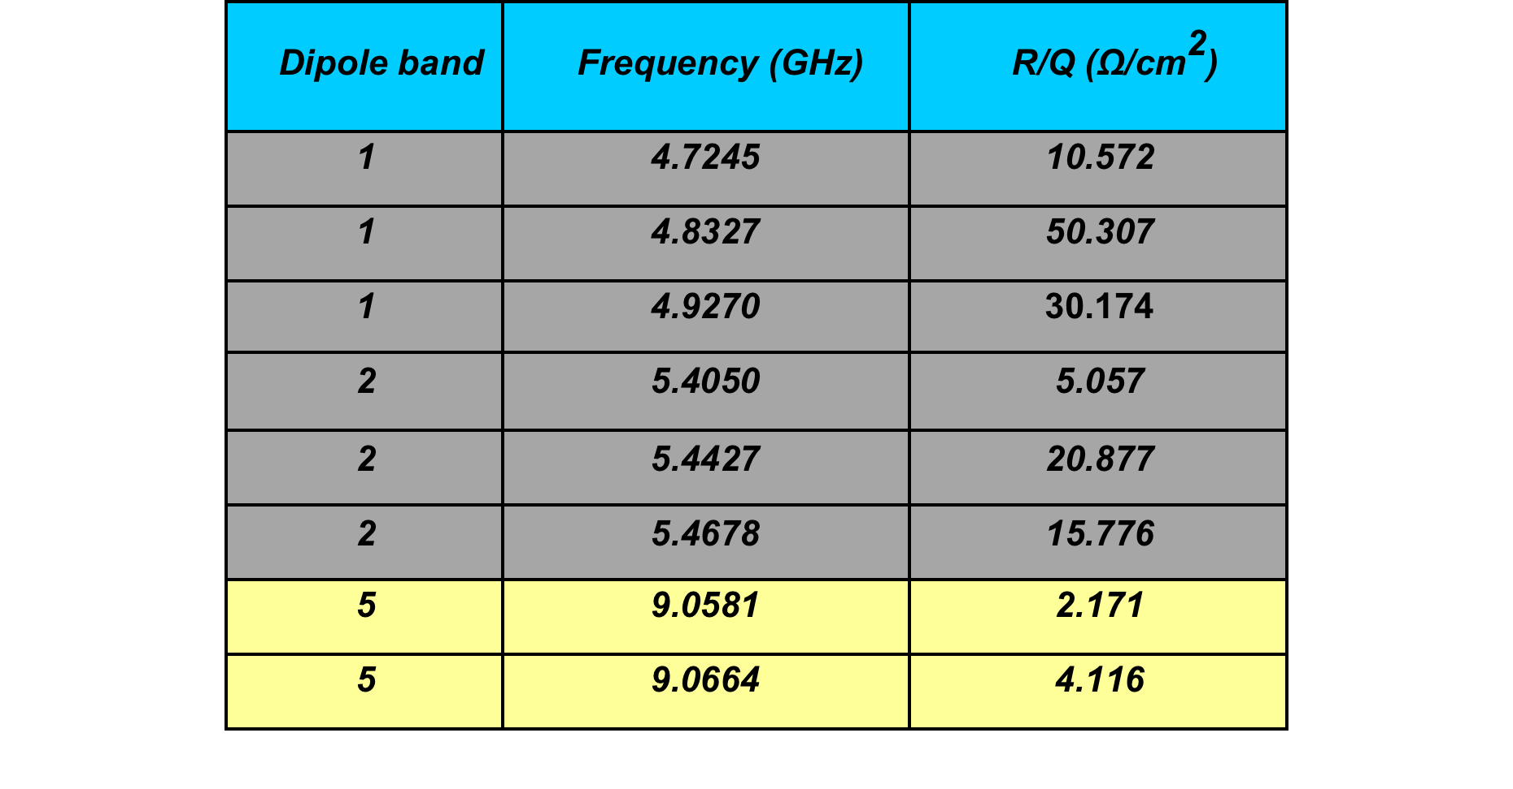
12.4 Band Structure of HOMs
in 3.9 GHz Cavities
Coupled Cavity
Modes
RESOLUTION
x ~ 12 μm , y ~40 μm
(FLASH Module mode
at 5 GHz)¹
Trapped Cavity
Modes
x ~ 50 μm , y~ 100 μm
(FLASH Cavity mode
at 9GHz)¹
C.F. 1.3 GHz
Cavity Modes
x ~ 9 μm , y~ 4 μm
(FLASH 1.3 GHz cavities)²
Baboi et al, IBIC 2014
Molloy et a., PRST-AB 2006

Slide 10
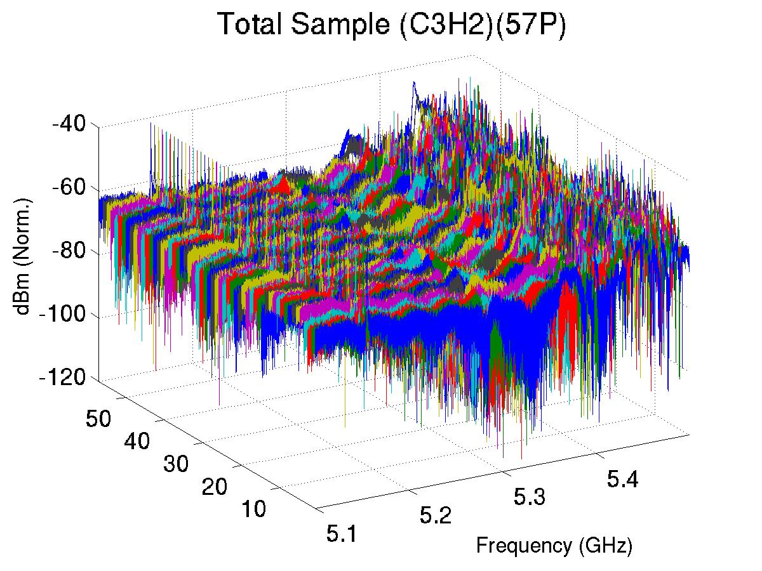
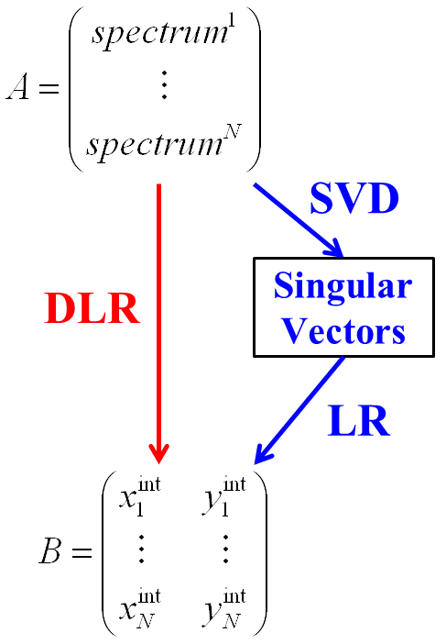
WP 12.4 Principle of HOM BPMs: DLR & SVD
2nd dipole cavity band
Direct Linear Regression (DLR)
Singular Value Decomposition (SVD)

Slide 11
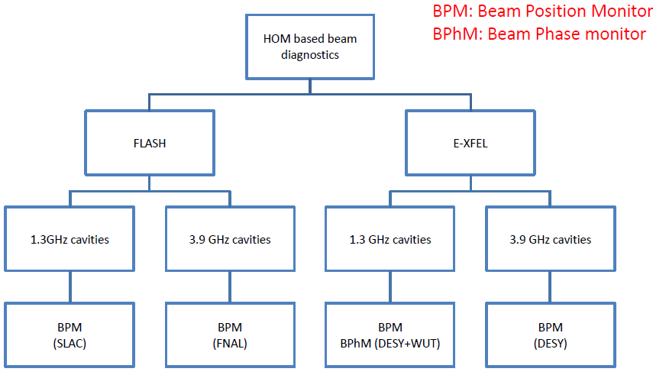
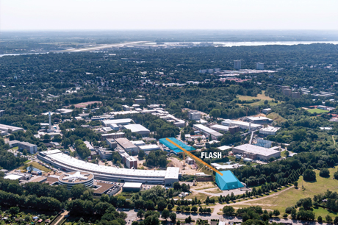
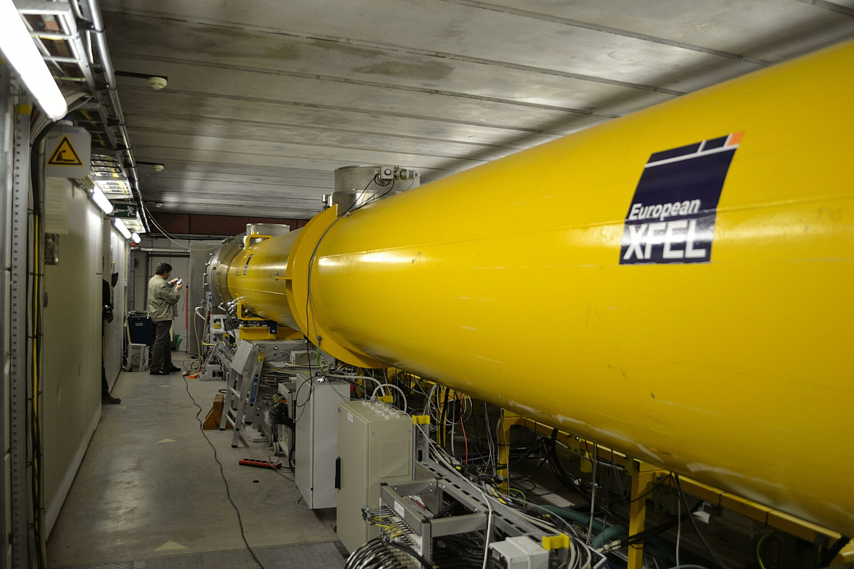

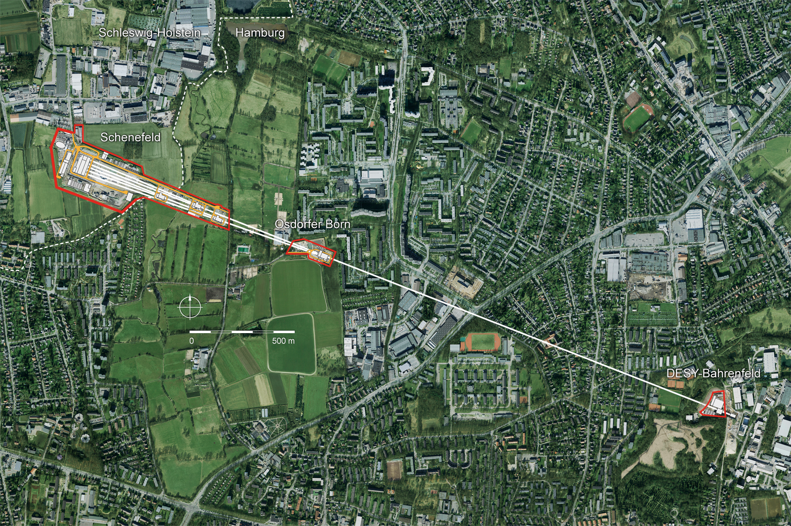

Overview of HOM-based Diagnostics
WP 12.4 Response of HOM
modes to beam EuCARD -> EuCARD2
EuCARD2

Slide 12
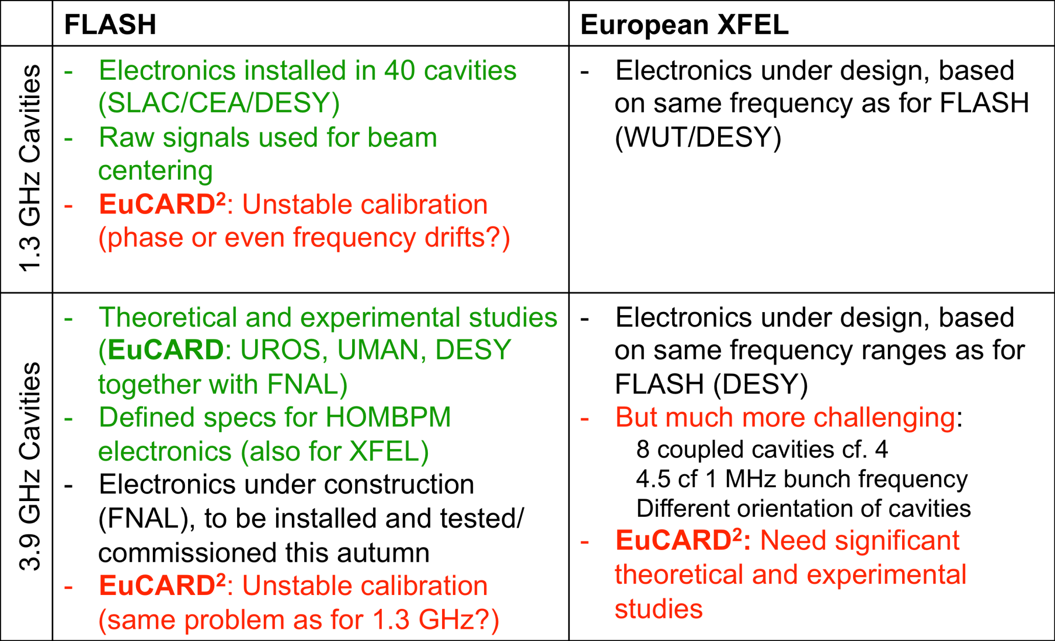
12.4 Summary of Plans and Status of HOM Position Diagnostics

Slide 13
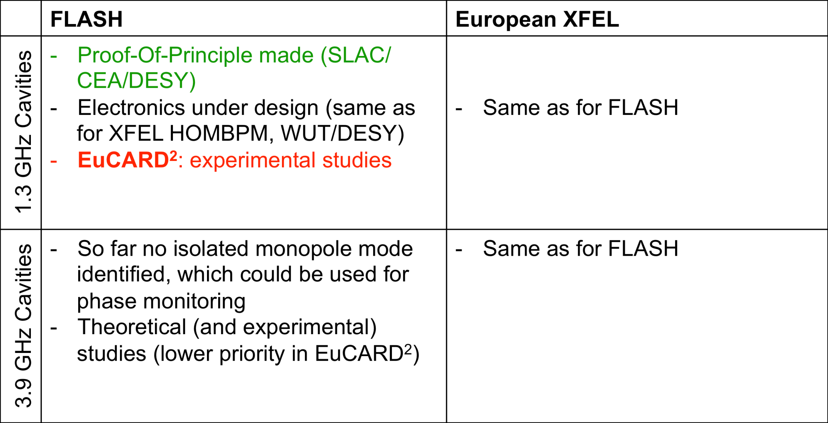
12.4 Summary of Plans and Status of HOM Phase Diagnostics
See WP12.4.1 talk by L. Shi/N. Baboi

Slide 14
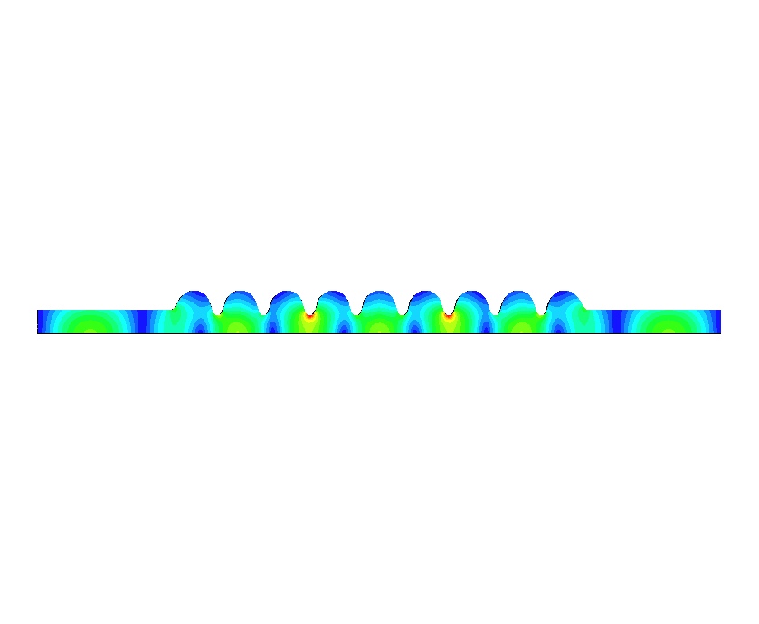
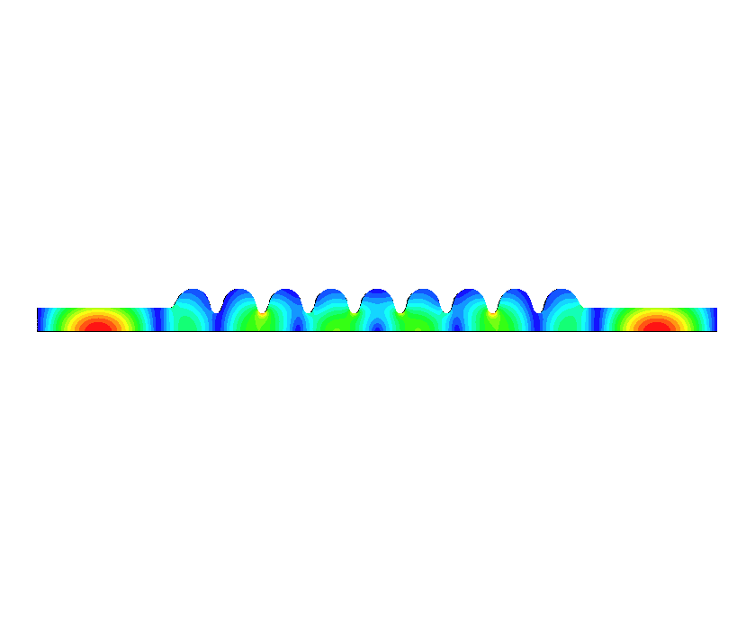
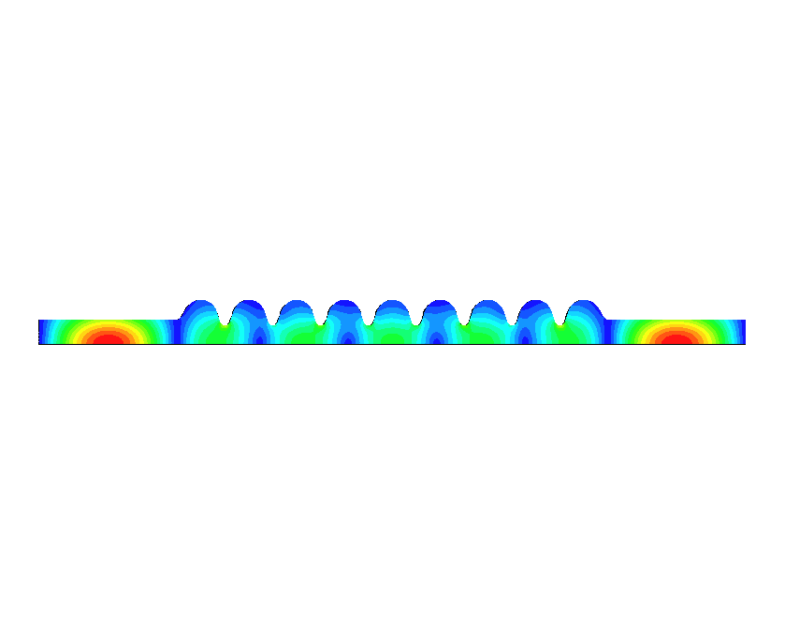
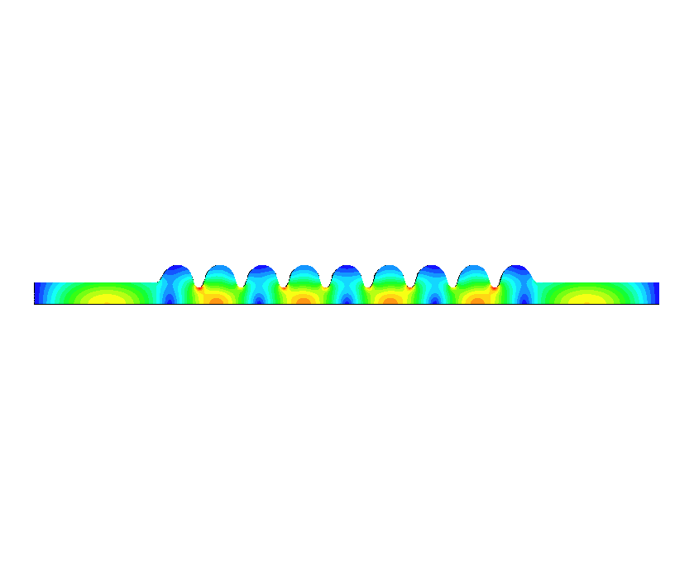
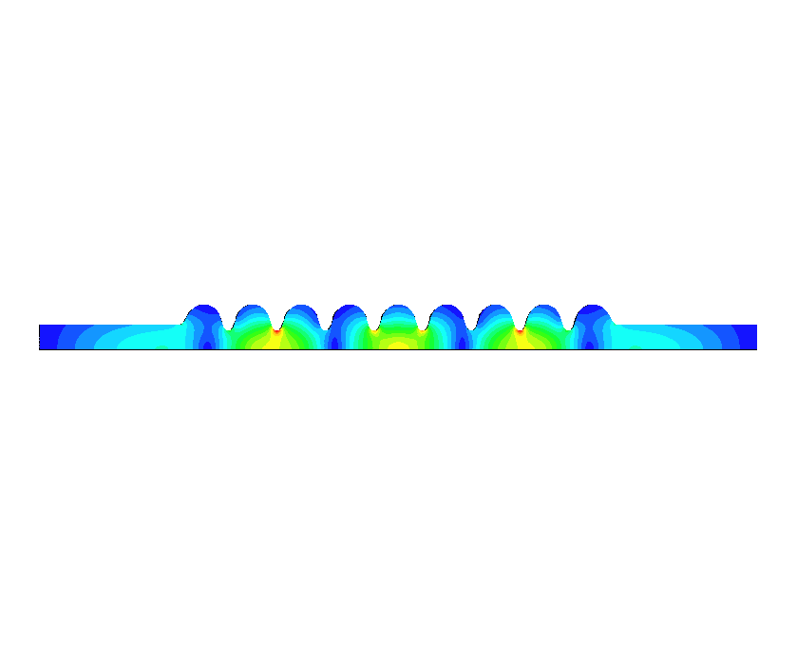
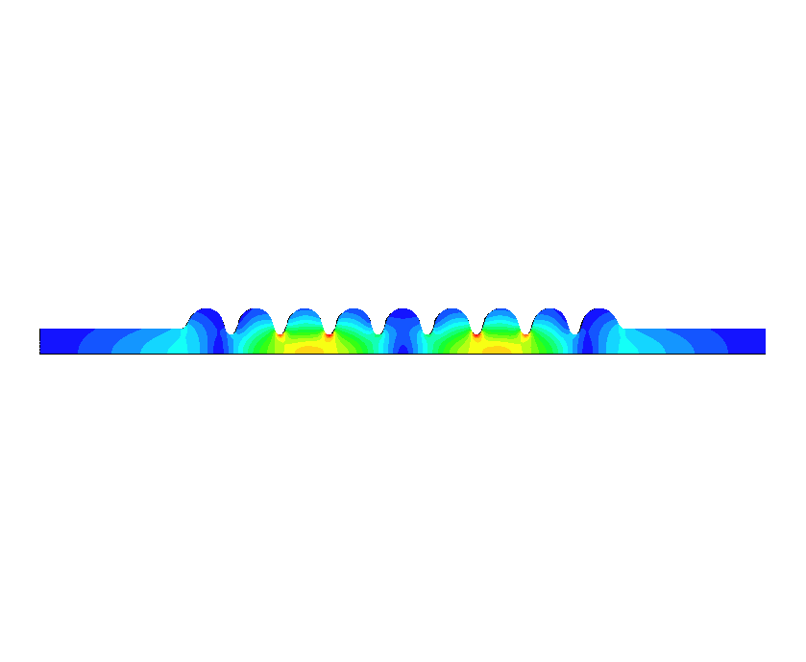
12.4 HOMs in 3.9 GHz SC Cavities
Cavity modes up to 10GHz –allows identification of potential trapped modes and modal types, monopole, dipole, quadrupole and sextupole
Contains all 6 cavity dipole bands below 10GHz
HFSS results agree well with by MAFIA simulations
E-field distribution | ω/2π (GHz) | Band type | R/Q: Ω/cm²
 | 4.2953 | D Band 1 #1 EE | 0.00
 | 4.3580 | D Band 1 #2 EE | 0.29
 | 4.4460 | D Band 1 #3 EE | 0.00
 | 4.5388 | D Band 1 #4 EE | 1.08
 | 4.5972 | D Band 1 #5 EE | 0.79
 | 4.6399 | D Band 1 #6 EE | 0.16
Modes within the modules can be inter-cavity, beam pipe or trapped
Majority within the first six passbands are inter-cavity –computationally expensive and sensitive to small geometrical perturbations!
We require characterization of a limited number of modes for HOM diagnostics (large R/Q desirable)

Slide 15
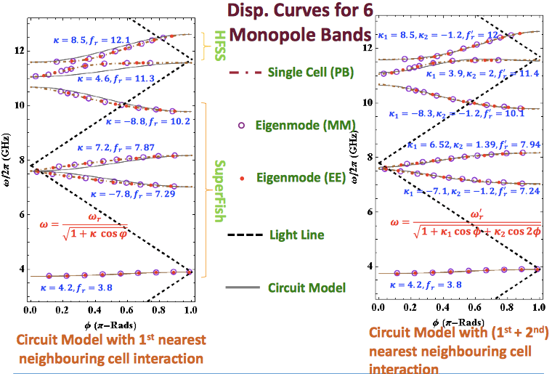
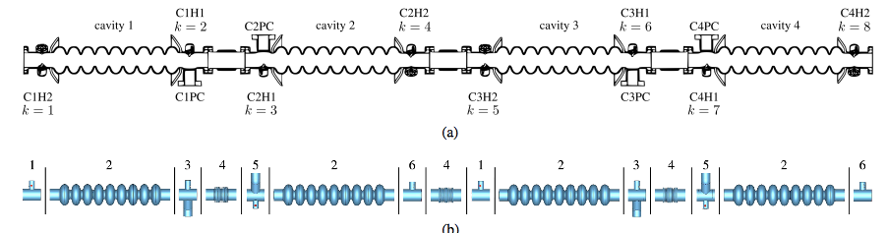
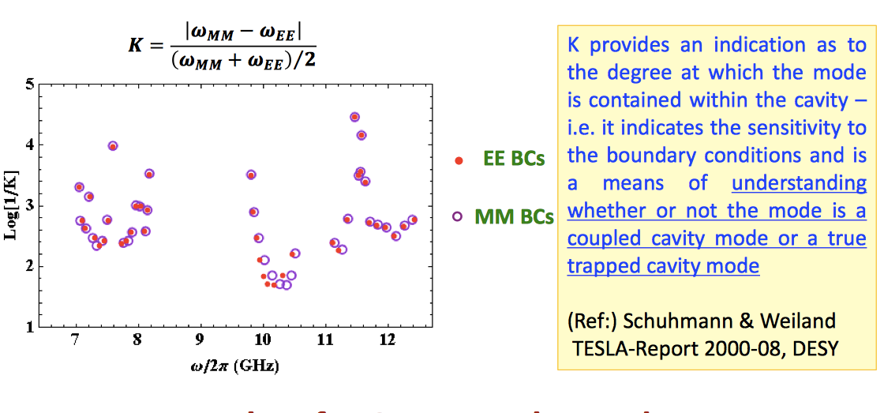
WP 12.4 Mode Characterisation
Modes of passbands have been characterised to aid diagnostics
P. Jain WP 12.4.2

Slide 16
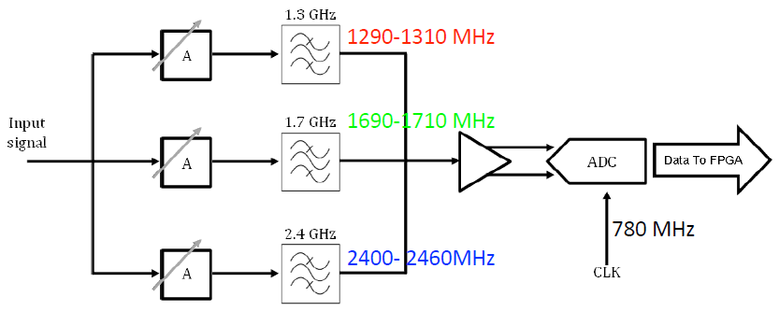
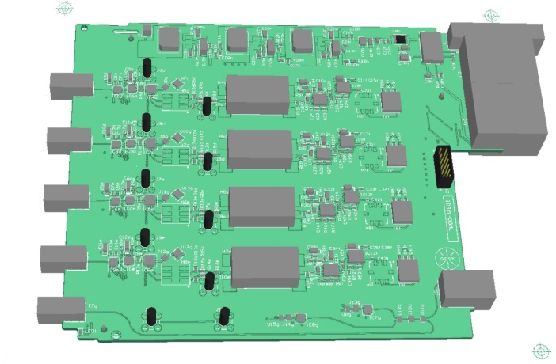
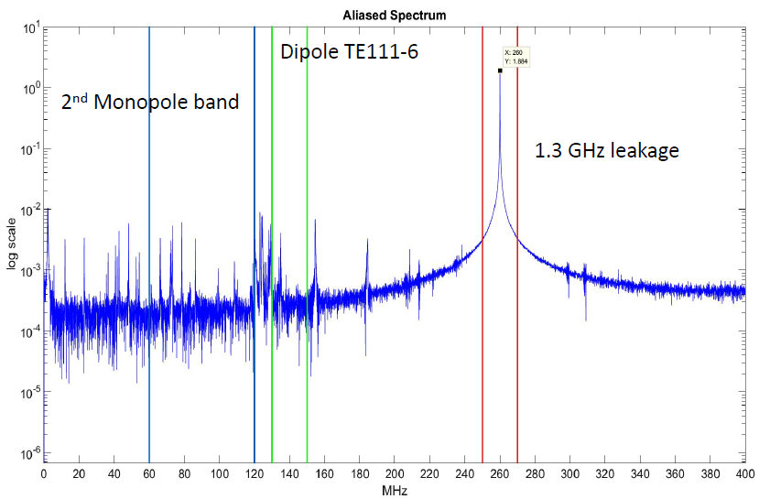
Sub-Task 12.4.1: Progress and Plans:
Electronics for E-XFEL Cavities
WP 12.4 Repeatability Measurements on 1.3 GHz HOMBPMs
Initial beam with test electronics for 1.3 GHz cavities
  Identified monopole and dipole mode regions
  Prototype electronics being fabricated (Samer Bou Habib –WUT & DESY)
Redesign of non-functioning 5 GHz electronics for 3.9 GHz cavities complete (see M18 report)
  Boards under construction (Thomas Wamsat –DESY)
Notes:
Deliverable electronics being redesgined (library error in addition to bad solder joint) -> architecture redesign

Slide 17
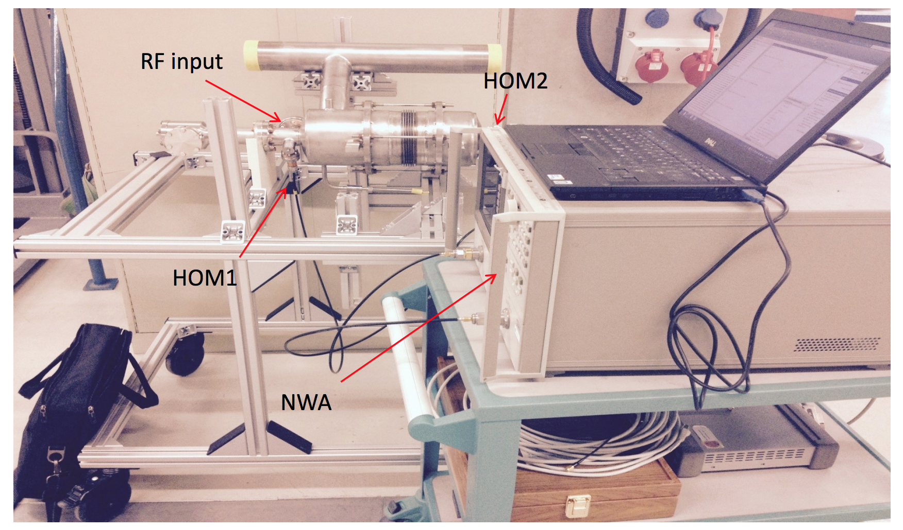
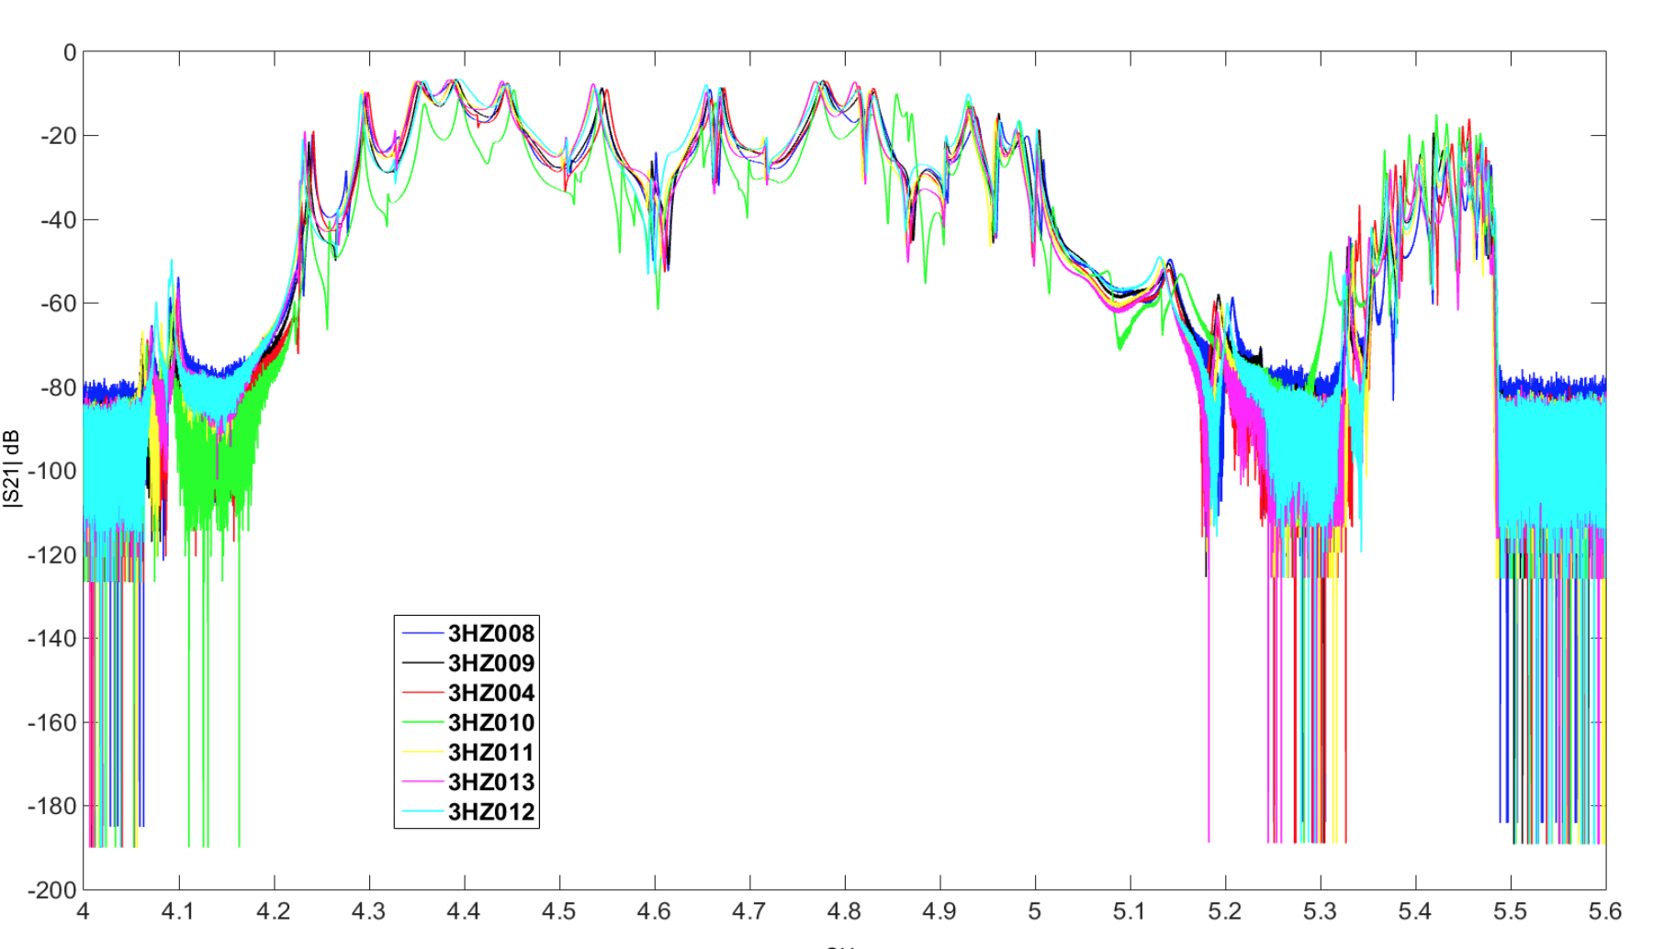

Sub-Task 12.4.1: Progress and Plans:
Measurements of E-XFEL 3.9 GHz cavities
WP 12.4 Summary of Transmission Measurements on Third Harmonic Cavities
Measured (L. Shi & N. Baboi) S21 for seven out of the eight 3.9 GHz cavities needed for XFEL modules
  Room temperature measurements of S21 (sans final input coupler)
  3HZ010 has an input coupler and was also measured at 2K
  These measurements may shed some light on subsequent measurements to be performed on the 8 cavities with a module (coupled cavity spectrum)
Next steps:
  Measure S21 for cavities in string (at room temperature and at 2K)
  Measure S21 for reserve 3.9GHz cavities (and later for 2nd injector)
2nd Dipole Band
5th Dipole Band
Each colour represents
a different cavity
See WP12.4.1 talk by L. Shi
Notes:
Measured 7 out of 8 –measured one cold. Hence different HOM characteristics. Two more cavities arriving in the next two months?

Slide 18



WP 12.4 Measurements on S-Matrices through 3.9 GHz 8-Cavity Module
Transmission measurements at 293 K and 2 K. (see L. Shi’s talk) -ports terminated with 50 Ω loads
Dense spectrum of coupled modes
Transmission through Complete Module
Transmission through Sections of Module
--Single Cavity
--8 Cavities
--Room Temp (290K)
--SC (2K)

Slide 19





WP 12.4 Simulations of S-Matrices and Eigenmodes through XFEL
3.9 GHz 8-Cavity Module
CSC –to State Space Concatenation (SSC)
–see T. Flisgen’s talk
Globalised Scattering
Matrix (GMS)
–see N. Joshi’s talk
05.04.2016
T. Flisgen, J. Heller, and U. van Rienen UNIVERSITÄT ROSTOCK
19

Slide 20



WP 12.4: Experimental Measurement of S₂₁ vs GSM Simulations in 8-Cavity XFEL Chain
Cavity-1 HOM1 to Cavity-2 HOM2
First comparison of HOM spectrum from 8 cavity module AH1 at 2K (see N. Joshi’s talk) In this initial simulation some parameters were modified to aid comparison:
-bellows excluded to enable rapid calculation
-attenuation in cables, transitions etc accounted for by rescaling ordinate
beam pipe reflections accounted for by 45 MHz & 25 MHz rescaling of 1st and 2nd bands
--Experimental measurement
--GSM Simulation
Cavity-1 HOM1 to Cavity-4 HOM2

Slide 21


WP 12.4 R/Q Calculations for Complete 3.9 GHz 8-Cavity XFEL Module
SSC calculation. Dense spectrum of modes (see T. Flisgen’s talk)
Minimal mode separation –HOMBPM design difficult
monopole bands
dipole bands
quadrupole bands
05.04.2016
T. Flisgen, J. Heller, and U. van Rienen UNIVERSITÄT ROSTOCK
21

Slide 22

WP 12.4 S₂₁ of HOMs in
3.9 GHz Cavities at FLASH
Using concatenation techniques transmission through the complete FLASH module ACC39 is possible- using Coupled Scattering Calculation (CSC)
Accurately compute each section
Concatenate for complete module

Slide 23
Deliverables & Milestones
All taken from:
Deliverables (http://eucard2.web.cern.ch/science/deliverables)
Milestones (http://eucard2.web.cern.ch/science/milestones)
Deliverables
D12.3 Design of electronics for XFEL HOM diagnostics (M18 –complete)†
D12.7 Characterisation of HOMS in the 8-cavity XFEL module (M36)†✓
D12.4.1 Additional Report on characterisation of HOMS in XFEL coupled 3HC cryomodule (M48 –April 2017 )‡
Milestones
MS82 Completed coupled cavity simulations of 8-cavity module (M36)
†Commuted from milestones
‡ Original deliverable
✓ On track

Slide 24


Concluding Remarks on Task 12.4
Ongoing measurements (both parasitic and otherwise) on HOM diagnostics at FLASH provide vital information on methodology for XFEL
Stand-alone S21 measurements on 3rd harmonic cavities indicate similar spectra
Simulation of 4 coupled cavities was challenging -8 in the XFEL module is even more computationally demanding. Initial results e-field encouraging!
A compendium of modes will be generated for the 8-cavity chain within modules in XFEL
On track for deliverables/milestone. Had several skype meetings to review progress to date.
Publication highlights: PRST-AB paper 2014 (T. Flisgen et al, Scattering parameters of the 3.9 GHz accelerating module in a free-electron laser linac: A rigorous comparison between simulations & measurements). + Ph.D. Published as a EU Monograph -Vol. 33, Oct 2015 + Accel. News article June 2015 (N. Baboi + M. Dehler) on wakefield HOM monitors. Several IPAC06 + Linac06 papers
HOMSC16 August 2016 will be held at the Univ. of Rostock (http://indico.cern.ch/event/465683/)

Slide 25
Workshop on HOMs in SC Cavities
HOMSC16 at Univ. of Rostock
Dates: Aug 22-24, 2016
Early Reg June 25th, 2016
Papers published as NIMA special issue?
Contact Thomas Flisgen for further details!

Slide 26
Task 12.4 Talks
Overview of SRF HOM Diagnostics for the European XFEL task,
R.M. Jones (University of Manchester/Cockcroft Inst.)
HOMBPM: Measurements of FLASH and XFEL Cavities,
L. Shi (DESY/University of Manchester), N. Baboi (DESY)
HOMCD: Characterisation of HOMs in FLASH and XFEL Coupled Cavities using GSM, N. Joshi, R.M Jones (University of Manchester)
HOMGD: Progress On SCC Simulations in FLASH and XFEL Cavities, T. Flisgen, U. Van Rienen (University of Rostock)

