Slide 1
WP 12.3.3
Electrico-optical front end for wake field monitors – current state
M. Dehler, M. Leich
Paul Scherrer Institut
CH-5232 Villigen PSI, Switzerland
Notes:
^{<Foliennummer>}
^{<Foliennummer>}

Slide 2
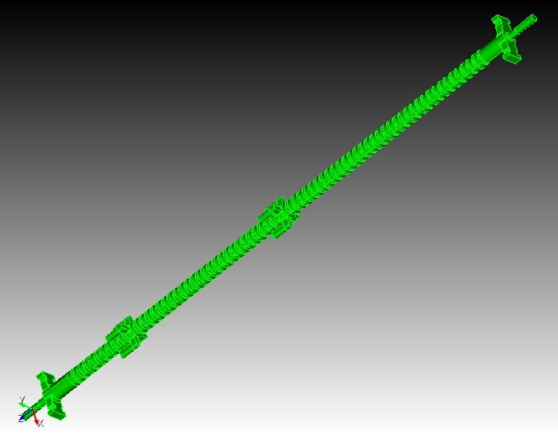
WFMs in the CLIAPSI X band structure
Constant gradient design: dipole band spread out in frequency.
Frequency of interaction correlated with position inside structure, low frequencies upstream, high ones downstream
Dipole modes don‘t extend over full length of structure
Big Advantage: Spectrum also contains information about tilt and internal misalignments (got 72 cavity BPMs in this structure!)
Minimum WFM signal == minimum emittance dilution!
Beam
Upstream WFM: receives offset signals of upstream half
Downstream WFM: receives offset signals of downstream part (ca 35% of structure)
Notes:
^{<Foliennummer>}

Slide 3
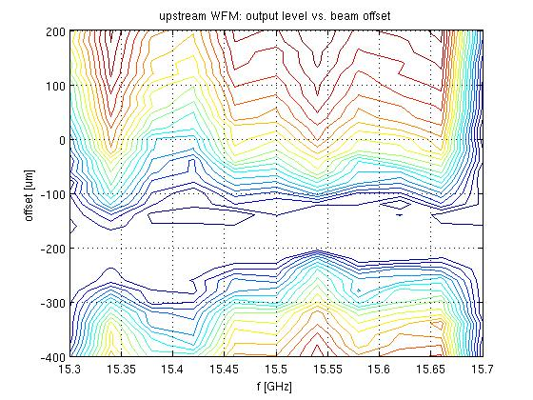
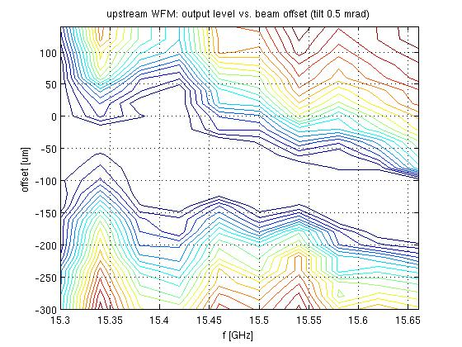
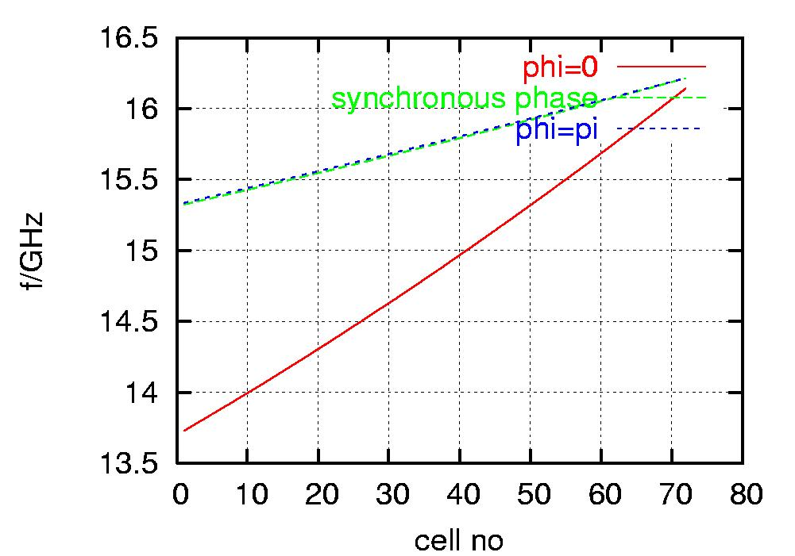
Offset vs. tilted structure:
Frequency scan
(Rather noisy) frequency scan with narrow band filter (BW 10 MHz):
Frequencies correspond to locations inside structure given by green sync. phase line shown left
Location of minimum versus frequency shows tilts (and bends, kinks …)
Looking forward to strongly improved resolution in final system
Notes:
<Foliennummer>

Slide 4
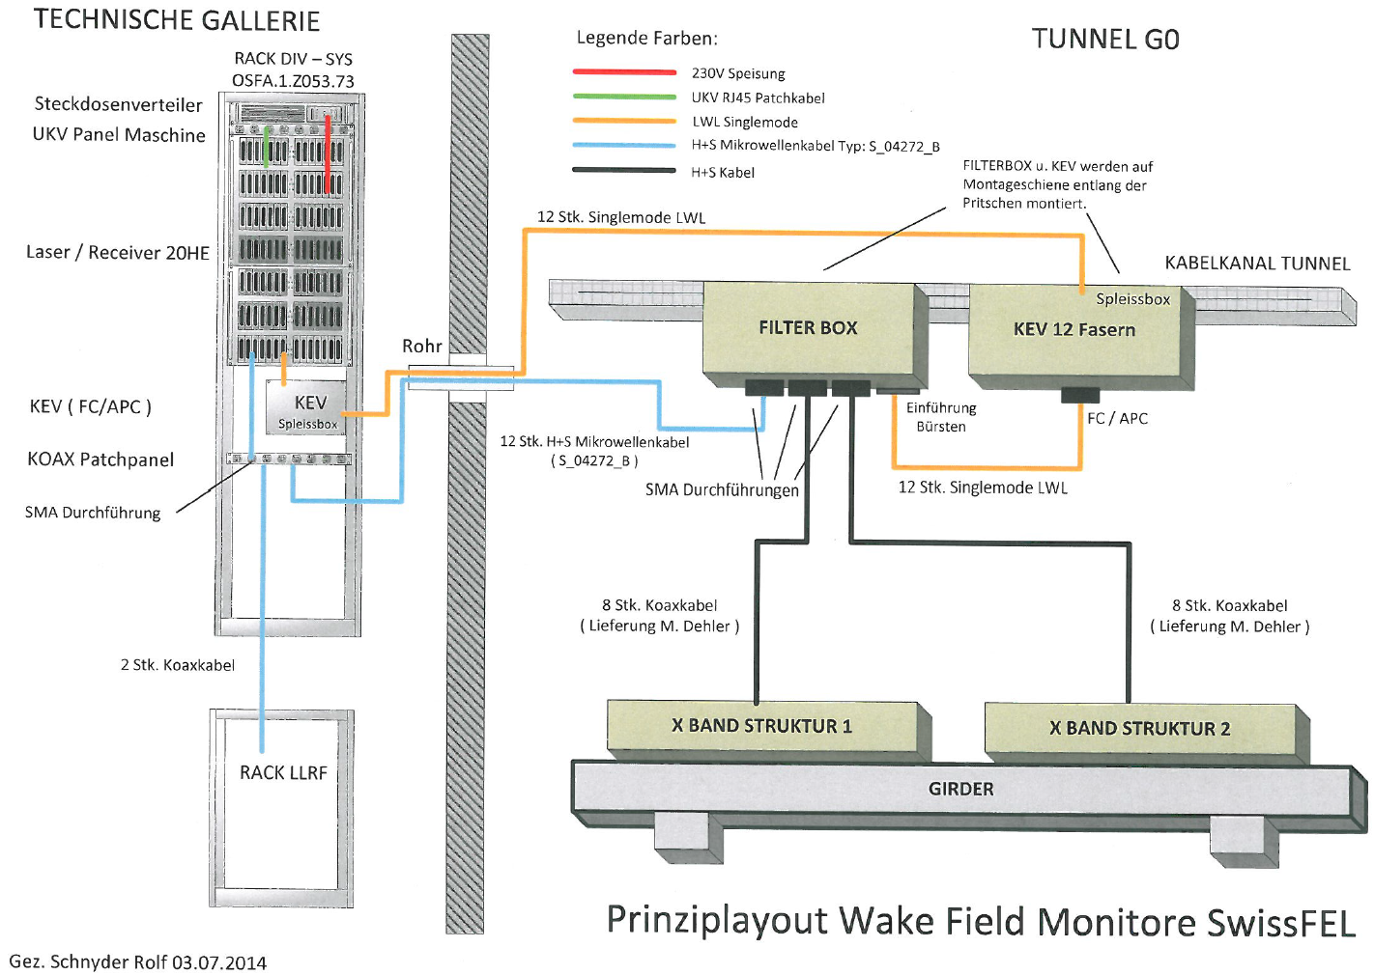
Sysem setup at SwissFEL

Slide 5
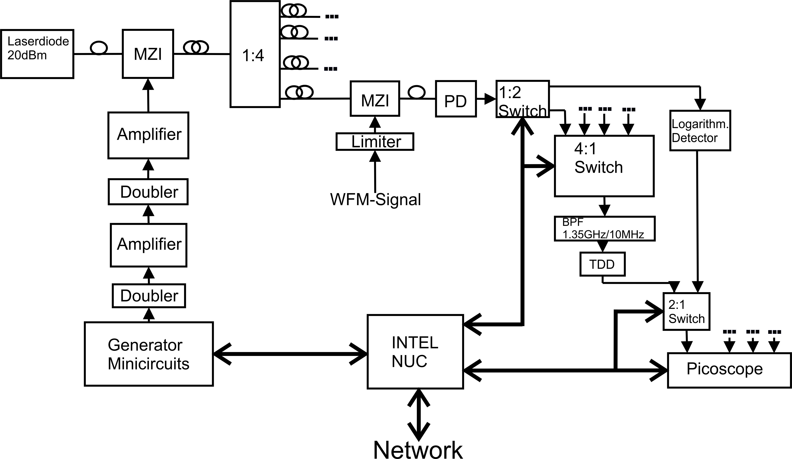
Block diagram
In the tunnel

Slide 6
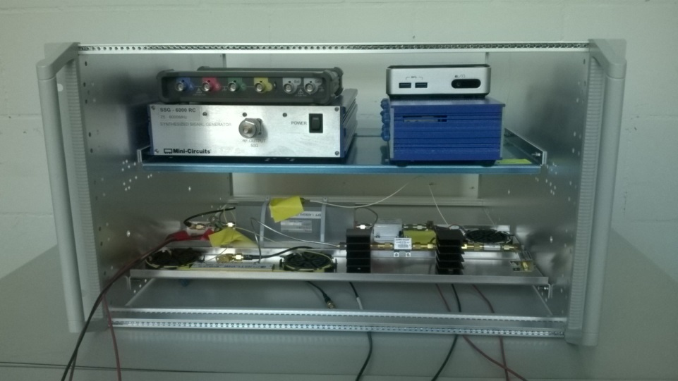
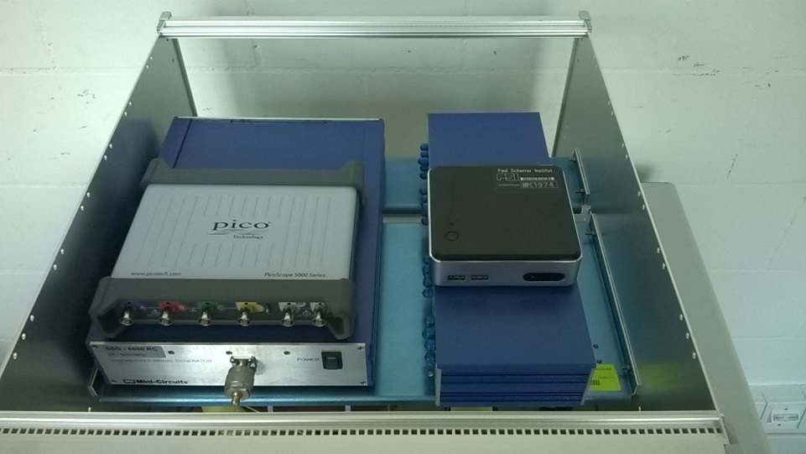
Last spring: partially assembled prototype system
Upper plane: signal generator, readout electronics, switches etc.
Lower plane: electro-optical system and analog post processing
Self contained system using passive cooled PC (Intel NUC)
Digital control of LO, 14 bit digital scope readout, RF switches etc. via USB
Planning to use Matlab for control and digital post processing

Slide 7
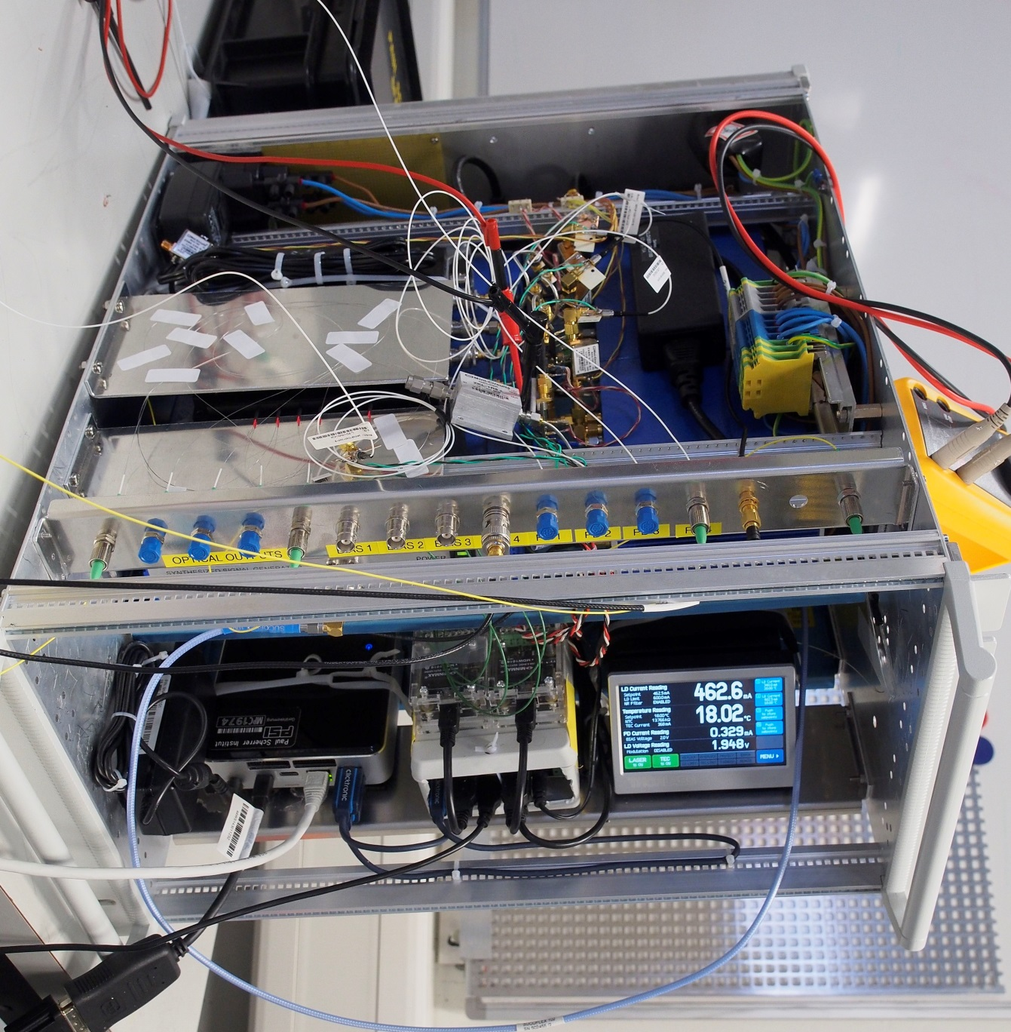
Now: partially disassembled (but complete) system: Optimizing optical detection system

Slide 8
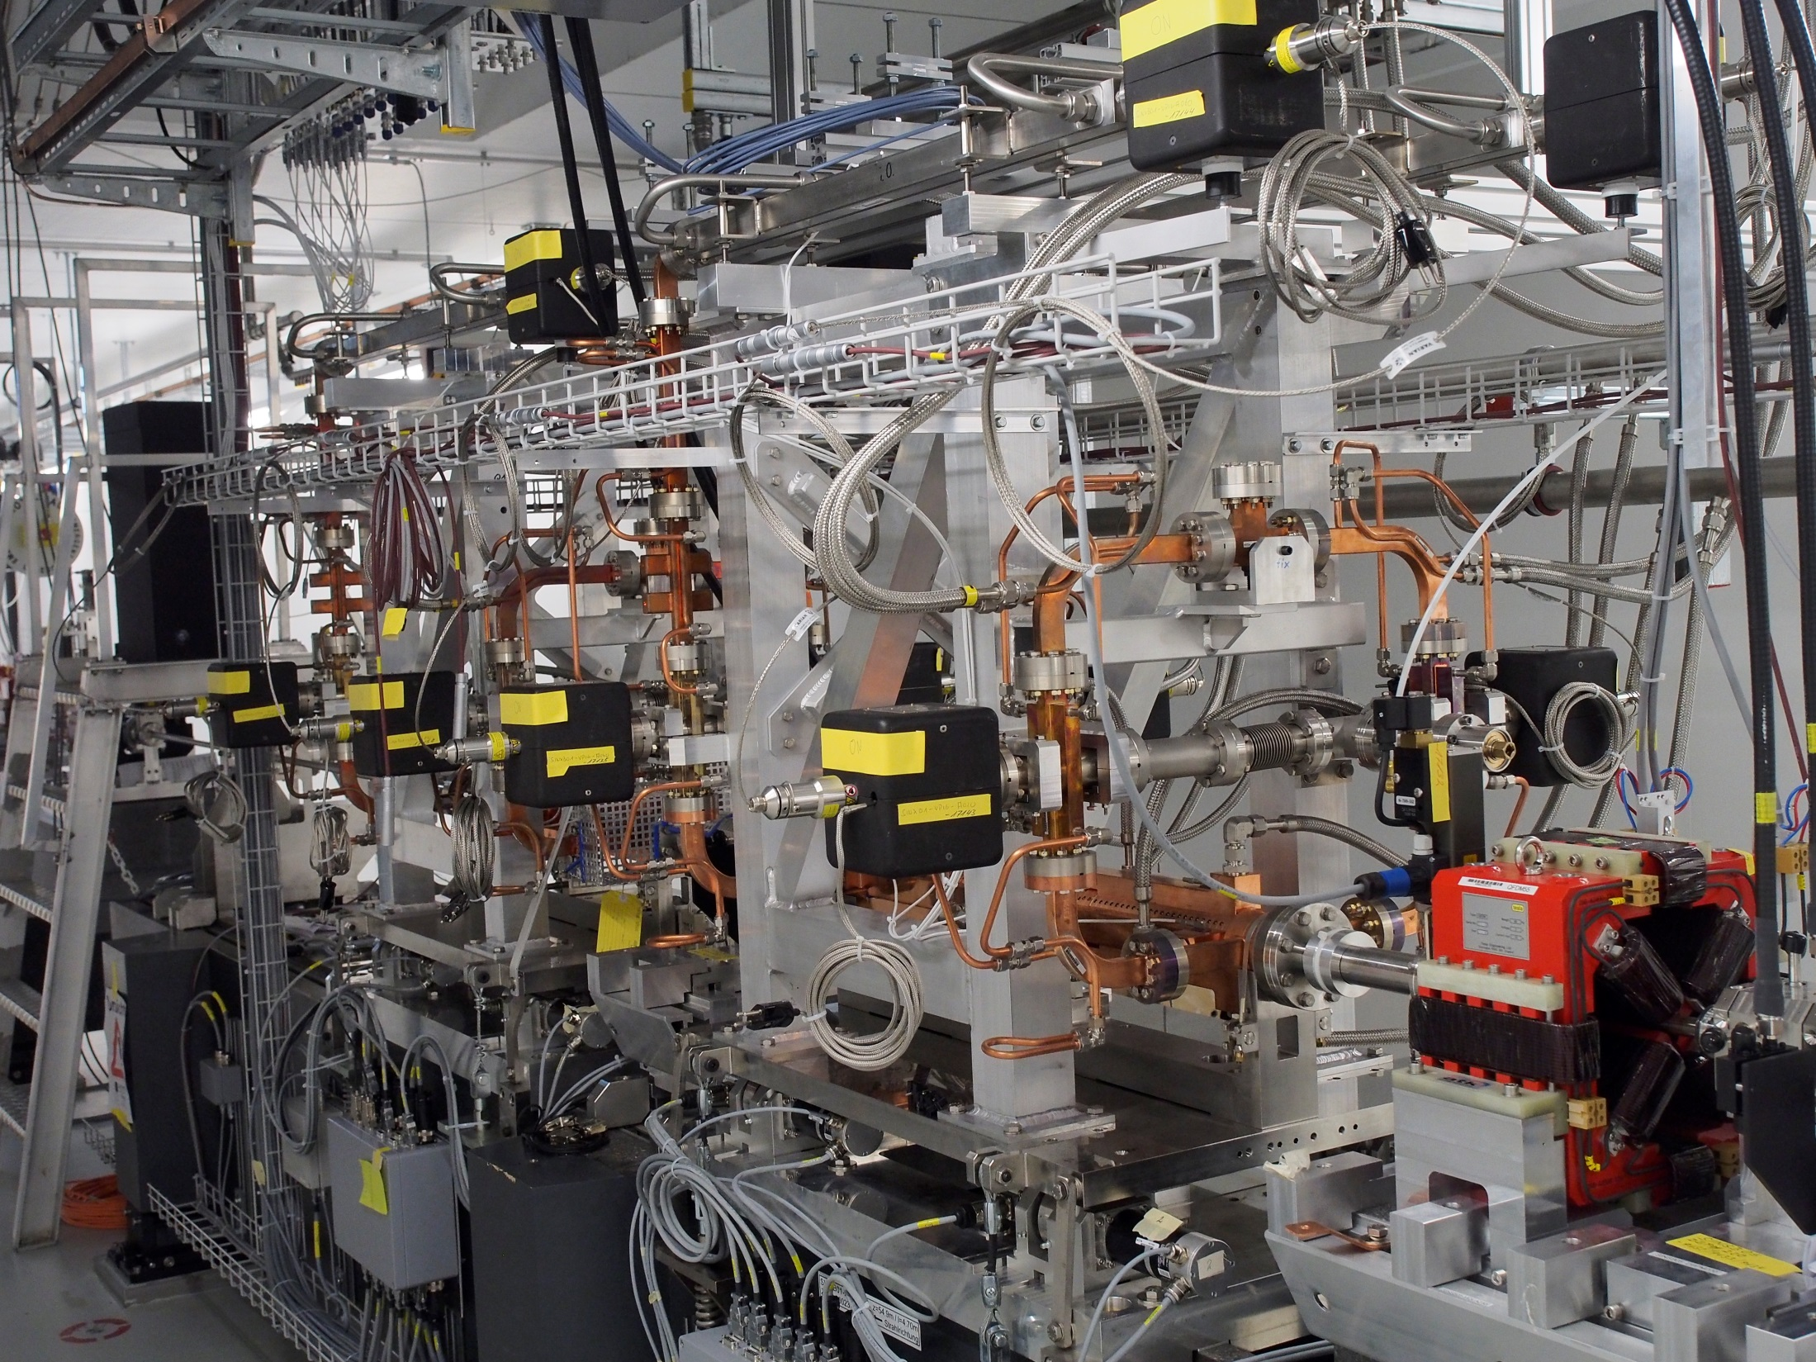

Slide 9
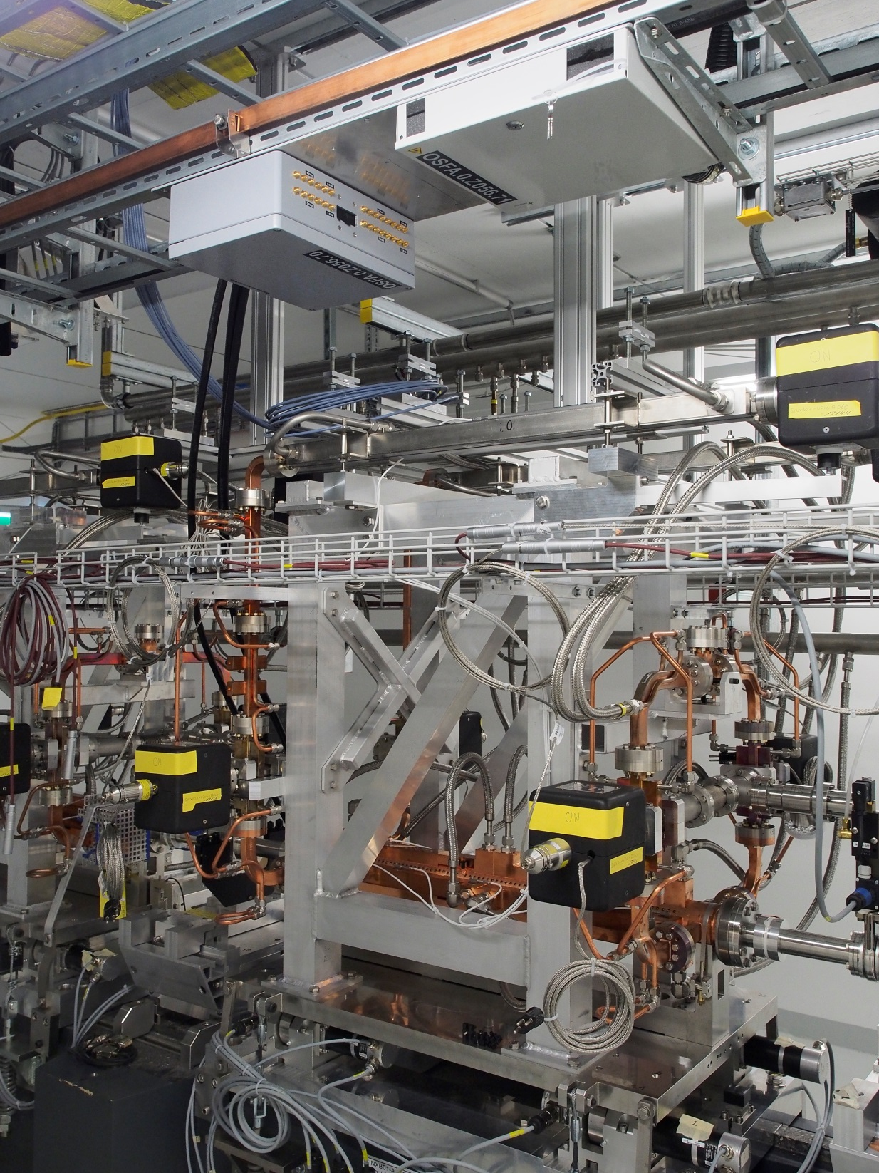

Slide 10
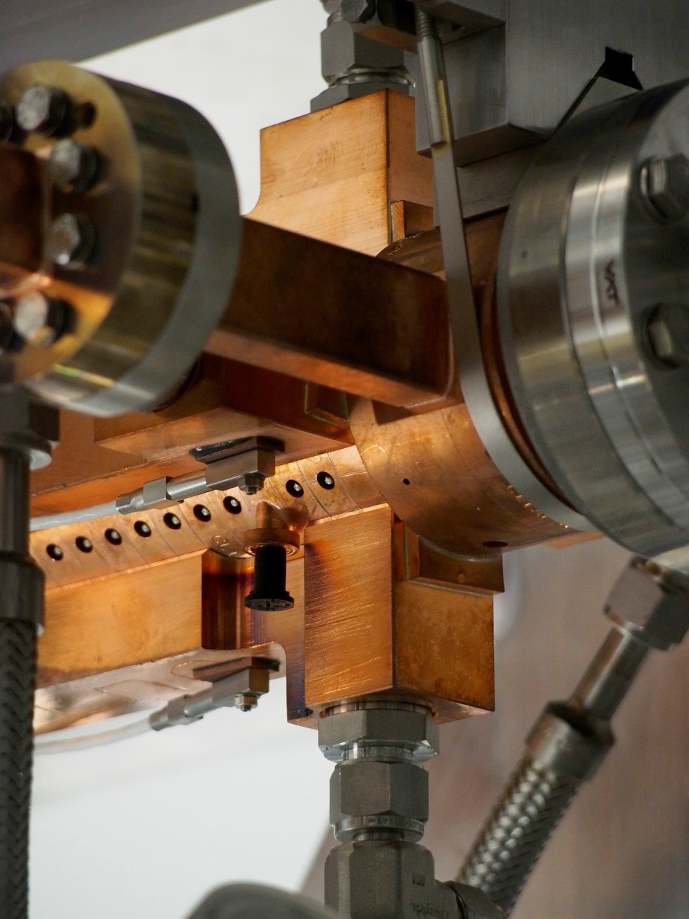
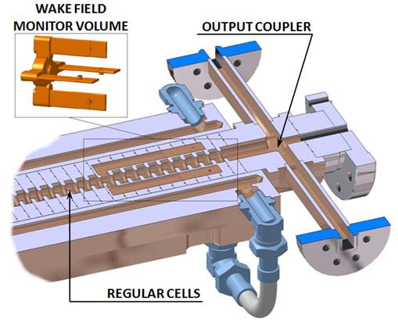
WFM pickup

Slide 11
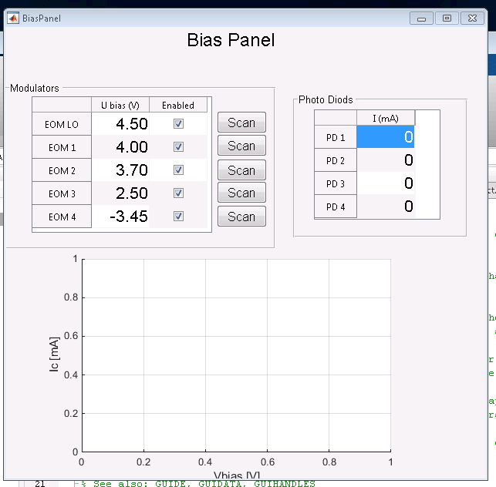
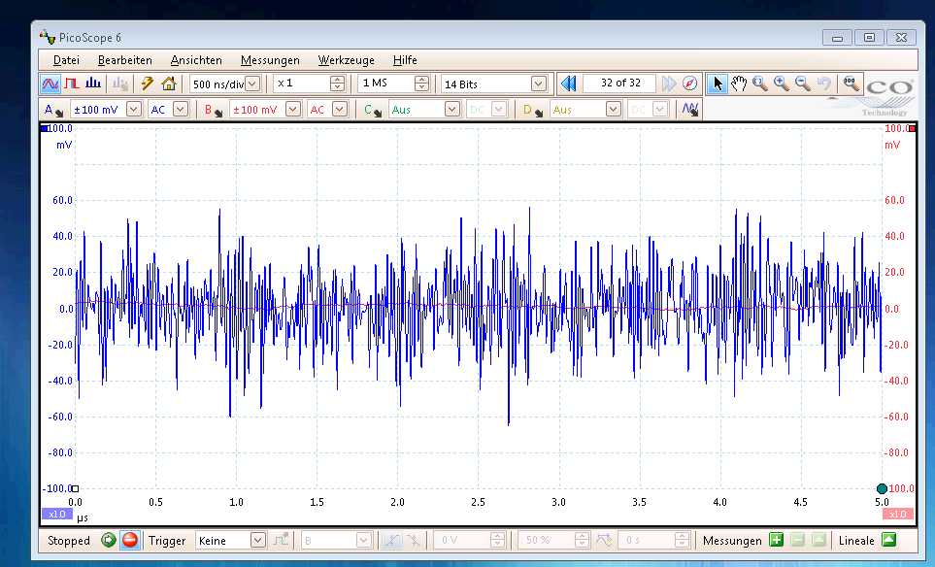
Grunt work:
Interfaces, GUIs, procedures
Standalone system
Intel NUC PC running windows
Devices interfaced via USB
Matlab as control software

Slide 12
Signal conversion factors
EOM modulated by wakefield signal
Modulation factor m = Vsig*π/Vπ or
m[dBc] = 0.5 Psig [dBm] – 7.5 dB
2nd modulation with LO: reduction by 6 dB
Photo diode with 0.98 A/W
P_{out} [dBm] = 2 P_{carrier} [ dBm] +2*m [dBc] -16 dB
Carrier power
theoretical: 20 dBm (LD) – 7dB (LO EOM) – 7dB (1:4 splitter)
– 7 dB (WFM EOM) -2..3 dB (transitions) = -3..4 dBm
measured -6 dBm
Total link insertion loss including splitter w/o optical amplification:
IL = -15 (EOM) -6 (LO) -12 (Carrier) -16 (PD) = -49 dB
Detection thresholds electronics:
Log amp: DT = -64 dBm
Tunnel diode: DT = -80 dBm
Signal thresholds for 4 um resolution:
Broad band measurement (BW=0.5 GHz): -33…-38 dBm
Intra structure misalignment (BW=10 MHz): -63… -68 dBm

Slide 13
Noise
Thermal noise
N=-174 dBm/Hz
Carrier noise
Relative intensity noise
N=-158 dBc/Hz
Shot noise
RIN = -201 dBc/Hz –P_{carrier} [dB] (carrier power in PD)
Johnson Noise (50 Ω termination)
N = -171 dBm/Hz

Slide 14
Noise paths (std setup)
RIN: Laser diode has -158 dBc/Hz
N(output PD) = 2*P_c + RIN -13 dB
= -12 dB -16 dB (IL PD) -158 dBc/Hz = -186 dBm/Hz = -96 dBm/GHz
Thermal Noise at input modulator: -174 dB/Hz
N_PD = -174 dB/Hz -49 dB (IL optischer link)
= -223 dBm/Hz = -133 dBm/GHz
Photo Diode
Shot Noise:
N_PD = -201 dBc – 6 dBm (Carrier power) =
-207 dB/Hz = -117 dBm/GHz
Johnson Noise:
N = - 171 dBm/Hz = -81 dBm/GHz
Thermal noise in photo diode dominates followed by RIN of laser source.
Thermal noise in photo diode independent of carrier power.
Theoretical detection threshold (1 GHz BW): -33 dBm (at the limit)
For internal alignment measurement (10 MHz BW): -53 dBm (~10 um) ☹

Slide 15
Improving noise/detection threshold
Strategy 1: Improve power of optical carrier, reduce insertion loss, increase signal strength
  Expensive/complicated: Use fiber amplifier
☹ Amplification limited by power rating of EOMs
☹ Amplifier noise figure typically 3-4 dB
☹ price
☺ Max gain in DT: 12 dB
    Replace on 1:4 optical splitter by optical switch
☺ price
☺ Gain in DT: 12 dB
☺ Tested – works!
☹ cannot measure four channels in parallel (important?)

Slide 16
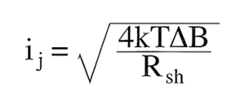
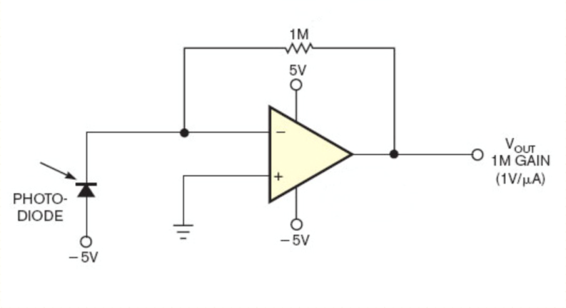
Improving noise/detection threshold
Strategy 2: Reduce thermal noise in photo diode by trans-impedance amplifier
Johnson noise (other than shot noise) determined by shunt resistance of photo diode
(50 Ohms in current std configuration):
Use socalled trans-impedance amplifier to increase R_{sh}
  Can theoretically decrease PD noise to shot noise limit by 30 dB
  Some reduction of bandwidth (if controlled, welcome)
  Practical limit in setup given by RIN of laser diode, giving theoretical improvement of detection limit by 15 dB
Currently evaluating approach, still need to practically prove improvement

Slide 17
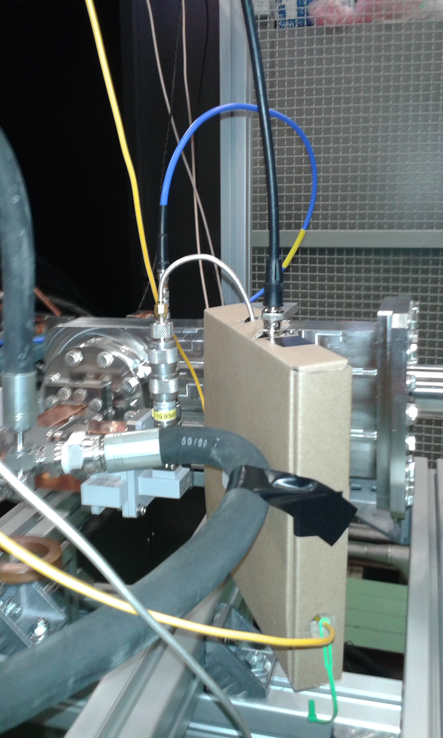
Other applications:
Quick and dirty tests at Xbox measuring 12 GHz break down signals
To the right:
How to do a provisorical front end
Within 1 ½ days ...
works in principle, problems with optical connection (signal level fluctuated, when moving fiber)
not ideal test case – signal is narrow band width, system is ultra wide band width and so noisy
no definite conclusions, due to time constraints could do only one test.

Slide 18
Outlook
Still improving detection threshold
  Easy way out with strong improvement would be to insert LNAs between pickup and EO modulator, but would contradict philosophy of passive, radiation hard front end ….
Finish software (partially needs to be done together with beam tests)
Beam tests:
SwissFEL injector commissioning expected to start June
Fall back solution: WFM measurements at CALIFES?
Signal level, spectra, indirect test of specs.
  Outreach
submitted abstract for LINAC ‘16 (MSU/USA)
PRST paper on SITF (section on WFM stuff), to be submitted

