Slide 1



Progress and Status of HOM based beam diagnostics for FLASH and the E-XFEL
Presenter: L. Shi (U. Manchester / DESY)
Members: N. Baboi (DESY), R.M. Jones (U. Manchester), T. Wamsat (DESY),
B. Lorbeer (DESY), N. Eddy (FNAL), P. Zhang (IHEP), S. Bou-Habib (WUT)
The work is supported partly by EuCARD² with Grant No. GA 312453

Slide 2
Outline
  Overview of Higher Order Modes based beam diagnostics
  Diagnostics at FLASH
  Diagnostics at the E-XFEL
  Summary and Outlook.

Slide 3
HOM based Beam Diagnostics –
FLASH and the E-XFEL
BPM : Beam Position Monitor
BPhM: Beam Phase monitor
HOM based beam diagnostics
FLASH
1.3 GHz cavities
3.9 GHz cavities
(4 cavities)
E-XFEL
1.3 GHz cavities
3.9 GHz cavities
(8 cavities)
BPM
(SLAC)
BPM
(FNAL)
BPM
BPhM (DESY+WUT)
BPM
(DESY)

Slide 4
  Overview of HOM based beam diagnostics
  Diagnostics at FLASH
    HOMBPM for 1.3 GHz cavities
    HOMBPM for 3.9 GHz cavities
    Beam Phase Monitor
  Diagnostics at the E-XFEL
    S21 measurements for 3.9 GHz cavities
  Summary and Outlook.

Slide 5
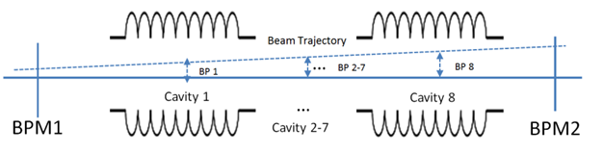
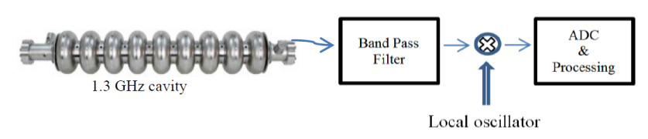
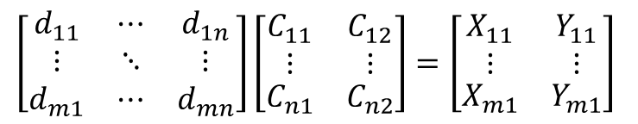
HOMBPM Review
Beam position inside each cavity is interpolated from two BPMs.
Dipole signals are measured via each HOM port.
The correlation between dipole signal and beam positions can be established.
$$\left[\begin{matrix}d_{11} & ⋯ & d_{1n} \\ ⋮ & ⋱ & ⋮ \\ d_{m1} & ⋯ & d_{mn}\end{matrix}\right]\left[\begin{matrix}\begin{aligned}C_{11} \\ ⋮\end{aligned} & \begin{aligned}C_{12} \\ ⋮\end{aligned} \\ C_{n1} & C_{n2}\end{matrix}\right]=\left[\begin{matrix}\begin{aligned}X_{11} \\ ⋮\end{aligned} & \begin{aligned}Y_{11} \\ ⋮\end{aligned} \\ X_{m1} & Y_{m1}\end{matrix}\right]$$

Slide 6
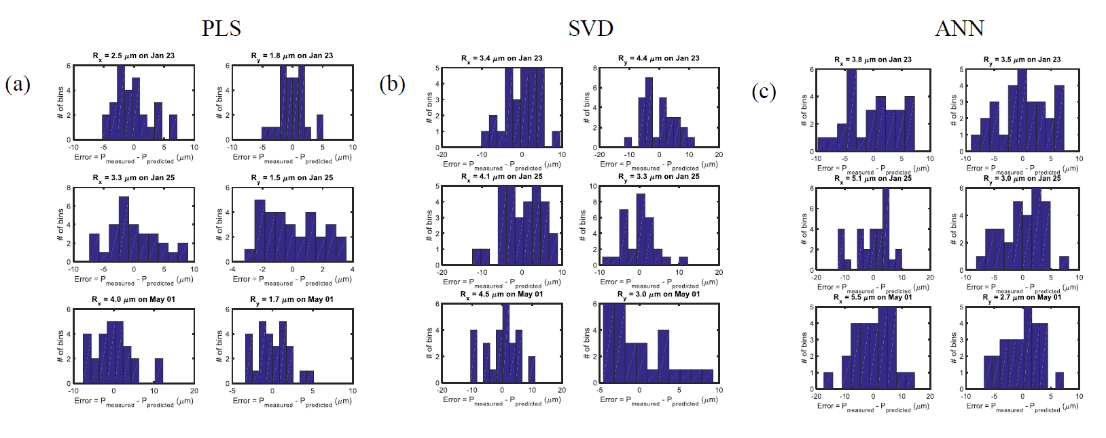
  HOMBPM at FLASH - 1.3 GHz cavities
PLS: Partial Least Square
SVD: Singular Value Decomposition
ANN: Artificial Neural Network
Most of the results obtained are below 5 microns.
L. Shi et al, 2015, Stability and resolution studies of HOMBPMs for the 1.3 GHz superconducting accelerating cavities at FLASH, Physics Procedia 77 (2015) 42-49

Slide 7
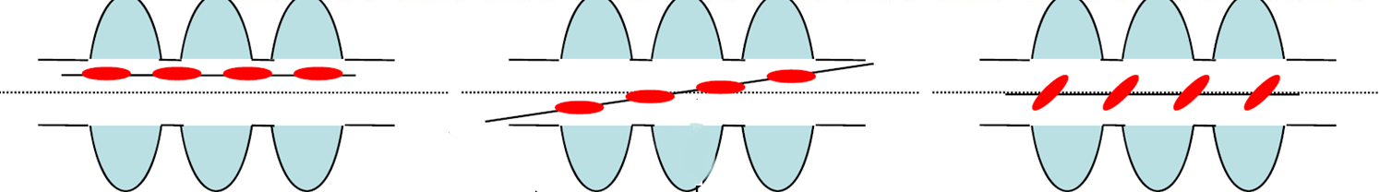





HOMBPM at FLASH - 1.3 GHz cavities
Beam Excited Angular Wakefields
(a) Offset x
(b) Angle $θ$
(c) Angle $α$
$$V_{x}(t)∝xe^{−\frac{t}{τ}}sin⁡(ωt)$$
$V_{θ}\left(t\right)$ $∝−θe^{−\frac{t}{τ}}cos⁡(ωt)$
$V_{α}\left(t\right)$ $∝−ασ_{z}^{2}e^{−\frac{t}{τ}}cos⁡(ωt)$
Scenario (b) can play an important role in beam position determination.
For scenario (a) and (b), beam with 1 mm offset excites signal with the same amplitude as with 100 μrad angle.
We are currently investigating the effects based on simulation and measurements.
Notes:
0 position but non zero

Slide 8
  Overview of HOM Based beam diagnostics
  Diagnostics at FLASH
    HOMBPM for 1.3 GHz cavities
    HOMBPM for 3.9 GHz cavities
    Beam Phase Monitor
  Diagnostics at the E-XFEL
    S21 measurements for 3.9 GHz cavities
  Summary and Outlook.

Slide 9
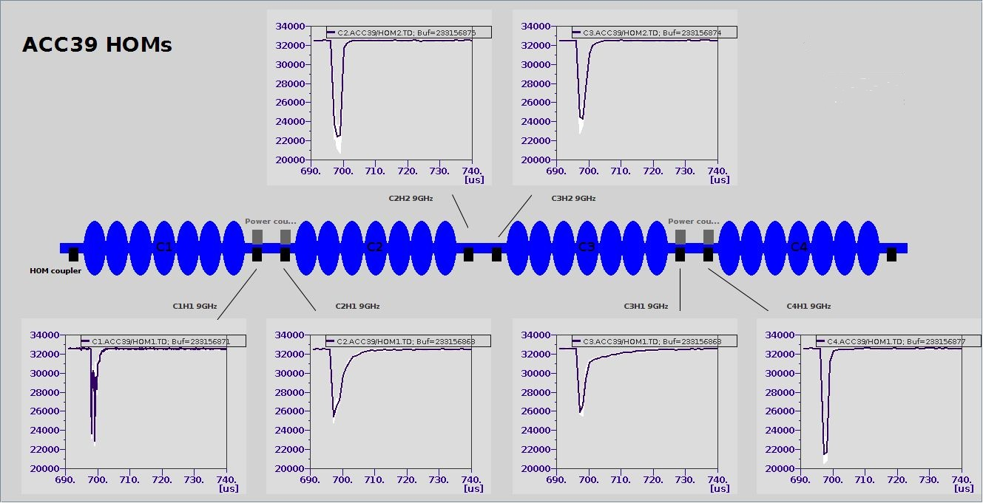
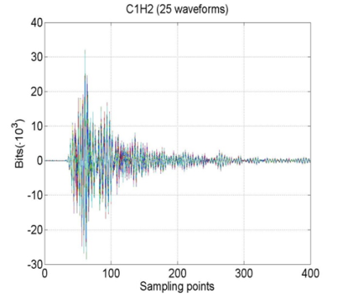
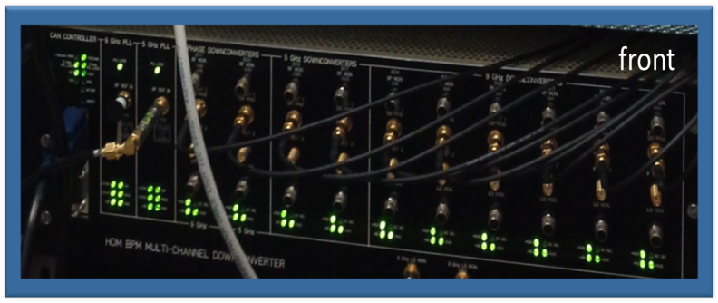
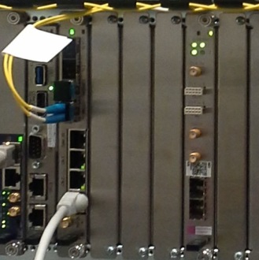
HOMBPM at FLASH – 3.9 GHz cavities
Beam Direction
C4H2 5GHz
C1H2 5GHz
C1H1 9GHz
Band pass
Filter
~5.43 GHz or 9.06 GHz
100 MHz BW
Mixer
30 MHz
IF
μTCA Digitizer
SIS8300
(108MS/sec)
N. Baboi et al, TUPF06, IBIC14
Notes:
Potential issues.

Slide 10
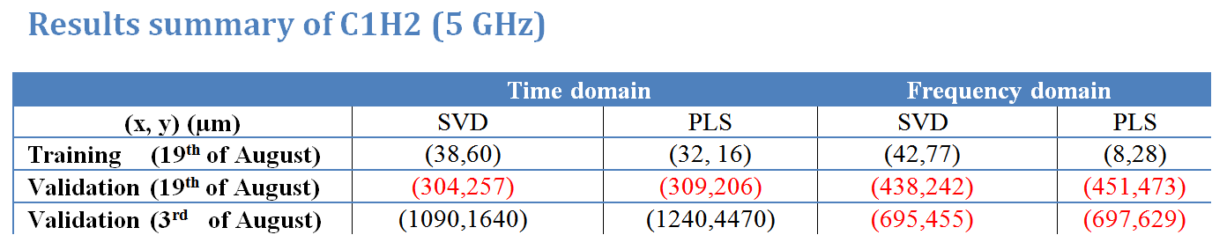
HOMBPM at FLASH – 3.9 GHz cavities
The analysis methods of the HOMBPM for 1.3 GHz cavities were applied to the 3.9 GHz cavities. But the results obtained so far are not acceptable.
  Example:
  The calibration (training) and validation are separated by only ½ hour.
  This may result from the phase instability and also the spectra variation over time.
  The parameters of the electronics are not properly set.

Slide 11
  Overview of HOM Based beam diagnostics
  Diagnostics at FLASH
    HOMBPM for 1.3 GHz cavities
    HOMBPM for 3.9 GHz cavities
    Beam Phase Monitor
  Diagnostics at the E-XFEL
    S21 measurements for 3.9 GHz cavities
  Summary and Outlook.

Slide 12
Field Control inside cavity
FEL operation requires high stability of amplitude and phase.
 | Amp | Phase
FLASH | 0.1% | 0.1 degree
E-XFEL | 0.01% | 0.01 degree
IPAC 2013,WEPME009
Notes:
To make electron beam radiate coherently, there are requirements on emittance, energy spread, and peak current etc. High precision control of RF field inside the cavity is required. The system to regulate the field is generally referred as LLRF system.

Slide 13
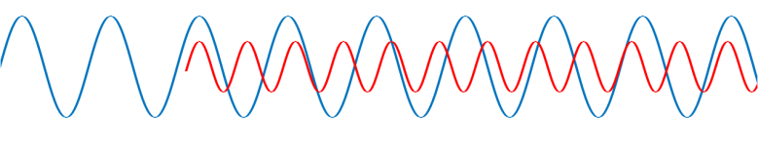
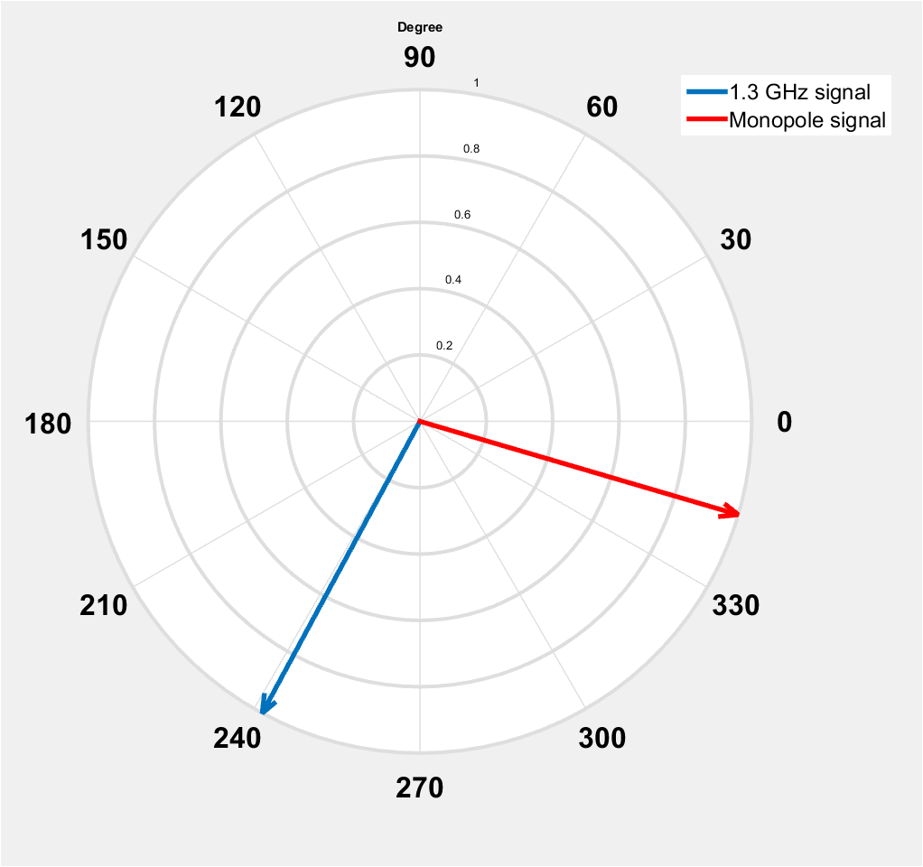
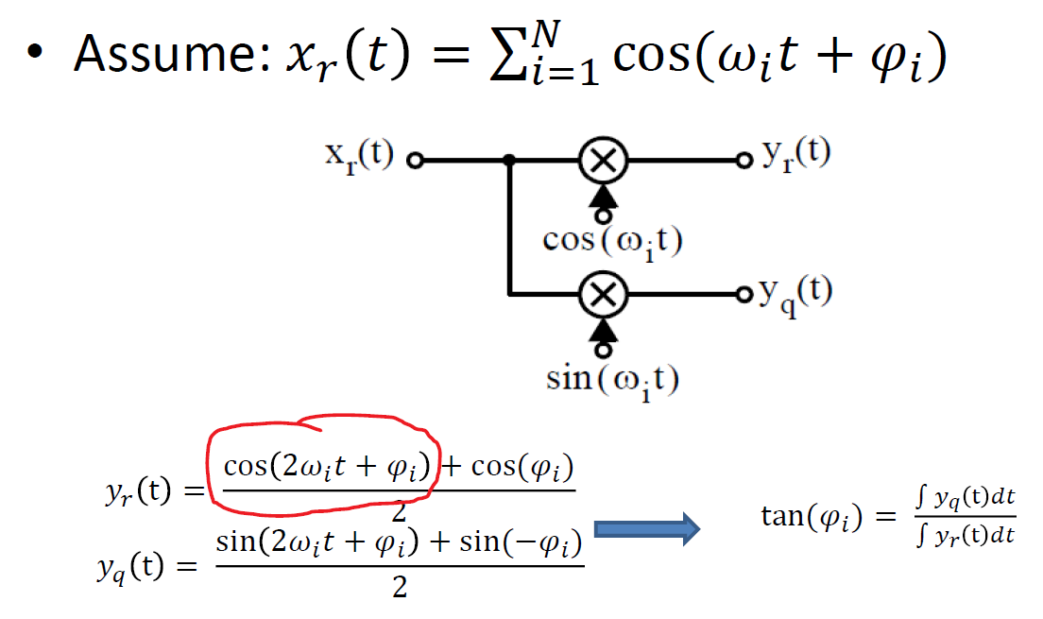


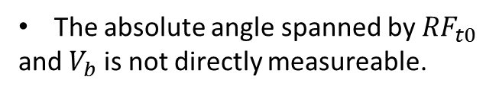





How to determine the beam phase
$${RF}_{t0}$$
${RF}_{t1}= {RF}_{t0}+V_{b}$
${RF}_{t0}:1.3 GHz$ signal
$$V_{b}:\sim 2.4 GHz beam induced signal$$
${RF}_{t1}:1.3+2.4GHz$ signal
$$t_{0}$$
$$t_{1}$$
Flat top of RF field inside cavity
The absolute angle spanned by ${RF}_{t0}$
and $V_{b}$ is not directly measureable.
Notes:
Relative measurement.
Phasor diagram

Slide 14
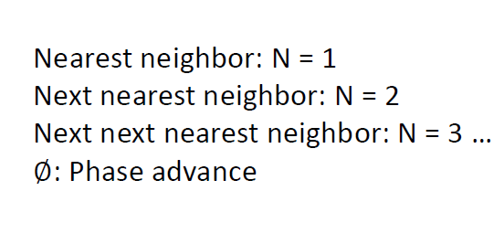
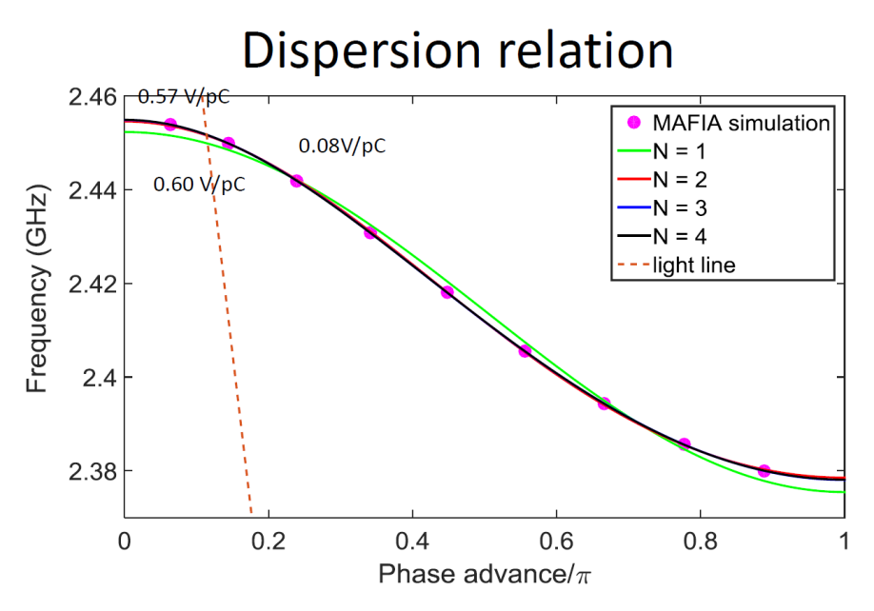
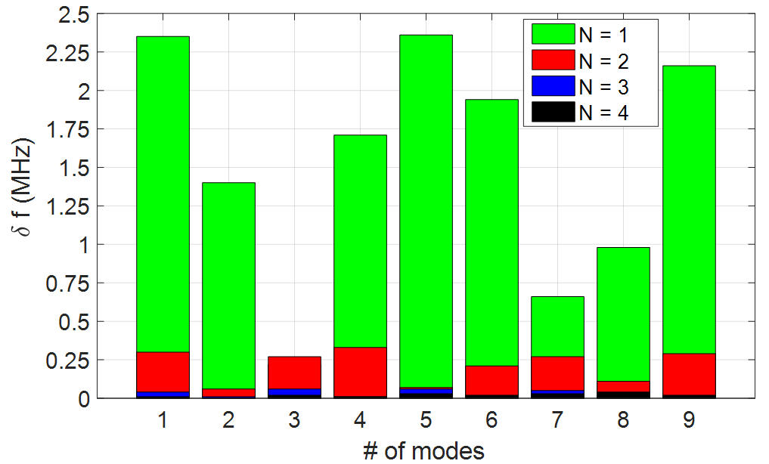
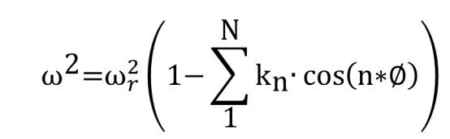
Beam Phase Monitor for 1.3 GHz cavities – Circuit model
Single chain of coupled parallel RLC circuit was used to facilitate the beam phase monitor development.
1
|CM – MAFIA|

Slide 15
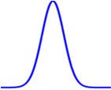
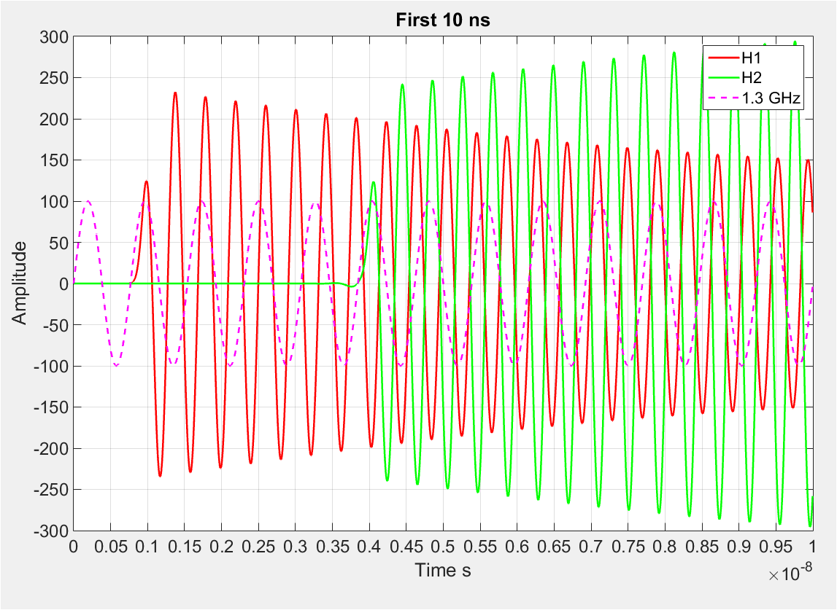
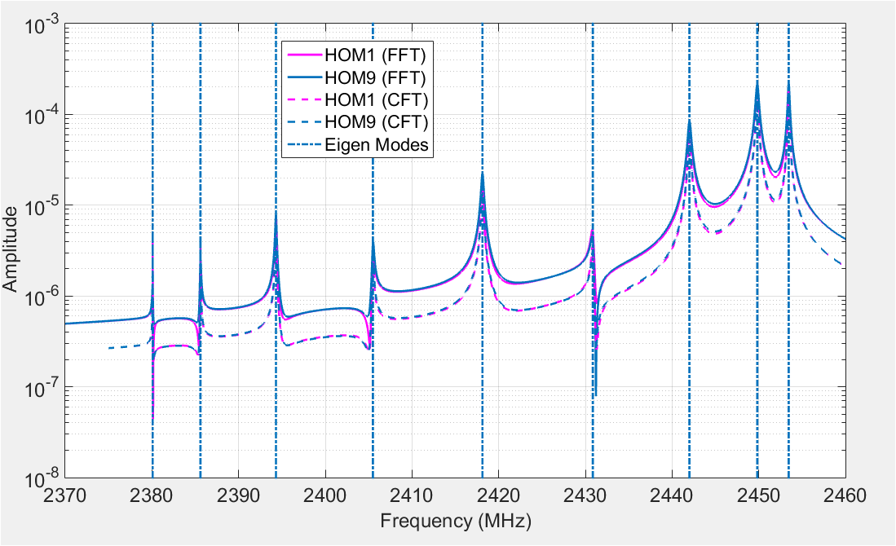

Voltage Waveforms at cell 1 and 9
$$t_{0}=\frac{1}{2}⋅\frac{1}{1.3}ns$$
50 µs long waveform
Notes:
Add beam Gaussian pulse

Slide 16
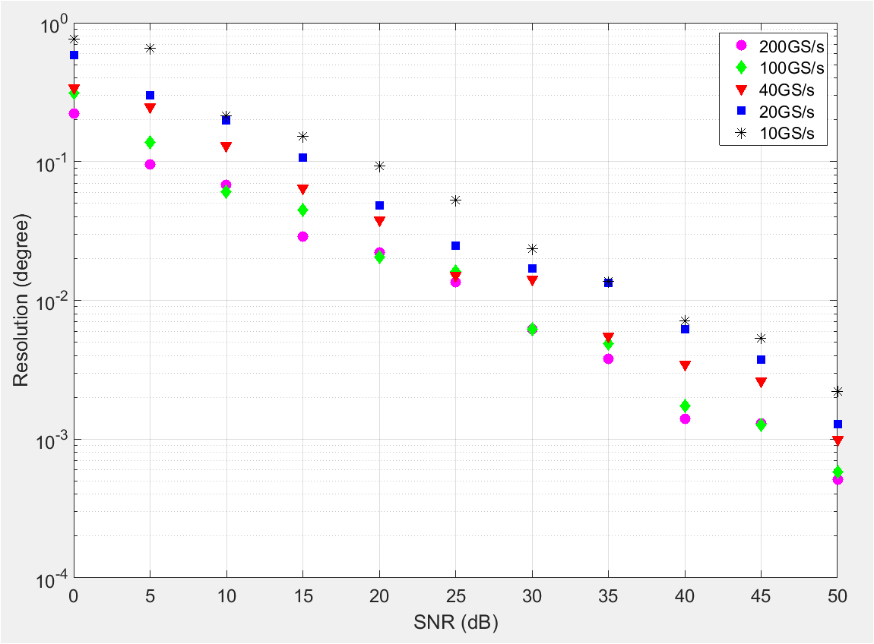
Beam Phase Monitor - Circuit model
By increasing SNR, resolution can be improved.
The resolution also depends on the sampling frequency.
Note: SNR is varied by keeping signal power fixed and varying noise power. Alternative way exists!

Slide 17
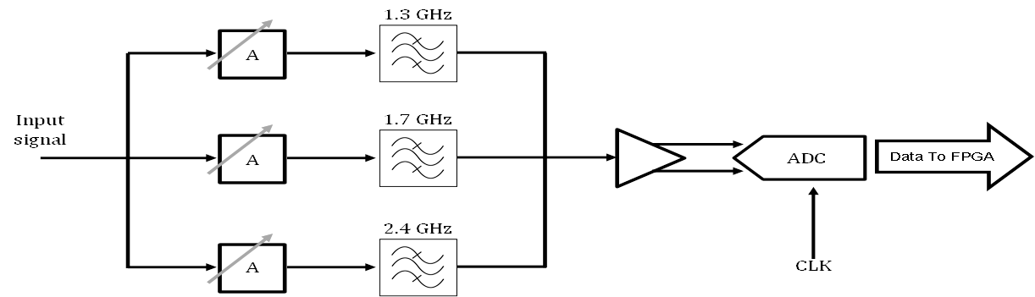
Electronics of HOM based beam Phase measurements
1290-1310 MHz
1690-1710 MHz
780 MHz
2400- 2460MHz
Signal can be aliased to 250-270 MHz (fundamental Monopole), 130-150 MHz (Dipole),
60-120 MHz(2nd monopole band) respectively.
The final electronics will be based on different sampling frequency .

Slide 18
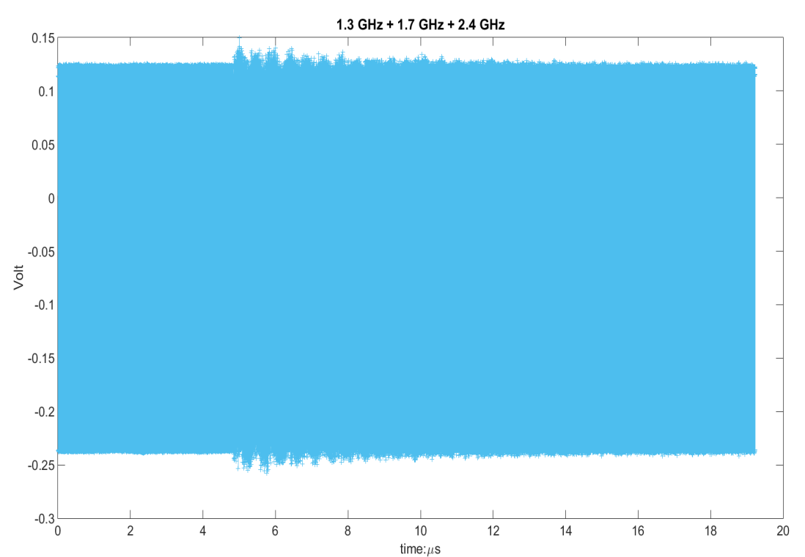
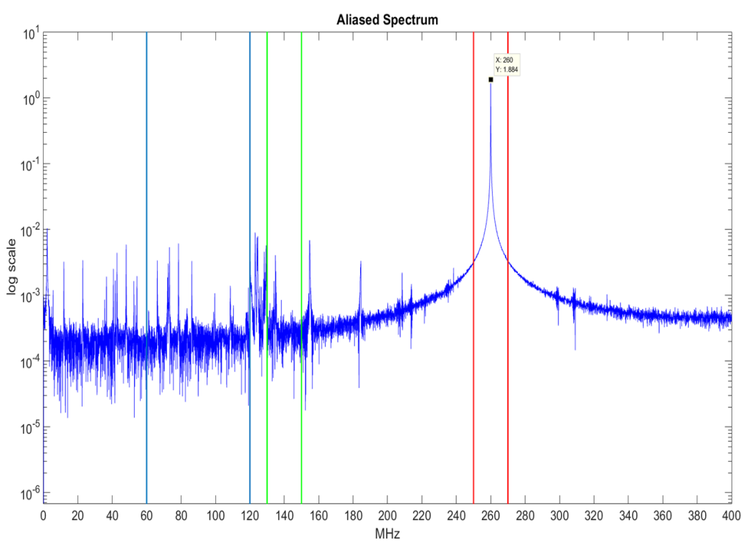
Example of outputs of test electronics
Beam arrival
Amplitude
1.3 GHz leakage
2nd Monopole band
Dipole TE111-6
1.3 GHz leakage
Clearly, attenuation or amplification for each channel needs to be matched with each other. (Sampled at 780 MHz)
Measured by Mr. Samer
Notes:
Add the voltage of Monopole signal and Voltage of 1.3 GHz

Slide 19
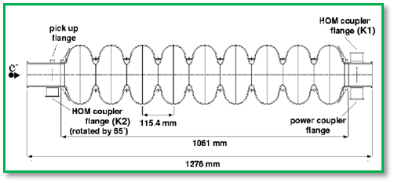

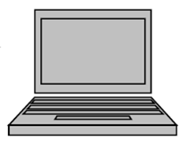
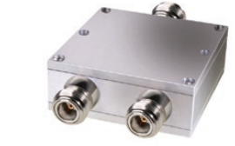

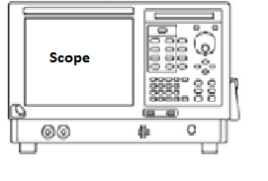
Setup for the beam phase measurements
– Data link
– Command link
– Clock link
System trigger clock
HOM1
HOM2
TCP IP Client
TCP IP Server
DC-1400 MHz
DC-1400 MHz
Commands
Data
2340-2530 MHz
2340-2530 MHz
Band Pass
Band Pass
VX11-LAN connection

Slide 20
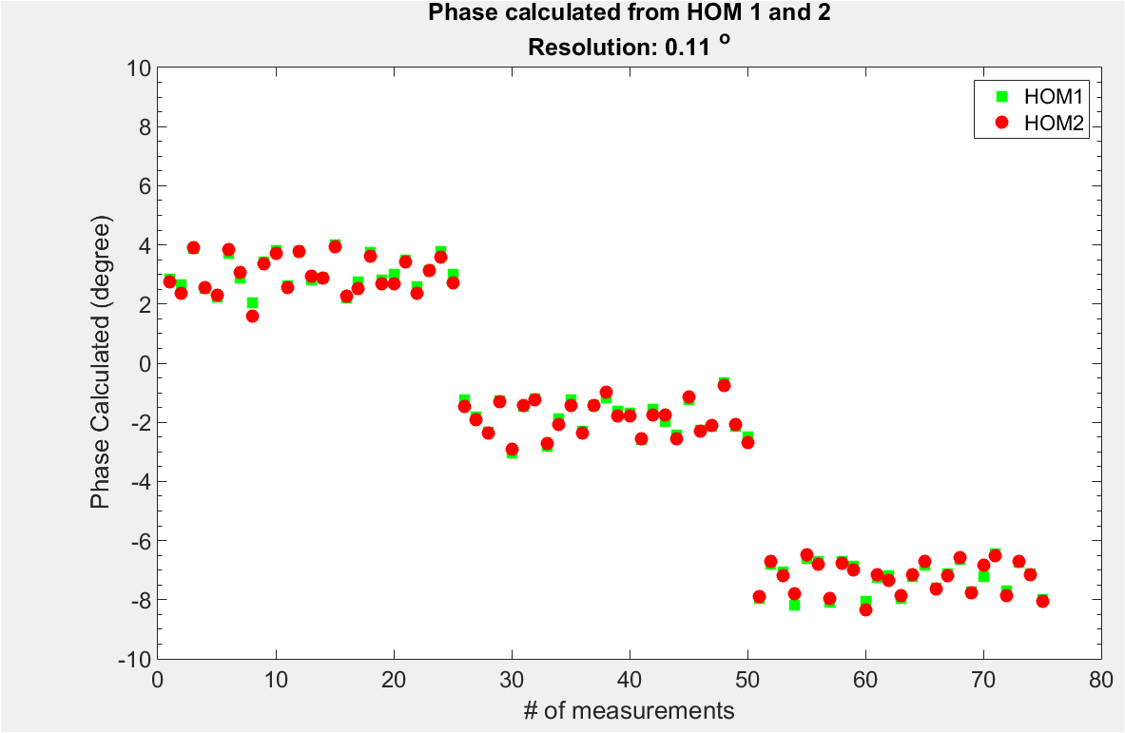
Beam Phase Monitor for 1.3 GHz cavities - Results
Simulation (200 GS/s)
Experiment（20 GS/s）
0.21
0.11
0.04
Estimation of SNR from scope shows it is
between 10 and 20 dB.
Phase change -5 to 5 degree from
Klystron. Resolution is about 0.1 degree.
Notes:
Replace the second of with other plots; add one slide from the probe measurements.

Slide 21
  HOM Based beam diagnostics at FLASH
    HOMBPM for 1.3 GHz cavities
    HOMBPM for 3.9 GHz cavities
    Beam Phase Monitor
  Diagnostics at the E-XFEL
    S21 measurements for 3.9 GHz cavities
  Summary and Outlook.

Slide 22
HOM Spectra measurements and characterization
The spectra of 3.9 GHz cavities are more complicated than the 1.3GHz cavities.-> single dipole mode filtering is impossible [1].
Which part of dipole spectra can be used for the beam position monitoring. ->Electronics specification
Is the selected band of spectra stable over time?
[1]. P. Zhang Beam Diagnostics in Superconducting Accelerating Cavities, Springer Theses. Springer International Publishing; 2013.
Notes:
Eight coupled cavities are more complicated than four.

Slide 23
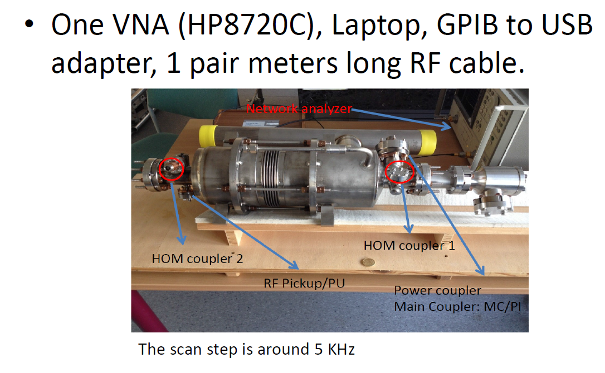
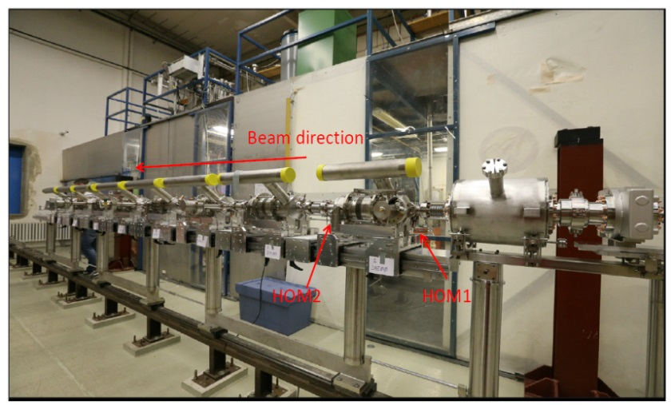
    E-XFEL: S21 measurements for single cavity
Coupled cavity measurements
filled with Argon, at ~293K. Couplers
are not terminated.
Single cavity measurements
vacuum state, in room temperature

Slide 24
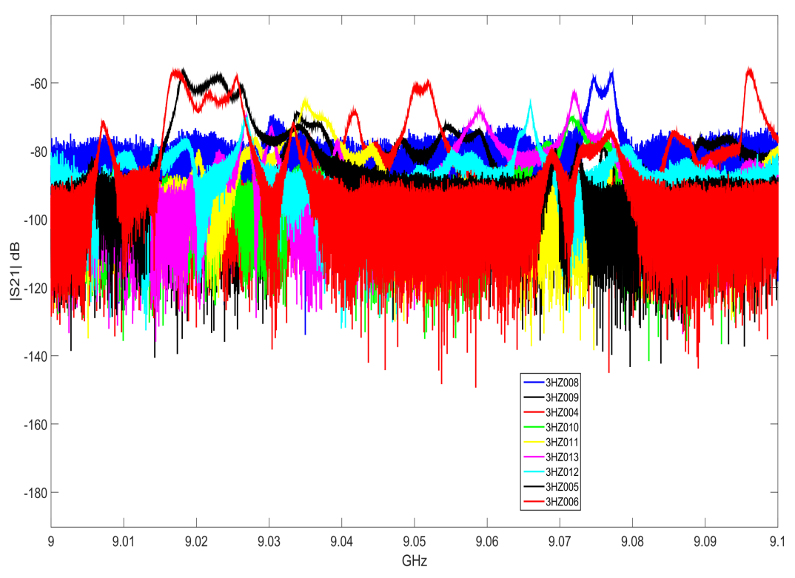
E-XFEL: S21 measurements for single cavities at 293K
1st and 2nd dipole band
5th dipole band
2nd dipole band
1st dipole band
The second dipole band spans ~200 MHz

Slide 25
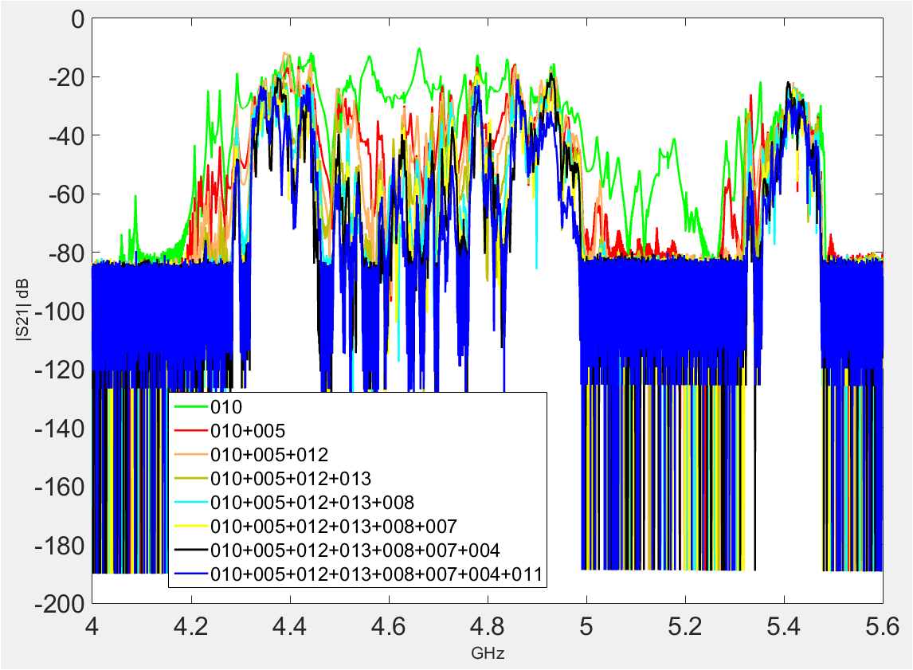
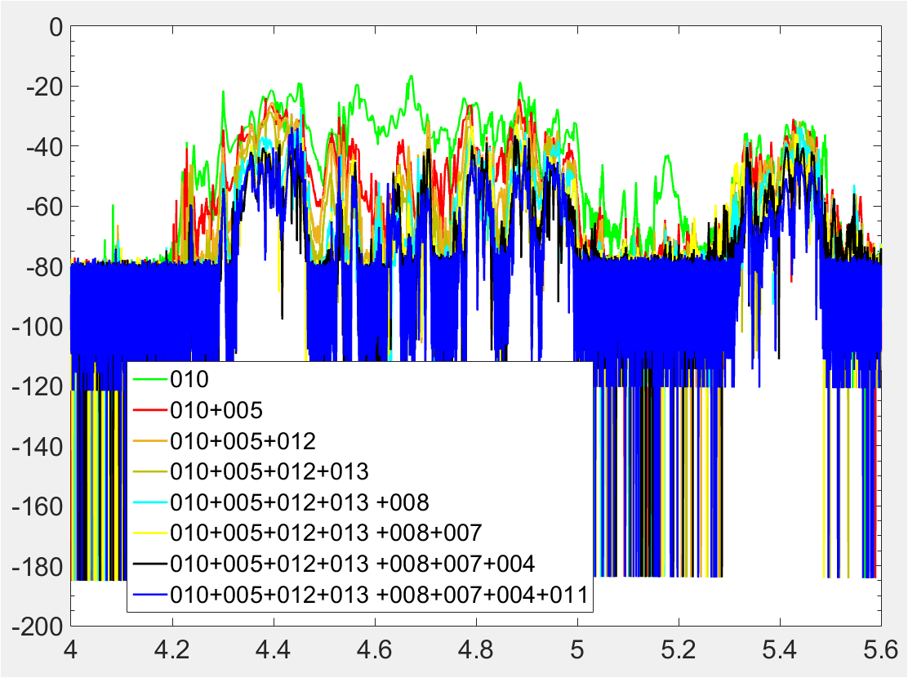
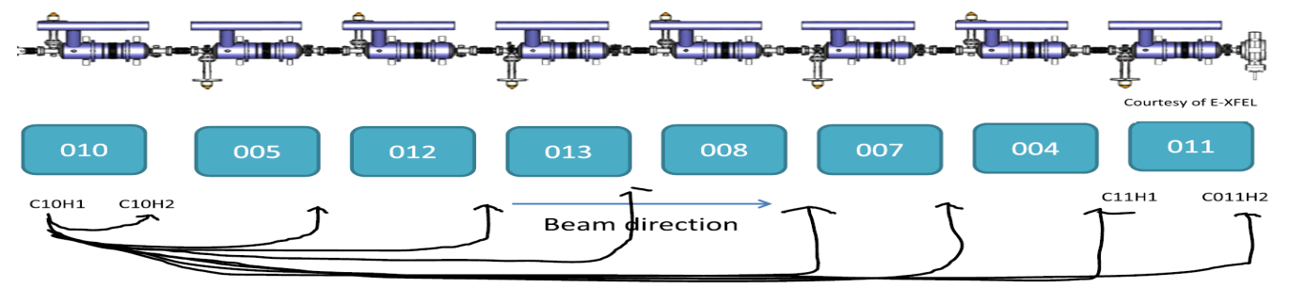
E-XFEL: S21 measurements for coupled cavities
Warm state (~293K)
Cold state (~2K)
Notes:
10 MHz shift
200-100Mhz
Further slice the band

Slide 26
Summary and Outlook
For the Beam diagnostics of 1.3 GHz cavities:
  For beam position monitor, the drift of calibration is correlated to the phase stability of the system. Beam angle on the beam position prediction is not negligible.---Beam Position Monitor
  Circuit model aided the development of beam phase monitor. Signal and noise power level need to be optimized to gain higher resolution.--- Beam Phase Monitor
  Beam phase measurements at the E-XFEL is scheduled. Upon the availability of the electronics for the E-XFEL, we will test it during beam time.---Beam position and Phase Monitor

Slide 27
Summary and Outlook
For the Beam diagnostics of 3.9 GHz cavities:
  The parameters of the electronics need to be optimized at FLASH.
  Long term monitoring of the HOM spectra is essential to investigate the instability issue of the HOMBPM at FLASH.
  HOM spectra measurements ant characterization are done for the E-XFEL.

Slide 28
Thank you for your attention!

