Slide 1
Intra-Task Collaborations?
Simulation
  High Gradient (cavity and klystron) and SRF HOM
  SRF Thin Films, RF photo-cathodes
Material Preparation & Analysis
  SRF Thin Films and RF Photo-cathodes
    Sample deposition and analysis exchange:
      Plug configuration differences, possibly provide online database for systems used including drawings.
RF Breakdown
  High Gradient (cavity), RF photo-cathodes and SRF Thin Films
    Analysis, sample exchange and breakdown studies
HOM Management
  High Gradient (cavity) and SRF HOM optimisation, electronics development?
Experimental Evaluation
  High Gradient (WFM) and SRF HOM analysis and optimisation
Collaborative efforts may enhance the efficiency or outcome of some planned activities. However it is clear that it is not always feasible, due to the limited man power and existing commitments.
Even when not feasible at this time, collaborative efforts could facilitate the foundation for future, longer term benefits, beyond EuCARD-2.

Slide 2
WP12 Closing Remarks
Peter.mcintosh@stfc.ac.uk
Nicoleta.baboi@desy.de
Juliette.plouin@cea.fr
4 - 5th April 2016
WP12 3rd Annual Review Meeting, STFC Daresbury Laboratory

Slide 3
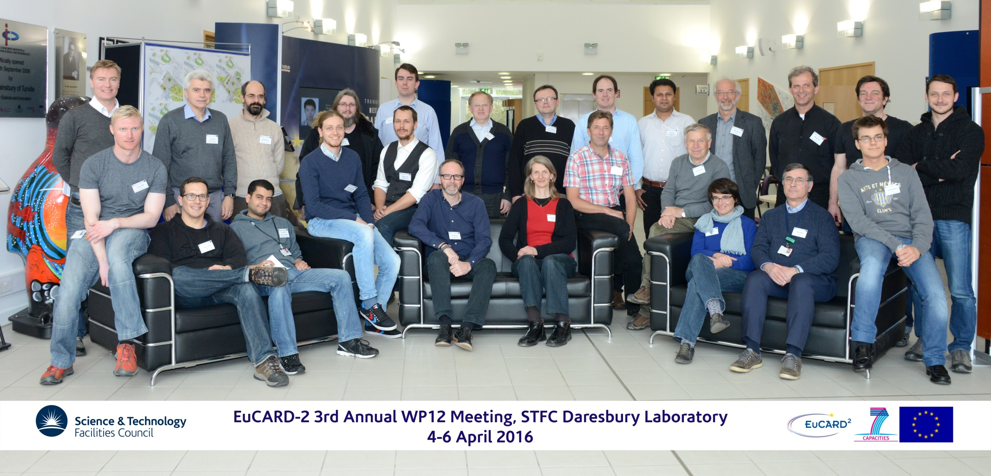

Slide 4

Many thanks to our ASTeC organisers for the excellent hospitality!
  Sue, Marie, Reza & Shrikant particularly.
  Plus all of the ASTeC tour guides – it’s really impressive to see the breadth of research being undertaken!
Many thanks to all Task Leaders and Speakers for a series of really impressive talks!
Really enjoyed this third review
and the fact we continue to
generate significant results!

Slide 5
Impressive Progress Again!
Task 12.2 SRF Thin Films
  First bias coated HIPIMS sample generated – very promising (CERN).
  First A15 phase confirmed with NB₃SN and first V3Si coatings generated (CERN).
  PEALD deposition achieved at 250C, results to be published, ongoing work with NbN (INP).
  QPR commissioned successfully at HZB up to 125mT, sample geometries being optimised (HZB).
  Collaboration areas identified for: substrate complementarity, analysis and material priorities (HZB/CERN).
Task 12.3 High Gradient NC
  CLIC crab cavity high power tested and breakdown analysis and post-mortem completed (ULAN/CERN).
  High efficiency TH2166 ‘kladistron’ design developed by CEA, >65% efficiency predicted, prototype being developed and hardware now being produced by Thales, tests expected by end 2016 (CEA/Thales).
  First high-resolution, WFM electronics systems being installed in SwissFEL, first commissioning in Jun16 (PSI).
  Flexible modulator development underway with Scandinova, accommodate variety of different klystrons with the same K2/3 modulator platform (UU/Scandinova).
Task 12.4 SRF HOM Diagnostics
  Cavity characterisation at 1.3 GHz and 3.9 GHz completed, beam tests performed on FLASH with good, repeatable performance. Electronics performance to be optimised and noise sources reduced (DESY).
  GSM simulation technique developed, identifying good correlation with experimental measurements, errors sources being explored (UMAN).
  Dangerous intra-cavity HOMs identified at HOM coupler using SSC technique, multi-cavity HOMs evaluated.
Task 12.5 RF Photocathodes
  New photocathode load-lock and transport system designed, fabricated and ESCALAB-II analysis system implemented, bulk metal fabrication processes developed with first experiments expected soon (STFC).
  Compared Pb coating treatment with laser and plasma pulsed-irradiation, good QE performance demonstrated with laser cleaning, new QE measurement system implemented (NCBJ).
  First Mg photo-cathodes prepared and qualified with excellent QE, repeatable performance but sensitive to vacuum conditions (HZDR)
  Preparing long-term Pb/Nb tests of NCBJ prepared PC for further tests with DESY SC gun (HZDR/NCBJ/DESY).

Slide 6
Really nice to see ….
Even more Phd and post-doc students providing high impact in a number of areas.
More Phd students to qualify:
  Thomas Fligsen (UROS) – qualified already
  Ben Woolley (ULAN) – qualified already
  R. Kleindienst (HZB) – to qualify soon
Our results continue to generate journal publications, Accelerating News articles and Monographs:
  Keep up the excellent work!
  Remember to include the correct Accreditation for all publications – IPAC16, HOMSC16, IBIC16, LINAC16, NA-PAC16 and journals!

Slide 7
Many thanks to all for a very productive and enjoyable review!
Looking forward to seeing many of you again for EUCARD-2 Annual Review in 2 weeks @ University of Malta.
Have a safe journey home!

Slide 8


