Slide 1

Mg Photocathode in SRF Gun for medium current e⁻ - beam
Jochen Teichert, Rong Xiang
on behalf of the SRF Gun Crew at ELBE

Slide 2
Outline
Status of SRF Gun II & photocathodes
Laser cleaning for Mg photocathode
Metallic photocathode in SRF gun-II
Summary
EuCARD-2 3rd Annual WP12 Meeting
4-5 April 2015 at STFC Daresbury Laboratory

Slide 3
Future – ELBE User operation
1. Status of ELBE - SRF Gun II & photocathodes
ELBE user requirements for SRF gun (simulstion result @ 7MV/m)
user application | bunch charge | norm trans. emitt. | final bunch length | beam size at IP | average current
IR FELs (13 MHz) | 77 pC | 2.2 µm | < 1 ps |  | 1 mA
Neutrons (100 kHz) | 500 pC |  |  |  | 50 µA
Positrons (500 kHz) | 200 pC |  |  |  | 100 µA
THz radiation (100 kHz) | 350 pC |  | 200 fs |  | 35 µA
CBS x-rays (10 Hz) | 450 pC |  | 1 ps | 30 µm
J. Teichert, ERL2015

Slide 4
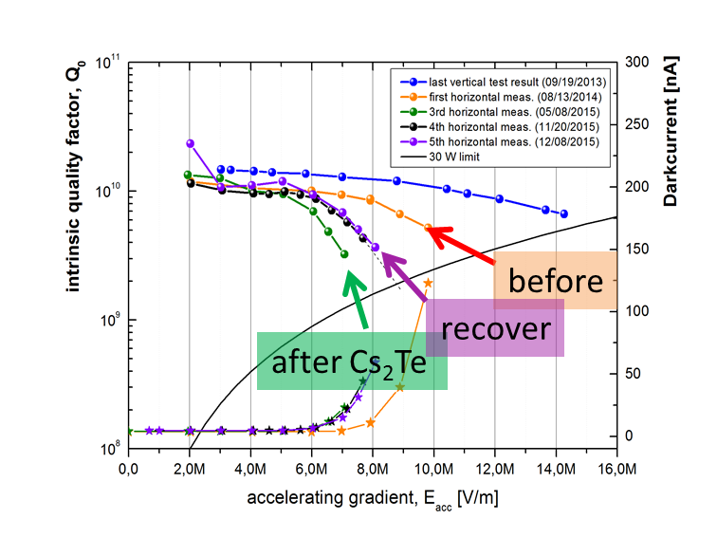
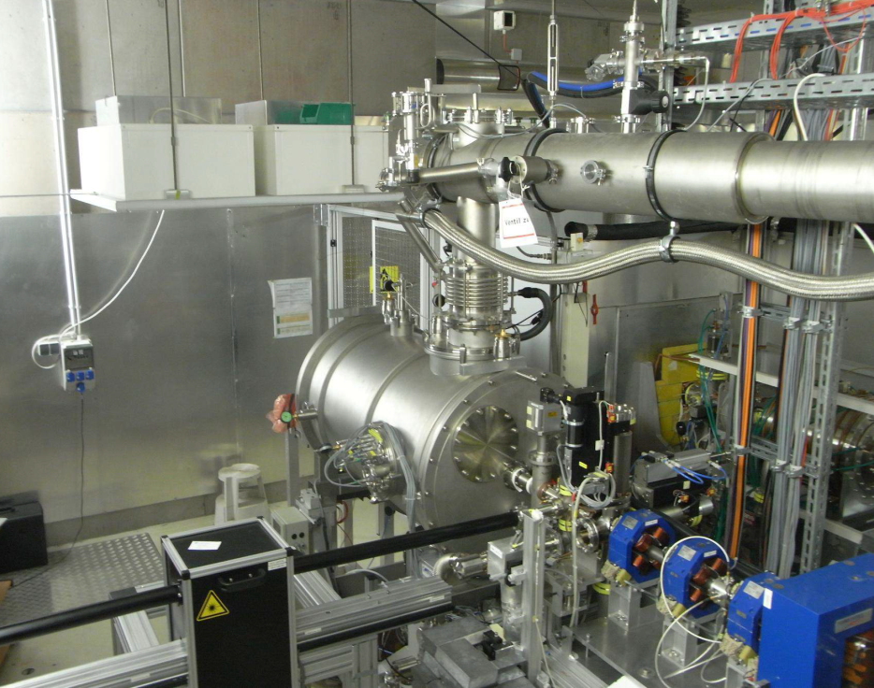
1. Status of ELBE - SRF Gun II & photocathodes
GUN
E_{acc} = 8 MV/m CW (20.5 MV/m peak field)
- 5 kV DC bias @ Cathode
dark current in FC <100 nA @8 MV/m
UV laser: 258 nm, 100 kHz, Gaussian
PHOTOCATHODE
Cu cathode 2 x 10 ⁻⁵ @ 258 nm
the 1st experiment of Cs₂Te in gun failed
Mg cathode
SRF Gun-II in ELBE hall
Notes:
In 2014, the SRF Gun-II has been commissioned with a Cu cathode .
The beam with low bunch charge has been guided into the ELBE.
Gradient of gun cavity degraded strongly after the first Cs₂Te test on 2015-03
and then heal slowly 2015-11 , with Mg cathode 2015-12

Slide 5
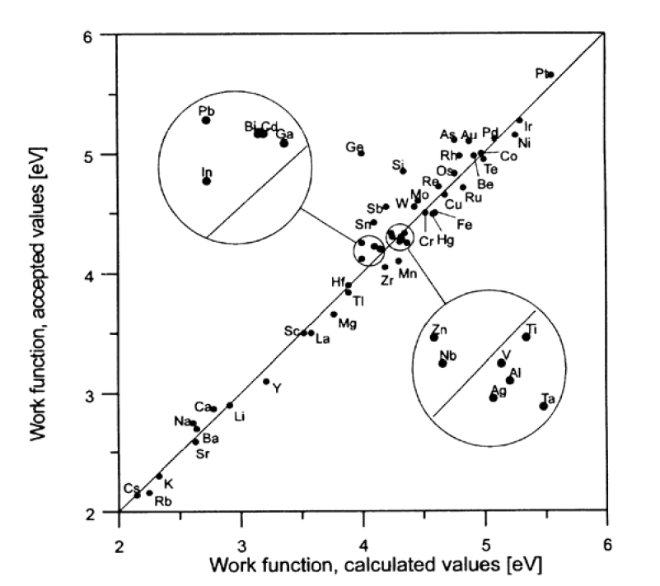
2. Laser cleaning for Mg photocathode
Motivation: to search for a „Clean“ (Cs-free) cathode for SRF gun
Metal (polycrystalline ) | QE (%) | ɸ (eV)
Cu | 10⁻⁶ - 10⁻⁵ | 4.6
Mg | 10⁻⁶ - 10⁻⁴ | 3.6
Mo | 10⁻⁶ | 4.5
Nb | 10⁻⁶ | 4.3
Pb | 10⁻⁶ | 4.25
Working plan:
- laser cleaning test with 200 mW UV laser (√) - Ar⁺ ion beam cleaning
- heating cleaning
Lide, D. R.. Properties of Solids, in: CRC Handbook of Chemistry and Physic, Internet Version 2005. Boca Raton, FL: CRC Press; 2005, P. 124
S. Halas, Materials Science-Poland, Vol. 24, No. 4, 2006
Notes:
highest QE 0.2 % @ 260 nm
MgO layer removal in-situ
- laser cleaning
- ion beam sputtering
long life time in UHV (<1e⁻⁹ mbar)
high e-current up to 100 µA
and up to 500 pC
No cavity contamination from alkali material

Slide 6
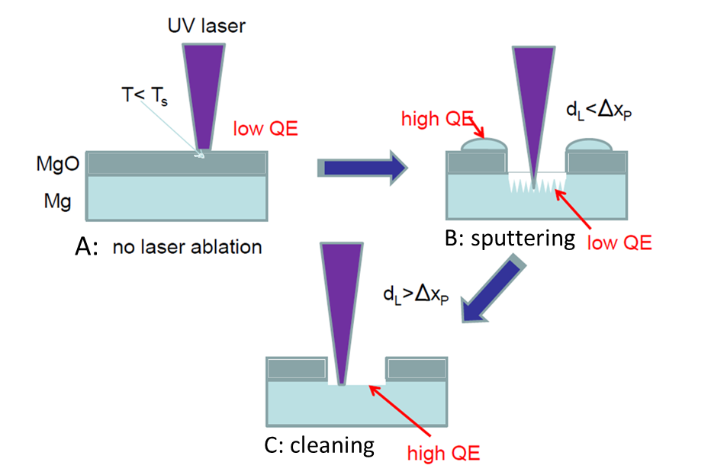
2. Laser cleaning for Mg photocathode
laser parameter:
UV: 258 nm (4.8 eV)
rep. rate: 100 kHz
unltra short pulse: 10ps
mean power: 100 mW
min. spot: r=30 µm
Intensity threshold *
Illuminating duration
Surface roughness of sample
Mono-crystal or poly- Mg
* photoemission in gun 0.1-0.2 W/mm²

Slide 7
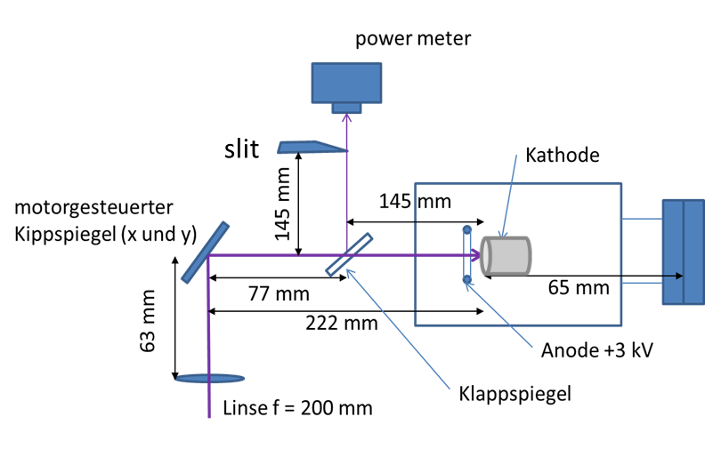
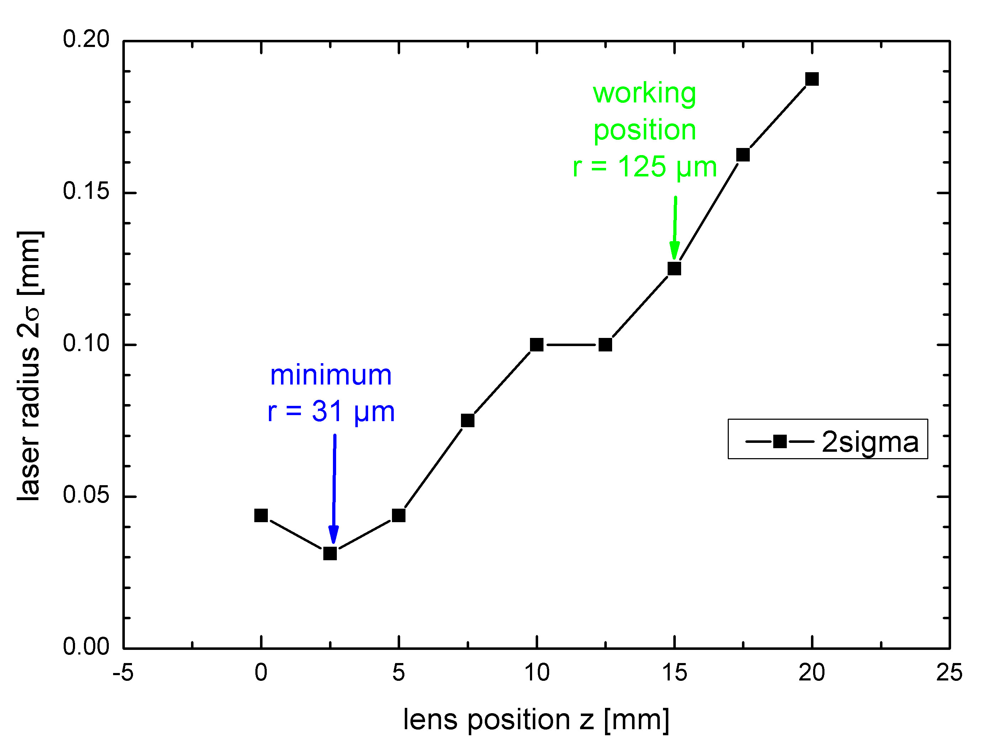
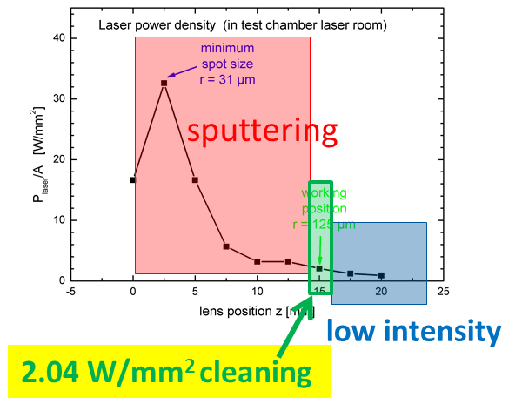
2. Laser cleaning for Mg photocathode
in test chamber
Test chamber with UHV 2×10⁻⁹ mbar
important:
adjust focusing lens position to search for the suitable power density
* photoemission in gun 0.1-0.2 W/mm²

Slide 8
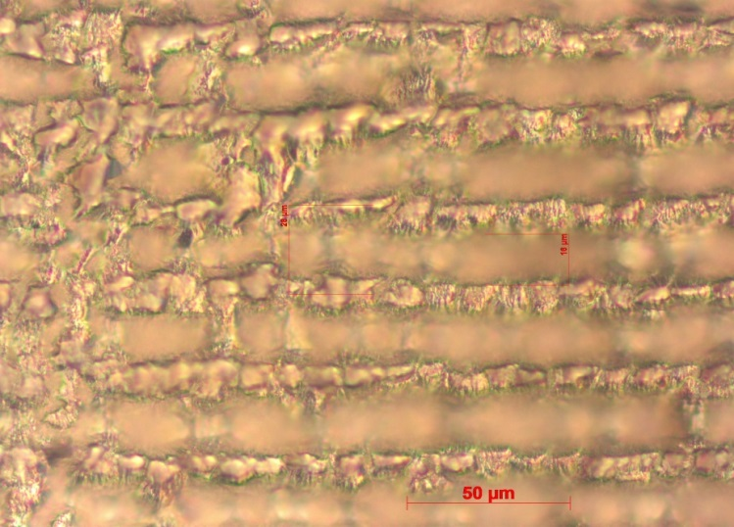
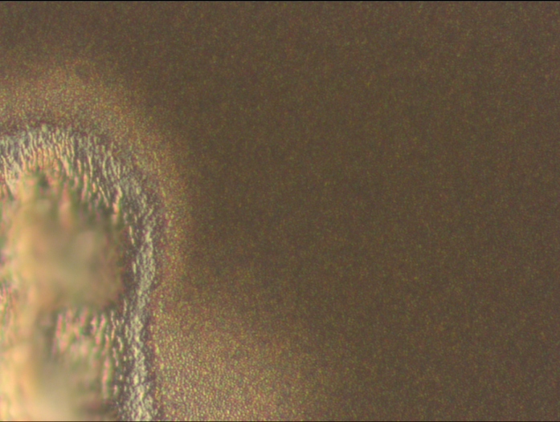
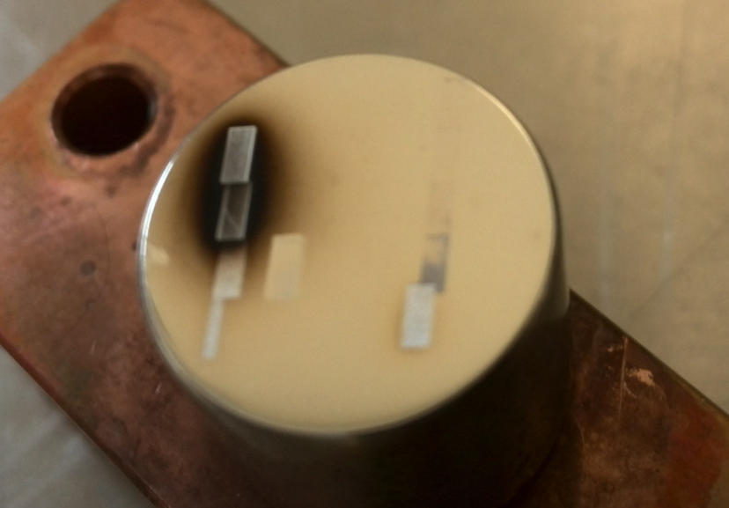
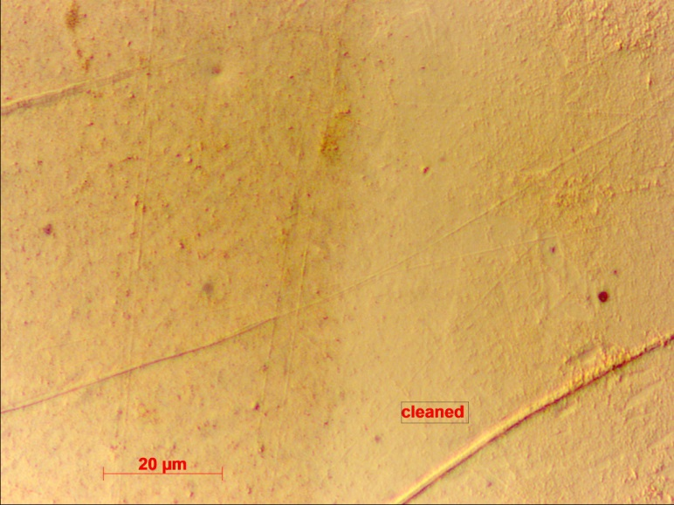
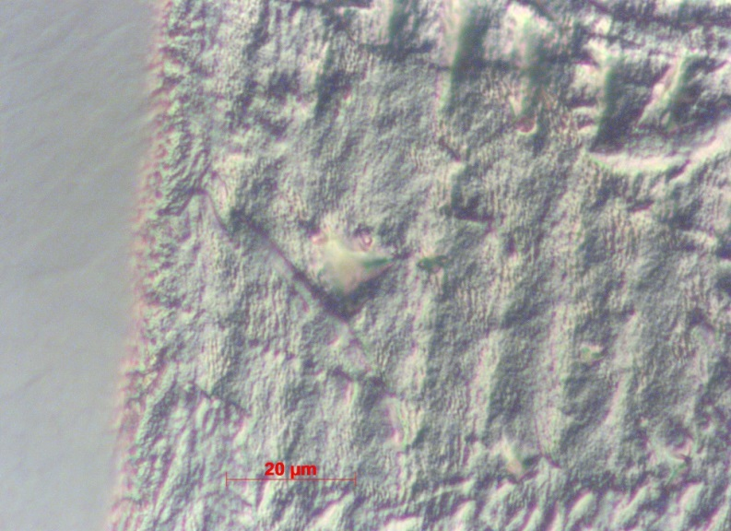
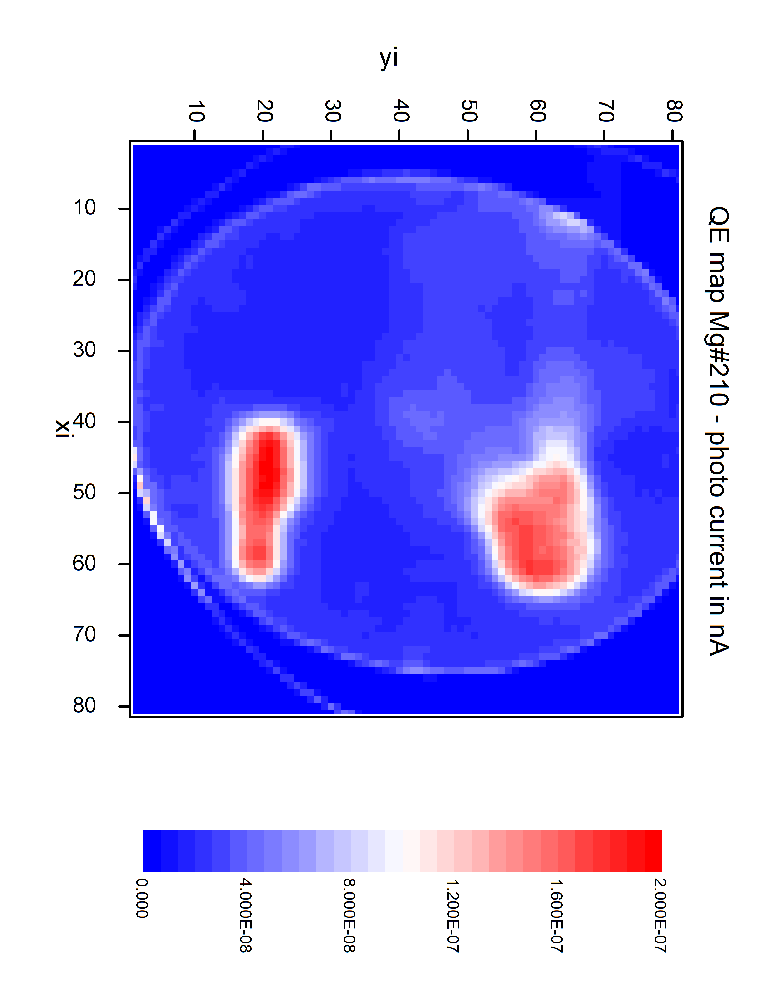
2. Laser cleaning for Mg photocathode
in test chamber
pos.1, x50, strong ablation, ~ 6 µm deep
low QE
x100, sputtered droplets, high QE but very short life time
8
1
Virgin
5
2
6
1: sputtering
3
1: sputtering
4
7
sample #210
pos.4, x100
low QE
pos.7, x100, molten and recondense.
High QE.
4: low intensity
QE mapping
7: clean, 2.04 W/mm²

Slide 9
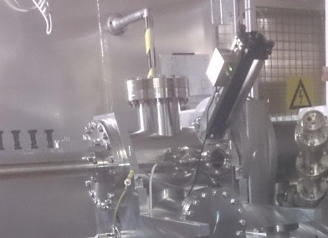
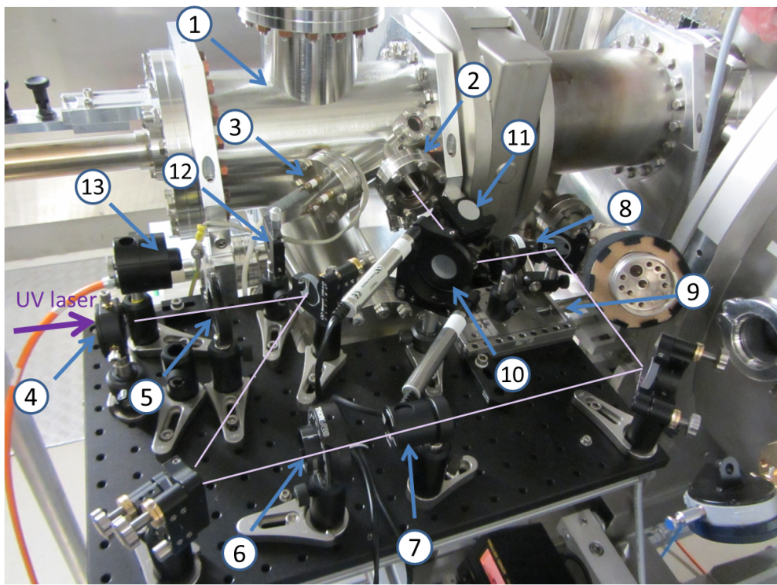
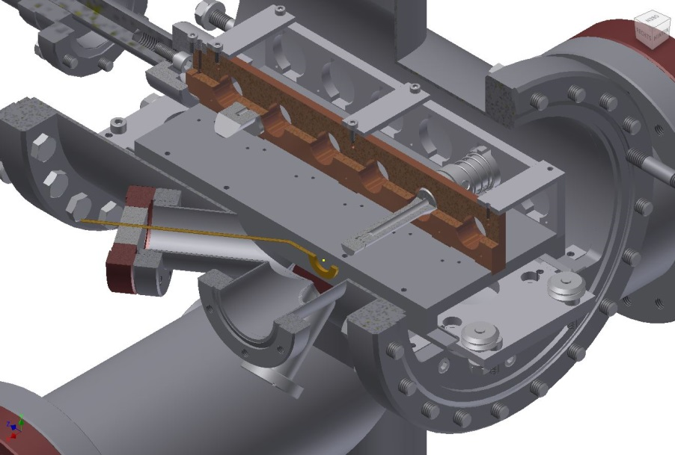
2. Laser cleaning for Mg photocathode
in transport chamber
accurate QE measurement with LED
cathode
Anode
Photograph of laser cleaning setup
window
transport chamber
Notes:
- Transportkammer mit Platz für sechs Photokathoden,
- Quarzglas-Eintrittsfenster für den UV-Laserstrahl,
- HV-Durchführung zur ringförmigen Anode,
- Linse mit f = 250 mm,
- Eintrittsblende,
- Wellenplatte zur einstellbaren Drehung der Polarisationsrichtung,
- Polarisator,
- Fokussierlinse mit f = 200 mm,
- Mikrometertisch zum Positionieren der Fokussierlinse,
- Kippspiegel mit Schrittmotoren,
- Klappspiegel,
- Schneidkanten-Schlitzblende,
- Leistungsmesser

Slide 10
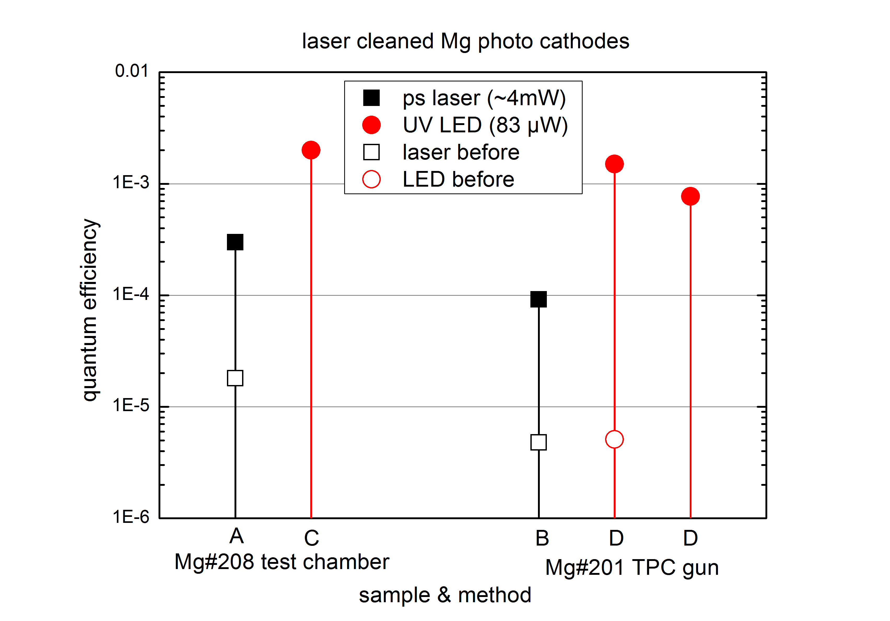
2. Laser cleaning for Mg photocathode
QE measurement
cathode | date | Methode | Place | power | current | QE | Bemerkung
Mg#210
Mg#208 | 18.01.16 | (Laser/K) | Test | 4 mW | 15 nA | 1.8 x 10-5 | before laser cleaning
 | 20.01.16 | (Laser/K) | Test | 3.2 mW | 215 nA | 0.0003 | after
 | 26.01.16 | (LED/K) | Test | 83 µW | 35.12 nA | 0.20% | After
Mg#201 | 13.01.16 | (LED/A) | TPK4/Pos3 | 83 µW | 88 pA | 5.1x10-6 | before laser cleaning
 | 26.01.16 | (Laser/A) | TPK4/Pos3 | 4 mW | 4 nA | 4.8x10-6 | before laser cleaning
 | 02.02.16 | (Laser/A) | TPK4/Pos3 | 4 mW | 76.8 nA | 9.2 x 10-5 | after
 | 03.02.16 | (LED/A) | TPK4/Pos3 | 83 µW | 25.25 nA | 0.15% | after
 |  | (LED/A) | TPK4/Pos3 | 83 µW | 13.35 nA | 0.077% | after
Mg#202 | 17.02.16 | (Laser/A) | TPK4/Pos4
Mg#207 | 17.02.16 | (LED/A) | TPK4/Pos2 | 83 µW | 35-40 nA | 0.2 -0.23%
 | 18.02.16 | (LED/A) | TPK4/Pos2 | 83 µW | 14.2 nA | 0.08%
Mg#211
Cu | 13.01.16 | (LED/A) | TPK4/Pos3 | 83 µW | 56 pA | 3.2x10-6 | Jörg
QE 10⁻³

Slide 11
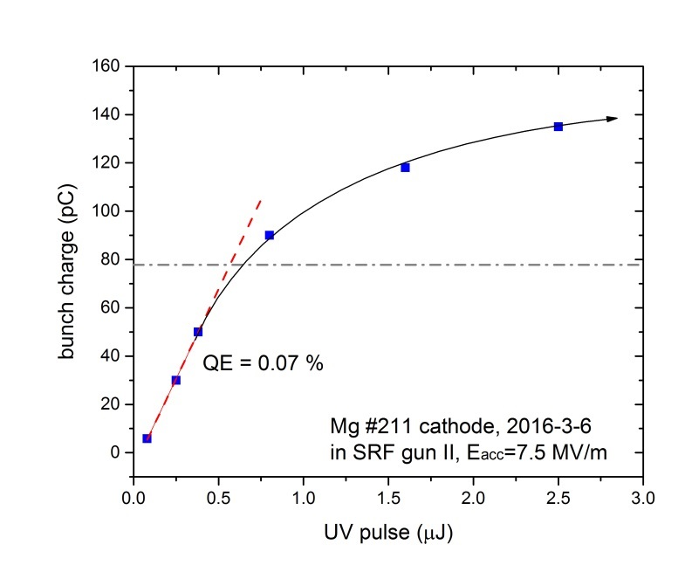
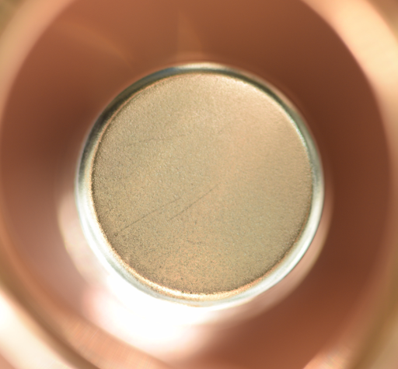
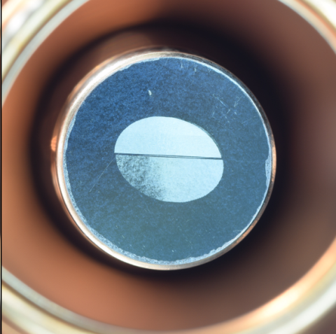
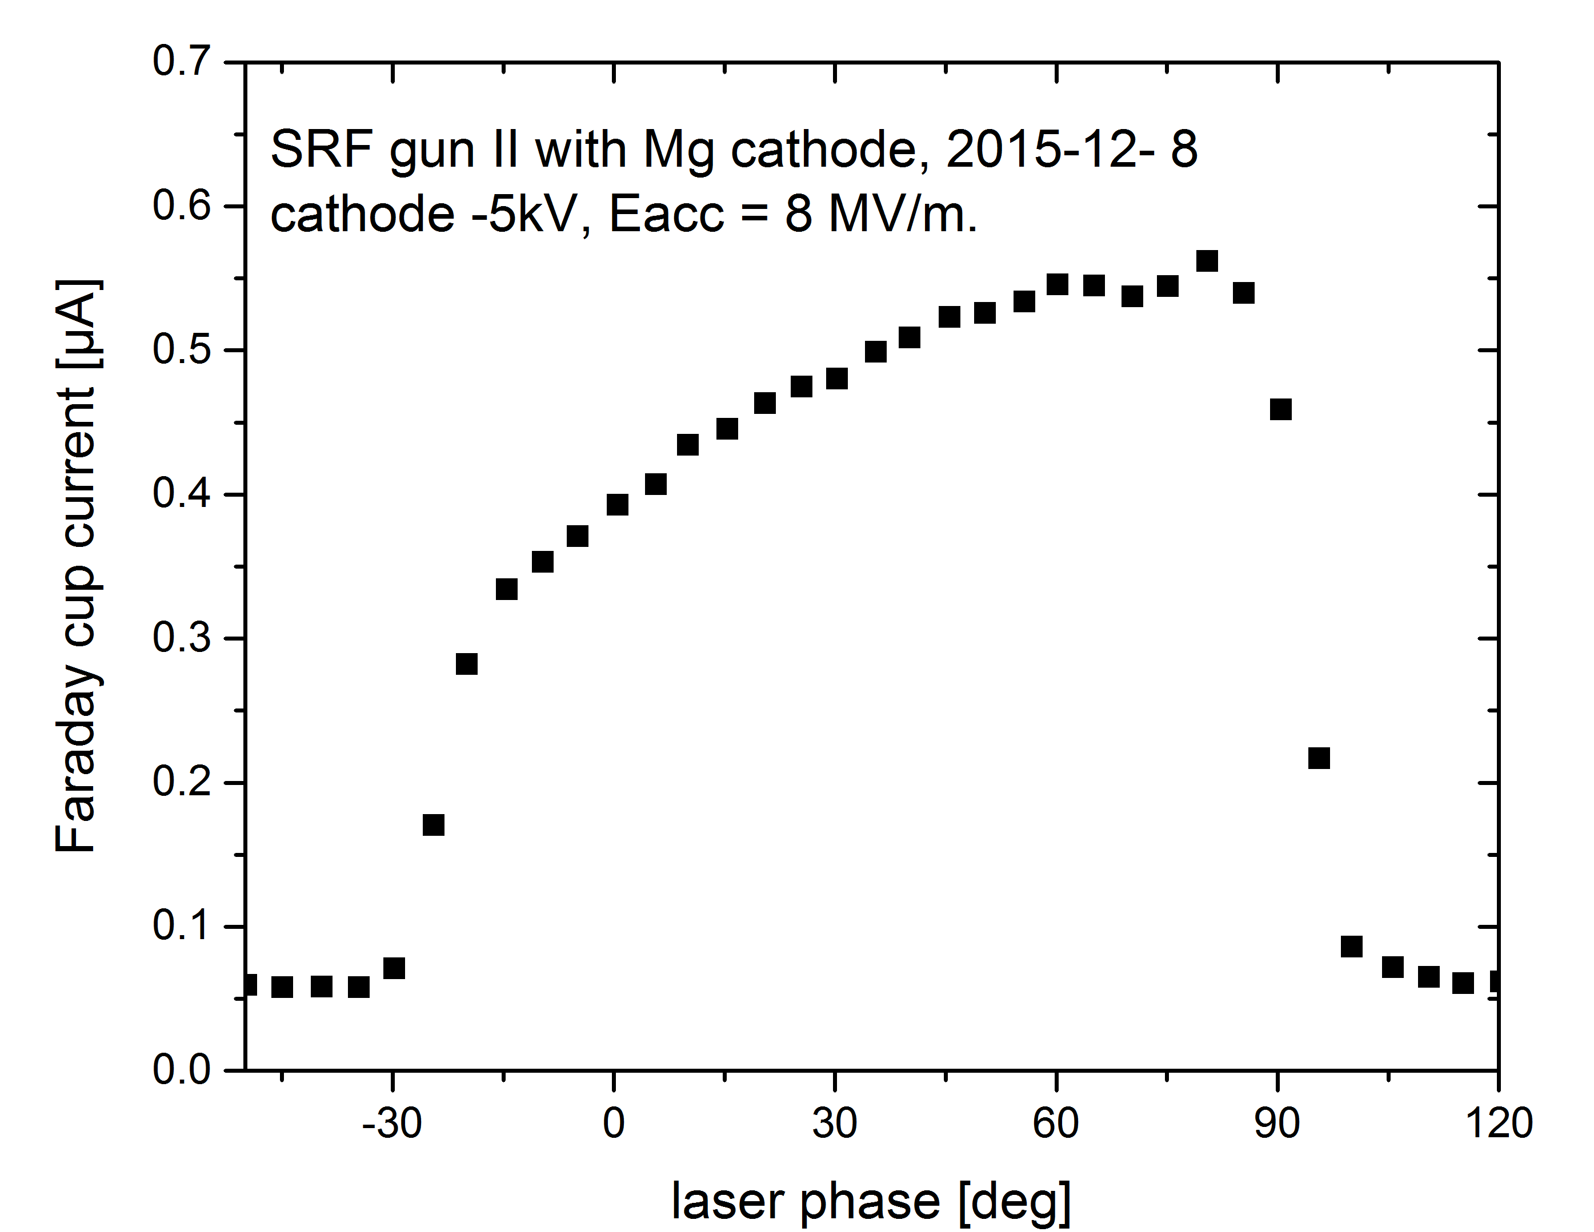
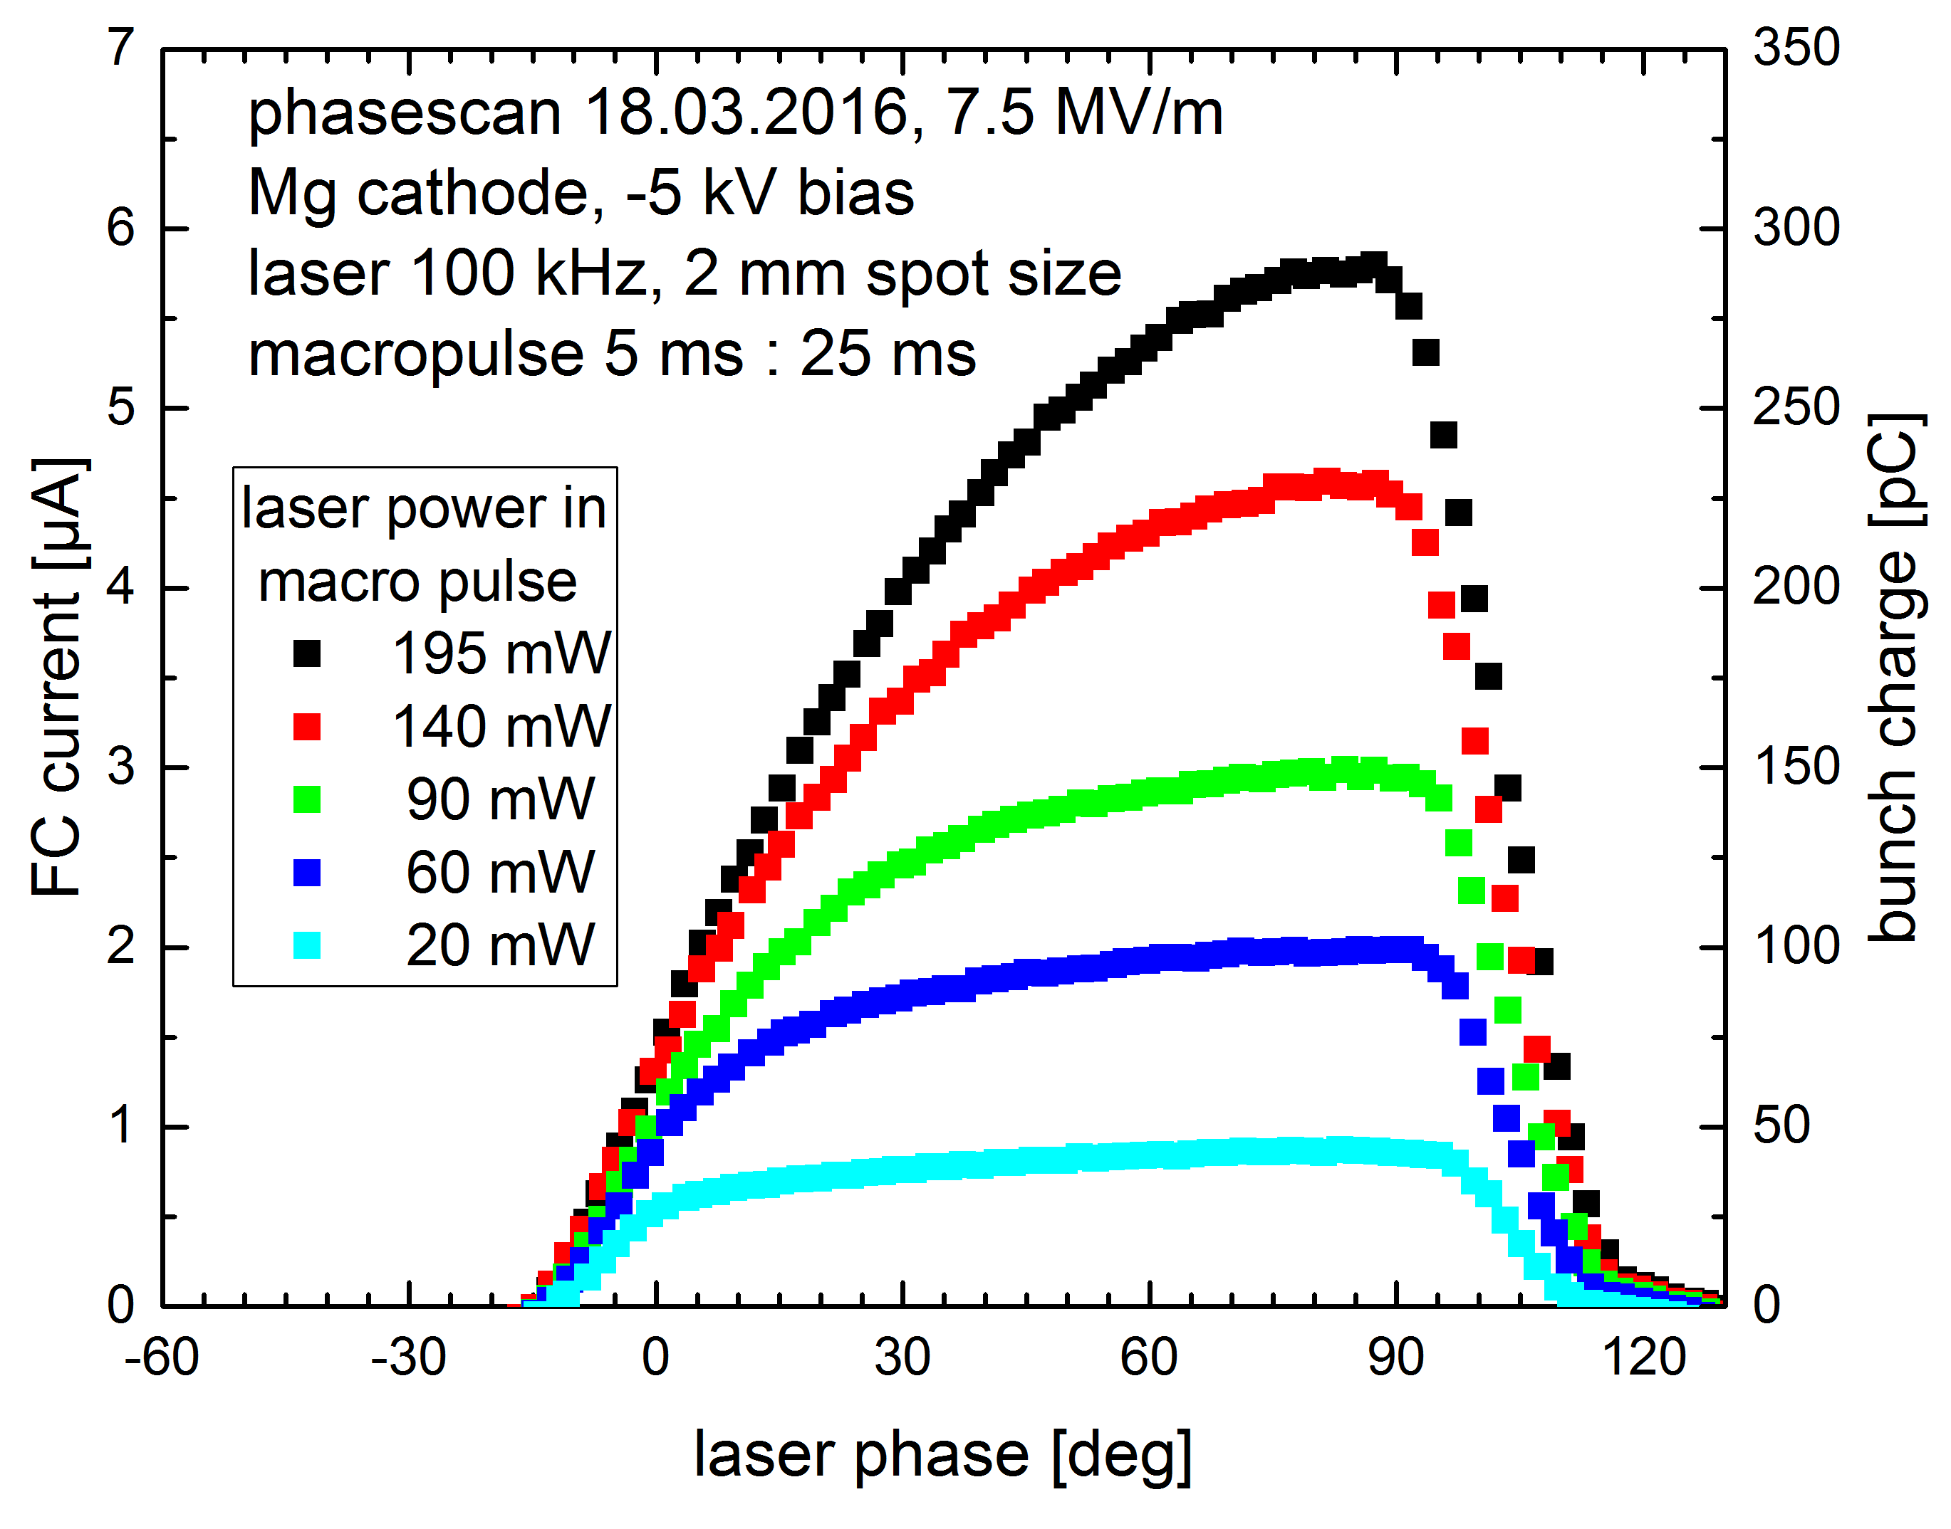
3. Mg photocathode in SRF gun-II
Laser phase scan and QE of Mg photo cathode in SRF gun
2015.12.7 Mg ~ 10⁻⁵
2016.03.05 Mg ~ 10⁻³
Schottky effect

Slide 12
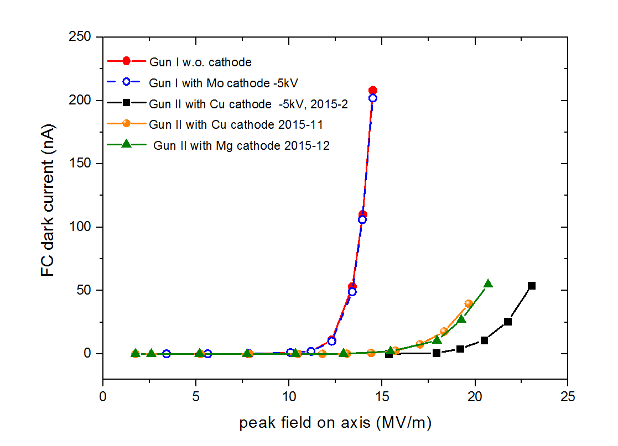
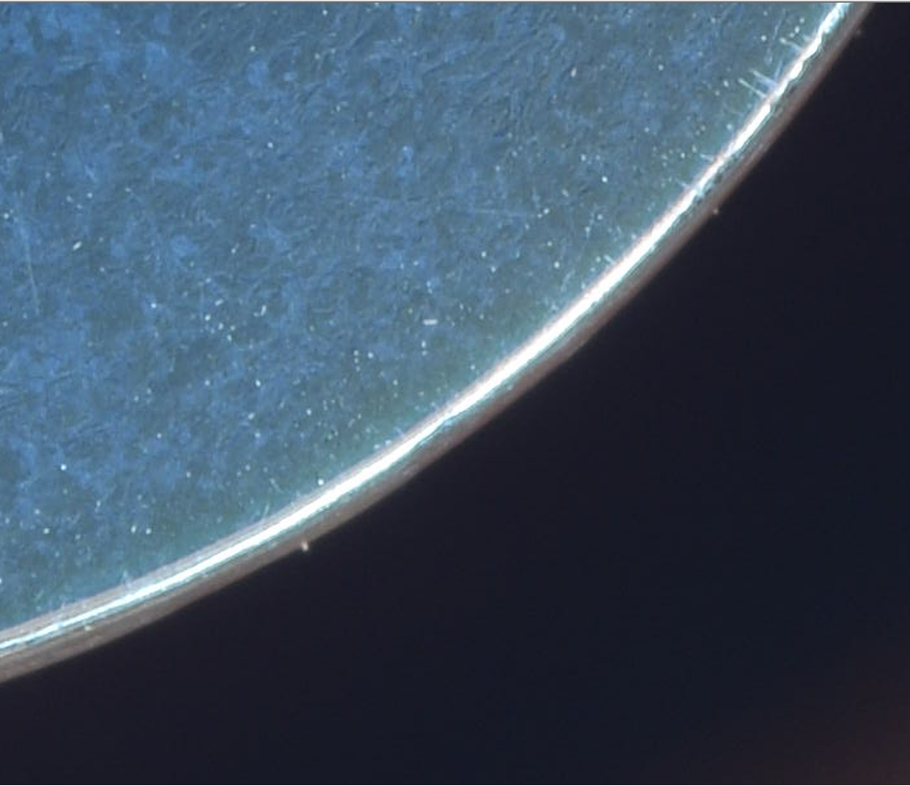
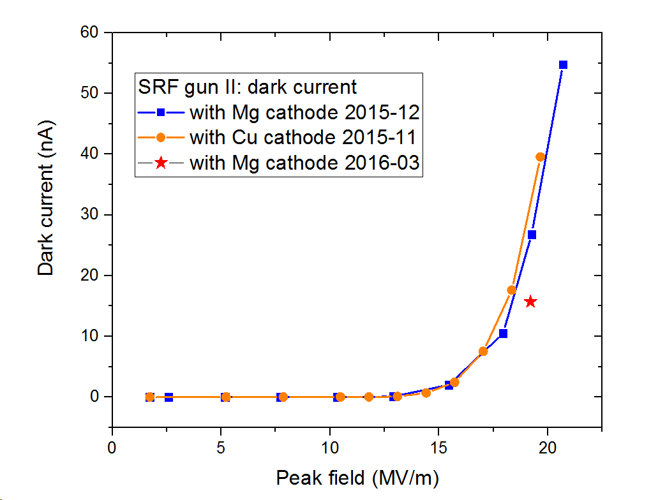
3. Mg photocathode in SRF gun-II
Dark current
Gun-I
polished and cleaned Poly- Mg plug ɸ 10mm
Gun-II
scratch and particles: field emission risk
E_{cath}=E_{peak} x 0.6
β_{Mg}= 428 (3.6eV)
β_{Cu}= 568 (4.6eV)

Slide 13
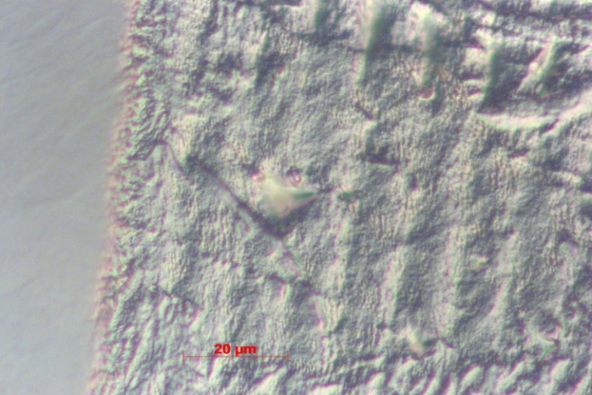
3. Mg photocathode in SRF gun-II
QE increased 2 orders of magnitude
removal of the surface contamination (MgO, ɸ: 4.2eV)
plasmon enhanced photoemission due to roughness (nm level)*
Experiment very well repeatable
Cleaned Mg is very sensitive
stable in 10⁻⁹ mbar
10⁻⁸mbar, loses 60% of QE in the 1st day
Effect of surface change
reduced work function
thermal emittance
dark current
virgin
cleaned
*Qian, H. J. et al., Applied Physics Letters, 97, 253504 (2010)

Slide 14
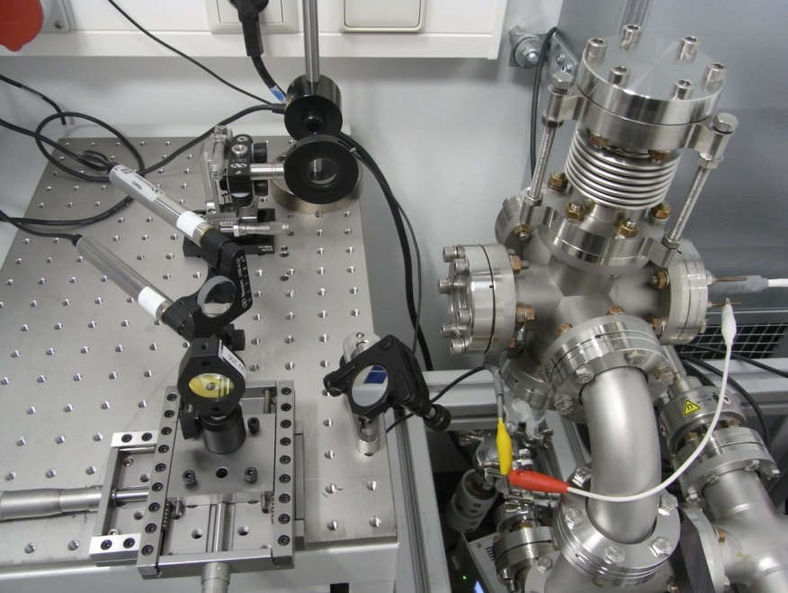
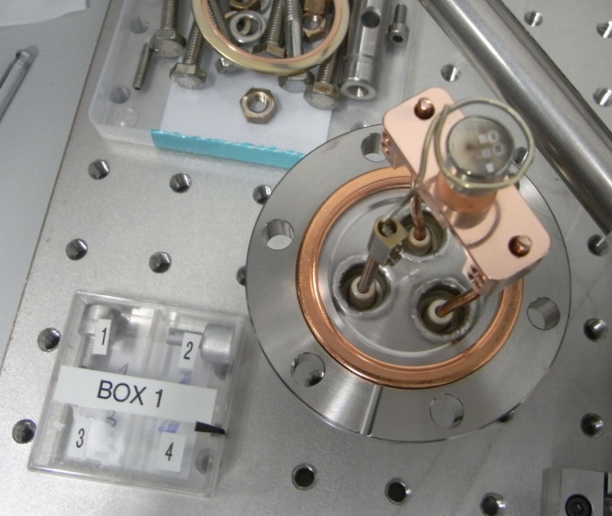
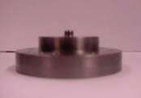
Long-term photo emission test of a Pb/Nb photo cathode at HZDR
Test chamber for laser cleaning in
the UV drive laser room
Nb plug from DESY for SC cavity
Pb layer deposition at NCBJ Swierk
at HZDR:
laser cleaning, QE measurements
performance test with several weeks laser irradiation @ 258 nm
using the ELBE SRF gun drive laser in the nights
Pb/Nb plug of the SC gun cavity

Slide 15
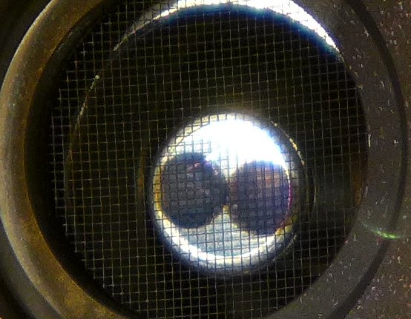
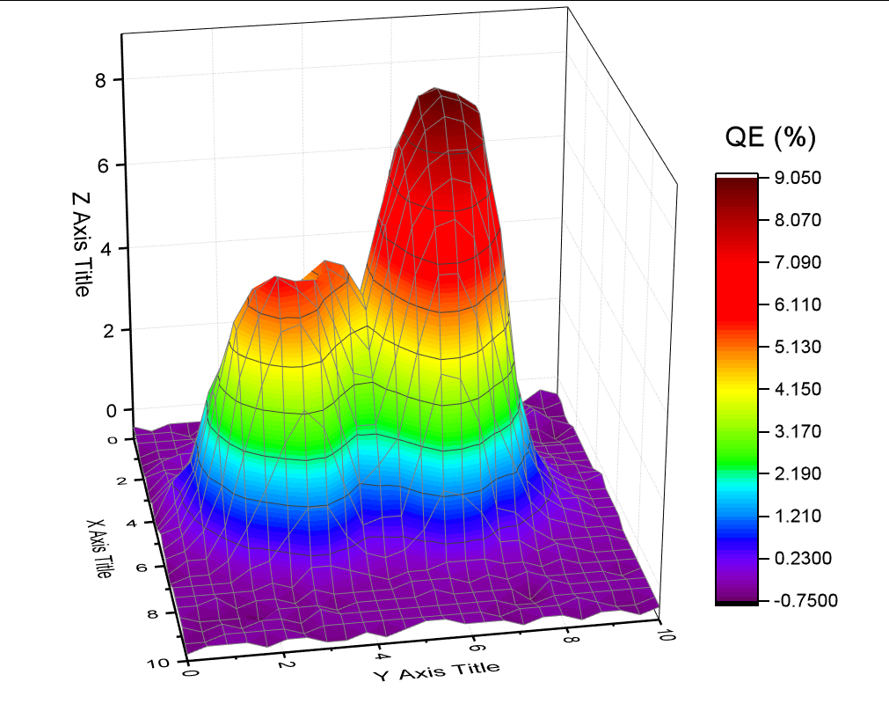
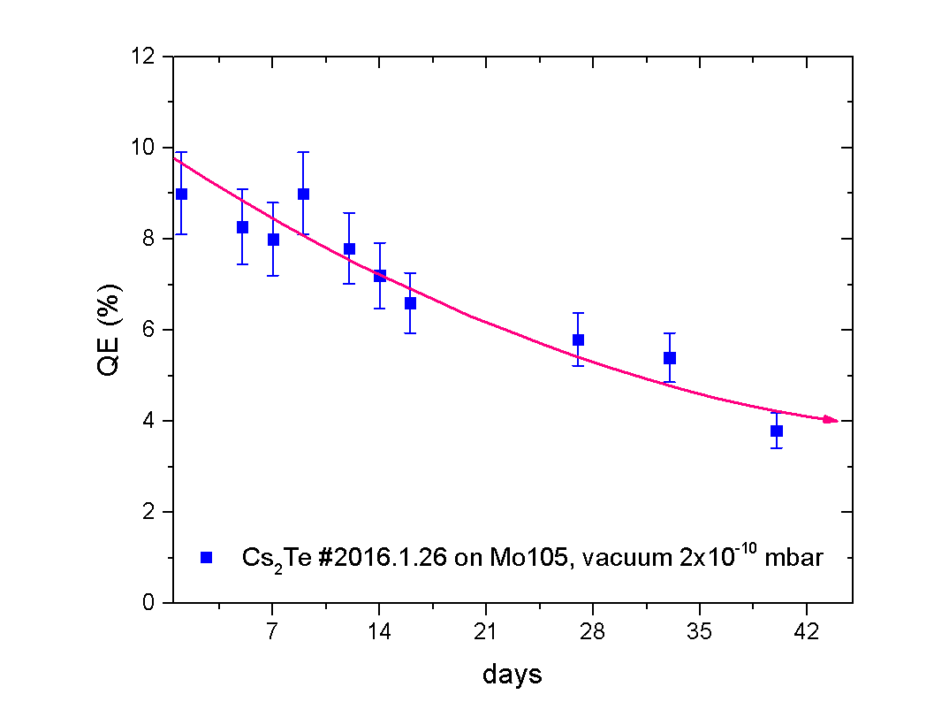
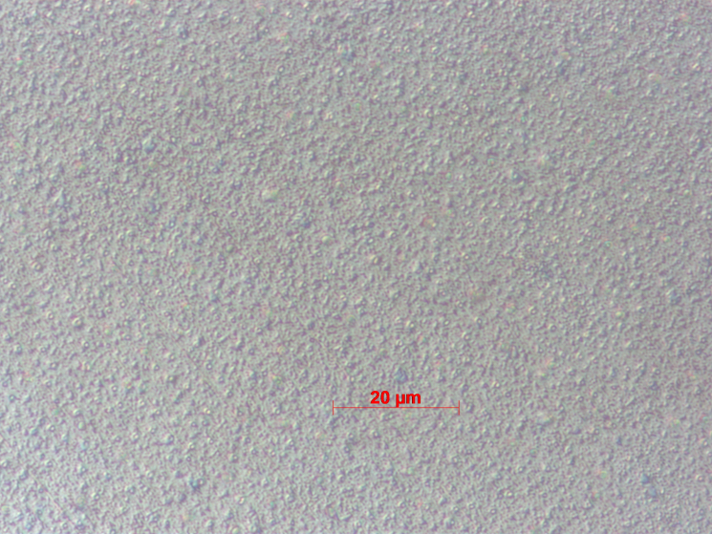
Cs₂Te will be carefully going on… SRF Gun-II will run with Cs₂Te in 2016.
test plug with two Cs₂Te emitters behind mesh for QE mapping
homogenious Cs₂Te under microscope x100
QE is above 1%
Notes:
Carbohydrates

Slide 16
4. Summary
SC RF gun with NC photocathode is promising but very challenging …
Metallic photocathodes are safe for SC cavity.
Cu for the gun commissioning and low bunch charge measurement
Mg can reach high QE of 10⁻³ , for medium current application.
Semiconductor photocathodes for high bunch charge /high current
Cs₂Te will be back in SRF gun in 2016
GaAs (Cs,O), GaN(Cs) considered as candidates (proposed HOPE2)
Cs₂KSb from HZB

