Slide 1

Evaluating Federated Data Infrastructure in Russian Academic Cloud for LHC experiments and Data Intensive Science
17th International workshop on Advanced Computing and Analysis Techniques in physics research (ACAT)
A.Klimentov, A.Kiryanov, D.Krasnopevtsev, A.Zarochentsev and P.Hristov
Brookhaven National Laboratory
National Research Center “Kurchatov Institute”
St.-Petersburg State University
Petersburg Nuclear Physics Institute
CERN

Slide 2
Main Topics
Original Motivation
Requirements to Federated Data Storage
Technology Choice
Test infrastructure and methodic
  Synthetic tests
  ATLAS and ALICE test suite
Preliminary results and future plans

Slide 3
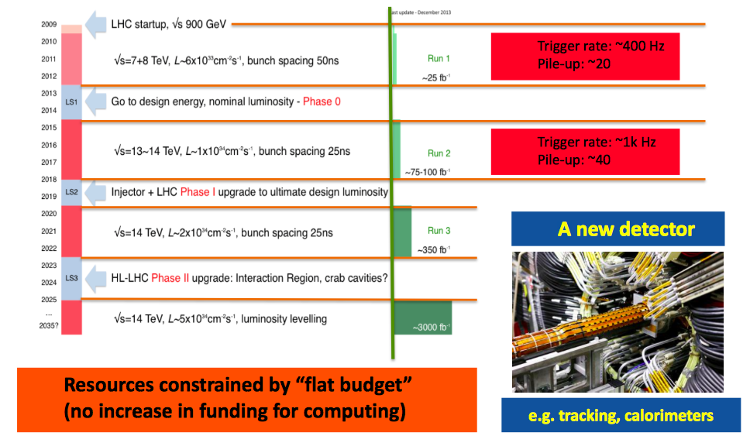
LHC Challenges. The Run2 and beyond

Slide 4
LHC Computing Scale of Needs
Run1
Run2
Run4
ATLAS
+
CMS
Run3
ALICE
+
LHCb
CPU needs per event
RAW data volume
CPU needs (per event) will grow with track multiplicity (pileup) and energy
Storage needs are proportional to accumulated luminosity
Grid resources are limited by funding

Slide 5
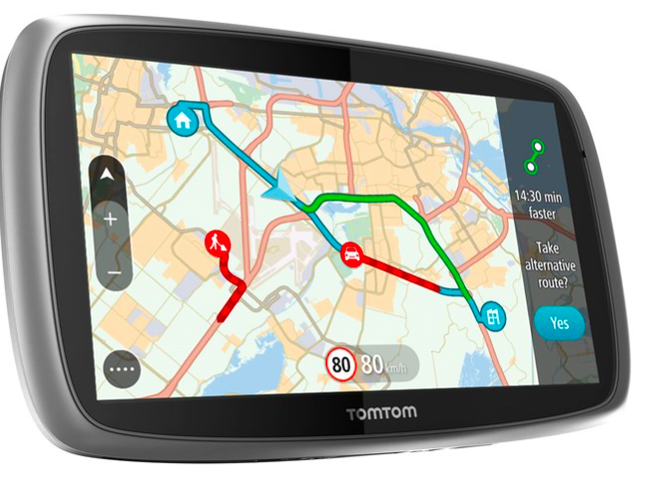
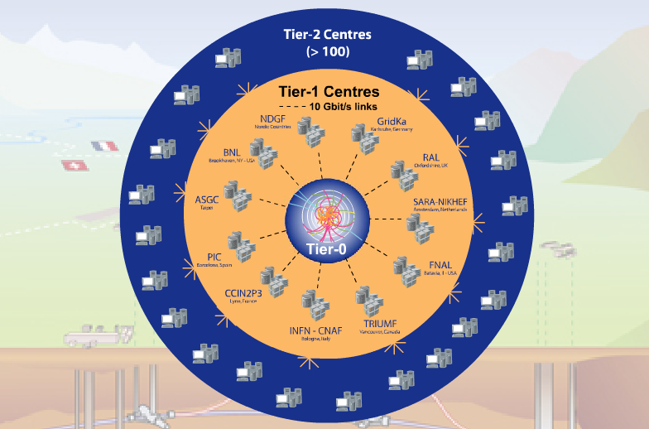
LHC Computing Challenges
A lot of data in a highly distributed environment.
  Petabytes of data to be treated and analyzed
    For example ATLAS managed data volume ~160 PB, distributed world-wide to O(100) computing centers and analyzed by O(1000) physicists
    ATLAS Detector generates about 1PB of raw data per second
    More than a hundred of computing centers had to work together
  Dozens of complex applications
Very large international collaboration
  Hundreds Institutes and Universities from many countries
  Thousands of physicists analyze the data
But the landscape has changed
Have we updated the maps ?
LHC Experiments use grid computing paradigm to organize distributed resources;
A few years ago Cloud Computing RnD projects were started to explore virtualization and clouds
Now we are evaluating how high-performance and super-computers can be used for data processing and analysis and disks federation and try to reduce complexity.
15%
45%
40%

Slide 6
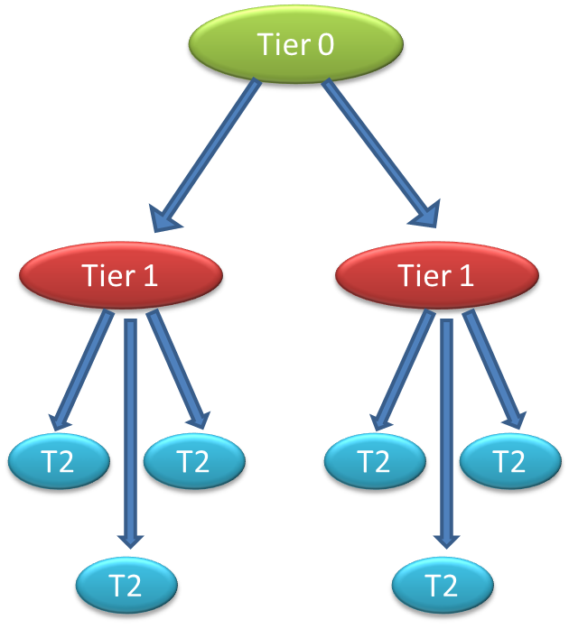
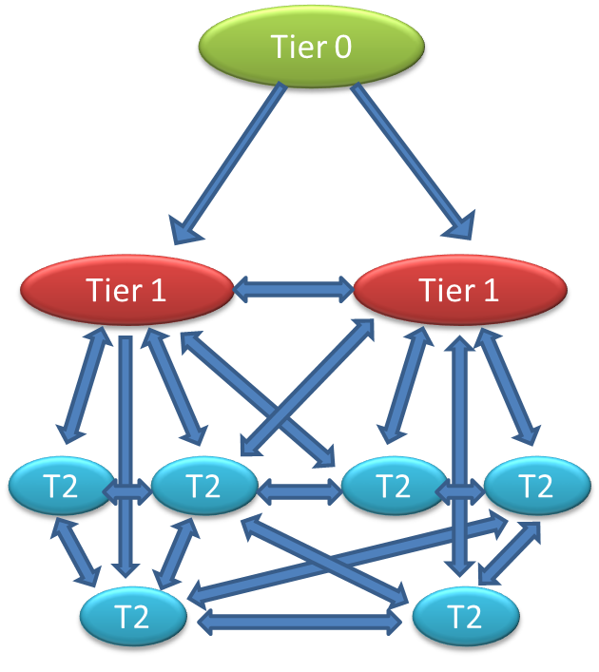
How to Face the Run2+ Challenges. Reducing Complexity.
Evolution of computing models
Hierarchy
Mesh
Network capabilities and data access technologies have significantly improved our ability to use resources independent of location
Relaxing hierarchical model : Flat instead of Tiered Grid model

Slide 7
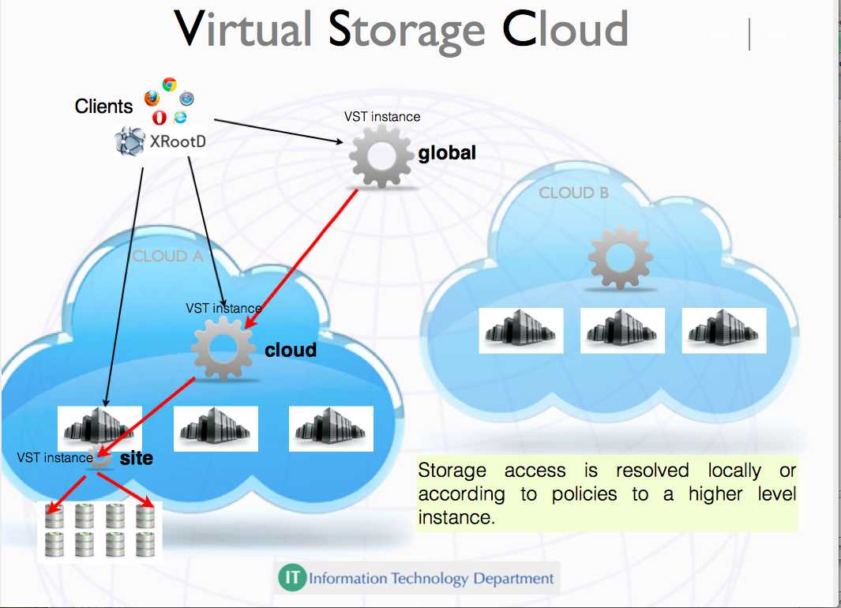
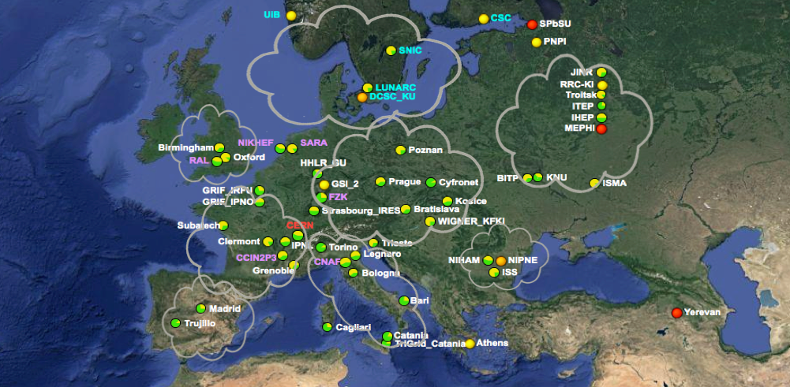
How to Face the Run2+ Challenges. Reducing Complexity. Cont’d.
CERN-IT : site or cloud is represented by
Virtual Storage Cloud Node
Xrootd ATLAS Federation (FAX)
ALICE :
Virtually joining together the sites based on proximity (latency) and network capacity into Regional Data Clouds
  Each cloud/region provides reliable data management and sufficient processing capability
  Dealing with handful of clouds/regions instead of the individual sites

Slide 8
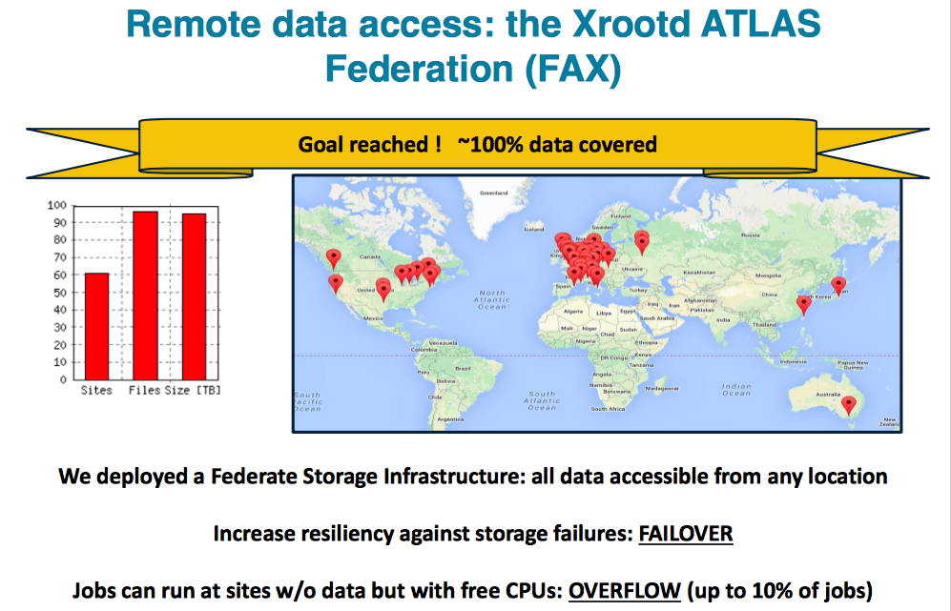
ATLAS Federation (FAX).
S.Campana CHEP2015

Slide 9
R&D Project Motivation
Computing models for the Run3 and HL­LHC era anticipate a growth of storage needs of at least two orders of magnitude.
The reliable operation of large scale data facilities need a clear economy of scale.
A distributed heterogeneous system of independent storage systems is difficult to be used efficiently by user communities and couples the application level software stacks with the provisioning technology at sites.
  Federating the data centers provides a logical homogeneous and consistent reliable resource for the end users
Small institutions have no enough people to support fully-fledged software stack. Distributed stuff like FAX, ALICE xrootd, EOS@CERN, AAA / CMS, dCache, etc (mostly) works.
  In our project we try to analyze how to set up distributed storage in one region and how it can be used from Grid sites, from HPC, academic and commercial clouds, etc.

Slide 10
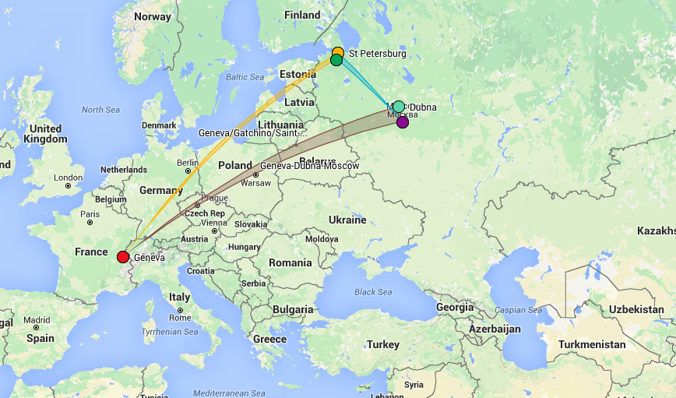
Sites and “triangles”.
SPbSU
PNPI
JINR
NRC KI
CERN
Tested : T2 (ATLAS, PNPI, Gatchina), T2 (ALICE, SPbSU, Petergof), CERN
Ready for tests : T2 (ATLAS, PNPI, Gatchina), T2 (ALICE, SPbSU, Petergof), T1 (NRC-KI, Moscow)
Planned : T0 (JINR, Dubna, NICA), T0/T1 (NRC KI, Moscow, FAIR), T0 (CERN, LHC)

Slide 11
Incomplete List of Requirements
Single entry point
Should be usable by major “players” (at least 2-3 LHC experiments)
  And it should be interested to the future experiments beyond LHC
Scalability and Integrity
  it should be easy to add new sites
Data transfer optimization: transfers should be routed directly to the disk servers avoiding intermediate gateways and other bottlenecks
Stability. Fault tolerance.
  core components redundancy
Built-in virtual namespace, no dependency on external catalogues

Slide 12
Technology choice.
We had to find a solution that supports federation of distributed storage resources. This very much depends on a transfer protocol support for redirection. Two protocols that are good at it are xroot and HTTP.
  HTTP-based federation is implemented in DynaFed software developed by IT/SDC group at CERN. This software is highly modular and only provides a federation frontend while the storage backend (s) have to be chosen separately. It would be interesting to try it out but we were looking for more all-in-one solution.
  xroot-based solution is EOS. It’s also developed (and supported) at CERN, has characteristics closely matching our requirements.
    We decided to try it first and then to repeat the same with dCache.

Slide 13
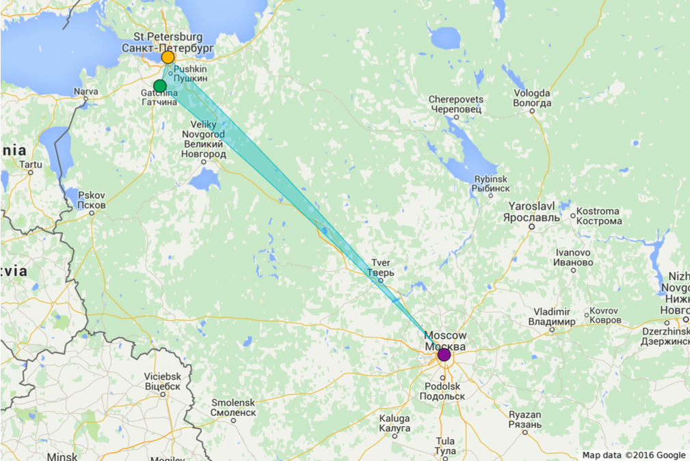
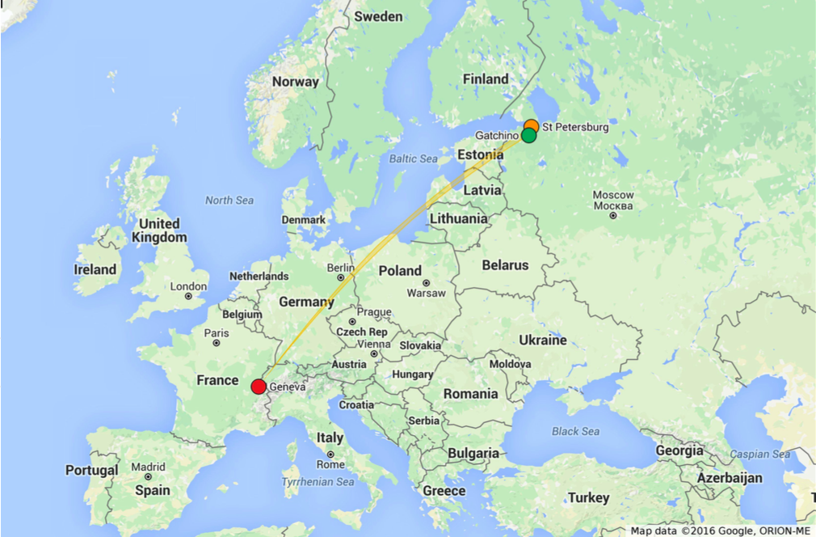
Testbed Infrastructure and Configuration
CERN :
  MGM (master) + perfSonar + UI
NRC-KI
  perfSonar
SPbSU
  MGM (master) + FST+ perfSonar + UI
  MGM (slave) + FST + perfSonar + UI
PNPI :
  MGM (master) + FST + perfSonar + UI
  MGM (slave) + FST + perfSonar + UI
No dedicated network
Commodity servers, disks and switches
Test servers set-up
  Base OS: SL6/x64
  EOS Aquamarine
  Authentication scheme: GSI
Tests
  Bonnie++ (file I/O test on FUSE-mounted file system)
  ATLAS test: standard ATLAS event reconstruction workflow with Athena
  ALICE test: sequential ROOT event processing
PerfSONAR
  Network performance monitoring
EOS
  MGM – management server
  FST – file storage server, storing file’s by file id
  UI : User’s I/F to handle system configuration
perfSonar
  widely-deployed test and measurement infrastructure that is used by science networks and facilities around the world to monitor and ensure network performance

Slide 14
Conducted Tests
Synthetic tests :
  Bonnie++
    PNPI FST local
    SPbSU FST local
    UI PNPI to ALL
    UI SPbSU to ALL
    UI CERN to ALL
  PerfSonar
    CERN-PNPI
    CERN-SPbSU
    PNPI-SPbSU
HENP test suite
  ATLAS TRT Reconstruction/Analysis (files distributed between two servers)
    ATLAS objectives:
      One of the important studies to understand ATLAS Inner Detector performance at high occupancy conditions is а reconstruction of proton-proton events with large number of interactions in Transition Radiation Tracker. It is actually great challenge for computers since events reconstruction in TRT require reconstruction of each hit on track for events with high number of simultaneous interactions. Important feature of every ATLAS standard reconstruction job is the presence of very detailed log files with information about CPUs used during the operation. Calculations from these log files can be used to study the performance of new federated system. Output files after the reconstruction can be also tested on physics to validate SW on a different clouds (storage parts).:
    Input RAW data files for reconstruction are located on the different storages:
    Data accessed locally and remotely, the output is always local
    UI PNPI to ALL (fuse, xrootd)
    UI SPbSU to ALL (fuse, xrootd)
    UI CERN to ALL (fuse, xrootd)
    Launching of the identical tasks with identical input files but located on alternative storage elements allow us to estimate I/O efficiency and benefits of distributed federated storage vs local (Grid) storage
  ALICE events selection (files distributed between two servers)
    ALICE Objectives.
      Read event by event, select events according to criteria (TPC “pattern”) and store them in output file. Both input and output are ROOT files
    UI PNPI to ALL (fuse, xrootd)
    UI SPbSU to ALL (fuse, xrootd)
    UI CERN to ALL (fuse, xrootd)

Slide 15
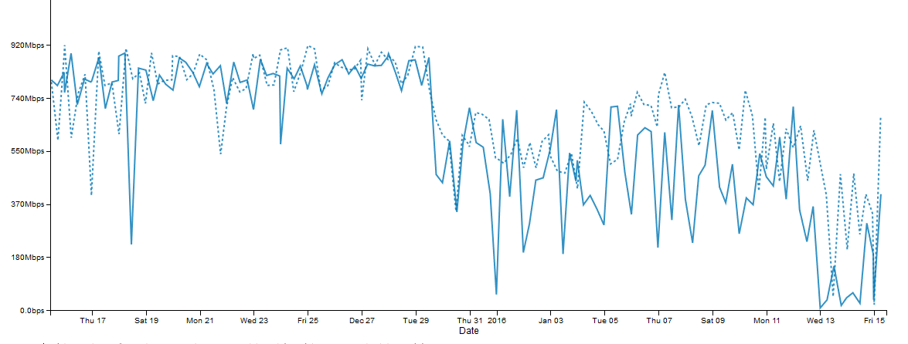
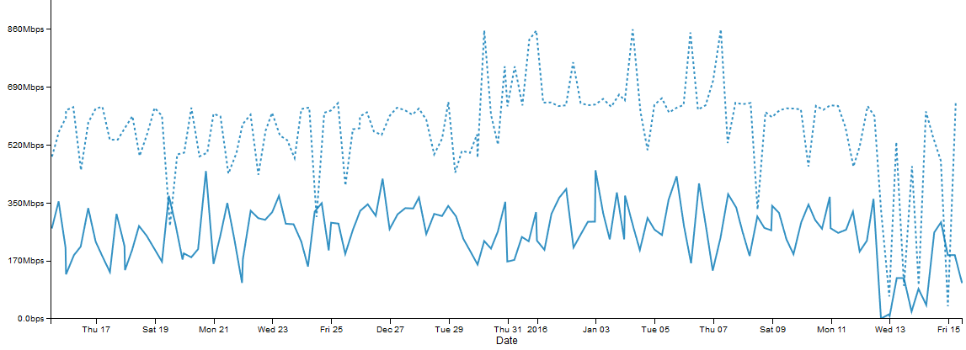
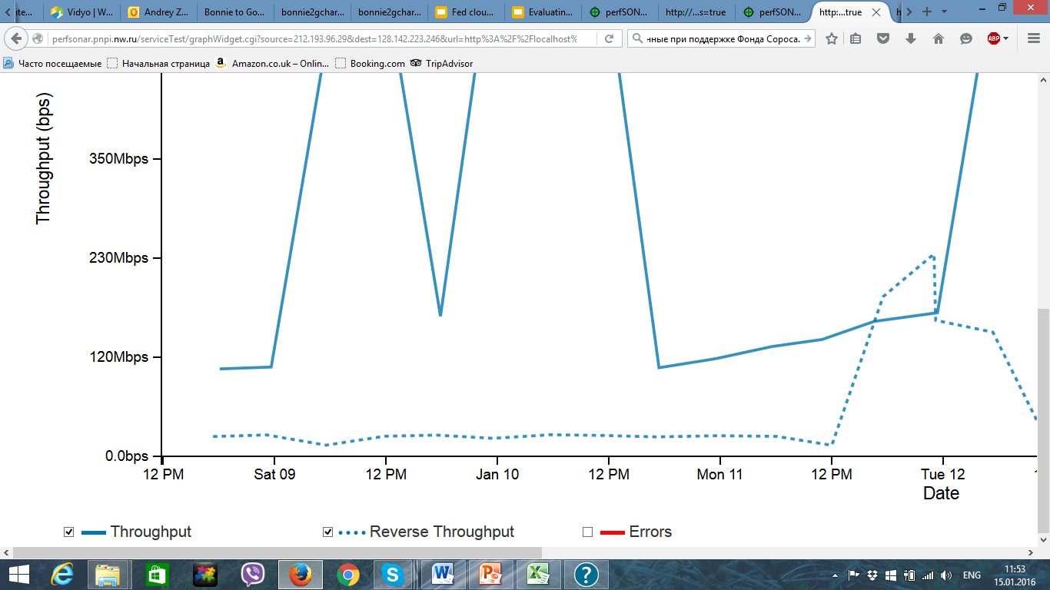
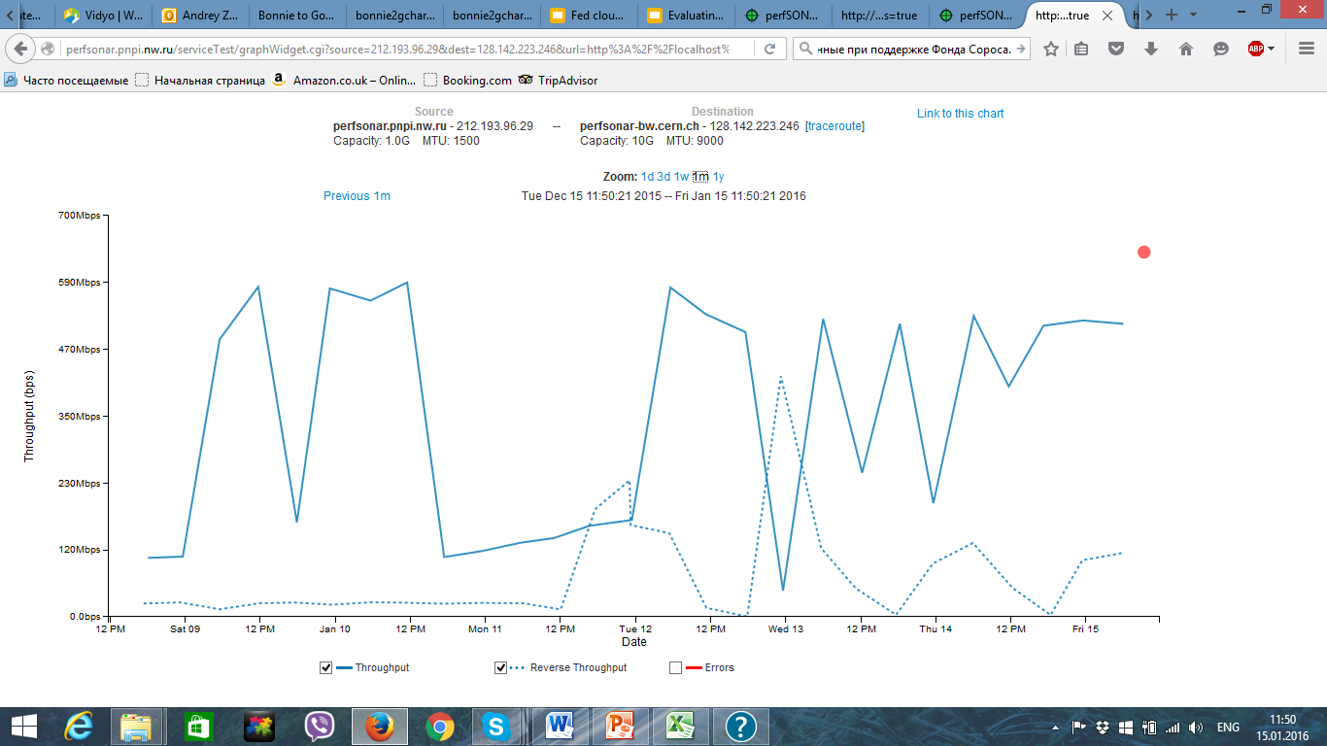
Network Monitoring with PerfSonar
1
Monthly Throughput in Mbit/s (15.12.15-15.01.16)
1. PNPI- SPbSU
2. CERN-SPbSU
3. PNPI-CERN
2
Jan issues with WAN
3
PerfSonar is used to
monitor network state
Federation sites have no
dedicated network

Slide 16
Synthetic Tests I. Bonnie++ Bloc I/O
Legend
  CERN-ALL : client@CERN, data@PNPI+SPbSU, MGM@CERN
  SPBU-ALL:client@SPbSU, data@PNPI+SPbSU, MGM@CERN
  PNPI-ALL: client@PNPI, data@PNPI+SPbSU, MGM@CERN
  SPBU-LOCAL : client@SPbSU, data@SPbSU, no federation
  PNPI-LOCAL : client@PNPI, data@PNPI, no fedration

Slide 17
Synthetic Tests II. Bonnie++ File Metadata
Discrepancy in performance between
local FS and federation for metadata
handling needs more studies
Legend
  CERN-ALL : client@CERN, data@PNPI+SPbSU, MGM@CERN
  SPBU-ALL:client@SPbSU, data@PNPI+SPbSU, MGM@CERN
  PNPI-ALL: client@PNPI, data@PNPI+SPbSU, MGM@CERN
  SPBU-LOCAL : client@SPbSU, data@SPbSU, no federation
  PNPI-LOCAL : client@PNPI, data@PNPI, no fedration

Slide 18
HENP Tests I. ALICE
Test execution time in sec
Metadata @PNPI (local)
Major difference in performance
Metadata @CERN (remote)
Legend
  PNPI-PNPI-PNPI : client@PNPI, data@PNPI, MGM@PNPI
  PNPI-CERN-PNPI: client@PNPI, data@PNPI, MGM@CERN
  SPBU-PNPI-PNPI: client@SPBU, data@PNPI, MGM@PNPI
  SPBU-CERN-PNPI : client@SPBU, data@PNPI, MGM@CERN

Slide 19
HENP Tests II. ATLAS
Test I/O part execution time in sec
Metadata @CERN (remote)
Legend
  PNPI-PNPI : client@PNPI, data@PNPI, MGM@CERN
  PNPI-SPBU: client@PNPI, data@SPBU, MGM@CERN
  SPBU-PNPI: client@SPBU, data@PNPI, MGM@CERN
  SPBU-PNPI : client@SPBU, data@PNPI, MGM@CERN
  SPBU-SPBU: client@SPBU, data@SPBU, MGM@CERN
Meta-data are always at CERN
FST mounted via xrootd and fuse

Slide 20
Outline
EOS Federation including three sites have been setup
  No dedicated network
  Commodity servers, disks and switches
  Technical support from EOS core SW team is essential for the success
Run ATLAS and ALICE event reconstruction/analysis realistic applications to study federation performance.
  No major obstacles to have it as production like federation
    But it is important to have EOS features in place
  No major loss in data analysis/reconstruction performance
  No Federation impact on total execution time for CPU intensive applications
JINR (Dubna) is interested to join R&D
The same exercise will be done for more combinations
  CERN-JINR-NRC/KI
  SPbSU-PNPI-NRC/KI
  SPbSU-PNPI-CERN-JINR
  SPbSU-PNPI-CERN-NRC/KI
  …and with access from HPC machines to the Federation

Slide 21
Thanks
This talk drew on presentations, discussions, comments, input from many
Thanks to all, including those I’ve missed
  P.Buncic, S.Campana, K.De, D.Duellmann, P.Fuhrmann, M.Grigorieva, V.Ilyin, O.Keeble, V.Korenkov, M.Lamanna, A.Peters, L.Robertson, E.Ryabinkin, M.Schulz, V.Velikhov …
Acknowledgements.
  This project was funded in part by the Russian Fund of Fundamental Research under contract “15-29-07942 офи_м” and U. S. DOE, Office of Science, High Energy Physics and ASCR under Contract No. DE-AC02-98CH10886

