Slide 1
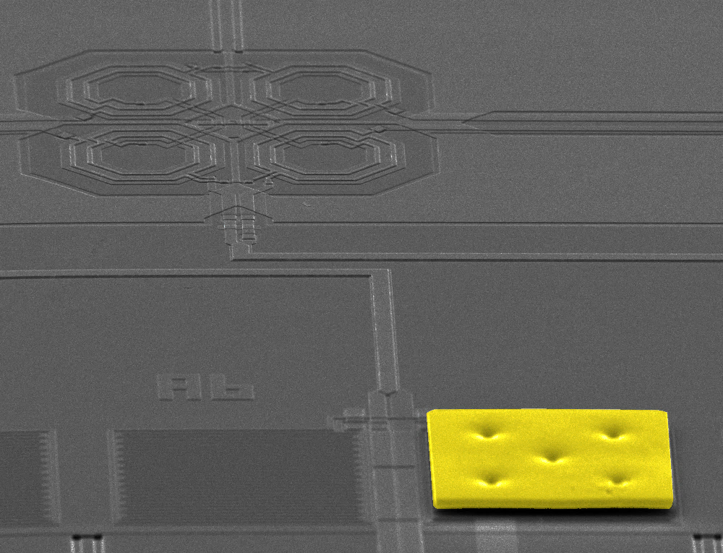
Microwave SQUID multiplexer for the readout of large MMC arrays
Mathias Wegner
01.06.2016

Slide 2
Contents
Metallic magnetic calorimeters
From single detectors to very large arrays
Microwave SQUID multiplexer
Multiplexer chip design
Experimental results
Summary and outlook

Slide 3
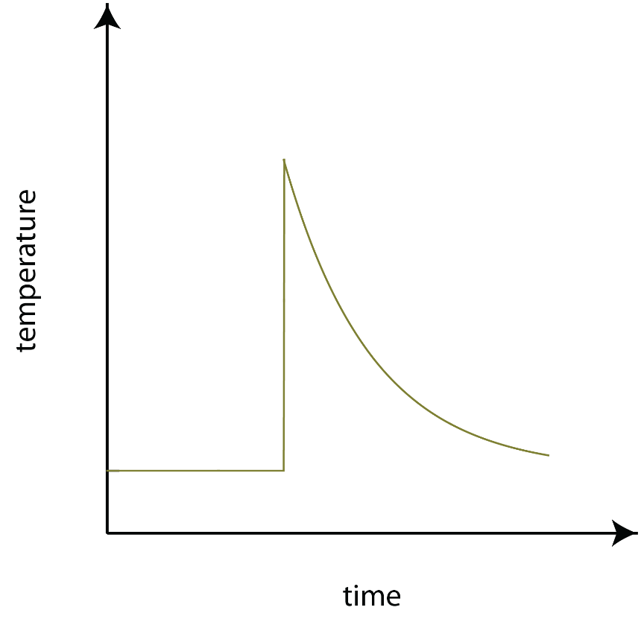
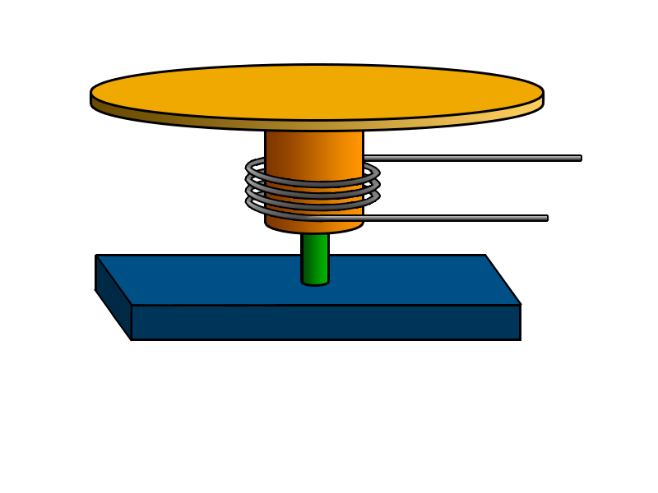
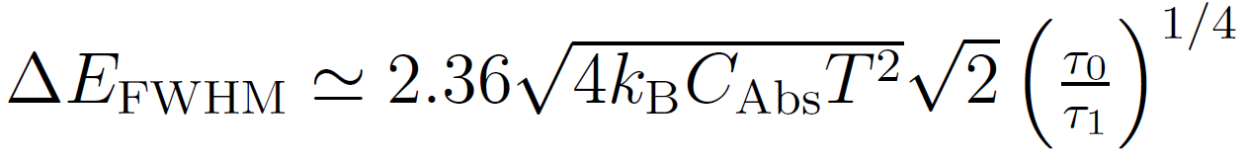
Metallic magnetic calorimeters
Detector principle
Signal rise
τ₀ < 100 ns
Absorber
Paramagnetic
sensor
Signal decay
τ₁ > 1 ms
Pickup-coil
To SQUID
Weak thermal link
Magnetic
field
Thermal bath @ T ~ 30 mK
Fundamental energy resolution
Micro calorimeter operated at
low temperatures T < 50 mK

Slide 4
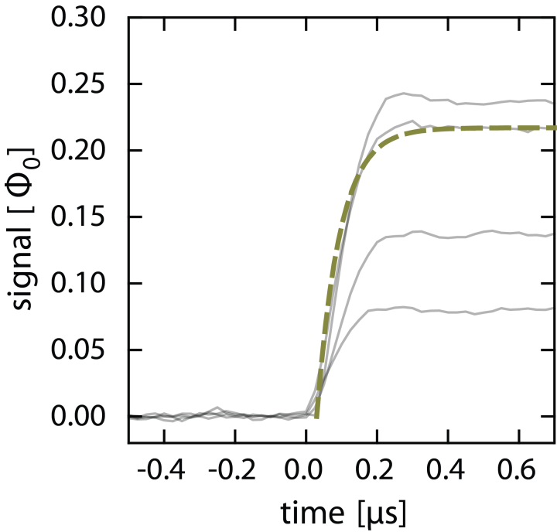
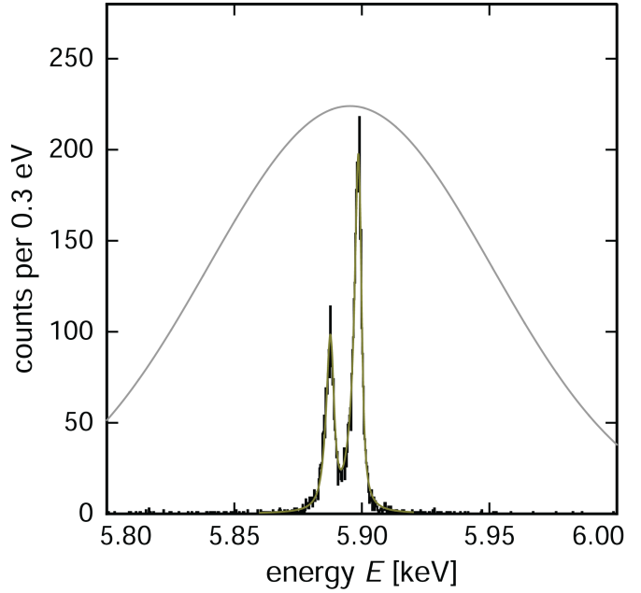
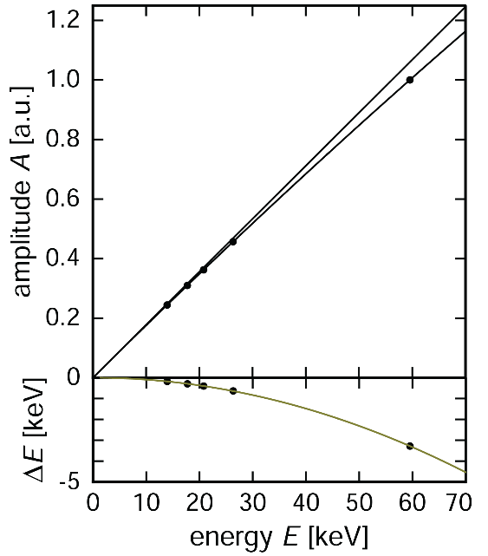
Metallic magnetic calorimeters
Single channel detector performance
Fast signal rise time
Very good energy resolution
Excellent linearity
Semiconductor
detector
⁵⁵Mn, K_{α}
τ₀ < 100 ns
ΔE_{FWHM} = 1.6 eV @ 6 keV
5.9 % @ 60 keV
Three world records related to microcalorimeters

Slide 5
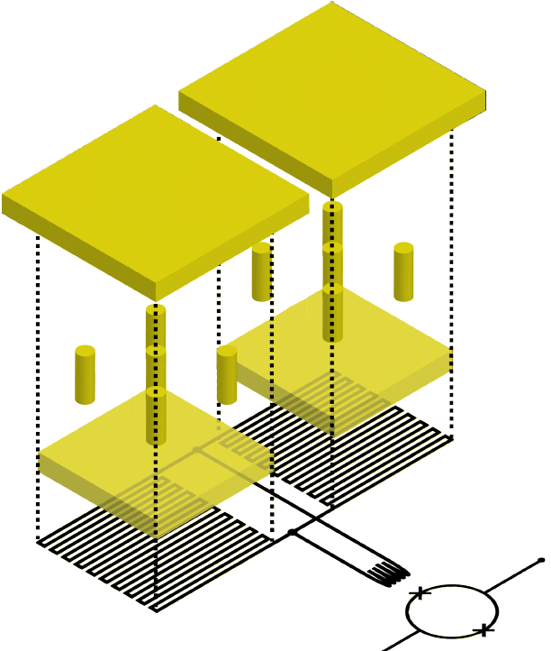
Metallic magnetic calorimeters
Detector geometry
Absorber
Paramagnetic sensor
Stems
SQUID input coil
Meander-shaped
pickup coil
dc-SQUID

Slide 6
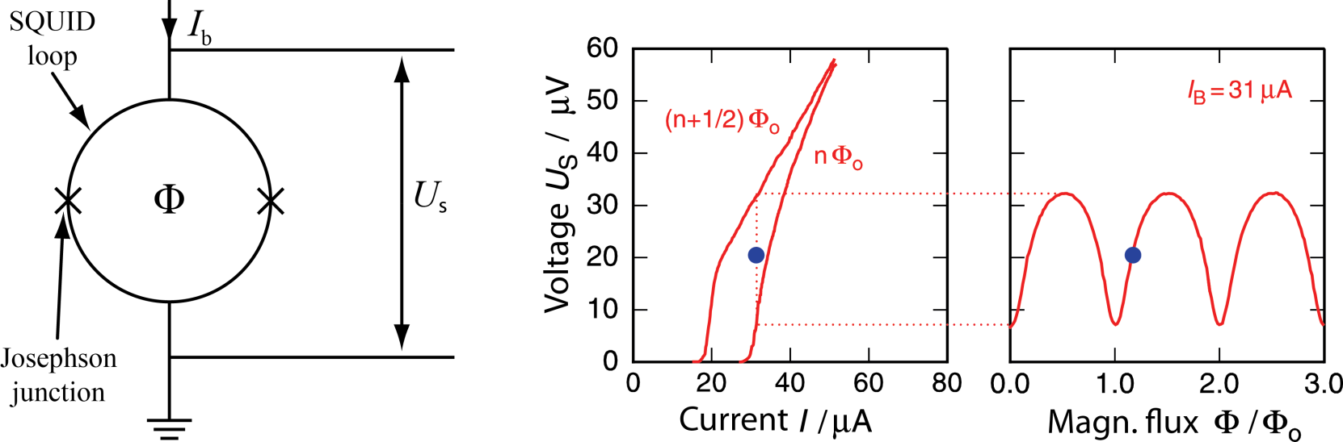
Single channel dc-SQUID readout
Why dc-SQUID readout?
Operation at very low temperatures
Quantum limited noise level
Very large bandwidth
dc-SQUID operation principle
I_{c}
I_{c}
dc-SQUID = periodic flux to voltage converter

Slide 7
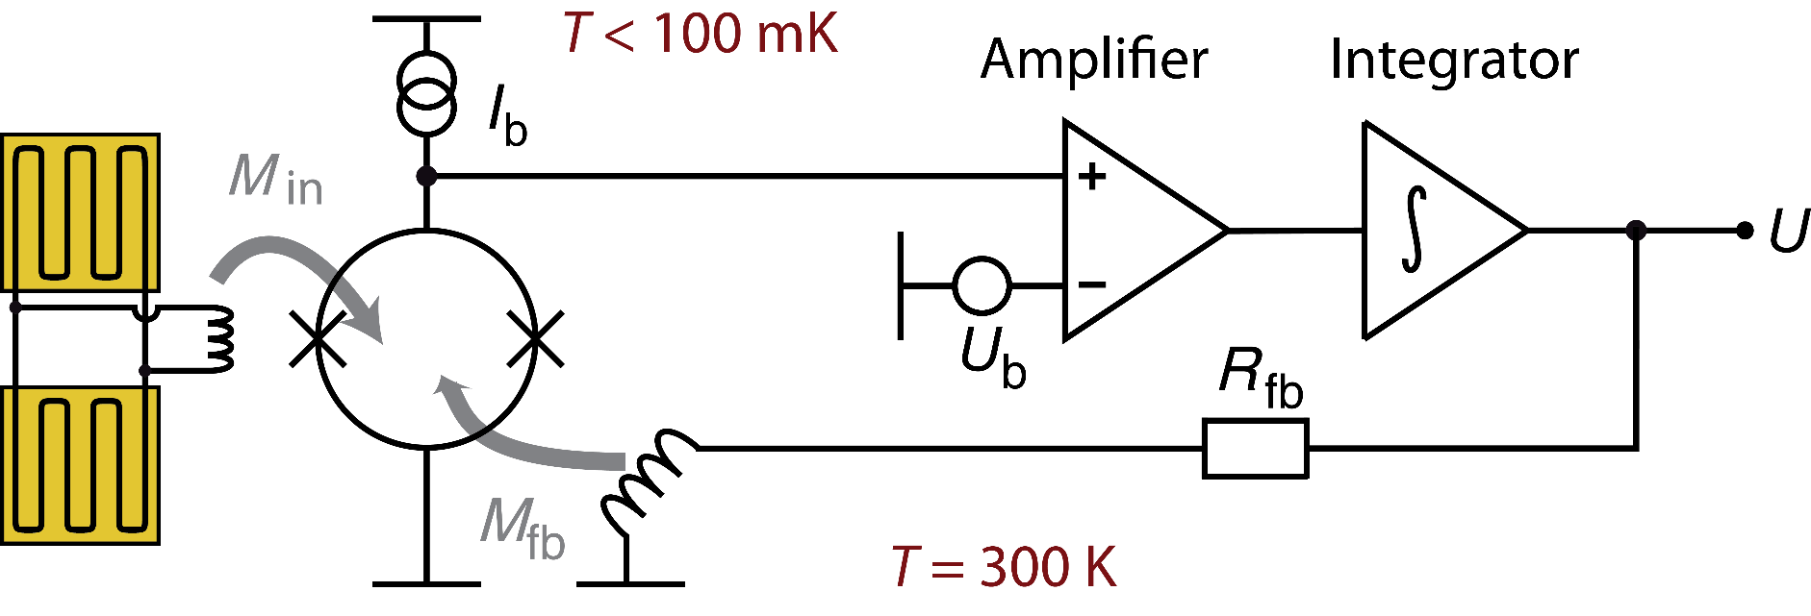
Single channel dc-SQUID readout
Signal linearization (flux locked loop)
Linear range of dc-SQUID response very small (Φ < Φ₀/4)
Negative flux feedback for compensation of initial flux change

Slide 8
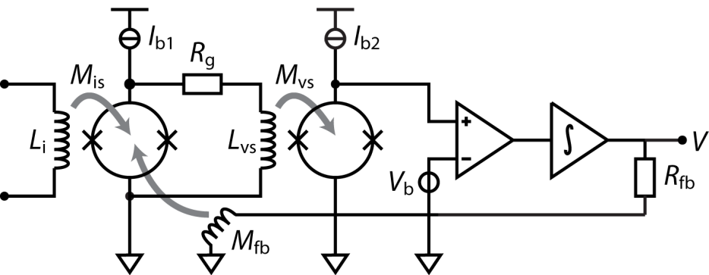
Single channel dc-SQUID readout
Double-stage SQUID configuration
Semiconductor amplifiers have much higher noise level than SQUIDs
Making use of a 2nd dc-SQUID for signal amplification
T < 100 mK
100 mK … 4 K
T = 300 K
Large bandwidth
Very low noise
Low power dissipation

Slide 9

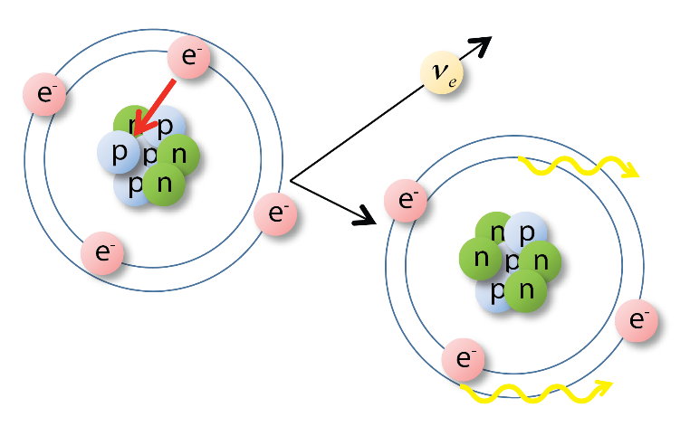
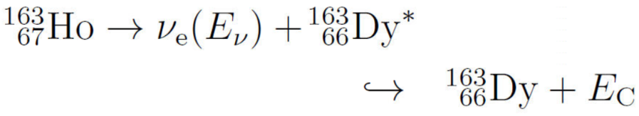
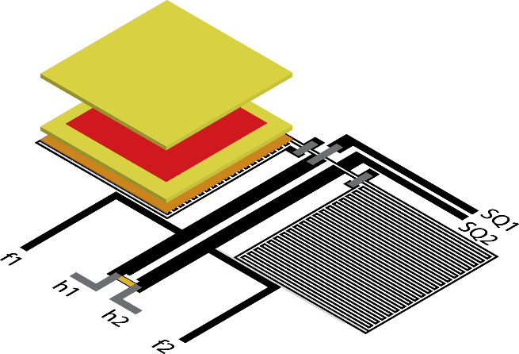
Application: The ECHo experiment
Electron capture of ¹⁶³Ho
τ_{1/2} = 4570 y
Q_{EC} = 2833(30)_{stat}(15)_{sys} eV
Calorimetric measurement of decay spectrum
Absorber top
Embedded holmium in absorber:
Quantum efficiency > 99.99%
Measure independent of BR
Implanted ¹⁶³Ho
Absorber bottom
AuEr sensor
Detector bias

Slide 10
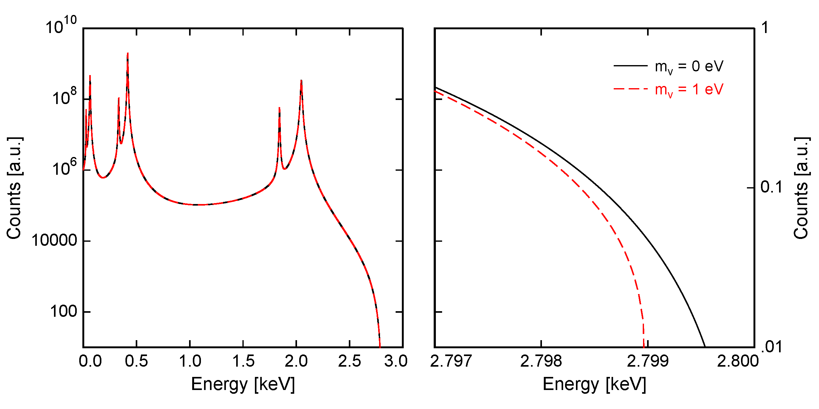
Application: The ECHo experiment
Calorimetric spectrum of ¹⁶³Ho
Non-vanishing electron neutrino mass distorts spectrum around endpoint
Sub-eV sensitivity for ν_{e} mass requirements
Statistics: N_{ev} > 10¹⁴ Activity: A ~ 10 Bq / pixel Large arrays: N_{det} > 10⁵

Slide 11
Towards large MMC detector arrays
Why is multiplexing mandatory?
How to read out such large number of detector channels?
Single detector channel requires:
- 2 SQUIDs
- 10 wires
- Room temperature electronics
Duplication of single-channel readout not scalable
Number of wires
Parasitic heat load
System complexity
Costs
Multiplexing necessary
~ N of channels - time domain
- freqency domain
- …

Slide 12
Towards large MMC detector arrays
Frequency domain multiplexing
Example: Radio frequencies in Stuttgart
amplitude
89.5 MHz
BigFM
92.3 MHz
SWR3
96.2 MHz
SWR2
103.9 MHz
Klassik Radio
frequency
System bandwidth divided into non-overlapping frequency bands
Modulation of carrier frequency by low frequency signal (amplitude, frequency,…)
Advantage: Simultaneous signal transmission of all channels

Slide 13
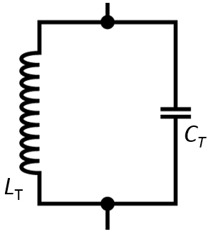
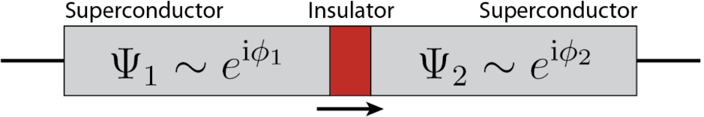


Towards large MMC detector arrays
Components for cryogenic frequency domain multiplexing
Carrier frequency selection
Non-linear element
Tank circuit
Josephson junction

Slide 14
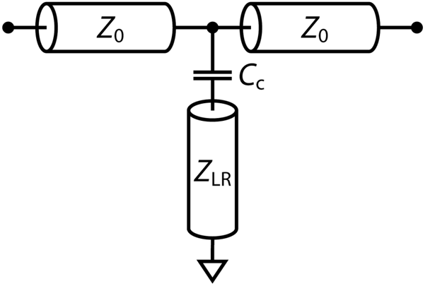

The microwave SQUID multiplexer
Superconducting coplanar waveguide λ/4 resonators
transmission
f_{r}
frequency
Operation at cryogenic temperatures T < 100 mK
Quality factors Q_{i} > 100.000 possible extremely low power consumption
Resonance frequencies to GHz possible large bandwidth per channel

Slide 15
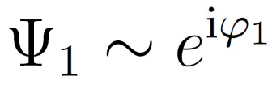




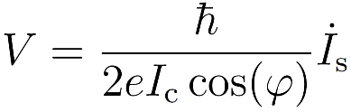

The microwave SQUID multiplexer
The Josephson junction
Phase difference:
Supercurrent: I_{s}
Voltage: V
1. Josephson equation:
2. Josephson equation:
Non-linear inductance

Slide 16
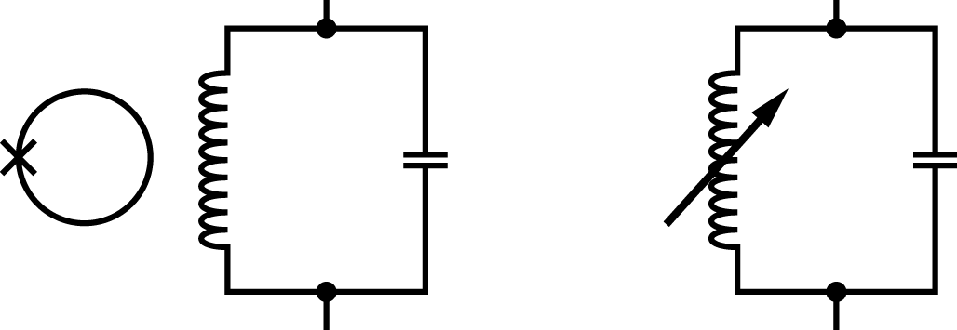
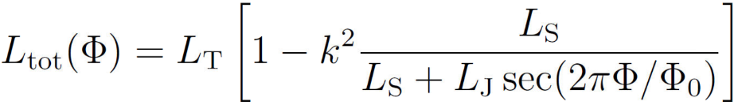
The microwave SQUID multiplexer
rf-SQUID operation
k
Tank
circuit
L_{tot}
Tank
circuit
L_{J}
Φ
C_{T}
L_{S}
L_{T}
Phase difference φ given by magnetic flux Φ through the SQUID loop
rf-SQUID = flux dependent inductance
Dissipationless compared to dc-SQUIDs

Slide 17
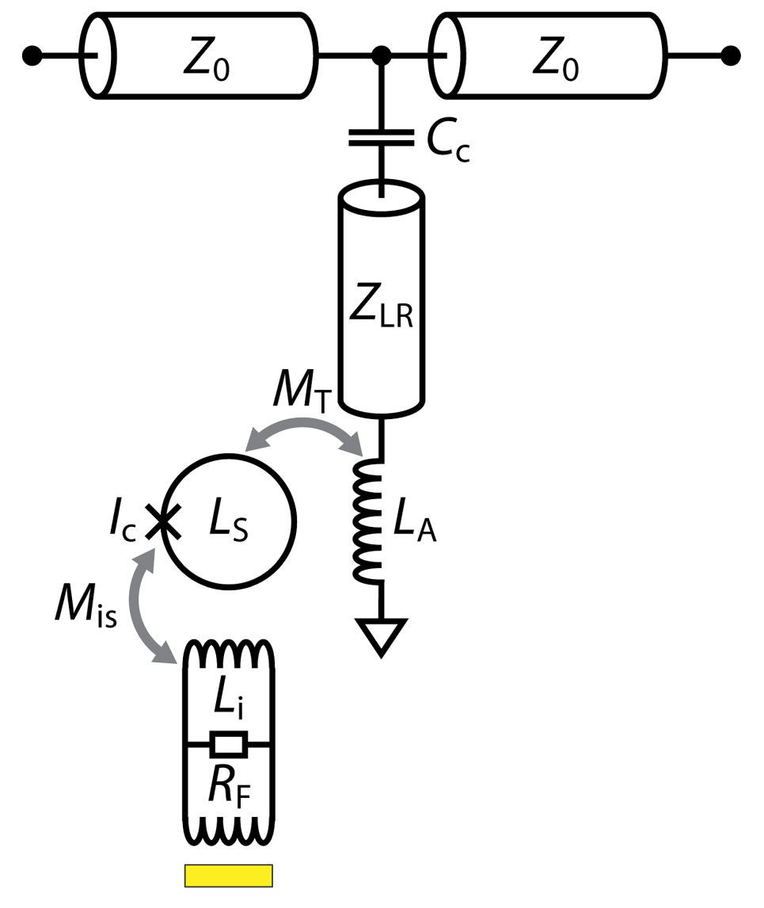
The microwave SQUID multiplexer
Principle single multiplexer channel
Monitoring resonance
frequency shift
Feedline
Shift of resonance frequency of corresponding resonator
Superconducting
quarter-wave
resonator
rf-SQUID
Magnetic flux change
In rf-SQUID
Magnetic flux change in
related temperature sensor
Energy deposition in absorber
Single detector

Slide 18
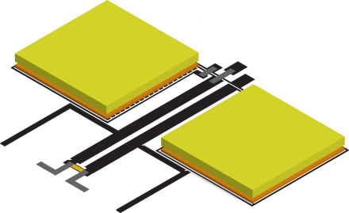
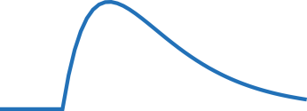
The microwave SQUID multiplexer
signal
time
transmission
f_{r}
frequency

Slide 19

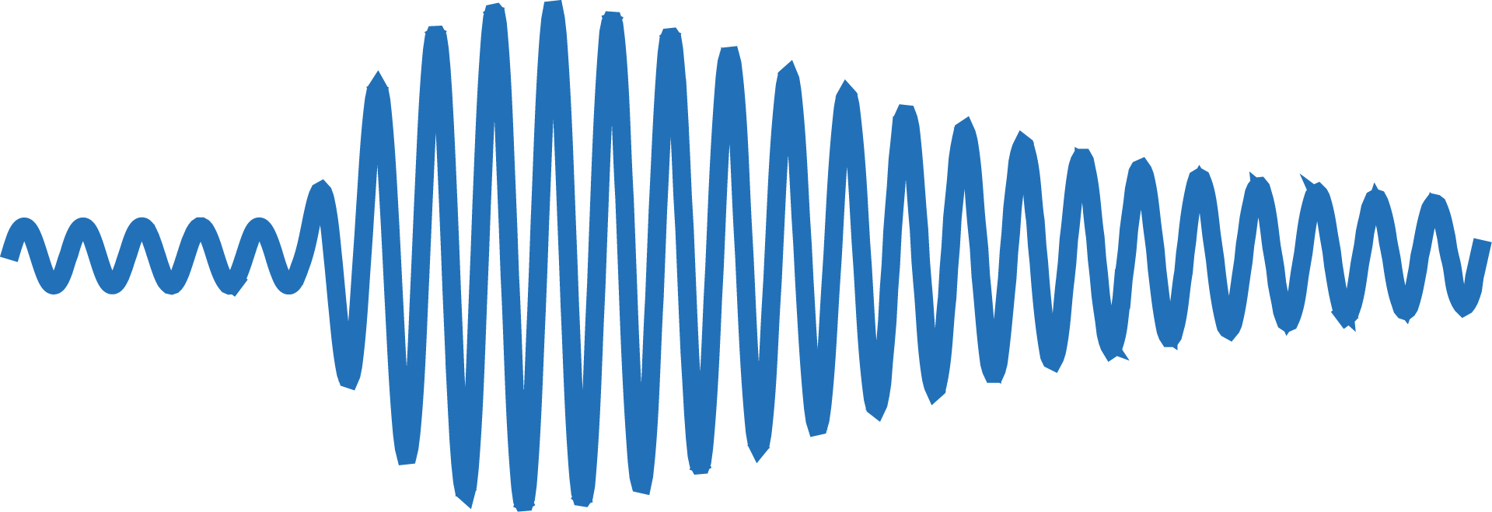
The microwave SQUID multiplexer
in
multiplexer
out
f₁
temperature
f_{exc}
time
transmission
amplitude
f₁
frequency
time

Slide 20
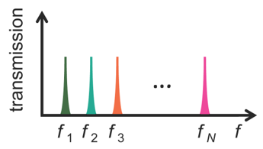
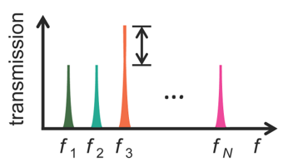
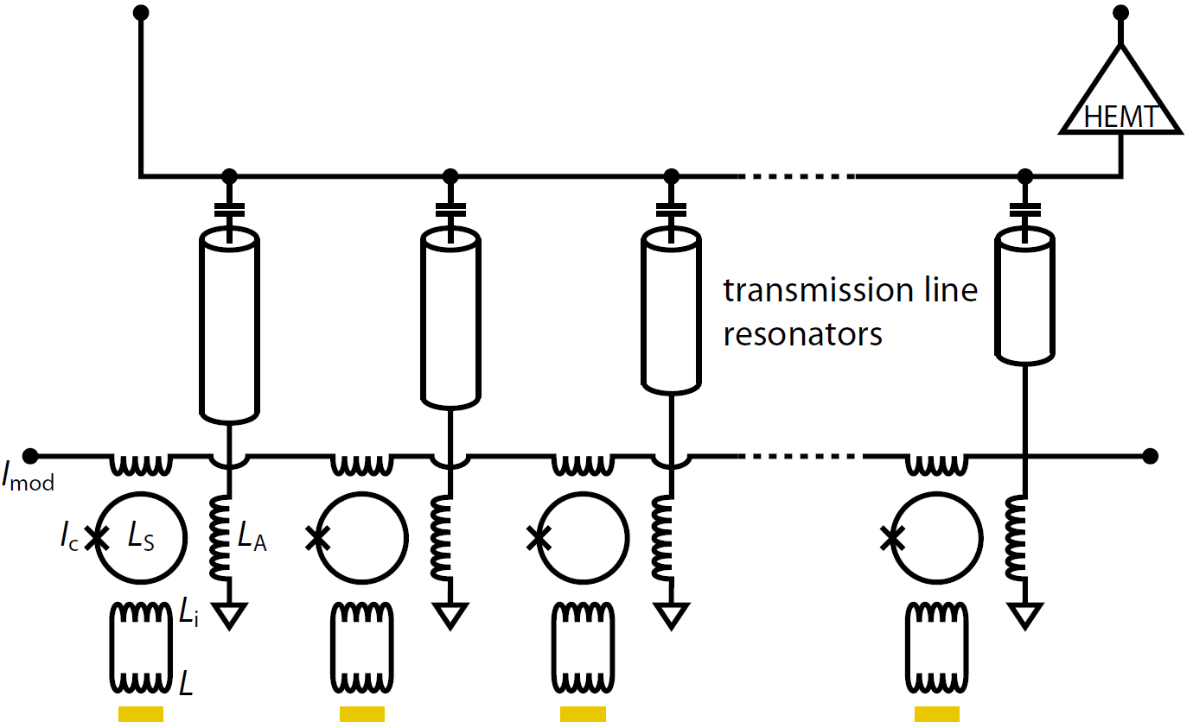
The microwave SQUID multiplexer
Principle N multiplexer channels
Injection of
frequency comb
Extraction of
amplitude
Energy input in channel 3
f₁
f₂
f₃
f_{N}
Two cables and one amplifier for the readout of hundreds of channels

Slide 21


The microwave SQUID multiplexer
Software defined radio (in development)
amp
amp
[MHz]
[GHz]
[MHz]
[GHz]
DAC
FPGA
DAC
µMUX
FPGA
µMUX
Signal
modulation
ADC
ADC
amp
amp
[MHz]
[GHz]
[MHz]
[GHz]

Slide 22
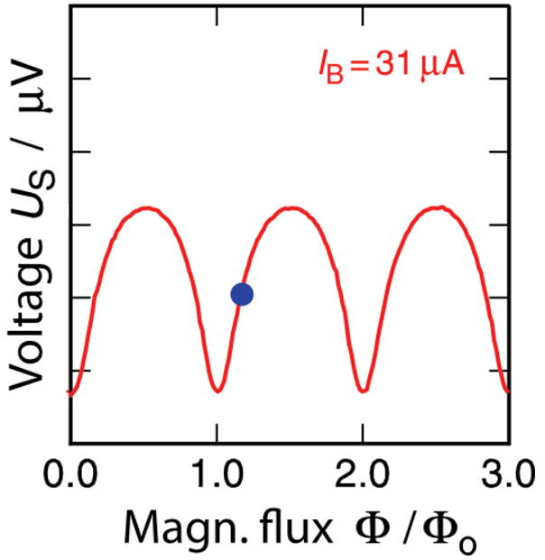
The microwave SQUID multiplexer
Flux ramp modulation (in development)
rf-SQUID output strongly non-linear (periodic as dc-SQUID)
Linearization with FLL impossible for multiplexer (2 wires per channel)

Slide 23
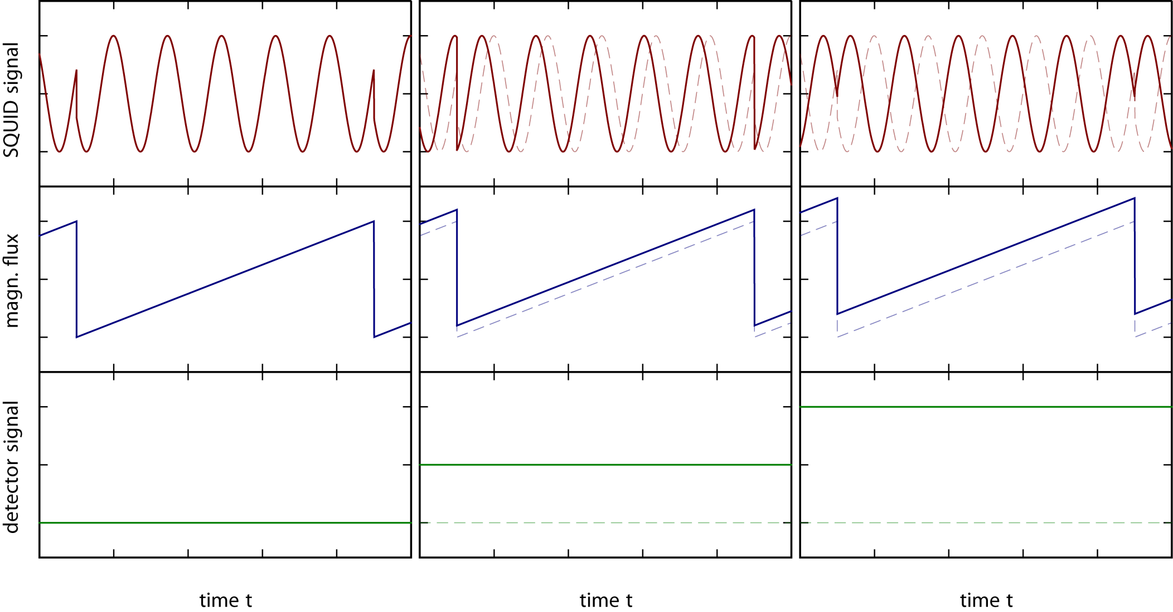
The microwave SQUID multiplexer
Flux ramp modulation (in development)
Linearization by transducing SQUID output signal into a phase shift
Simultaneous linearization of hundreds of channels using only 2 wires

Slide 24
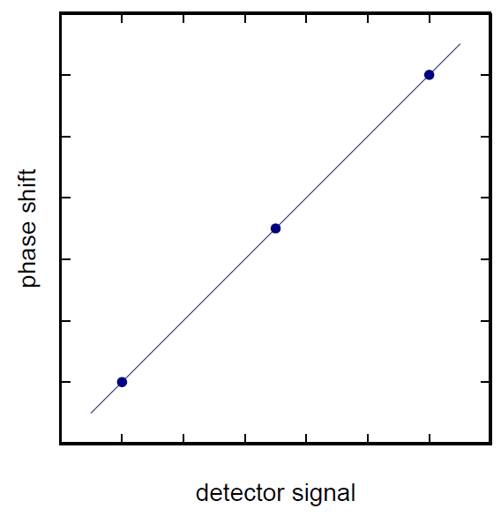
The microwave SQUID multiplexer
Flux ramp modulation (in development)
Linearization by transducing SQUID output signal into a phase shift
Simultaneous linearization of hundreds of channels using only 2 wires

Slide 25
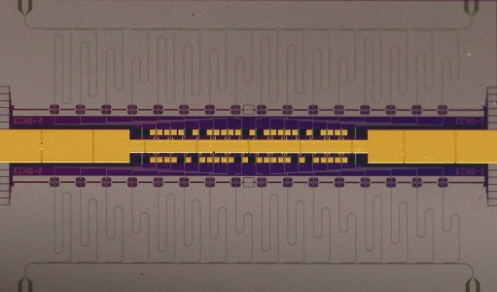
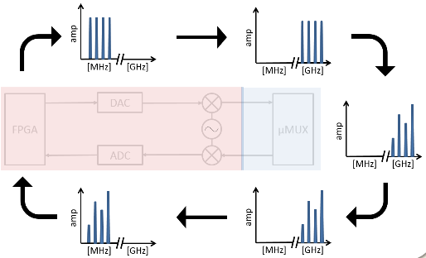
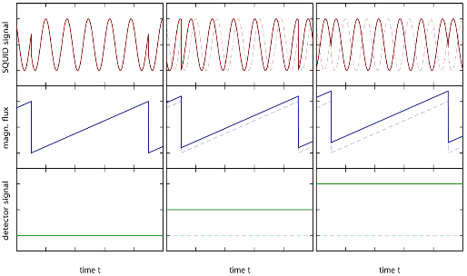
The microwave SQUID multiplexer
Microwave SQUID multiplexing components
Multiplexer Chip
Simultaneous readout of N detector channels
First prototypes available and operationable
Software Defined Radio
FPGA based readout of multiplexer
in development
Flux Ramp Modulation
rf-SQUID linearization
in development
Very large bandwidth
Very low noise level
Linear response

Slide 26
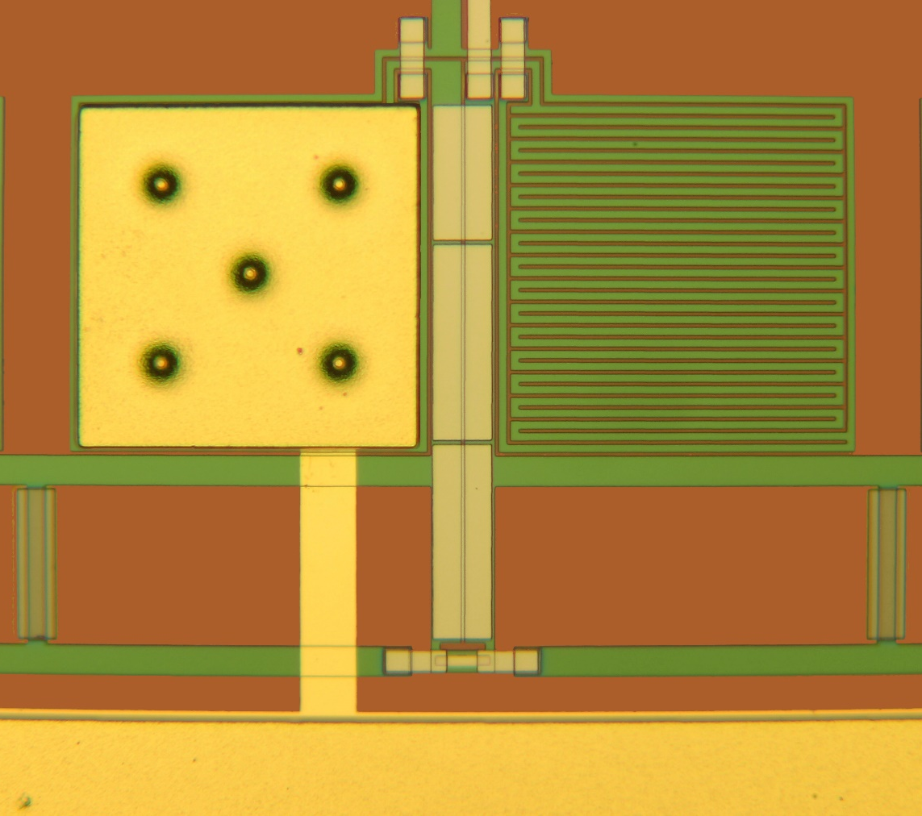
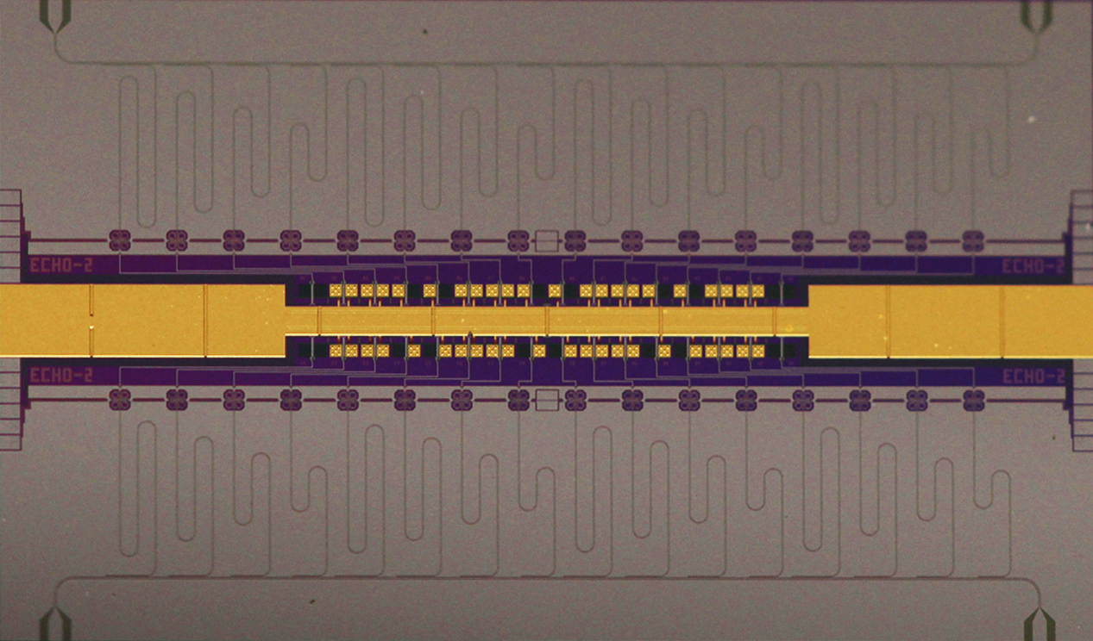
Multiplexer Chip Prototype
64 MMC pixels with on-chip multiplexer
19 microfabricated layers: sputtering, wet & dry etching, electroplating…
HF input
Au absorber on stems
on AgEr_{300ppm} sensor
To SQUID
input coil
HF output
Superconducting
microwave resonators
rf-SQUIDs
Detector bias
On-chip heat bath
Detector array
9.1 mm
Meander-shaped
pickup coil
Weak thermal link
Thermal bath

Slide 27
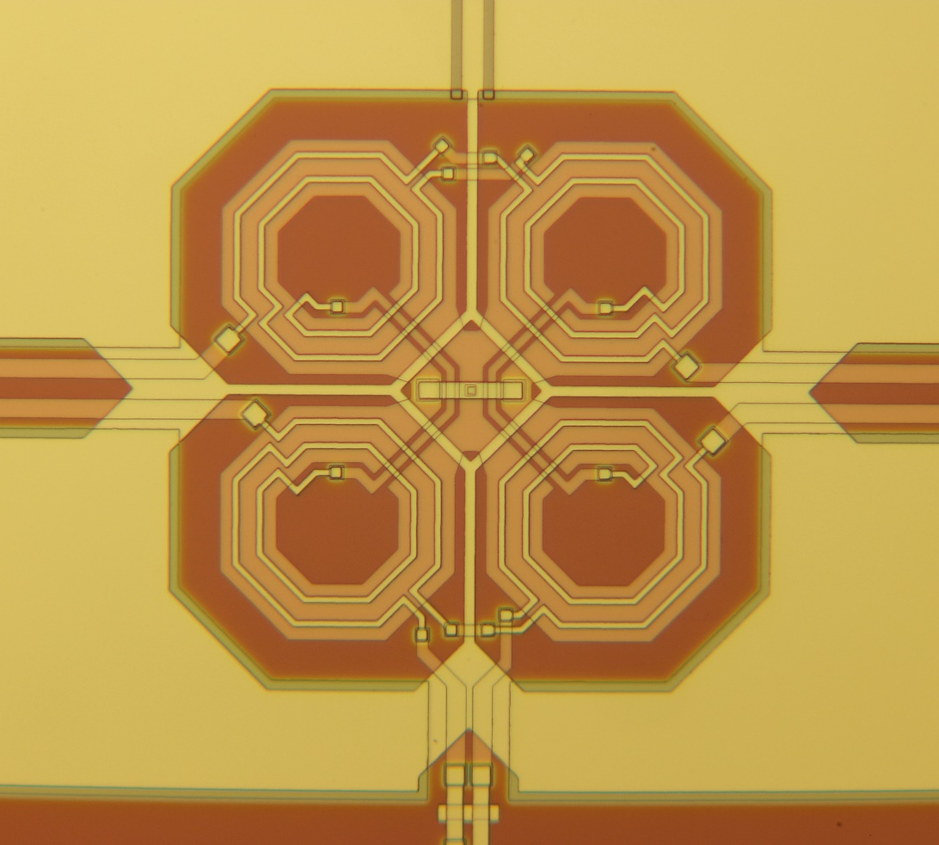
Multiplexer Chip Prototype
64 MMC pixels with on-chip multiplexer
19 microfabricated layers: sputtering, wet & dry etching, electroplating…
HF input
HF output
To resonator
Modulation coil
Washer coil
Superconducting
microwave resonators
rf-SQUIDs
-
+
Detector bias
On-chip heat bath
Detector array
9.1 mm
Josephson
Junction
+
-
Input
coil
To detector

Slide 28
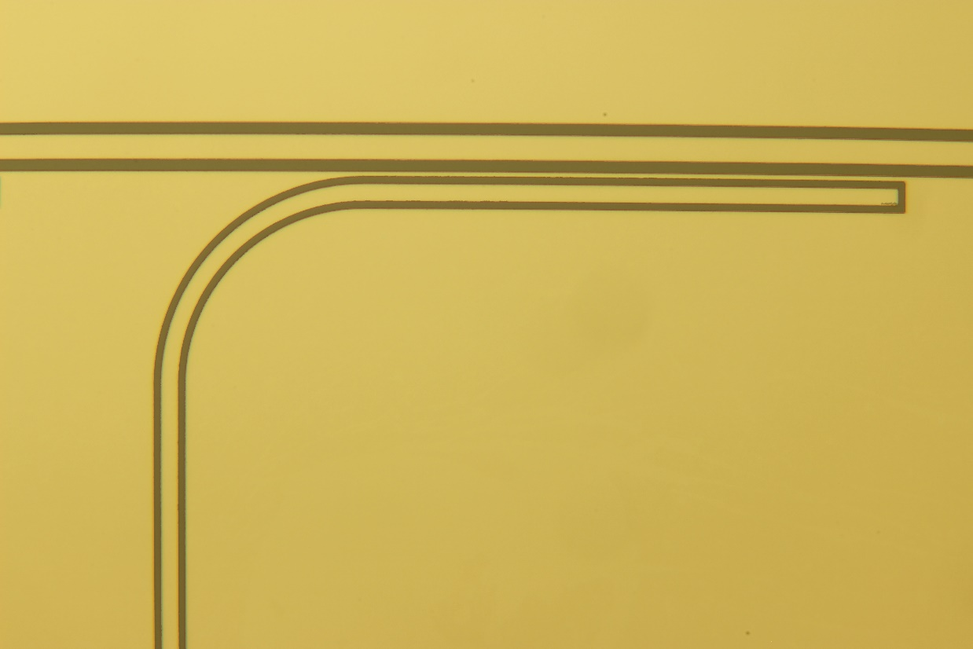
Multiplexer Chip Prototype
64 MMC pixels with on-chip multiplexer
19 microfabricated layers: sputtering, wet & dry etching, electroplating…
HF input
HF output
Common
feedline
Elbow coupler
Superconducting
microwave resonators
rf-SQUIDs
Detector bias
On-chip heat bath
Detector array
9.1 mm
HF range 4 … 8 GHz
Bandwidth ~ 1 MHz
Coplanar
waveguide

Slide 29
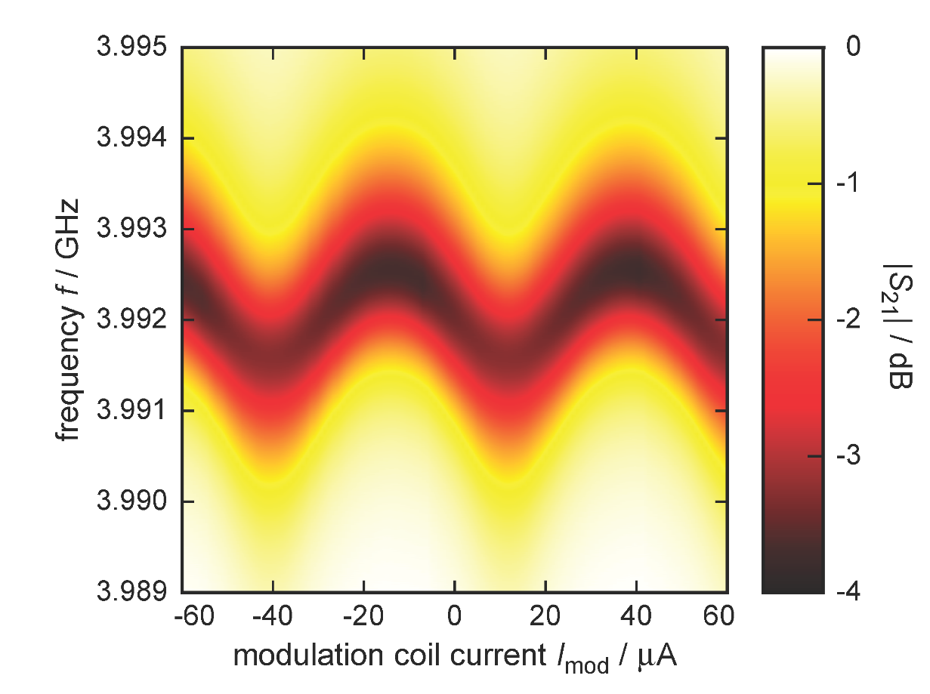

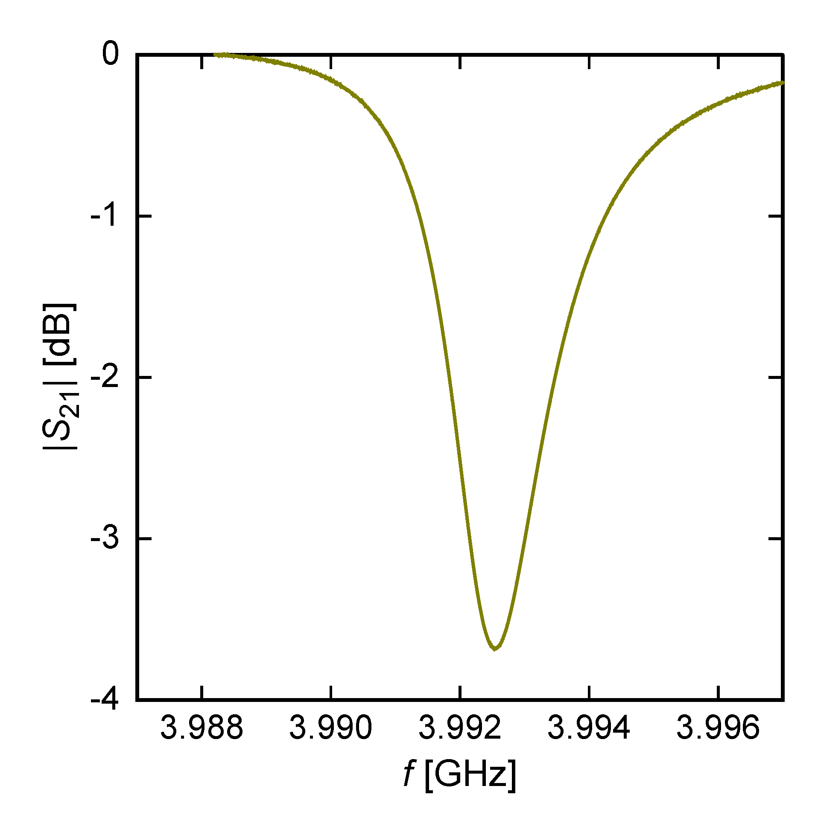
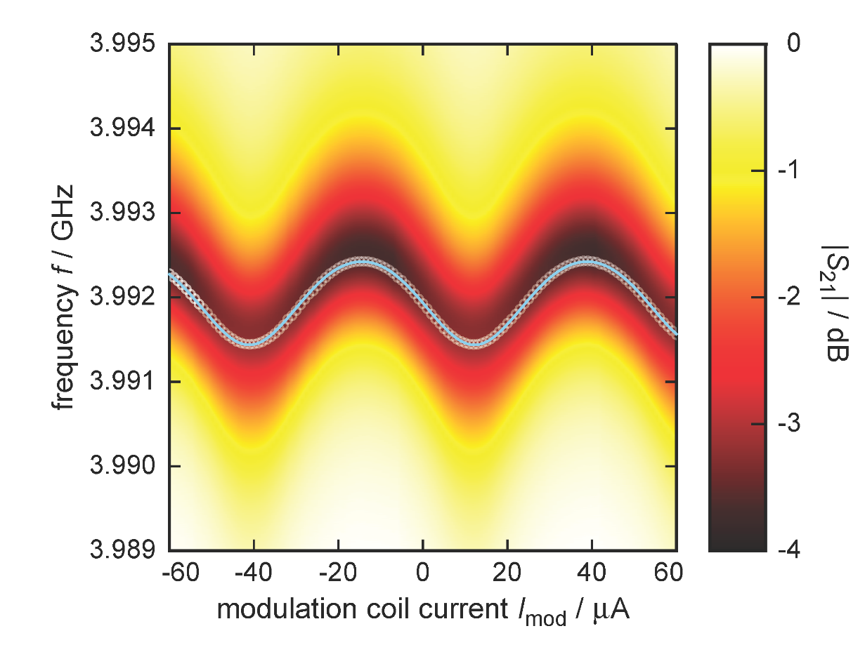
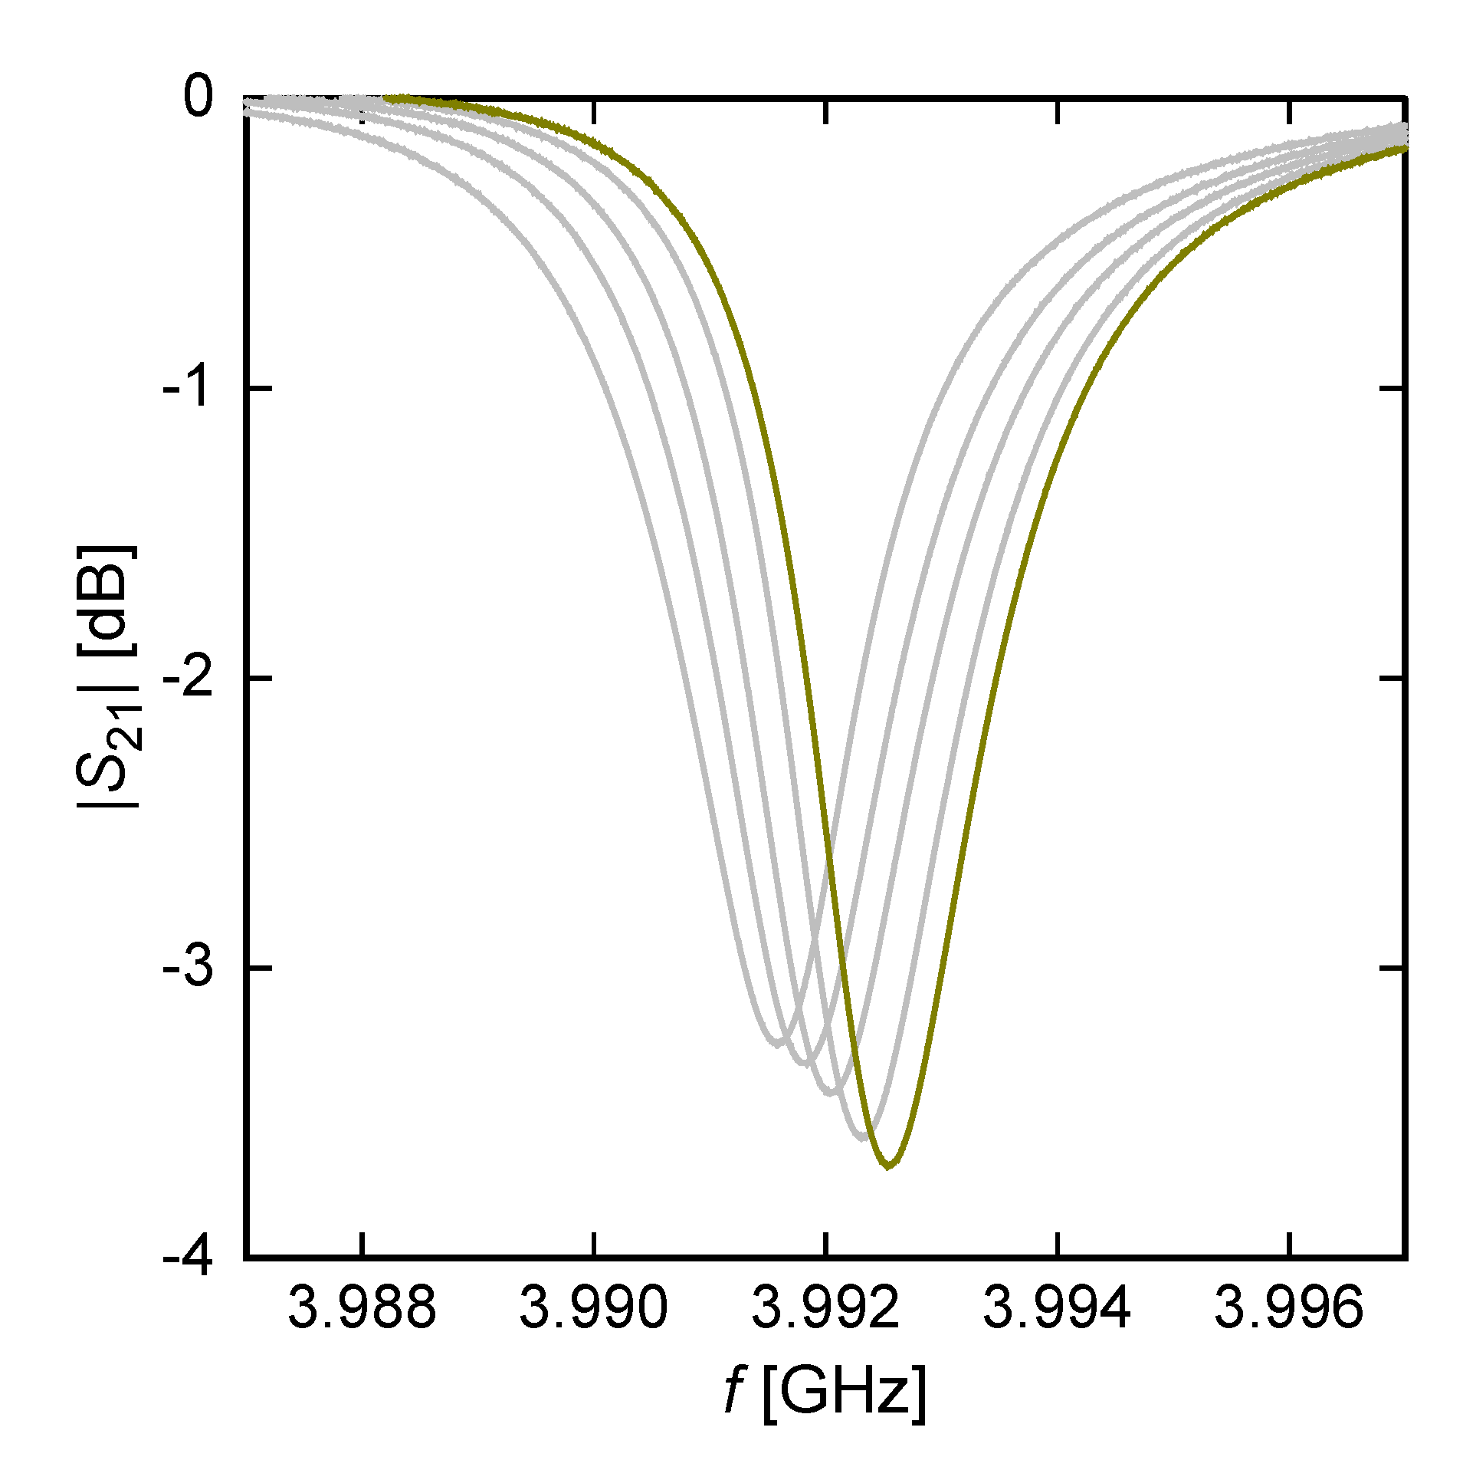
Multiplexer Characteristics
Characterization by means of a vector network analyzer
f_{r} (Φ)
Δf_{max} ~ 1 MHz
I_{mod} = -14 … +12 uA
fixed SQUID flux
Resonance frequency shift by rf-SQUID close to design value

Slide 30
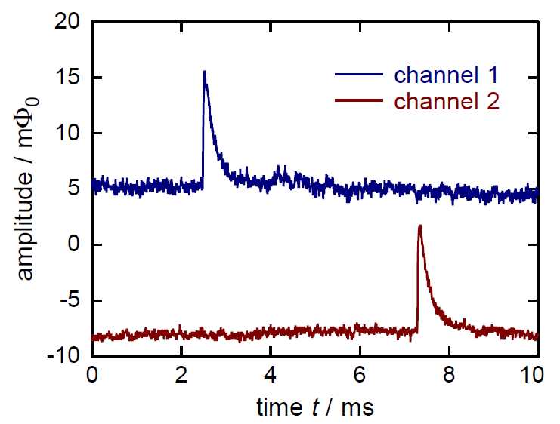
Multiplexer Performance
First demonstration of multiplexed readout 2016
Fully analog setup with 2 HF signal generators
Simultaneous acquisition of signals from two independent MMC detectors

Slide 31
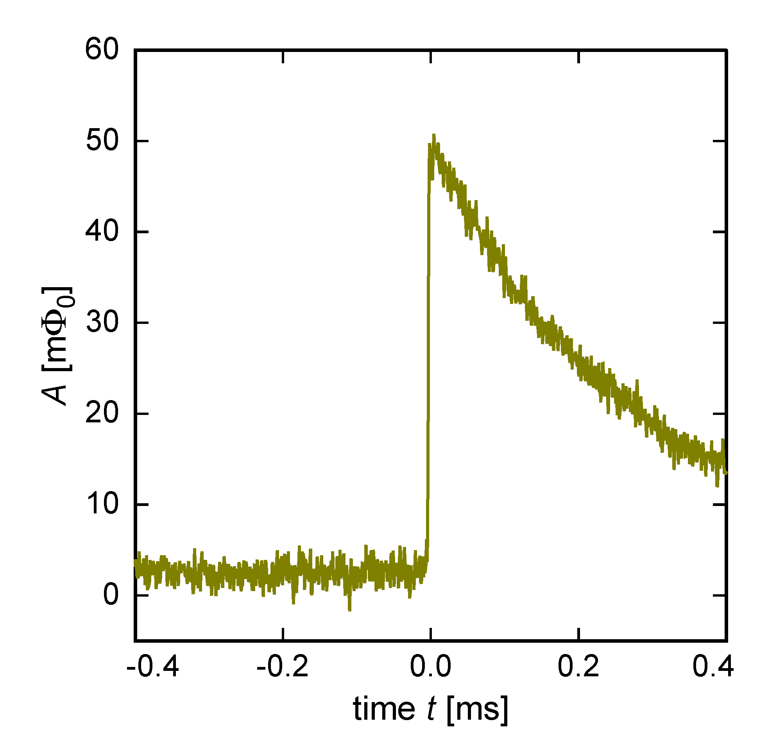
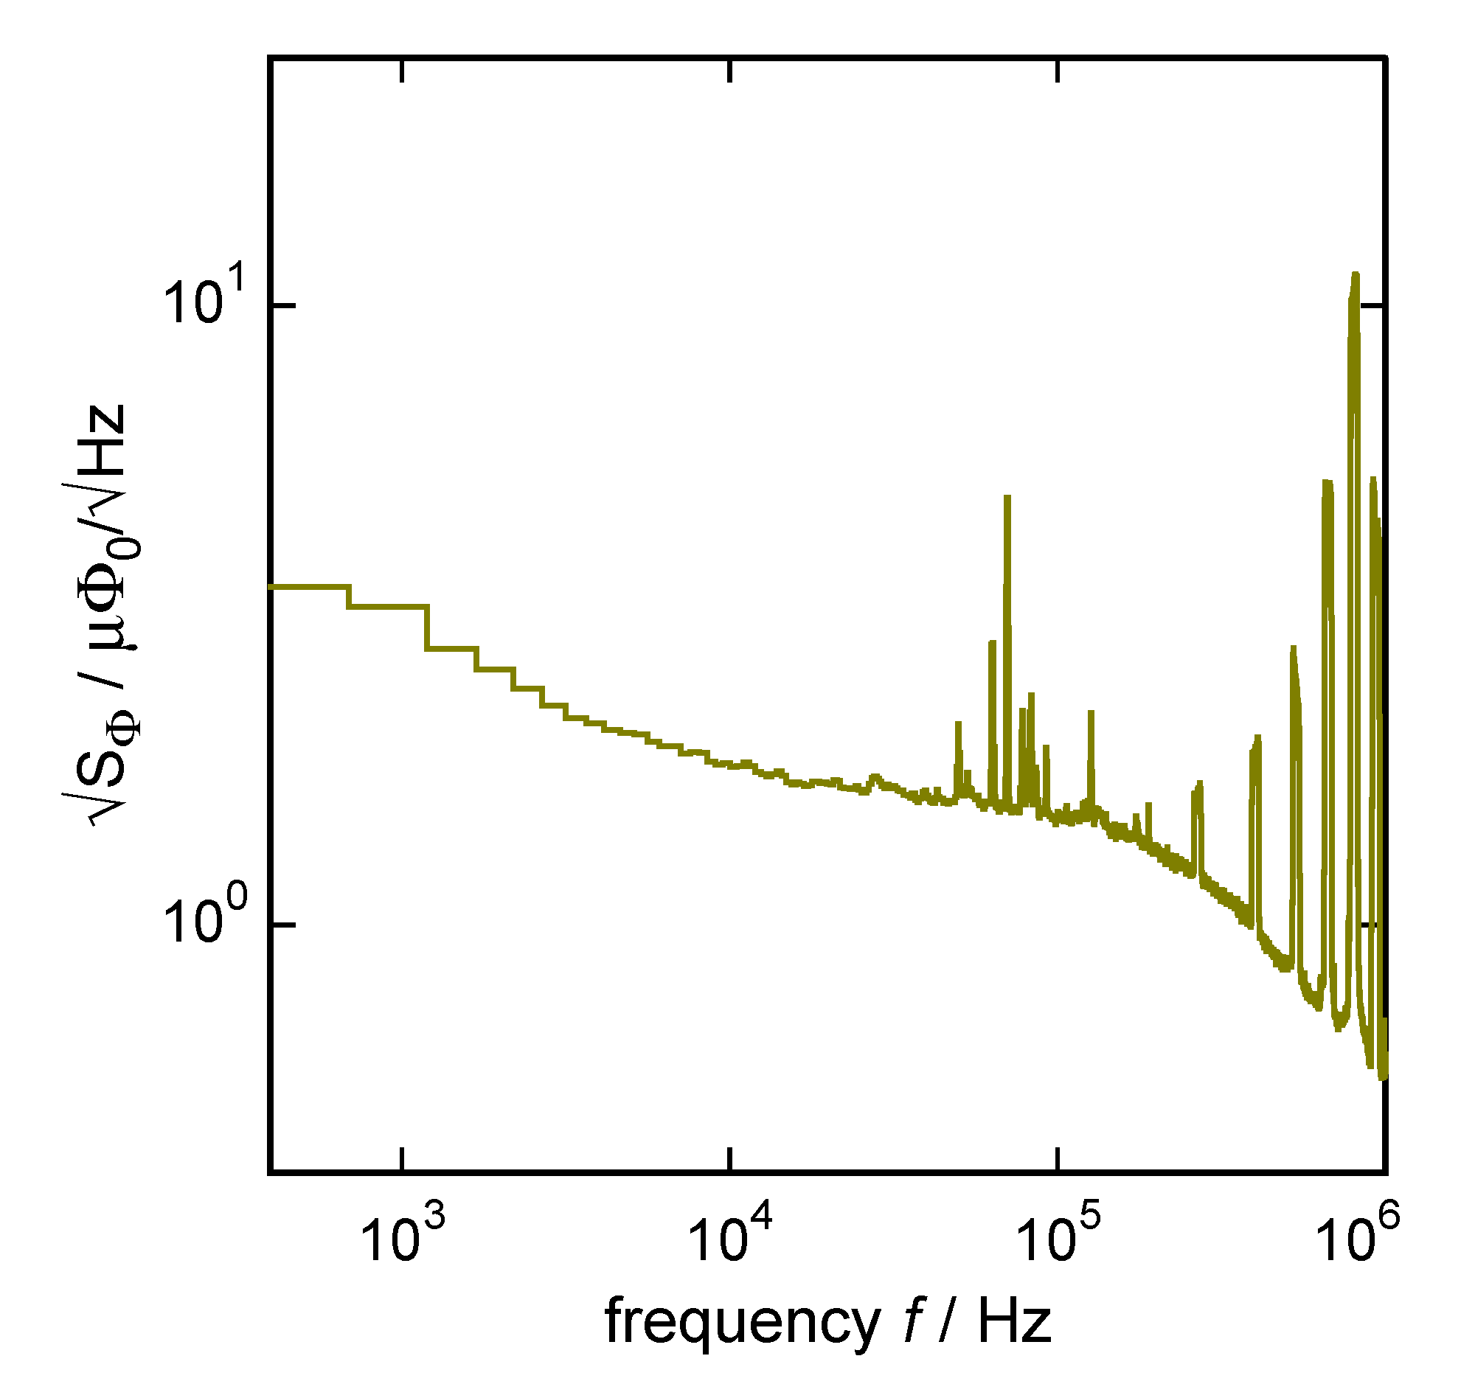
Multiplexer Performance
Signal size & noise performance
  T_{Chip} > 50 mK
  τ₁ ~ 340 µs
  1.6µΦ₀/√Hz
  τ₀ ~ 640 ns
  Low pulse height due to high chip temperature and too less persistent current
  Increased flux noise level due to low read-out power of multiplexer

Slide 32
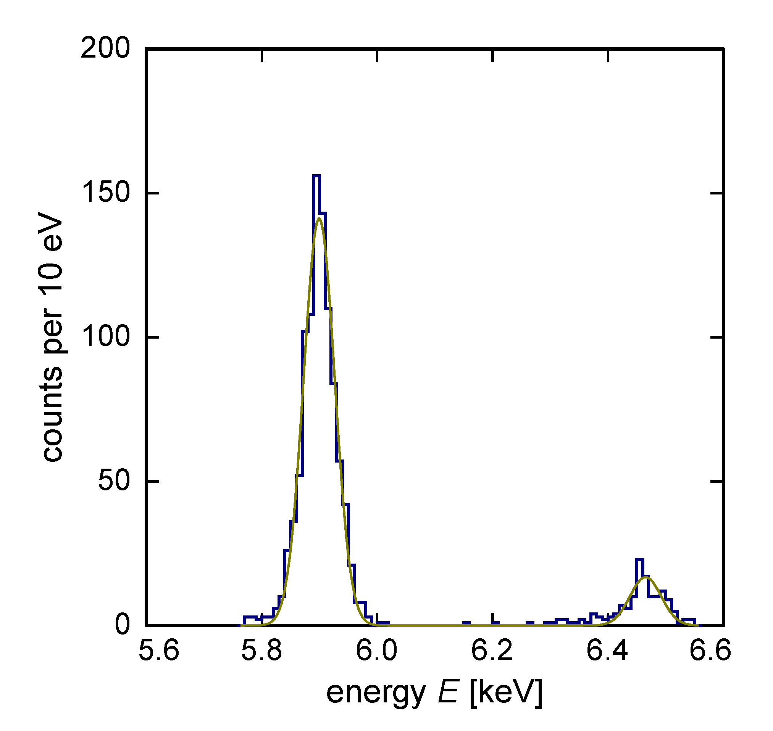
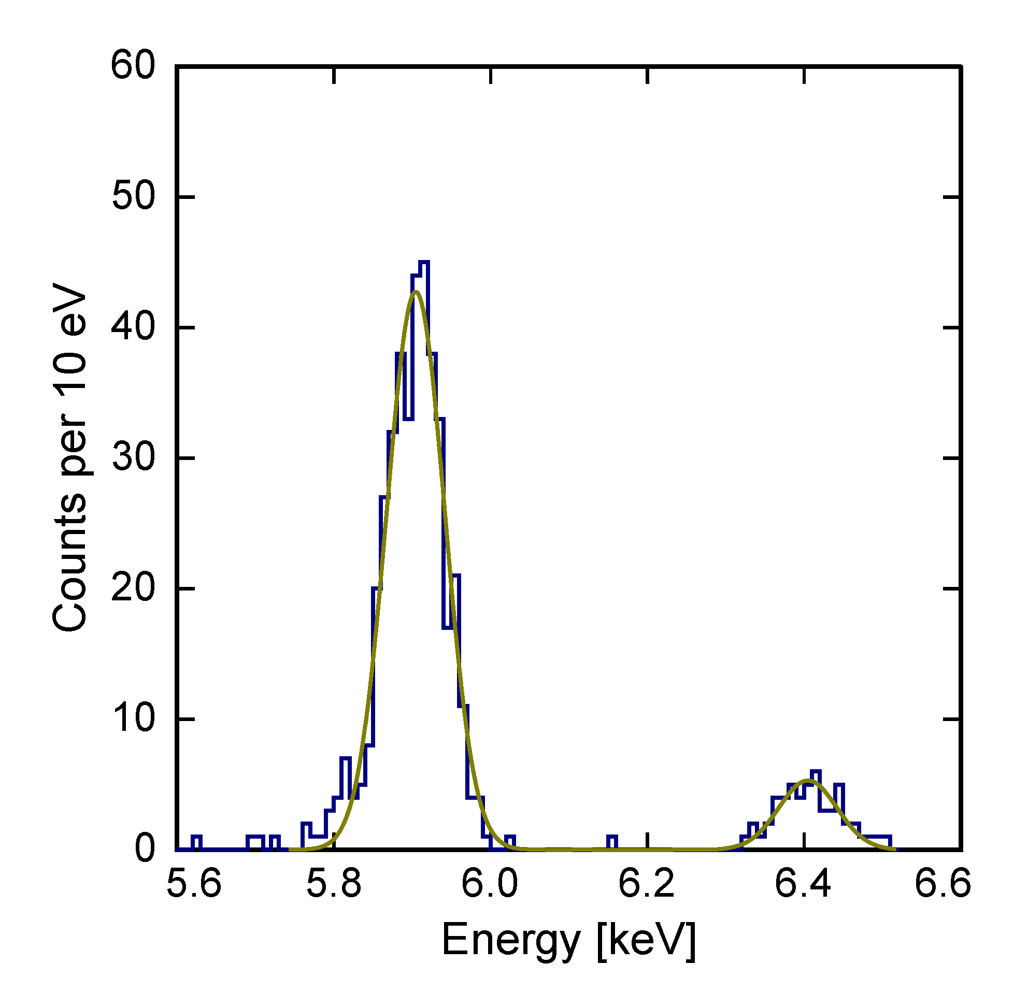
Multiplexer Performance
Channel 1
Channel 2
  ⁵⁵Mn
  ⁵⁵Mn
ΔE_{FWHM} = 64 eV @ 6 keV
ΔE_{FWHM} = 87 eV @ 6 keV
  Energy resolution degraded due to small signal size and too high noise level
  Different performance due to different signal-to-noise ratios

Slide 33
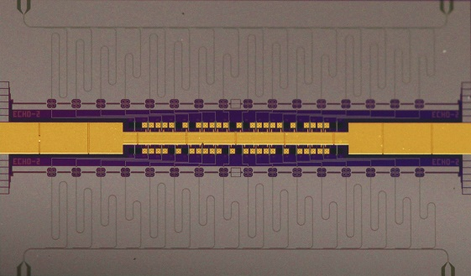
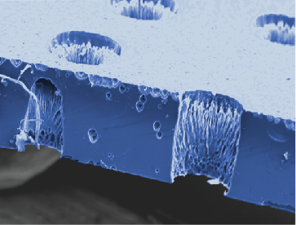


How to improve?
Chip temperature > 50 mK
Problem: Heat bath very large (1.5 cm)
Solution: Heatsink pixels to chip backside
Pixel 1
Pixel 2
200 µm
Wafer
Hole with Au
Thermal bath on chip backside
Rather large noise level
Simulations for optimizing multiplexer parameters in progress
  Energy resolution ΔE_{FHWM} < 10 eV possible in near future

Slide 34
Summary & Outlook
Excellent performance of metallic magnetic calorimeters
Single channel readout not possible for large arrays
Microwave SQUID multiplexer suited for readout of large arrays
First simultanous readout of two detector channels demonstrated
Detector performance degraded due to:
  High chip temperature
  Non-optimal sensor magnetization
  Rather high noise level
New detector thermalization and multiplexer simulations in progress
ΔE_{FWHM} < 10 eV possible in near future

Slide 35
Thank you for your attention

