Slide 1
Future Accelerator Studies
Section
SMB-SE-FAS
John Osborne
Group Meeting 5 Feb 2016

Slide 2



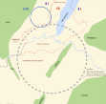
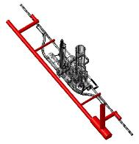


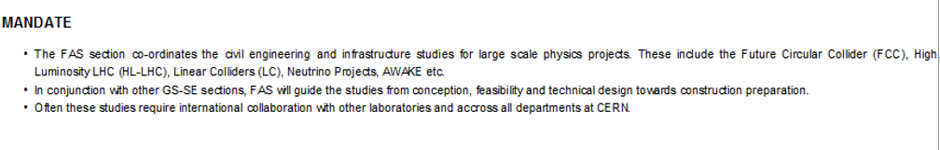
SMB/SE/FAS : 2015
Future Accelerator Studies Section (FAS)
LHeC
Linear Colliders
SL: John OSBORNE
R2E
Engineers
Charlie COOK
Martin MANFREDI
Joanna STANYARD
Future Circular Collider (FCC)
High Luminosity LHC (HL-LHC)
SHIP
Laguna
SMB

Slide 3



HL-LHC WP17 SubWork Packages
General Infrastructures Services Department
WP17.1 Civil Engineering
J. Osborne, M.Manfredi
WP17.6 Survey & Alignment
H. Mainaud Durand
WP17.2 Electrical Distribution
G. Cumer, N. Dos Santos, JC. Guillaume
WP17.7 Transport
C. Bertone, B. Feral
WP17.3 Cooling & Ventilation
M. Battistin, P. Pepinster
WP17.8 Upgrad. & Cons. of Test/Assembly Facilities for HL-LHC
I. Bejar Alonso
WP17.4 Access & Alarms
T. Hakulinen, P. Ninin
WP17.9 Logistics & Storage
I. Bejar Alonso
WP17.5 Technical monitoring
T. Hakulinen, P. Ninin
WP17.10 Operational Safety
T. Otto
From Sept 2015 : Jo Stanyard SE-FAS, Pieter Mattelaer SMB-DI, DOP Section &
M.Poehler for permits/local affairs

Slide 4
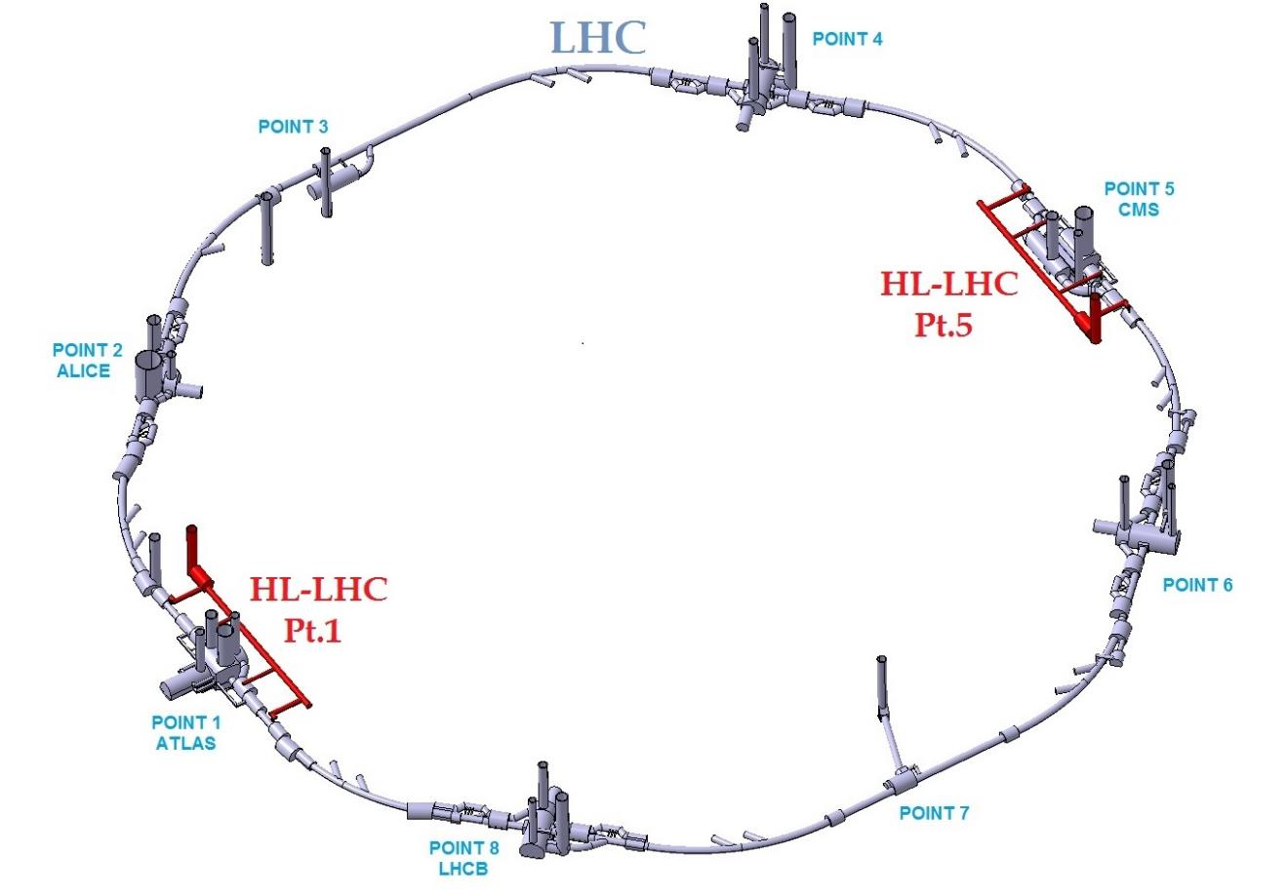
SE:FAS HL Underground Works (in red)

Slide 5
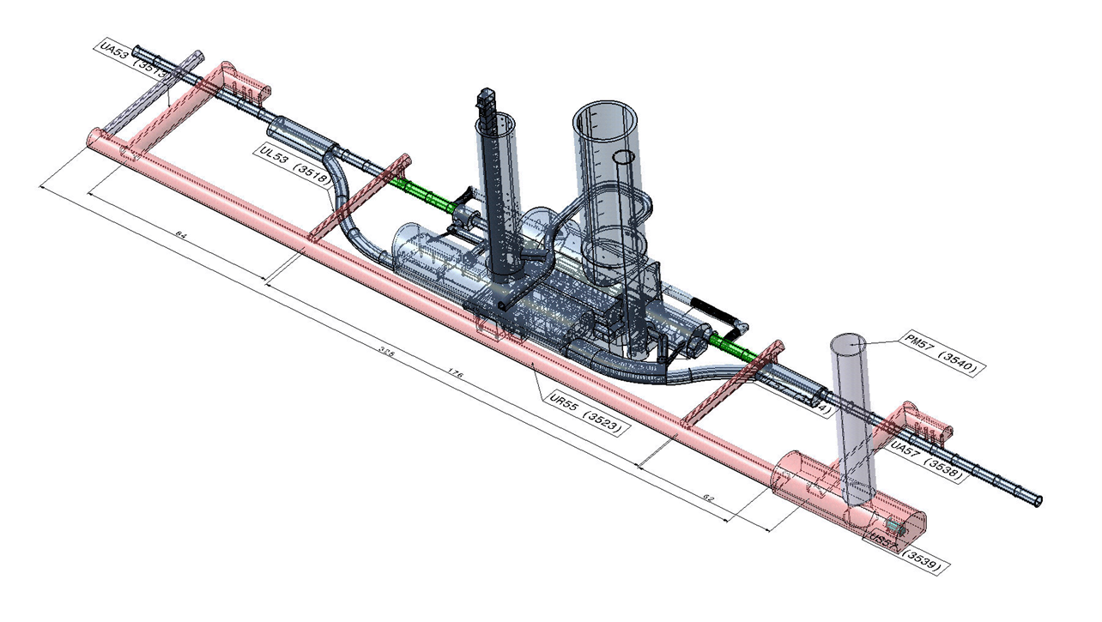
HL Underground Civil Works at Point 5
General Infrastructures Services Department

Slide 6
Civil Engineering :
Layouts Point 5
CMS
France
IT-4155/SMB/HL-LHC

Slide 7
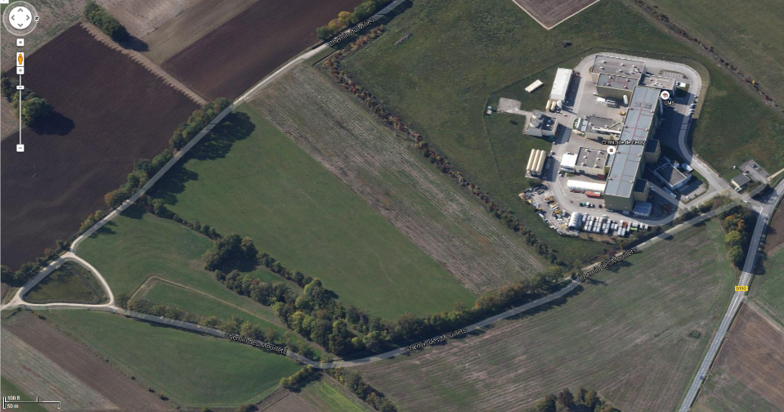
Proposed site boundary enlargement for civil works : Point 5 CMS
Worksite Area
(approx. 30% increase in CMS surface area)

Slide 8
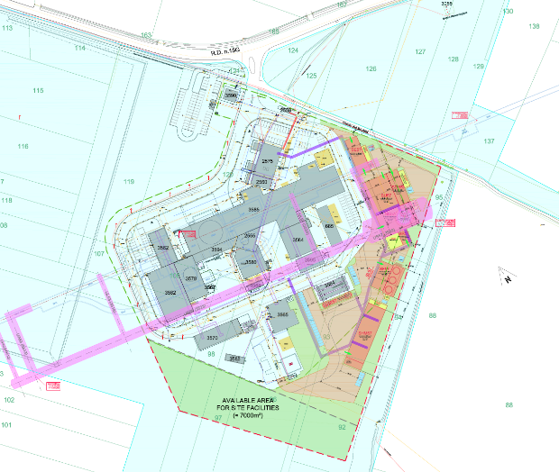
The Works for HL-LHC at Point 5

Slide 9
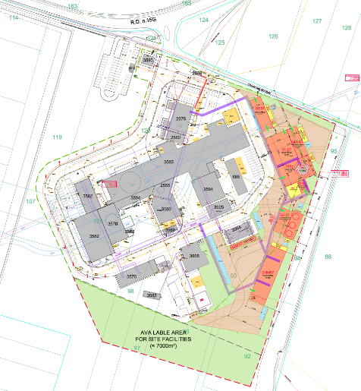
The surface works for HL-LHC at Point 5
Electrical Building
Ventilation Building
Helium Liquefier Building
Head Shaft Building
Rectifier Building
Cooling Towers
Compressor Building

Slide 10
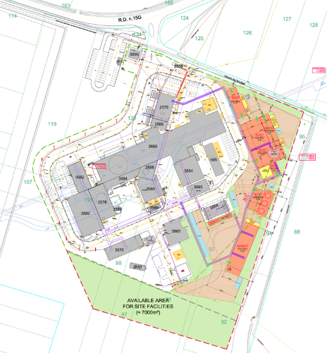
The surface works for HL-LHC at Point 5 – Concrete buildings
= concrete building
Ventilation Building
Rectifier Building
Cooling Towers
Compressor Building

Slide 11
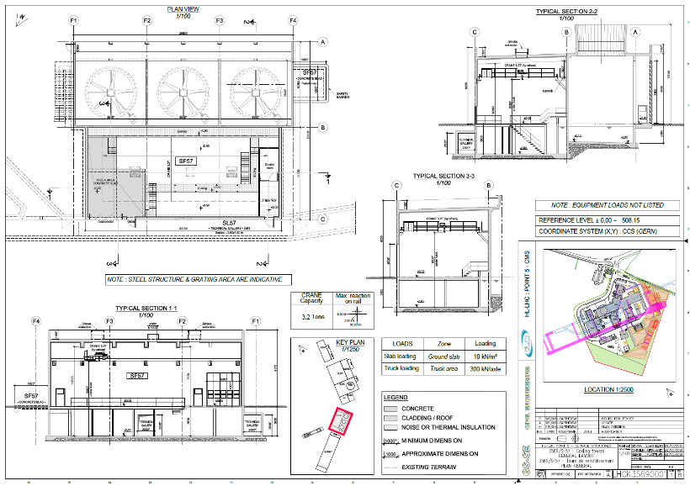
SF57 - Cooling Towers

Slide 12
The surface works for HL-LHC at Point 5 – Steel Buildings
= steel building
Electrical Building
Helium Liquefier Building
Head Shaft Building

Slide 13
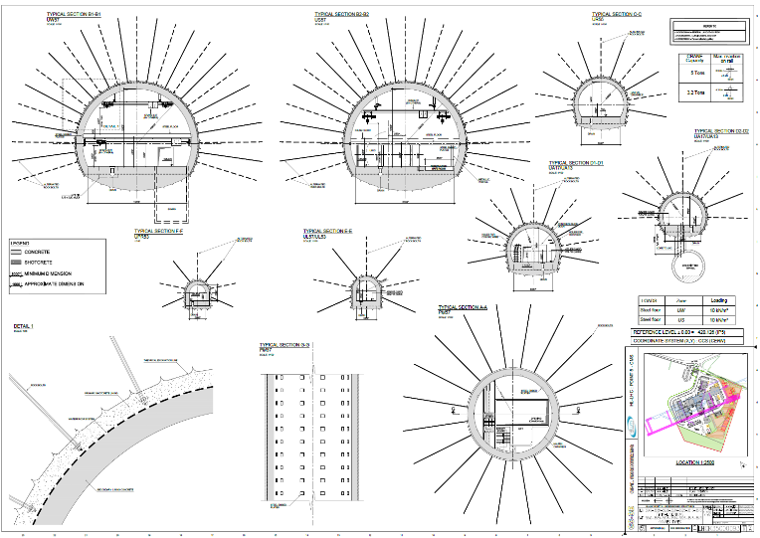
Typical sections of Underground works at Point 5

Slide 14
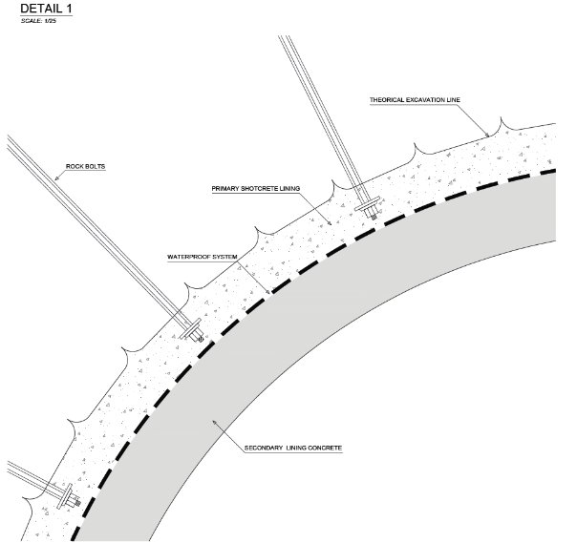
Typical section of underground works

Slide 15
Civil Engineering :
Layouts Point 1
ATLAS
Switzerland
IT-4144/SMB/HL-LHC

Slide 16
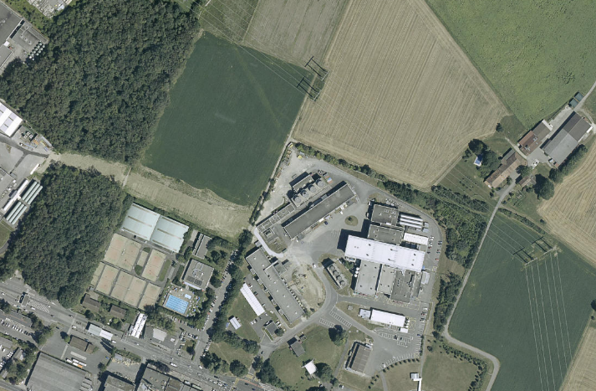
Site Boundary enlargement for civil works : Point 1 ATLAS
Worksite area (approx. 20% increase in ATLAS surface area)
Worksite access

Slide 17
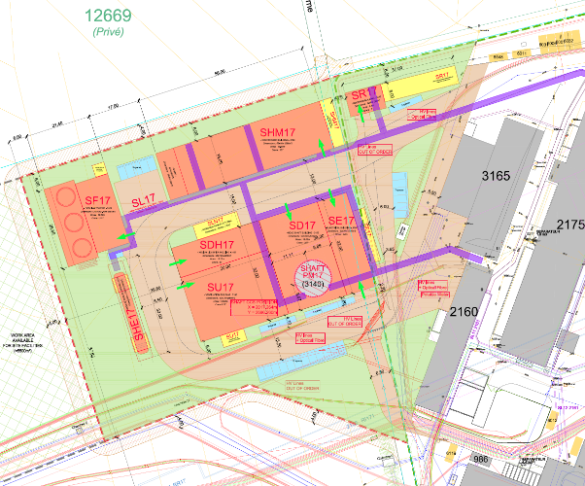
The Surface Works at HL-LHC at Point 1
Rectifier Building
Compressor Building
Cooling Towers
Helium Liquefier Building
Electrical Building
Head Shaft Building
Ventilation Building

Slide 18
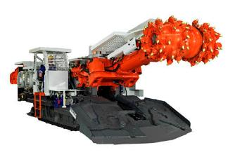
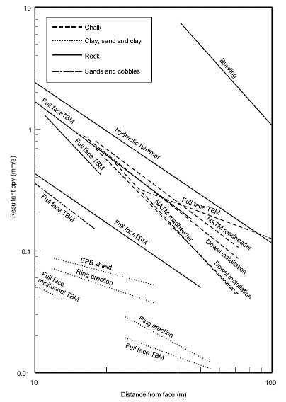
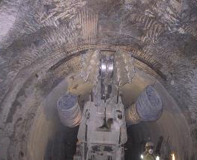
Results from Dr Hiller’s (Arup) studies - Vibration from tunnelling
The main ‘vibration’ activities are driving the civil engineering planning
General Infrastructures Services Department
Roadheaders will be used for excavation
0.2 mm/s
2x10⁻⁴ m/s
200µm/s
New measurements needed for concrete pump, hydraulic hammer, roadheader,
Jumbo
At 45m, tunnelling vibration would give ~200µm/s peak
More testing planned with EN/MME
45m

Slide 19
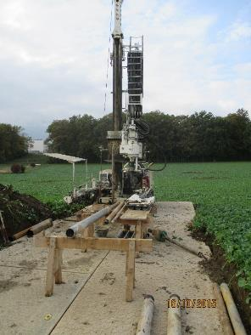
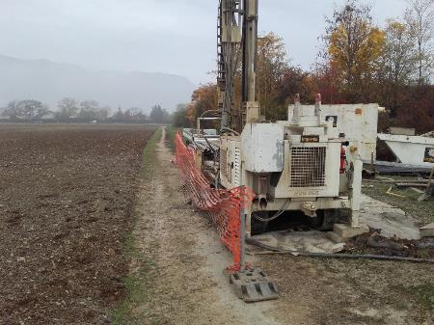
Site Investigations
In addition to existing geotechnical information from LHC, site investigations were undertaken at Point 1 and Point 5 for HL-LHC.
Site investigations at P5
Site investigations at P1

Slide 20
Preliminary findings from geotechnical survey
Point 5 :
Layer of made ground above glacial formations with a maximum depth of 50m, covering Molasse.
These conditions are in agreement with results from existing geotechnical surveys of the area.
At the new shaft location the depth of the Moraines is approximately 25m.
Point 1 :
A thin layer of made ground above 3 to 10 m of moraines.
Hydrocarbons were detected in 3 of the coring locations. Lab testing is on-going.
The full factual report will be provided as soon as it is available (most likely March ‘16)

Slide 21
Agreed HL-LHC CE Contract Strategy
Packages 1 :
1a : Architect contract for building permit submission (CH)
1b : Consultants for design of underground and surface
1c : Contractor for underground and surface works
Packages 2 :
2a : Architect contract for building permit submission (F)
2b : Consultants for design of underground and surface
2c : Contractor for underground and surface works

Slide 22
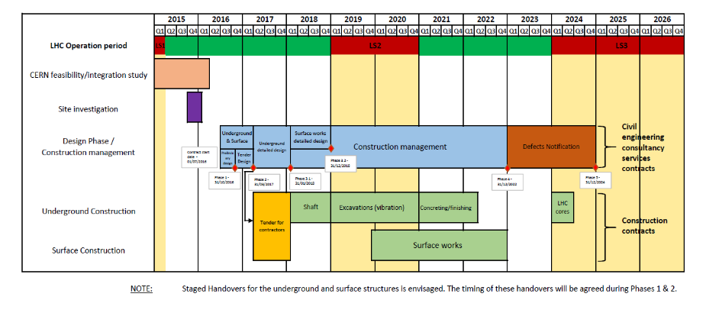
Agreed Civil engineering planning in Consultants Tender
24hr working for underground

Slide 23
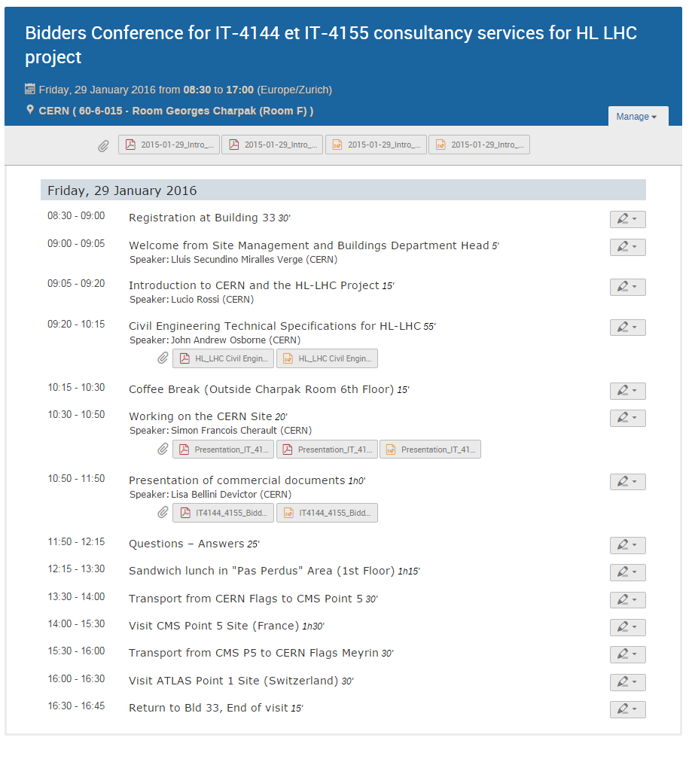
15 companies attended
46 participants
Deadline for replies extended to 9 March (at CERN)
June FC
Early start in May ?
HL-LHC Bidders Conference 29 Jan 2016

Slide 24

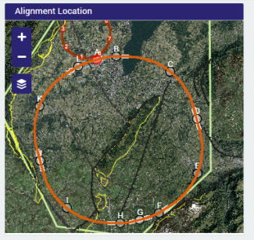
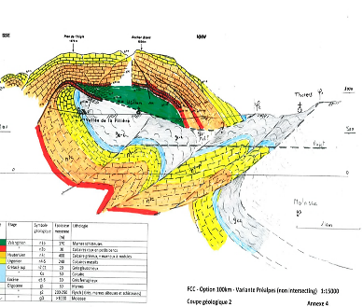
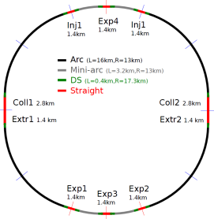
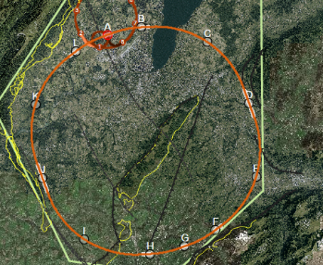

SE-FAS : Future Circular Collider
Progression of CE Study
Quasi-circular machine proposed of lengths 80km, 87km, 93km & 100km.
Injection lines studied
Narrowed down to four options; 1a (93km), 2a (100km), 1b (93km), 2b (100km)
FCC CE study presented at FCC week, Washington 2015
Footprint, positioning and planarity assessed by review panel – Decision taken to focus on 100km FCC machine
Geological profile of the Prealpes, upgrades to TOT, general risk assessment and comparison of 100km options
26/09/14
19/11/14
25/03/15
11/06/15
Up to FCC week, April 2016
FCC CE Workshop
FCC Week, Washington
Study Phase 2
CE/Geology and Optimisation Meeting 5
FCC Review Meeting
John Osborne, Charlie Cook GS-SE-FAS

Slide 25

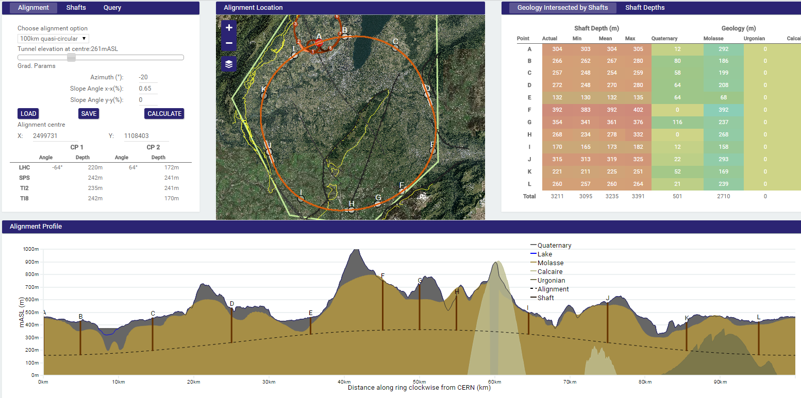
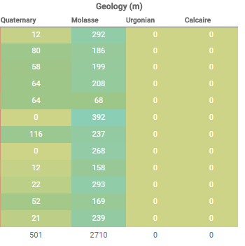
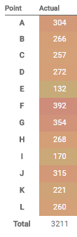
100km Intersecting Option
Mandallaz
20,800m
Lake
Geneva
Vallée de l‘Arve
Le Rhône
Avoids Jura limestone: No
Max overburden: 650m
Deepest shaft: 392m
% of tunnel in limestone: 13.5%
Total shaft depths: 3211m
Point A Campus: Prevessin (large potential area)
Challenges:
7.8km tunnelling through Jura limestone
300m-400m deep shafts and caverns in molasse

Slide 26
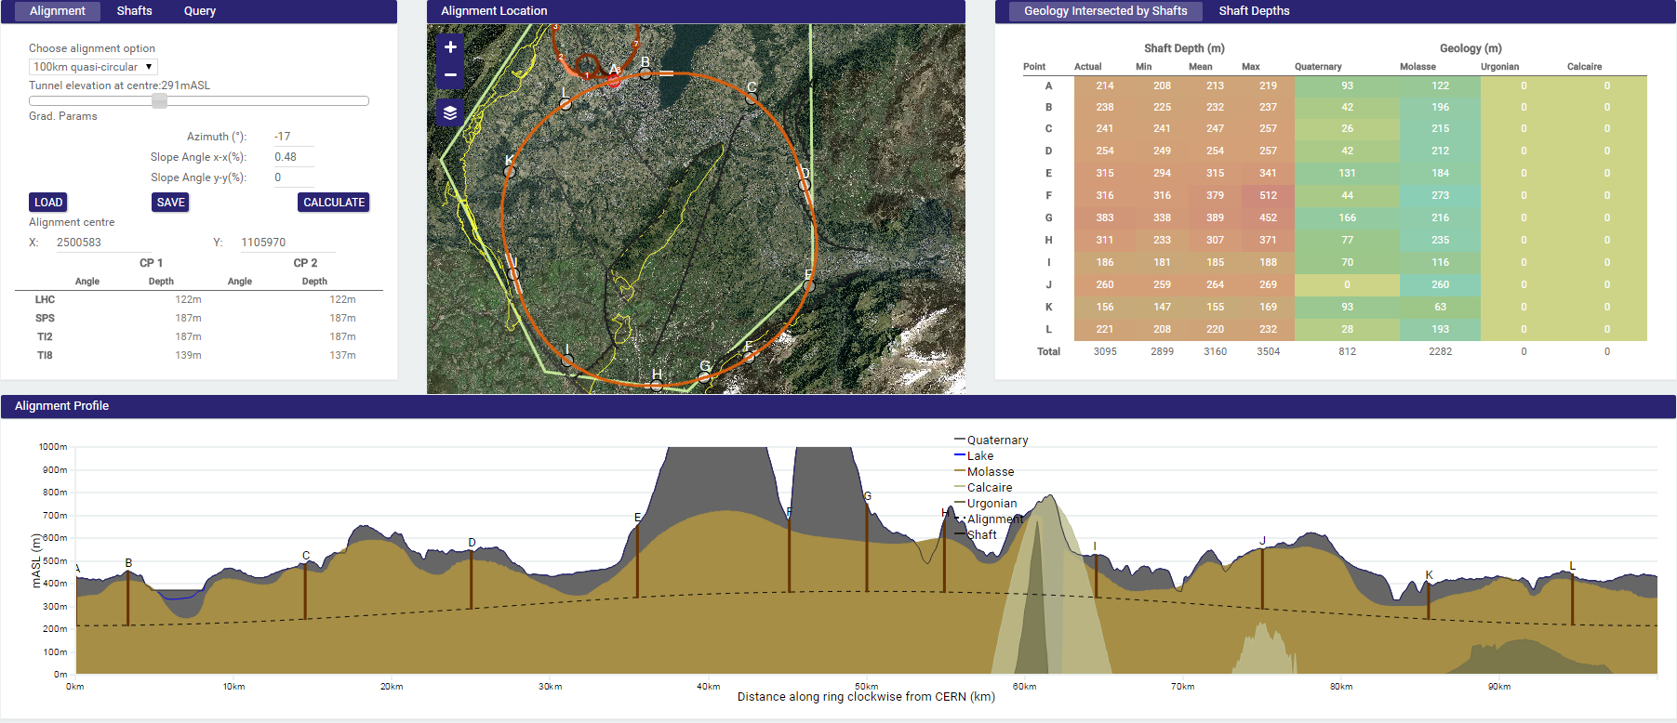
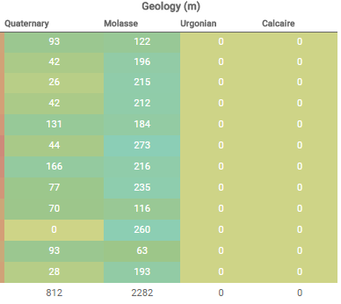
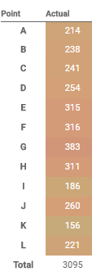
100km Non-intersecting Option
Limestone in this area
is yet to be included in TOT
Mandallaz
Lake
Geneva
Vallée de l‘Arve
Les Usses
Le Rhône
Avoids Jura limestone: Yes
Max overburden: 1350m
Deepest shaft: 383m
% of tunnel in limestone: 4.4%
Total shaft depths: 3095m
Point A Campus: Meyrin (small potential area, next to airport)
Challenges:
1.35km tunnel overburden
300m-400m deep shafts and caverns in molasse

Slide 27

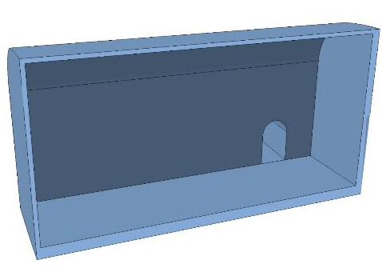
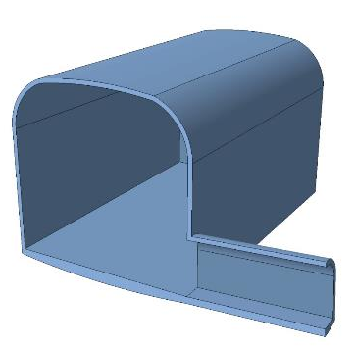
Twin Solenoid detector cavern with shaft
Cavern Option | Access solution | Shaft/tunnel diameter [m] | Detector design | Required dimensions for installation [m] | Width of metallic structures [m] | Cavern dimensions (LxWxH) [m] | Span [m]
Option 1 | Shaft | 28 | Twin Solenoid | 65x30x36 | 8 | 65x38x36 | 38
Option 2 | Inclined tunnel | 14 | Toroid | 86x36x42 | 8 | 86x44x42 | 44
44 m
42 m
86 m
13 m
First Draft
8 m

Slide 28
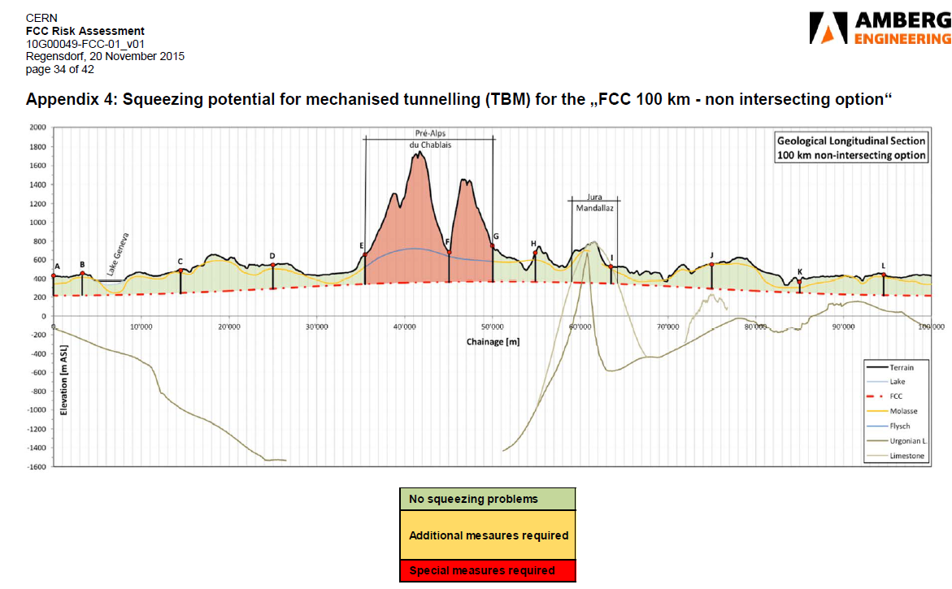
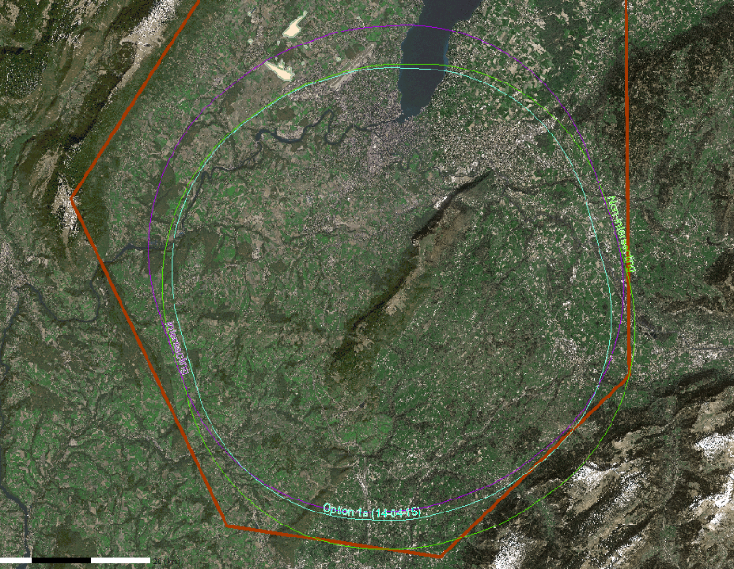
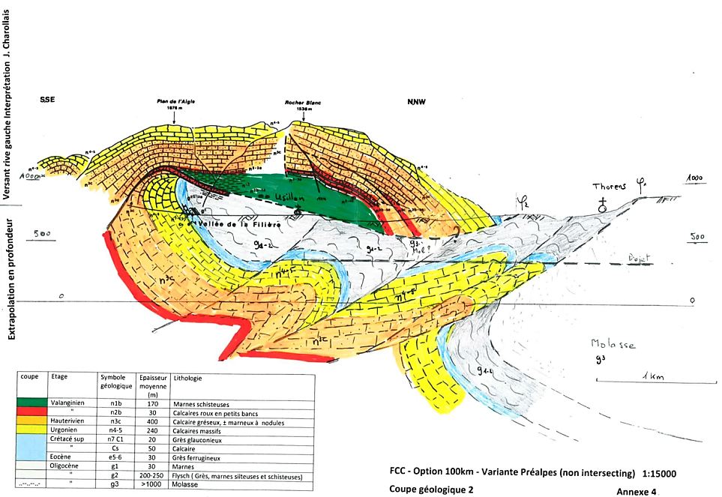
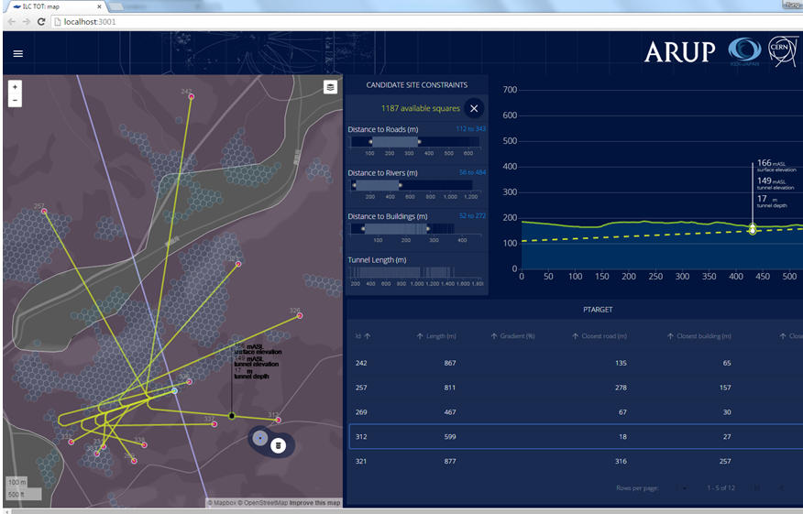
FCC Study Phase 2
FCC Risk Assessment (AMBERG)
FCC Comparison Study (AMBERG)
Geological representation of the Prealpes (GADZ)
Upgrades to TOT (ARUP)

Slide 29
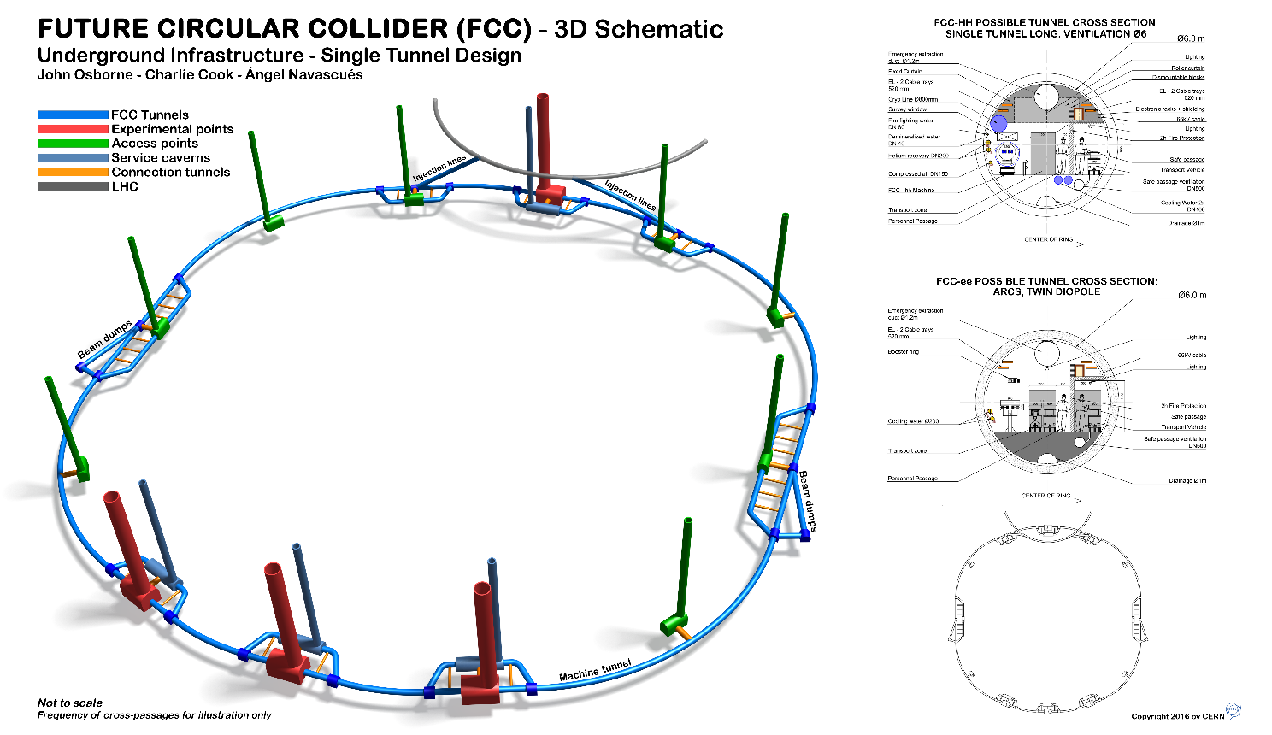

Slide 30
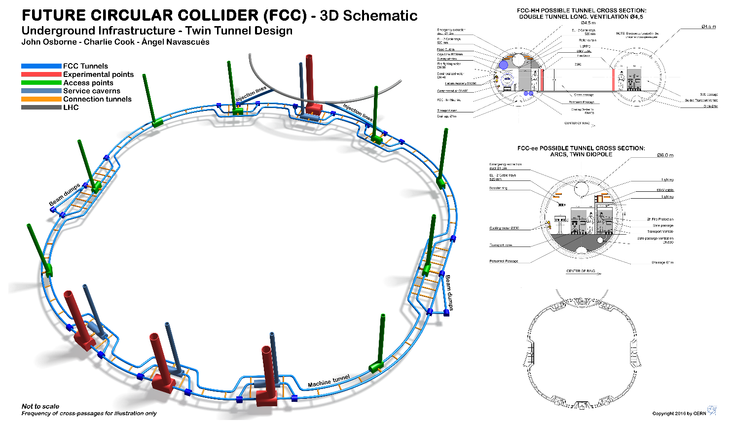

Slide 31
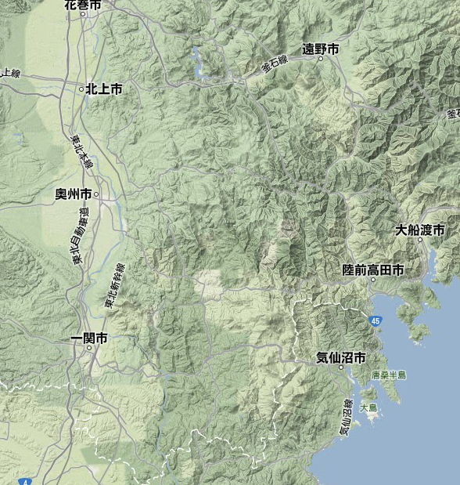
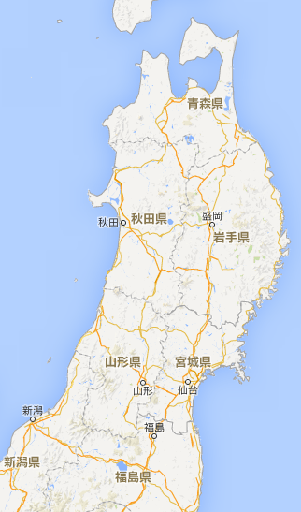
SE-FAS : International Linear Collider ILC
ILC Site Candidate Location in Japan: Kitakami
Oshu
Express-
Rail
Ofunato
Kesen-numa
Sendai
Ichinoseki
John Osborne GS-SE-FAS

Slide 32
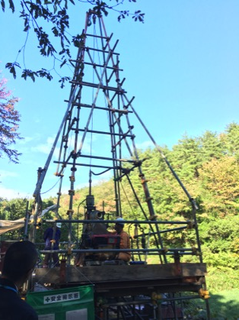
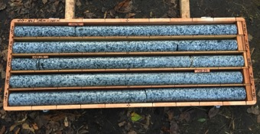
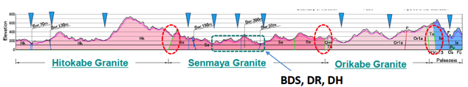
A New Boring at a Candidate Interaction Point
Courtesy: T. Sanuki
A new boring test progressed to demonstrate the “vertical access feasibility” for detector hall at IP
IP Region, candidate

Slide 33
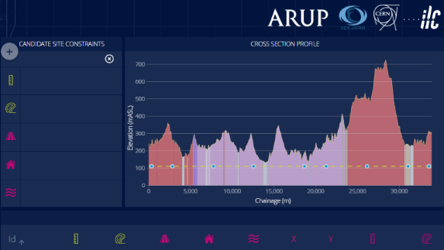
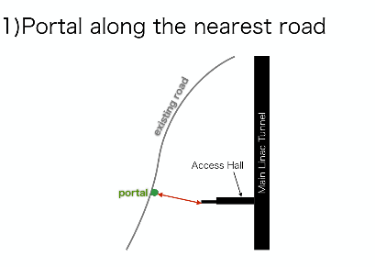
SE-FAS : CERN/KEK Collaboration to develop TOT for ILC Optimisation

Slide 34


Digital and Technology
Arcadis with Transport for London (TfL)
Arup with CERN
Atkins with Department for Education
Baringa Partners with Nationwide
CSC with Network Rail
Deloitte with Philips
Efficio with Network Rail
Elixirr with TUI Group
GE Healthcare Finnamore with Health Education England
North Highland UK with Sainsbury's
TOT now being developed for tunnel under Stonehenge

Slide 35
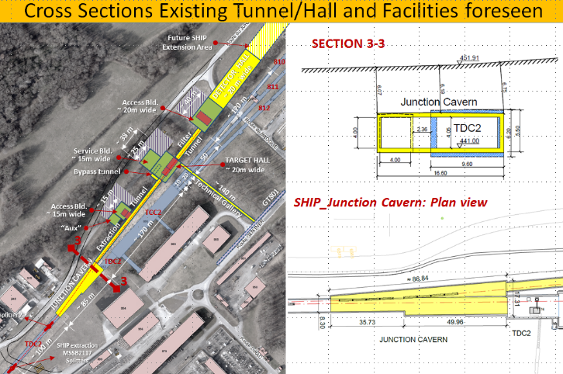
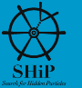
SE:FAS : Search for Hidden Particles (SHiP)
Feasibility report (Technical Proposal) issued in 2015
Major CE works required in North Area
John Osborne, Martin Manfredi GS-SE-FAS

Slide 36
2016 Outlook
HL:LHC
  TDR CE Chapter
  External Independent Engineers appointed and managed
  Assist in Adjudicator Selection and co-ordination of visits
  Freeze Layouts
  Issue Geological reports
  Vibration measurements
  Consultants Bid analysis
  Consultants appointment in June FC, (early start may ?), Preliminary Design to be Completed in 2016
  Building Permits submitted
  Safety Co-ordinators MS / IT required
  Cost and Schedule reviews (April and October)
  MS for contractors
FCC
  Single tunnel v double tunnel decision
  Tunnel Optimisation Studies on-going using TOT
  Advising FCC-ee lattice design on CE constratints
  Cost/Schedule studies
  Interface with various working groups (hh, ee, he, I&O, MDI, Injectors)
  Workshop April 2016
Linear Colliders
  CLIC : New Baseline Layouts (One detector only, revised energies)
  ILC : TOT fully developed for Japan Site, Change Requests, TDR design refinements
SHiP : Design developed towards CDR
LHeC : Request for Layout studies to continue, especially in relation to FCC

Slide 37


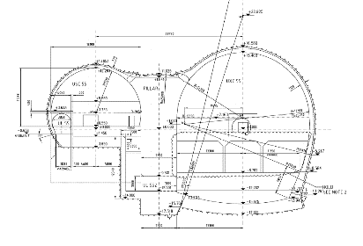

SMB/SE/FAS : 2016
Future Accelerator Studies Section (FAS)
Linear Colliders
SL: John OSBORNE
Engineers
Charlie COOK
Joanna STANYARD
Martin MANFREDI
Richard Morton
HL-LHC
Contract preparation and monitoring
Vanessa Di Murro
Future Circular
Collider (FCC)
SHIP
Tunnel Asset Management
SMB

