Slide 1
SMB-SE-DOP section
M. Poehler

Slide 2
DOP – Section mandate
“The DOP section is responsible for Civil Engineering design, Geographic and Patrimony data in the following categories:
the study and design of Civil Engineering works (underground, surface and special works, piping networks, roads and landscaping); the 2D integration, the modeling of structures in 3D Catia; the support to project manager and work requester
the administration of the CERN Geographic Information System (GIS), the update, archive and diffusion of the CERN base maps (sites, parcels, roads, networks, buildings, tunnels, rooms, …) and the patrimony data; the land surveying activities;
The support for project manager and work requester, for technical specifications, cost estimations, and blanket contract (data base of technical specifications and prices)
The management of external relations with the technical offices of the local authorities.

Slide 3
DOP – Section organigram (01.01.2016)
Section Leader: M. Poehler
Deputy SL: E. Perez-Duenas
Design Office
CE Processes
Patrimony
and Site Information
Ingénieur structure
Raul FERNANDEZ
Projeteurs AutoCad-Catia
Ludovic BARTHELEMY
Laurent FAISANDEL
Patrick RIEDO
Projeteurs contrat cadre
Oscar LOPEZ MARTINEZ*
Alexis SANCHEZ MOLINA*
Angel NAVASCUES CORNAGO*
Adrian VALLEZ ALVAREZ *
Maria ALVARADO MARTIN*
Pedro LOPEZ VIILLAMARIN*
Cristo PEREGRIN*
Blanca VAZQUEZ***
Hyo CHO***
Ingénieur «processes»
Eliseo PEREZ-DUEÑAS
Technicien «processes»
Stéphanie RICHARD
Ingénieur Géomètre
Youri ROBERT
Géomaticien
Poste à pourvoir
Nicolas GUILHAUDIN**
Technicien
Samuel ZELER
Francois VILLAGRASSA
Technicien contrat cadre
Florence FANJAT*
Emilie TER-LAAK*
* Personnel en prestation de service
***Personnel en prestation de service détaché
** VIA, Fellow, stagiaire, COAS ou autres contrats

Slide 4
SMB-CE DOP Section
Patrimony and External relations
Consolidation program execution
Mainly machine
Project execution
Mainly tertiary
Studies for future accelerators
and existing tunnel structures
Works, Operation and Maintenance
Important interaction
with other section

Slide 5
SMB-SE DOP Section
Design office
Patrimony and site information
CE Processes
External relations with the technical offices of the local authorities

Slide 6
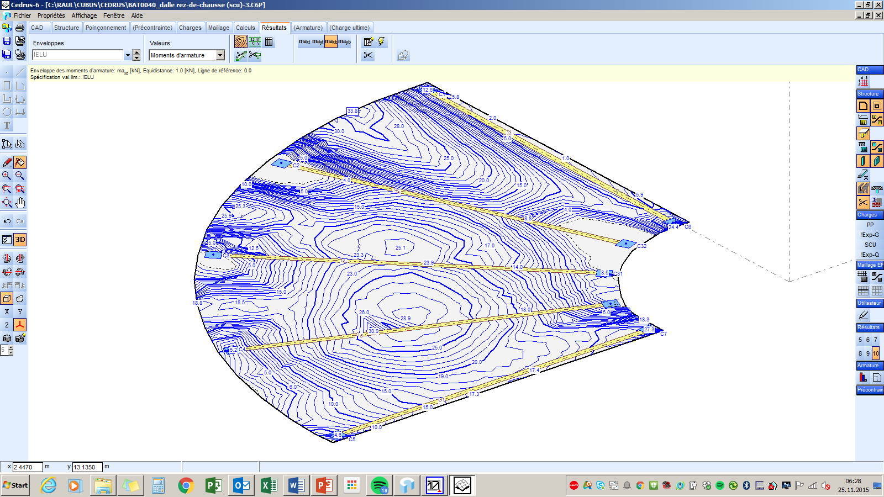
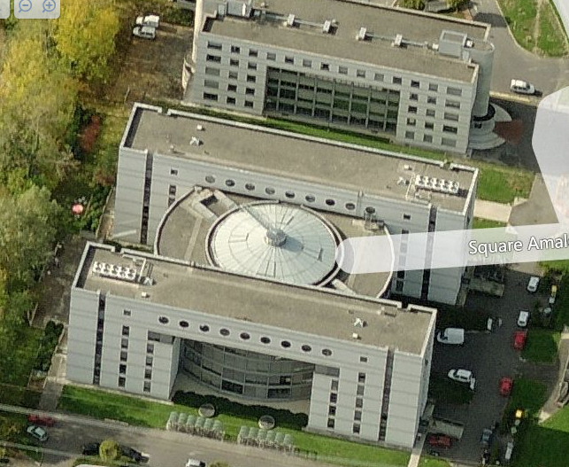
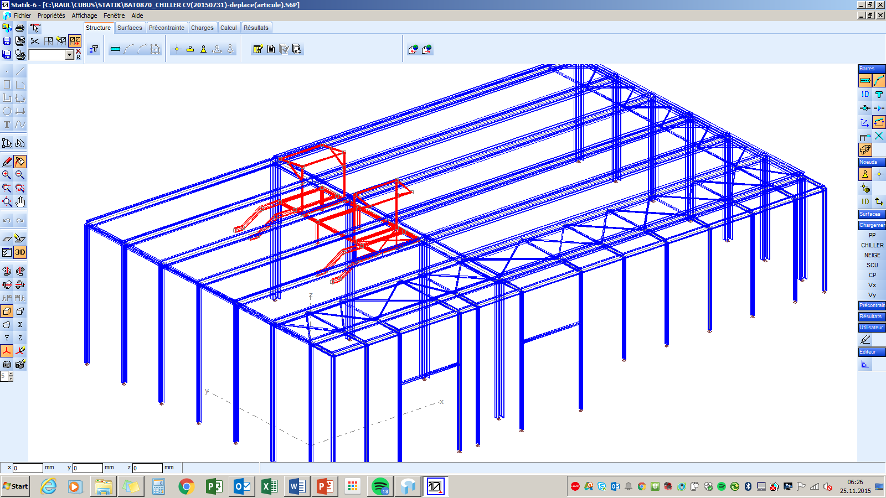
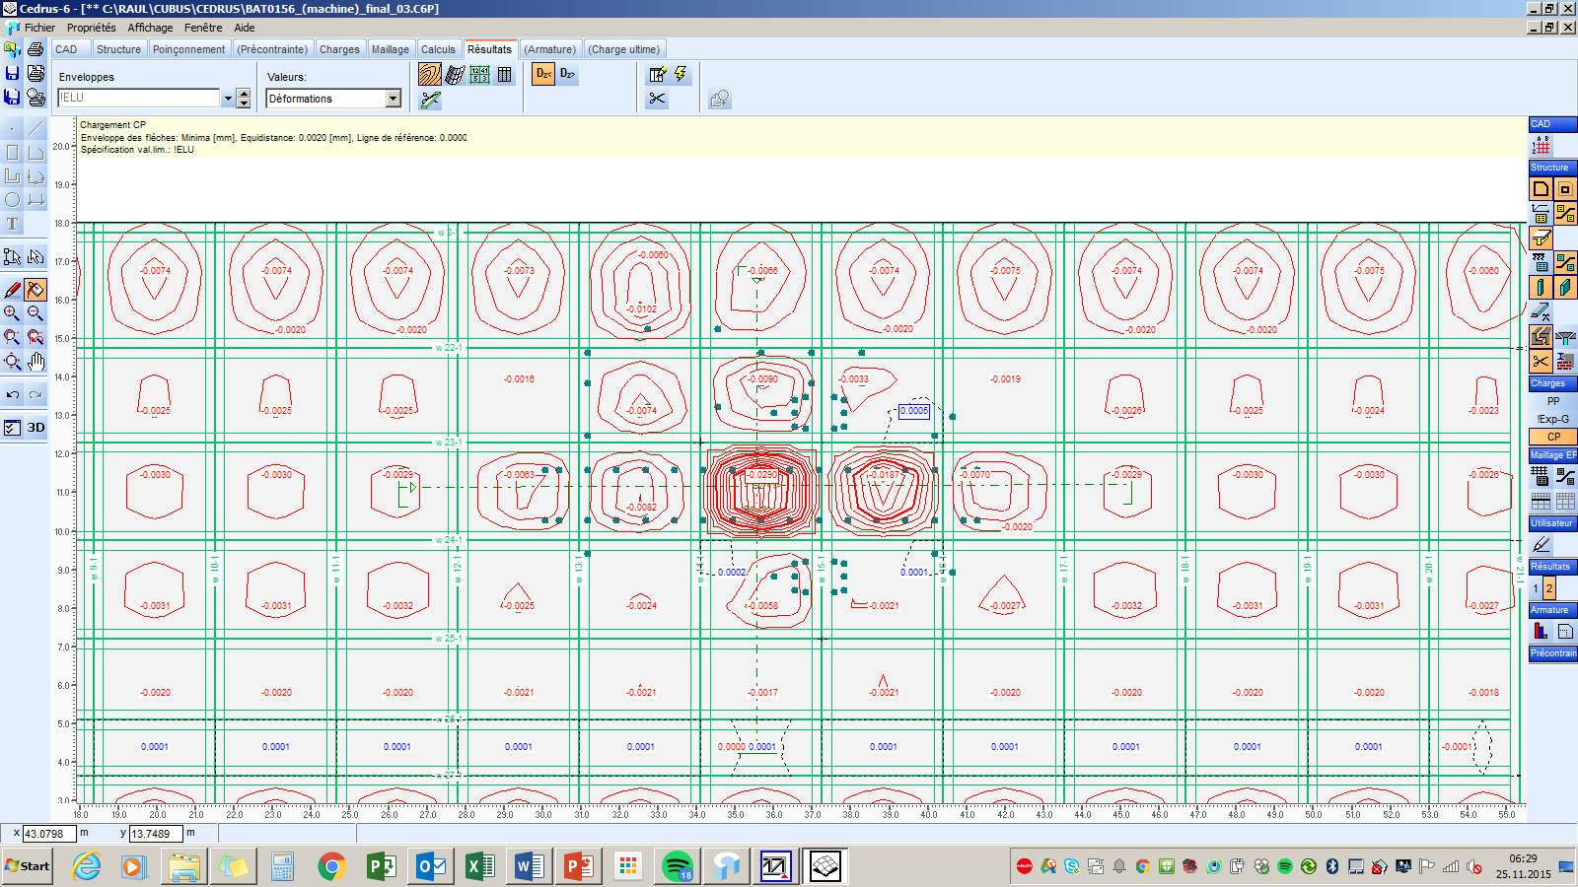
DOP – Design Office
Structural calculations and checks (~300 requests/year)
Static verifications
Construction designs
Feasibility studies
Standards requests
Design assessment
Bld-40
(admissible loads on
the ground floor)
Bld BA3-870
(Steel structure
for CV Equipment)
Bld-156
(deflections under heavy loads)

Slide 7
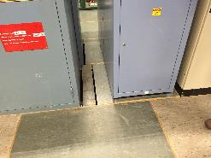
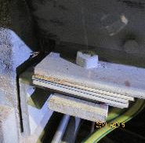
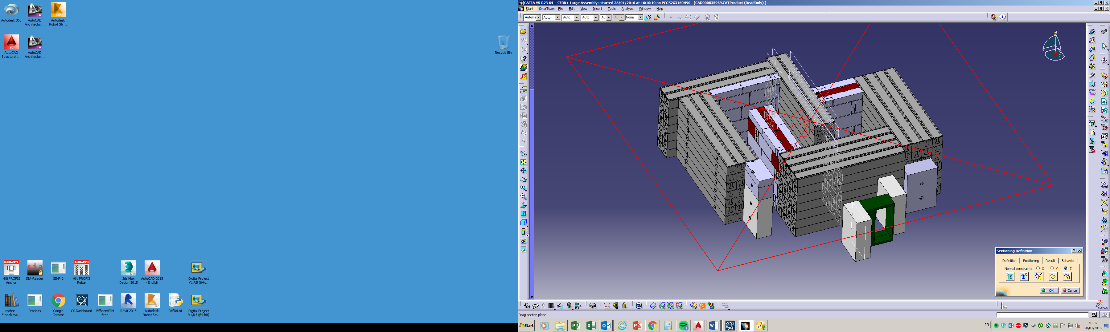
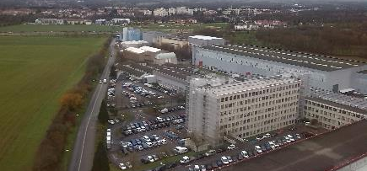
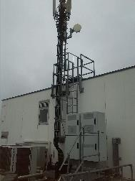
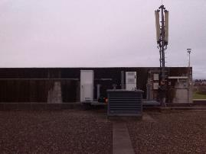
DOP – Design Office
Structural calculations and checks
Structural assessment in
BA buildings (SPS):
Seismic studies
New mobile Phone antenna
New ME91Sub-station

Slide 8
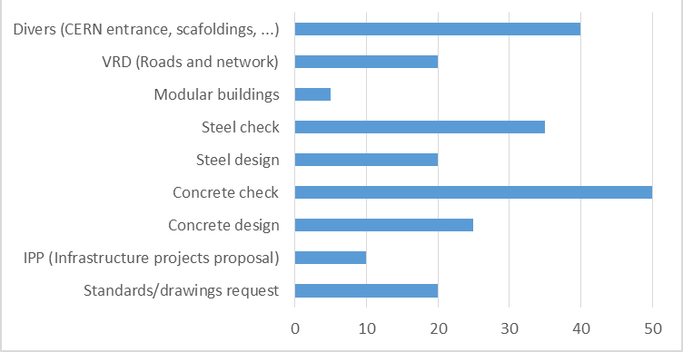
DOP – Design Office
Number of request
 | 2013 | 2014 | 2015
Graphic studies | 65 | 90 | 180
Structural studies | 195 | 240 | 300 (*)
(*) 80% complete, 10% ongoing, 10% canceled by requester
Type of studies
(Approx. values)

Slide 9
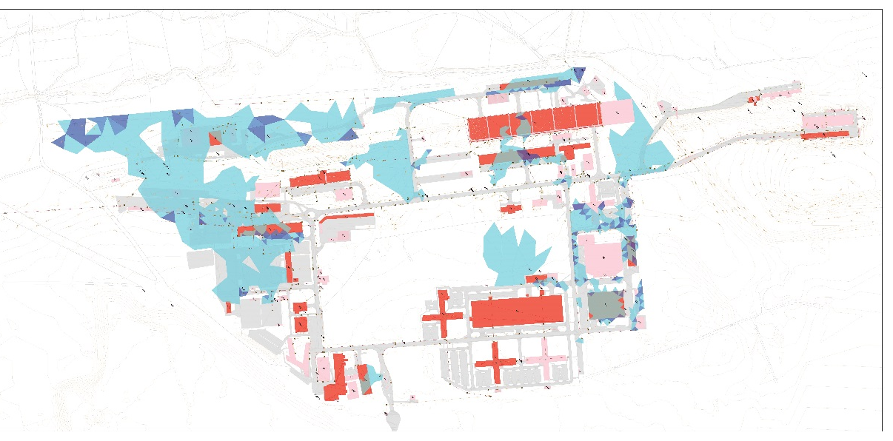
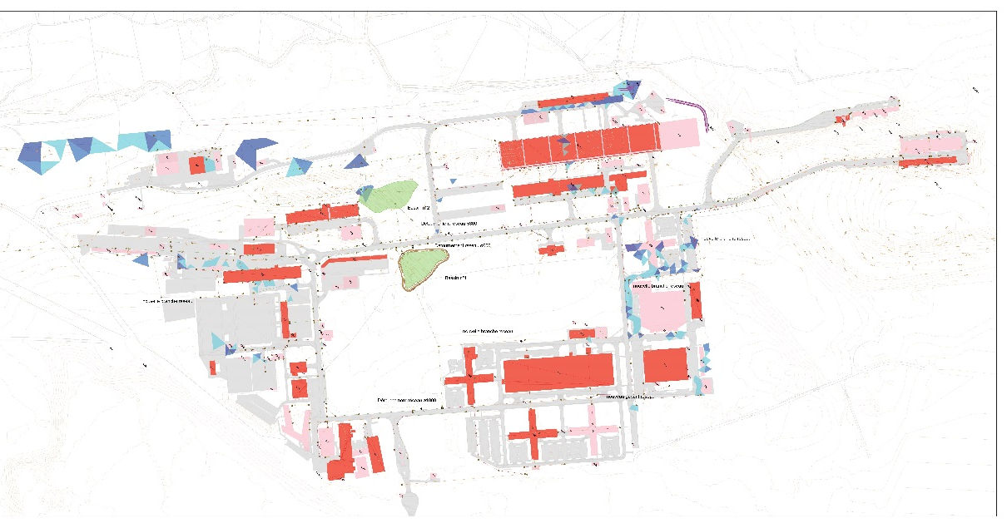
DOP – Design Office
PoliChem working group
Working group for the prevention of liquid and chemical pollution
Representation of the SMB department for the information and actions on:
  Liquid products in the central store
  Petrol stations
  Sewage Network (included oil separators and retention basins)
  Hydraulic studies
  Waste disposal (hazardous products)
Coordination of the actions and works to solve the risk situations

Slide 10
DOP – Design Office
Distribution of design draftsmen works by section
 | N° studies (~) | N° working hours
PROJECTS-DIVERS (DOP) | 75 | 3700
GS-SE-CEB | 65 | 2180
GS-SE-FAS | 3 | 1170
GS-SE-PO | 3 | 890
INTEGRATION | 35 | 2930
Resources for the main projects
HL-LHC | Ludovic, Angel, Adrian
Building 107: | Patrick, Martina, Cristo, Oscar, Laurent
Building 311: | Patrick, Pedro, Raul, Laurent
ISR-RWTC | Alexis, Raul
Building 887-Extension | Patrick, Cristo, Laurent
FCC | Angel
PoliChem working group | Raul, Alexis, Oscar
Civil models for Integration | Cristo, Pedro, Maria

Slide 11
DOP – Design Office
Internal invoicing jobs (2015)
Project | Value (CHF)
RWTC-ISR (Radioactive Waste Treatment Center) | 44.000
Consolidation projects | 39.600
Building 196 AD-Target | 5.500
Building 773 IT-Hub | 3.300
Building 245 | 4.950
Building 311 | 4.950
Building 887 | 4.950
Modification CERN entrance | 7.975
FCC | 2.475
Building 113_Creation of a Gas point | 2.200
HL-LHC | 66.000
Total: | 185.900

Slide 12
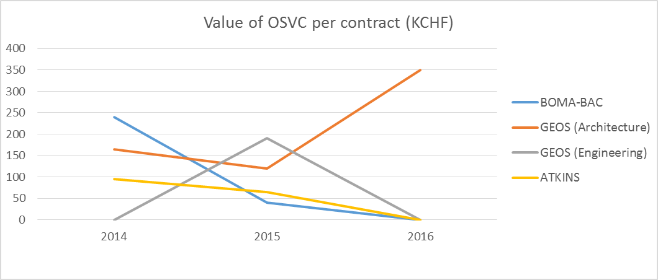
DOP – Design Office
Frame contracts
Civil Engineering and Architectural Consultancy Services
Value in KCHF | BOMA-BAC (22%) | GEOS (50%) (Architecture) | GEOS (15%) (Engineering) | ATKINS (13%)
2014 | 240 | 165 | 0 | 95
2015 | 40 | 120 | 190 | 65
2016 (expected) | 0 | 350 | 0 | 0
Design services (Draftsmen)
  7 persons working on CERN site in the DOP section
  2 persons collaborating in other services (HL-LHC; ALICE)
  Collaborations with different projects:
    HL-LHC
    Catia Integration models
    ISR-RWTC (radioactive waste treatment center)
    FCC
    ADAM
    PoliChem working group

Slide 13
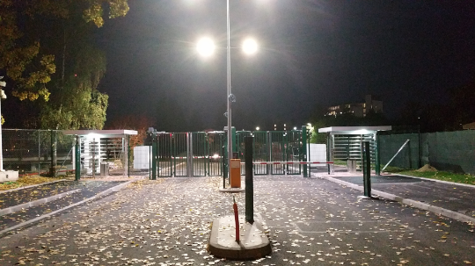
DOP – Design Office
2D Drawings – Studies and Projects (~150 requests/year)
HL-LHC lay-out
and buildings design
Feasibility studies
Preliminary designs
Construction designs
Tender designs
Coordination designs
Archive drawings research
New Entrance A
Bld-311 checking drawings
from external consultants
HL-LHC. 2D and 3D models
for underground infrastructures
Bld-311 Building design
(definition d’ouvrage)

Slide 14
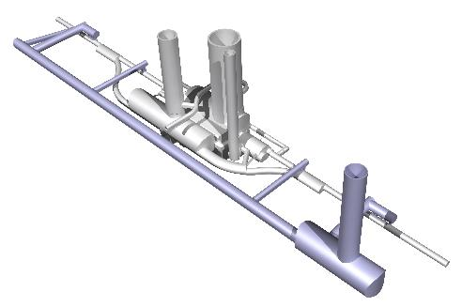
DOP – Design Office
HL-LHC project in point LHC-1 and LHC-5
3D model for underground
infrastructure.
Connection to LHC
General site lay-out.
Implantation of future buildings
Exemple for point LHC-1
Test with a Revit 3D model
for building SHM17
Conceptual design for the
tunnel cross section

Slide 15
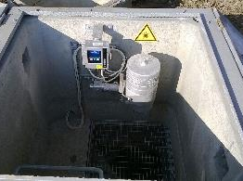
DOP – Design Office
2D Drawings – Studies and Projects (~120 requests/year)
Reinforced concrete
Steel structure
External layouts
Architectural design
Refurbishment
Detailing
Concrete foundation for the new
building 312 for
asbestos removal facilities
2D and 3D model on Autocad for the steel structure on the Bld 870-BA3 for CV Equipment
Hydrocarbons measurements chambers example in point 1

Slide 16
DOP – Design Office
Revit and BIM (Building Information Modeling)
New concept for Building design and projects -> Project Management
Based on 3D numerical Models -> 3D design in Revit
Including all the Information of the building -> QMS (quality management system)
Start Revit-2015
Software
Standards
Procedures
Way of work
CHANGE
Collaboration with other domains
  HVAC, EL, Architecture, VRD, ETC.
Consider the lifecycle of the project
  Studies, project, construction, maintenance, dismantling
Implantation BIM-2017

Slide 17
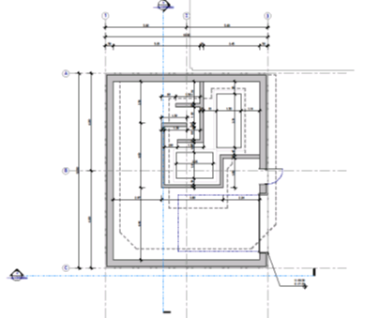
DOP – Design Office
Revit and BIM (Building Information Modeling)
First step – 3D modeling with Revit
3D-MODEL
(bld 196)
3D-SECTIONS
3D-VIEWS
DRAWINGS
DRAWINGS

Slide 18
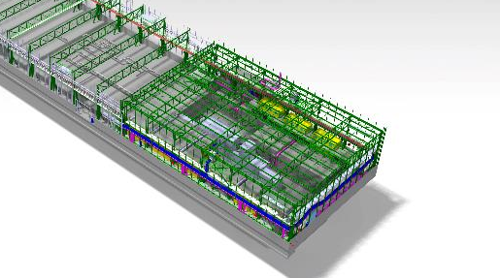
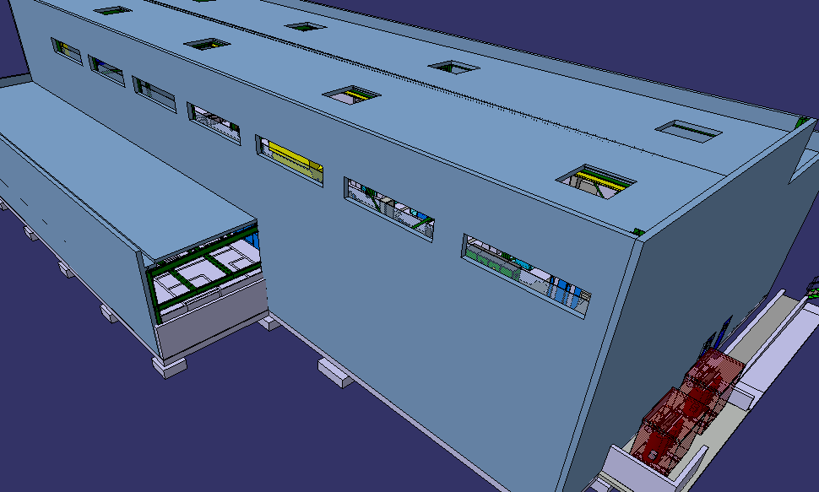
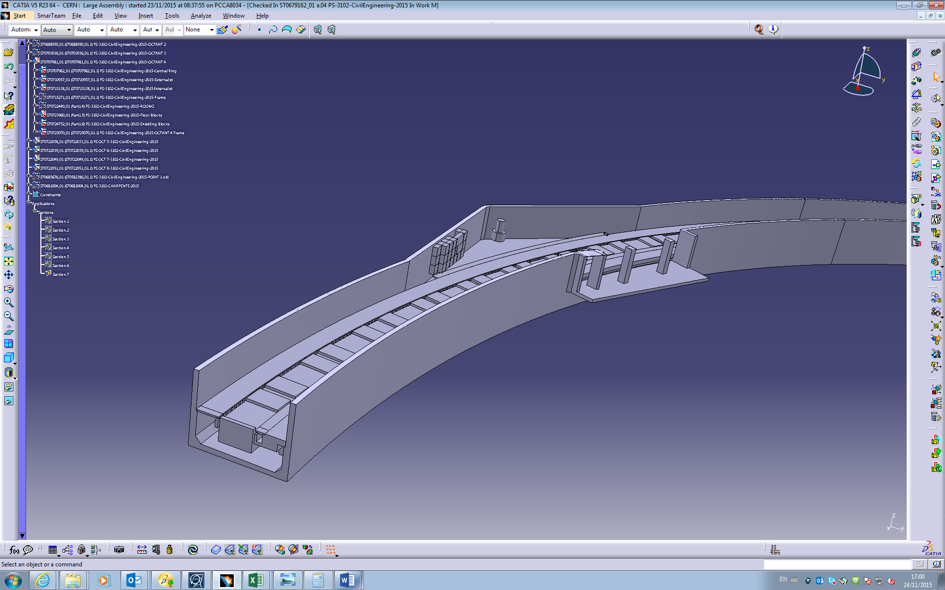
DOP – Design Office
3D Models – Studies and Projects (~50 requests/year)
New buildings As built
Feasibility-tender design
Extension
of building 887
3D CATIA model of the whole
PS-RING
3D CATIA model of Bld-311 for integration.
Update with execution drawings

Slide 19
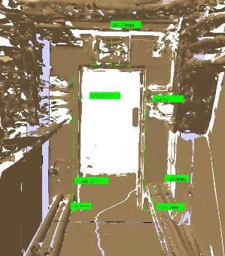
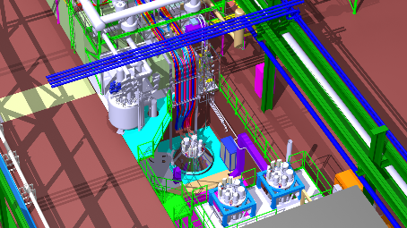
DOP – Design Office
3D Models – Studies and Projects (~50 requests/year)
Platforms
Detailed studies
Scan analysis
3D CATIA model of the existing
steel platforms in SPS pt 5 (ECX5)
Use of 3D scan in PS To update the models.
Example of the fire resistance doors implantation
SM18 Cluster-D. 3D models of the steel Platforms

Slide 20
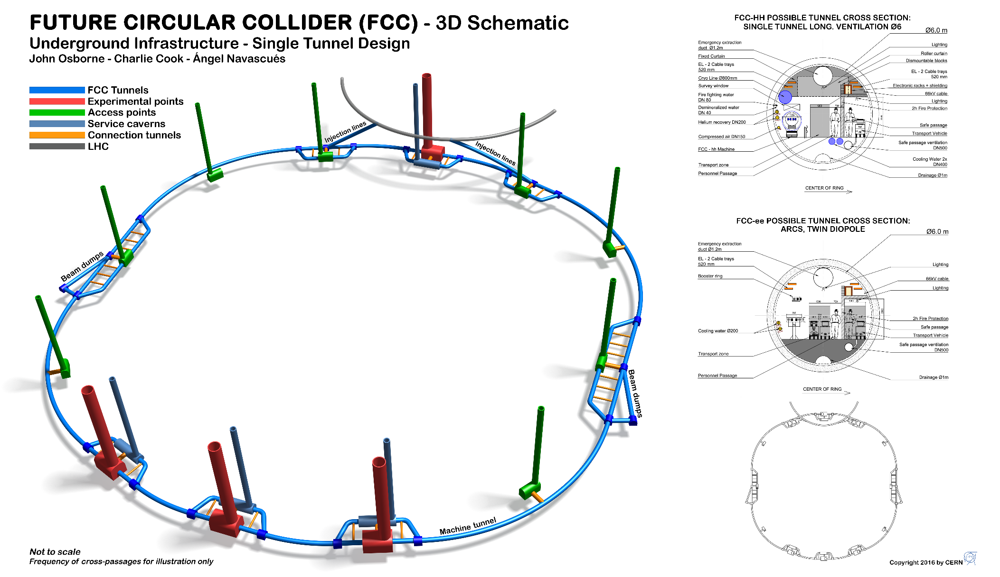
DOP – Design Office
FCC – 2D et 3D design

Slide 21
DOP – Design Office
Objectives 2016
Strengthen support to other section through streamlines/standard procedures/templates.
Service oriented and client satisfaction
Increment of the number of studies completed and a maximum register of information in EDMS, MTF, CDD
Revit projects (3D models): 2-3 buildings/works per draftsman to be developed in Revit.
Implantation of the first phase of BIM (Working in 3D models, even with external contractors)
Use of service-now to follow the advancement of the studies and register them
Increase capacity of design integration
Significant Advanced of the quality plan
2016 - Resources
1 Civil engineer
5 CAD-Revit draftsmen
4 CATIA draftsmen
Personnel 2015
Needs 2016
(in addition)
Fellow – Civil Engineer Support (Structural calculations, reports, studies)
Technical student (BIM implementation)
Cad draftsman for HL-LHC support (request to be fulfilled)

Slide 22
SMB-SE DOP Section
Design office
Patrimony and Site Information
CE Processes
External relations with the technical offices of the local authorities

Slide 23
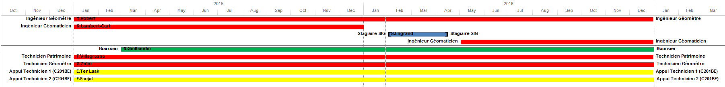
DOP - Patrimony
Tasks and resources 2015 - 2016
 | Y.Robert | Geomaticien | N.Guilhaudin (Fellow) | F.Villagrassa | S.Zeler | E.Ter laak (C201) | F.Fanjat (C201) | Total
 |  | (à pourvoir)
SIG / Web | 30% | 80% | 90% |  |  | 10% |  | 210%
Foncier - Relations ext. | 20% |  |  |  |  | 10% |  | 30%
Topométrie -dessin | 5% | 5% | 5% | 15% | 90% | 5% | 5% | 130%
DICT- permis | 5% |  |  |  | 10% | 25% |  | 40%
Collecte et intégration de données | 5% | 5% |  | 15% |  | 15% |  | 40%
Plans Particuliers | 5% |  |  |  |  | 15% |  | 20%
Archivage et recherches plan |  |  |  | 15% |  |  |  | 15%
Baraques (location) |  |  |  | 50% |  |  | 5% | 55%
Plans d'intérieur |  |  |  |  |  |  | 90% | 90%
Gestion service | 20% | 5% |  |  |  |  |  | 25%
Divers | 10% | 5% | 5% | 5% |  |  |  | 25%
TOTAL | 100% | 100% | 100% | 100% | 100% | 80% | 100% | 680%

Slide 24
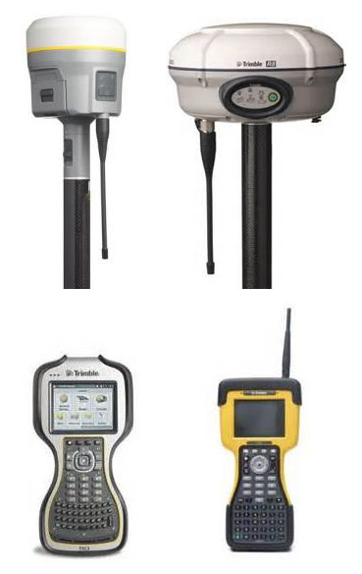
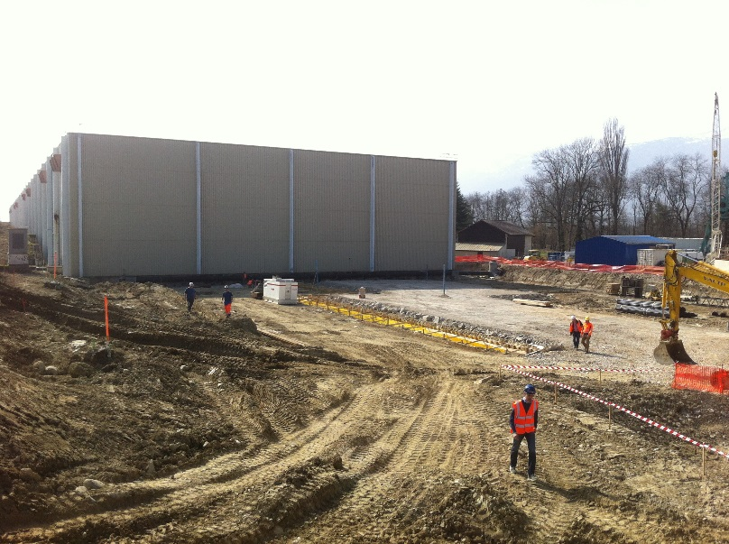
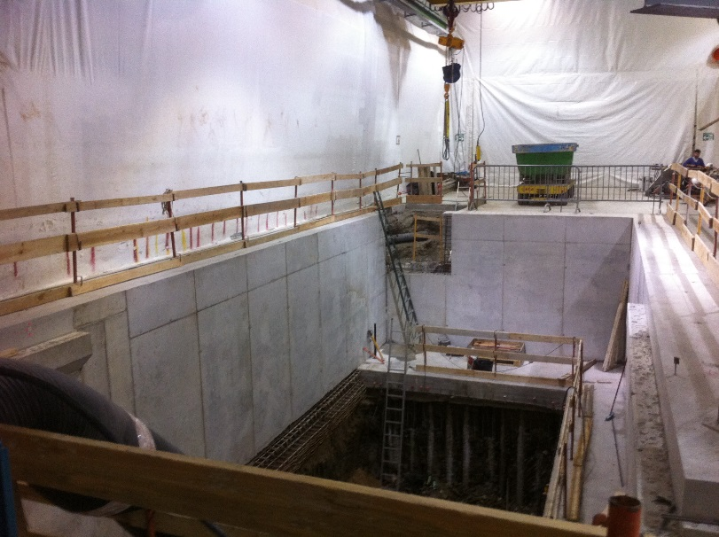
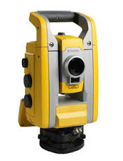
DOP - Patrimony
Main Achievement 2015 - Topography - Land Survey
The Service is responsible for “surface” civil engineering surveys :
- Land surveys for design office studies and Update of CERN maps (100 done in 2015)
  Setting outs of new buildings and networks (150 done in 2015)
  Monitoring surveys of CE Works when necessary (4 campaigns in 2015)
  Note: high precision surveys, underground surveys, and rail crane surveys are EN/ACE-SU responsibility
Ex: 887 building extension : set out of CE works
Ex: SM18 : monitoring of CE Works

Slide 25
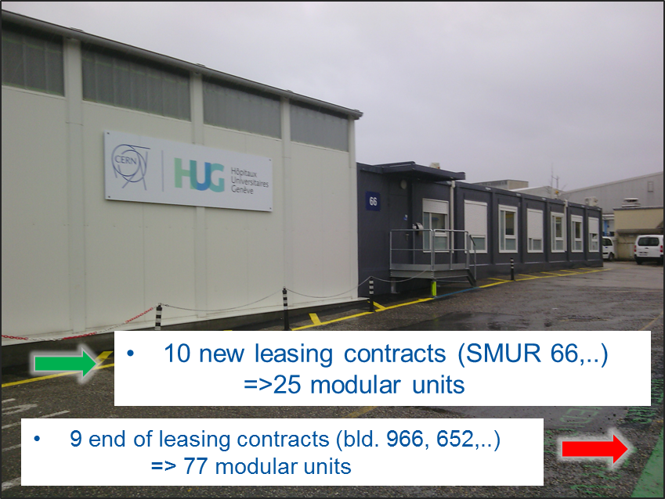
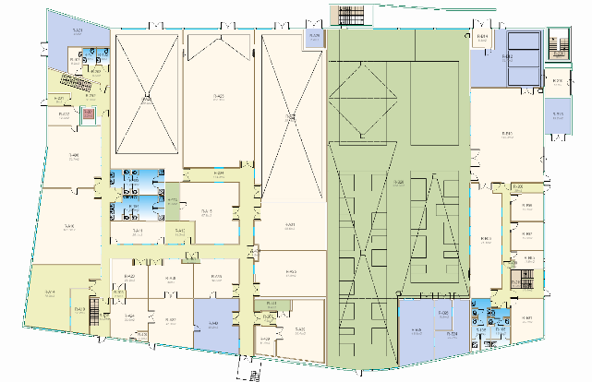
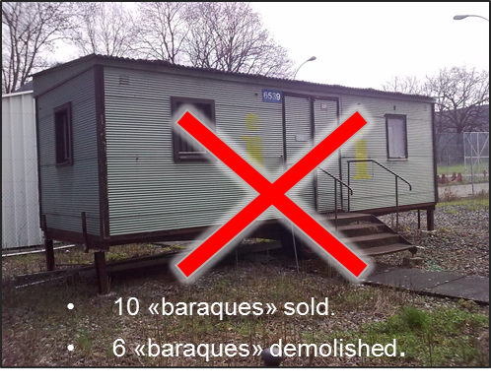
DOP - Patrimony
Main Achievement 2015
Modular Building leasing
Updated floor maps
(room numbering and door maps)
133 SNOW Tickets processed:
Ex: Building 107 floor R
New drawing process
  Lines => Surfaces
  Advantages:
  Each object (door, window,..) is uniquely identified (=> ready for inventory)
  Drawings ready for 3D extrusion
  Display speed improved (less objects)
  Improved «aesthetics»
Ex: Bld 66 : SMUR

Slide 26
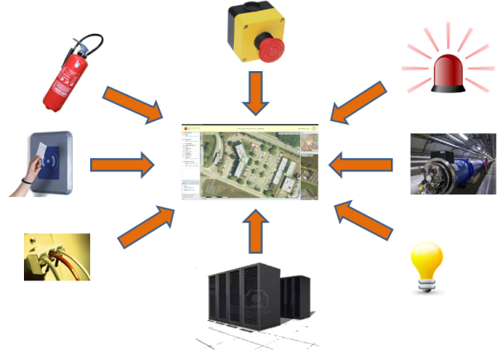
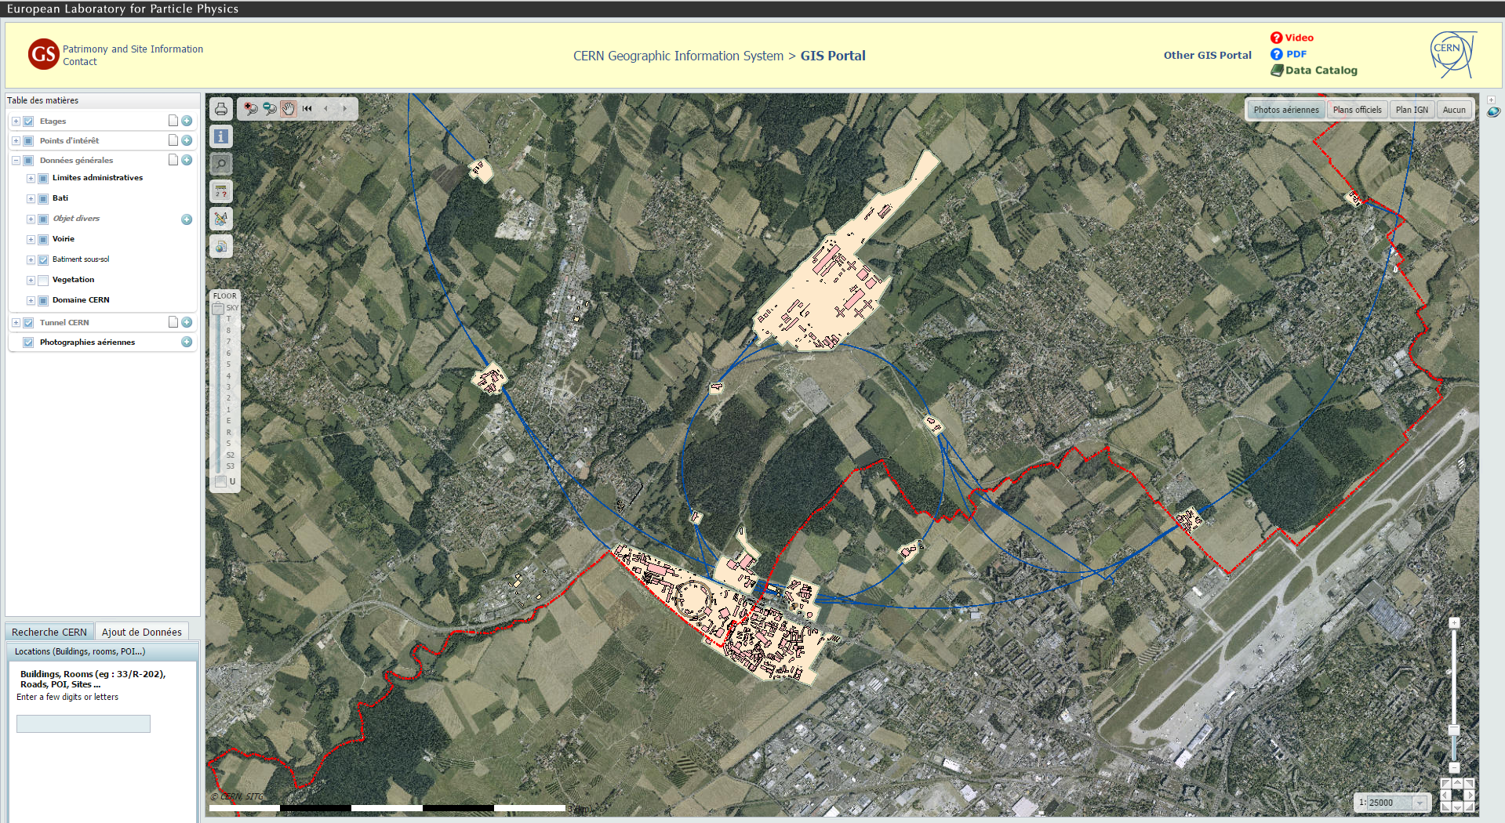

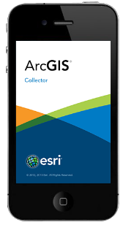
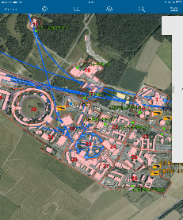
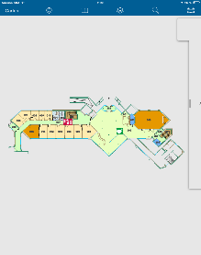
DOP - Patrimony
Geographic Information System
180 000 new geotagged assets
7’000 clim. unit, lighting
5’300 Extinguishers, RIA
5’000 doors, alarm
7’000 Electrical equipment
80’000 IT outlets
50’000 magnets
13’000 Racks
25’000 sewage assets (pipes,...
=> 200 000 assets
Mobile app for Fire Brigade
Offline
IOS and Android
Possibility to edit items

Slide 27
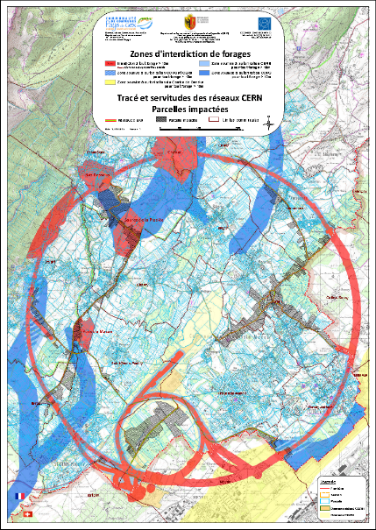
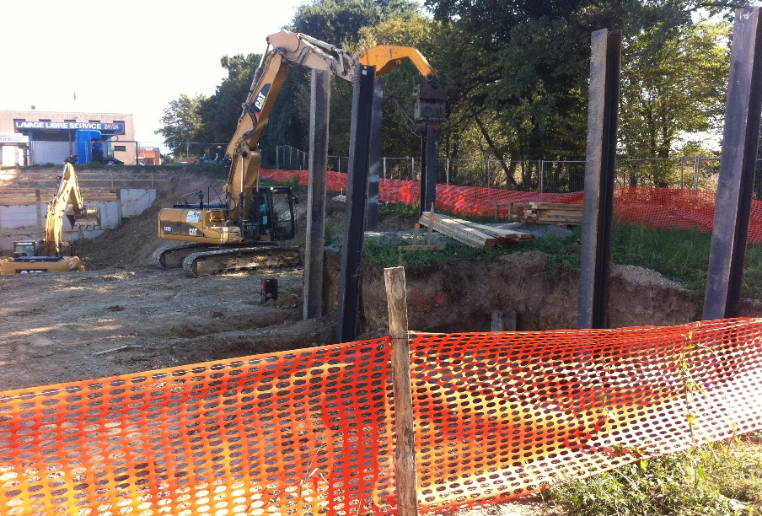
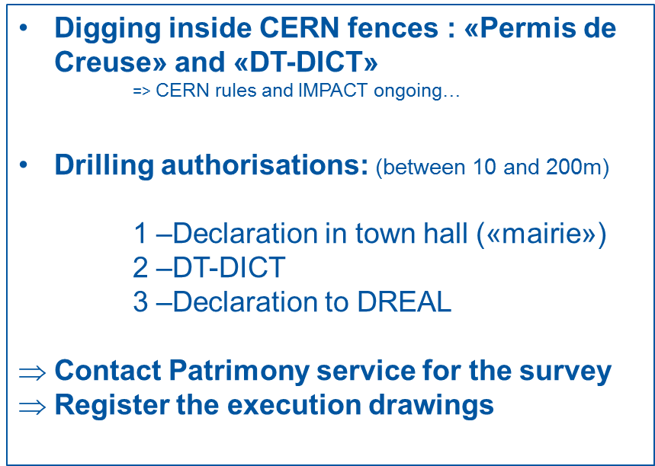
DOP - Patrimony
Digging authorization
6 Digging authorizations next to the tunnel
10 Study and authorizations for building permits next to the tunnel
220 DICT* processed ( 97 concerned)
Reminder
Ex: Fieldwork «Grand frais» : LHC Pt8
* Déclaration d’Intention de Commencement de Travaux

Slide 28
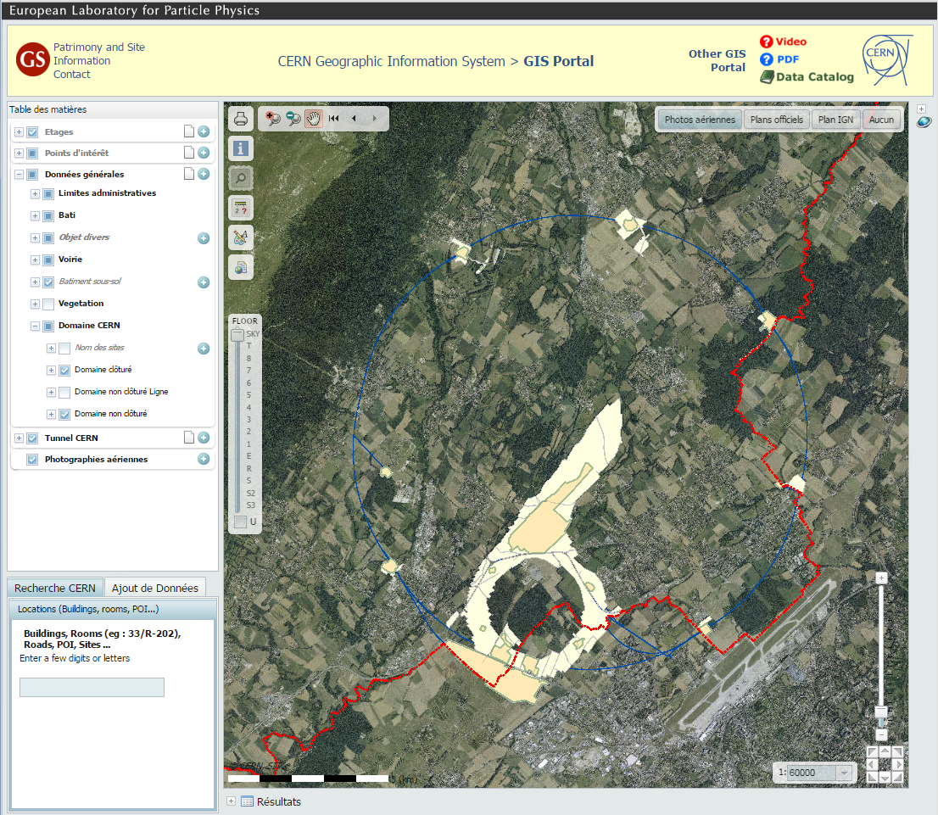

DOP - Patrimony
Objectives 2016
Improve burried networks information
    Digging permit in AOC…
    Attachement of pictures
Increase the quality of floor maps
    Continue line to surfaces conversion
Consolidate GIS IT Infrastructure
    Target 100% availability
    Face growing amount of data and users
    Improve Gis Portal speed
Provide new offline mobile apps
    To acces Gis data on the field
    To collect and edit data and information with tablet or smartphone
Investigate how to add heights (Z) to 2D data
    To be able to provide 3D base drawings to Design Office
    To store height information of burried networks
    To visualise galeries, tunnel, building in 3D in the GIS

Slide 29

SMB-SE DOP Section
Design office
Patrimony and Site Information
CE Processes
External relations with the technical offices of the local authorities

Slide 30

DOP-CE Processes
collaboration with SE group sections and others Departments for technical specifications (MS and IT) and cost estimates,
to draw up IPPs (Infrastructure Project Proposal),
to draw up blanket contracts,
set up of DB of technical specifications, unit prices and firms,
05.02.2016

Slide 31
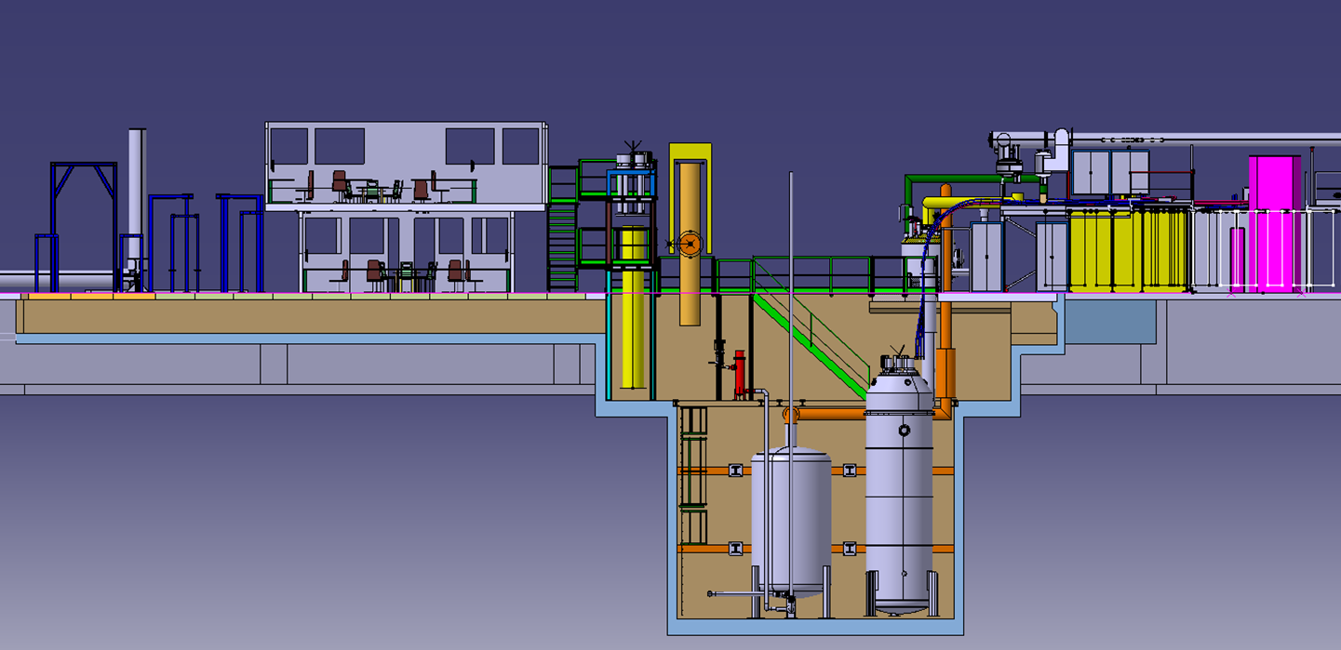

DOP-CE Processes
Technical specifications
Bldg 773
SM-18 CLUSTER-D
MS, PE and IT
    - more than 15 new documents (DO-29044, DO-29111, DO-29245, DO-29550, IT-4049, IT-4076, IT-4119, IT-4152,…)
05.02.2016

Slide 32


DOP-CE Processes
SMB-SE Group (HE not included), MS-PE-IT created in 2015
27%
40%
40%
73%
60%
60%
2/5
4/15
6/10
05.02.2016

Slide 33
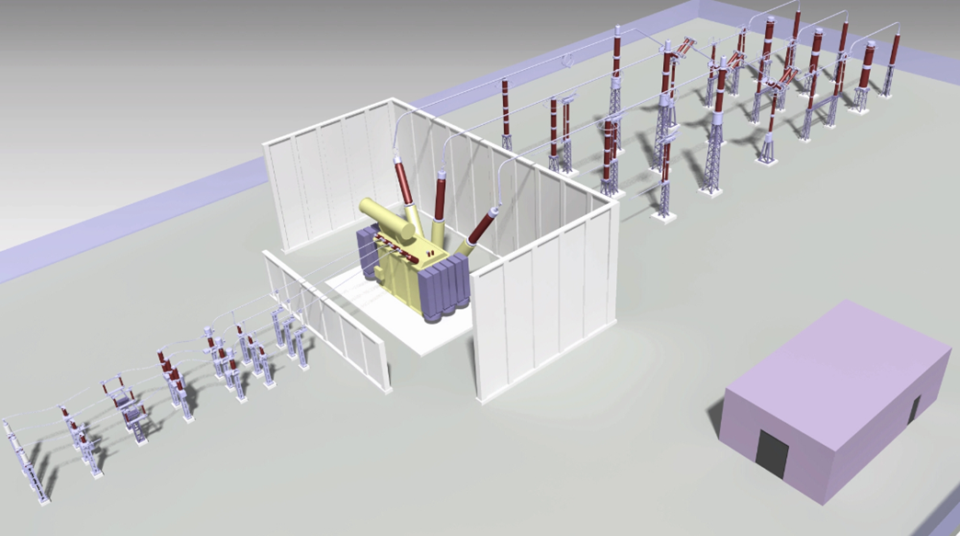
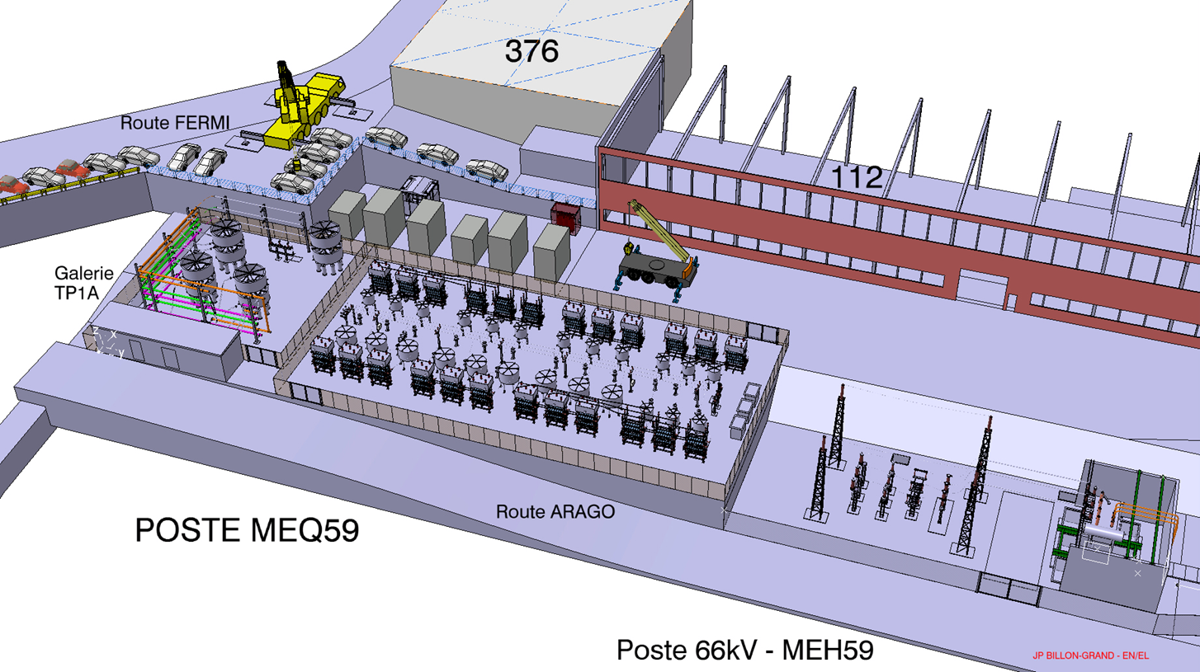


DOP-CE Processes
MS and IT in coordination with others Departments
Substation BE2 Bois-Tollot (EN-EL)
SVC MEQ59 Site de Meyrin (TE-EPC)
Collaboration with others Departments for technical specifications (MS and IT)
    MS and IT-4072/EN (supply of concrete blocks and beams)
    IT-4030/EN (MEDICIS shielding doors)
    IT-4114/EN (substation BE2)
    Point 1.8 new CV building
    Site de Meyrin, SVC MEQ59 (TE-EPC)…

Slide 34

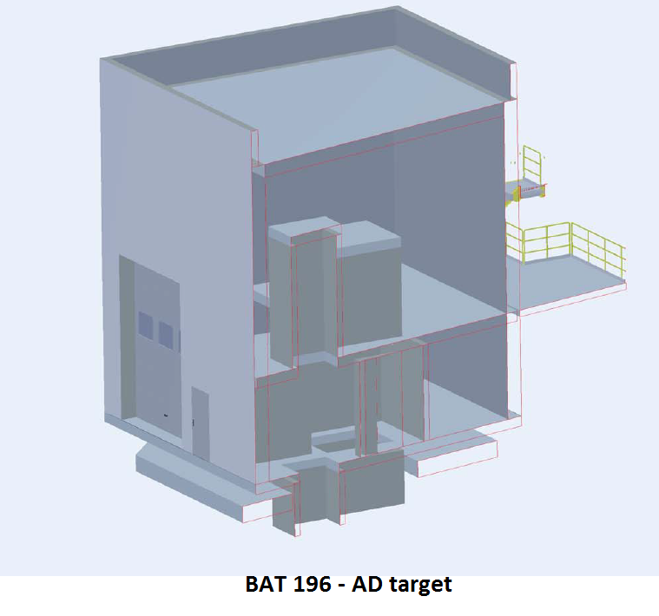
DOP-CE Processes
cost estimations
- more than 50 estimations per year
technical requests from all Departments
about buildings and civil engineering items,
2014* from April to December 2014
05.02.2016

Slide 35

DOP-CE Processes
to draw up IPPs (Infrastructure Project Proposal)
- processed 8 proposals in 2015 (total 17)
47%
53%
05.02.2016

Slide 36


DOP-CE Processes
Objectives
closer collaboration with others SMB-SE Sections
complete the DB of civil engineering data (pricing, firms, etc.)
definitive library of template of MS, PE and IT
05.02.2016

Slide 37
SMB-SE DOP Section
Design office
Patrimony and Site Information
CE Processes
External relations with the technical offices of the local authorities

Slide 38






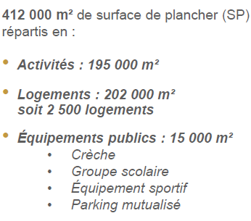
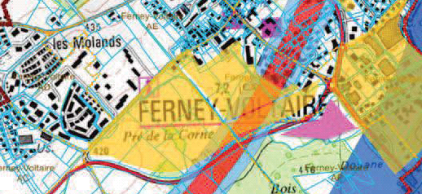
SMB-SE DOP Section
External relations with the technical
offices of the local authorities
Permis de construire – 12 permis de construire en 2015 (8)
Comité Quadri-partite – Comité Transport et environnement
Suivi des PLUi
Nouveau carrefour de l’entrée du Site CERN Prévessin
Piste cyclable route de l’Europe – MO Commune de Prévessin
Gestion des déblais du Pays de Gex
Prolongation TCMC (douane – Saint Genis Pouilly)
BHNS (Bus à Haut Niveau de Service) Gex – Ferney
Projet Hilumi - Groupe de travail autorités FR
ZAC de Ferney – Autorisation de forage

Slide 39

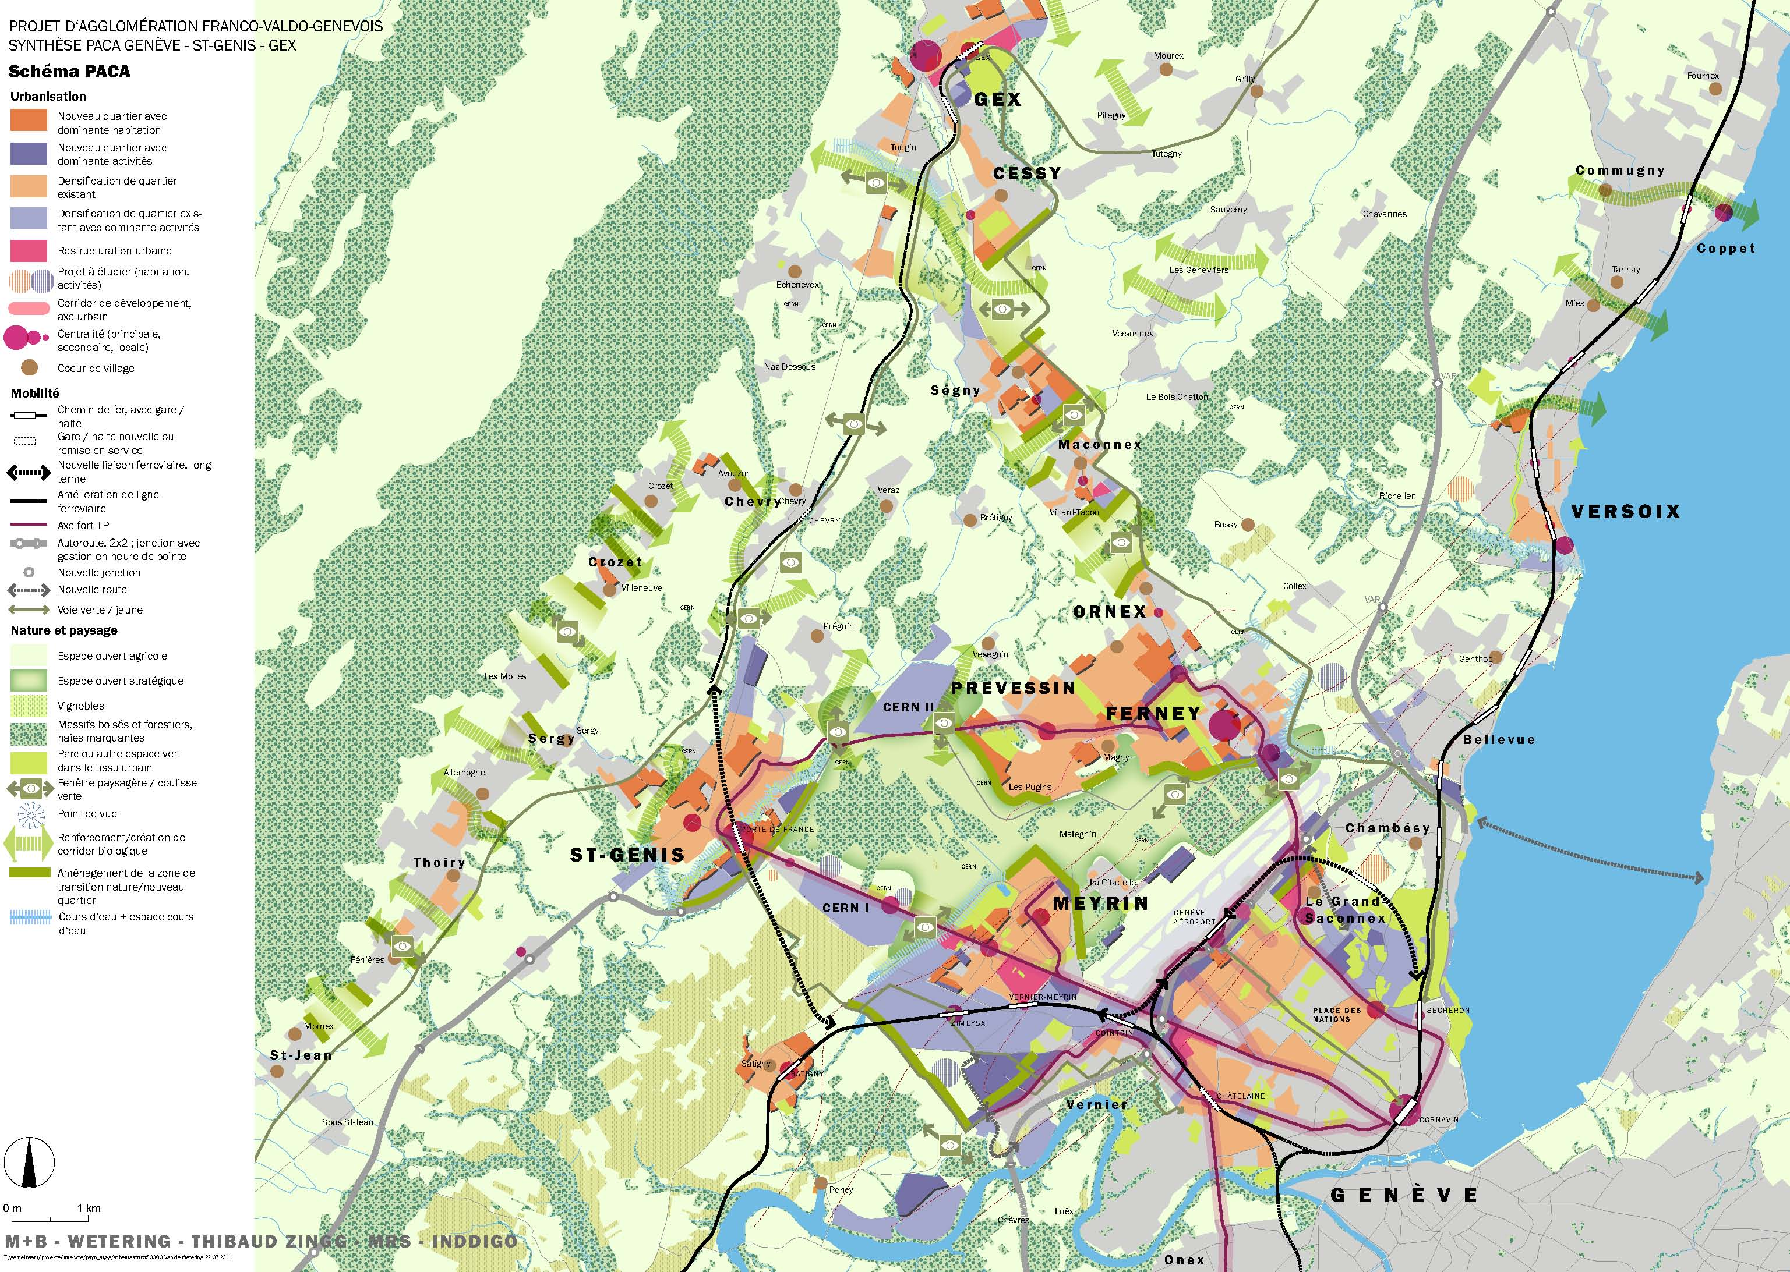





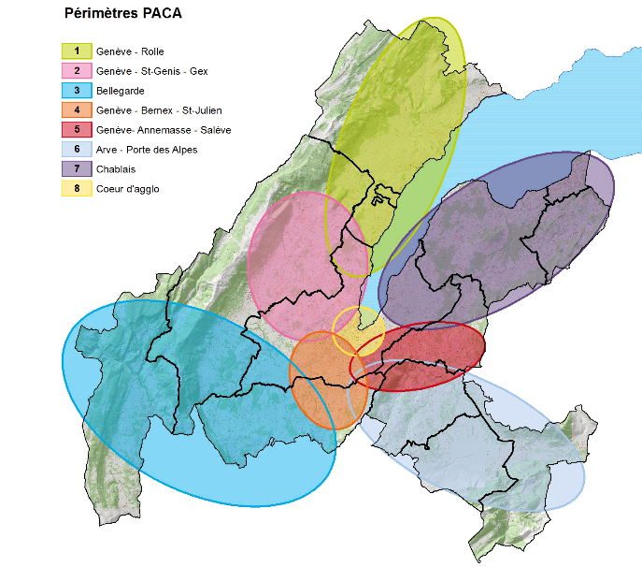
SMB-SE DOP Section
External relations with the technical
offices of the local authorities
Permis de construire – 3 permis de construire en 2015 (2)
Forum Agglo-Genève – F. sur le Grand Genève entre représentants de la société civil
Géothermie 2020
Prolongation TCMC (Globe – douane)
GéoFabGG
Recensement architectural du CERN Meyrin - Office du Patrimoine
SITG : - Présidence de la commission technique
Projet Hilumi - Groupe de travail autorités CH
PACA (Périmètres d'aménagement coordonné d'agglomération) – Cercle de l’innovation

Slide 40
SMB-SE DOP Section
Design office
Patrimony and Site Information
CE Processes
External relations with the technical offices of the local authorities
Some projects

Slide 41
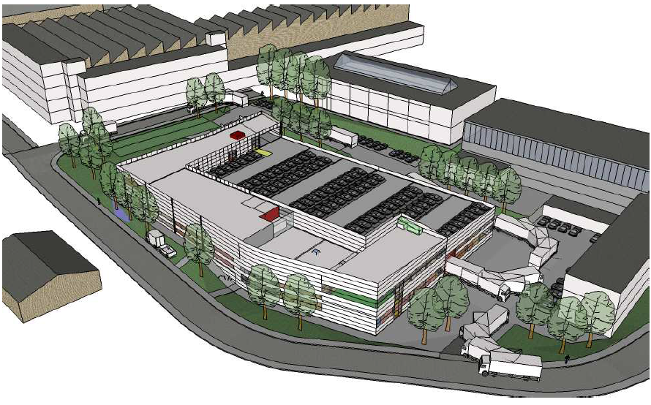




SMB-SE DOP Section
Last projects …
Bat 774 – Finally delivered
Bat 107 – restarting
Esplanade des Particules – probability to start end of spring 2016

