Slide 1

  SMB/SE-HE
  2015 Annual Review
Edms 1578456 v.1

Slide 2

  SMB/SE-HE
  2015 Annual Review
  5th February 2016
  Mandate
  Budget
  Structure
  Statistiques
  Methods
  Works pictures
  2016 Perspectives

Slide 3
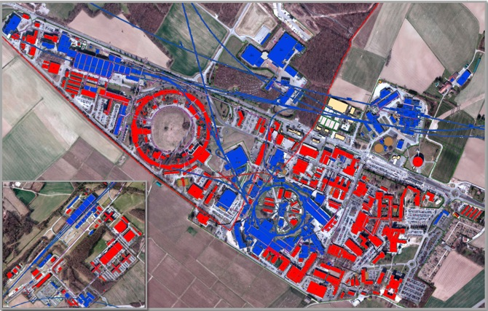
SMB/SE-HE Mandate
  SMB/SE-HE section is in charge of:
  The design, operation, repairing, maintenance,
  works and special works in the following fields:
      HVAC (Heating, Ventilation, Cooling, air conditioning, specific extraction)
      Fluids (water cooling, compressed air, gas, fire fighting, filling)
      Electricity (power distribution, lighting, machine powering)
      Sanitary (drinking water, domestic water, solar panels, fountains, safety)
      Catering (catering equipment).
  For tertiary buildings

Slide 4
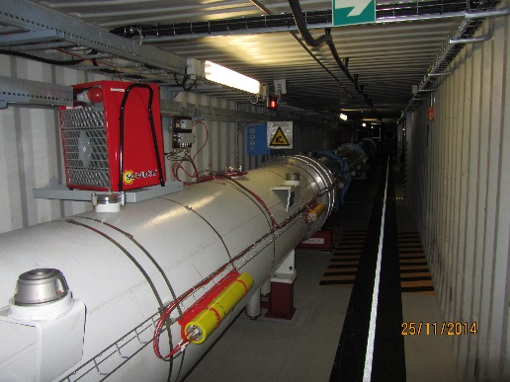
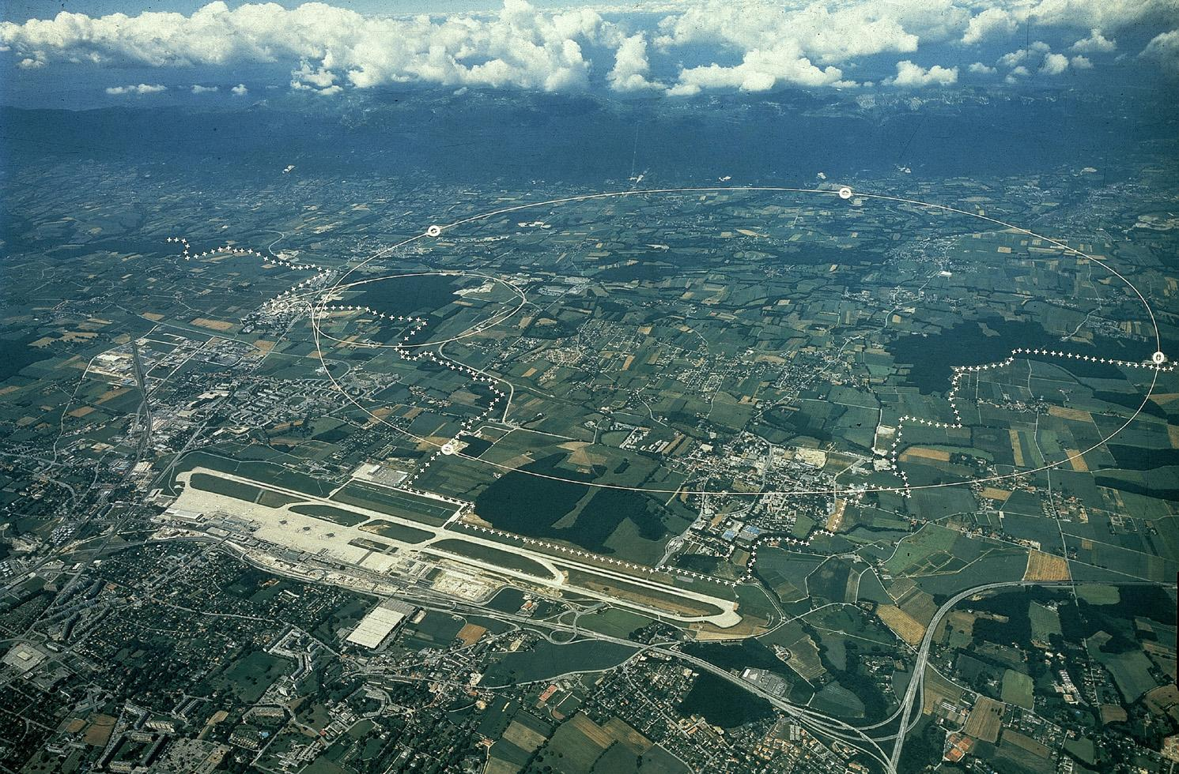
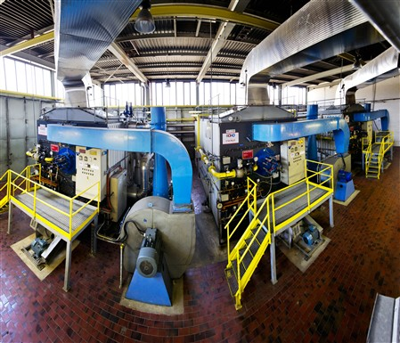
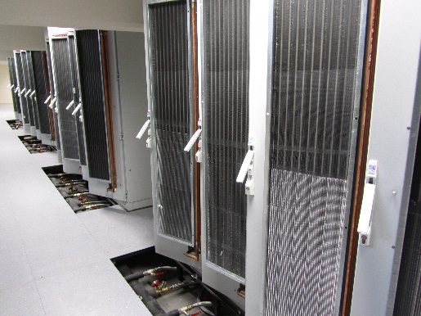
SMB/SE-HE Parc
407 buildings, 75 technical galleries
1 children school, 3 restaurants, 3 hotels (495 rooms), 10 cafeterias,
150 meeting & conference rooms,
100 workshops, 400 labs, > 30 clean rooms, 20 RP areas and 40 source labs.
2 heating plants, 27 km district heating.
200 radiators circuits
> 100 000 lighting points
> 500 AHUs, > 350 extraction fans
52 chillers, >300 split systems
> 3000 electric boards,
220 PLCs.

Slide 5
  SMB/SE-HE
  2015 Annual review
  1st February 2016
  Mandate
  Budget
  Structure
  Statistiques
  Methods
  Works pictures
  2016 perspectives

Slide 6
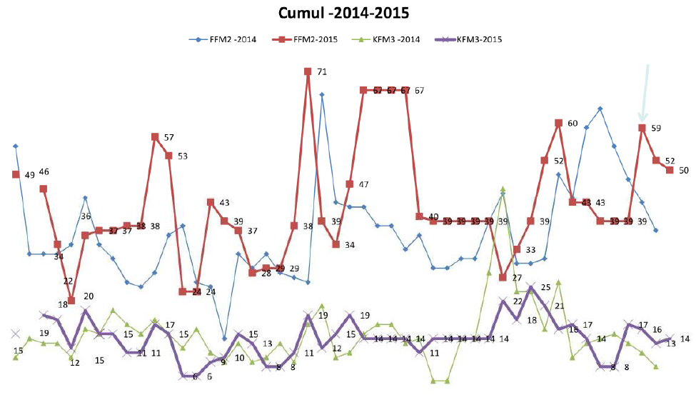
SMB/SE-HE E109 DALKIA Budget
HVAC & SANITARY
Maintenance & Works
Average Trend: +10%/year

Slide 7
SMB/SE-HE E109 2015 Budget
Monthly amount per intervention type [€]
Annual repartition
per intervention type [€]

Slide 8
SMB/SE-HE FSU- GS-03 2015 Electrical Works
55%
45%
+42%

Slide 9
SMB/SE-HE 2015 Consolidation Budget
HVAC, SANITARY & ELEC
+20%
+35%

Slide 10
SMB/SE-HE Section Budget

Slide 11
  SMB/SE-HE
  2015 Annual review
  1st February 2016
  Mandate
  Budget
  Structure
  Statistiques
  Methods
  Works pictures
  2016 perspectives

Slide 12
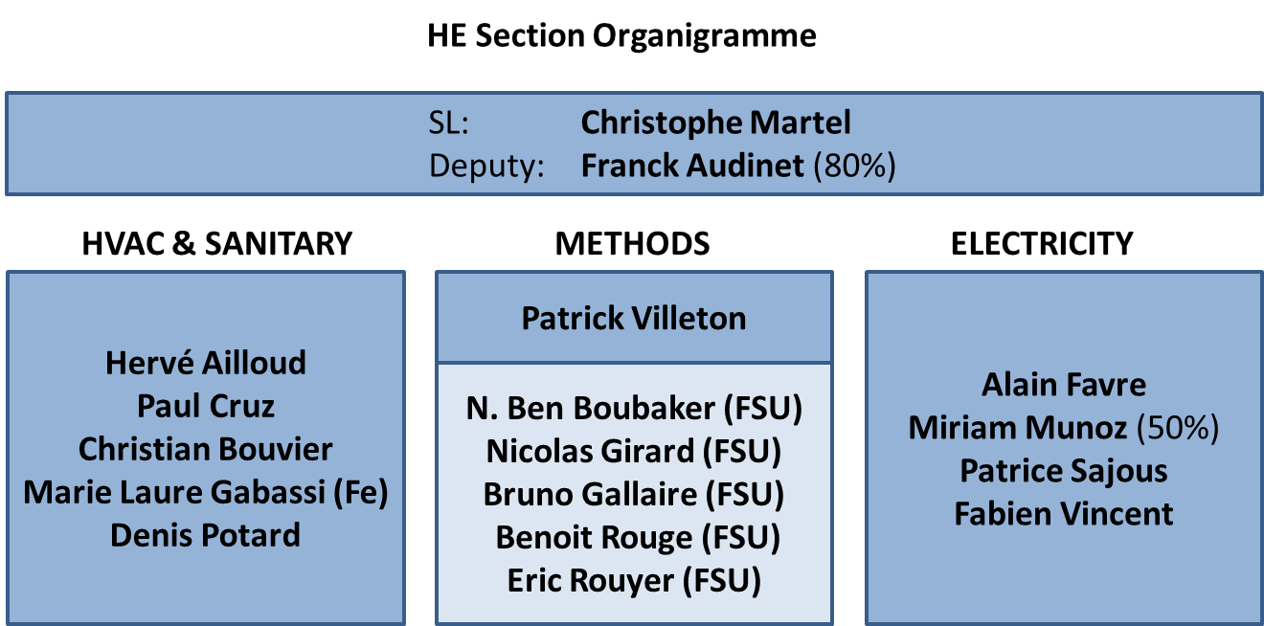
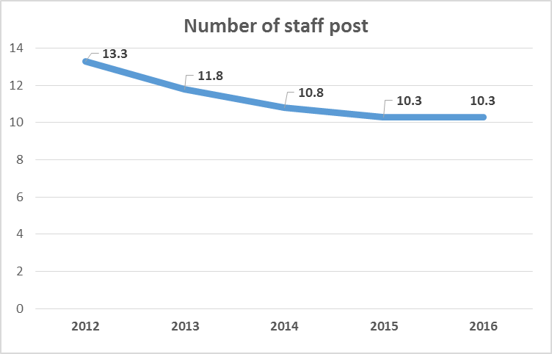
SMB/SE-HE Human Resources
10.3 Staffs
1 Fellow
5 FSU’s

Slide 13
  SMB/SE-HE
  2015 Annual review
  1st February 2016
  Mandate
  Budget
  Structure
  Statistiques
  Methods
  Works pictures
  2016 perspectives

Slide 14
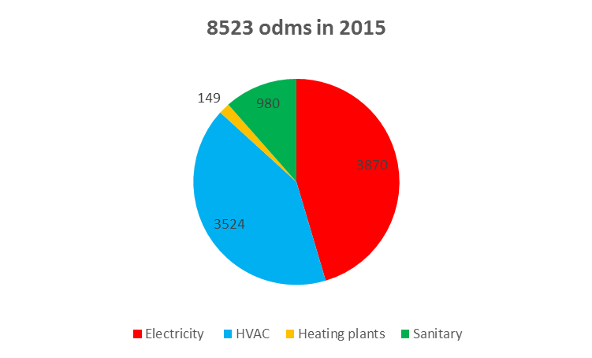
SMB/SE-HE 2015 ODMs
HVAC, SANITARY & ELEC
11.5%
1.7%
45.4%
41.3%

Slide 15
SMB/SE-HE 2014 vs 2015 ODMs
HVAC, SANITARY & ELEC
+12%
+35%
Global
+15%
-30%

Slide 16
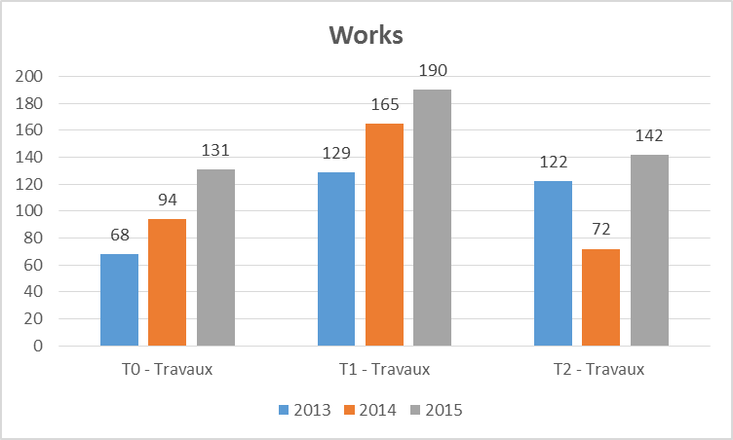
SMB/SE-HE 2015 HVAC: 3524 ODMs
2015 Backlog:
Requêtes

Slide 17
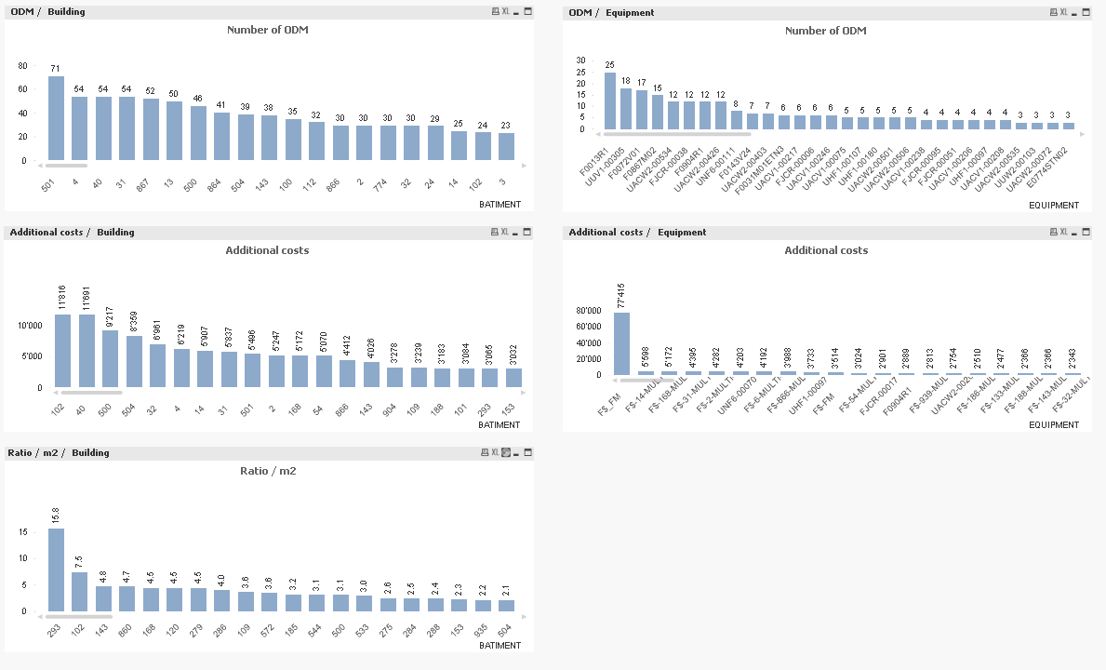
SMB/SE-HE 2015 HVAC ODMs





Total annual costs / Building
Total annual costs / Equipment
VIP buildings
867: new safety requirements
774 modifications
102 important reliability & safety maintenance
TOPS correctifs

Slide 18
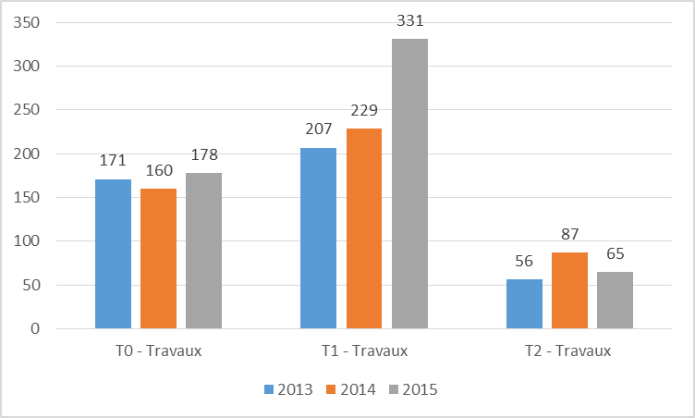
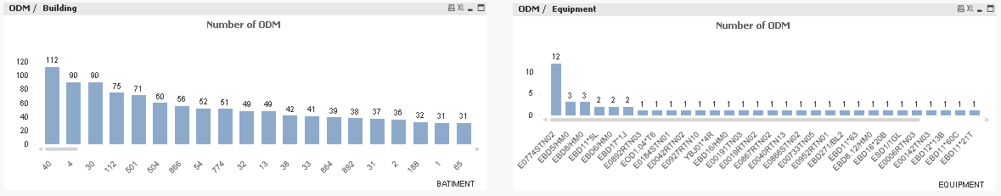
SMB/SE-HE 2015 ELEC: 3870 ODMs
VIP buildings
30-112: waiting for complete renovation
774 modifications
TOPS correctifs




Slide 19
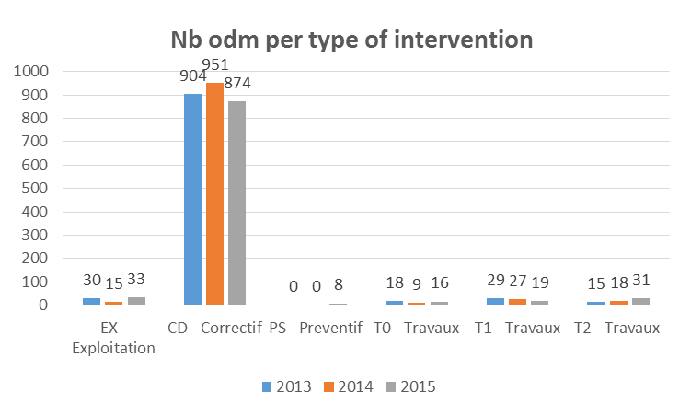
SMB/SE-HE 2015 SANITARY: 980 ODMs

Slide 20
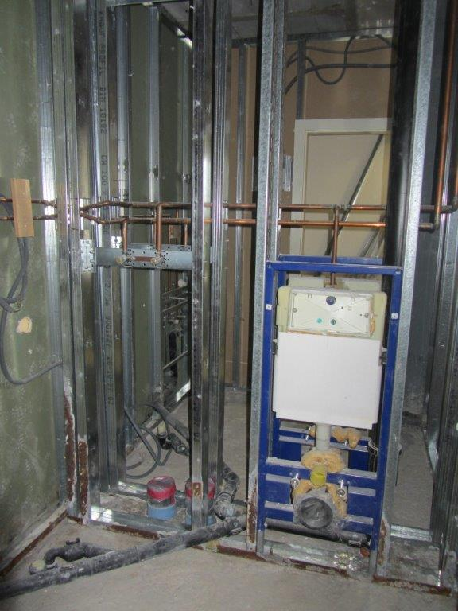
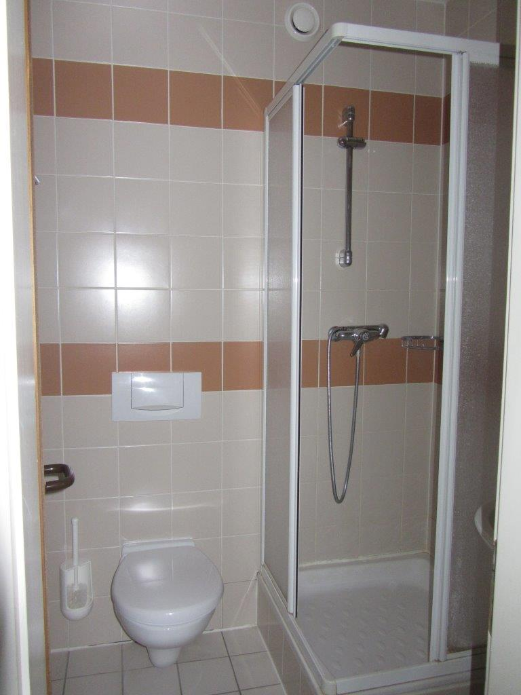
SMB/SE-HE 2015 SANITARY ODMs
TOPS correctifs
VIP buildings
864, 865, 866, 892: waiting for consolidation
774 modifications

Total annual costs / Building

Slide 21
  SMB/SE-HE
  2015 Annual review
  1st February 2016
  Mandate
  Budget
  Structure
  Statistiques
  Methods
  Works pictures
  2016 perspectives

Slide 22
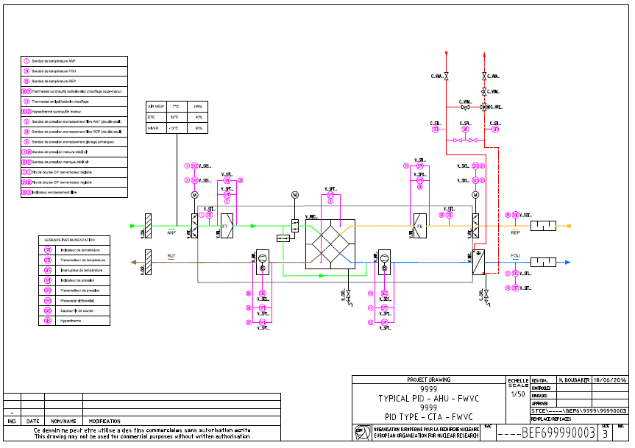
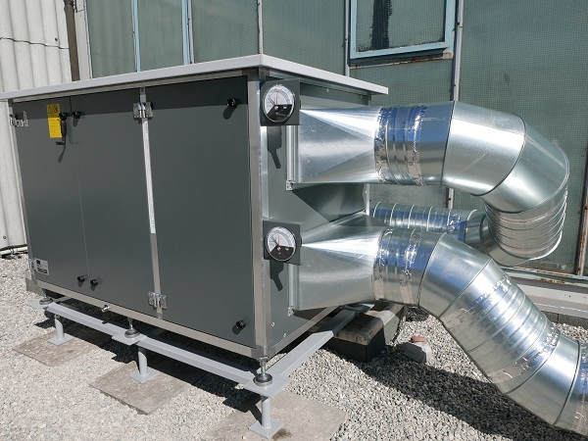
SMB/SE-HE Standards
As built detail level
Standards: sanitary fittings, PID, DIUO, ahu, heating sub-station, compressed air sub-station, power cubicles, control cubicles.
2016: PLC programs, sensors and actuators.
Spec, PID, dwg, DIUO

Slide 23
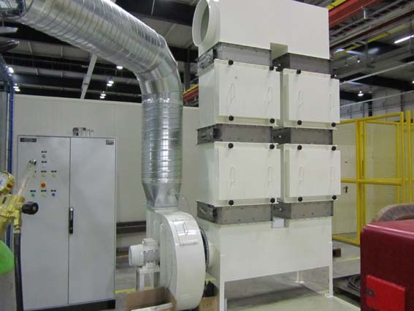
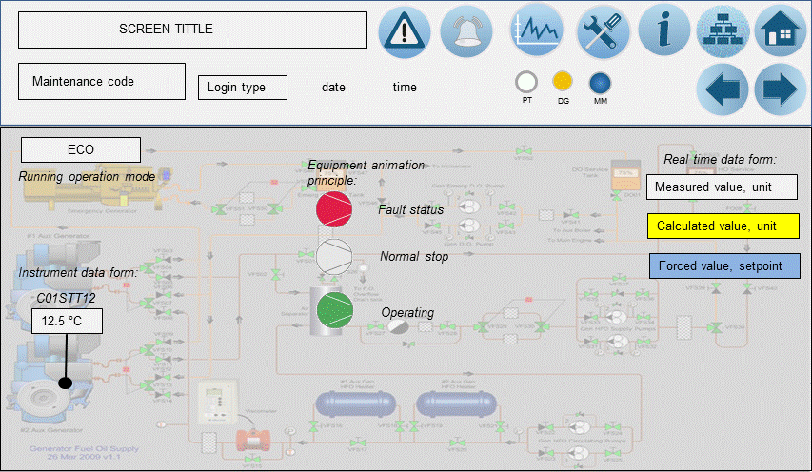
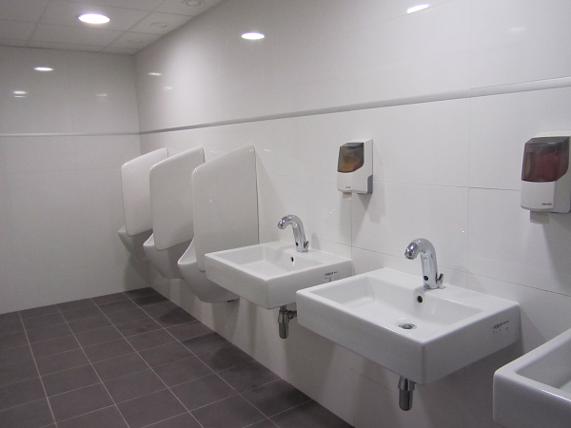
SMB/SE-HE Conditional & Tele Maintenance
Air filters (pressure transmitters, two thresholds)
Optimisation of the prefilter class (F9+H14, F7+F9)
Two levels remote alarms ambience thresholds (piquet)
Waterless urinals (invest < 40%+maint+>50000l/year))

Slide 24

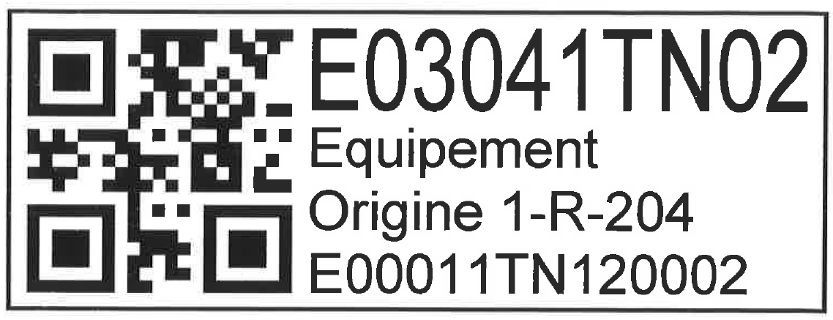
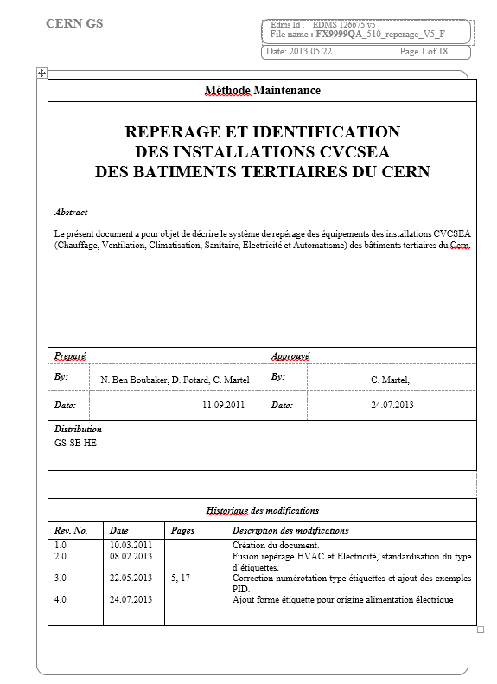
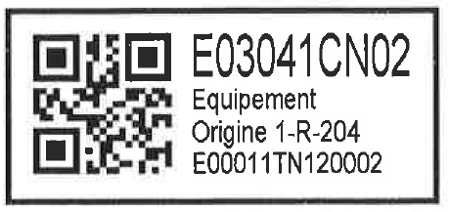
SMB/SE-HE Methods
Codification
Building / parent = circuit / child = component
Classification
Systeme/parent/child/part
Système | Code
Réseau de chaleur | C
Chauffage | C
Ventilation | V
Refroidissement | R
Sanitaire | S
Incendie | I
Air Comprimé | A
Distribution de gaz | G
Electricité | E
Multi technique | M
Restauration | T
Marking = CAMM code
Quality Assurance Plan
FX9999QA_510_reperage_V5_F
Edms 126675 V5

Slide 25
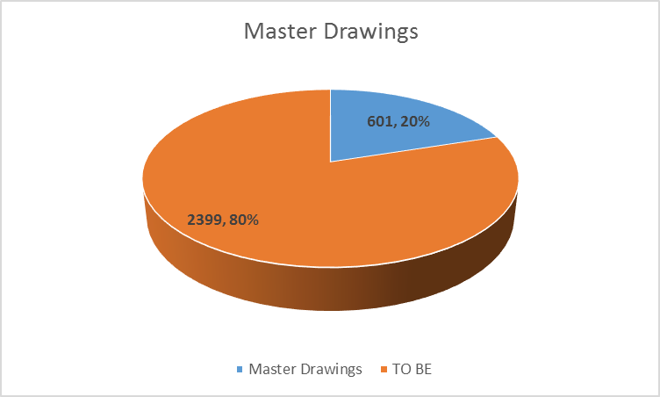
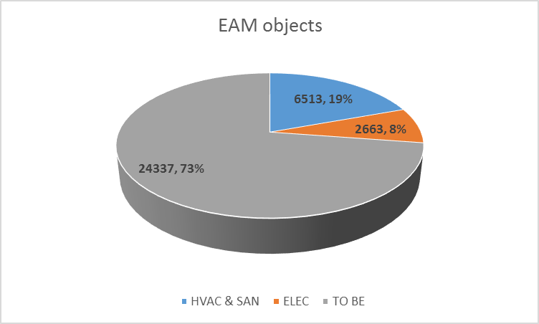
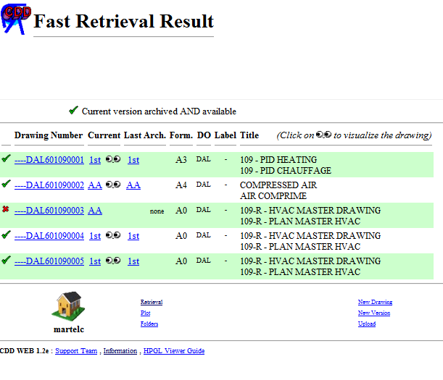
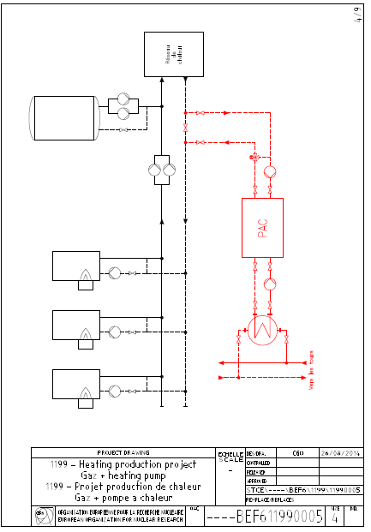
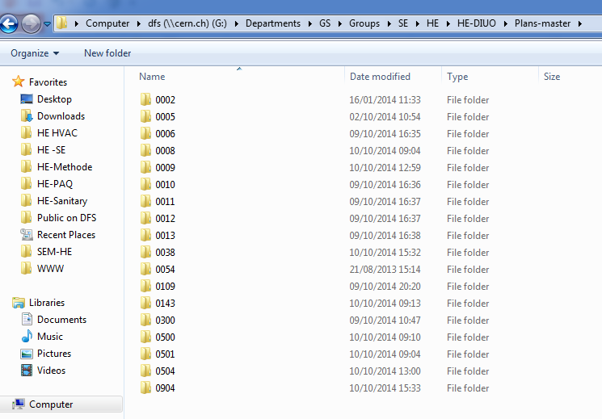
AUTOCAD GIS & EAM Information
SMB/SE-HE Methods
407 ouvrages 1000 étages
GIS: master drawing: 601 / 3000 drwgs
EAM: 9100/ 27000 records (Hvac: 6513, Elec: 2663)

Slide 26
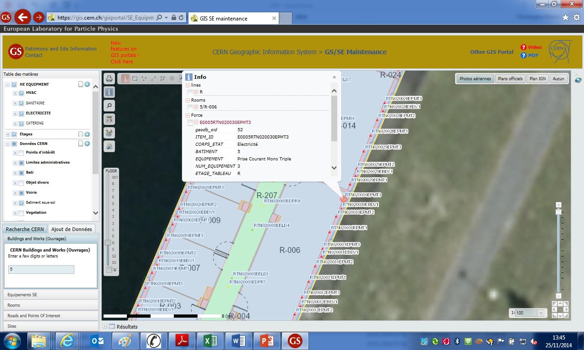
SMB/SE-HE GIS Integration

Slide 27
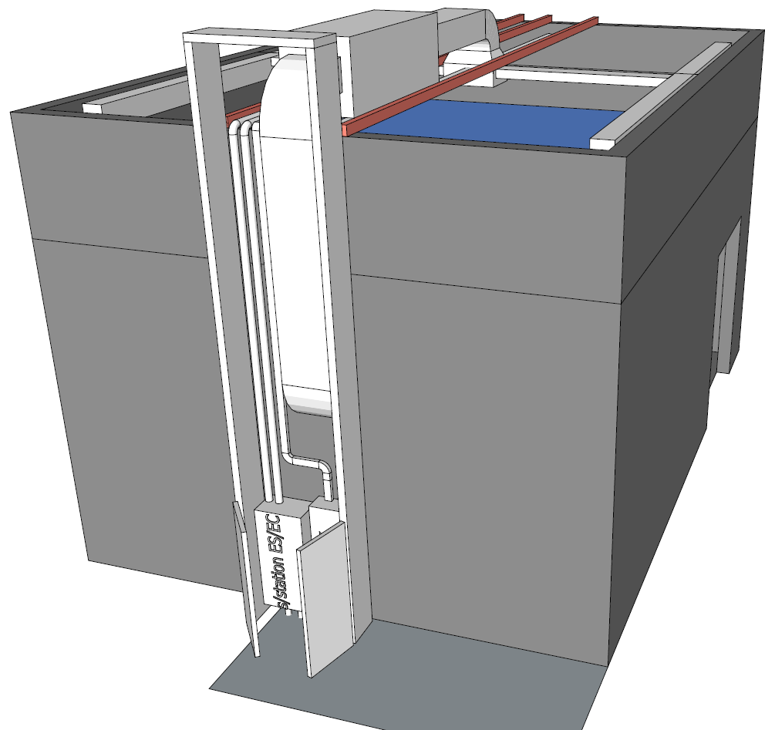
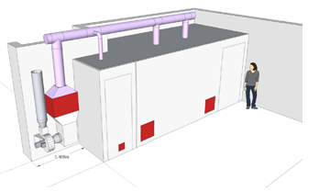
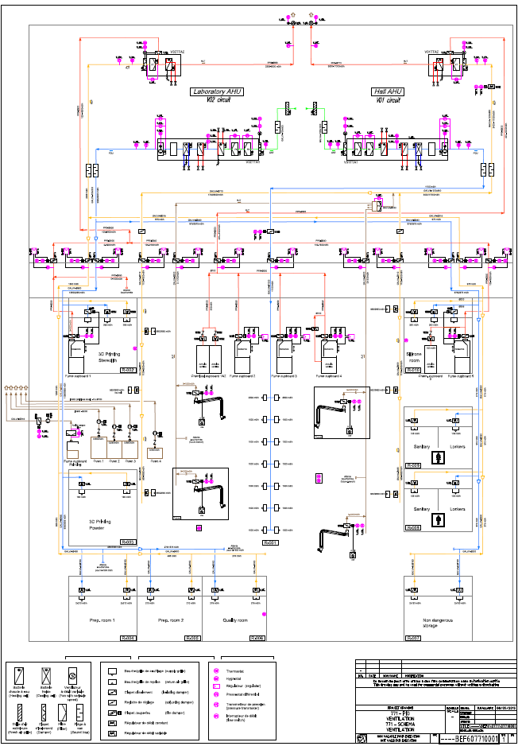
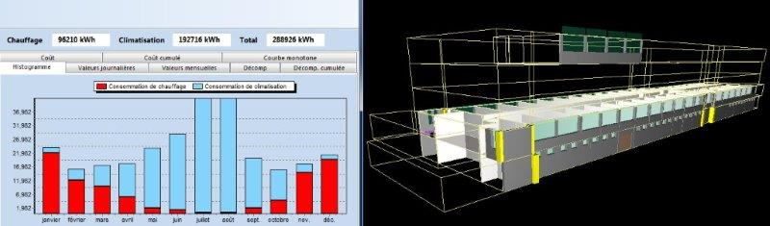
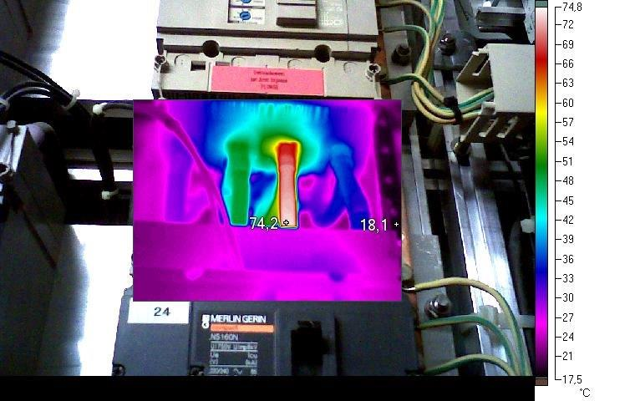
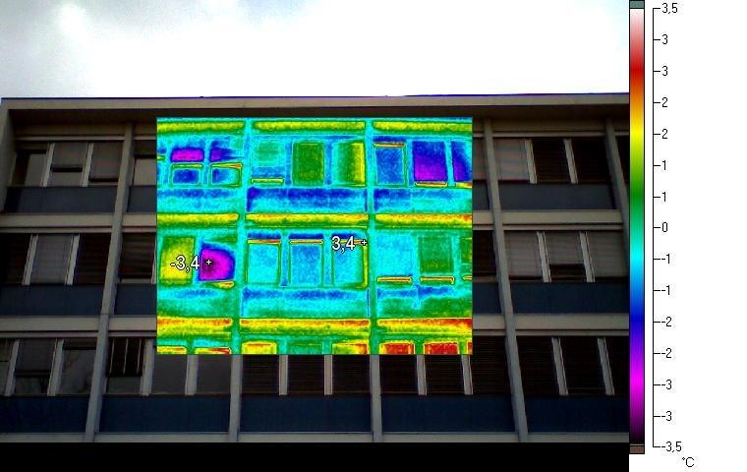
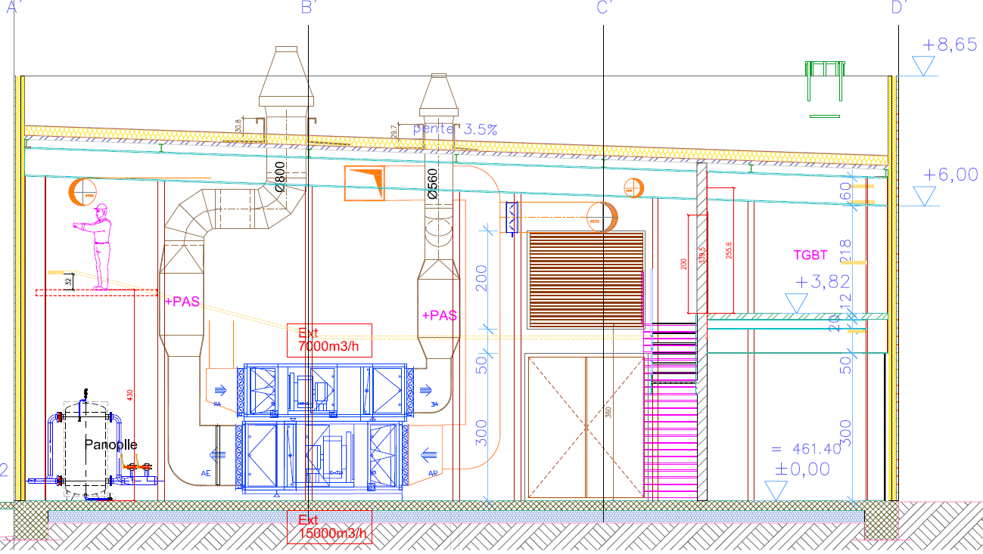
SMB/SE-HE Methods
156
864
771

Slide 28
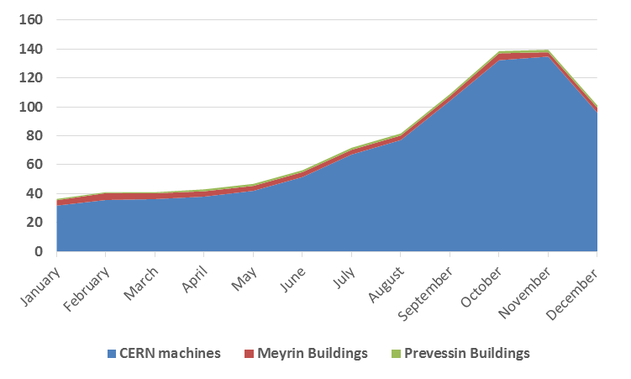
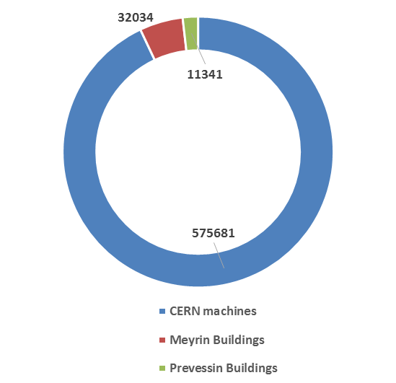
Electricity usage
CERN total
Annual electrical
consumption [MWh]
Monthly operational electrical power [MW]

Slide 29
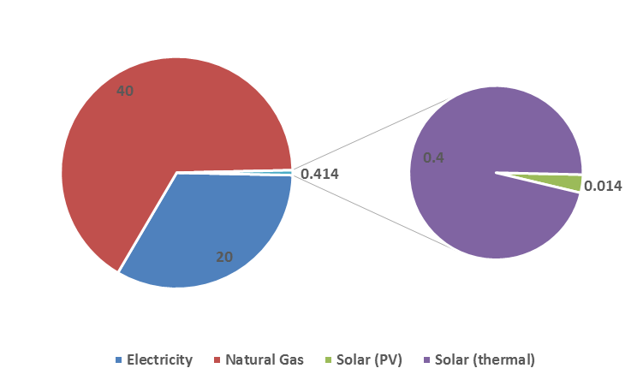
Energy numbers
CERN infrastructure not linked to accelerator’s operation

Slide 30
Electricity usage
CERN non machine buildings
Evolution of the annual electrical consumption [MWh]
Annual electrical
consumption [MWh]
Energy saving not visible:
New buildings
New processes

Slide 31
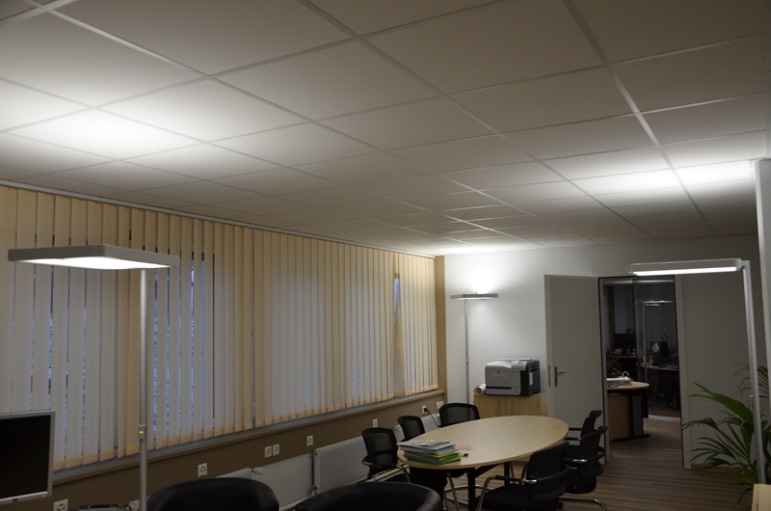
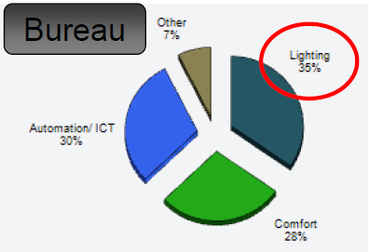
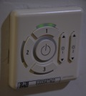
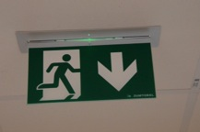
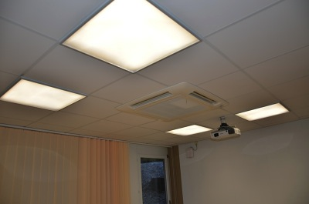

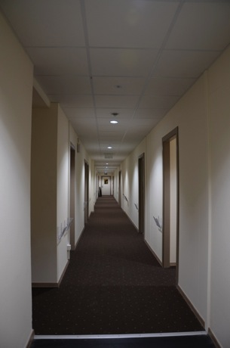
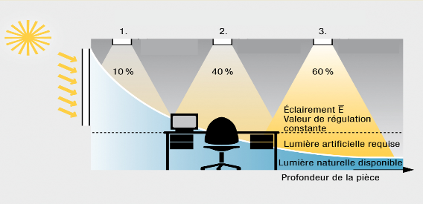
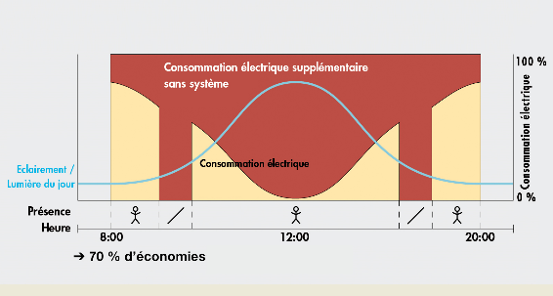
SMB/SE-HE Tele Maintenance
Lighting Management
Dali protocol
LED
*AFE
Digital benefits
Individual & grouping communication
Changes via software (rooms config, scenes)
Two-way communication (feedback)
Energy saving (50%)
Predictive maintenance
Auto adaptative (flux)
Life prediction

Slide 32
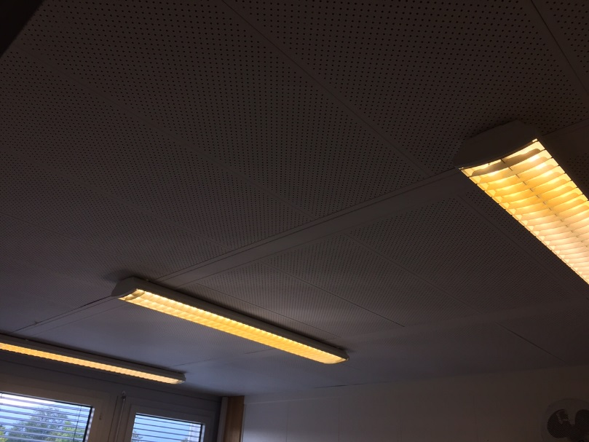
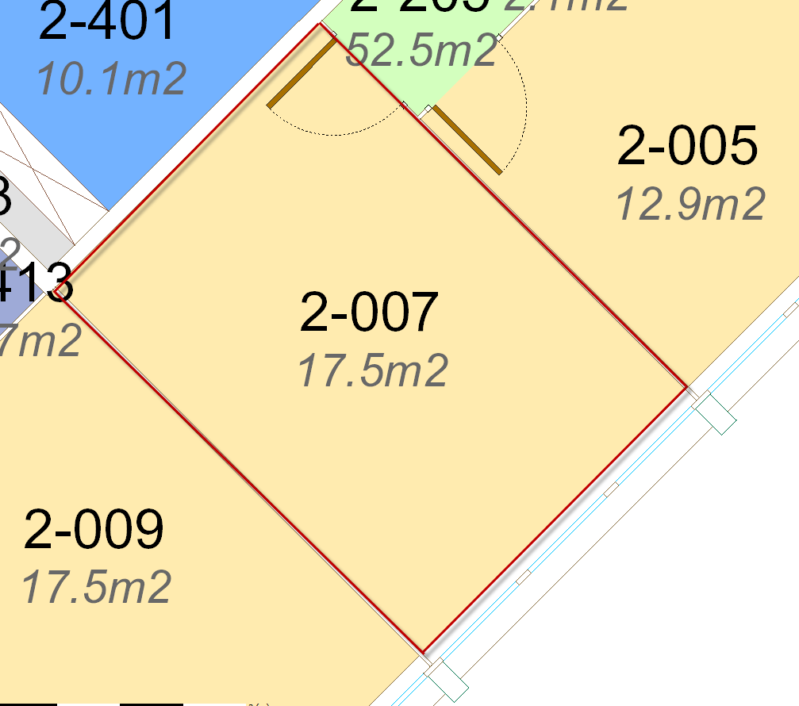

Electricity optimisation
Office lighting example
Typical CERN office
CERN renovated office
3 lights (fluo T8 2x58W)
Switch command
Installed electrical power:
23 W/m²
Lighting where necessary
Lighting when necessary
Presence detection
Natural luminosity
1 vertical light (LED 105W)
Presence lighting regulation
Luminosity lighting regulation
Installed electrical power:
6 W/m²
÷ 4

Slide 33
Natural gas
Prévessin gas consumption study
Total gas annual consumption [MWh]
CERN wide heating
Addionnal buildings in 2012 (867, its annexes, etc)
Heating confort improved in 2012

Slide 34

Water usage
Drinking water for sanitary facilities
Demineralised water and fire extinction network supply
Compensation of cooling towers
A/C units using water as coolant

Slide 35


Water optimisation
Minimalism of the design (Two capacities WC, eco taps, etc)
Water saving devices in showers and taps
Waterless urinals (140 u, 14% of parc, 14 000 m³/year, 0.5 % of consumption)
112 ovens cooling project (2% of Meyrin annual consumption).
Suppression of drinking water leakages (renovation)
Suppression of district heating leakages (from 10 to 5 m³/day, rénovation)
Regular dismantling of old chillers using water as coolant

Slide 36
  SMB/SE-HE
  2015 Annual review
  1st February 2016
  Mandate
  Budget
  Structure
  Statistiques
  Methods
  Works pictures
  2016 perspectives

Slide 37




SMB/SE-HE SAFETY
E109: DALKIA
  No accident > 500 days
  6/10/2014: in Meyrin gallery.
  Alert forms follow up.
FSU GS-03: SOTEB ALTEAD
  No accident > 75 days
  19/11/2015: without stop
  Training, car changes
SMB/SE-HE section: CERN
  Habilitations updates
  New RP procedures
  Active dosimeter underway

Slide 38


SMB/SE-HE Maintenance with absestos presence

Slide 39



SMB/SE-HE Maintenance with water presence

Slide 40


SMB/SE-HE HVAC & ELEC regulation
201 heating plant - autocontrol

Slide 41


SMB/SE-HE HVAC & ELEC regulation
774 heating monitoring
Energy savinSMB

Slide 42



SMB/SE-HE New central cooling production 30-112
Reliable cooling
Evolutive concept
Natural refrigerant
Sustainable cooling

Slide 43




SMB/SE-HE 375-ISR
Electrical renovation
Machine powering

Slide 44

SMB/SE-HE Renovated lighting – 867 hall

Slide 45



SMB/SE-HE Meyrin new district heating link 53-503

Slide 46

SMB/SE-HE Globe Smoke Test - 80

Slide 47

SMB/SE-HE LIGHTING 184-ISR
LED execution
70% instaled power reduction
No delay when switcing on
Instant lighting start
Life time: 50000 hours
20% level of illumination increase

Slide 48


SMB/SE-HE Outdoor lighting
LED
ISR area
4-5 Parking

Slide 49


SMB/SE-HE 156
Open space arrangement – HVAC & Elec.

Slide 50



SMB/SE-HE Hotel 38
Roof ventilation
Monitoring
New bathroom

Slide 51




SMB/SE-HE Laser welding workshop -100
Fine tuning regulation
Dehumidifcation control.
Vapour humidification control

Slide 52




SMB/SE-HE
Safety
118
860
252 new smoke vent
167 gas point

Slide 53
SMB/SE-HE New ventilation cafeteria 6

Slide 54



SMB/SE-HE New ventilation glass box 501

Slide 55

SMB/SE-HE New ventilation restaurant 3

Slide 56


SMB/SE-HE New Globe Lighting – 80

Slide 57
SMB/SE-HE 2016 Perspectives
  Continuous efficiency (+10%, +15%, +35%, +42%)
  Continuous increasing work load (works, safety, etc)
  Important forthcoming staff turnover in the section
  Safety campaigns (restaurants, halls, etc)
  Preventive maintenance plan
  Site remediation (R22, water pipeworks, compressed air, etc)
  Energy efficiency (gas, water and electricity)
  Radioactive storage in the ISRs
  101 coating lab renovation
  112-30 cooling production (natural fluid)
  156 extension and hall arrangement
  167, 186, 904 ALICE & CMS clean rooms
  771 HVAC, elec & sanitary construction

