Slide 1
Optics studies for 2016
R. De Maria
Thanks to M. Giovannozzi, R. Tomas, R. Bruce, S. Redaelli, S. Fartoukh

Slide 2
Optimized MKD-TCT in IR1-IR5
Requirements: Δμ_{x} MKD[A-O] to TCTH[15] smaller than 20 deg mod 180 for β*<80cm
Constraints:
do not vary triplet strengths for small β* (β* and β at the triplet difficult to control without BPM amplitude calibration)
change only last part of the squeeze (minimize differences w. r. t. 2015)
Preferable same IR1/IR5 optics, rather than same phase advance.
Optics options:
Redo the IR1/5 squeeze below 1m. Limited tunable change, impact in 2 LSS only for beta, dispersion and phase. Global changes only for dispersion induced by crossing angles. Easy to adapt to 2015 beam process.
From 80cm, Trim MQ and MQT in the arc 56, 81, 12 and absorb beta-beating in IR5,6,1,8,2. Large tunable range, small quadrupole strength trims and small beta variation in a 3 arcs and 5LSS of the ring. Global phase advance changed as above. Free choice phase advances MKD-TCT and IP15. Different type of beam process (similar to the 90 m one) for pp beam process.
Focusing on option 1. Other variations of above possible.

Slide 3
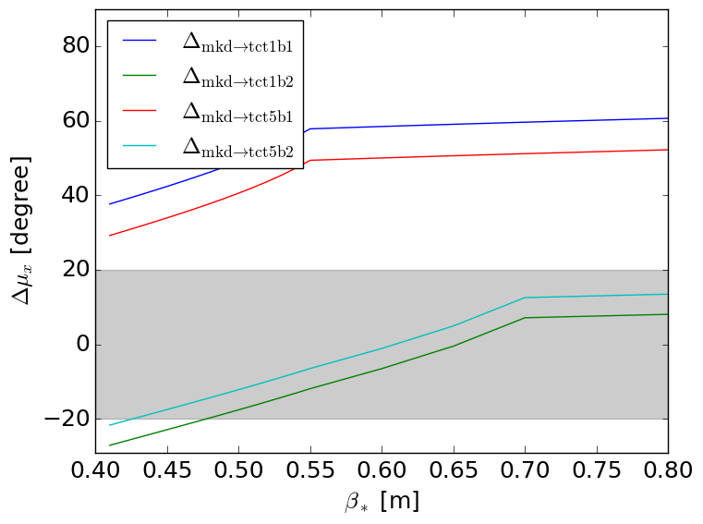
MKD-TCT phases during squeeze
Squeeze 2015: MKD.[AO]5[LR]6.B[12]-> TCTPH.4[LR][15].B[12]

Slide 4
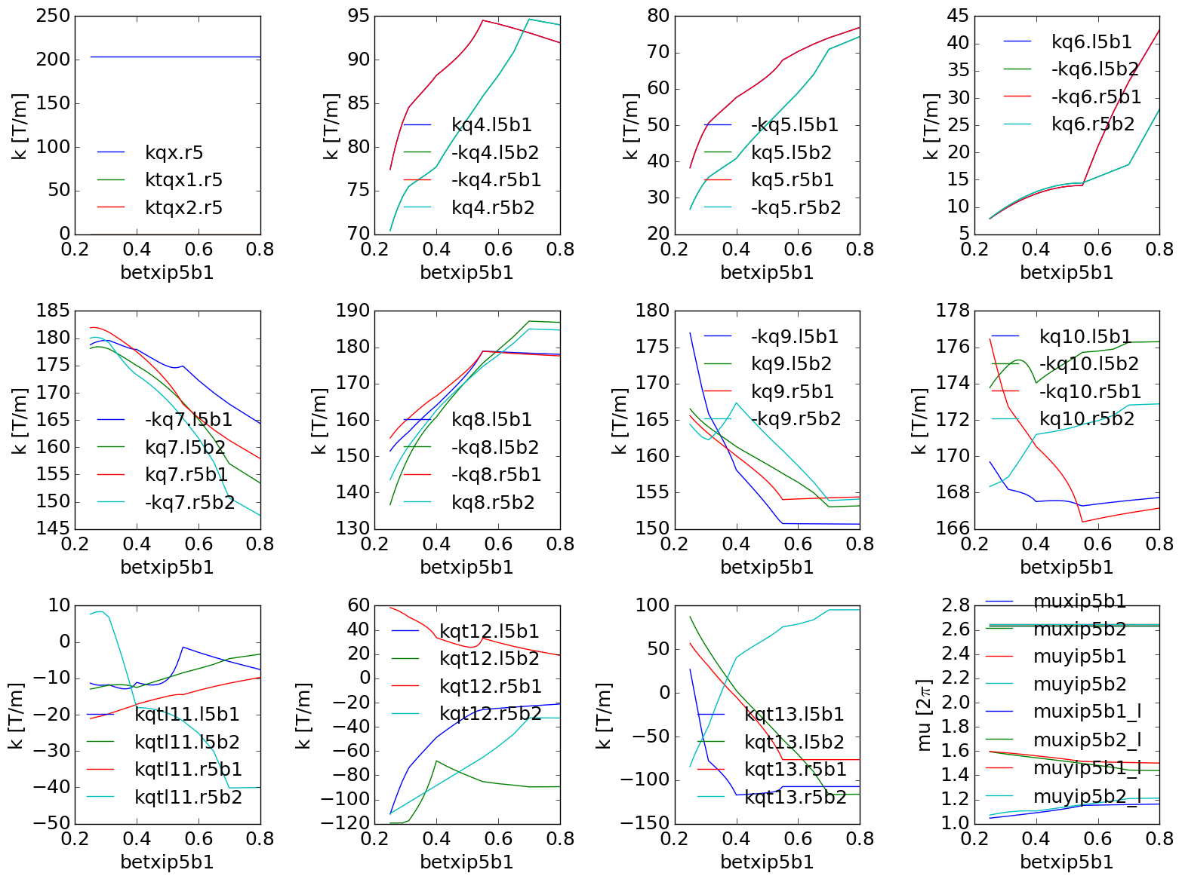
Squeeze 2015

Slide 5
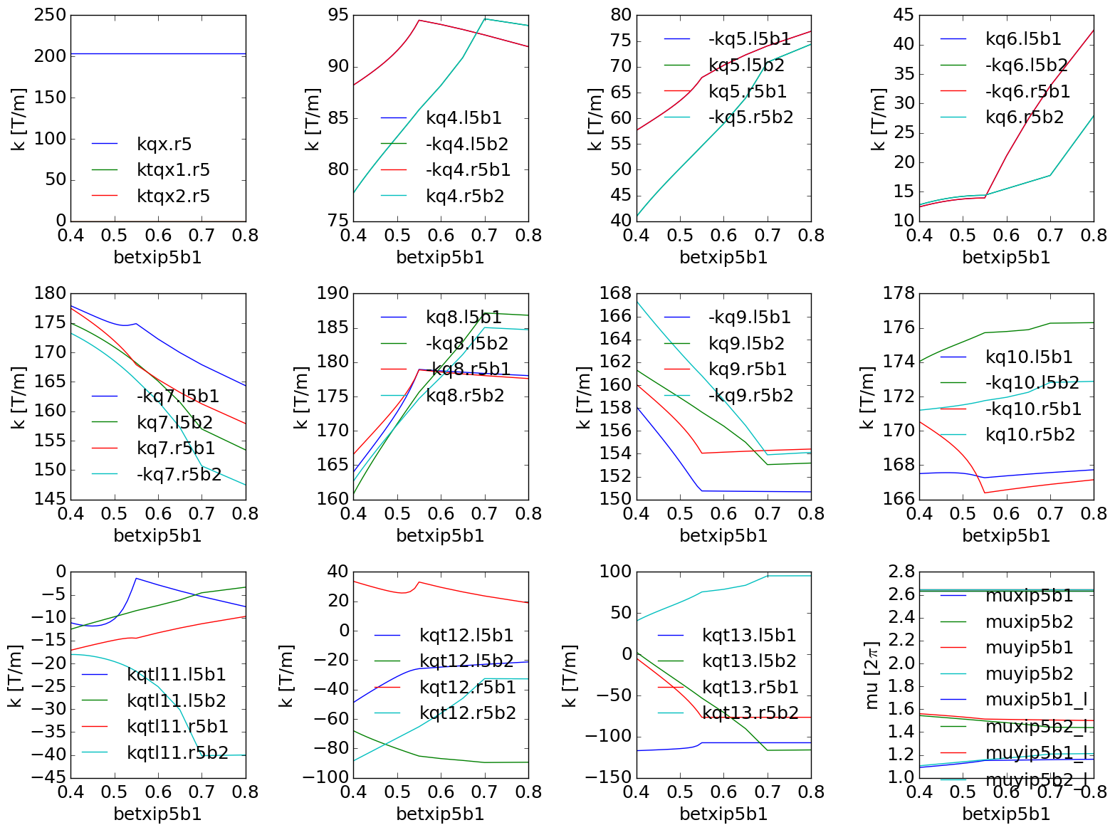
Squeeze 2015

Slide 6
Phase 2015 Squeeze

Slide 7
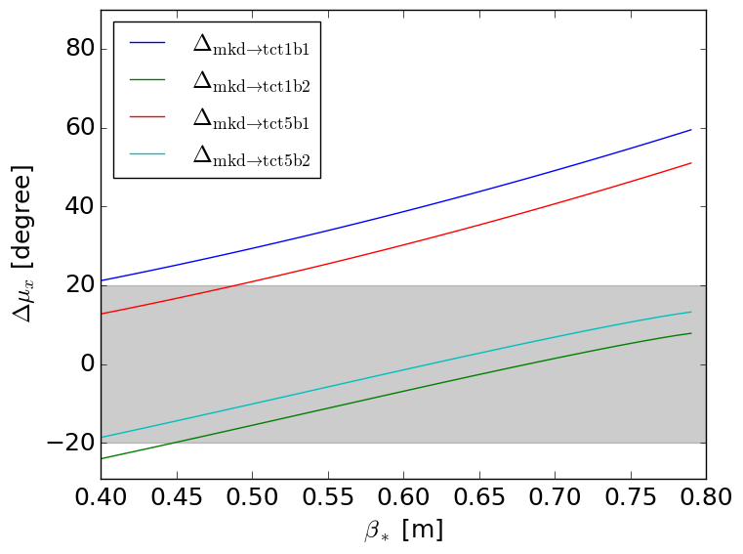
Phase New Squeeze (1)

Slide 8
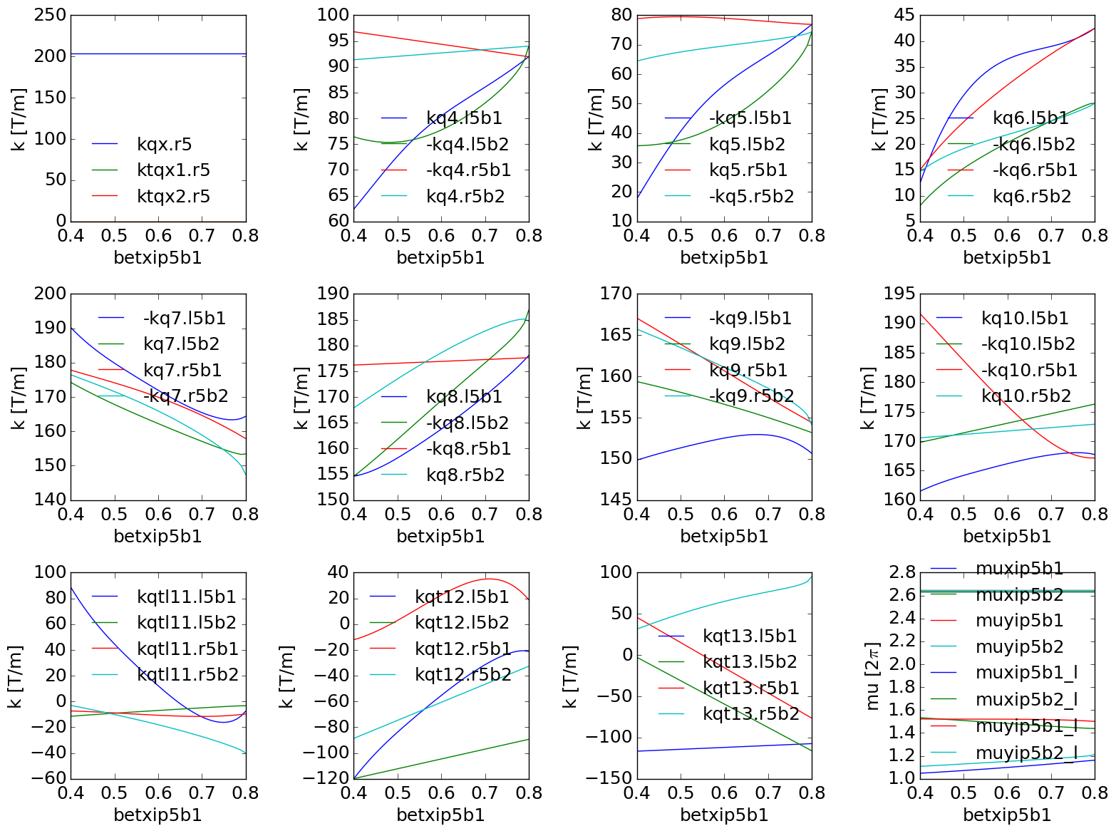
Squeeze (1)

Slide 9
Squeeze(1) new phase

Slide 10
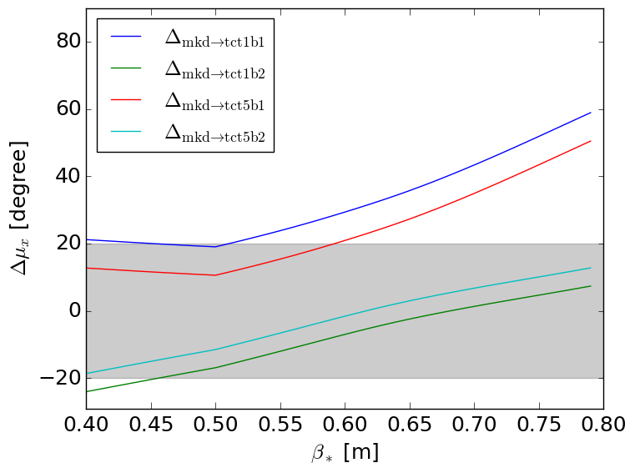
Squeeze(2) new phase

Slide 11
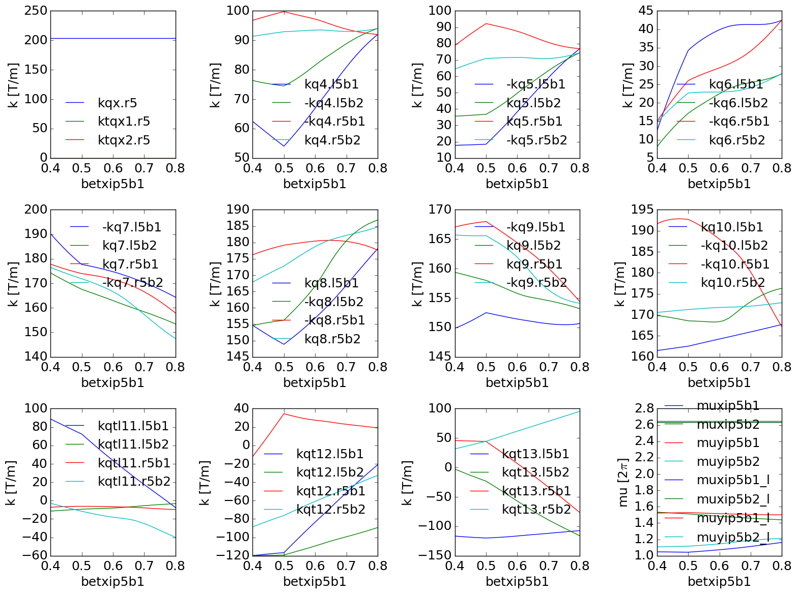
Squeeze(2) new phase

