Slide 2
Cryogenic safety - HSE workshop
CERN 21st to 23rd September
Simon Baird
Notes:
Welcome you all to this seminar workshop? And especially those from outside of CERN I would like to welcome you to CERN
And thank you all for coming
Thanks to Andre and his team for setting up such an interesting and varied program
Start by giving you a very short introduction to safety at CERN
Followed by a few words on Cryogenic activities,
It will be short for 2 reasons You have a very full program and I am sure you do not want to listen to me and two I certainly not an expert

Slide 3
Safety @ CERN
Safety policy is under the responsibility of the DG and aims to
  Ensure the best possible protection of all persons on site and in the vicinity
  Limit the Organisation’s impact on the environment
  Guarantee best practice in matters of Safety
CERN establishes safety rules applicable to the Organisation’s activities, taking into account Host State and EU regulations
HSE is CERN’s centre of competence in matters of Safety and, as such
  Ensures implementation of the CERN Safety Policy
  Provides support to all parts of the Organisation in matters of Safety
  Establishes and updates CERN Safety rules as required
  Provides a fire and rescue service
  Provides a medical service for occupational health
  Grants authorisations for the operation of installations with major safety implications
Notes:
Now Cryogenics

Slide 4
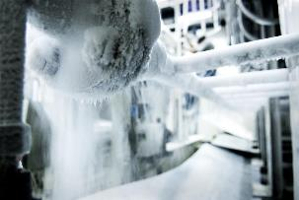
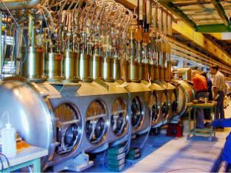
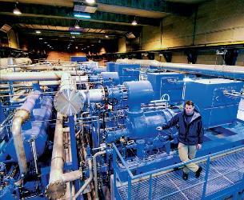
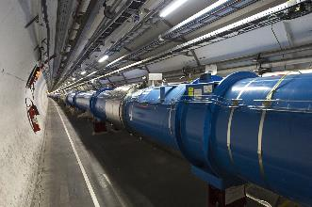
Notes:
The LHC at CERN is the largest cryogenic installation in the world and that brings very special safety concerns
People plus >100 tons liquid Helium in a confined underground space
Pressure vessels Electrical power Industrial compressor plants etc… plus all the risks associate with cryogenic liquids cold gases etc…
Also equipment safety is a major concern when things go wrong
this becomes this

Slide 5
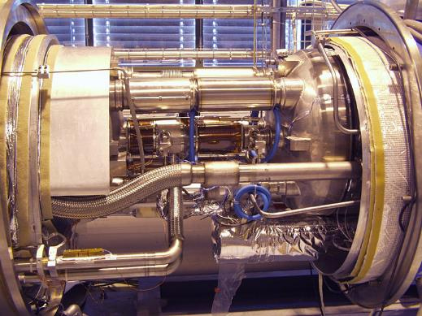
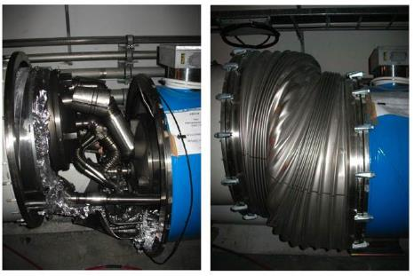
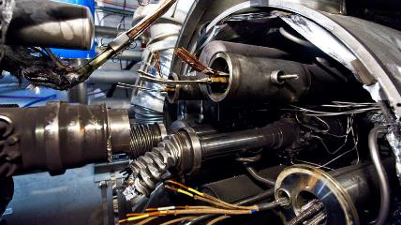
LHC start-up
Notes:
One sub-standard braise between 2 copper bars = A strong reminder that this is still very much cutting edge research and personnel and equipment safety are of the utmost importance
This kind of Safety = technological development R&D electronic QPS system development, measurements, safety valves, energy extraction….
as well as rules, regulations, procedures training, personal protective equipment etc…
This R&D is what you will discuss over the next 3 days to learn from each other, pool our ideas, set up collaborations and learn from what others are doing

Slide 6
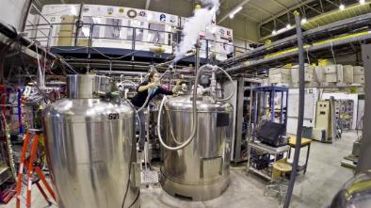
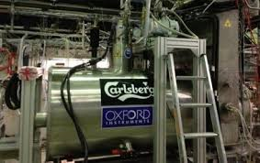
Cryogenics at CERN is not just LHC
  Many smaller users
  AD…
Notes:
CERN is not just LHC CERN has many small standalone cryo genic installations from HIE ISOLDE superconducting LINAC to AD experiment.
Although I am not really 100% sure what they are cooling here
For smaller installations many of the risks are the same but there are a number of additional challenges concerning safety
Small teams mean it is more difficult to have expert knowledge, less resources to devote to online sophicticated safety systems, more things done manually
But the message is the same
Cryogenics is now an essential part of research programs at many institutions across the world, and the technology is evolving
Therefore Cryogenic Safety is also a vital part of these programs
For both people and equipment and Cryogenic safety too must evolve to keep up with the new technological developments

Slide 7
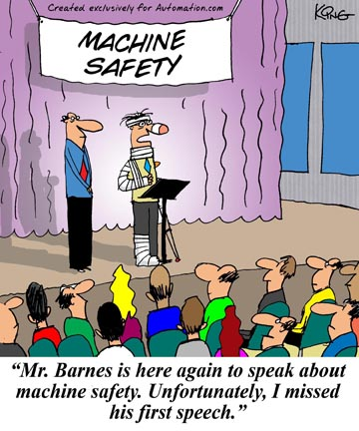
Have an interesting workshop

