Slide 1
Software used to size the safety devices
Jean-Marc Poncet, Eric Ercolani, Philippe Gully, Chantal Meuris

Slide 2
Abstract
Abstract
  To avoid mistakes during the calculation, CEA/SBT has decided to write a software that take into account all the situations it is possible to encountered (subcritical state, supercritical state, …). The goal is to permit to the engineer in charge of a cryostat manufacturing to perform this calculation; he is the only person able to do the accidental analysis which is fundamental for the sizing of the safety device. The software written is presented.

Slide 3
Content
Summary
  Safety approach at CEA/SBT
  Description of the tool
  Result of the calculation
  Conclusion

Slide 4
Safety approach at CEA/SBT
Safety analysis
  Parameters:
  Final use of the cryostat (magnet, MLI, …)
  Design of the cryostat (weak point, bellows, …)
  Performed by the project leader: adapted to the size of the projects developed in the lab
Choice of the heat fluxes deposited on the cold surfaces
  Situation can be complex if difficulties appear with the size of the safety device (see quantification of heat flux in supercritical helium)
Sizing of safety device
  A specific software has been developed at CEA/SBT based on the article: “Sécurité en cryogénie” – Techniques de l’ingénieur BE 9814 – English version available soon
Safety report
  Analysis and sizing reported in a dedicated document

Slide 5
Safety approach at CEA/SBT
Only one tool authorized in the lab (if applicable)
  With the cryostats designed in the SBT lab, an analytical approach is often sufficient.
  Calculation is not so simple then the tool to be used is imposed to avoid calculation error.
  With the approach proposed in the “Techniques de l’ingénieur”, the software has been written and exhaustive verifications have to be finished.
User friendly
  It is not an easy work but a software as user friendly as possible has been written
No parameters blocked
  By experience with the previous version of the software, no parameters have been blocked. It is really important in complicated situation to understand where margins are available to modify the design.
  Users have no access to formula but discussions are always open

Slide 6
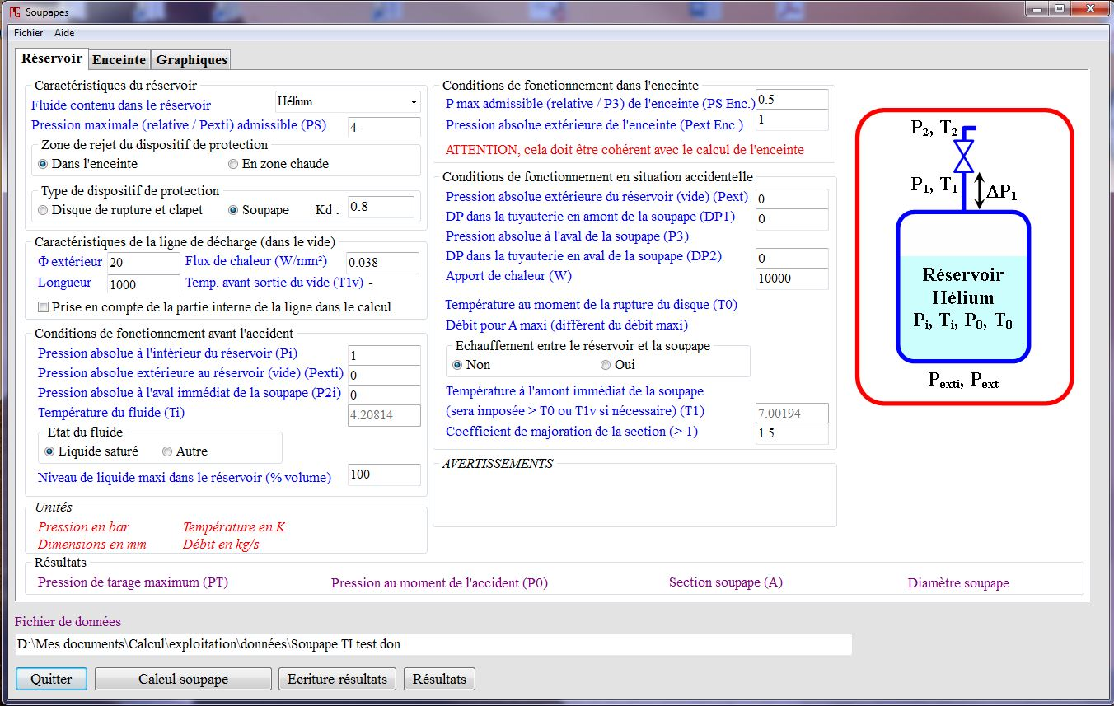
Description of the tool
Calculation of the safety device for the reservoir or the vacuum vessel

Slide 7
Description of the tool
The patterns are adapted to the situation for a better understanding
  (reservoir, valve with discharge into the vacuum chamber or not, vacuum vessel)
P₃
P₂, T₂
P₃
ΔP₂
P₂, T₂
ΔP₂
ΔP₁
P₁, T₁
P₂, T₂
P₁, T₁
ΔP₁
P_{i}, T_{i}
P₀, T₀
P₁, T₁
ΔP₁
Réservoir
Hélium
P_{i}, T_{i}, P₀, T₀
Réservoir
Hélium
P_{i}, T_{i}, P₀, T₀
Réservoir
Hélium
P_{hei}, T_{hei}
P_{he}, T_{he}
P_{exti}, P_{ext}
P_{exti}, P_{ext}
Enceinte à vide
P_{exti}, P_{ext}
The software adapts the required input data to the cryostat configuration

Slide 8
Description of the tool
Different sets of data to fulfil
  Maximum Allowable working pressure
  The structure of the cryostat (eventually the characteristics of the vacuum vessel for the calculation of the reservoir safety device, …)
  Parameter of the cryostat in normal operation
  Description of the accidental situation

Slide 9
Results
Results
  Maximum required cross section of the safety device (responsibility of the safety device manufacturer)
  Temperature corresponding to the maximum required section
  Mass flow rate
  The set pressure of the safety device (relative pressure)
  The maximum pressure during the accident

Slide 10
Results
Results
  Evolution of the discharge of the reservoir during the accident
Maximum mass flow rate and cross section not for the same specific volume

Slide 11
Results
Dimensionnement de soupape
Version 1.0 du 7 septembre 2016
Gaz utilisé : Hélium
Type de système à protéger : RESERVOIR
Zone de rejet du dispositif de protection : Dans l'enceinte
Type de dispositif de protection : Disque de rupture
Pression maximale admissible (PS) : 4
Conditions de fonctionnement avant l'accident
Pression abs. dans le réservoir (Pi) : 1
Pression abs. extérieure au réservoir (Pexti) : 0
Pres. abs. à l'aval immédiat de la soupape (P2i) : 0
Température du fluide (Ti) : 4,20814
Niveau de liquide MAXIMUM (% du volume) : 100
Conditions de fonctionnement en situation accidentelle
Pression abs. extérieure au réservoir (Pext) : 0
DP dans la tuyauterie amont de la soupape (DP1) : 0,1
ATTENTION : DP tuyauterie amont (DP1) > 3% de PT : 0,1 > 0,075
DP dans la tuyauterie aval de la soupape (DP2) : 0
Apports de chaleur (W) : 10000
Echauffement entre le réservoir et la soupape : Non
Température du réservoir (T0) : 6,96703
Température amont immédiat de la soupape (T1) : 6,96703
Pression de tarage maximum (PT) : 2,5
Pression abs. dans le réservoir (P0) : 4,4
Pres. abs. à l'amont immédiat de la soupape (P1) : 4,3
Pres. abs. à l'aval immédiat de la soupape (P2) : 1,55
Débit (m) : 0,41423
Dimensions de la soupape et grandeurs servant au calcul
Coefficient de décharge de l'organe (Kd) : 0,8
Coefficient de majoration de la section : 1,5
Section de l'organe de sécurité (A) : 222,318
Diamètre de la soupape (D) : 16,8245
Results
  Input data and results written in a text file

Slide 12
Conclusion
A safety approach is proposed for all the CEA/SBT lab.
A common tool is available for the persons who need to size some safety devices in the lab. This tool is based on the article: “Sécurité en cryogénie” – Techniques de l’ingénieur BE 9814. The exhaustive validation has to be finished. The use of the tool will certainly required some improvements.
Depending on the design of the safety circuit, other tools (e.g. thermohydraulic software) can be necessary (e.g. long pipes between the circuit to protect and the safety device with external heating)
Results are available to facilitate the written of the safety reports.

