Slide 2
Application of Risk-Based Inspection for Cryogenic Equipment
Simon Marsh HSE-SEE-XP

Slide 3
Equipment Integrity
Operating units need to be able to demonstrate proper management of pressure equipment integrity
  Legal and moral requirement
    “Our assets are safe, and we know it”
    Continued safe operation is ‘good business’

Slide 4
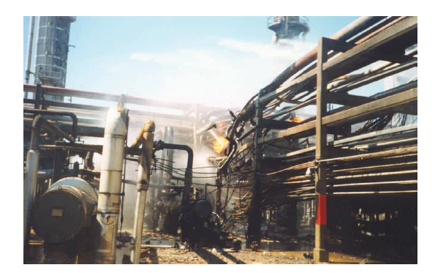


Slide 5
Equipment Integrity
Starts with sound designs, materials selection, adequate quality assurance and quality control during manufacture, appropriate consideration of safety aspects, correct commissioning, operating within design limits…
…and continued verification that the equipment is still safe to operate

Slide 6
Why use Risk-Based Inspection?
An RBI approach can be a significant part of pressure equipment integrity management
Periodic inspection conditions and requirements vary between countries
  Inspection periods are often a legal requirement
  In some countries exclusions or extensions based on RBI are possible
  Other countries fully recognise RBI as the inspection basis in pressure equipment integrity management
Potential cost savings
  Allows inspection effort to be focused on critical items, and using appropriate inspection techniques
  Assists in achieving lowest lifecycle costs by avoiding unnecessary inspection

Slide 7
What is Risk-Based Inspection?
RBI focus is on maintaining mechanical integrity of pressure equipment items and minimising loss of containment due to deterioration
  Complementary technique to PHA, HAZOP, etc.
Inspection periods and inspection techniques are set according to the probability of failure and consequence of failure of the equipment (i.e. set according to the risk)
  Usually involving a facilitated multidisciplinary team
Systematic evaluation of each potential degradation mechanism and estimation of probability of failure (PoF)
  In RBI, this is not only a function of time but also of ‘knowledge’ of the equipment and inspection effectiveness
Determination of possible and credible consequences (harm to people, environment, asset losses) in case of equipment failure (CoF) resulting from the degradation mechanism
The combination of PoF and CoF defines the risk, typically depicted on a risk matrix, and from which an inspection interval factor is set
Based on the inspection interval factor and the remnant life (or design life for new facilities), the next inspection date is determined
The appropriate inspection technique and inspection coverage for the degradation mechanism is determined

Slide 8
RBI Challenge with Cryogenics
RBI assessments are usually done per degradation mechanism
  General thinning, local thinning, pitting, environmental cracking,…
Cryogenic equipment operating at cold effectively have no degradation mechanisms
  Provided that original materials selection and mechanical design were fit-for-purpose
  Provided operated as per original design intent, within design temperature and pressure operating window
  Provided not subject to unexpected upsets or external influences
However, because the consequences of failure can be very high, some operating units want to do “something” in terms of inspection
  For example, defaulting to an intrusive inspection at the maximum inspection interval generated by RBI (e.g. 80%) as a proportion of the original unit design life
  But must be balanced against risk of doing the inspection itself and associated safety aspects
    For example, controlling moisture ingress and ice formation on cooldown

Slide 9
A Risk-Based Approach
Elements of RBI can be used nevertheless in the integrity management of cryogenic equipment
  Multidisciplinary assessment of risk
    Documented, traceable and defendable
  Control of management of change
  Ensuring that residual risk factors for loss of containment are understood and mitigated, including consequential effects from/on neighbouring equipment
    Assists to put appropriate compensatory measures in place
  API RP 581 Risk-Based Inspection defines standard “release hole diameters” for assessing PoF and CoF
    “Small” – d=6.4 mm up to “Rupture” d = min [D, 406] mm
      Such an approach can be used to standardise and compare release scenarios

Slide 10
CERN
2302 pressure vessels, of which 1286 are considered cryogenic
In accordance with its intergovernmental status, CERN establishes and updates Safety Rules to implement its Safety Policy
Inspection and testing requirements for cryogenic equipment given by Safety Rule GSI-M-4
Inspection intervals pushed out compared to previous rules, based on assessment of experience and risk

Slide 11
CERN Inspection Requirements
Fixed cryogenic pressure equipment
  External visual inspection, including safety accessories, at 5 year interval
  No additional requalification tests, unless under management of change
Transportable cryogenic pressure equipment
  External visual inspection, including safety accessories, at 5 year interval
  Pressure and leak-tightness test at 90% maximum allowable pressure (PS), at 10 year interval
Cryogenic pressure equipment liable to have major safety implications
  External visual inspection, including safety accessories, at 3 year interval
  No additional requalification tests, unless under management of change

Slide 12
CERN Inspection Requirements
Safety Valves
  Functional test 5 year interval
    Inert fluids in ‘non-fouling’ situations
  Functional test 3 year interval
    ‘Fouling’ situations
    Flammable or oxidising cryogenic fluids
    Pilot-operated valves
    Valves protecting cryogenic equipment liable to have major safety implications
Rupture discs
  Replaced at manufacturer-defined intervals
  Replaced if any signs of damage
  Replaced after 10 years at the latest

Slide 13
Summary
RBI, done properly, can be considered a robust component of pressure equipment integrity management
Despite the issue of determining degradation mechanisms, elements of the RBI process can be applied with validity to ensuring integrity of cryogenic equipment by evaluating and documenting risk, and assisting in promoting and maintaining safety in operation.

