Slide 1
European standardization activities on
safety of liquid helium cryostats
Steffen Grohmann
Cryogenic Safety Seminar, CERN, September 21-23, 2016

Slide 2
Outline
Safety of pressure equipment – What is special in LHe cryostats?
Brief review of a national standardization project (2010 – 2015)
European standardization project
Cross-link among projects
Notes:
Andre:
-Ok for the topics to present

Slide 3
What is special in Lhe Cryostats?
Safety of pressure equipment

Slide 4
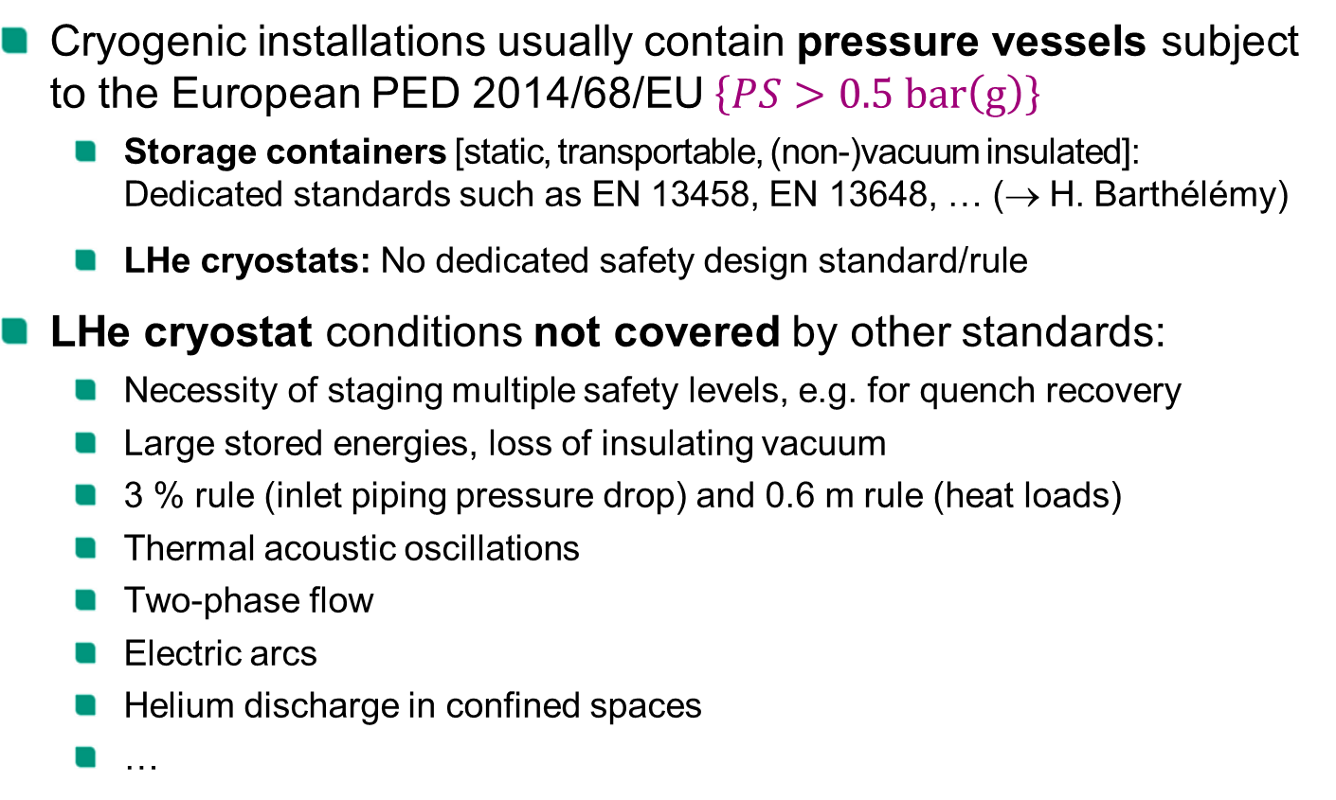
Safety of cryogenic pressure equipment
Cryogenic installations usually contain pressure vessels subject to the European PED 2014/68/EU $\left\{PS>0.5 bar\left(g\right)\right\}$
  Storage containers [static, transportable, (non-)vacuum insulated]:
  Dedicated standards such as EN 13458, EN 13648, … (→ H. Barthélémy)
  LHe cryostats: No dedicated safety design standard/rule
LHe cryostat conditions not covered by other standards:
  Necessity of staging multiple safety levels, e.g. for quench recovery
  Large stored energies, loss of insulating vacuum
  3 % rule (inlet piping pressure drop) and 0.6 m rule (heat loads)
  Thermal acoustic oscillations
  Two-phase flow
  Electric arcs
  Helium discharge in confined spaces
  …

Slide 5
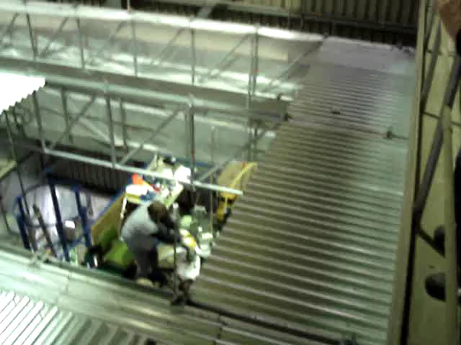

What is special in LHe cryostats?
Process dynamics
  Large heat fluxes of several W/cm² during failures
  Very low latent heat of helium → ${\left.\frac{∆h_{v}}{L liquid}\right|}_{1bar}\left(He :N_{2} :H_{2}O\right)=1 :62 :835$
  Nearly instantaneous
  evaporation
  Pressure gradients in
  the range of $\left({bar}/s\right)$
Quench test of a sc. solenoid (KATRIN)

Slide 6
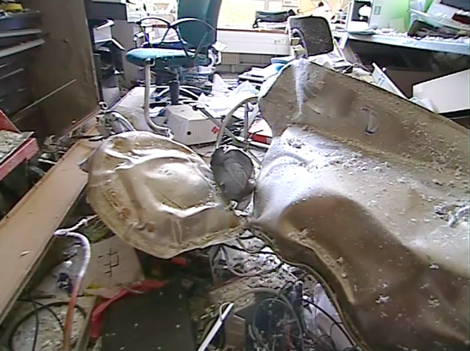
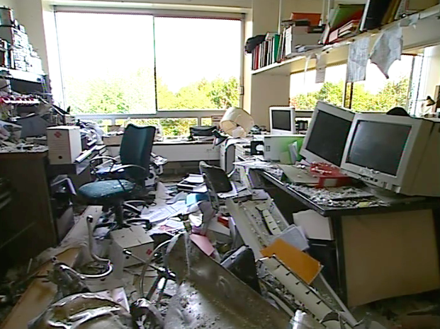
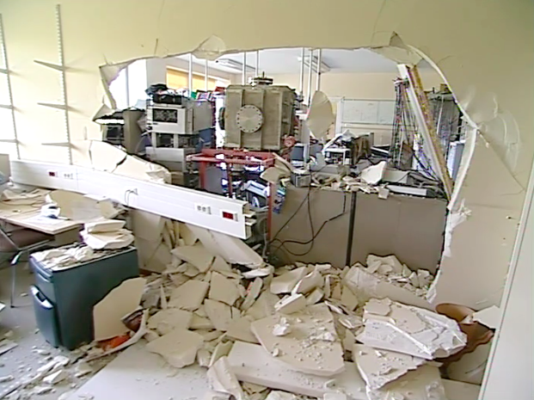
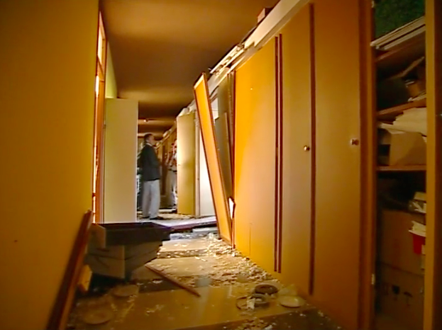
Explosion of a 70 L helium dewar
Accident in a
laboratory
(09/2005)

Slide 7
What is special in LHe cryostats?
Common pressure equipment | Liquid helium cryostats
Cryogenic storage containers | Sc. magnet cryostats, RF cavities
Protection against disruptive failure Extreme and rare failure scenarios | Protection against disruptive failure Extreme and rare failure scenarios
 | Protection against operation failure Expected and frequent failure scenarios (quenches) Need of staging safety levels!
 | Large number papers, individual reports and experience BUT no systematic guideline
Standardized task (limited complexity) | Individual and complex design task

Slide 8
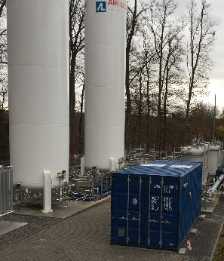
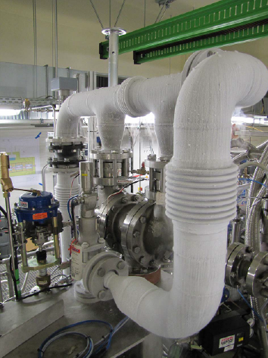
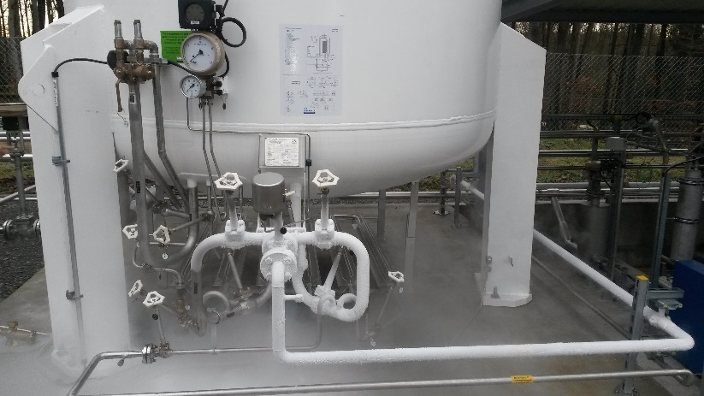
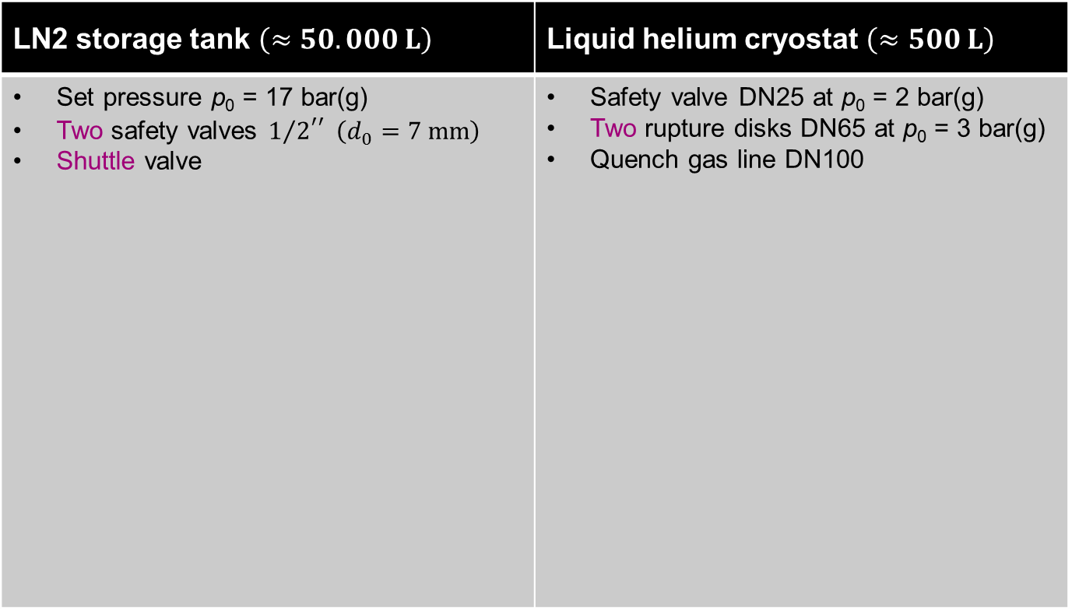
Examples of typical safety units
LN2 storage tank $\left(≈50.000 L\right)$ | Liquid helium cryostat $\left(≈500 L\right)$
Set pressure p₀ = 17 bar(g) Two safety valves ${1/2}^{′′} \left(d_{0}=7 mm\right)$ Shuttle valve | Safety valve DN25 at p₀ = 2 bar(g) Two rupture disks DN65 at p₀ = 3 bar(g) Quench gas line DN100
Source: Air Liquide
Source:
KATRIN

Slide 9
National standardization project
(2010 – 2015)
Safety of liquid helium cryostats

Slide 10
Contributions
Industry
Blum, Lars | Linde Kryotechnik AG
Otte, Wolfgang | Air Liquide Deutschland GmbH
Reinhardt, Matthias | Herose GmbH
Schulenberg, Olaf | Goetze KG Armaturen
Universities and Research Centers
Grohmann, Steffen | Karlsruhe Institute of Technology
Haberstroh, Christoph | Technical University Dresden
Heidt, Carolin | Karlsruhe Institute of Technology
Raccanelli, Andrea | Research Center Jülich GmbH
Schröder, Claus | GSI Gesellschaft für Schwerionenforschung mbH
Süßer, Manfred | Karlsruhe Institute of Technology
Organization
Lau, Markus | German Institute for Standardization (DIN)

Slide 11
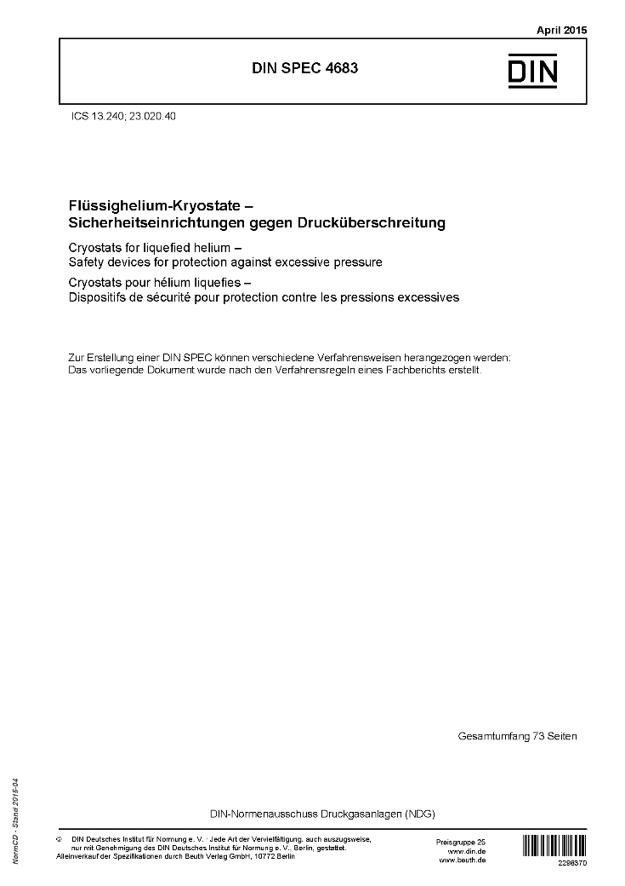
Workout of a DIN SPEC
Technical guideline rather than a standard
Can be the basis for a consensus-based standardization process
Publication of the DIN SPEC 4683 in 04/2015

Slide 12
European standardization project
Safety of liquid helium cryostats

Slide 13

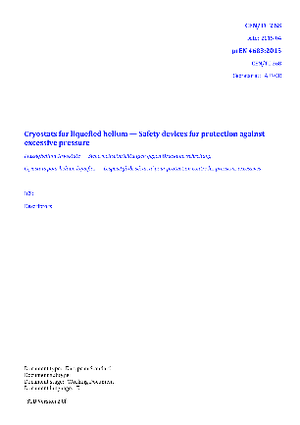

European standardization project
Satellite meeting at European Cryogenics Days 2015 (Grenoble)
  Agreement to advance a European standardization process
  Translation of DIN SPEC 4683 and CEA documents
  Inconsistent nomenclature in different standards
  Different definitions of set pressure in ISO 4126 (2013), API 520 (2014) and ASME PTC 25 (2014)
prEN 4683:2015
Working document
(07/2016)
Notes:
EN ISO 4126: Safety devices for protection against excessive pressure (2013)
American Petroleum Institute: API Standard 520 - Sizing, Selection, and Installation of Pressure-relieving Devices (2014)
ASME PTC 25: Pressure Relief Devices (2014)

Slide 14
Present contents of prEN 4683:2015
(1)…(4) Scope, references, terms…
Hazard analyses,
risk assessment and
safety concept
Scenarios of pressure increase
Dimensioning of safety
relief devices
Design and operation of safety
relief devices and safety units
Release of the working fluid
Commissioning, maintenance
Materials for safety relief devices
+ 10 Annexes = 84 Pages
Presentations in this seminar
Thomas Otto, Duy Phan, Gunnar Lindell, Hans Guenter Mueller, Vladislav Benda, Ruggero Pengo, Luca Dassa, Carlos Arregui Rementeria, Stefan Rath
Carolin Heidt, Eric Ercolani, Jaroslaw Polinski, Maciej Dziewiecki,
Andre Henriques, Sebastian Protz, Jean-Marc Poncet, Eric Ercolani, Christina Weber, Jürgen Schmidt, Quang Dang Le, Ziemowit Malecha
Vittorio Parma, Fridolin Holdener
Ziemowit Malecha, Thorsten Koettig
Simon Marsh
Organizational/strategic talks:
Carlos Arregui Rementeria, Zoe Lawson, Simon Marsh, Hervé Barthélémy

Slide 15

Aim of the European standard
Collect, structure and harmonize state-of-the-art rules, procedures and know-how from labs, institutes and companies in Europe
Provide a comprehensive overview on all major aspects of safe design and operation of liquid helium cryostats
Solve conflicts with other standards by the indication of alternative options
Provide the first international standard on safety of LHe cryostats
European standards are produced by all interested
parties through a transparent, open and consensus
based process

Slide 16
Project organization
Establishment of a new working group at CEN/TC 268 –
Cryogenic vessels and specific hydrogen technologies applications
  Chairperson: Dr. Hervé Barthélémy, Air Liquide
  Link: CEN/TC 268
WG 1 | Design
WG 2 | Compatibility, insulation, accessories
WG 3 | Operational requirements
WG 4 | Fundamental requirements
WG 5 | Specific hydrogen technologies applications
+
WG 6 | Liquid helium cryostats

Slide 17
Formal procedure to start the project
DIN sends new work item proposal to CEN/TC 268
Secretariat verifies proposal and sends inquiry within CEN/TC 268
  Typical deadline for response 4-6 weeks
National Standardization Bodies contact their experts concerning relevance and participation
  Some countries have mirror committees of CEN/TC 268,
  some countries don‘t…
  Make sure you get registered at your National Standardization Body as a participating expert
  Your National Standardization Body will delegate you later to the new WG
The National Standardization Bodies vote at the end of the deadline
  For the project approval, at least 5 participating countries must indicate active members with their names

Slide 18
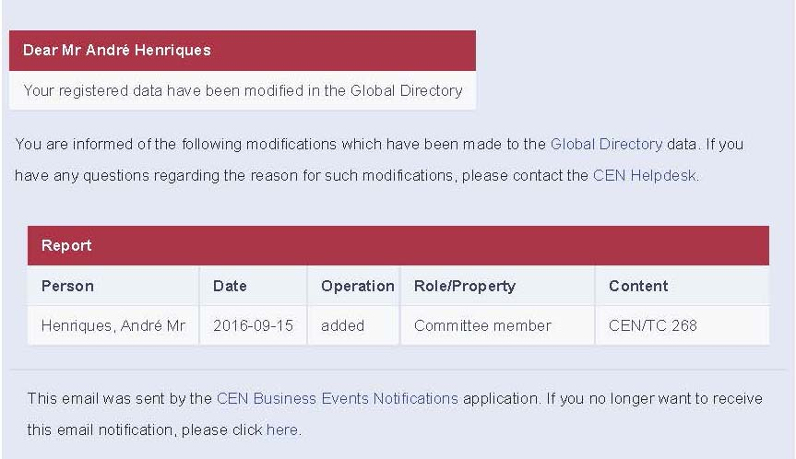
Expert registration
Example for individual registration at the National Standardization Body
If you want to participate, please register and send me a confirmation
  Contact: steffen.grohmann@kit.edu
  DIN files the new work item proposal once experts from 5 countries have registered

Slide 19
Project planning
Project management by WG secretariat at DIN (Berlin)
Kick-off meeting in early 2017
  Doodle poll among participating experts
Two project meetings/year
Finalization of the working draft in ≤ 3 years
Submission to TC chairperson and TC secretary for CEN Enquiry

Slide 20
Cross-link among projects
Safety of liquid helium cryostats

Slide 21
Horizon 2020 project
Approval of EU project:
Accelerator and Magnet
Infrastructure for Cooperation
and Innovation (AMICI)
  Aim: Knowledge transfer
  Coordination: CEA Saclay
  10 participating organizations
WP5.3: Harmonization – Cryogenic safety procedures
  KIT, CEA, CERN
  Cross-link to the new working group at CEN/TC 268
1 | CEA | FRANCE
2 | CERN | SWITZERLAND
3 | DESY | GERMANY
4 | INFN | ITALY
5 | IFJ PAN | POLAND
6 | CNRS | FRANCE
7 | STFC | UNITED KINGDOM
8 | UPPSALA UNIVERSITET | SWEDEN
9 | PSI | SWITZERLAND
10 | KIT | GERMANY

Slide 22

Thank you for your attention!

