Slide 2

ODH at CERN:
Hazards, risks & mitigation measures
Cryogenic Safety – HSE seminar
21-23 September 2016
CERN, Geneva Switzerland
Gunnar Lindell (HSE-unit CERN)

Slide 3
Outline
ODH @ CERN
CERN ODH risk assessment approach
- Evacuation time
- Reduced O₂ - Effects on the human body
Example of an assessment & mitigation actions
Accidents

Slide 4
ODH@CERN - many different types of installations
Small laboratories: 50-200 liters mostly LN₂
Experimental halls: 1’000-10’000 liters LN₂, LHe, LAr, LKr
R&D detectors for Neutrino physics (18’000 & 500’000 l LAr)
LHC tunnel: 8 sectors, 15 ton/sector 3.3km (120’000 l LHe)
ATLAS detector: LAr, LN₂ & LHe
Inert gases used in many different applications.

Slide 5
CERN ODH risk assessment approach
ODH risk assessments are done on a
case-by-case basis as each situation is unique.
It is crucial to make sure people can evacuate safely at all time in case of an ODH situation!

Slide 6
CERN ODH risk assessment approach
Methodology:
Input
Define failure scenarios leading to a release – operations, maintenance, accident.
Find out what the consequences would be concerning O₂ levels, temperatures, vapour clouds, propagation speed, increased pressure etc.
Could the release spread to adjacent areas – directly or via ventilation?
Define the evacuation time needed – consider people at height (maintenance/repair of overhead cranes, lights etc.).
Find out what O₂ levels people will be exposed to as well as the exposure time.
Occupancy – x persons, x days/week, x hours/day
Duration of the activity – 1 week, 6 months or several years?
Final question:
Can people evacuate safely at all time in the chosen release scenarios?

Slide 7
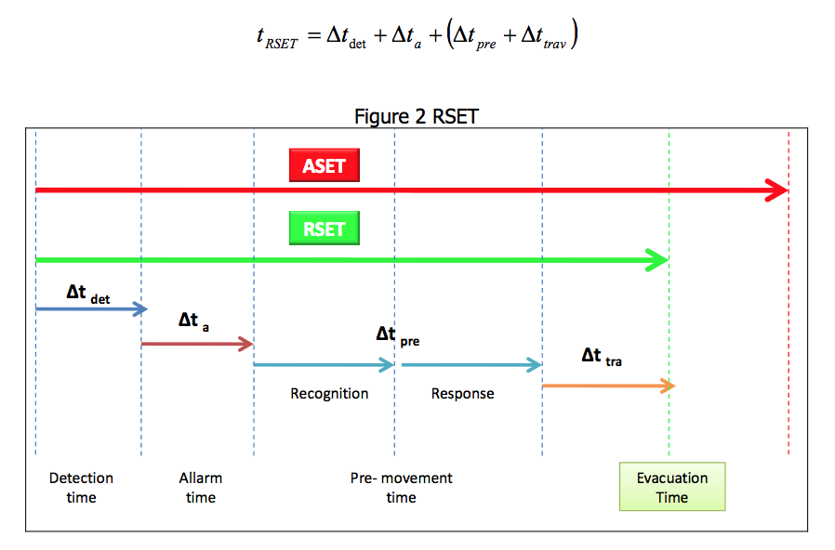
CERN ODH risk assessment approach
Evacuation time
ASET
Available Safe Escape Time
(Applying emperical correlations or fire modelling.)
RSET
Required Safe Escape Time
Time between the
release & detection
by an automatic system
or by first occupant
△t_{tra} travel time - Unimpeded evacuation speed of a person:
Approx. 1.2 m/s travelling horizontally
Approx. 0.8 m/s travelling downstairs
Approx. 0.7 m/s travelling upstairs
+ the time for occupants to flow through exits & escape routes.
Time from
detection
to alarm

Slide 8
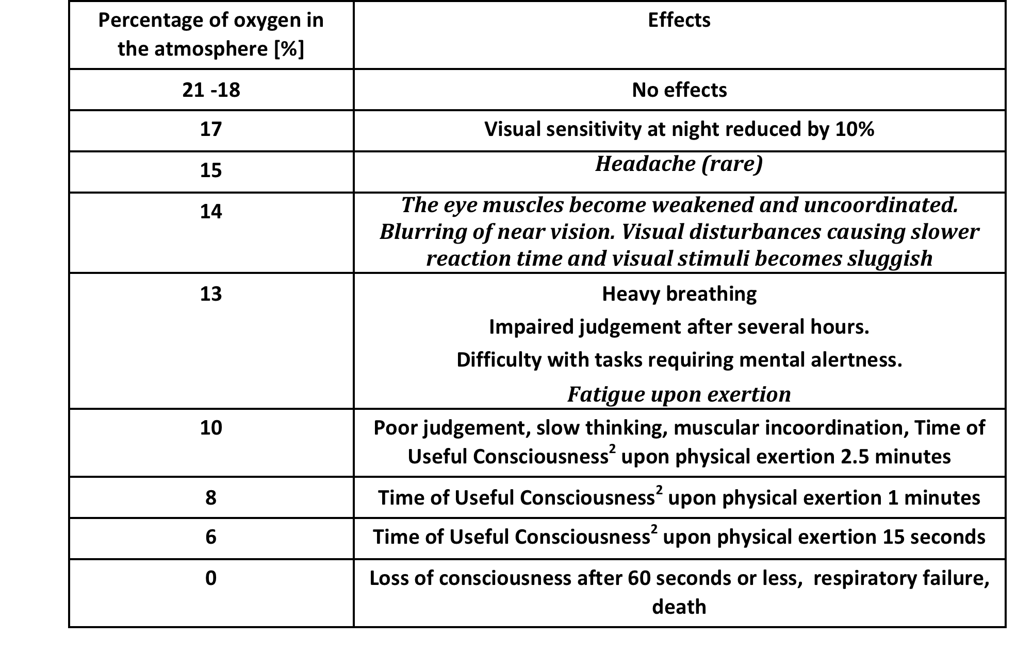
CERN ODH risk assessment approach
Reduced oxygen levels - Effects on the human body
Poor physical health such as heart,
circulation, lung or blood diseases,
heavy smokers, pregnant women or
high degrees of physical exertion
aggravate the effects of oxygen-deficient
exposure.
Time of Useful Consciousness:
Period of time from exposure to
reduced O2 level to the time a person
No longer is capable of taking proper
corrective and protective action.
Source: Aviation and Submarine studies.

Slide 9
CERN ODH risk assessment approach
Reduced oxygen levels - Effects on the human body
Important effects starts below 15% of oxygen concentration.
It is not unusual for the exposed person to be unaware of the effects. They may even experience a false sense of security and wellbeing.
Poor physical health such as heart, circulation, lung or blood diseases, heavy smokers, pregnant women or high degrees of physical exertion aggravate the effects of oxygen-deficient exposure.

Slide 10
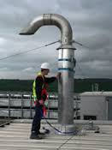

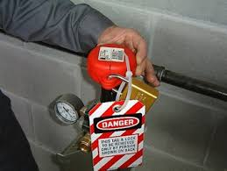
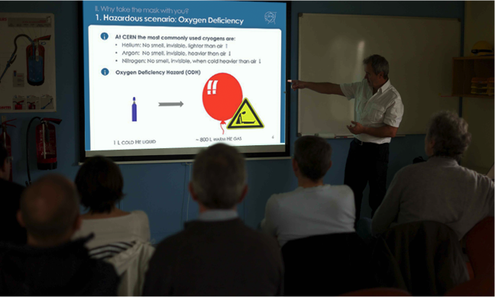
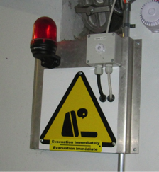
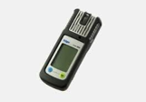
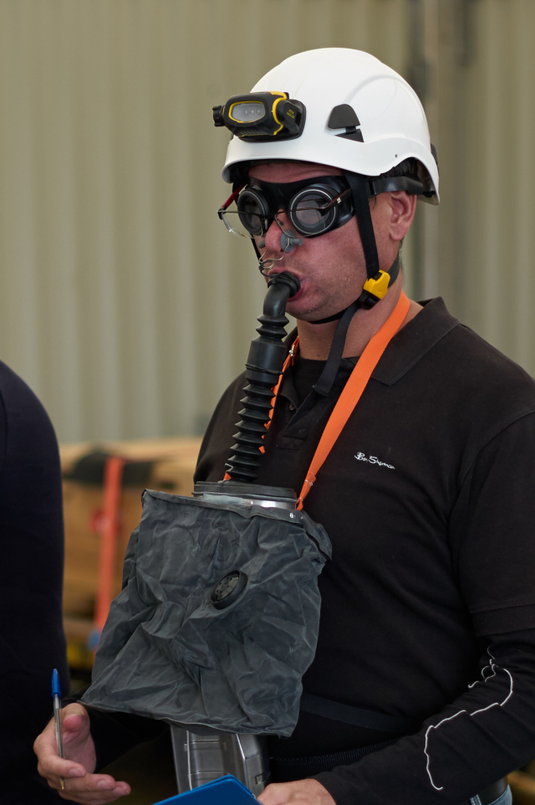
CERN ODH risk assessment approach
Mitigation actions (examples)
Suppression of the risk
Change to harmless fluid, no access when increased risk (magnets powered, cool down), vent line (marked)
Minimise the probability of a release
Build, install, test & inspect according to regulation, avoid mechanical impacts via technical and organizational measures, Lock-out Tag-out procedure etc.
Reduce the consequences in case of a release
Store outside, increase the volume of the area, reduce the volume of the fluid, access control, ventilation
Competent personnel
Qualification, experience, training →Fire drills, Self Rescue Mask training
Collective protection
Detection, alarm, warning signs, adequate escape routes/emergency exits (number and size)
Individual protection
Detection & alarm, self rescue mask,
Emergency procedure
Define what to do in case of a release, in case of an alarm, in case of injuries etc.

Slide 11
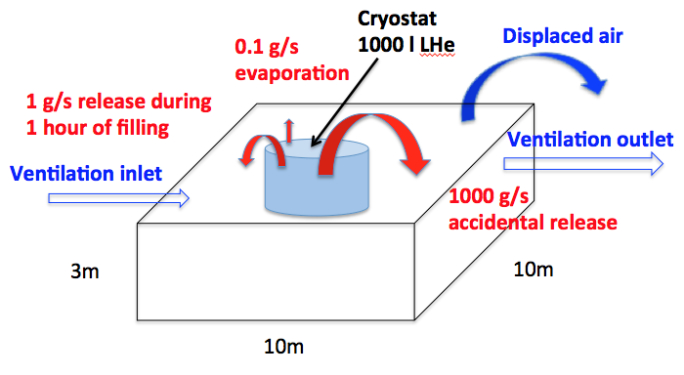
CERN ODH risk assessment approach
An example:
Consequences for the different scenarios with stopped ventilation.
0.1 g/s → 0% O₂ after 6 days (winter break..).
1 g/s during 1 hour (filling) → 22 m³ → 22 cm of pure helium under the ceiling
1000 g/s → 6 m³/s
Escape time: 10s+5s+12s=27 s → 9.5% O₂ (perfect mixture) or 1.85 m pure helium under the ceiling!
Mitigation actions
Cryostat built, installed, tested & inspected according to legislation.
Vent lines marked “Helium outlet” release at points
Fixed ODH sensors with alarms inside & outside the area + ODH signs.
2 emergency exits
Organizational & technical procedures to avoid mechanical impacts. < 1000g/s
Controlled access + No access during cool down
Alarm if ventilation stops
Training (technical, hazards, fire drills etc.)
Emergency procedure

Slide 12
CERN ODH risk assessment approach
Mitigation actions (example) – Self Rescue Mask Training @ CERN
LHC mock up tunnel
2 h course
theoretical &
practical part

Slide 13
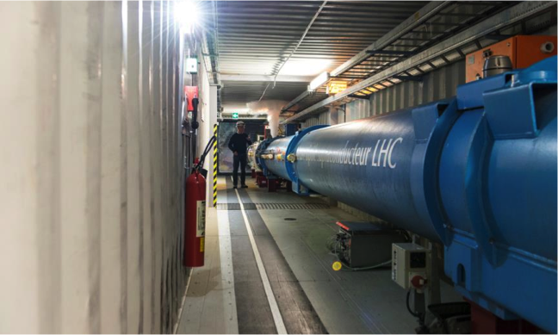
CERN ODH risk assessment approach
Mitigation actions (example) – Self Rescue Mask Training @ CERN
LHC mock up tunnel

Slide 14
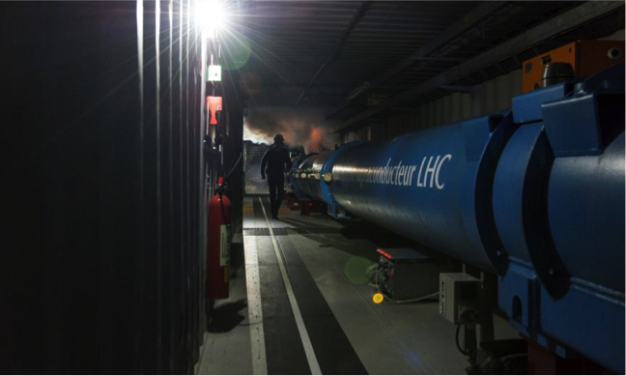
CERN ODH risk assessment approach
Mitigation actions (example) – Self Rescue Mask Training @ CERN
LHC mock up tunnel

Slide 15
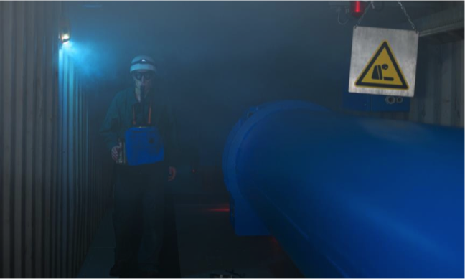
CERN ODH risk assessment approach
Mitigation actions (example) – Self Rescue Mask Training @ CERN
LHC mock up tunnel
Qualification
Theoretical test
&
Practical test: Mask applied within 40 s
Validity → 3 years
Training >1500 people/year.

Slide 16
Accidents due to ODH
Quickly unplanned rescue scenario
A person suddenly collapses in a vessel, a partially enclosed space, pit, trench, small sized room etc.
The colleague(s) runs to rescue and becomes 2nd or even 3rd victim.
This is one of the most common causes of multiple fatalities.
WARNING: The colleague(s) must assume that his/her life is at risk entering the same area!
Ideally, the colleague should raise the alarm and call for assistance for a prepared rescue.

Slide 17
Thank you for your attention!

