Slide 1
HIE-ISOLDE Project:
Status of cavities and plans for CM3
Y. KADI
for the HIE-ISOLDE Project Team
9th HIE-ISOLDE Physics Coordination Group Meeting
CERN, 30 June 2016

Slide 2
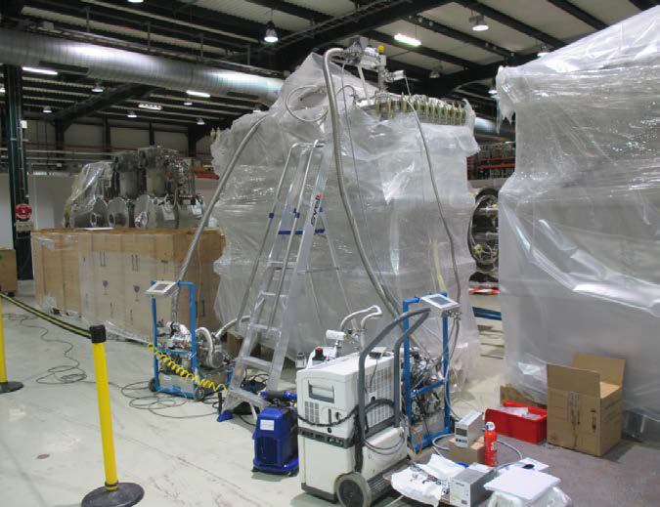
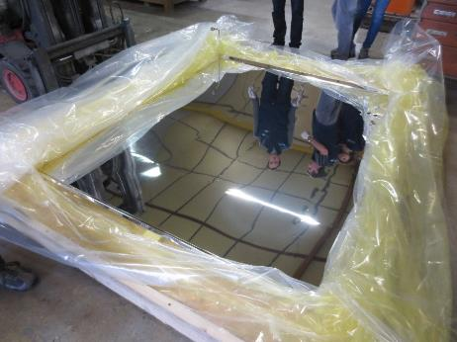
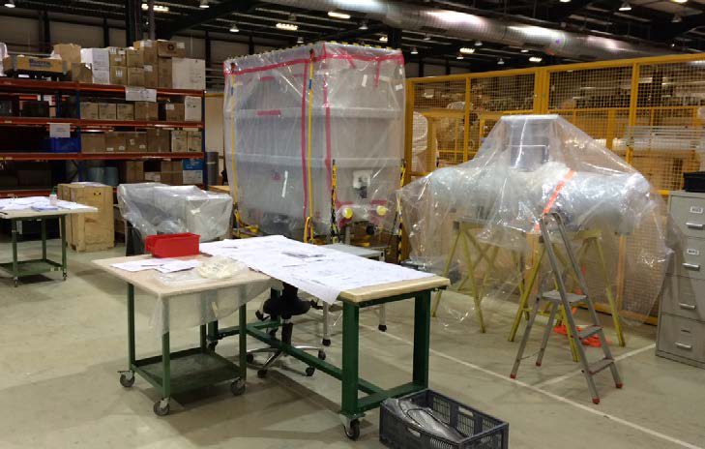
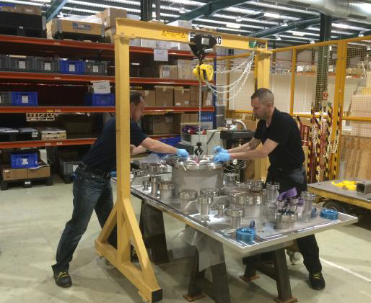
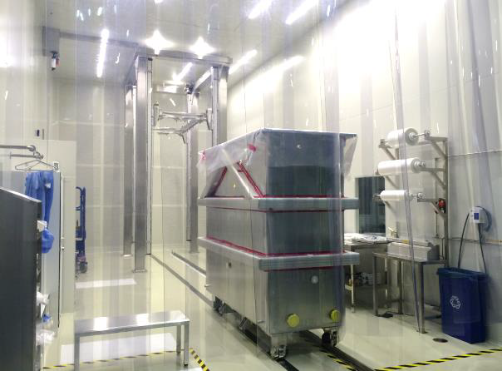
Phase 2: Assembly of CM3

Slide 3
CM3 assembly
Planning:
  Baseline 24w (+2w contingency) as for CM2
  + 2 weeks final testing (initially planned in bunker)
  On schedule so far
Organisation
  Same team as for CM1-CM2
  All parts ready before assembly start
  Use of upgraded procedures
Installation solenoid
Installation cavities

Slide 4
4 out of 5 cavities available (tested) for CM3
QS15 coated in week 25
QS6 and QS16 in the pipeline, still in time for CM3

Slide 5
Forecast for HIE-ISOLDE Phase 2 (2016-2017)
SM18 tests ?
Cav CM3
ISS ?
cryo ?
Cav CM4
F. Formenti

