Slide 1
MDI for FCC-ee
One of the most striking conclusions of the FCC general meeting at Washington
was the need for a FCC-ee Machine Detector Interface (MDI) working group.
A mandate was drafted last year and the working group has been invited to convene
with Manuela Boscolo (INFN Frascati) and Nichola Bacchetta (INFN, Padova, CMS)
as convener and co-convener.
The MDI group establishes a bridge between the accelerator and physics studies.
The task is to study the integration of beams, machine elements and detectors able to produce/exploit the very high luminosities expected at FCC-ee at the interaction regions (IR). The group is charged to come up with a plausible design and, if needed, a set of necessary technical R&D or measurements.

Slide 2
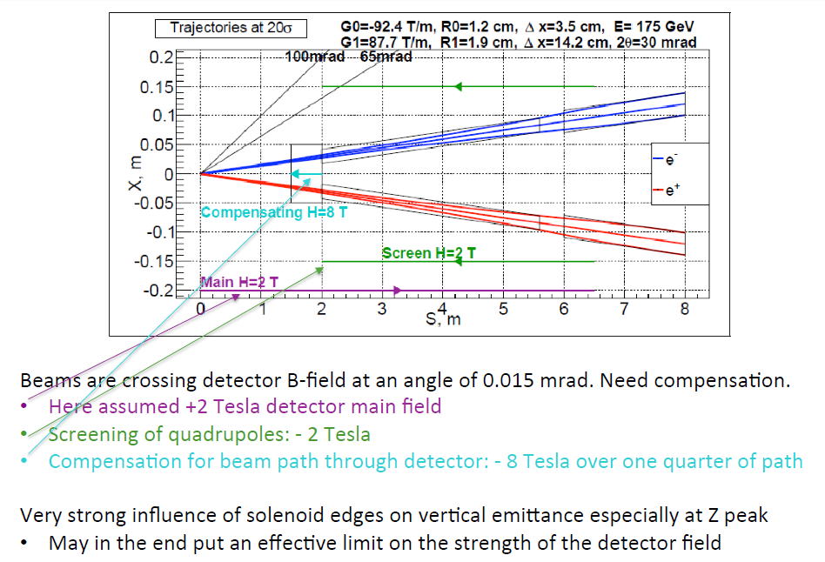
Luminosity
monitor
centered
on outgoing
beam
Bogomyagkov, Dam, Koratzinos

Slide 3
Experimenters wishlist
Luminosity as high as possible! (no limitation from pile-up in the e+e- machine)
Vertex detector as close as possible from IP, but with reasonable occupancy
and radiation damage not exceeding lifetime of the experiment and allowing
detection of such channels as e+e- → Z H (H→‾bb
Luminosity monitor with bhabha cross-section at least 30 nb at Z pole.
i.e. closest angle to the outgoing beam is about 40 mrad
Well defined acceptance limit at small angles, around 100-140 mrad
Solenoid magnet with sufficient magnetic field to allow
good enough momentum measurement,
but not too large, because of the effect of the magnet on the beams which cross
at an angle.

Slide 4
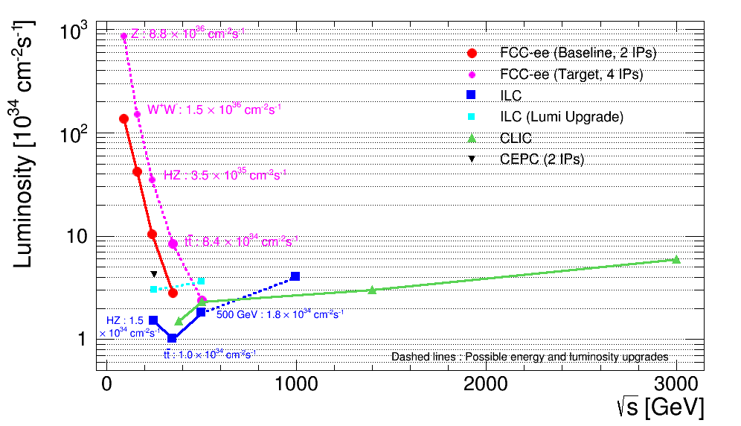
The goal is to achieve
that one
We know that this one can be done -- and its great!

Slide 5
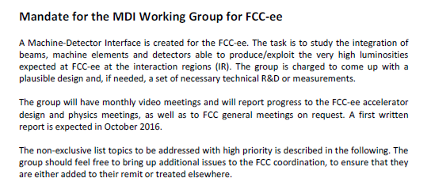
Comments and updates to the mandate are welcome as needed.
Today is a good time to
-- Get accointed to the issues, collect questions
-- Discuss what to do, possibly where to start, and how to achieve the goals.

Slide 6
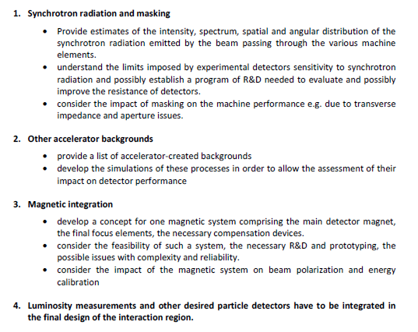

Slide 7
Everyone has agreed.

