Slide 1
Cosine-theta configurations for
S.C. Dipole:
Magnetic design ver. 5
Vittorio Marinozzi & Massimo Sorbi
on behalf of:
INFN LASA & Genova Team
Giovanni Bellomo, Pasquale Fabbricarore, Stefania Farinon, Vittorio Marinozzi, Massimo Sorbi, Giovanni Volpini
Collaboration video-meeting,
11 March 2016

Slide 2
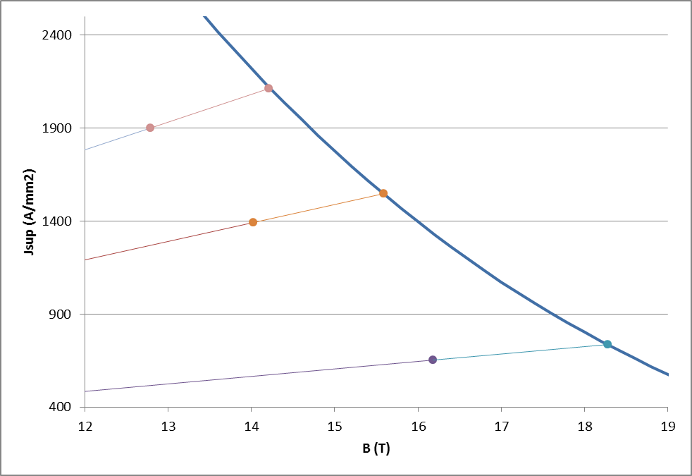
INTRODUCTION
Updated parameters
Main constrains:
Bore inner diameter 50 mm
Bore nominal field 16 T
Operating temperature 4.2 K
Nominal op. point on load line ≤90% (100% is intersection on critical current line)
Strand max diam. 1.1 mm
Max strand N./cable 40
Nominal insul. thick. 0.15 mm
Layer N. per cable type 2 (double pancake)
Yoke out. rad. (single/double apert.) 275/400 mm
Field quality (geo/sat) b3,b5,…< 3/10 unit
Fringing field (out of cryostat?) <0.1 T
Peak temperature (105% op.curr.) 350 K
Inter-layer additional insulation 0.5 mm
Additional constrains:
Cu/S.C. ≥ 1
90%
100%

Slide 3
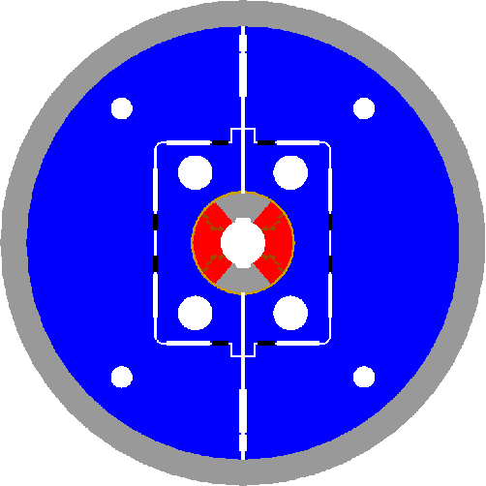
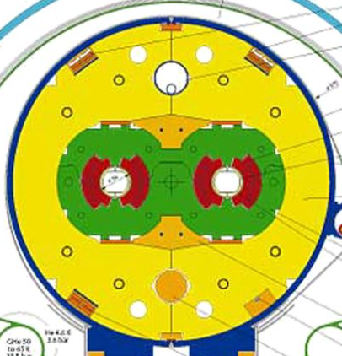
The magnetic configuration depends by mechanical choices.
Now we are passing from classic stainless steel collar to «bladder&keys» with iron yoke close to coils

Slide 4
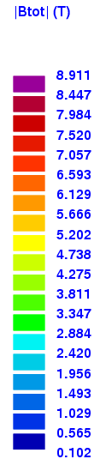
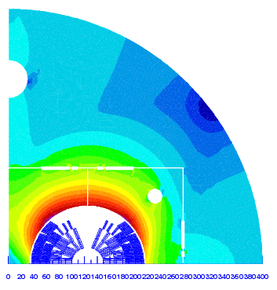
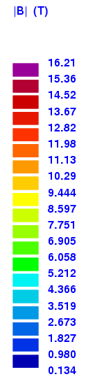
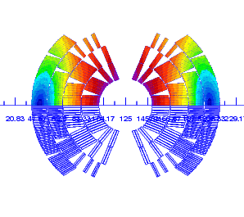
Conf. - 28b-38 ver.5
Typical bladder&key
iron lay-out
2 cable types:
cable1 cable2
N. Strand 28 38
Str. diam. (mm) 1.1 0.7
Cu/non-Cu. 1 2.04
I_{op} = 10275 A
NORMAL RELATIVE MULTIPOLES (1.D-4) @ 16 T:
b 1: 10000.00000 b 2: -19.94001 b 3: -0.01412
b 4: -0.39382 b 5: 0.96882 b 6: -0.00731
b 7: -0.87239 b 8: -0.00016 b 9: 0.27816
b10: 0.00000 b11: 0.66251 b12: 0.00000
b13: -0.12716 b14: 0.00000 b15: 0.03012

Slide 5
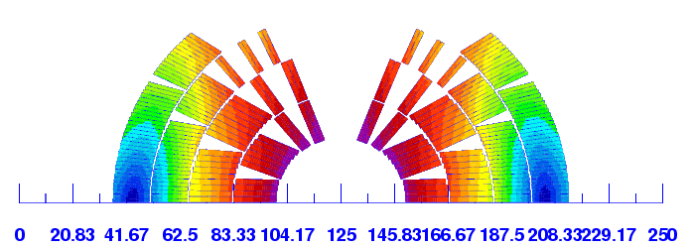
Conf. - 28b-38 ver.5 – (main modifications respect to previous configurations)
Bladder & Key solution
Op.Current 10275 A
Peak field 16.21 T (blc 4) 89.6% load line @ 4.2 K
Peak field 12.49 T (blc 10) 89.6% load line @ 4.2 K
Inter-layers & inter-coils
additional insulation 0.5 mm
One more slitting of block
(to reduce peak field)
Turn n.
Layer 1 14
Layer 2 21
Layer 3 37
Layer 4 43
Total: 230/apert
NI/apert.=2.36 MAt

Slide 6
Quench calculation of old design (conf. 28b-38 ver.3)
0. Nominal case: All blocks quench at 40 ms, 1. ”Realistic” heater delays in the coil turns
Case | Non-quenching blocks | Tmax (K) | Max |V to gnd| (V) | |V turn-to-turn| (V) | |V layer-to-layer| (V)
0 | N/A | 360 | 2200 | 70 | 2200
1 | N/A | 310 | 2200 | 100 | 2100
(from T. Salmi presentation, 19-02-2016)
With the new configuration ver.5, we have Tmax reduction of ~30 K (the current has been reduced of 3.6% ) → Tmax well below 350 K @ 105% I_{op}
If the layer-to-layer and layer-to-ground Max Voltage is confirmed an issue, a different connections of the windings has to be considered (for example cross connection between outer layer upper pole and outer layer lower pole). The work is in progress

Slide 7
About conductor area
Conductor 1:
28 strands
∅ = 1.1 mm
Cu/non-Cu = 1
J_{cu} = 934 A/mm²
Strand Area= 37.3 cm²/apert.
Conductor 2
38 strands
∅ = 0.7 mm
Cu/non-Cu = 2.04
J_{cu} = 1047 A/mm²
Strand Area= 46.8 cm²/apert.
TOTAL: = 84.05 cm²/apert.
In order to reduce cost, conductor 2 can be arranged in a different way:
25 superconducting strands with Cu/non-Cu = 1
13 pure copper strands
With this configuration the TOTAL strand area is (conductor 1 & 2):
68.04 cm²/apert. of S.C. strands (expensive material)
16.01 cm²/apert. of pure-Cu strands (cheaper material)
Additional vantage:
In the pure-Cu strands, high RRR ~ 150-200
Unique production of S.C. strands with same Cu/non-Cu = 1 for both conductors.

Slide 8
28b-38 vers.5
Bladders & Keys
Updated Table (2-D double aperture):
Type | Cable str. N. | Str.diam. (mm) | Cu/S.C. (average) | Rcoil-out. (mm) | Current (kA) | Operating point on load line (%) | Energy (MJ/m) | L (mH/m) | En./cond (J/mm³) | Strand area (cm²) | NI (MAt)
28b-38 Double ap. | 28 38 | 1.1 0.7 | 1 2.04 | 88.7 | 10.275 | 89.6 (lay.1) 89.6 (lay.3) | 2*1.40 | 2*25.6 | 0.17 | 136.1 (SC) 32.0 (Cu) | 2*2.36
Corner bending radius = 6.3 mm

Slide 9
Conclusion
A new configuration applicable to Bladder&Key mechanical solution has been studied.
  Field quality is satisfactory
  The operating point on load line is at 89.6% of short sample limit of I_{c}
  The hot spot temperature is ~330 K @105% I_{op}, with the 40 ms of intervention delay time requested
  A proposal of Rutherford cable with pure-copper strands mixed with s.c. strands would reduce significantly the cross section of s.c. strands, from 168.1 cm² to 136.1 cm² .
  Investigation and analysis of layer-to-layer and layer-to-ground has to be completed

