Slide 1
Quality Control (QC) preparation for the NSW Micromegas anode board production
Fabian Kuger^{1, 2}, for the ATLAS Micromegas group
sponsored by the

Slide 2
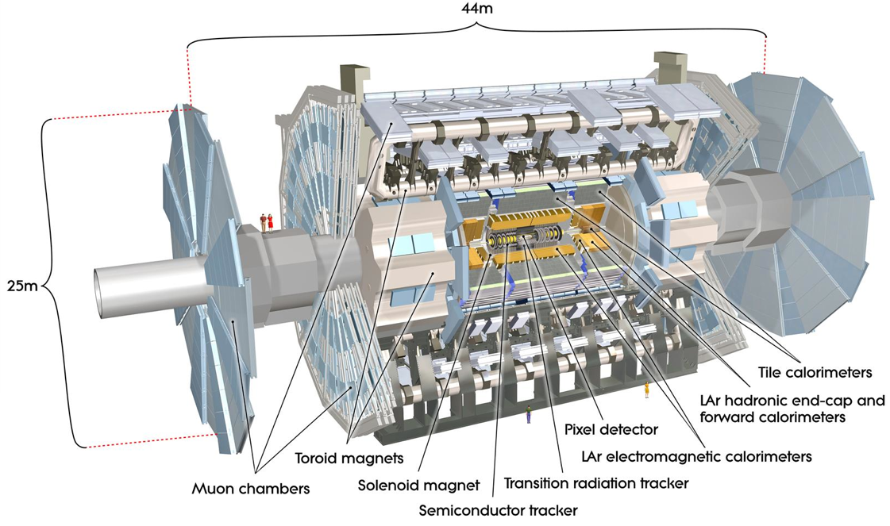
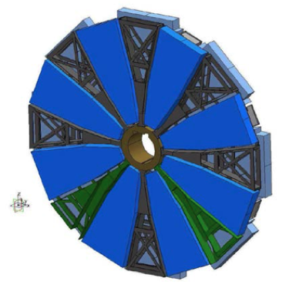
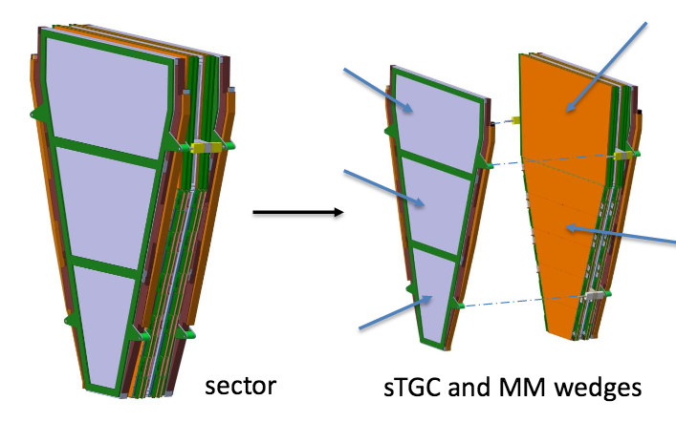
The ATLAS NSW Upgrade
The innermost forward detector wheels of the ATLAS Muon system will undergo an upgrade during LHC Long Shutdown 2 (2019/2020) → New Small Wheels (NSW)
9.3 m
2 x 4 layers (Quadruplets) of Micromegas and sTGC detectors / NSW Sector
The NSWs will comprise an active detector area of 2x1280m², divided in 128 MM Quadruplets of 4 different types and 192 sTGC Quadruplets of 6 different types with more than 2 M channels.
The NSWs shall provide Muon p_{T} measurement with 10% resolution at 1 TeV (offline) and contribute to the improved Level 1 (1mrad accuracy).

Slide 3
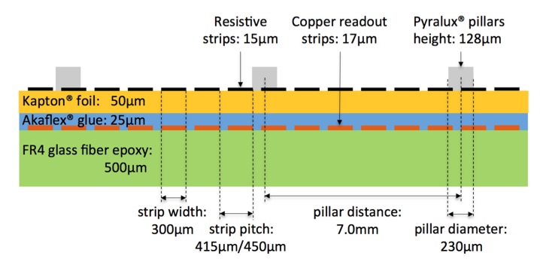
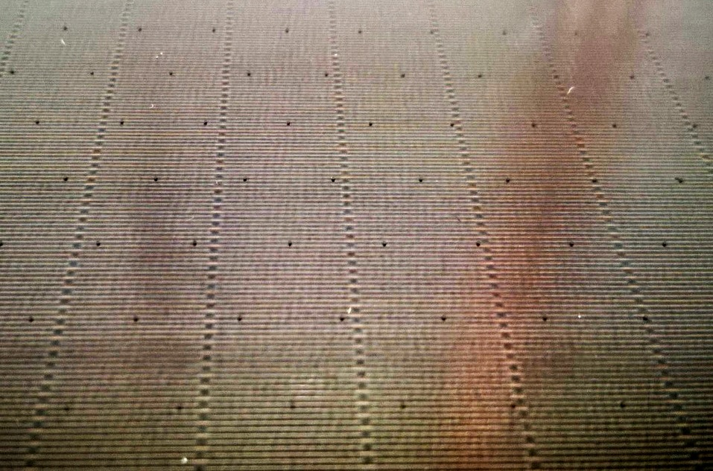
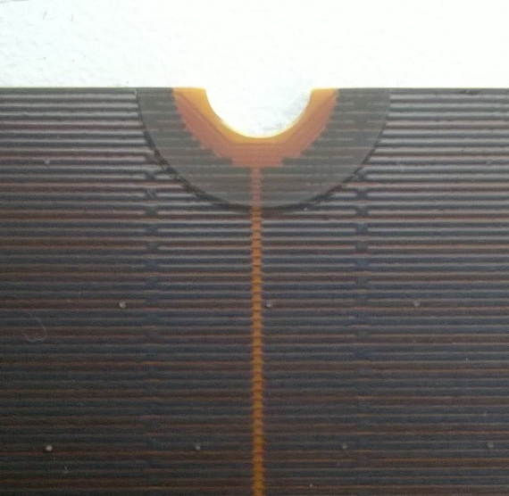
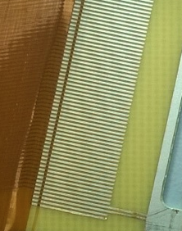
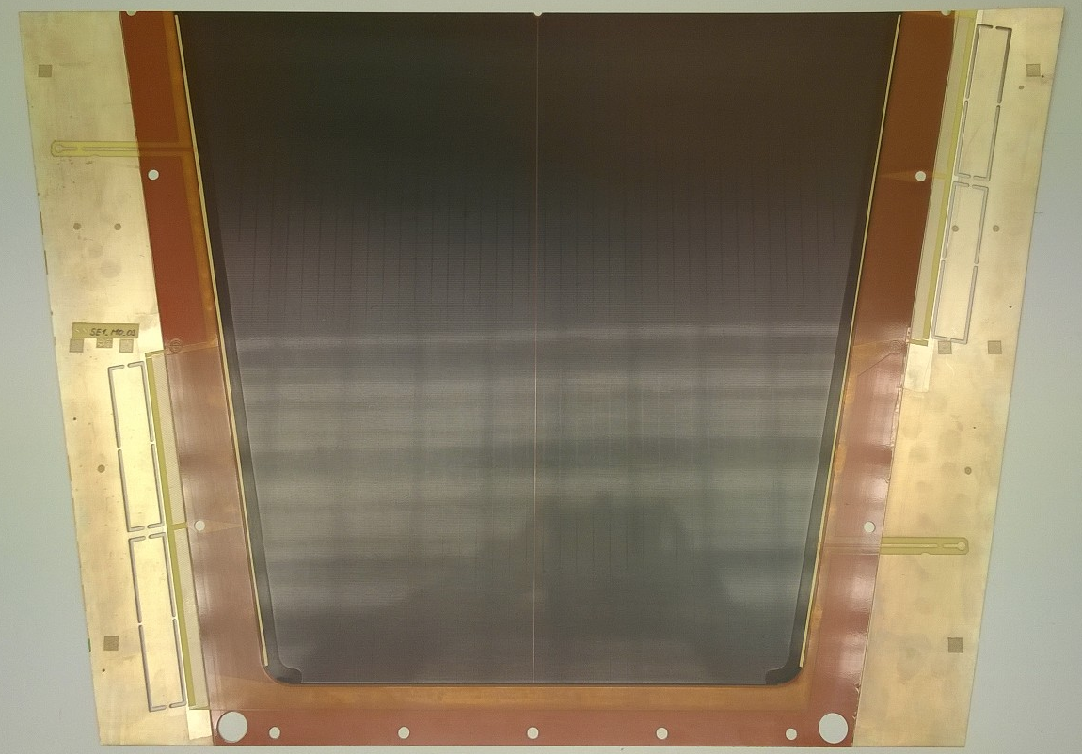
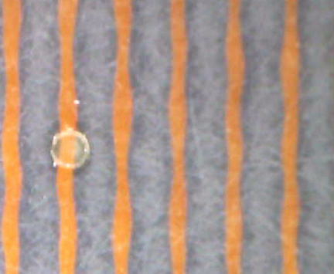
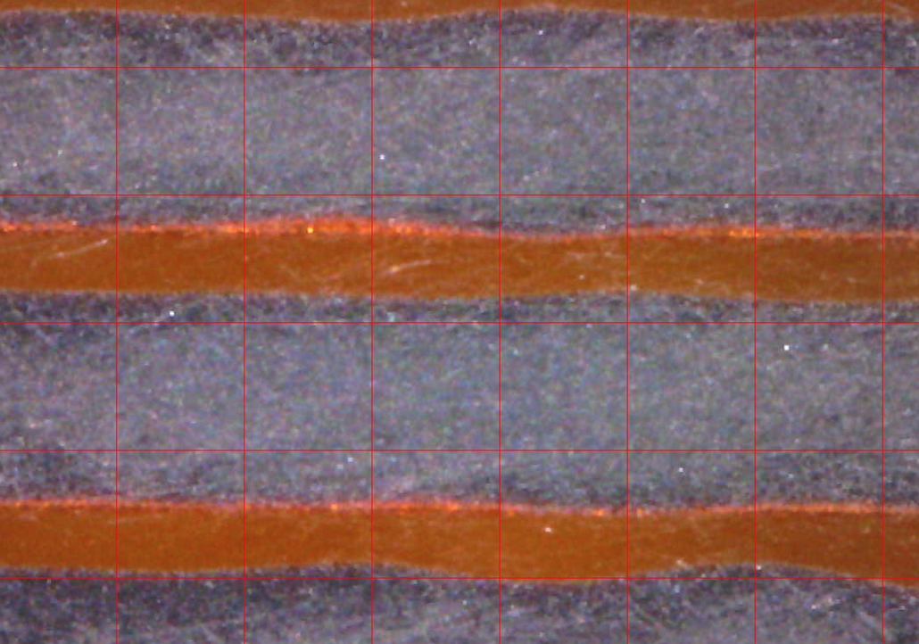
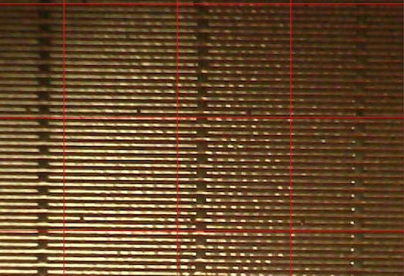
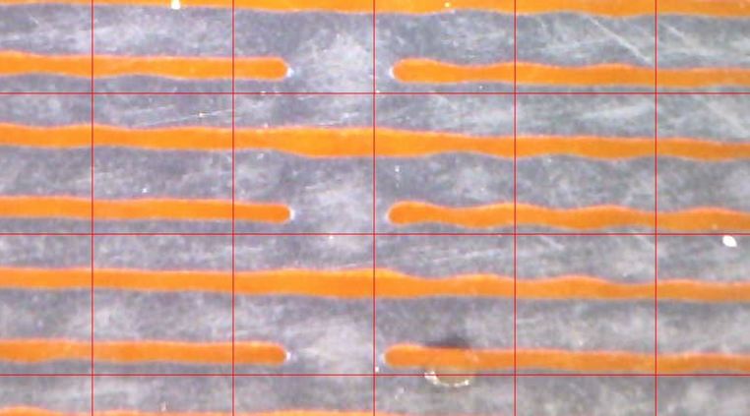
NSW MM anode boards
The readout PCBs are the critical item for the Micromegas construction, which have to be produced in industries
Surface structure of the board, with regular patterns of pillars and interconnections of resistive strips
Centre-top hole for detector assembly. Visible are the routing of the readout strips around the hole and the central separation of the resistive pattern
Pads for elastomeric connector (Zebra)
Zoom of the board surface with a pillar
415/450 μm strip pitch 300 μm width
1022 strips/board
Screen-printed resistive pattern
(~1 MΩ/☐, 415/450 μm pitch 300 μm width, interconnections every 10 mm)
Two HV sectors for each board: resistive
strips interrupted in the middle
Pillars 128 μm height, 280 μm diameter
Strips routed to the left (bottom half) and right (top half) to pads for elastomeric connector (Zebra)
Example of NSW Micromegas anode board (smallest type)
Zoom of the resistive strip interconnections

Slide 4
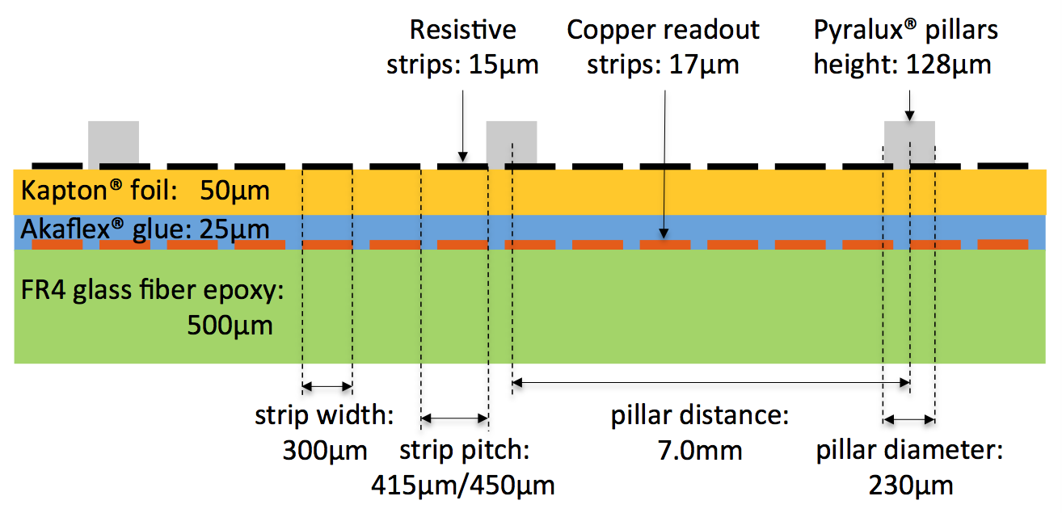
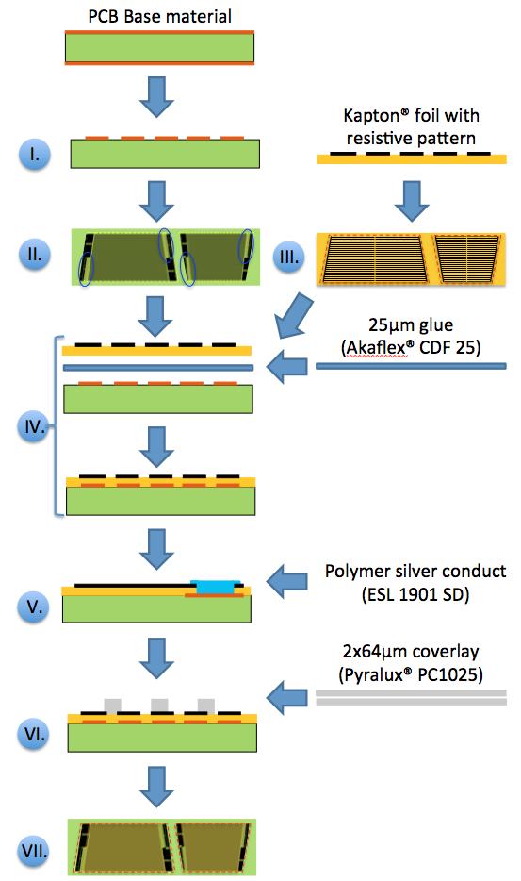
NSW MM anode boards
All production steps are standard in industries, still
  the combination of these steps is rather uncommon,
  the large size (0.6 x 2.2m²) complicates production,
  the stringent quality requirements result in a considerable challenge for PCB producers.
Significant delays for Module-0 PCB order due to production faults / insufficient quality / very low yield.
Lessons learned and actions taken on the PCB production:
Strengthen the In-Industry QC (→ increase yield)
Insist on quality requirements, delivery schedules (Improved situation in pre-series / full production contract)
Follow-up more closely and more regularly at the producers premises. (Module0, Pre-series, full production)
Schematic of the NSW Micromegas anode board layers and dimensions of its main structures (not to scale).
Process chart of the anode board construction:
I. Copper pattern creation; II. Connector pad plating; III. Kapton® foil cutting; IV. Kapton® -PCB gluing; V. Silver conduct application; VI. Pillar pattern creation; VII. Cutting and drilling.

Slide 5
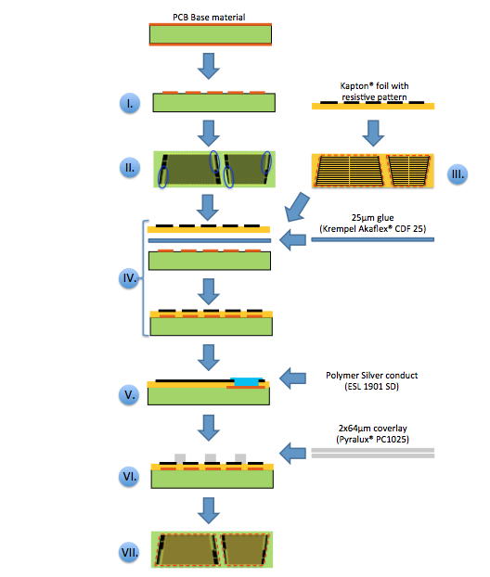
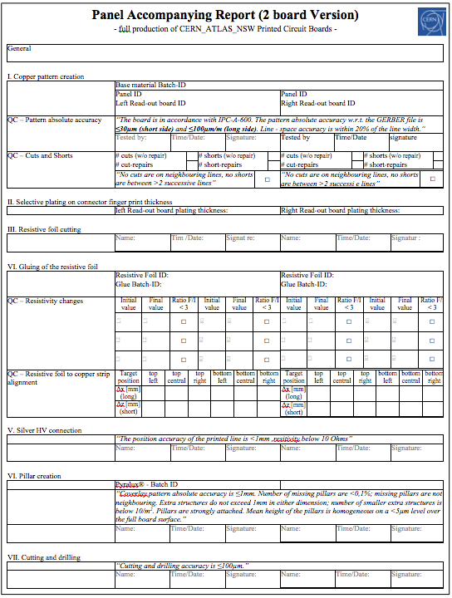
QA/QC scheme for MM anode board production
A multi-step QC scheme is applied prior to, during and after anode board production:
1. PCB Base material QC (CERN)
Thickness QC (Requirement: 500±50µm) on defined sample per batch
In case of any deviation: Extension of the sample.
2. Resistive Layer QC (JAPAN)
Scan & Pattern recognition on each foil to identify pattern blemishes
Resistivity mapping on each foil
3. In-Industry QC (PCB producer)
Suppliers are obliged to fill a QC-report for each PCB, stating results from QC tests on:
#Cuts & #Shorts
Plating Quality & Thickness
Change of Resistivity during gluing
Alignment accuracy
Additionally they will sign compliance statements on:
PCB overall dimensions & Line width accuracy
Positioning & Quality of the Silver conduct line
Quality of the Pillar Pattern
Accuracy of the drilling & cutting
4. Interfering QC (CERN)
Double-Check Dimensions, #Cuts & #Shorts on samples
+ Whichever additional QC we want to do.
5 . Final Acceptance QC (CERN)

Slide 6
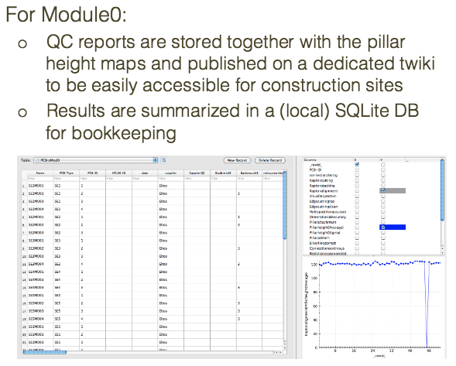
Final Acceptance QC at CERN (Module-0)
The multitude of QC tests for final anode PCB acceptance at CERN can be grouped in:
Visual inspection
Dimension validation
Drilling and Cutting Accuracy tests
Electrical properties and Resistivity
Pillar pattern & - height
Copying results from paper report to DB
Module-0 PCB QC was based on paper forms:
Copy of the report ‘travels’ with the board to ensure information transfer before DB setup
Changes are quickly implemented (6 Iterations)
Systematic search for faults is difficult
Waste of time in copying to DB

Slide 7
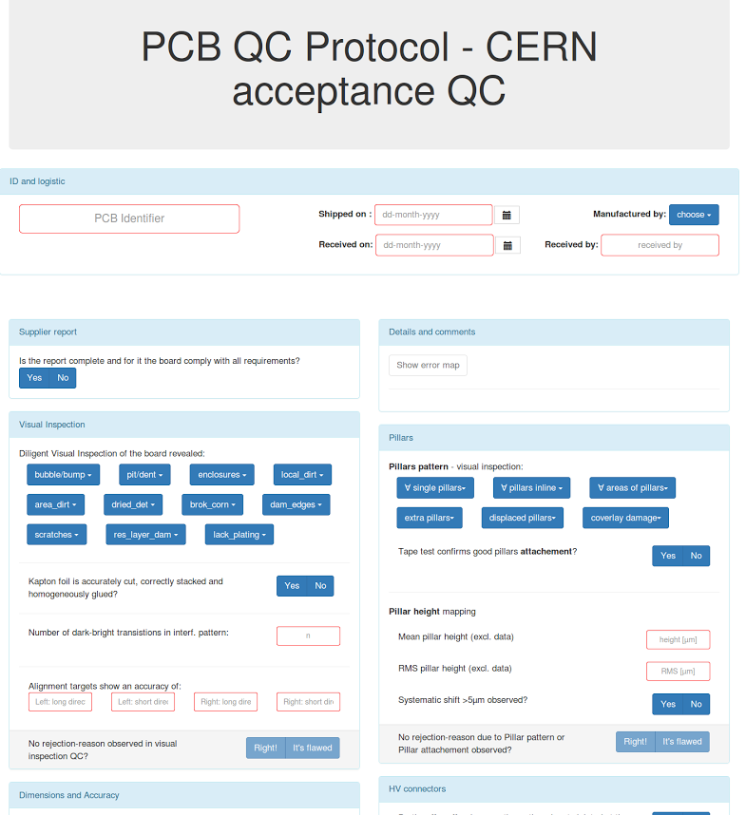
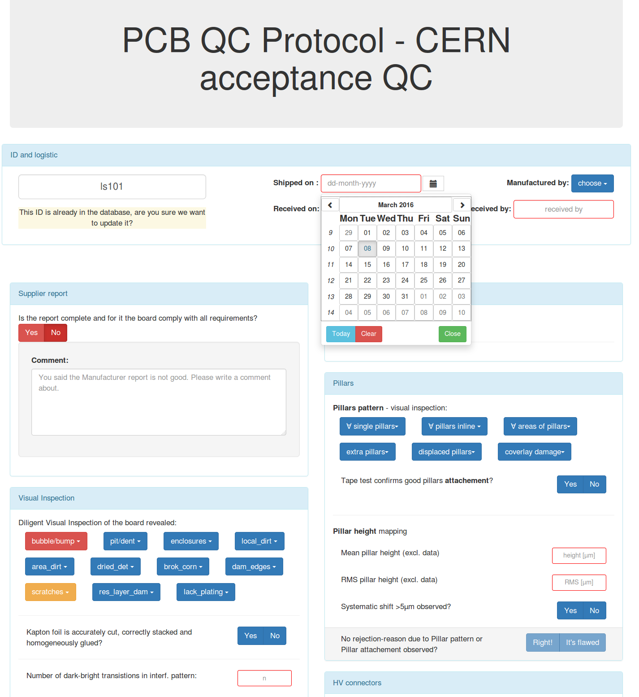
Final Acceptance QC at CERN (NSW production)
The testing structure is maintained (although more elaborated in some details) during NSW production.
Visual inspection
Dimension validation
Drilling and Cutting Accuracy tests
Electrical properties and Resistivity
Pillar pattern & - height
Online report
to be filled
The reports will be filled digitally with a custom User Interface, providing a direct link to measurement software (speeding up QC) and to the DataBase (proper storing).

Slide 8
Visual inspection

Slide 9
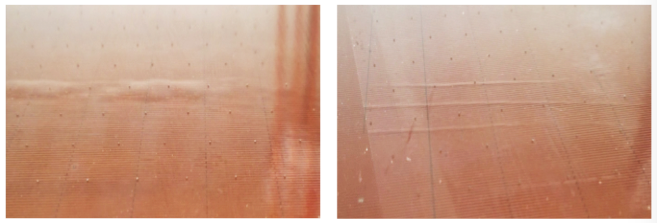
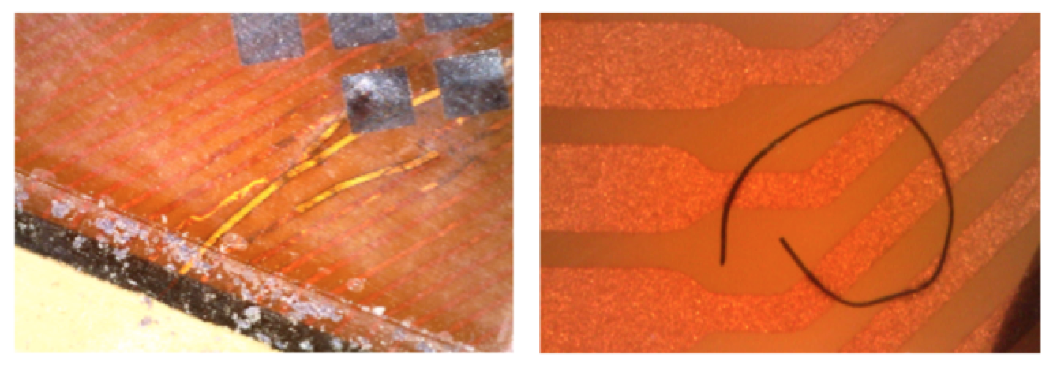
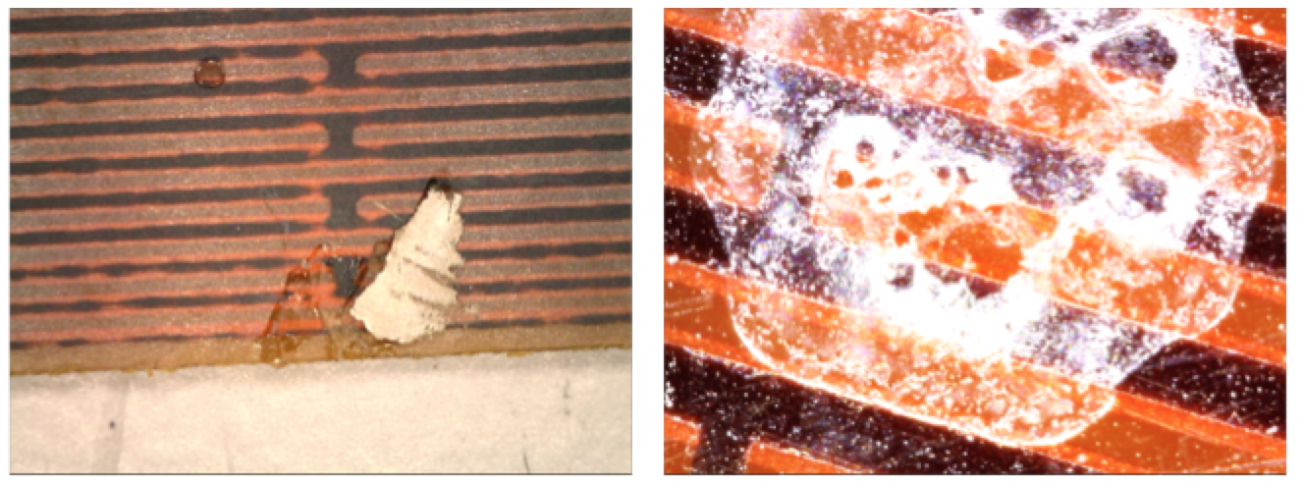
QC – Visual inspection (Module-0)
A large variety of defects has been observed on the Module-0 anode boards.
They are rated case-by-case as either:
Minor: if repairable or only localized effect on the detector, if any
Non-conformity acceptance considered
Major: non-repairable and effect on the full detector / plane / larger area
Rejection mandatory
Only a careful visual inspection by a trained operator can reveal all kind of occurring imperfections.
Localization and classification (if possible) is mandatory.
Bubbles on the resistive surface, caused by air enclosures between the PCB and the Kapton foil (left) and a series of folds in the foil.
Strip repairs causing a bump in the active area (middle) and fiber enclosed in the glue between PCB and Kapton (right).
Two examples of contaminations: A piece/drop of metalized glue or silver printing paste (left), detergent remnants (right).

Slide 10
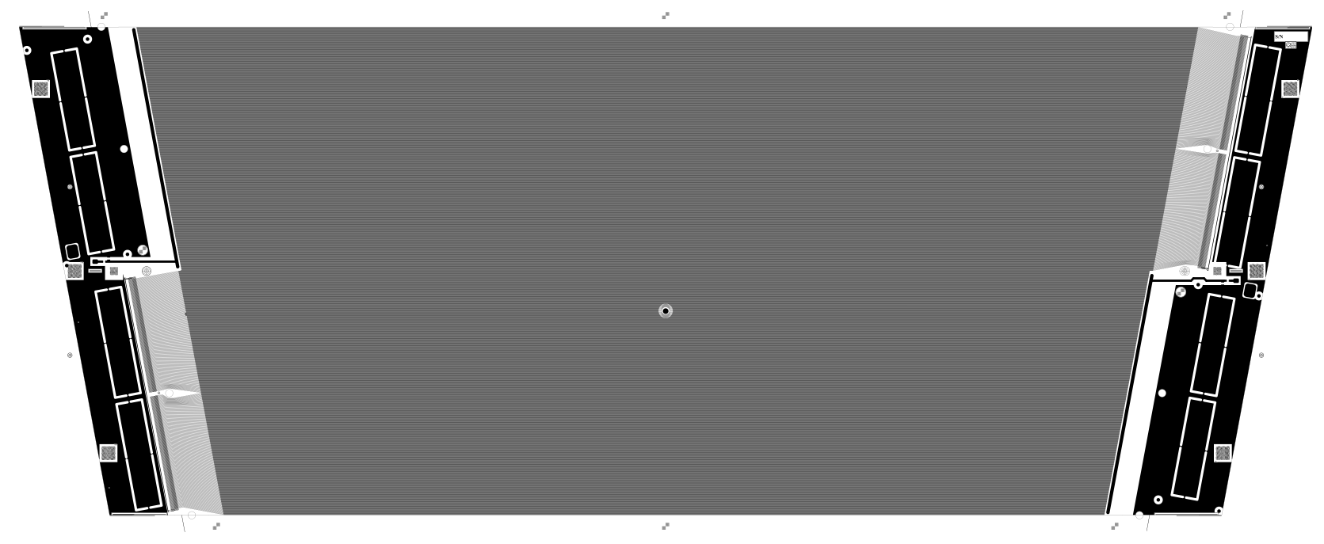
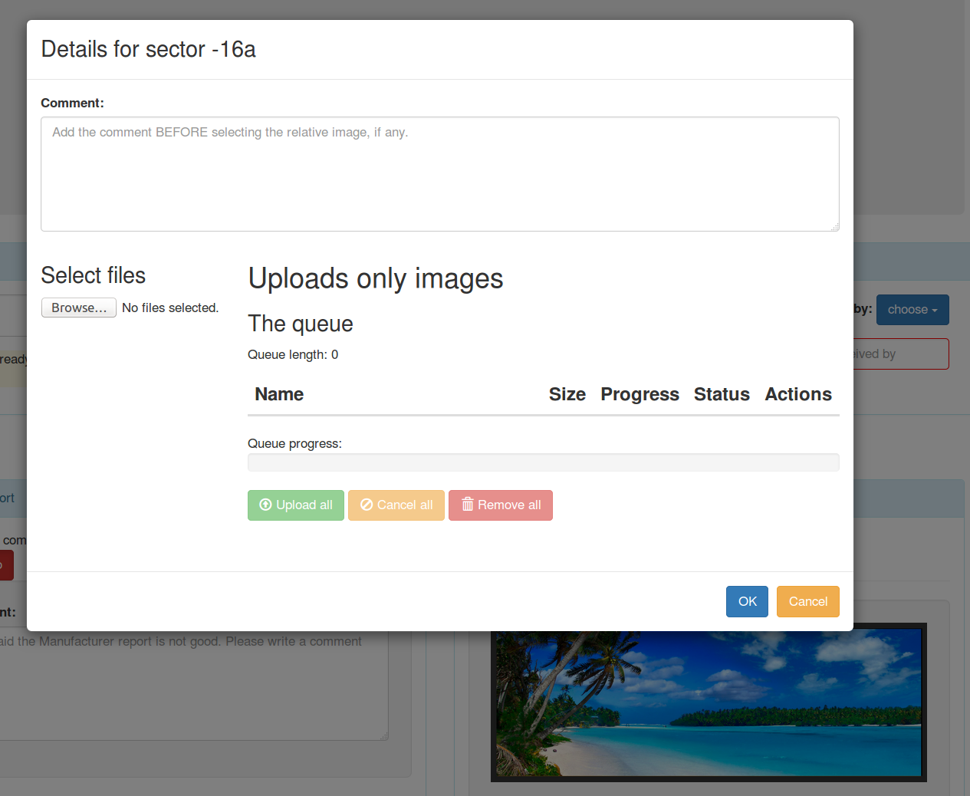
QC – Visual inspection (NSW production)
Visual inspection remains a key QC, although a lower number of ‘new’ defects is expected.
(valuable experience from Module-0 in classification of blemishes and test on repair possibilities)
Localization is done with a coarse ≈10x10 cm² ‘coordinate system’, referring to the center of each board.
Classification is supported by choices of known / observed blemishes
For in-classifiable cases (microscope) pictures can be added
 | -6 | -5 | -4 | -3 | -2 | -1 | 1 | 2 | 3 | 4 | 5 | 6
A
B
C
D
Simplified ‘square-coordinate system’ for localization of defects on NSW MM anode boards
C4

Slide 11
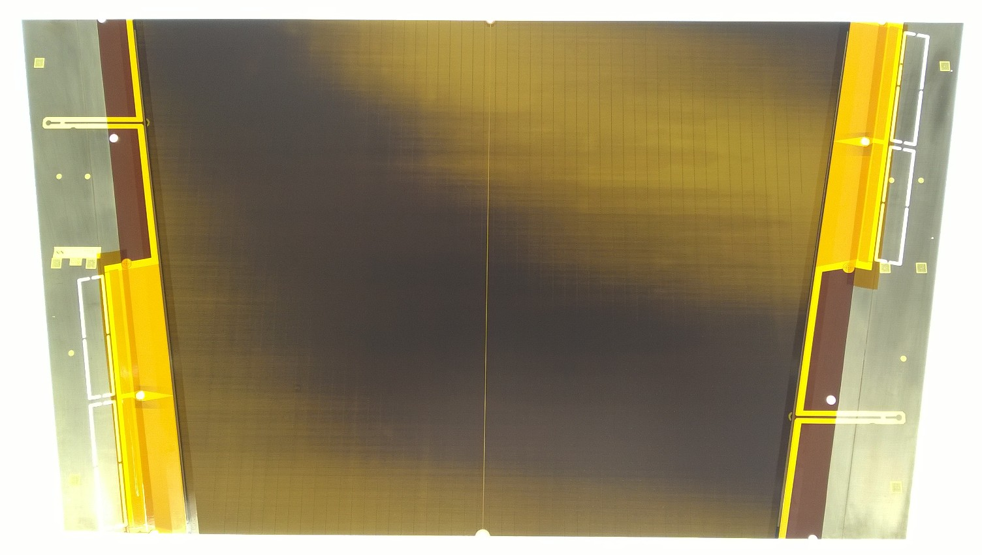
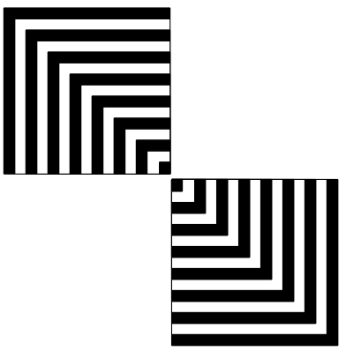
QC – Visual inspection (NSW production)
The Alignment between resistive pattern and readout strips can be checked:
Very quick by looking at the interference pattern on a light table
Measured visually by using Alignment Markers on the foil and board
Module0: 2x3 for use in company
copper pattern on FR4
Backside Illuminated PCB showing the interference pattern between resistive layer and readout strips, corresponding to a ≈600µm left-right misalignment.
New: +2 targets for CERN QC
resistive pattern on
Kapton® foil
3 mm
In this example:
∆x = +1.0mm
∆y= +0.4mm
3 mm
Alignment of copper- to resistive pattern is directly measureable counting 200µm wide lines / spaces.

Slide 12
Dimension validation

Slide 13
QC – Dimension (global)
Inaccuracy / deformations in the cu pattern are critical blemishes of the boards. Although measurement during production (AOI) are required we need a method to cross-check these results.
Only ‘global’ pattern deformations are likely, not local displacements
Linear shrink or elongation in
long direction (<100µm/m)
Linear shrink or elongation in
Short direction (<100µm/m)
‘banana-shape’ deformation
→ Non linearity of the strips
Testing the three parameters: x-elongation, y-elongation and strip linearity (on with sufficient high granularity) could identify all modes of global deformation

Slide 14
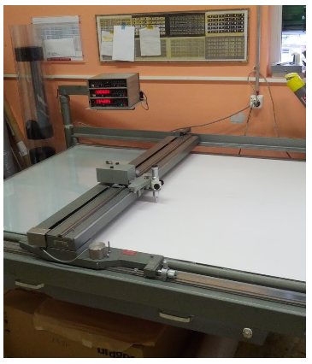
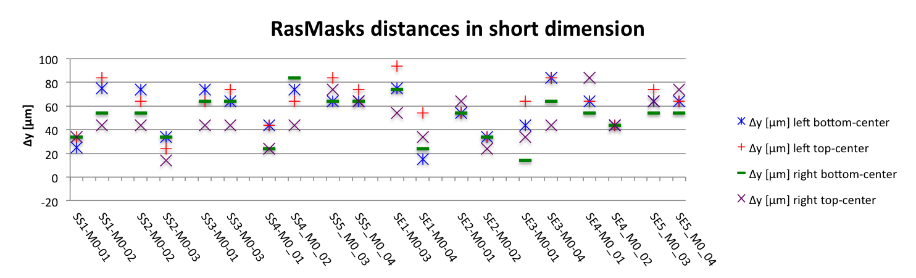
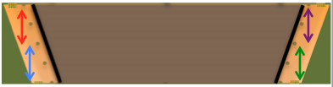
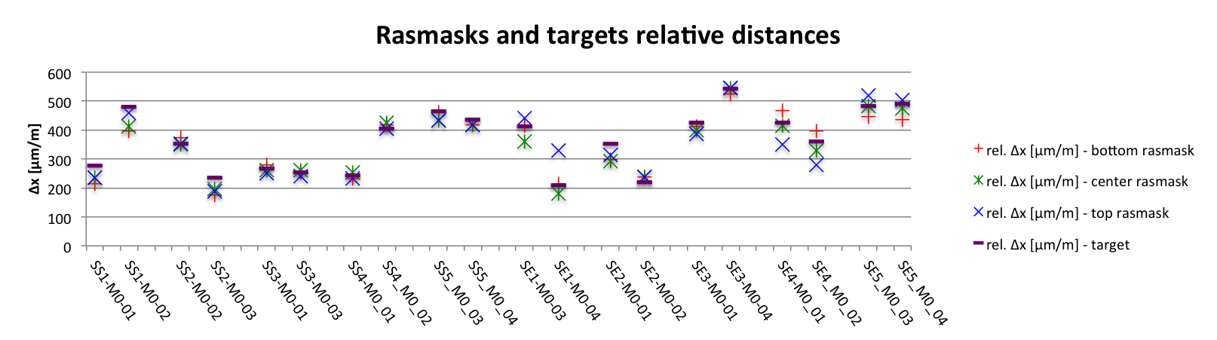
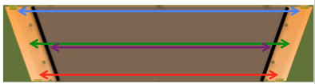
QC – Dimension (global) (Module-0)
During Module-0 PCB QC dimensions have been measured using a microscope table (1,80 x 1,20) with an accuracy of ±20μm.
Very time consuming (≈ 30min / board)
Repeatability of measurements is limited, accordingly only distances are measured.
± 30μm
±200μm

Slide 15
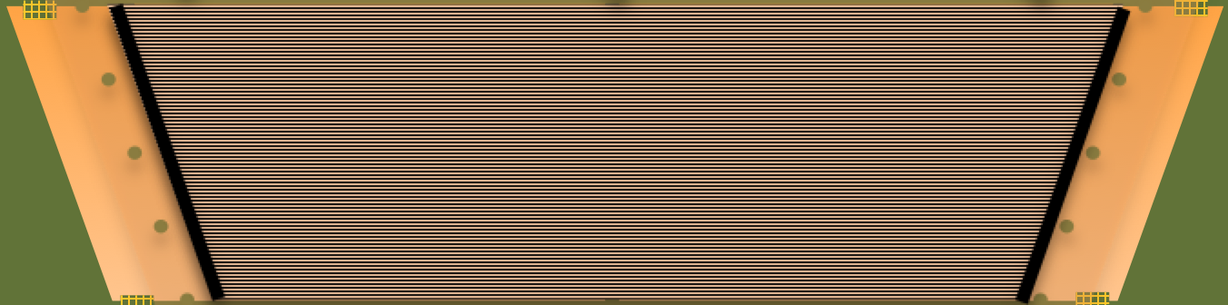
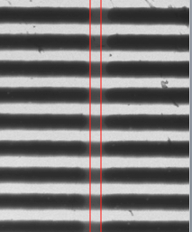
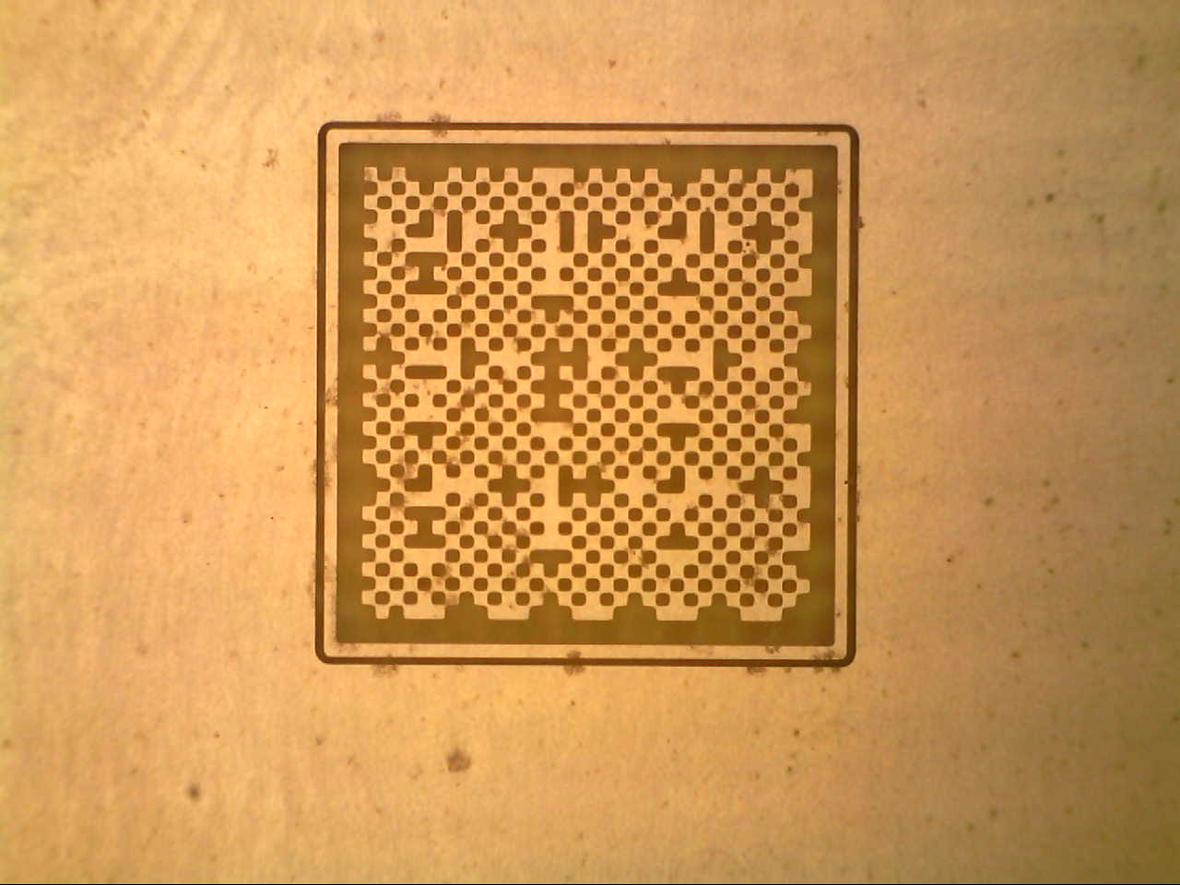
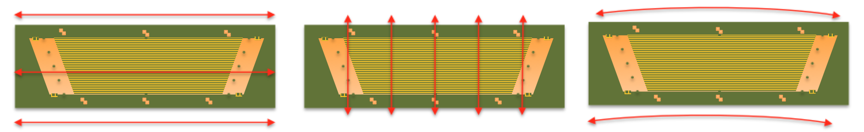
QC – Dimension (global) (NSW production)
For NSW production the position of Rasnik Masks (3x left, 3x right – both coordinates) + Anode strips in the center (one coordinate only) are measured simultaneously using a precision table with in-build C-CCDs.
In this configuration we have good control over x-elongation, y-elongation and ‘limited’ access to and strip linearity (3 points over up to 2m length)
Tooling and Software development is ongoing, expected time <3min / board.

Slide 16
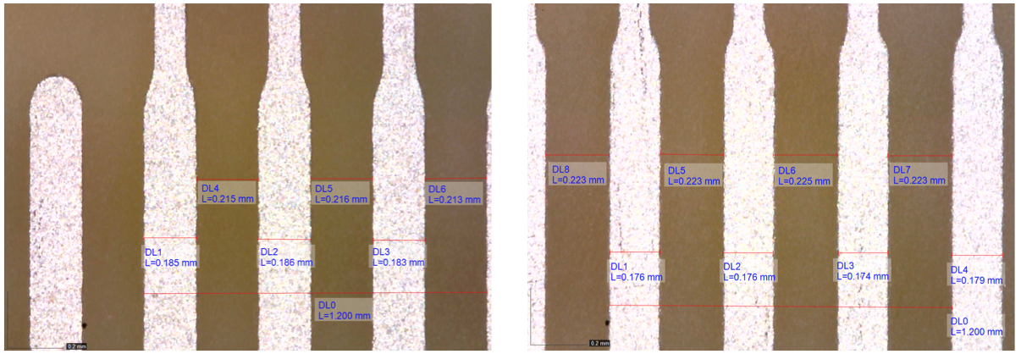
QC – Dimension (local) (NSW production)
Additionally the local strip / gap width accuracy has to be checked.
(e.g. on the Zebra-Connector Pads an accuracy of ±20µm is required.)
Systematic width deviation of 15µm → acceptable
Width of by 24µm
→ Not within specification
Module-0: Measurements with a calibrated Microscope and manual image evaluation has been performed (2-3min / picture → >5min / board)
NSW production: Pattern recognition for automatized measurements (c-CCD)
(<1min per point → 1-2min / board)

Slide 17
Drilling and Cutting Accuracy

Slide 18
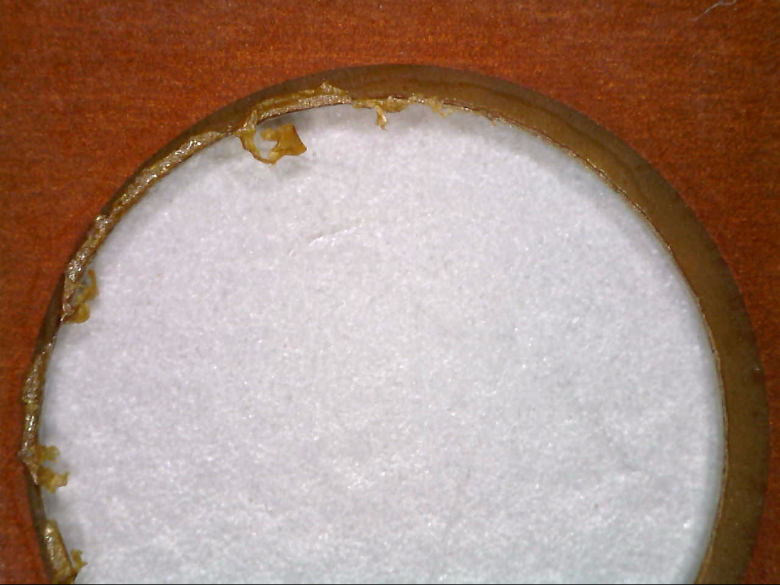
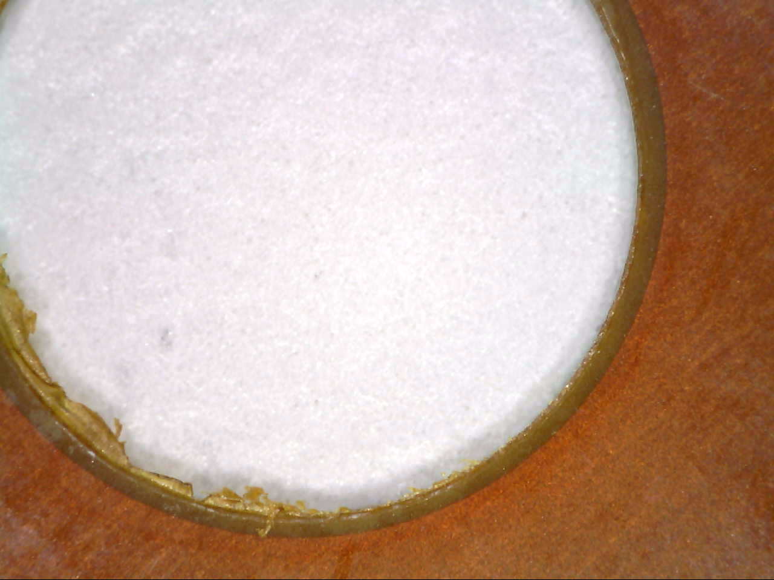
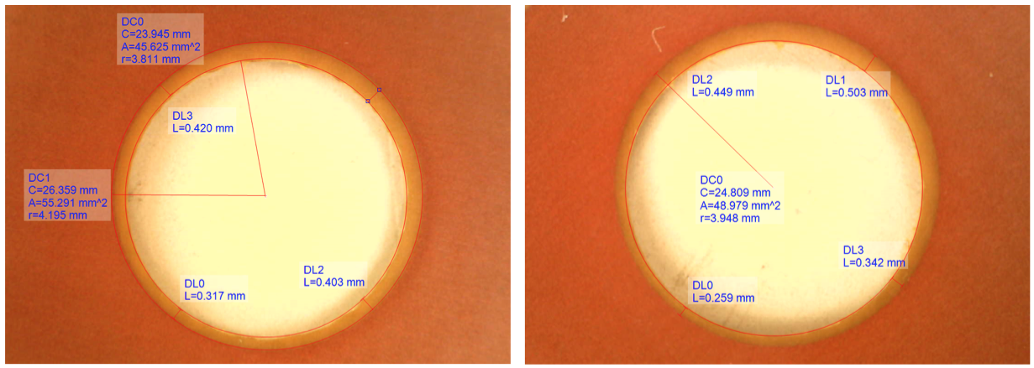
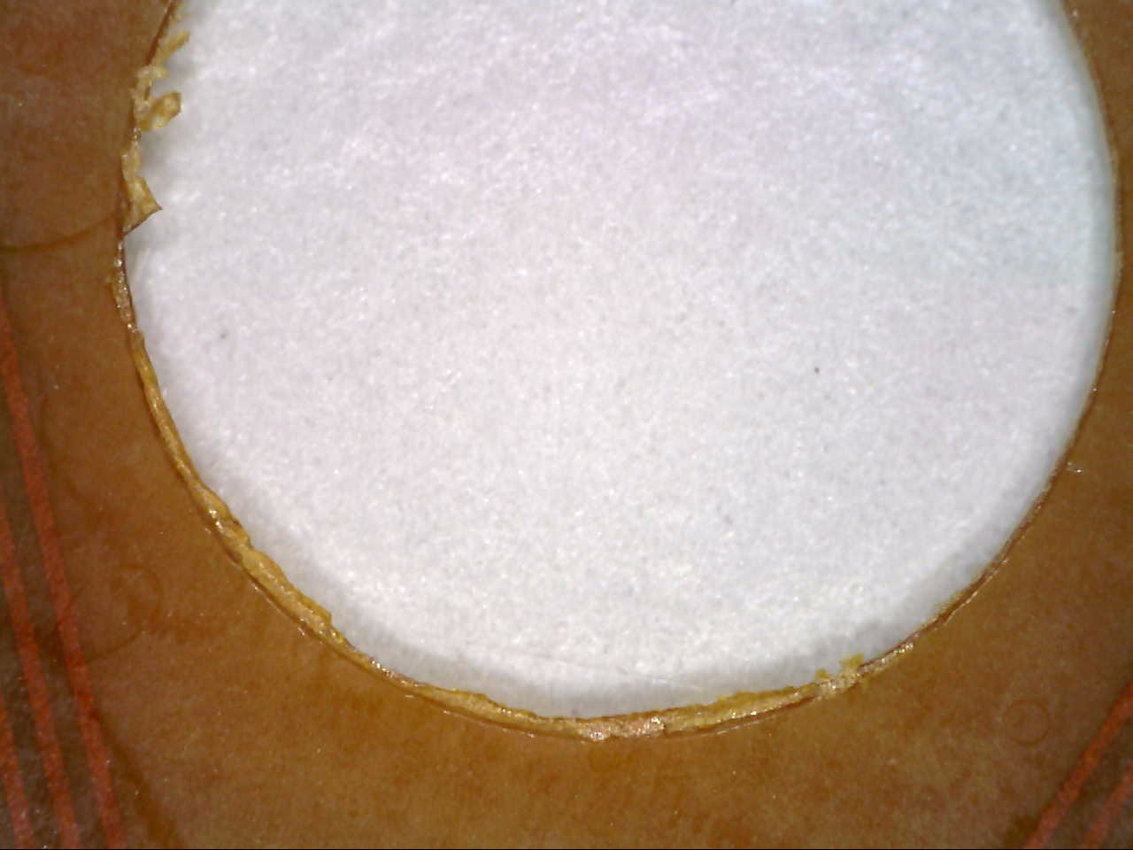
QC – Drilling accuracy (Module-0)
The position of the (no-precise / mechanical) holes in the PCB is required to be accurate to ±100µm.
Judging this visually is difficult, especially in regions where no concentric Cu-pattern is around.
Measurements with a calibrated microscope are time consuming >1min / hole.
Example measurements of the hole accuracy: The distance between copper pattern hole and drilled hole varies between 300-420µm (left) resp. 250-510 µm (right), equivalent to a ≈ 60 µm (accepted) resp. 130 µm (non-conform) displacement of the hole centers.
Examples of inaccurately drilled holes on Module-0 PCBs.

Slide 19


QC – Drilling accuracy (NSW production)
For NSW production we added an extra ring in the Cu pattern around the nominal hole position allows for quicker visual QC tests:
Before drilling:
The copper ring inner-diameter is 100µm wider than the concentric hole
After drilling:
copper pattern on FR4
The hole is either within the ring,
→ acceptable
∆r = 100 µm
cuting / drilling position
nominal
hole position
… or touching / violating it
→ Not within specification
copper pattern ring
During NSW production all hole positions can be checked visually to be within / out of specifications in less than 1min.

Slide 20
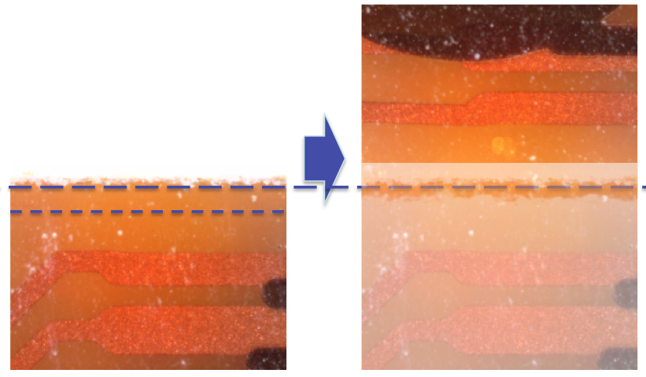
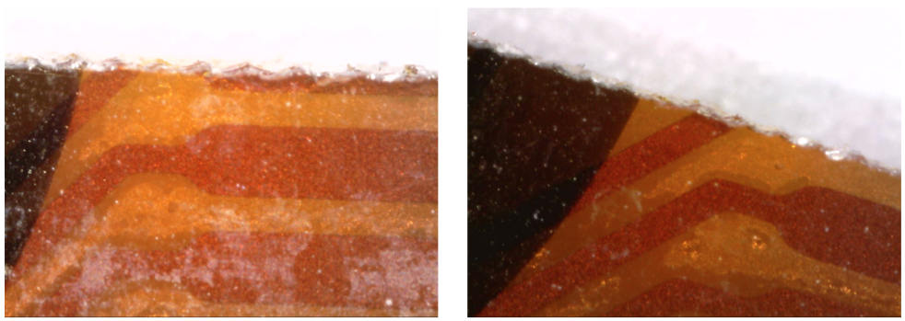
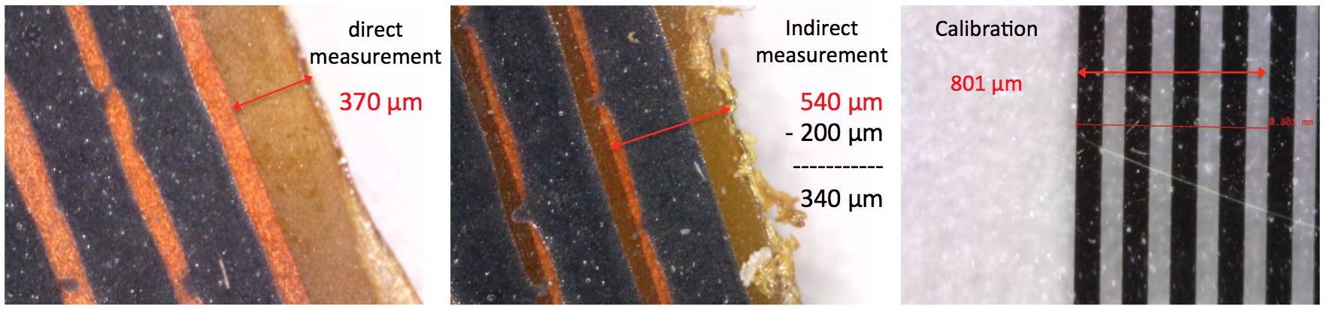
QC – Cutting Accuracy (Module-0)
The distance between the last r/o strip and the PCB edge is required to be 300 ± 100µm.
Cutting Edge too close (left) to the last strip, violating or removing a r/o strip or too far (right) causing interference when joining two boards.
During Module-0 PCB QC the distance between last r/o strip and PCB edge has been measured with a calibrated microscope manual image evaluation has been performed (≈1/2 min / picture → 5 min / board)
Examples for direct (left) and indirect (middle) strip-edge to cutting-edge measurement and a calibration measurement (right). The left picture shows a clean cut while in the middle picture the cut is full of Kapton splinters.

Slide 21
QC – Cutting Accuracy (NSW production)
To speed up this procedure additional QC markers have been added on the Cu-pattern for NSW production.
Before cutting:
The nominal cutting line goes through the center of the pattern
copper pattern on FR4
Line /gap
width 100µm, shift of 50 µm
cutting / drilling position
After cutting:
The cut chops part of the pattern away and the deviation can be counted by counting lines
One line on the right the full gap in the middle are visible, indicating an ≈150µm shifted cut.
The cut position is checked on the sides and the linearity of the cut is tested by pressing against a rectified bar on an illuminated table.
→ A quick acceptance decision can be taken visually within < 1min.

Slide 22
Electrical properties and Resistivity

Slide 23
QC - Resistivity & Electrical properties (Module-0)
QC tests on the electrical properties of the anode boards comprise:
Insulation test between R/O strips and resistive layer (≈4 min)
Conductivity of the HV-distribution line (≈ 2 min)
R-mapping of the resistive layer (point-point or point to HV-distr.) (20-30 min)
Capacitance Measurement between between R/O strips and resistive layer (≈2 min)
Capacitance Measurement between between R/O strips and resistive layer (≈2 min)
Strong correlation to violated / cut strips. Important test for the functionality of the detector
Turned out to be dominated by fluctuations in R.

Slide 24
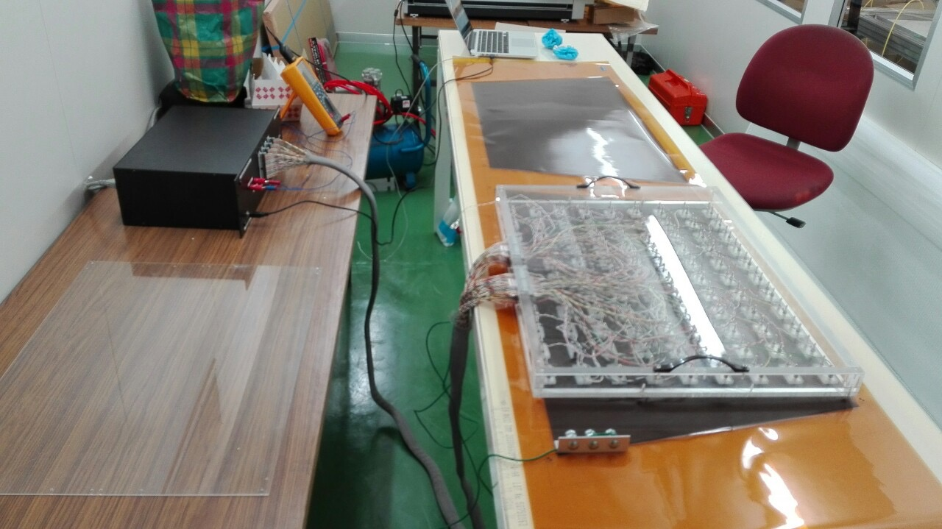
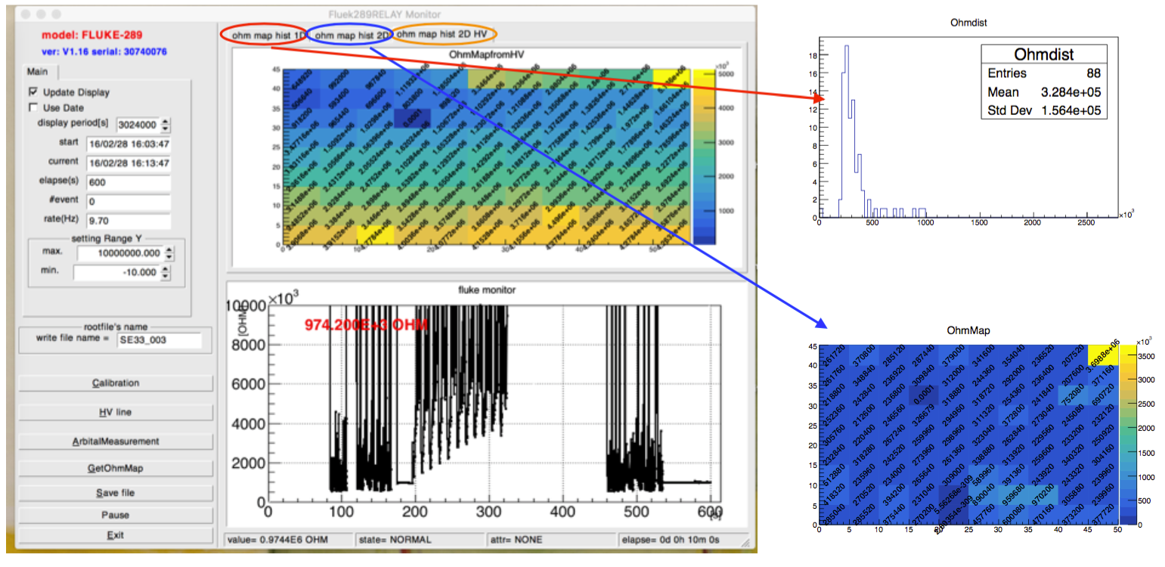
QC - Resistivity & Electrical properties
QC tests on the electrical properties of the anode boards comprise:
Insulation test between R/O strips and resistive layer
Conductivity of the HV-distribution line
R-mapping of the resistive layer (point-point or point to HV-distr.)
Capacitance Measurement between between R/O strips and resistive layer
Combined in one measurement
Fruitful collaboration between Kobe (Japan), Würzburg (Germany) and CERN resulted in a very elaborated R-mapping tool & software.
→ < 5 min / foil or board (both mappings)
Fluke
RelayBox
Acrylic stage
Probe for HV line

Slide 25
Pillar pattern & - height

Slide 26
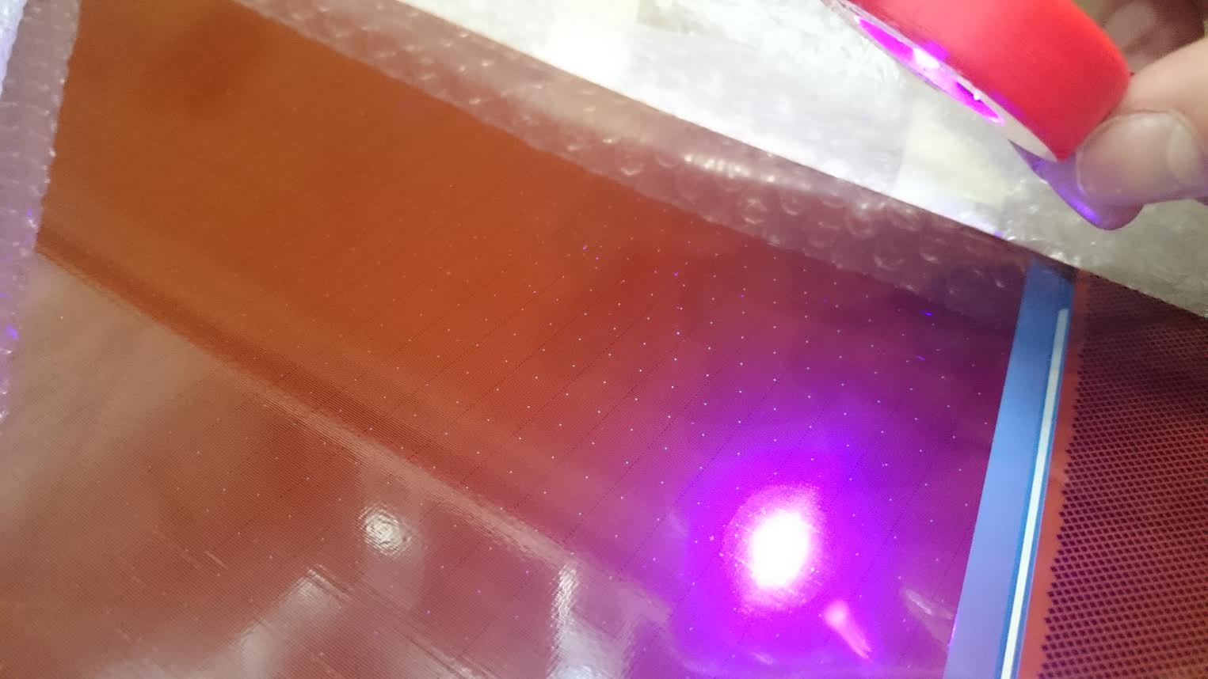
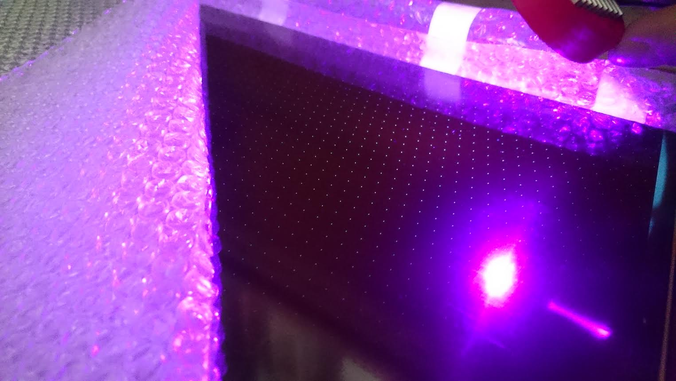
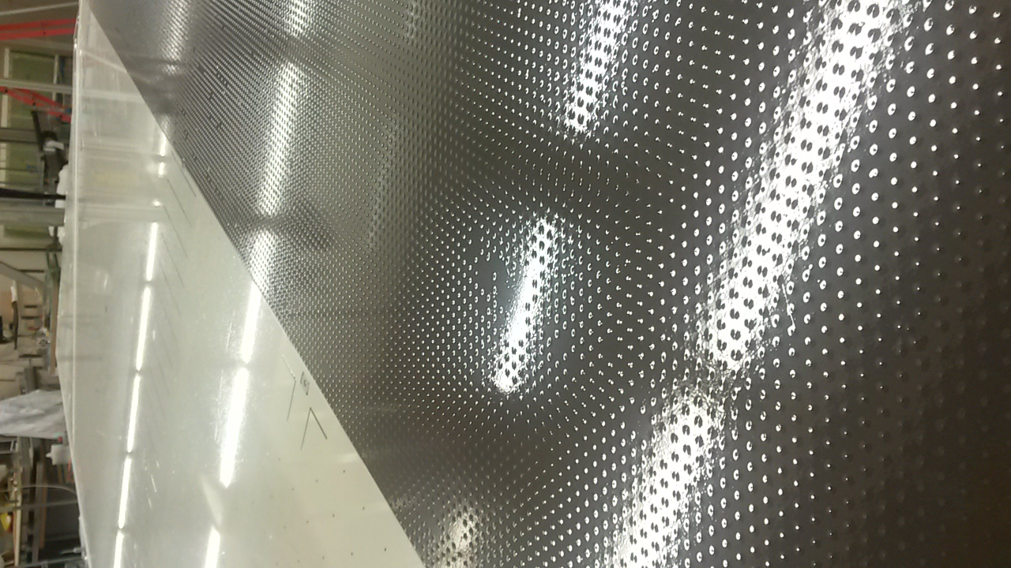
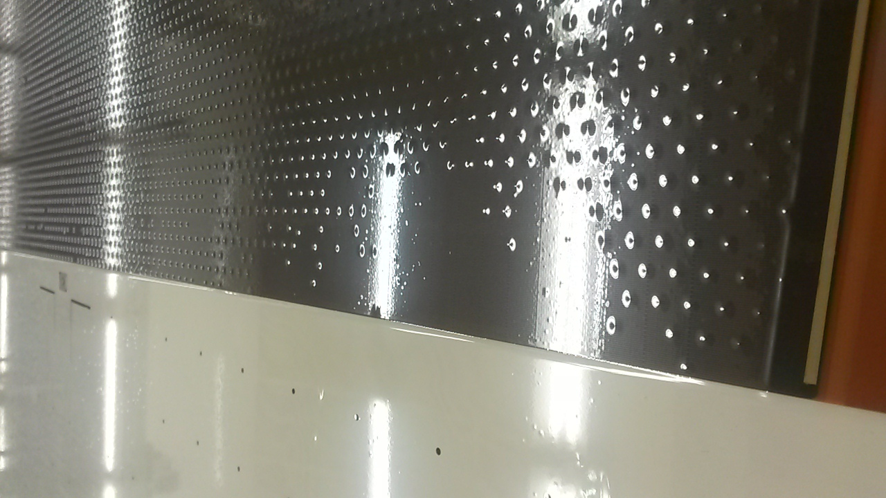
QC – pillar pattern & - height
Missing pillars turned out to be one of the major problems during Module-0 PCB production.
Completeness of the pillar pattern can be best checked visually using light reflection.
The test can be simplified by using UV-light.
(requiring darkness, difficult to achieve homogeneous UV illumination over the full PCB surface)
With normal light, the reflection can be magnified with a foil sucked over the PCB
(vacuum bag / vacuum table)
Pillar visibility under UV illumination.
Enhanced visibility of the pillar pattern under a vacuum sucked Mylar foil.

Slide 27
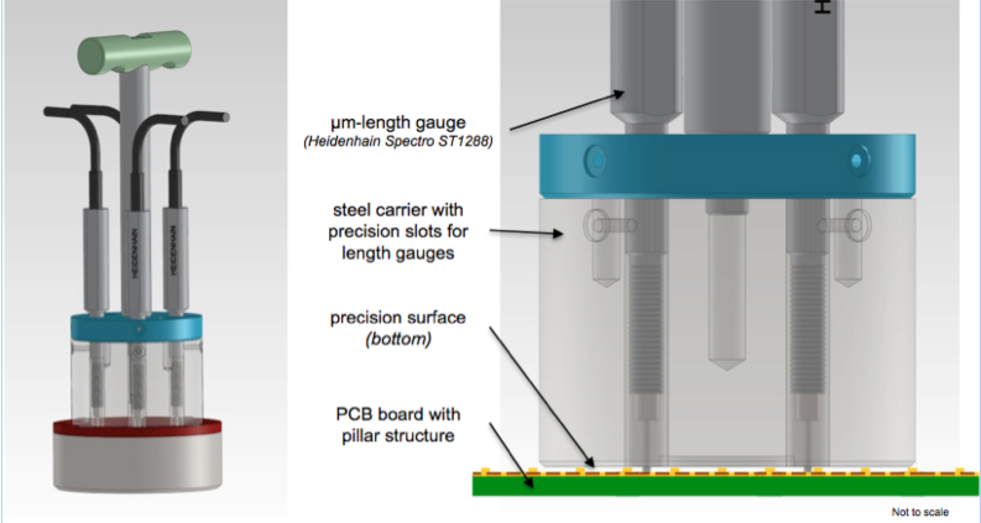

QC – pillar pattern & - height
The height of the pillars defined the Micromegas amplification gap and accordingly the gas gain of the chamber.
Few µm variation can have a large impact on the response-homogeneity / efficiency.
The mean pillar height is mapped over the full surface of each board:
Module-0: 3-6min (measurements)
+ 3-4min (data processing)
per board
NSW production:
Direct interface between analysis program
and measurement tool speeds up the
Measurement significantly. (<5min / board)

Slide 28
Summary – Anode PCB QA/QC at CERN
Module-0 experience has proven very valuable in terms of QC optimization
  Measurement ideas have been tested (HV insulation, C-measurement…)
  Visual inspection has become more systematic and ‘more objective’
  Methods have been optimized (R-measurements, pillar height…)
Introduction of QC-Markers in the PCB design facilitates QC significantly
All QC methods/ processes are ‘speeded up’
(≈2h / board for Module-0 → 30-40 min / board envisaged during NSW production)
Last tools are currently build and will become available in the next months
Digitalization (+ DB interface) of all processes is ongoing and will be ready before start of NSW mass production.

Slide 29
BACKUP

Slide 30

Backup – NSW MM anode boards production steps
I. Copper pattern creation by photolithography
→ Standard operation for PCB manufacturer except for board size (length; width is standard)
II. Selective plating on connector pads
Standard operation for PCB manufacturer
III. Cutting of Kapton foils with resistive pattern
Non-standard operation but not critical (accuracy ±1 mm)
IV. High pressure Gluing of Kapton foil on the PCB
High pressure gluing is part of PCB manufactures, complexity arises from board size and non-standard material (Kapton with resistive pattern)
V . Connection between HV input line and resistive strips (screen printed: silver conductive paste)
→ Simple operation to be done manually
VI. Pillar creation (2x 64μm Pyralux coverlay)
→ Standard operation with a highly ‘non-standard’ pattern (pillars)
VII. Cutting of the boards and drilling of the non-precision holes (holes for mechanical assembly and alignment)
→ Standard operation on CNC machine

Slide 31

Backup – NSW MM anode board Quality requirements

Slide 32
Concept of readout PCB QA/QC
Conduct QC tests as fine-meshed as possible
  The complexity of the process and lacking experience of large-area PCB production in industries requires multiple QC steps during the different steps of PCB production. This as well avoids unqualified parts to be further processed.
Shifting QC as close to industries as possible
    QC/QA shall be performed in industries and by industries personal whenever possible.
    This requires setups to be exported to industries which are reliable , simple and time efficient to use and provide accurate and repeatable QC results independent of the testing person.
    These requirements lead to largely automatized measurements, minimizing processes involving human handling.
Keeping track of QC tests and results
  Giving QC measurements to industries fortifies the need of proper bookkeeping. A database developed centrally by the NSW collaboration will be used to store all the information and results of each QC steps, including visual inspection of components with passed/not passed results.
Maintaining QC pressure on industries
  Minimizing the risk of negligent performed test in industries, CERN will requiring the possibility
  to re-test individual batches. This requires producing two sets of testing tools and manpower/responsible to keep track of the production and QA/QC. Regular visits to the industry premises are also foreseen to verify the respect of the defined procedures.

