Slide 1
Software performance in CMS
David Lange
May 4, 2016

Slide 2
Motivation: Technical improvements can pay off
CPU time/event and event size determine computing requirement per trigger
CPU
needed
N Events
CPU/Event
Faster
reconstruction
?
More
Physics
Or: less cost to do the same physics

Slide 3
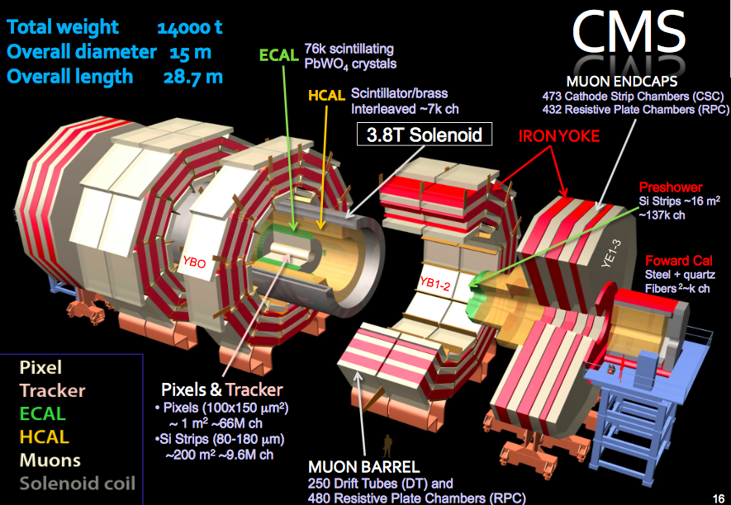
Basic components in CMS (software)
Multithreaded framework
Reconstruction (incl. HLT) is the primary performance target
  Tracking
  Particle flow based object reconstruction
  For the future: high granularity endcap calorimetry

Slide 4
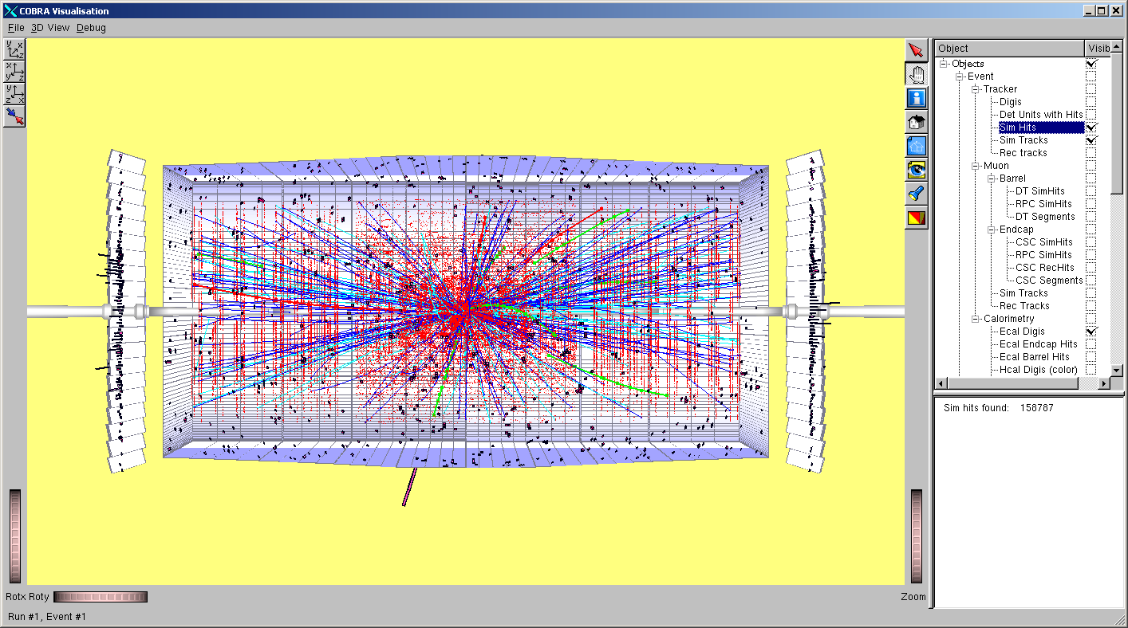
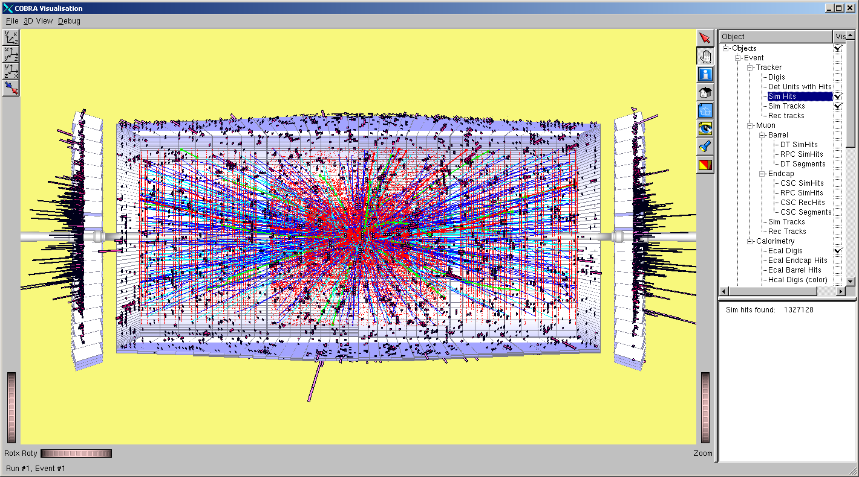
Challenge for LHC: Event complexity and data rates continue to grow
CMS at the start of Phase 2 (HL-LHC):
5x higher output rate of trigger compared to 2016
Significantly more complex events Events
(140+ interactions/crossing)
10³⁴
10³⁵
HL-LHC presents increased challenges for Triggering, Tracking and Calorimetry, in particular for low to medium P_{T} objects

Slide 5
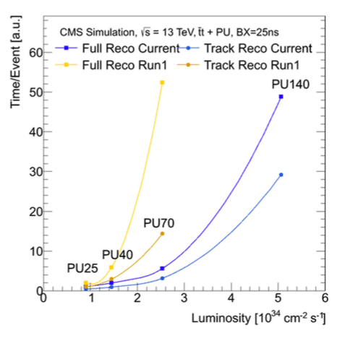
Processing time scales drastically with event complexity
Resources needed by combinatorically driven reconstruction algorithms increase
non-linearly with interactions/crossing
  Dedicated analyses of performance at high pileup resulted in scaling improved in recent years

Slide 6
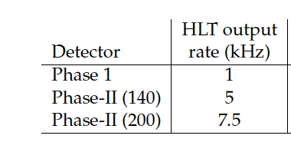
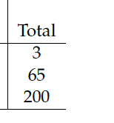
HL-LHC: Size of the processing problem if we continue as we continue with our current model
Factoring in the trigger rate and taking a weighed average of the data and simulation tasks we see the computing challenge is 65-200 times worse than Run2 (2016-like conditions)
Scale of computing
resource needs relative
to Run 2 including the
increase in projected
HLT output rate
Software improvements
are an important piece to close this gap
(More detailed estimates in our 2015 Technical Proposal)
https://cds.cern.ch/record/2020886?ln=en
Notes:
30 seconds for an event – using the same software would translate in 22 minutes

Slide 7
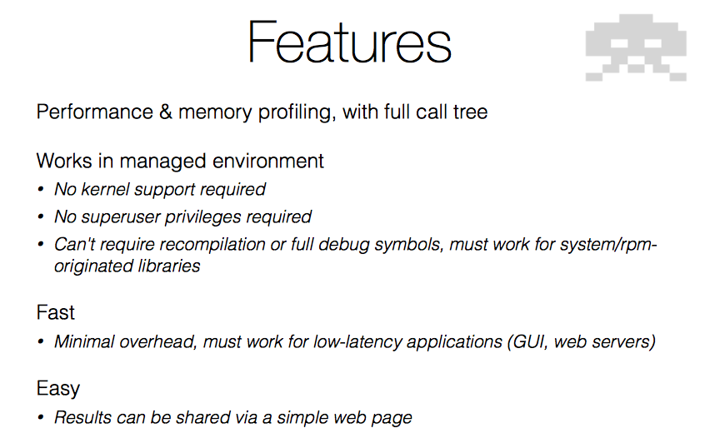
Most relied on optimization tools in CMS: igprof

Slide 8
Recent targets
Large individual targets are gone. Tool like igprof particularly important to identify hot spots for investigation at this stage
Redundant calculations: Remove
Numerical precision: Use whats needed
Math functions: VDT where possible
Push persistency overhead away: Use original objects in algorithms
Take advantage of C++11 constructs
Vectorization: Ensure loops are vectorized by compiler (but we miss automatic methods)

Slide 9
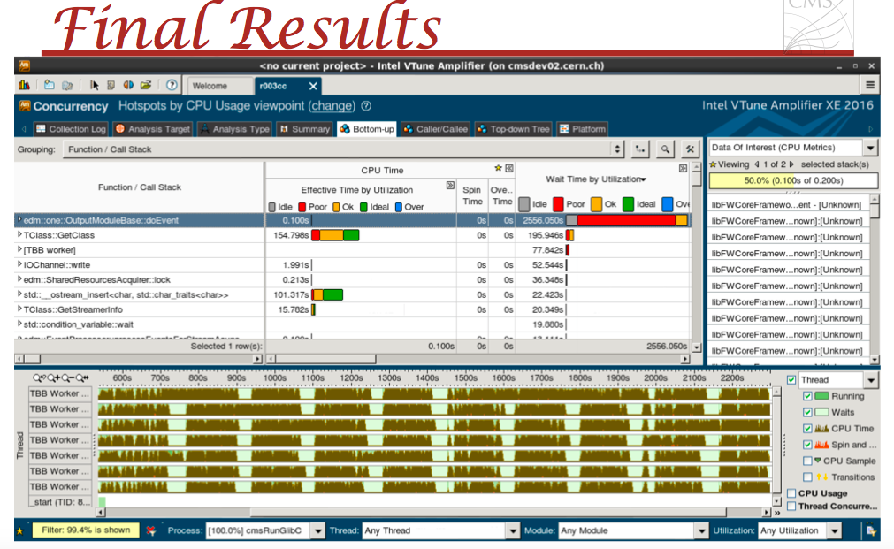
Threading optimization: We use VTune very successfully

Slide 10
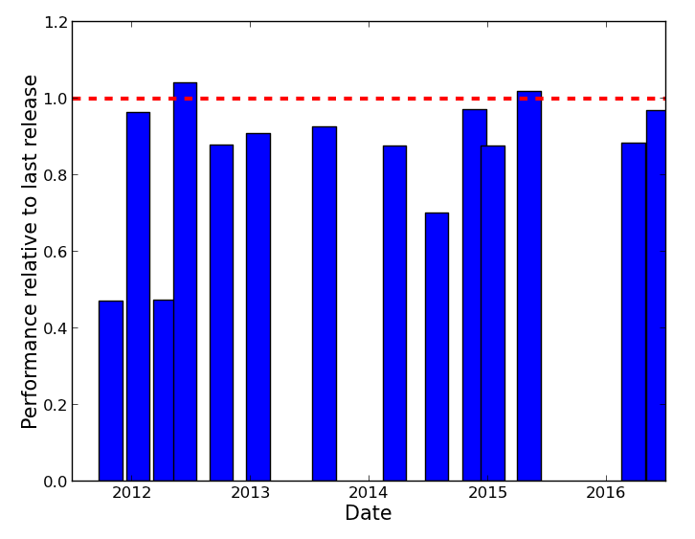
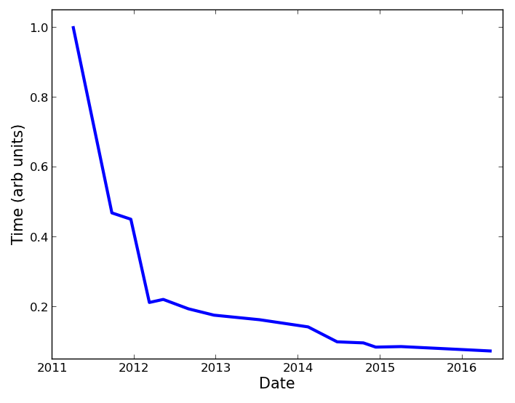
Reconstruction performance against 2015 data
Incremental progress continues through Run 2 while maintaining the physics

Slide 11
Conclusion
  CMS is successful in achieving continued technical performance gains sing a few tools as a guide for investigation
    How far can we push purely technical changes before we need to consider impacting physics?
Future hopes
  Detailed CPU/memory profiling with threading – be ready for a many-core environment
  Add CMS analysis to our list of applications

