Slide 1




Diamond timing detectors for TOTEM and CT-PPS
Mirko Berretti
(R. Linhart, N. Minafra, M. Bozzo, E. Bossini, G. Antchev, V. Georgiev, T. Naaranoja, D. Lucsanyi, J. Baechler, N. Turini, D. Druzkin, I. Atanassov, A. Karev)
LHC Working Group on Forward Physics and Diffraction
CERN, 16/03/2016
Installation in the LHC of TOTEM diamond detectors in the vertical RPs
Diamond detectors for CT-PPS: status and simulation studies

Slide 2
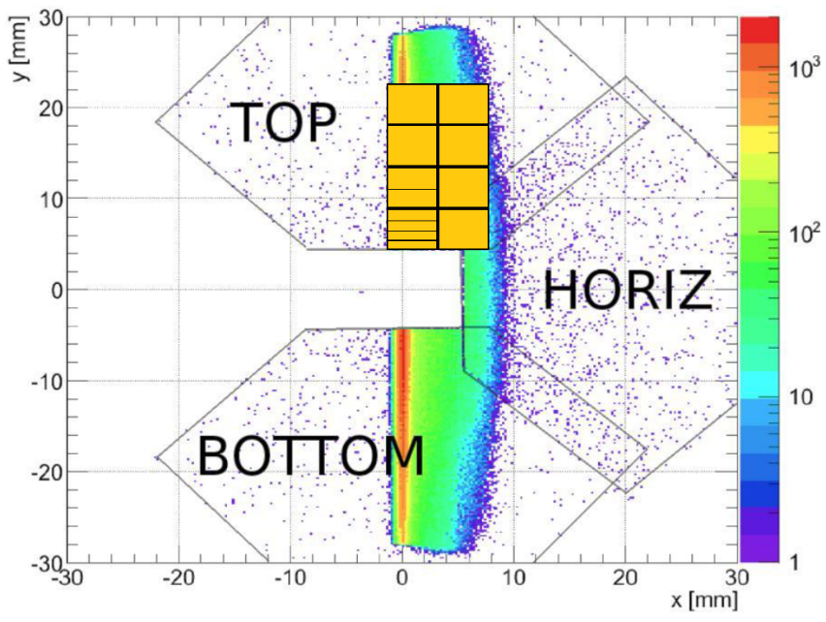
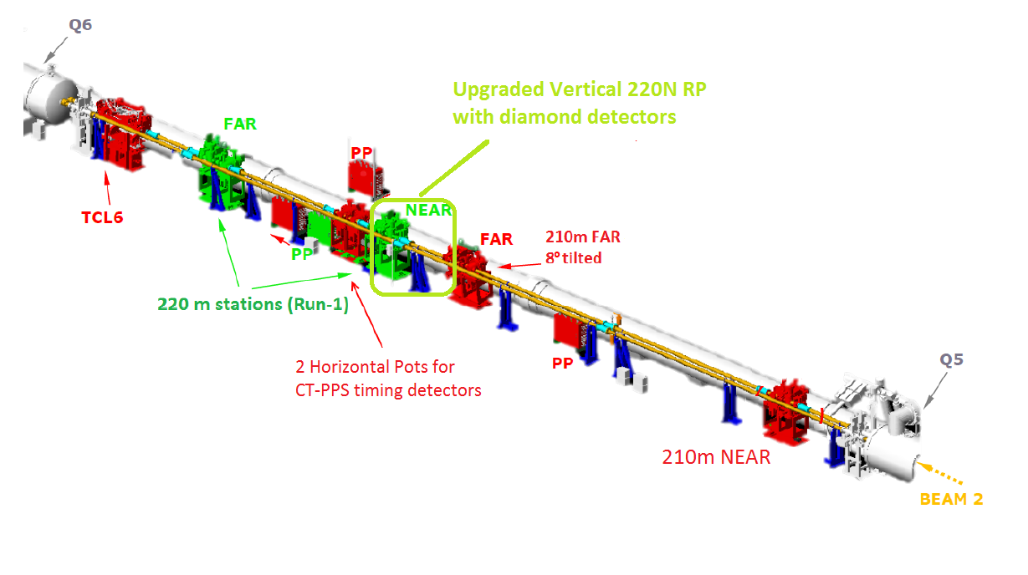
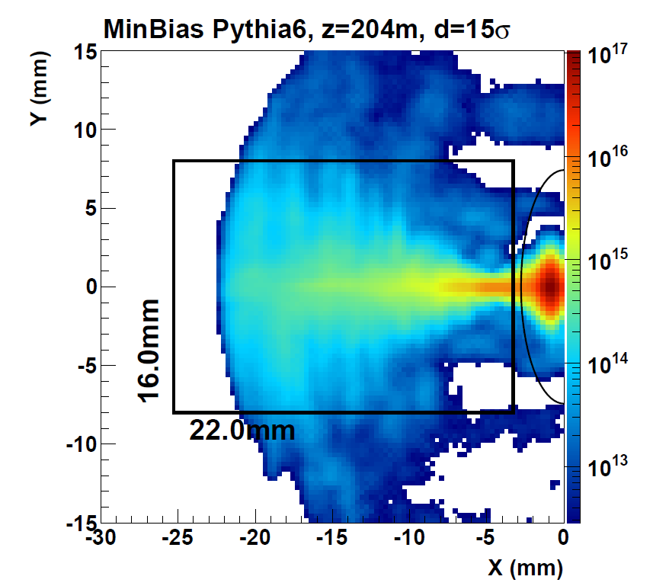
Reminder: diamond detectors for timing in the RPs
The TOTEM / CT-PPS upgrade programme focuses on improving the experiments capability to explore and measure new physics in Central Diffractive (CD) processes: p+p -> p + X + p.
The installation of proton Time-Of-Flight (TOF) detectors in the TOTEM Roman Pots allows to reconstruct the longitudinal vertex position and thus to assign the proton vertex to the proper vertex reconstructed by the CMS tracker, in presence of event pileup.
High β, μ=1, 50 ps/arm, Rate/Pixel: 10 KHz.
Low β, μ= 30, 10-30 ps/arm, Rate/Pixel: 1MHz.

Slide 3
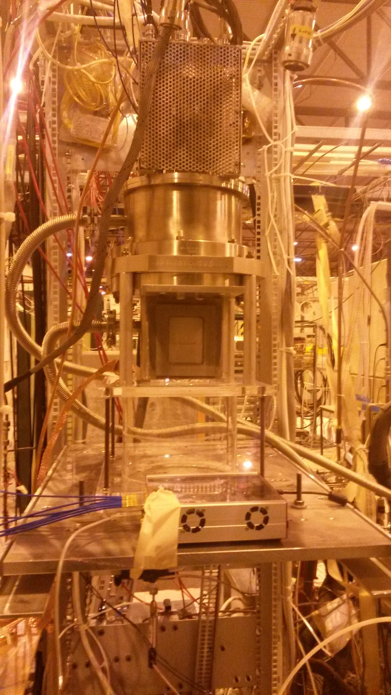
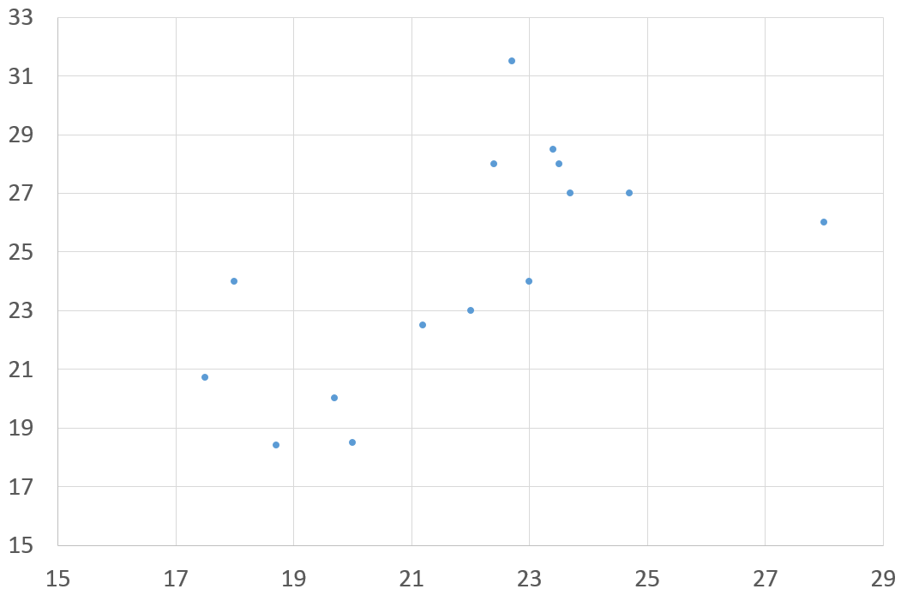
Developments since the last October WG meeting:
1. Full test of diamonds detector in H8 with secondary vacuum and cooling
The first tests in a secondary vacuum system were performed at T=-15 °C and P=30mb.
  We found different working point/noise of the board
  At 30 mb, we found discharge happening on the diamond board due to the HV.
In summary: noise/gain performance are dependent only on T while discharge
probability depends only on P (see the next slide)
We set higher T (with a compatible pressure) and we found that at T>10 °C the system behaves as expected in term of noise.
RMS noise TB (mV)
RMS noise Final config (mV)

Slide 4
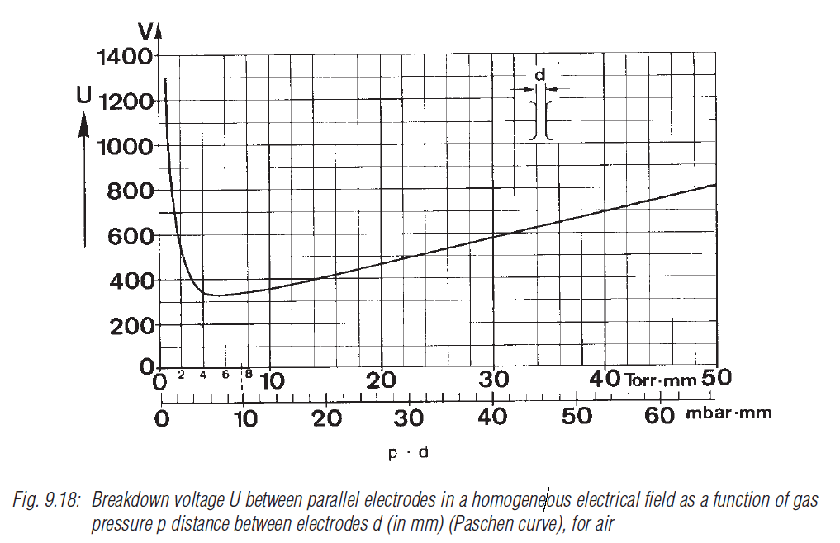
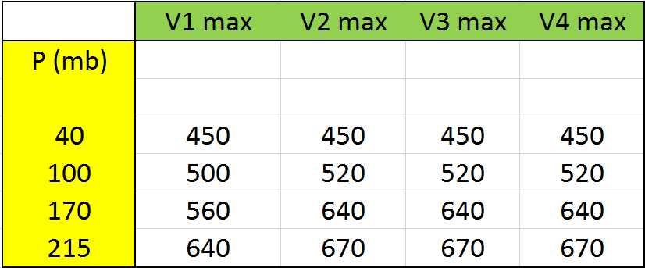
Maximum P-Voltage allowed
The most problematic thing was the HV ramp. The power supply, set at the maximum current limit of 1.5 μA (half of the value used in the TB) tripped already at about 450V for standard values of secondary vacuum.
This discharges were found to damage the channels much more than the ones seen in standard P/T tests during previous TB.
Empirical V max, defined as the maximum voltage at
which overcurrent is observed (Imax=1.5 μA)

Slide 5
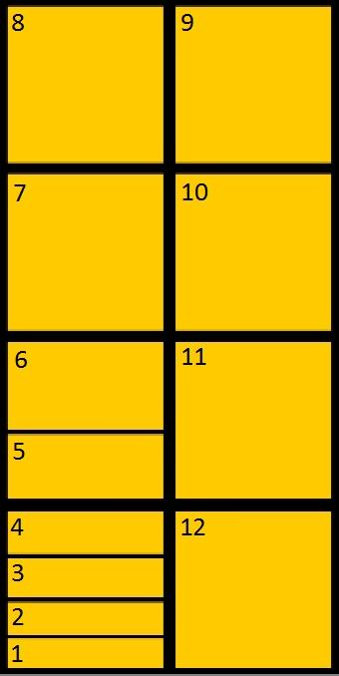
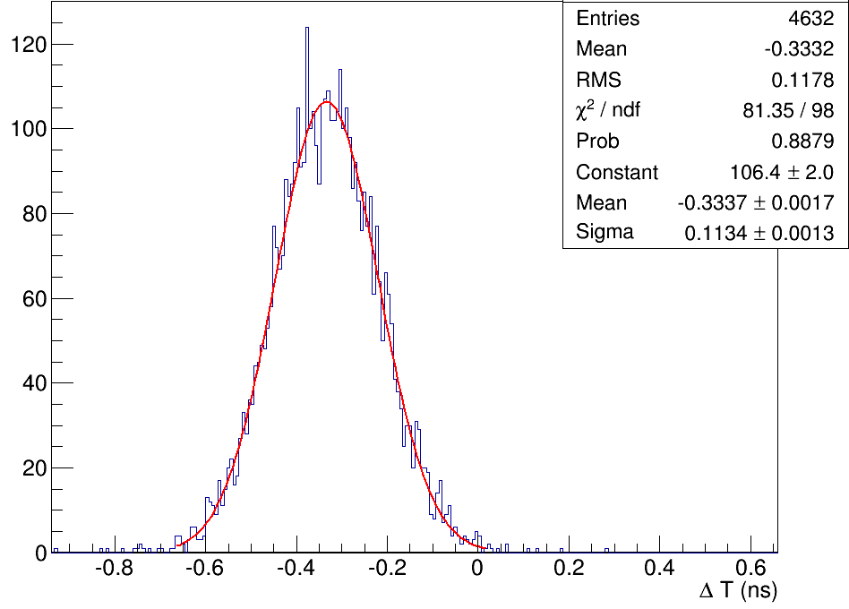
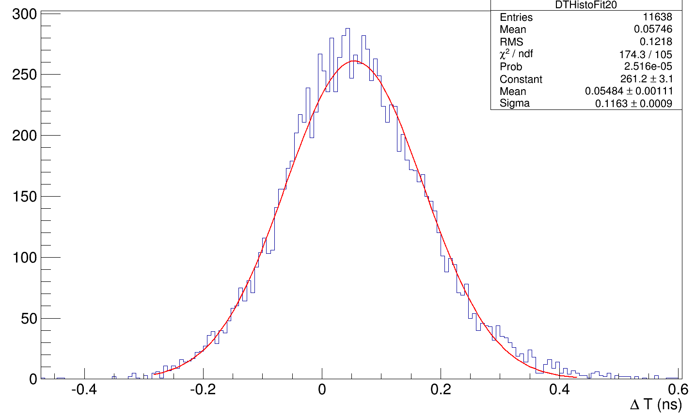
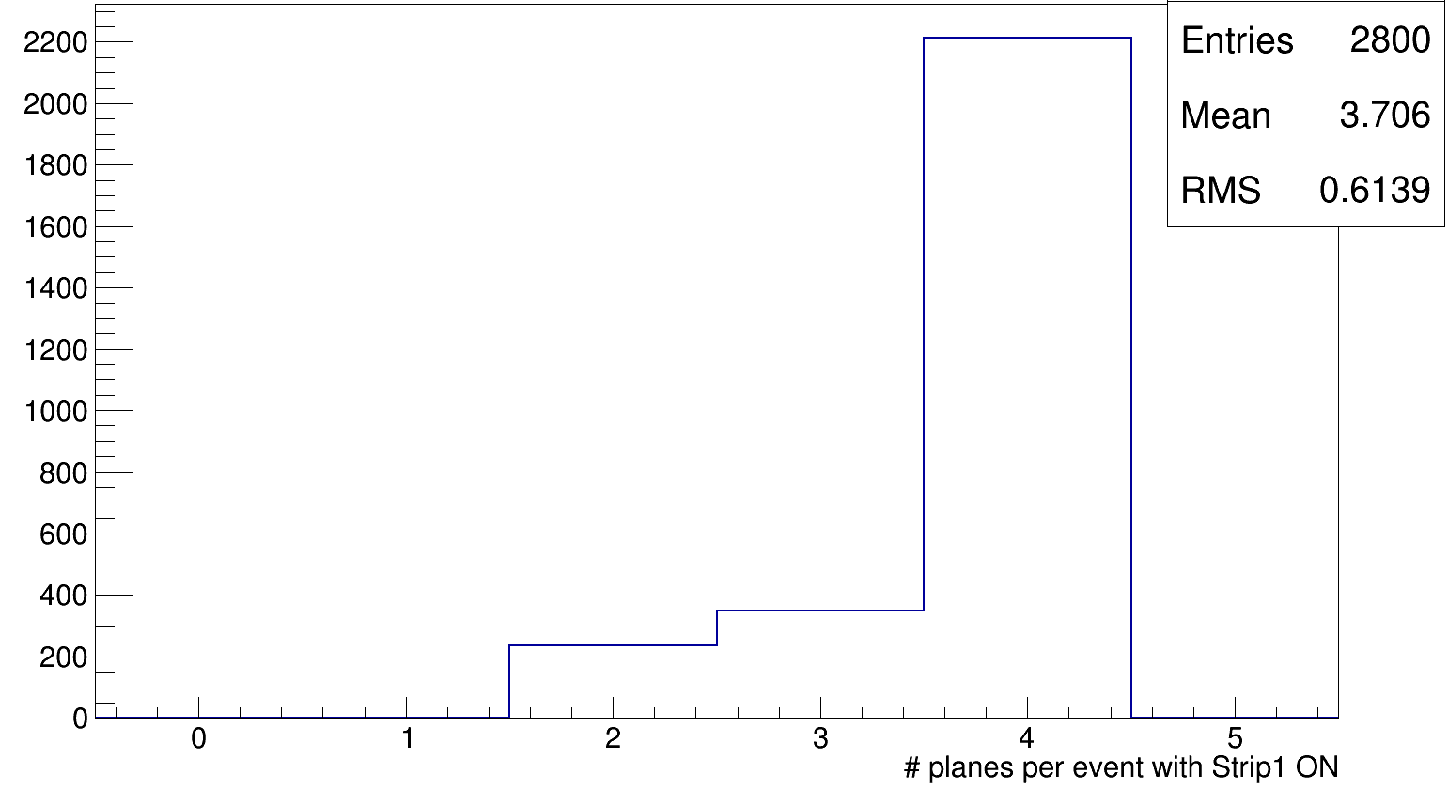
Test beam results with P=170 mb and HV=(560..640) V
Channel Numbering:
Pixel 3 was found to be aligned with the beam. Resolution measured with Oscilloscope and SAMPIC
σ=82 ps
σ=80 ps
(SAMPIC)
(oscilloscope)
Pixel 1 multiplicity
per event
(trigger on Pixel 1)
The time resolution was found to be better
than in the previous TB at 700V (enhanced S/N)
Oct. TB (ps): (B12,B13,B23) = (87,92,94)
This Test (ps): (B12,B13,B23) = (80, 90,87)
Compatible with
misalignment

Slide 6
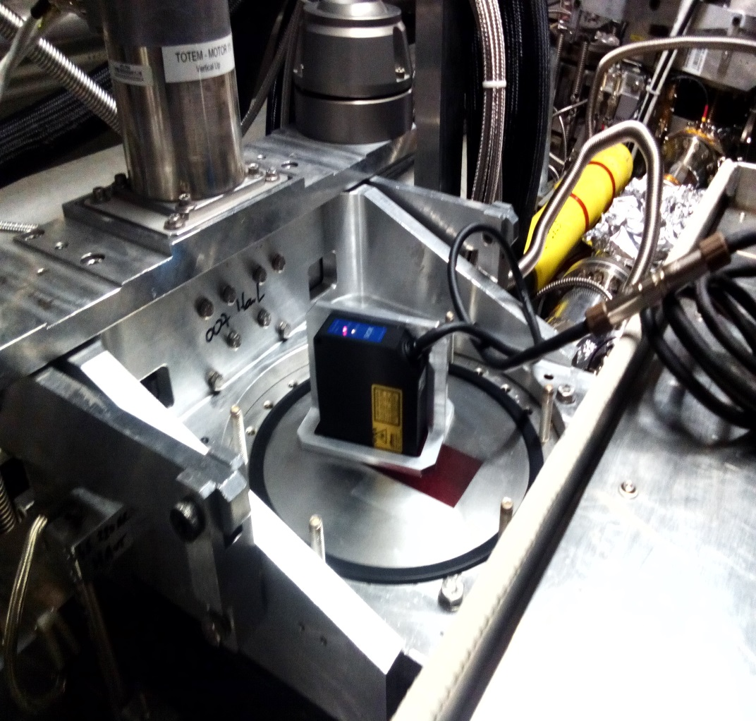
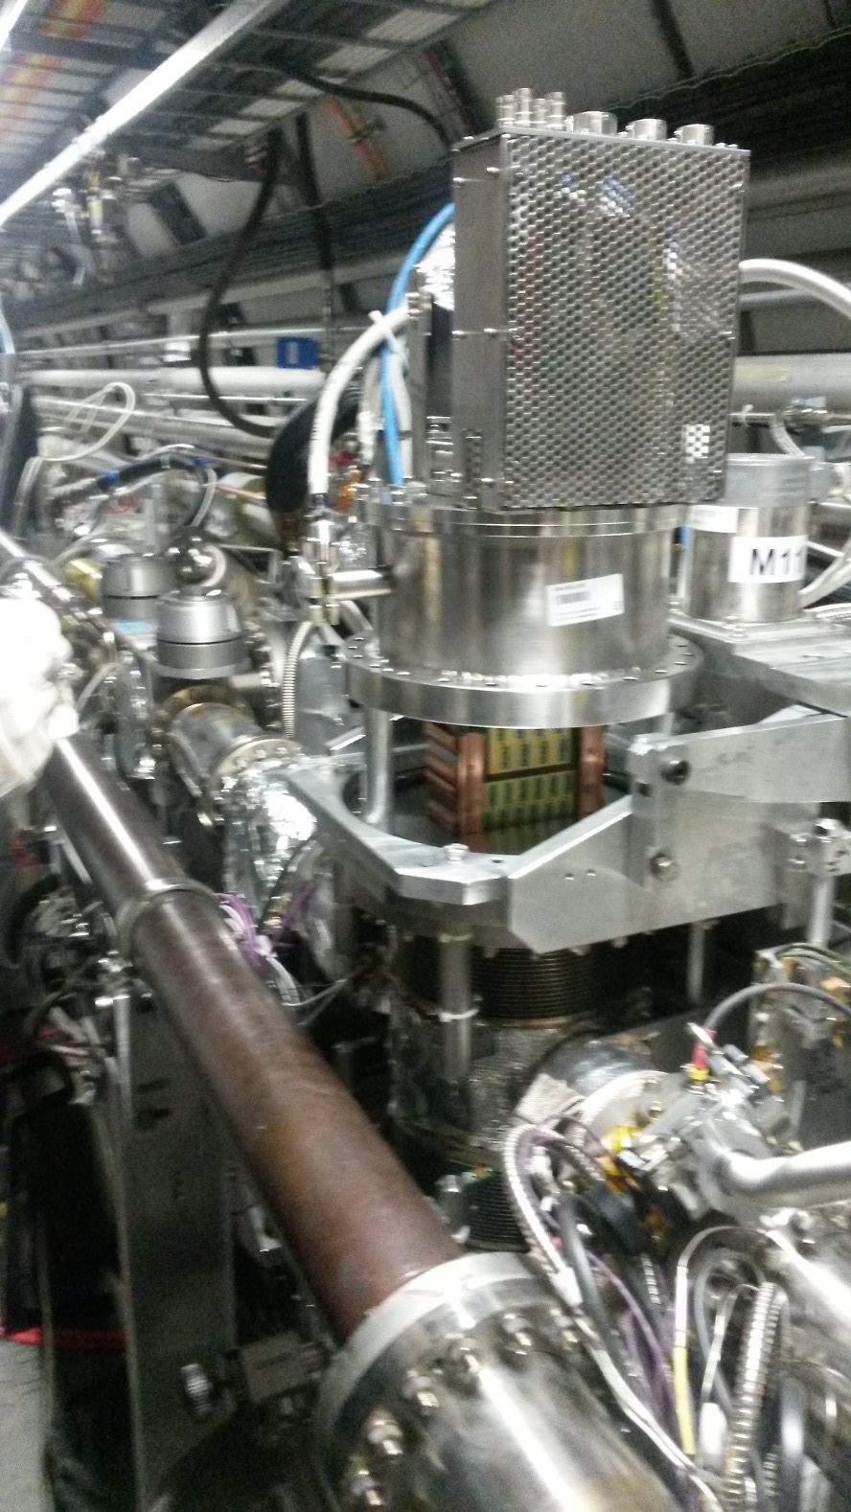
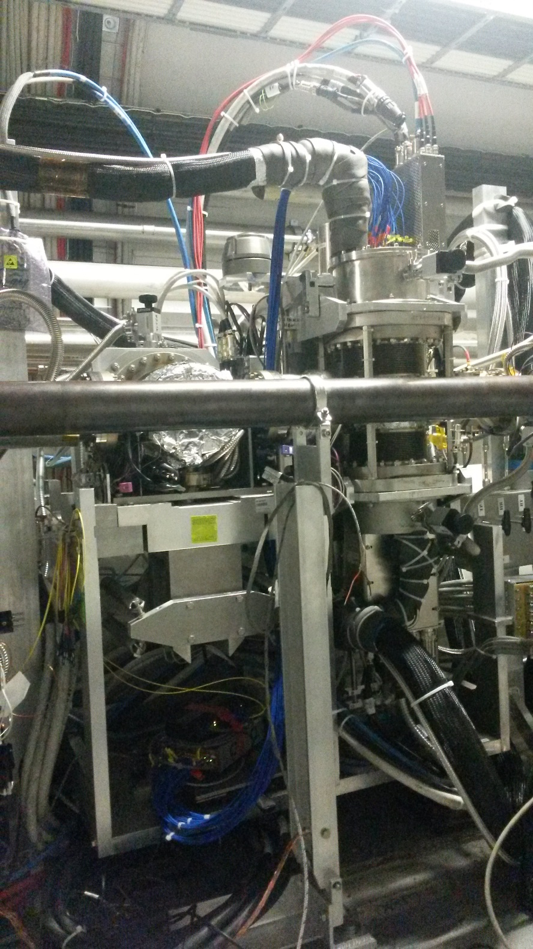
Tunnel installation
(Nov. 2015)
Closed 220N Top!
SAMPIC+
LAPTOP+
GSM data transfer
(fiber as backup)
Thin window measurement with the laser
σ_{L} < 10 μm
Insertion
Many thanks also to:
R. Stefanovitch, A. Baud, X. Pons, L. Kottelat…

Slide 7
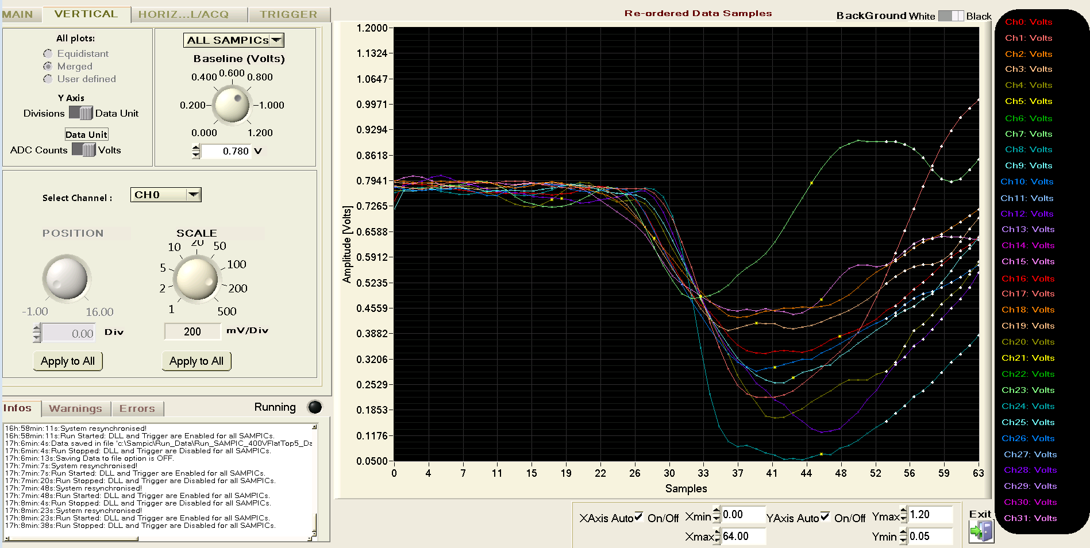
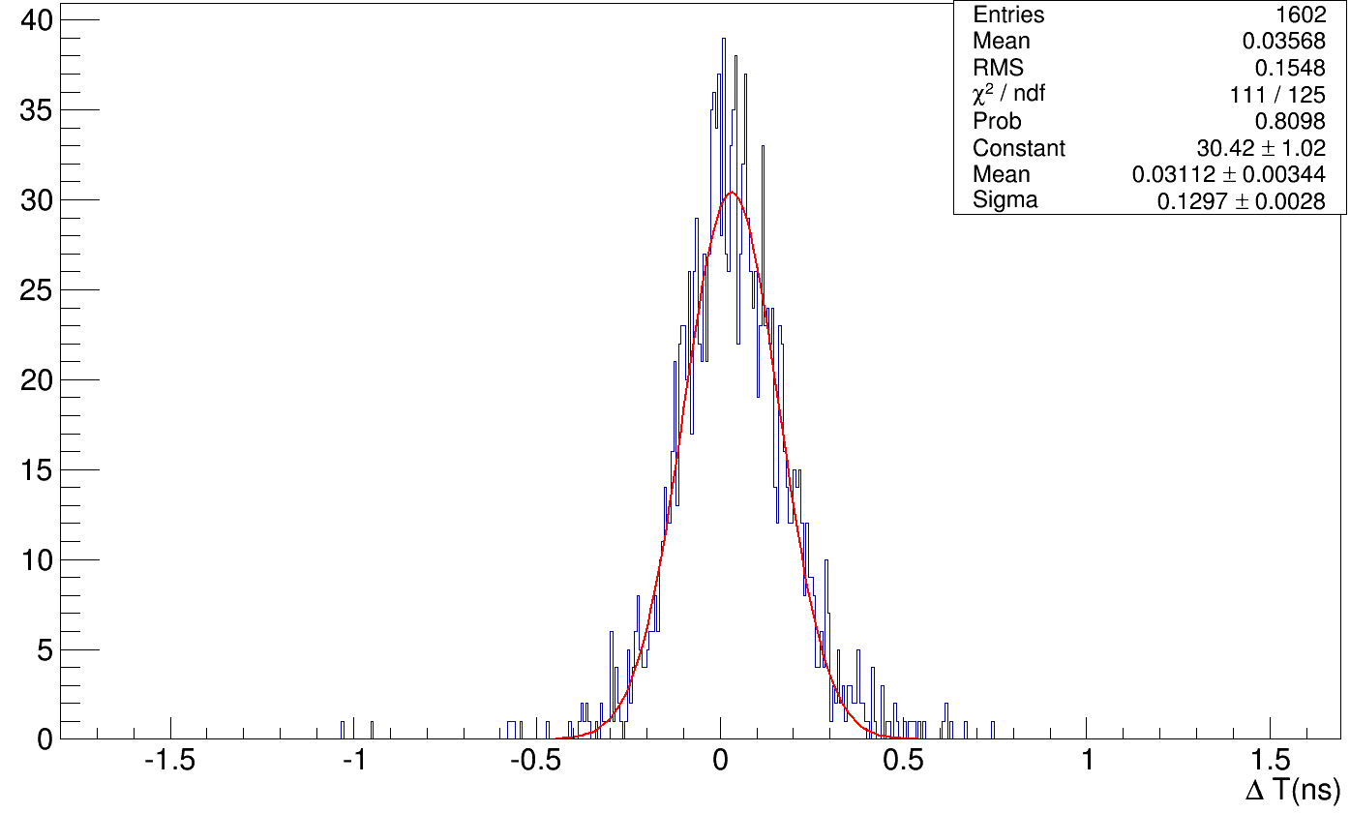
Tunnel results
The system have been tested inside the tunnel at hybrid T=20 C and P=200mb.
The noise was found to be identical to the one measured in H8.
The T/P were stable for all the data taking period ~20h.
RP was in garage position, only showers arrived at a low rate <10 Hz.
A more conservative current limit was set (0.5 μA), which allowed to ramp the system only up to 500V.
No extra dead channels (9 in total) was produced during the tunnel exercise.
Pix 3 B1-B2
SAMPIC display, LHC shower
σ=91 ps
NB: 500V
ΔT (ns)

Slide 8
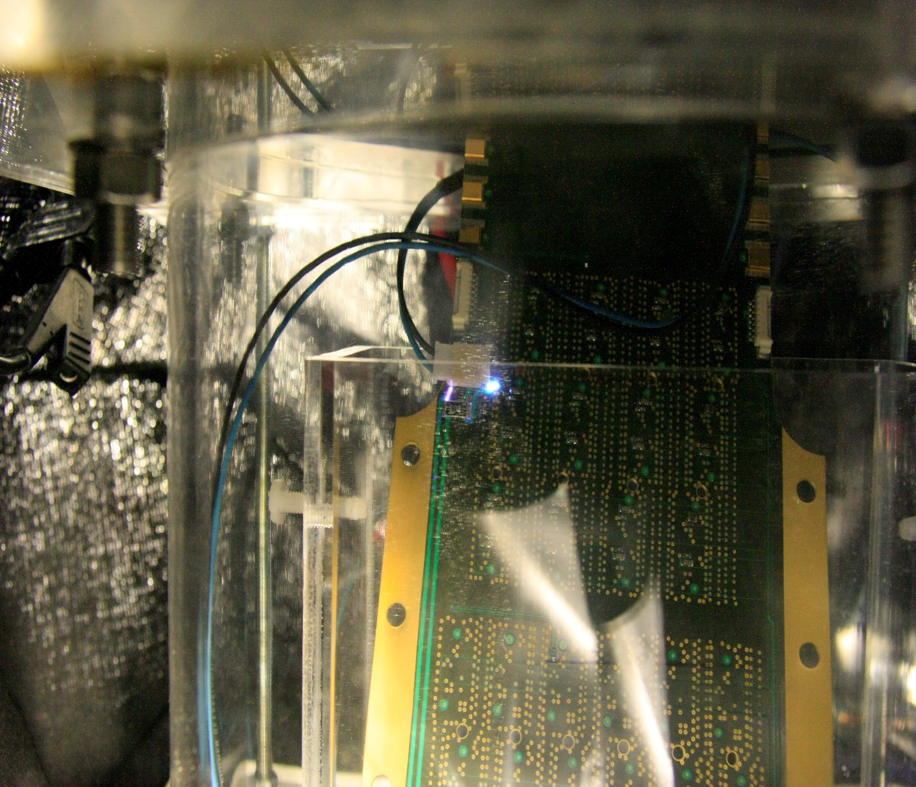
HV tests of the hybrid in vacuum
900V, 50mb
(continuous discharges)
First tests have been done by using the hybrid board without any diamond attached.
The systems, in P=50mb, shown the first discharges at V=720V.
By coating the HV distribution with Polyurethane the maximum voltage reached is 820V.
The weak point of the board was found to be the diamond+ bonding (discharge started at about 450 V)

Slide 9
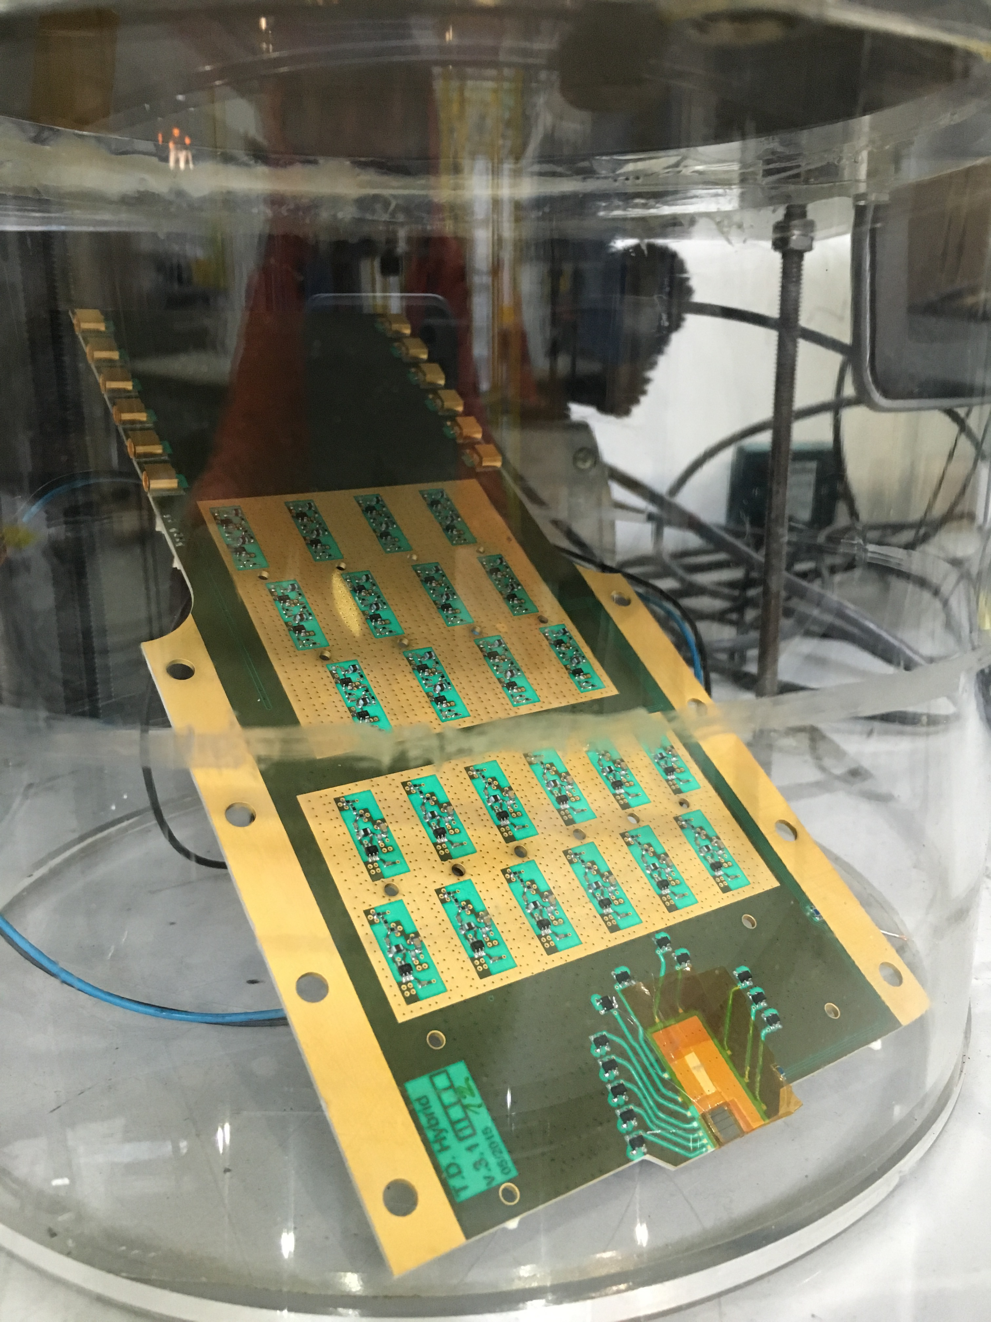
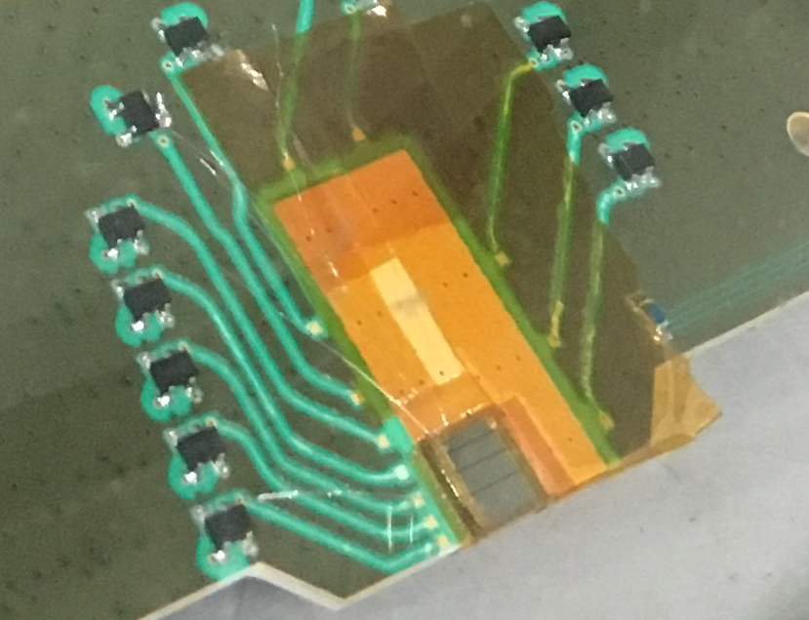
TOTEM diamond detectors for CT-PPS
Big effort has been done in order to avoid discharge in secondary vacuum.
Diamond board tested down to 10 mb pressure and position of the eventual discharges and weak points were identified.
Action taken to achieve nominal HV (700V) in secondary vacuum:
  Redesign the board
    Discharges on the board itself
      Simulation of discharges: Old board gave discharges at ∼600V (new design OK @ 900V)
  Coating and larger size wire bonding (weakest point)
    Reduce the HV gluing pads not to have uncovered HV spots
    Passivation of the uncovered spots
      Kapton glued on top (done), special resins (done, to be tested),bigger bonding wires (done, to be tested)
  →The tests done with the Kapton on the old board gave good results, but quite complicated to be implemented.
HV pad

Slide 10
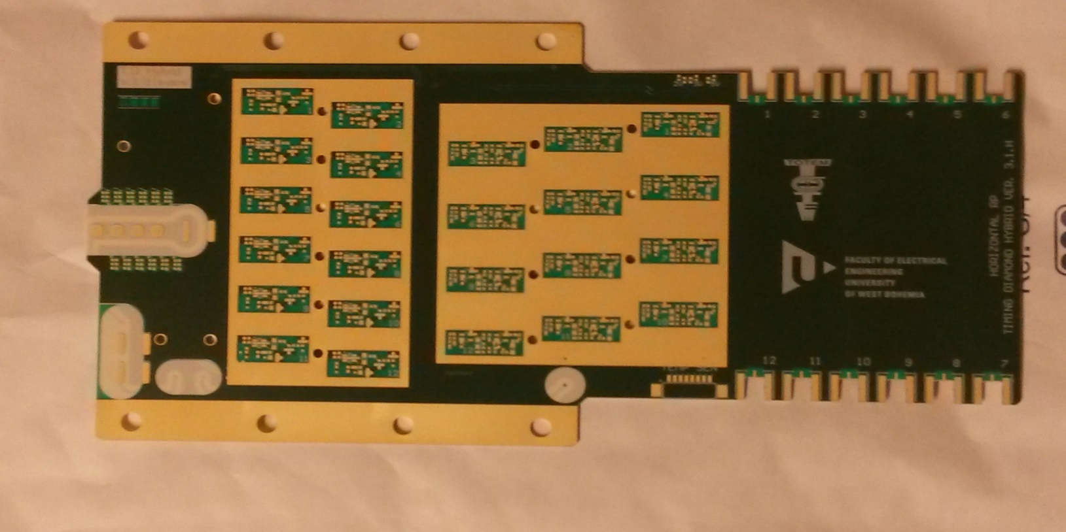
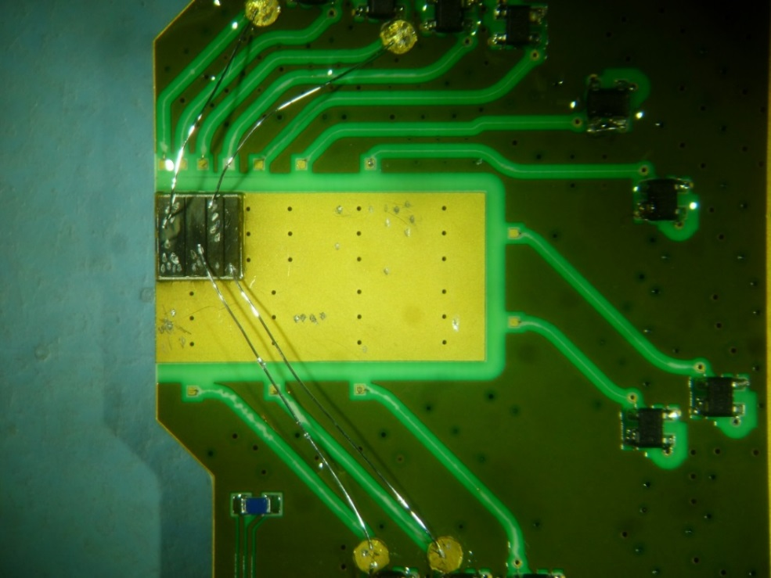
Horizontal board coating
PCB with special geometry for the horizontal RP and with better HV tolerance in vacuum already produced (population next 2 weeks)
One old board was sent to a company for coating and large wire bonding: better for field reduction and reduced impedance for the signal
Diamond HV pads with reduced sizes
Silicon-based coating, R_{V}=3·10¹⁵ Ωcm
150 μm wire bonding
First tests seems that the problem has been fixed (up to 840V at 60 mb)
NB: for tracking diamonds can be operated at ∼400V → NO PROBLEM

Slide 11
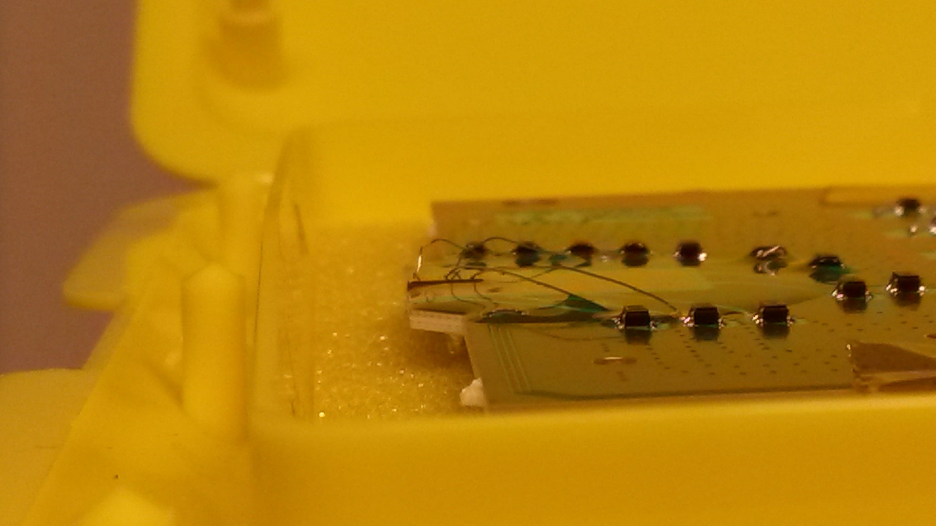
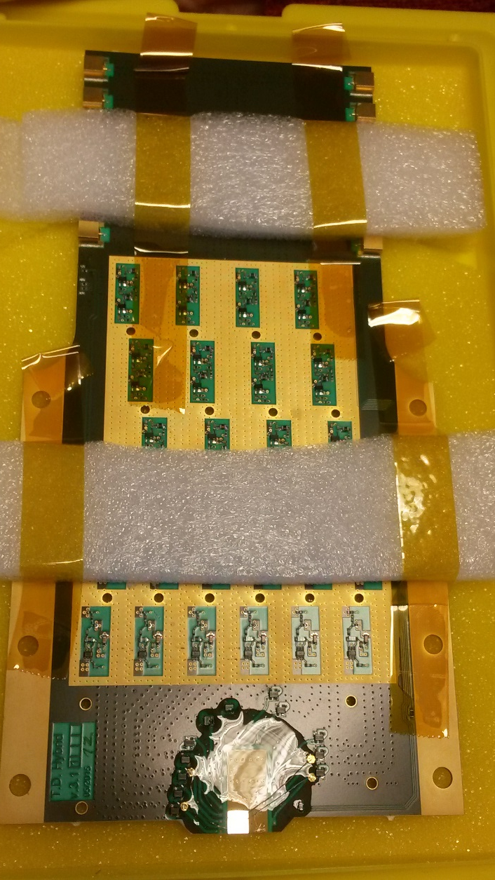
MIPOT board with coating and large wire arrived this morning.

Slide 12
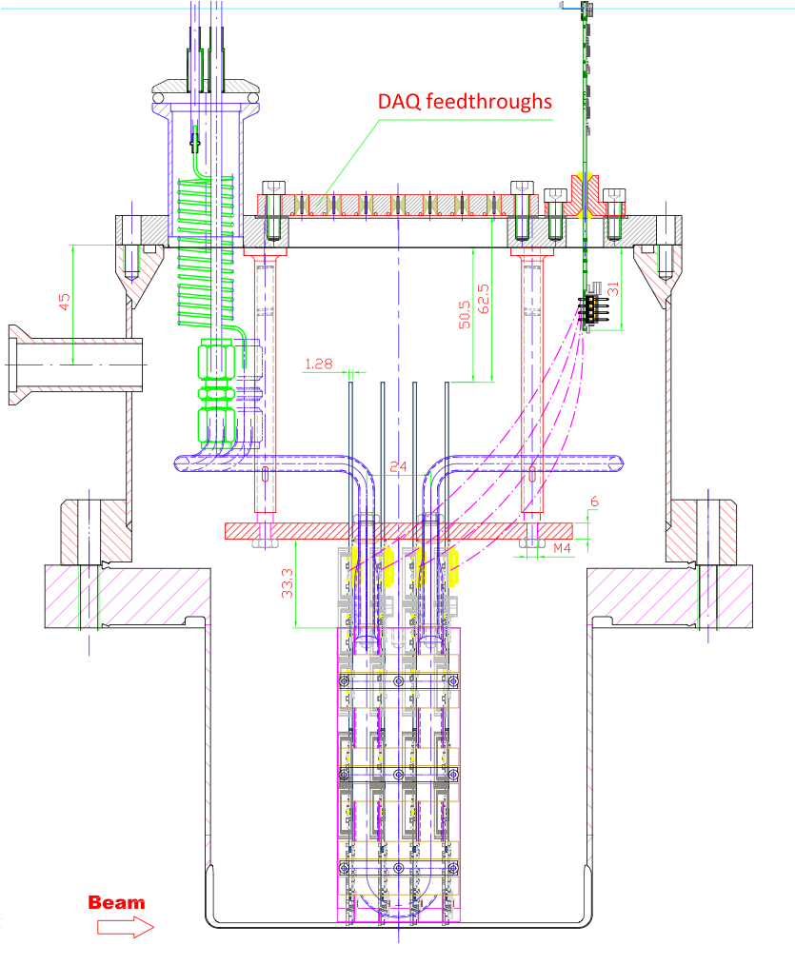
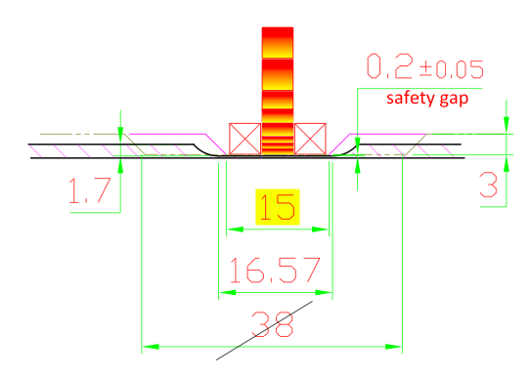
Diamond detectors for CT-PPS (1)
Minimal mechanical/cooling adaptation needed:
Thin window profile adapted to the hybrid
Apart from this, champignon and cooling system is exactly the same of the vertical one

Slide 13
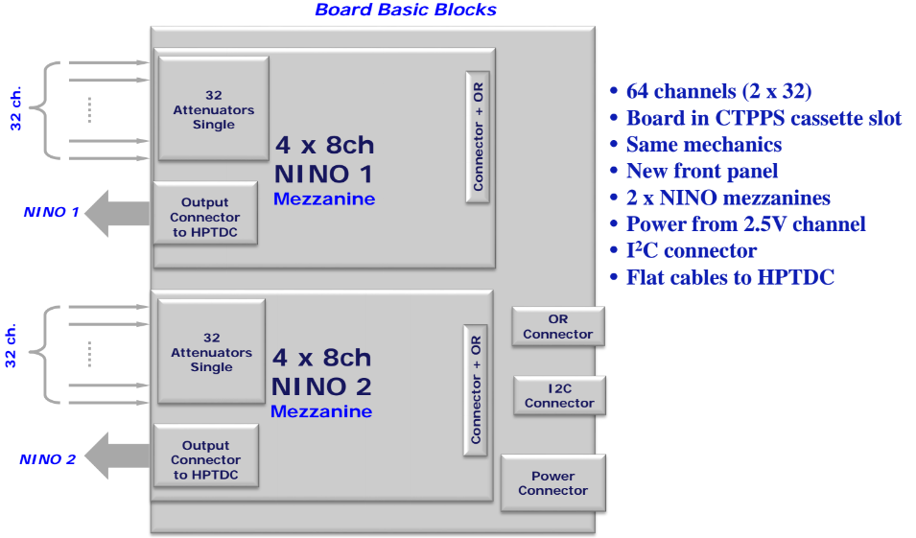
Diamond detectors for CT-PPS (2)
Biggest change: different digitizer
G. Antchev, Totem collaboration meeting
Unfortunately the Sampic cannot be used as we expect order of 3MHz per channel (Sampic tested safely for 350 KHz/8 channels) . Version 3 (not yet in production) can fix this problem by introducing a buffer for LS1 selection.
For the June installation, we will use the NINO+HPTDC, but the performance of this solution has to be verified.
The NINO board will be mounted externally as a mezzanine on the final digitizer board.

Slide 14
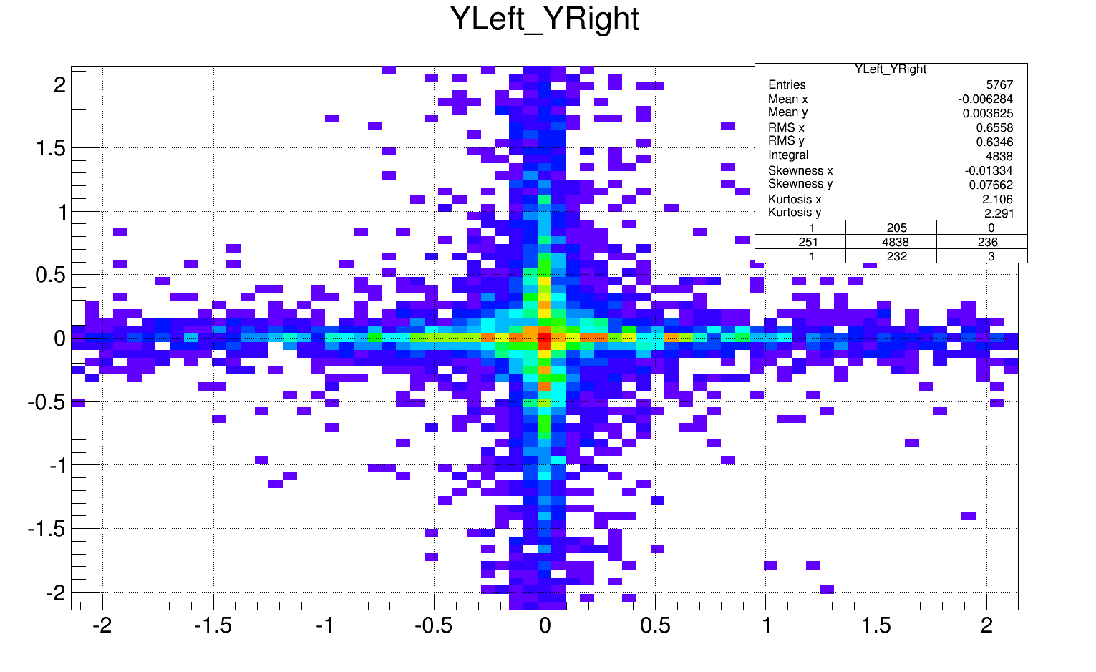
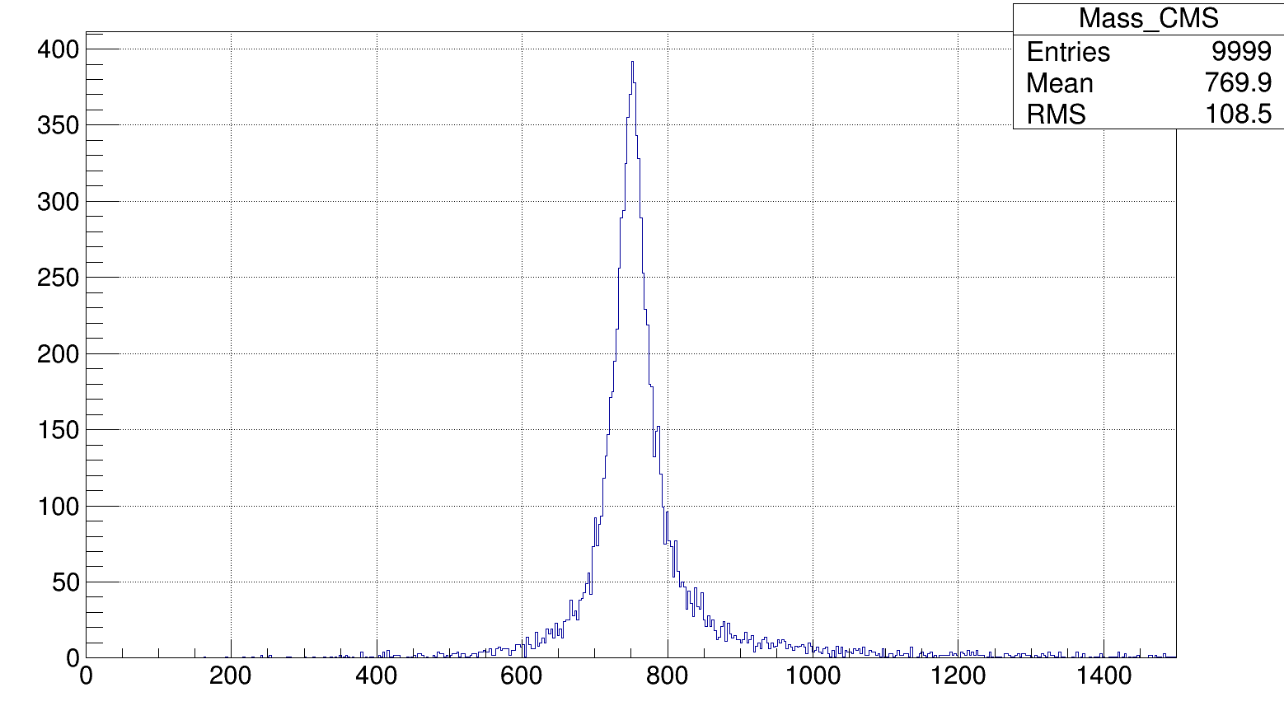
Diamond geometry for CT-PPS: simulation results (1)
FPMC simulation (thanks to C. Royon) has been used to optimize the diamond geometry
  It is enough one single diamond row (metallized width 4.2 mm).
Proton Y-left vs Y-right for 2γ simulation at 13 TeV and β=0.8m
Y left (mm)
FPMC mass output
Mass (GeV)
Y right (mm)

Slide 15
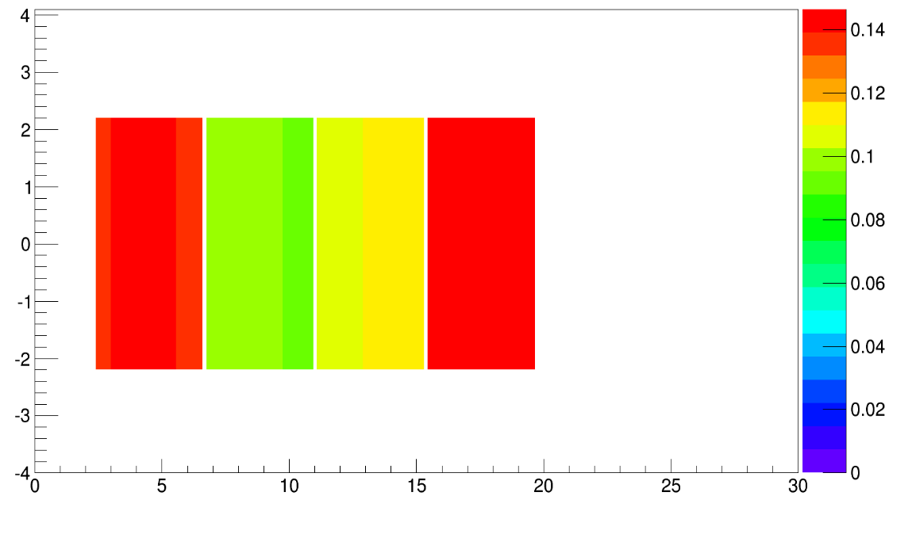
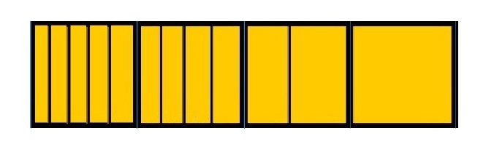
Diamond geometry for CT-PPS: patterns
Board for CT-PPS has been produced with 12 channels around a single raw in the X direction (4 diamonds):
Due to the time constraint the patterns with (1,2,4)-strips from the diamonds in the vertical RPs have been also used.
The diamond closer to the beam has instead a new pattern with higher granularity, optimized for a low occupancy.
Occupancy simulation
(including Physics and beam background, μ=30)
4 diamonds/plane with this pattern
(metallizations ongoing)
Y (mm)
Beam center
BEAM CENTRE
X (mm)

Slide 16
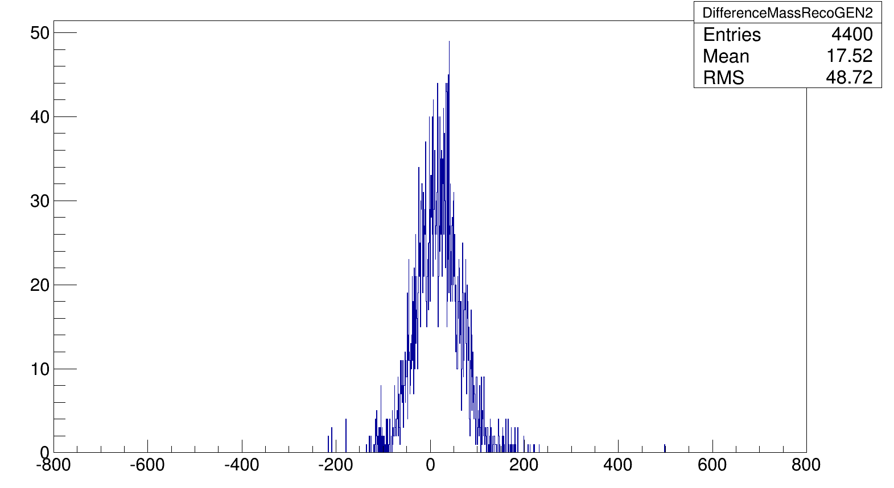
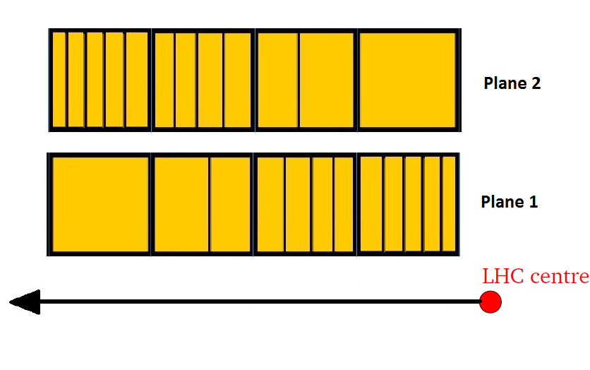
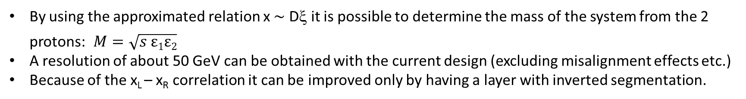
Diamond detector mass reconstruction capability
By using the approximated relation x ∼ Dξ it is possible to determine the mass of the system from the 2 protons: $M={\sqrt{s ε1ε2}}^{}$
A resolution of about 50 GeV can be obtained with the current design (excluding misalignment effects etc.)
Because of the x_{L} – x_{R} correlation it can be improved only by having a layer with inverted segmentation.
Generator mass – Reconstructed mass
Possible to improve it by ∼30% by swapping the pixellization in one plane
ΔM (GeV)

Slide 17
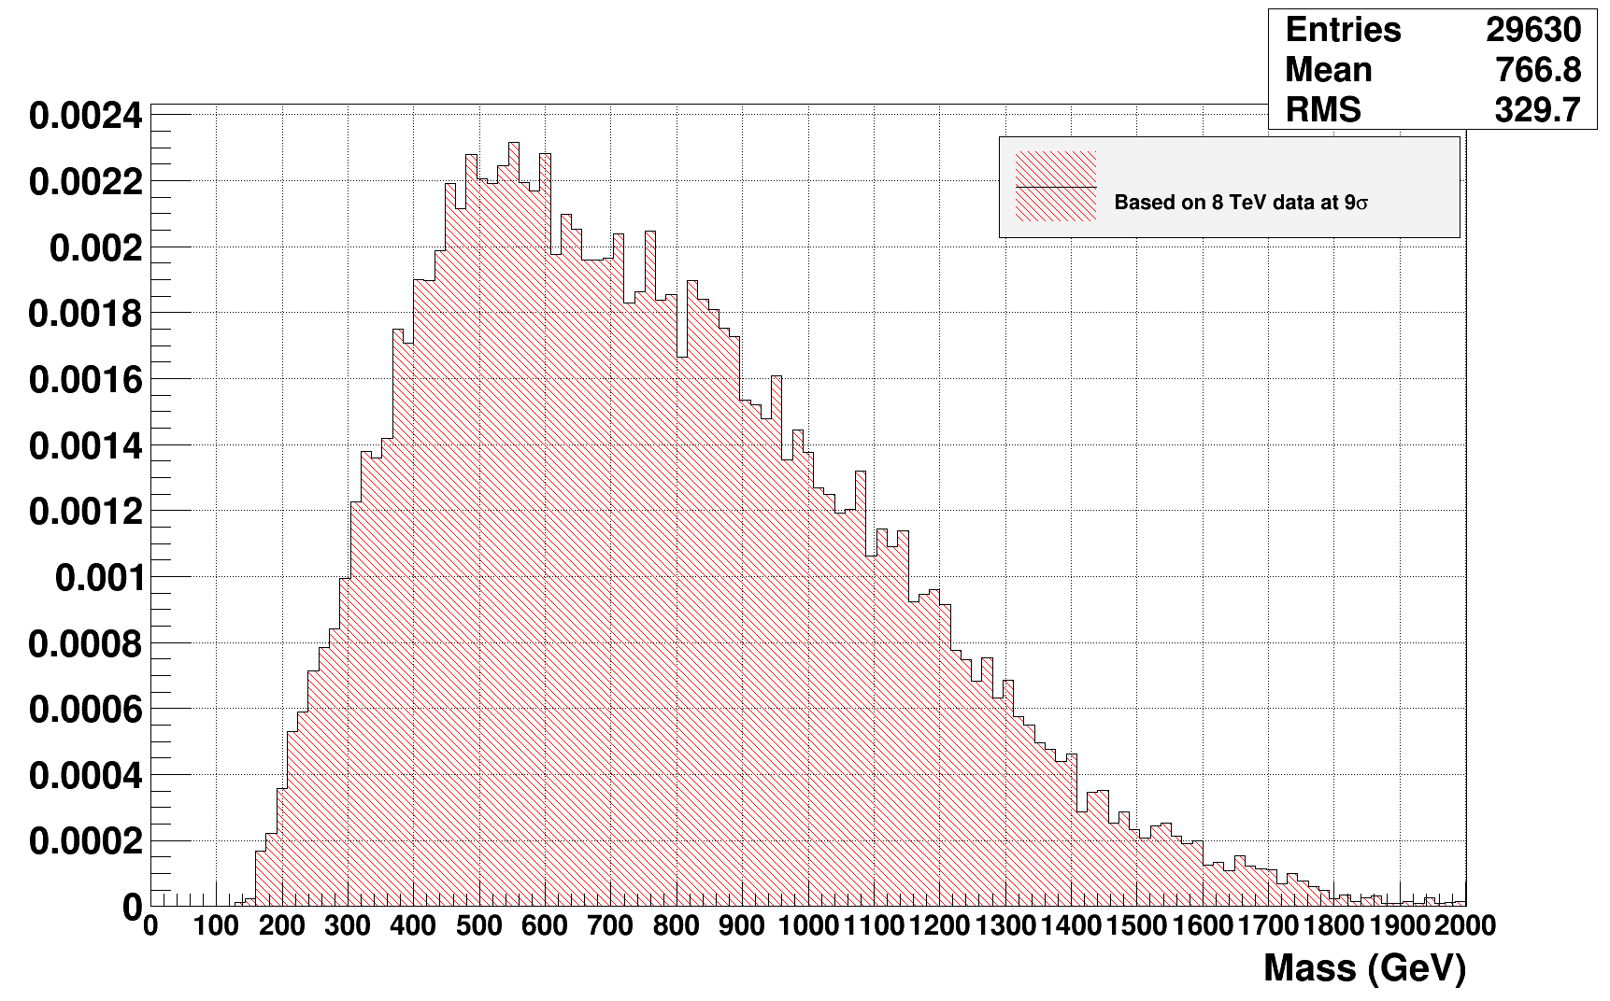
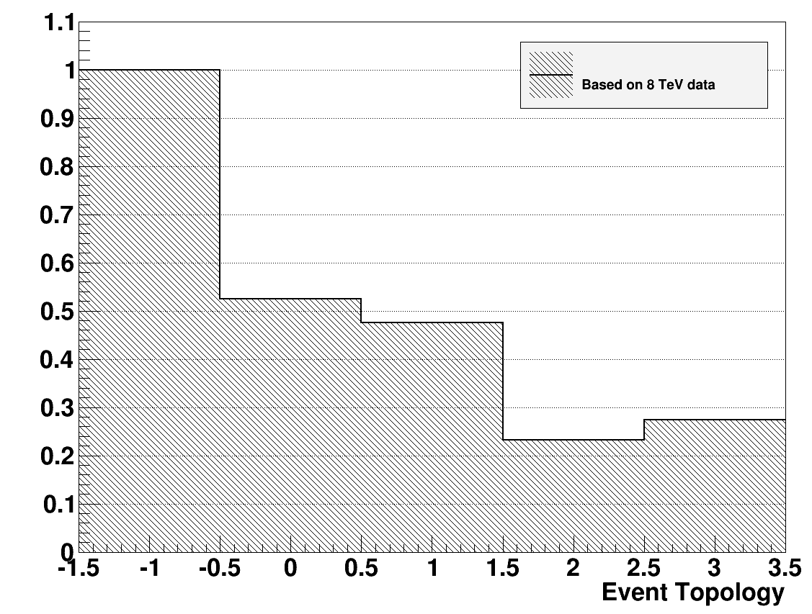
2γ analysis and background reduction with the diamonds (1)
γγ -> X(750 GeV) -> γγ signal is generated with FPMC (assumed ∼4-5 signals in acceptance in 25 fb⁻¹)
Main background is given by inclusive γγ+ proton pileup, σ=230 fb⁻¹ for P_{t} >50 GeV (http://arxiv.org/pdf/1312.5153.pdf)
Pileup has been simulated by Sherpa and pile-up protons from soft Phys. Beam back has been added
BX event topology in the RP
BX background mass probability
ALL BX
Detector edge
@ 15σ
NO 2-Arms
2-Arms
2-Arms
High Mult
2-Arms
Low Mult
2% (4%) of BX has a mass coincidence in the 700-800 GeV region, assuming low (all) track multiplicity in the RP

Slide 18
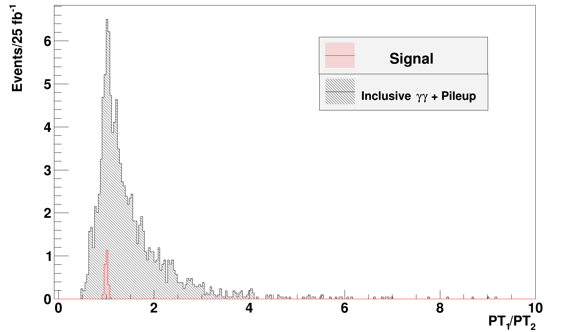
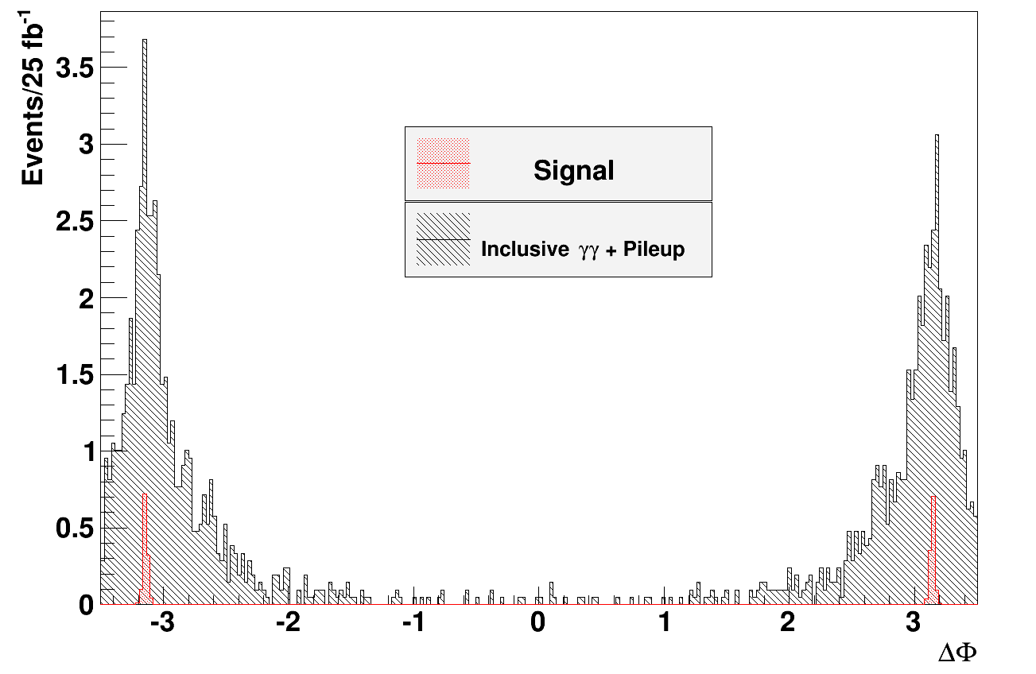
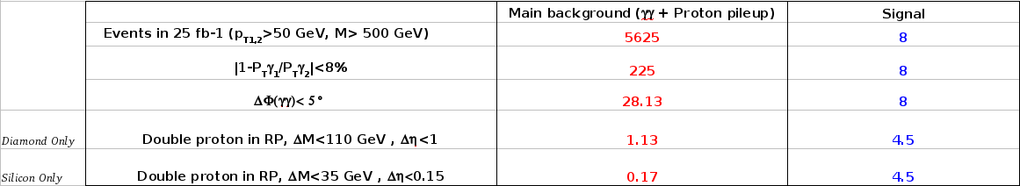
2γ analysis and background reduction with the diamonds (2)
Background can be also reduced by introducing a cut in the γ energy, γ P_{T} balance and in the γγ Δφ:
Data reduction and background suppression:
To be confirmed according to the final LHC optics setting

Slide 19
Radiation hardness

Slide 20
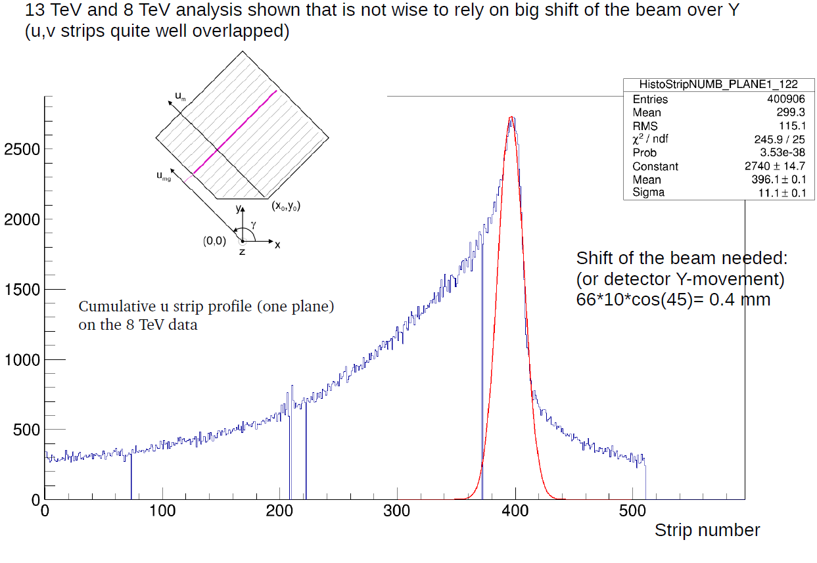
Silicon radiation hardness
Looking at the 8 TeV we see only few planes with strip shifted
No big shifts found in 13 TeV data (but there diffractive peak very weak due to collimation set.)
A shift of the plane/beam around the Y axis of about 0.4 mm can do the job.

Slide 21
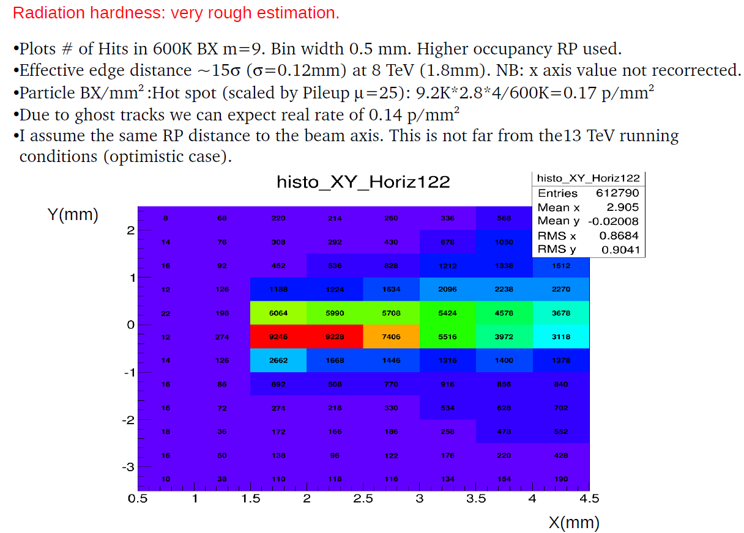
Silicon radiation hardness

Slide 22
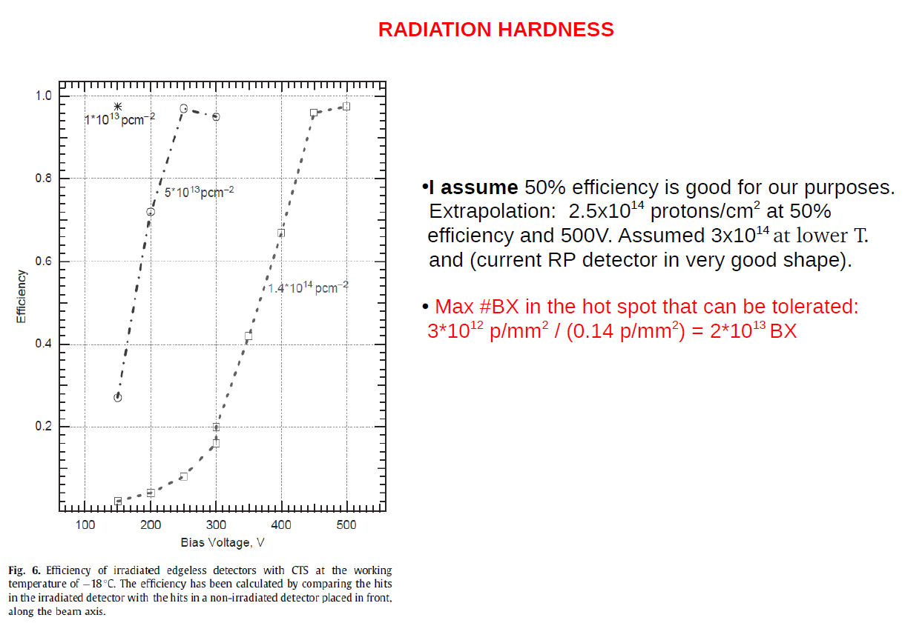
Silicon radiation hardness
28 days are needed to collect 20 fb⁻¹ (6.3 x 10¹³ BX)
Max number of BX in the hot spot was 2 x 10¹³
NEEDS ~3 detector packages in the worst case of fixed beam spot
(NB:other solutions already found)

Slide 23
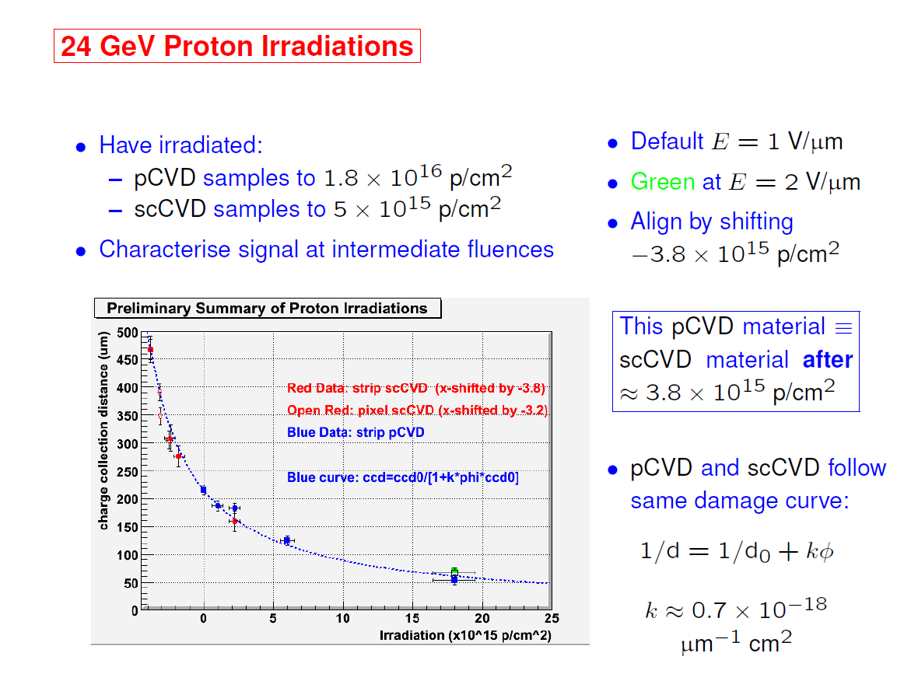
Diamond radiation hardness: from William Trischuk (RD42)
scCVD:
@ 4x10¹⁵ p/cm²expected
worsening of S/N of a factor 2 (still good efficiency)
At least factor 20 better than RP silicons

Slide 24
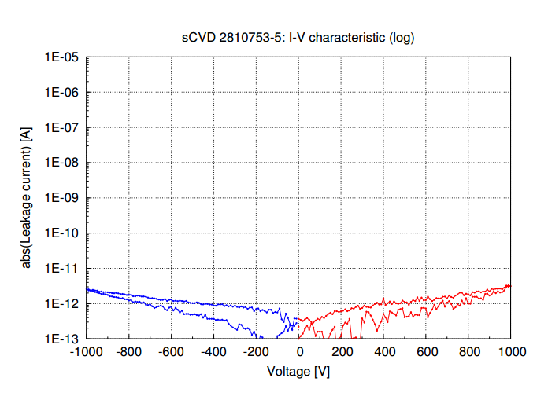
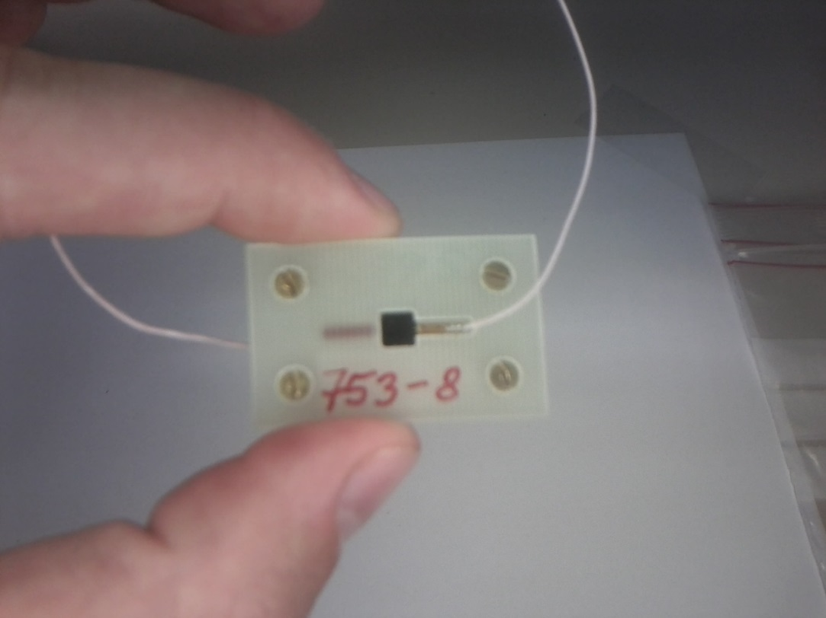
Preparing for new planes production:
Improved HV tests for diamond selection
Test performed in Desy (Thanks to W. Lohman and M. Hempel)
Selection of High quality diamonds (leakage<10 pA) at 1 kV to be patterned.
Both leakage current and rate under source measured.

Slide 25
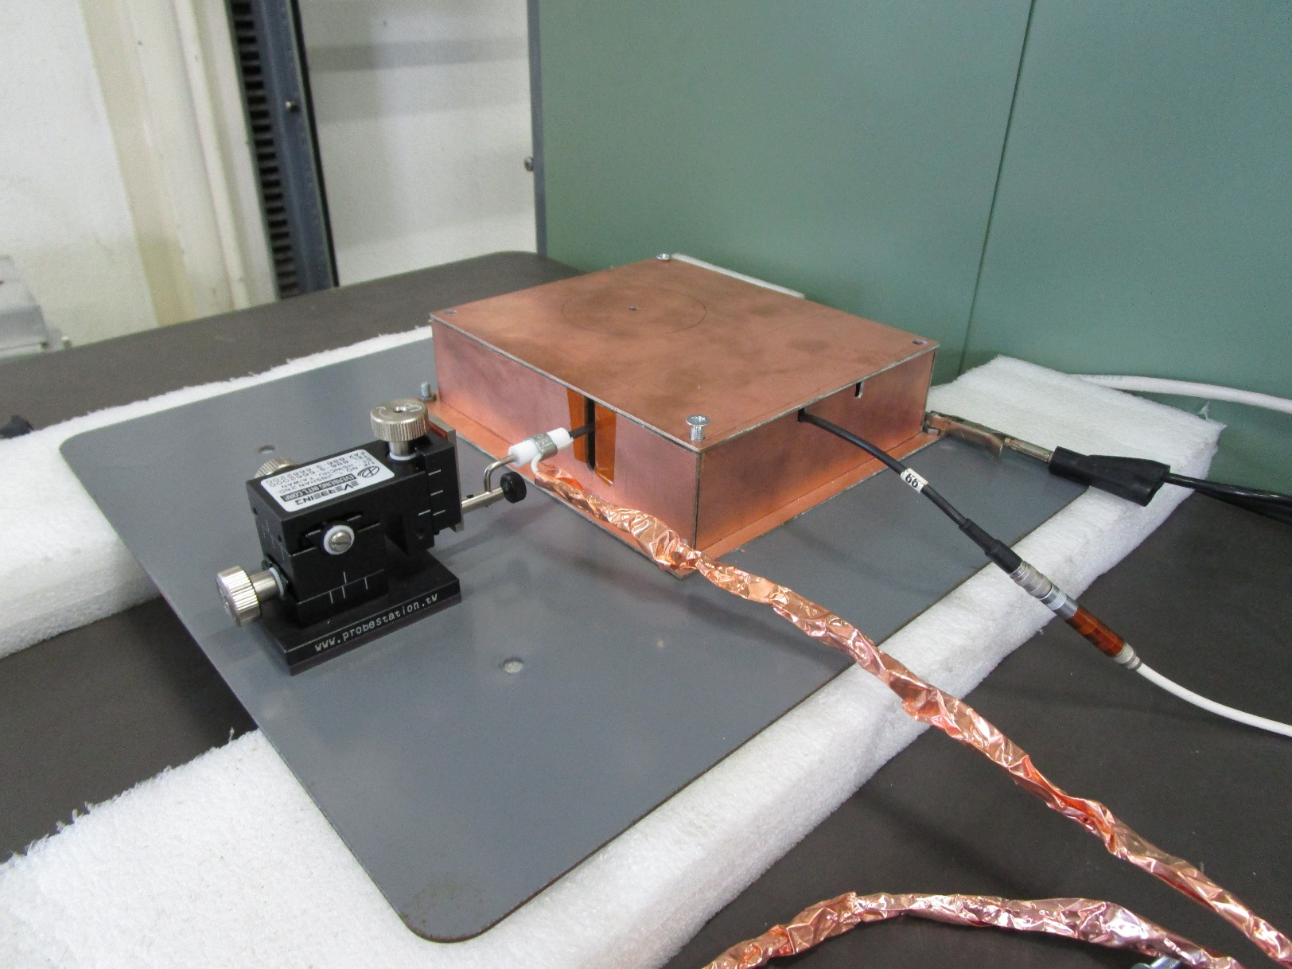
Improved HV tests for diamond selection
David and Tiina
Setup built also at CERN and Helsinki
We try to use spring probe instead of bonding to have a system ready to use at each arrival of the diamonds
Finalization of the system at CERN expected in 2 weeks
All diamonds for CT-PPS have been measured in terms of leakage current performance.

Slide 26
Short term plan:
Enough diamonds are metallized (under metallization) to equip 2 cylindrical RPs in June with 4 planes/side
Intense work ongoing to be sure that the pressure/temperature problems are fixed
Almost continuous TOTEM/CT-PPS test beam ongoing from 25 April to TS1, preparation of the experimental area
Production of the NINO+HPTDC+ digitized card and its interface ongoing/under testing (big effort/challenging)

Slide 27
Conclusions:
Simulation studies show that very good background suppression can be achieved with standard RP tracking capability while diamonds can help due to the superior radiation hardness even with lower mass resolution. Spare silicon packages available from TOTEM in case of rad-hard will be an issue. Possible to cover the 20 fb¹ with 2/3 exchanges. Further studies are ongoing, beam or vertical detector movement of about 0.5 mm would be enough.
New geometry for CT-PPS studied based on 2γ signal. Board produced and optimized for CT-PPS needs, diamonds/boards on schedule (even with tight margins for additional delays).
Final physics capability to be reviewed according to the final optics (dramatic dependence).

Slide 28
Thanks

