Slide 1
LIU beam parameters specification
Wrap-up of the 2015 beam parameters measured along the injectors chain and projected LIU performance
H. Bartosik, B. Goddard, G. Rumolo
LIU Beam parameter WG meeting, 12th February 2016

Slide 2
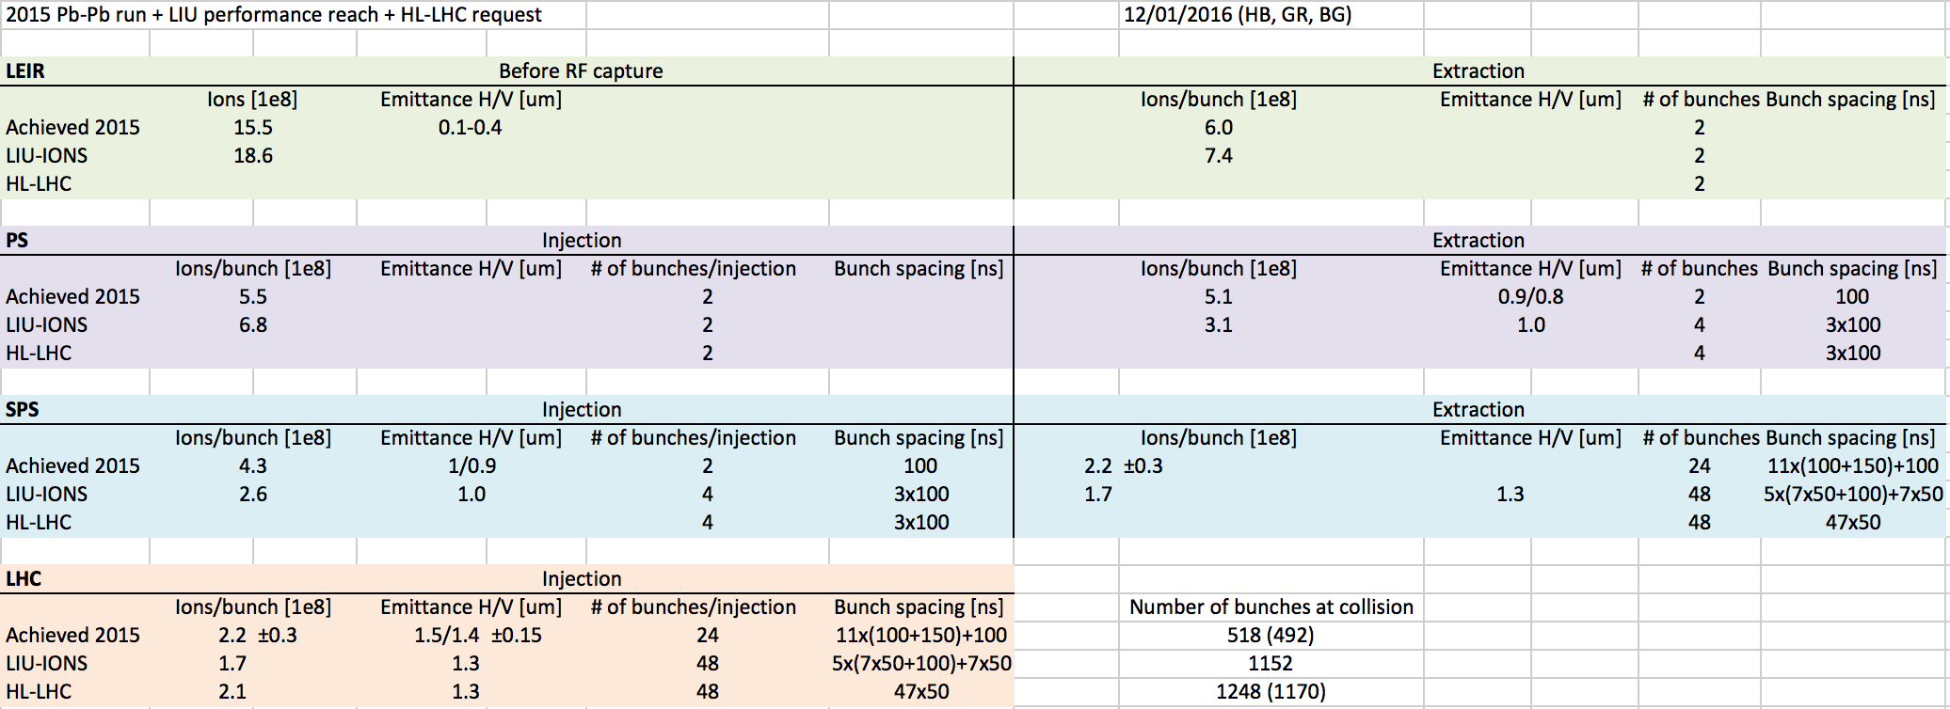
Ion parameter table
(achieved, LIU achievable and HL-LHC requested)
HL-LHC: J. Jowett et al., HL-LHC heavy-ion beam parameters at LHC injection, EDMS 1525065
Achieved 2015: H. Bartosik et al., Preliminary analysis of 2015 ion beams, LIU Beam Parameter WG meeting #2

Slide 3
Summary of achieved parameters (2015)

Slide 4
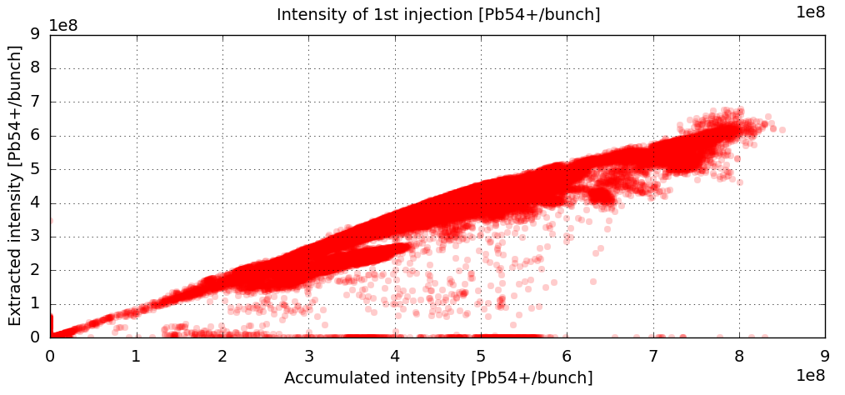
LIU-IONS beam parameter table:
LEIR transmission
Presently, the extracted intensity as a function of the accumulated intensity does not seem to level off
  There is a cloud of points for high accumulated intensity with very good transmission
Assumption: 100 ms injection rate + Linac3 improvements lead to 20% more accumulated intensity → Aim to extract 7.4e8 ions/bunch out of LEIR

Slide 5
LIU-IONS beam parameter table
 | Intensity (10⁸ ions/bunch) | Transverse emittance (μm)
LEIR (end of accumulation) | 9.3
LEIR extraction | 7.4
PS injection | 6.8
Here we include directly an additional 8% losses before injection into the PS, as was measured in 2015.
Emittance measurements are available with the IPM in LEIR but data are still being systematically analysed. However, from first look:
There seems to be large blow up at RF capture in LEIR (especially in V)
Injected values into PS could be around 0.5 μm

Slide 6
LIU-IONS beam parameter table
 | Intensity (10⁸ ions/bunch) | Transverse emittance (μm)
LEIR (end of accumulation) | 9.3
LEIR extraction | 7.4
PS injection | 6.8
PS extraction | 3.1
SPS injection | 2.6 | 1
PS: Bunch splitting + assumed losses of 8% (like today)
Emittance measurements available in TT2 and SPS injection
Values were around 0.8-1.0 μm in 2015 (blow up in the PS?)
We can still assume 1 μm for LIU at SPS injection
There is an additional 16% losses between PS and SPS (stripping foil)
A number of injections ≥10 from PS to SPS maximises number of ions in LHC → we choose 12, as it is now

Slide 7
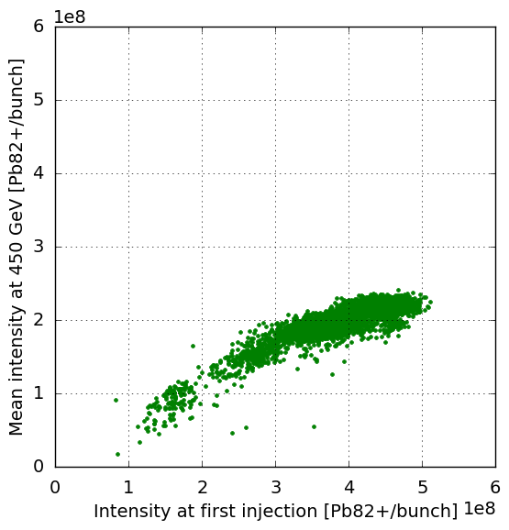
LIU-IONS beam parameter table:
SPS transmission

Slide 8
LIU-IONS beam parameter table
 | Intensity (10⁸ ions/bunch) | Transverse emittance (μm)
LEIR (end of accumulation) | 9.3
LEIR extraction | 7.4
PS injection | 6.8
PS extraction | 3.1
SPS injection | 2.6 | 1
SPS extraction/LHC injection | 1.7 | 1.3
Emittance measurements available at LHC injection
In 2015 a 40-50% emittance growth was measured in the SPS for injected intensities up to 5e8 ions/bunch
We can aim for ~30% emittance blow up with injected intensities of ‘only’ 2.6e8 ions/bunch
We assume same SPS transmission as today (but there will be slip stacking)

Slide 9
LIU-IONS beam parameter table
 | Intensity (10⁸ ions/bunch) | Transverse emittance (μm) | Number of bunches
LEIR (end of accumulation) | 9.3 |  | coasting
LEIR extraction | 7.4 |  | 2
PS injection | 6.8 |  | 2
PS extraction | 3.1 |  | 4
SPS injection | 2.6 | 1 | 48
SPS extraction/LHC injection | 1.7 | 1.3 | 1152
Emittance measurements available at LHC injection
In 2015 a 40-50% emittance growth was measured in the SPS for injected intensities up to 5e8 ions/bunch
We can aim for ~30% emittance blow up with injected intensities of ‘only’ 2.6e8 ions/bunch
We assume same SPS transmission as today (but there will be slip stacking)

Slide 10
LIU-IONS beam parameter table
Two bunches out of LEIR
Two bunches out of LEIR
Bunch splitting in PS

Slide 11
Possible paths to improve ion performance
Present ‘baseline’ reach is 1152b filled in 43 minutes (PS splitting, 150 ns MKP, SPS slip-stacking, 12 injections into SPS, 24 injections into LHC)
  Integrated luminosity could become >80% of the target value if a higher performance efficiency is assumed on the HL-LHC side (i.e. 62% instead of 50%)
Push the present LHC injection and extraction (MKI/MKD) kicker gaps to (realistic) limits (as done for MKP in SPS) → Could give 7% more bunches in LHC wrt present baseline reach (e.g. 1232b filled in 46 minutes, with 14 injections into SPS and 22 injections into LHC).
  Number of bunches in this case is already basically equal (~99%) to the HL-LHC “request”
  No new HW needed, only beam tests
100 ns upgrade of the SPS injection kicker system → Can provide up to 8% more bunches in LHC
  Significant new HW, cost is very high compared to gain (it was more attractive when spacing between SPS trains was assumed to be 250 ns)

Slide 12
Possible paths to improve ion performance
Can also consider filling schemes with 50 ns spacing in PS (25 ns in LHC)
  Trains of two bunches with 50 ns spacing out of PS (through batch compression at flat top), resulting in 3x25+125 in SPS after slip stacking and ~1100b in LHC, but ~100 minutes filling, and high current per bunch → Inefficient in the SPS and any improvement upstream of SPS would be useless
  Trains of four bunches with 50 ns spacing out of PS (through batch compression at flat top), resulting in 7x25+125 in SPS after slip stacking and ~1600 bunches in LHC in ~60 minutes → Requires new Finemet cavity in PS
  Trains of eight bunches with 50 ns spacing out of PS (through another double splitting at flat top), resulting in 15x25+125 in SPS after slip stacking and ~2200 bunches in LHC in ~60 minutes, but lower current per bunch → Difficult because too close to transition, could profit more if higher intensity is available out of LEIR
  Three bunches in LEIR and PS (no bunch splitting) → To be further explored
LEIR 2.4 s cycling with 100 ms injection rate?
Investigate and reduce losses, e.g. in the LEIR/PS or PS/SPS transfers?
Important figures to compare different scenarios are the total number of ions into LHC and the LHC filling time (but ideally the analysis should be carried out together with HL-LHC to optimise the integrated luminosity)

Slide 13
Possible paths to improve ion performance
Can also consider filling schemes with 50 ns spacing in PS (25 ns in LHC)
  Trains of two bunches with 50 ns spacing out of PS (through batch compression at flat top), resulting in 3x25+125 in SPS after slip stacking and ~1100b in LHC, but ~100 minutes filling, and high current per bunch → Inefficient in the SPS and any improvement upstream of SPS would be useless
  Trains of four bunches with 50 ns spacing out of PS (through batch compression at flat top), resulting in 7x25+125 in SPS after slip stacking and ~1600 bunches in LHC in ~60 minutes → Requires new Finemet cavity in PS
  Trains of eight bunches with 50 ns spacing out of PS (through another double splitting at flat top), resulting in 15x25+125 in SPS after slip stacking and ~2200 bunches in LHC in ~60 minutes, but lower current per bunch → Difficult because too close to transition, could profit more if higher intensity is available out of LEIR
  Three bunches in LEIR and PS (no bunch splitting) → to be further explored
LEIR 2.4 s cycling with 100 ms injection rate?
Investigate and reduce losses, e.g. in the LEIR/PS or PS/SPS transfers?
Important figures to compare different scenarios are the total number of ions into LHC and the LHC filling time (but ideally the analysis should be carried out together with HL-LHC to optimise the integrated luminosity)

Slide 14
Intensity modeling
Parameterize intensity as function of waiting time in SPS and LHC
Calculate filling scheme to obtain
  Total number of bunches in LHC
  Total number of ions in LHC
  Minimum LHC filling time
Input paramters
  SPS and LHC injection kicker gaps
  LHC abort gap length
  Number of bunches out of PS
  Bunch spacing in PS
  Slip stacking in SPS
maximum intensity
time on SPS flat bottom
time on LHC flat bottom
time constant SPS
time constant LHC
degradation in SPS
degradation in LHC
model parameters are obtained by fitting 2015 experimental data

Slide 15
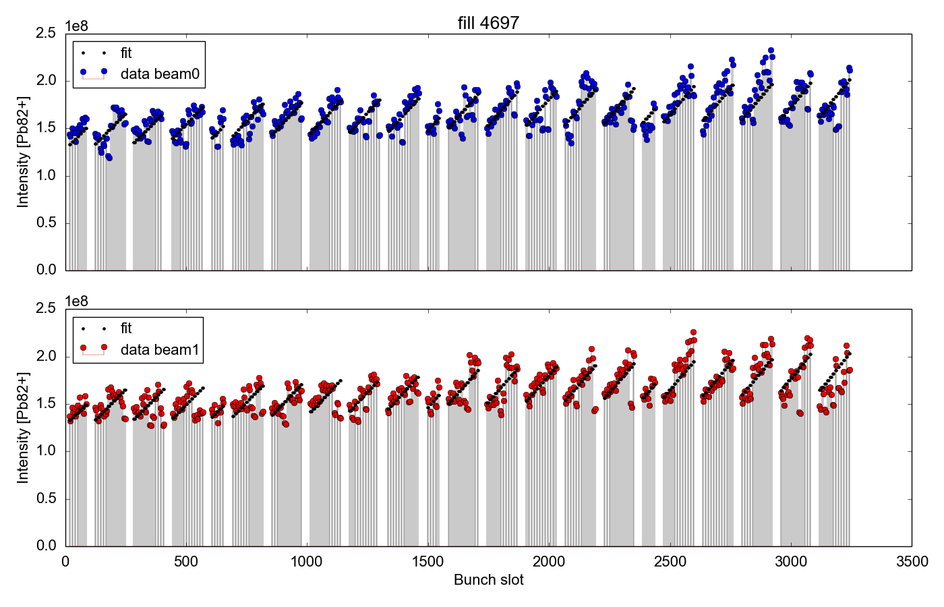
Reference fill from 2015
... chosen because it had same rms intensity as LIU baseline

Slide 16
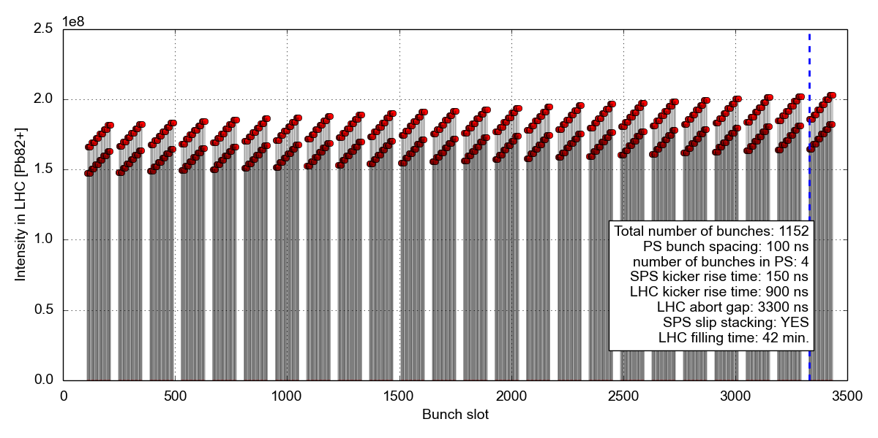
LIU baseline

Slide 17
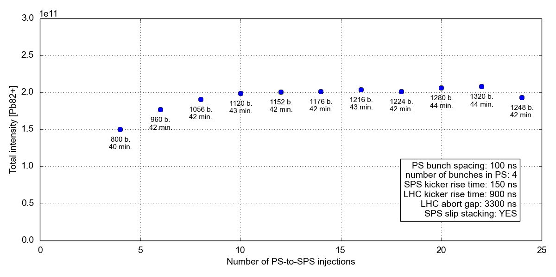
LIU baseline

Slide 18
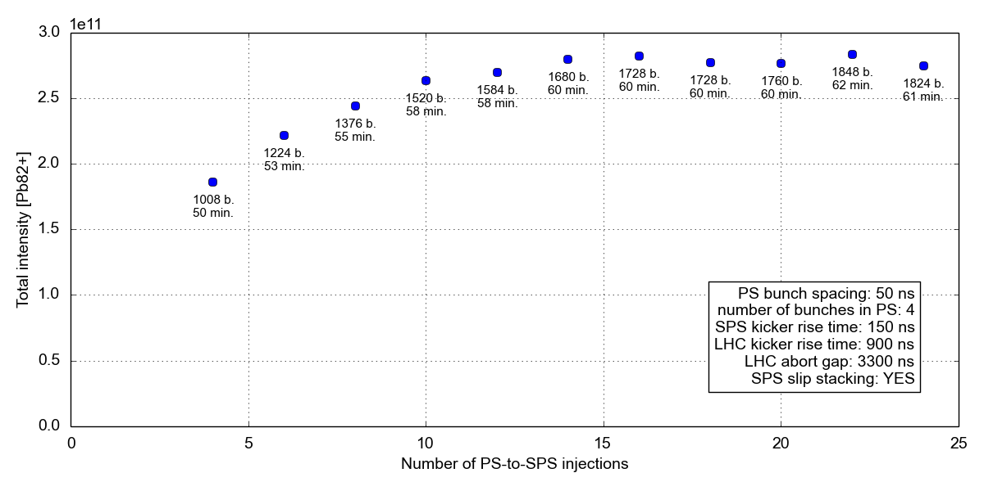
25 ns option

Slide 19
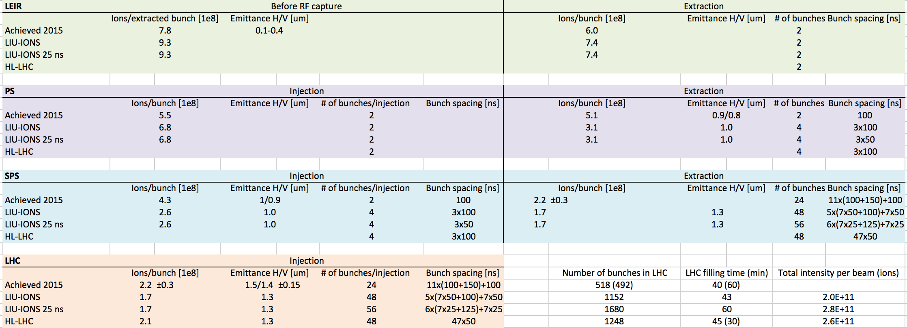
Table with 25 ns option
Option with 25 ns
Peak luminosity and number of ions in LHC optimised with 14 injections into SPS
Almost 1700 bunches in LHC
Results in larger number of ions in LHC than HL-LHC baseline!
But requires new Finemet cavity in PS …

Slide 20
Thank you for your attention

