Slide 1
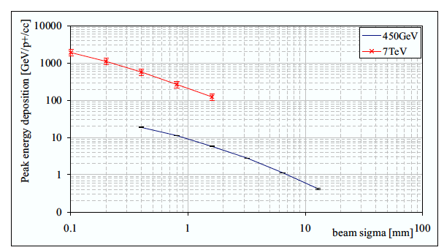
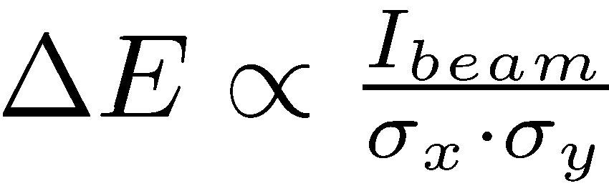
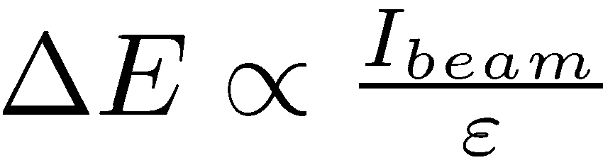
Energy deposition as function of intensity and emittance
The damage potential of a beam scales with beam brightness
Required attenuation scales with brightness, despite scattering
Emittance growth only after filamentation
Energy deposition as function of spot size σ_{x}×σ_{y}
Peak energy deposition in Cu
Assumed round beams for this simulation

Slide 2
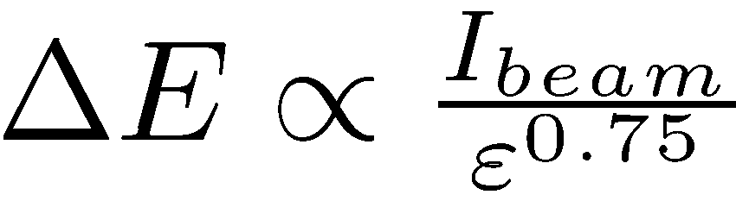
Robustness of protection devices: Energy Deposition in Graphite

Slide 3
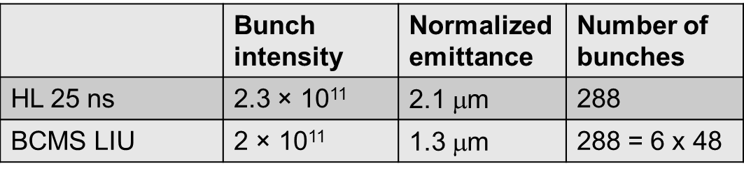
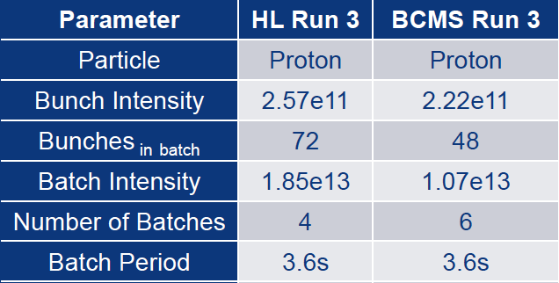
Design parameter for SPS LIU protection devices and dumps
@ 450 GeV
@ 26 GeV

Slide 4
Status
Device | Comment | Material | β_{x} x β_{y} [m²] | Upgrade for LIU
TIDVG | Sweep, intensity limitation not brightness. Continuous dumping problematic | Sandwich: Graphite, Al,Cu, W | sweep | YES. LSS5 internal dump
TPSG | 450 GeV: Assume all beam in one spot | Sandwich: graphite <-> CfC, Ti, Inconel | 2178 | YES, LSS4 integration still tricky
TED LHC | 450 GeV. Continuous dumping problematic. Graphite not in vacuum | Sandwich: Graphite, Al, Cu-Be, Cu | Check for new optics | NO, intensity interlocking upgrade required
TED HiRadMat | 450 GeV |  | Use dump spot size limit | TBD
TBSE | 450 GeV. Should survive one shot |  |  | NO
TIDP | Momentum collimator. n/a |  | Momentum halo | n/a
TBSJ | Injection dump: 26 GeV. Max intensity: 72 (48) bunches per shot | Stainless steel |  | OK, SPS 2 PS injection inhibit required
TIDH | Sweep. Dump at 28 GeV | Al | sweep | OK
TCDIs | 450 GeV. |  | 1239 | Yes. FS is out. ECR being finalized. Masks, HiRadMat
Scraper |  | Graphite | Betatron halo | OK, need fast BLMs

Slide 5
Status
Some details to be finalized but no show stoppers expected.
LIU SPS protection devices and dumps will be compatible with these parameters
Is it however OK to further increase bunch intensity for constant brightness?

Slide 6
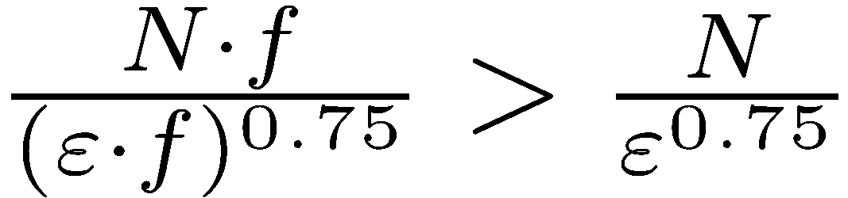
Brightness is not everything…
➔ Stress increases in low Z absorbers for higher intensity and same brightness
If intensity is increased: f > 1
Tank design, shielding and downstream mask as well as shower effect on nearby magnets depends mainly on the total intensity, less on brightness.

Slide 7
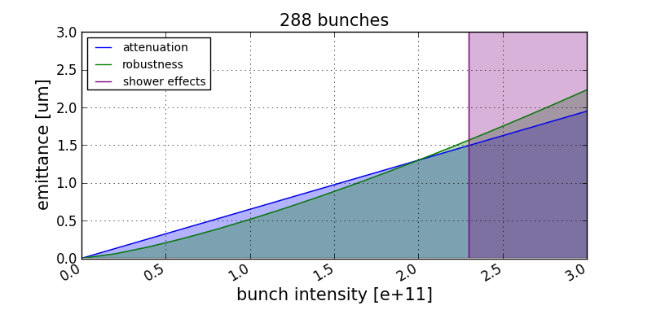
Conclusion

