Slide 1





Development of New Readout Electronics for the ATLAS LAr Calorimeter at the sLHC
Arno Straessner – TU Dresden
on behalf of the ATLAS Liquid Argon Calorimeter Group
Topical Workshop on Electronics in Particle Physics
Paris
September 21-25, 2009

Slide 2
Outline
The ATLAS Calorimeter Readout
Upgrade Scenario and Readout Architecture for the sLHC
Radiation Hard Front-end Electronics
High Bandwidth Back-end Electronics
Outlook

Slide 3

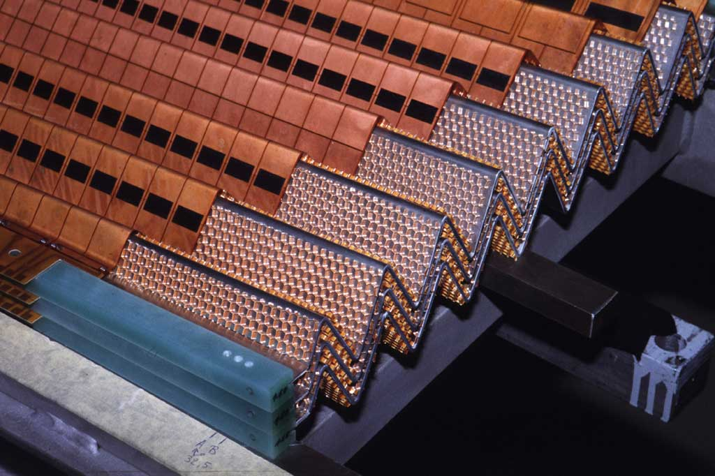
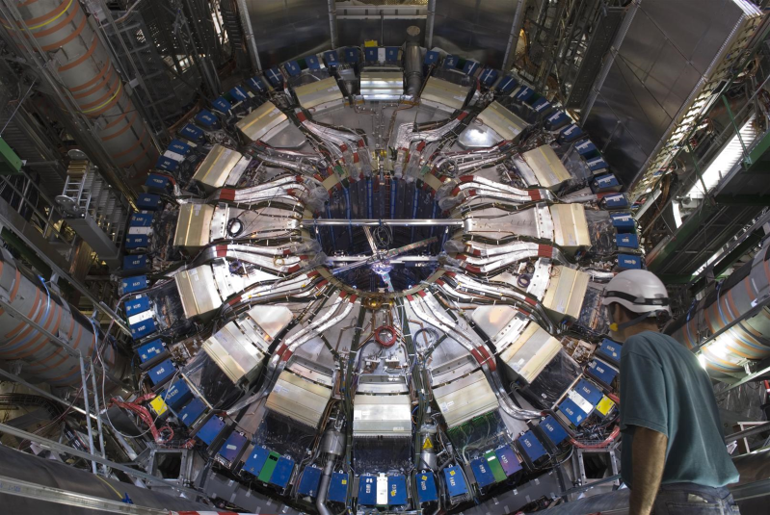
The ATLAS Liquid Argon Calorimeters
4 high granularity LAr calorimeters:
e.m. barrel Pb/LAr
e.m. endcap Pb/LAr
had. endcap Cu/LAr
forward calorimeter Cu/W/LAr
182486 readout channels
40 MHz proton-proton collision rate
front-end and trigger-sum electronics
→ on-detector in radiation environment
back-end electronics and more trigger logic
→ shielded counting room
accordion structure

Slide 4
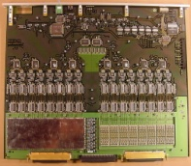
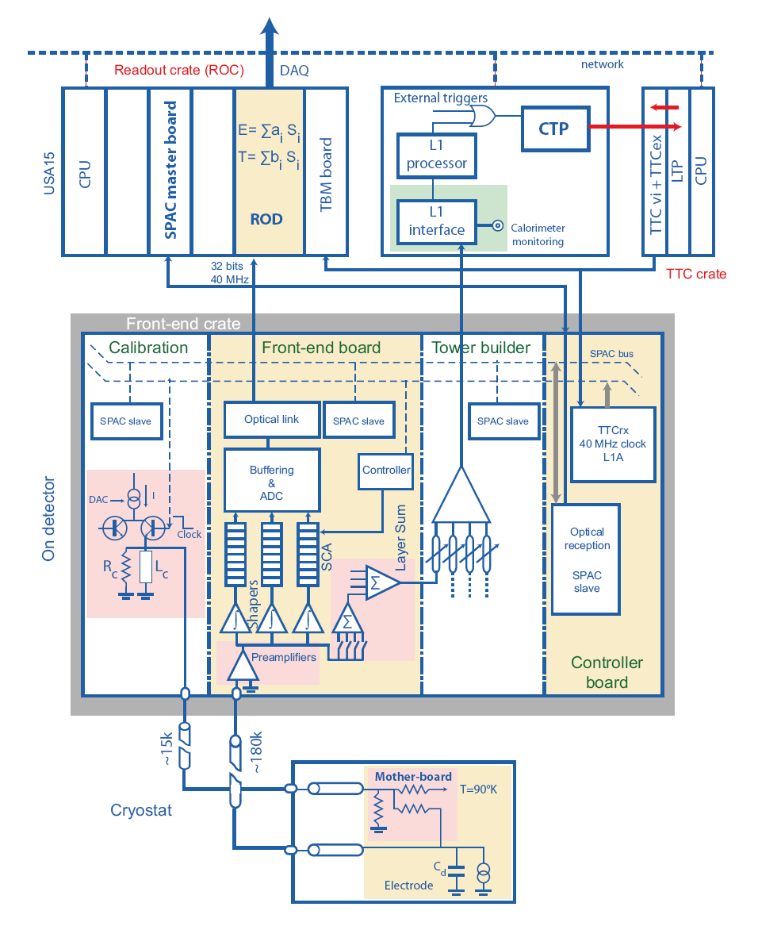
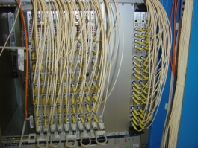
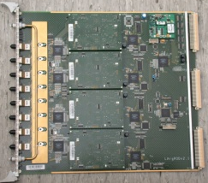
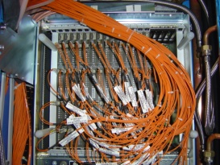
Current Layout of the Calorimeter Readout
1524 front-end boards (FEB)
  → up to 128 channels
  → preamp, pulse shaping, buffer and sampling
in 58 front-end crates
  → low-voltage power supplies (LVPS)
connected to off-detector electronics by 1600 optical links
192 read-out driver boards (ROD)
→ digital filter
800 optical links to DAQ PCs
68 read-out system PC’s (ROS)
→ DAQ and high-level trigger buffer

Slide 5
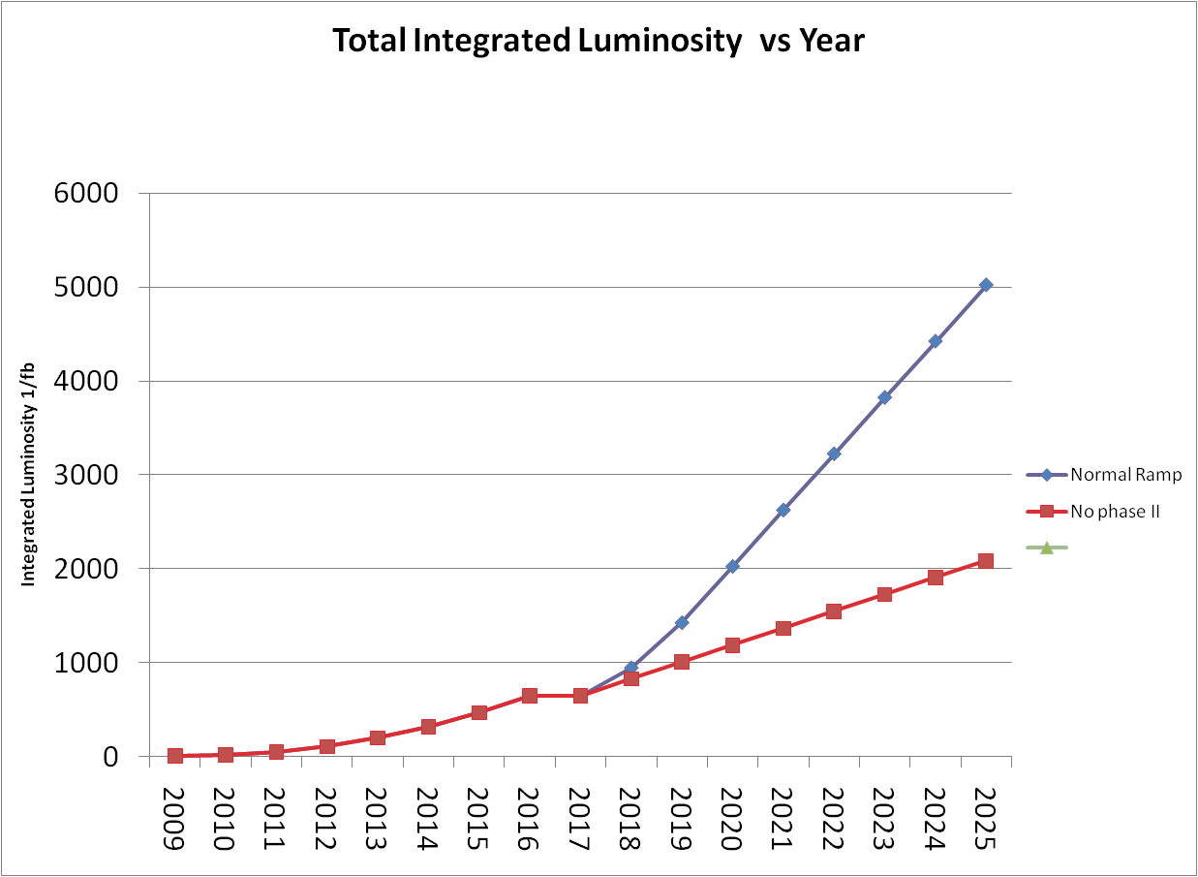
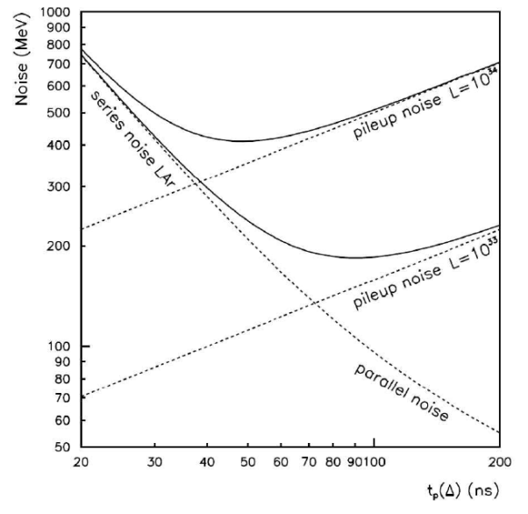
Upgrade to super-LHC
LHC upgrade in 2 phases
  sLHC starts in ~2019/20
sLHC challenges
  10x more radiation
  up to 20 times more pile-up events
  readout challenges
  → rad. hardness
  → same power consumption
  → same physics performance
    same dynamic range
    noise suppression
new calorimeter readout for 2019/20
2026
2025
2024
2023
2022
2021
2020
2019
2018
2017
2016
2015
2014
2013
2012
2011
2010
New injectors + IR upgrade phase 2
sLHC
sLHC
Noise (MeV)
Collimation phase 2
Linac4 + IR
upgrade phase 1
peak luminosity:
10³⁴ cm⁻²s⁻¹ → 3 x 10³⁴ cm⁻²s⁻¹ → 10 x 10³⁴ cm⁻²s⁻¹
Shaping - Peak time (ns)

Slide 6
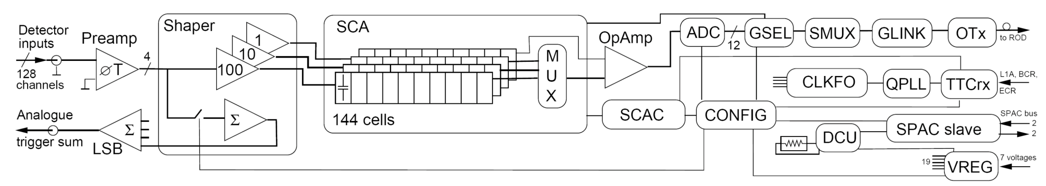
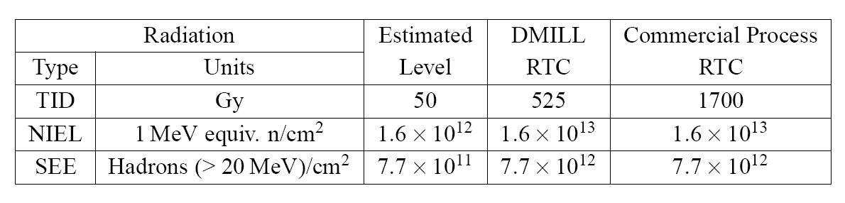
Current Front-End Limitations
complex board architecture:
  11 ASICs with different technologies
    some obsolete (DMILL, ...)
  19 voltage regulators
  analog pipelines (SCA)
  80 W/board
  water-cooled
main concern:
  qualified for 10 years of normal LHC operation (incl. safety factors)
  sLHC: 300 Krad and 10¹³ neq/cm²
  small number of spares (6%)
performance limitations:
  level-1 trigger rate only up to 100 kHz
  max. latency 2.5 μs
  min. level-1 intervals 125 ns
  fixed analog trigger sums
  (8-32 channels/trigger tower)
LHC Radiation Tolerance Criteria
replacement of single components impossible
→ new front-end boards based on today’s technology with same power budget

Slide 7
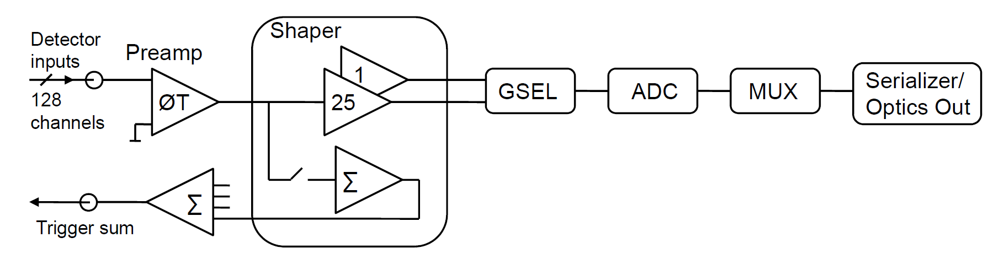
New Front-End Prototype Design
evaluate different options:
  shaper and gain settings
  analog ↔ digital pipeline
  on-detector ↔ off-detector pipeline
  analog ↔ digital gain selector
  analog trigger sums
  → possibility to keep current level-1 trigger system
R&D baseline:
  shaping and digitization at high rate
  → 128 channels at 40 MHz
  transfer rate → 100 Gb/s per FEB
  rad. hard optical links at ~10 Gb/s
  fully digital off-detector trigger
  → digital pipeline on ROD
  → trigger sums on ROD and calorimeter trigger
  → more flexible and higher trigger granularity

Slide 8
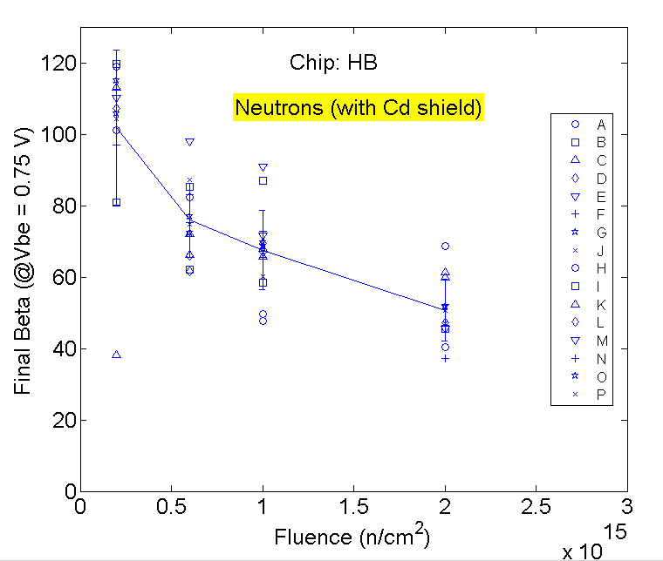
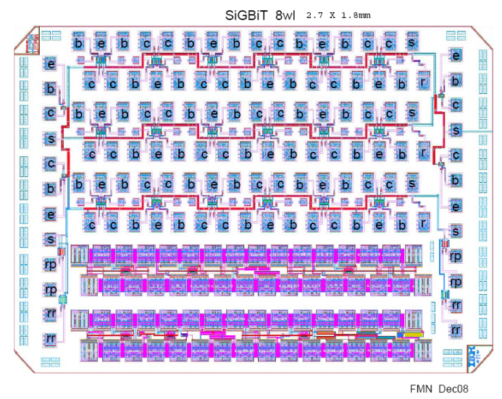
Analog Front-End R&D
SiGe IBM 8WL BiCMOS process (0.13 micron)
  technology also studied for ATLAS silicon strip tracker readout and ILC detectors
irraditation tests with spare IBM test structures
example: final gain after neutron irradiation:
  β>50 at 10¹⁴ neq/cm²
  dispersion due to irregular test structure
own chiplet submitted end of 2008
irradiation program finished and data is being
analysed
Tr. Emitter size
A .12x.52x1
B .12x1x1
C .12x2x1
D .12x3x1
E .12x4x1
F .12x8x1
G .12x12x1
H .12x1x2
I .12x3x2
J .12x8x2
K .12x12x2
L .12x3x4
M .12x8x1
N .12x3x6
O .12x8x6
P .12x16x6
Test Structure Chiplet
2.7mm x 1.8mm

Slide 9
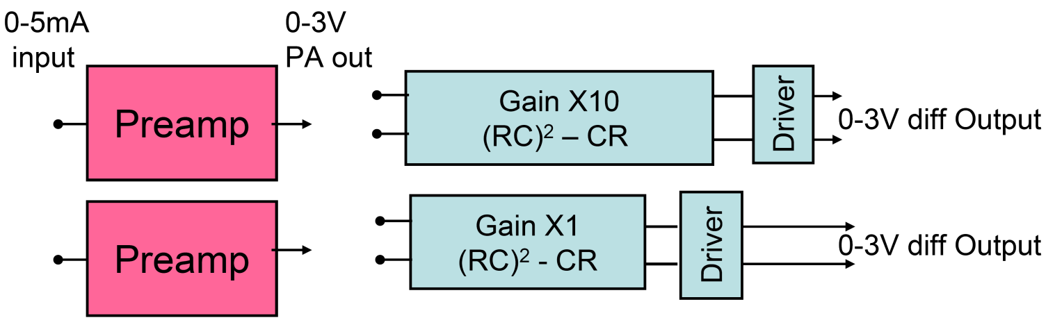
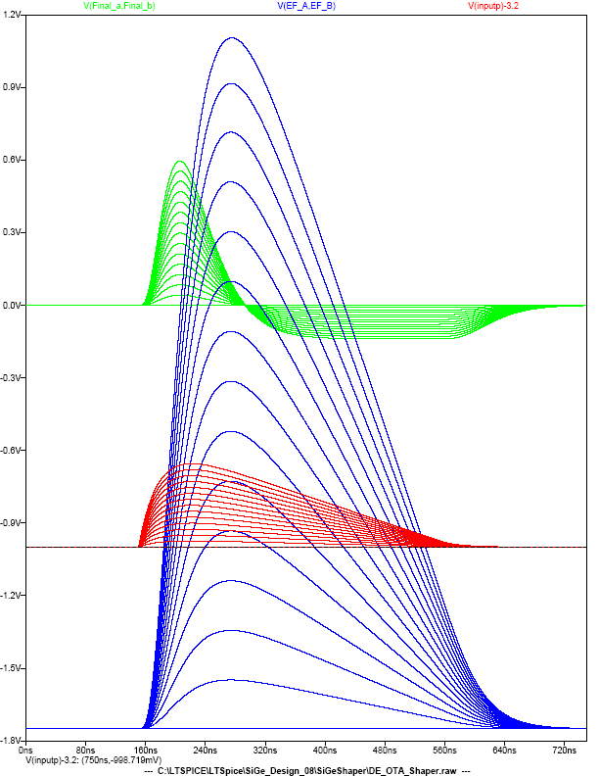
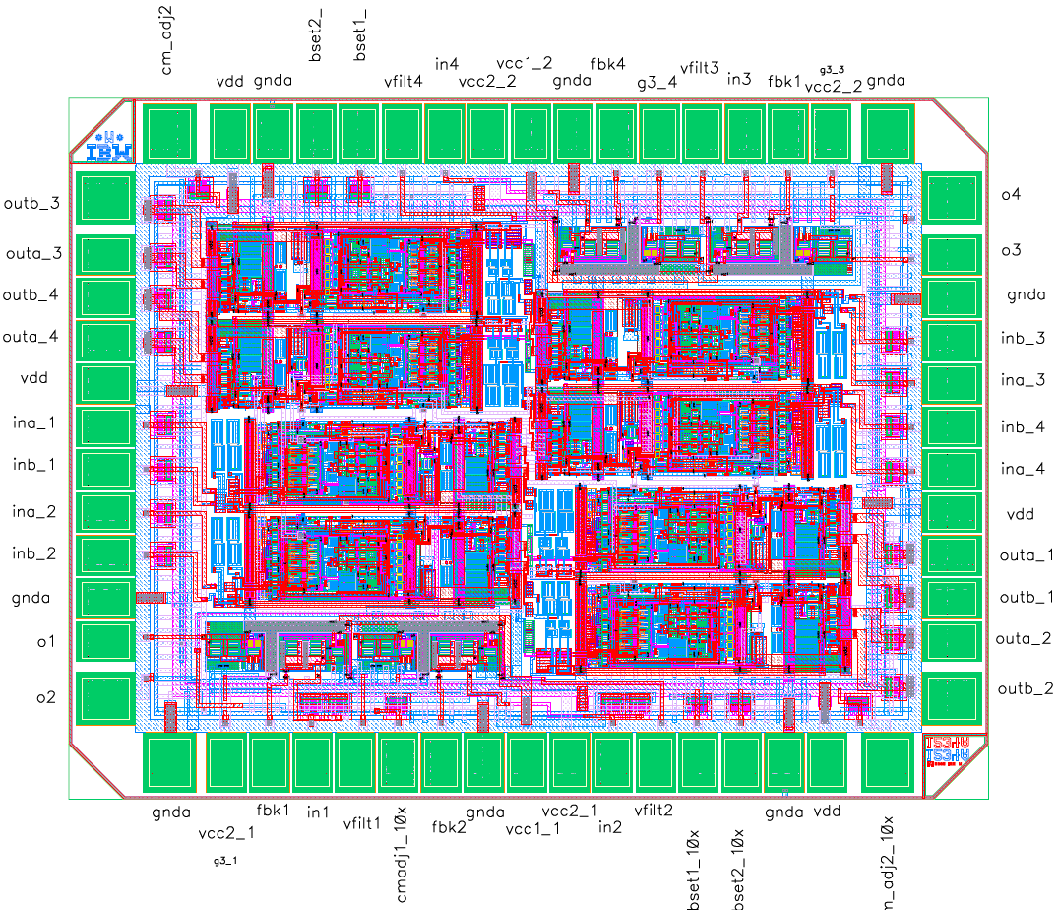
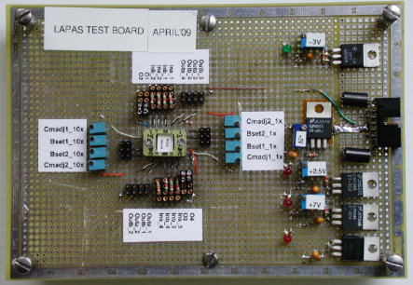
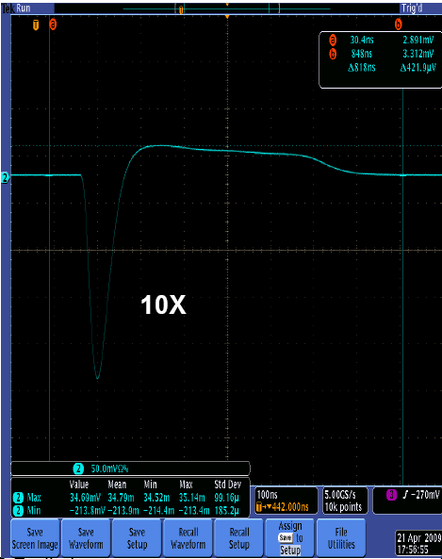
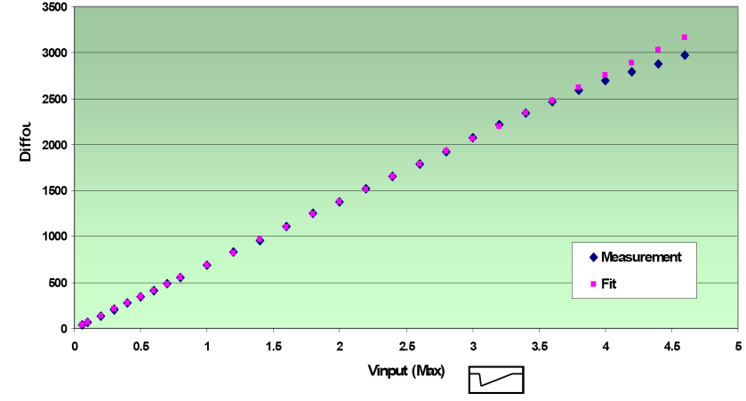
Preamp and Shaper Prototype
(RC)² 10X Shaper
(RC)²-CR
Preamp
  low noise ~0.25nV/√Hz, high dynamic range
  based on low noise line-terminating preamplifier circuit topology presently used in ATLAS LAr calorimeter
Shaper
  fully differential
  robust performance in low signal environment, excellent pickup rejection on and off chip
< 0.2% non-linearity
power ~ 40 mW / preamp and ~ 100 mW /shaper
  see: Parallel session A2 – ASICs – Mitch Newcomer
Preamp out
0-700 μA into
preamp
preamps
shapers x1
shapers x10
preamps
LAr Chiplet
2mm X 2mm

Slide 10
Mixed-Signal Front-End ADC
ADC is the most challenging component in the new “baseline” architecture
  15(16) bit dynamic range - 12 bit resolution – 40 MSPS
  radiation tolerant and immune to single event effects (SEE)
R&D strategies:
  evaluate commercial parts
      planning to test several COTS ADCs:
          AD9259 (14/12 bit), ST-RHF1201 (12 bit), TI ADS5281 (12 bit)
  development of a custom ADC
      started with IBM 8HP SiGe → 8RF CMOS is now the candidate technology
      shown to be radiation hard
      lower cost compared to SiGe
12 bit pipeline ADC with 1.5 bits/stage and digital error correction
  on-board correction will require rad-hard redundant memory
  for calibration constants
main building blocks of custom pipeline ADC:
  operational trans-impedance amplifier (OTA)
  core for the S/H and Multiplying DAC subsystems
  S/H capacitor important since noise ~ √kT/C
chiplet submitted to CERN/MOSIS with OTA + cascade of 2 T/H for testing
expected back by late October
V_{in}
S/H
Σ
G
+
-
V_{out}
ADC
DAC
1.5 bits/stage
+ error correction
Notes:
operational transconductance amplifiers OTA, T/H track and hold

Slide 11
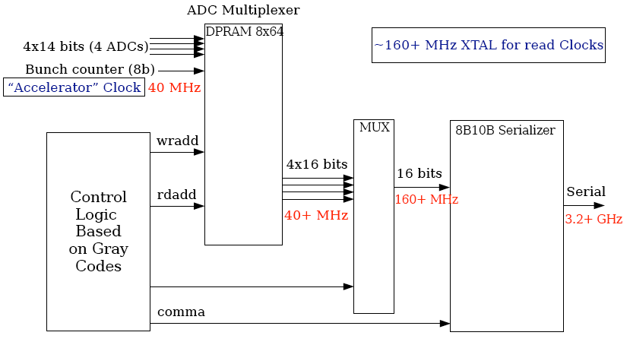
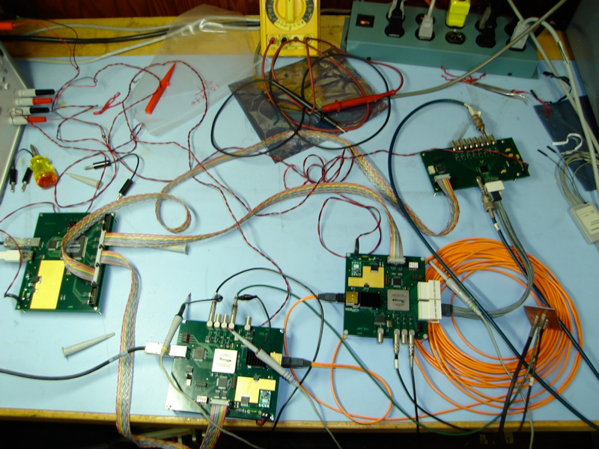
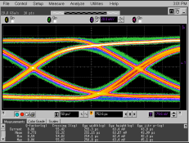
Digital Test of the Front-End
ADC
control
fanout
MUX
Tx
Rx
Notes:
operational transconductance amplifiers OTA

Slide 12

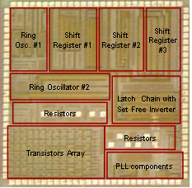
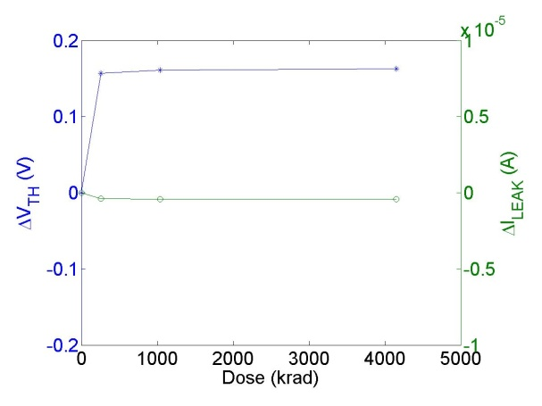
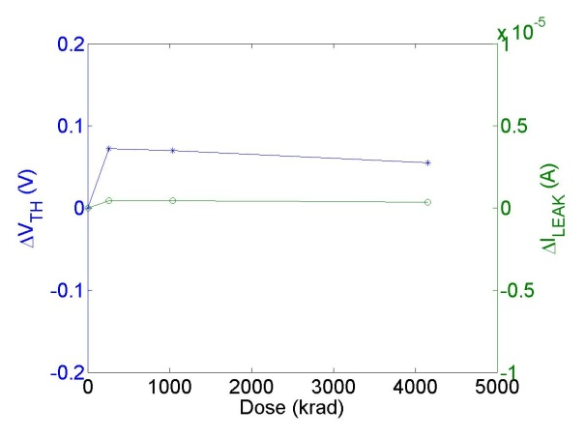
Raditation Hard Optical Links
Silicon-on-Sapphire (SoS) technology:
  0.25 μm UltraCMOS by Peregrine Semiconductors
  low power, low cross talk → good for mixed-signal ASIC designs
  economical for small to medium scale ASIC development
TID and SEE radiation tests performed in 2007:
  gamma irradiation with ⁶⁰Co source up to 4 Mrad
    with grounded substrate: small leakage currents (250 nA) and small threshold voltage increase
  irraditation in 230 MeV proton beam
    no SEE observed in shift registers at a flux of 7.7×10⁸ proton/cm²/sec
    still correctly functioning after total fluences of 1.9×10¹⁵ p/cm² (106 Mrad(Si))
NMOS transistors
PMOS transistors

Slide 13
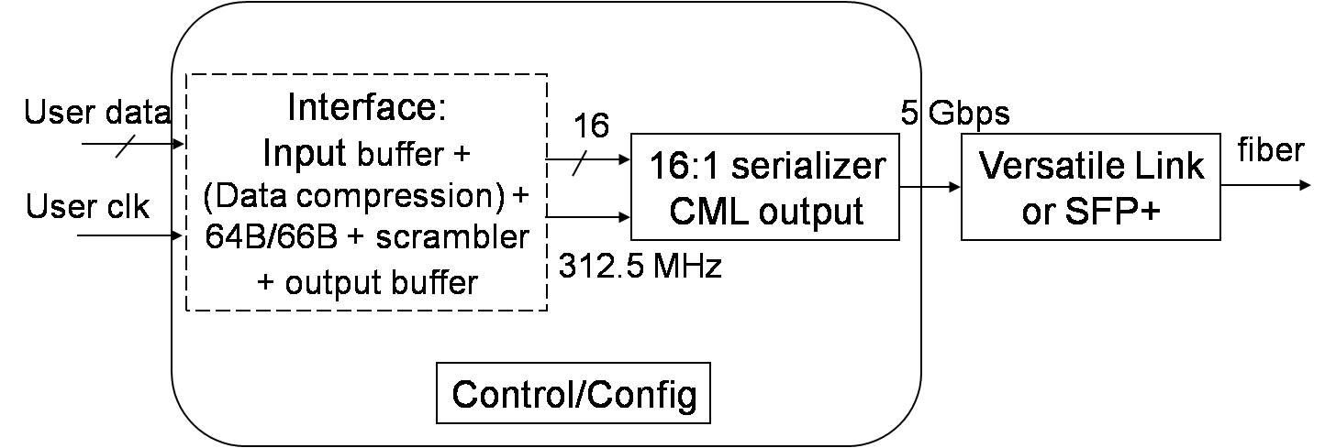
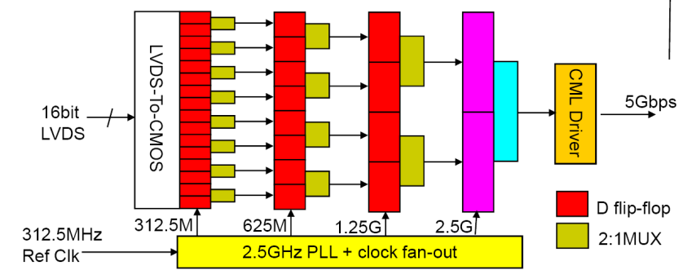
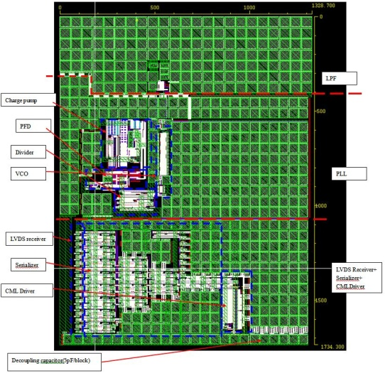
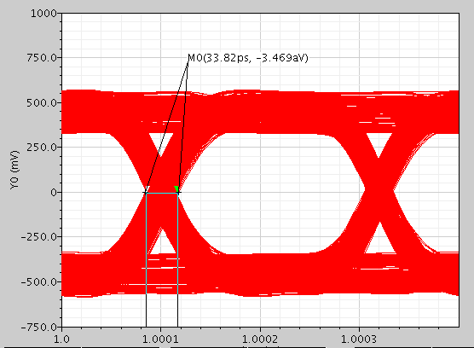
Link On Chip Prototype #2 (LOC2)
LOC1 prototype suffered of high jitter, now LOC2:
5 Gbps 16:1 serializer
  3 stages of 2:1 MUX
  last stage: 2 fast transmission gate D-flip-flops
input data and ref. clock in LDVS
output in CML at 5 Gbps → CERN Versatile Link
      Parallel Session B5 - Optoelectronics and Links: Paulo Moreira, Jan Troska
transmission bit error rate lower than 1×10⁻¹²
power consumption is below 500 mW or less than 100 mW/Gbps.
post-layout simulation show that critical components meet LOC2 requirements (PLL, DFF, CML driver)
user interface will be implemented in FPGA for tests
effort towards a 5 GHz LC-tank based PLL:
  random jitter < 1 ps (RMS) achieved in simulations
  needed for ultimate goal of a ~10 Gbps link
LOC2 layout
with ideal power source: TJ=34 ps

Slide 14

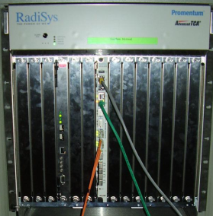
Readout Driver Upgrade
218 RODs in non rad-hard environment
1524 FEBs x 100 Gbps continuous data stream → 150 Tbps
12-fiber optical connectors MPO/MTP style → each 100 Gbps
Xilinx & Altera FPGA embedded SERDES
evaluate reduction of number of links by
    latency lossless data compression/decompression algorithm
  less bits at ADC
FPGA based Digital Signal Processing
  advantage of parallel data processing
system level architecture: AdvancedTCA
  take the advantage of industrial standard
  shelf management protocols, power management, fast fabrics
perform level 1 trigger sum digitally
  flexible and fine granularity
1 front-end crate
14 FEB
14
ROD
L1 trigger
L2 trigger DAQ
100 Gbps
10 GbE
ATCA
read-out
buffer
DAQ
10 GbE
front-end
challenges
ATCA crate

Slide 15
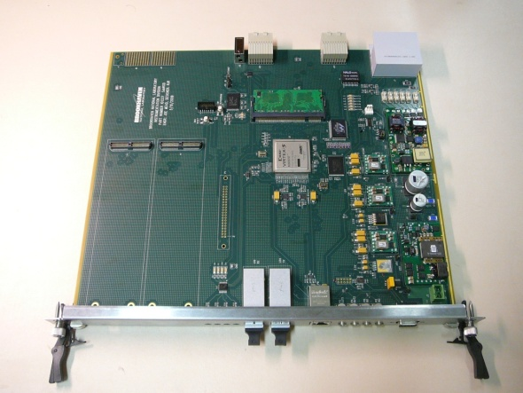
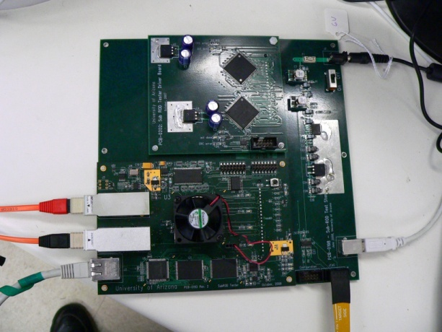
High Performance Digital Readout
  ROD prototypes with Xilinx Virtex 5 FX (XC5VFX70T)
  75Gbit/s fiber optic transceiver Reflex Photonics + SNAP 12
  ROD injector test with Altera Statix GX II
  6.5 Gbps/fiber transfer rate possible
  → with previous prototype: stable 2.4 Gbps/f. on 12 fibers
ATCA ROD prototype
ROD injector
digital linear FIR filter → FPGA embedded parallel DSPs (Xilinx Virtex 5 FX series, XC5VFX70T)
digital level-1 trigger sums
  pulse height and timing extracted from digitized pulse
  time alignment to be evaluated → current ROD has only asynchronous data transfer
total latency: 40 bunch-crossings → ~ 1 μs < currently allowed 2.5 μs
more system level tests ongoing (level-1/2 digital buffers on ROD/ROB, remote DMA, ...)

Slide 16
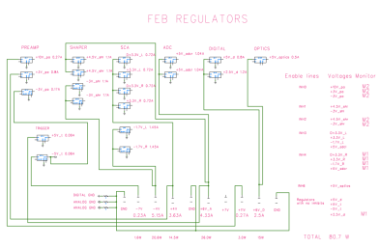
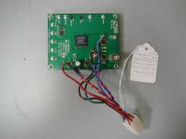
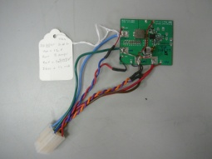
Radiation Hard Front-End Powering
current power supply scheme:
  380 VAC/3 phases → 280 V DC → DC-DC converter w/ 7 voltages → 19 voltage regulators on FEB
power budget remains approximately the same
rationalization of the number and levels of the voltages
use of point of load (POL) regulators
new LVPS architectures:
  Distributed Power Architecture
    main converter + POLs
  Intermediate Bus Architecture
    higher main voltage + 2nd bus voltages + POL converters
Card #1
POL Converter
POL
POL Converter
POL
POL Converter
POL
FEB
POL
POL
POL
2 POL tested in different positions inside front-end crate (FEC):
  LTM4602 – 6A High Efficiency DC/DC μModule
  IR3841 – Integrated 8A Synchronous Buck Regulator
noise shielding necessary if inside FEC → ready for radiation tests
POL
POL

Slide 17
Summary and Outlook
Radiation levels and physics performance at sLHC requires replacement of front-end electronics of the ATLAS Liquid Argon calorimeter
opportunity to apply modern technology and revise architecture:
  trigger-less data transfer to off-detector electronics
  fully digital trigger
several major R&D challenges:
  fast, rad-hard preamp, ADC and serial links
  high bandwidth off-detector readout
progress in all R&D activities
more results expected soon, also on radiation and performance tests of recently submitted or received 8RF CMOS, SiGe and SoS chiplets

Slide 18
Backup

Slide 19
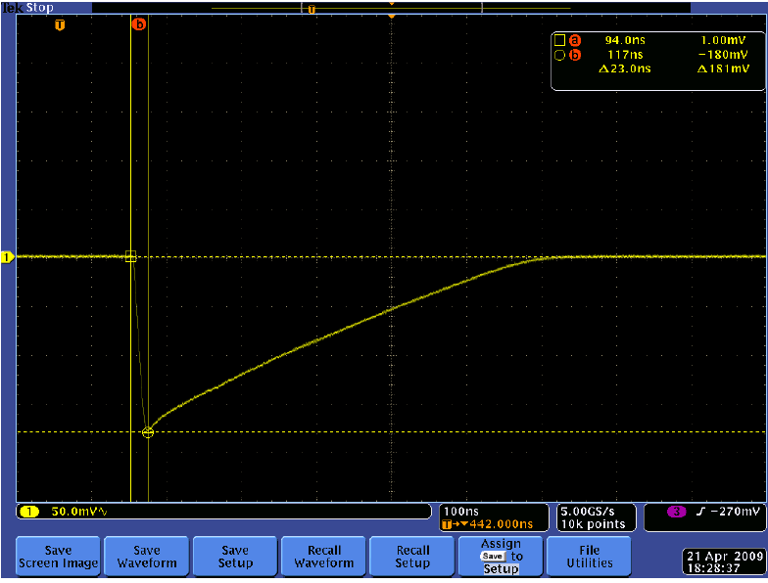
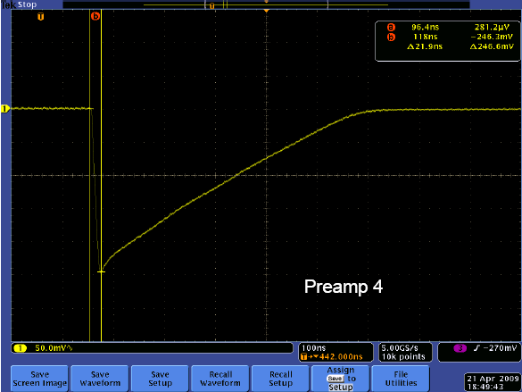
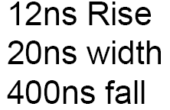
Preamp and Shaper Prototype Tests
Test board:
Input • Preamp • Shaper
preliminary linearity measurements:
goal:
  < 0.2% non-linearity
  power ~ 40 mW / preamp
  ~ 100 mW /shaper
radiation testing and data analysis is ongoing

Slide 20
Digital Test of the Front-End
2 independent clocks
  “TTC”-like clock for ADC and ADC multiplexer
  crystal derived clock for high speed components (MUX, serializer)
  → provides much better jitter control
Gray code control to manage multiplexer addresses
  minimize effect of upsets
data spends less than 8 bunch crossings in ADC multiplexer
  minimize upsets
triple redundant MUX
8B/10B encoding at level of the serializer
full DAQ chain tested with commercial components and debugged successfully
ADC
control
fanout
MUX
Tx
Rx
Notes:
operational transconductance amplifiers OTA

Slide 21
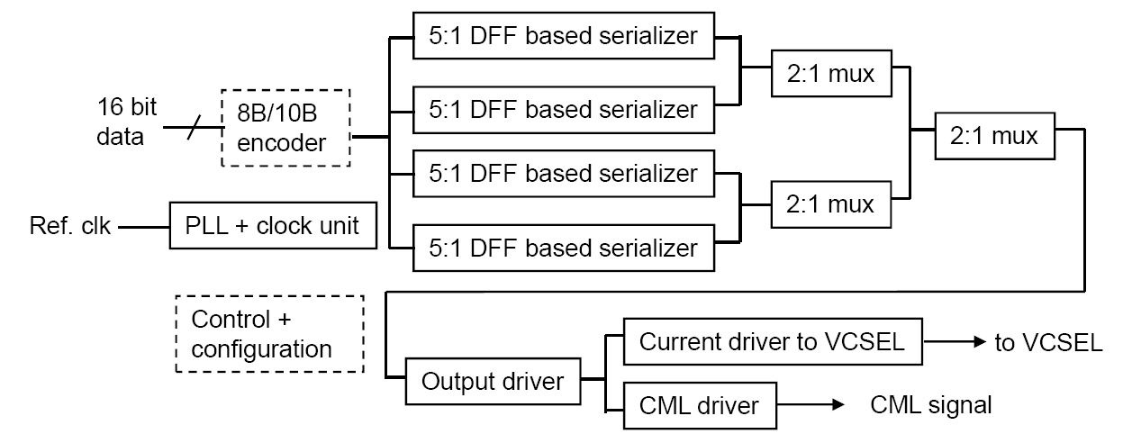
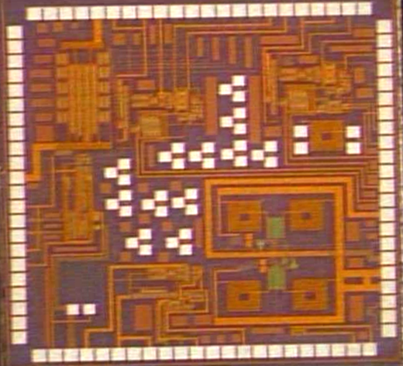
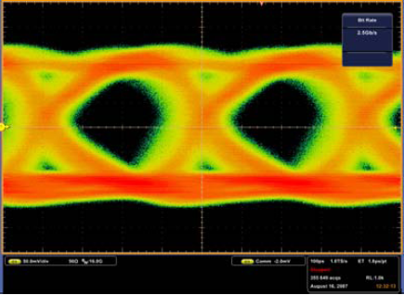
Link On Chip Prototype #1 (LOC1)
Link-
on-Chip
Standard-
alone
Ring-Type
PLL
Standard-
alone
LC-tank
PLL
solid line : implemented in LOC1
dashed line: implemented in FPGA
output rate at 2.5 Gb/s with 62.5 MHz reference clock
power consumption ~200mW
large jitter is observed and understood
  deterministic jitter from 4-arm 2-stage MUX serializer
  random jitter comes mostly from the PLL
  will be corrected in the second prototype → LOC2
  best BER reached ~10⁻¹¹
SEE test with 200 MeV proton beam
  error free for a fluence of 9x10⁹ p/cm²
  SEE cross section less than 10⁻¹⁰cm² (p)
    less than 1 error/link/h at sLHC
  data analysis is ongoing and more tests are needed
Eye diagram of a 2⁷-1 pseudo random input data, UI = 400ps

Slide 22
High Performance Digital Readout
  AdvanceTCA 8U Module
    fabric interface to implement 1/10 Gbit Ethernet, RapidIO or PCI Express protocol
    update channel to facilitate the communication between adjacent modules
    rear transition module interface for off-crate communication
  Xilinx Virtex 5 FX series FPGA (XC5VFX70T)
    6.5 Gbps RocketIO GTX transceiver
    PowerPC 440 microprocessor up to 550MHz operation
    550MHz DSP48E slices
  75Gbit/s parallel fiber optic transceiver
    Reflex Photonics 75Gbit/s SNAP 12 InterBOARD parallel fiber optic transmitter and receiver
    channel data rate of up to 6.25Gbit/s
  expansion slot on board
  ROD injector
    Altera Statix GX II FPGA is capable of running 6.375 Gbit/s
    (and more) → next version in AMC mezzanine format
  performance test with previous prototype version:
    2.4Gbps link running stably
    fixed pattern data transmission of 36 channels
    (over 12 fibers)
ATCA ROD prototype
ROD injector
→ more tests soon
with ATCA-format ROD

