Slide 1

Medipix3 Irradiation Studies
Irradiation Studies of a 130nm Large Area Pixel Chip
Richard Plackett – CERN Medipix Group
TWEPP 2009, Paris, 22nd September

Slide 2
Overview
Introducing the Medipix3 Chip
Updates from Medipix2
Charge Summation
Spectroscopic mode
Example Application
Brief Radiation Damage Overview
Specific Design Issues
Irradiation Measurements up to 460Mrad
Threshold, Noise and Gain Results
DAC Stability
Irradiation Measurements up to 3Mrad
Additional Run in the Worst Case
The Medipix3 Design team is Xavier Llopart, Rafael Ballabriga & Winnie Wong
These Measurements taken and analysed by myself, Xavier Llopart & Rafael Ballabriga
Thanks to them and all the CERN group for their support
Introduction to Medipix3
Radiation Damage
Design Issues
460MRad Irradiation
3MRad Irradiation

Slide 3
Hybrid Pixel Detectors
Ionizing Particle
A hit in the sensor deposits charge
Introduction to Medipix3
sensor
Radiation Damage
h+
The charge passes to the analogue amplifiers
e-
Design Issues
The Medipix 3 charge summing circuit operates
460MRad Irradiation
Positive or negative sensor bias
Analogue amplification
3MRad Irradiation
Digital processing
The counter is iterated and read out with the shutter
10001110101
Chip read-out
Medipix3 adds communication between the pixel analogue electronics

Slide 4
Imaging by Photon Counting
Application of HEP idea to x-ray detection and medical imaging, the concept behind Medipix chips.
Photon counting devices provide superior contrast and dynamic range to charge integrating devices.
Counting only hits that pass threshold rejects noise in the sensor giving clearer images.
Dynamic range is limited only by front end response and depth of in-pixel counters.
Introduction to Medipix3
Radiation Damage
Design Issues
460MRad Irradiation
3MRad Irradiation

Slide 5
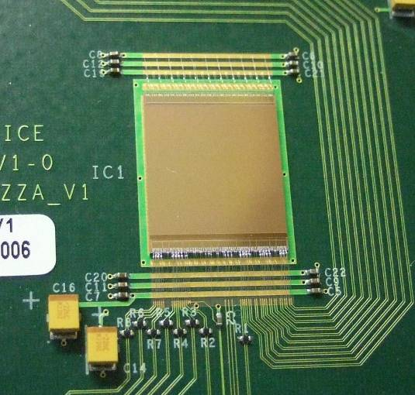
Medipix 3
Medipix3 builds on the success of Medipix2 as a single photon counting imaging chip
Added Features
  Analogue charge summing to keep all charge information
  Spectroscopic mode with 8 threshold levels
  Continuous readout mode (no dead time)
  Increased counter depth increasing dynamic range
  Increased readout speed
  Increased radiation hardness from 130nm CMOS process
Introduction to Medipix3
Radiation Damage
Design Issues
460MRad Irradiation
3MRad Irradiation

Slide 6
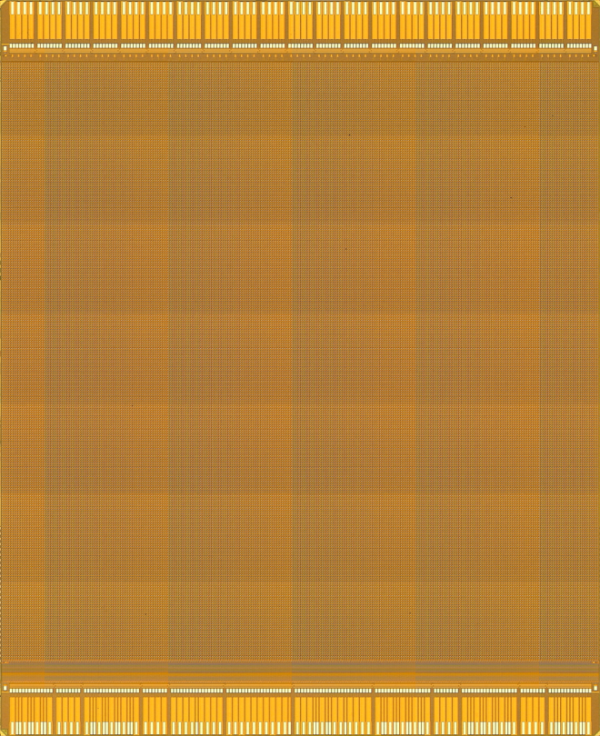
Status
First engineering run (12 wafers of 100 chips) delivered early this year
Wafer probing complete (from 11 wafers – 437 Class A + 166 ClassB)
Initial readout system working at low speed
Initial characterisation underway
One wafer diced and bonded to PCBs
First bump bonded assemblies with wafers expected soon
Initial radiation hardness measurements underway
Introduction to Medipix3
Radiation Damage
Design Issues
460MRad Irradiation
3MRad Irradiation

Slide 7
Charge Summing
Medipix3 can be set to sum charge across four pixel clusters to prevent hits being lost due to charge sharing
A hit in the sensor deposits charge across four pixels
Introduction to Medipix3
Radiation Damage
The analogue comparators assign the charge to the pixel with the most hits
Design Issues
460MRad Irradiation
This prevents ‘lost’ charge by partial hits not passing threshold
3MRad Irradiation
10001110101
The threshold is applied to the summed charge and read out when the shutter closes

Slide 8
Spectroscopic Mode
By connecting 4 pixels into a larger super pixel, eight threshold levels are available to us in the digital part of the pixel…
Introduction to Medipix3
Amplifier response
Radiation Damage
Counter 1
Counter 2
Design Issues
Counter 3
Counter 4
460MRad Irradiation
Counter 5
Counter 6
3MRad Irradiation
Counter 7
Counter 8
Each threshold is adjustable, allowing a wide range of settings.
This gives us enough flexibility to capture reasonable spectra in many different applications

Slide 9
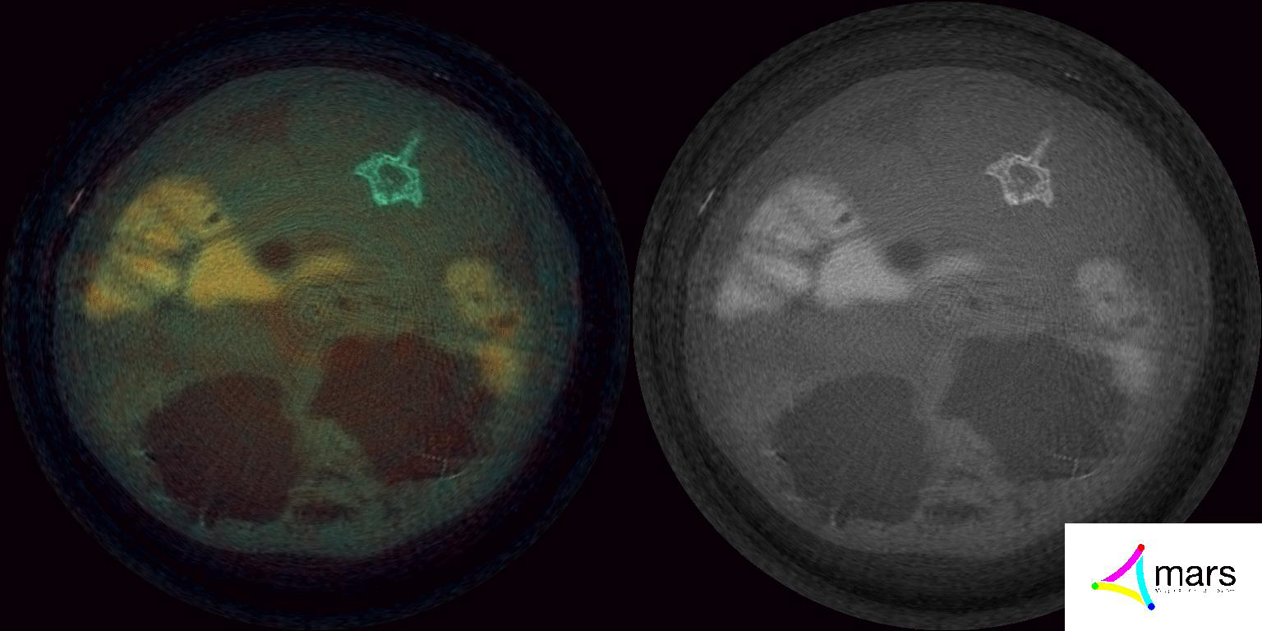
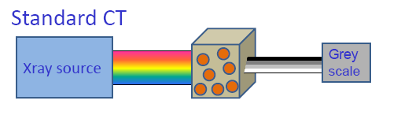
MARS Computed Tomography System
Introduction to Medipix3
Radiation Damage
Design Issues
460MRad Irradiation
3MRad Irradiation

Slide 10
Radiation Damage
130nm is expected to be significantly more radiation hard than 250nm CMOS because of the much thinner gate oxides
Radiation damage occurs because the regular crystal structure of a device is disturbed. This causes a number of effects among which are:
  Change of effective doping concentration (esp. in diodes)
  Increase leakage current (esp. in detectors)
  Charge trapping (esp. in detectors)
  Oxide charging (esp. in CMOS)
  Single Event Upset (in logic circuits)
Photons and hadrons cause different types of damage, point and cluster respectively.
Introduction to Medipix3
Radiation Damage
Design Issues
460MRad Irradiation
3MRad Irradiation

Slide 11
Analogue Switch Problem
One of the DAC outputs is particularly sensitive due to a minor design oversight
The current drawn by some minimum sized NMOS transistors when the matrix is irradiated can overload the DAC output stage stopping the pixel front end from functioning under nominal bias conditions
Here it happened at less than 1MRad so we were able to take no proper front end measurements during the 400MRad irradiation
Introduction to Medipix3
Radiation Damage
Design Issues
460MRad Irradiation
3MRad Irradiation

Slide 12
Solution
The chip operation can be recovered by modifying the DAC settings.
In particular the pre-amp reference voltage was reduced modifying the front-end operating point.
Next wafer production fix Cas DAC issue by eliminating the (unneeded) leaky NMOS
Introduction to Medipix3
Radiation Damage
Design Issues
460MRad Irradiation
3MRad Irradiation

Slide 13
400Mrad Irradiation
Introduction to Medipix3
On the Pixel Matrix 60Mrad
Threshold Variation
Gain Variation
Noise Increase
Radiation Damage
Design Issues
60 MRad
460MRad Irradiation
On the Periphery 400Mrad
Check DACs
E-fuses
Logic functionality
3MRad Irradiation
460 MRad
400 MRad
Used a calibrated X-ray machine (Seifert RP149)
Beam profile is smaller than the Medipix3 → Two runs:

Slide 14
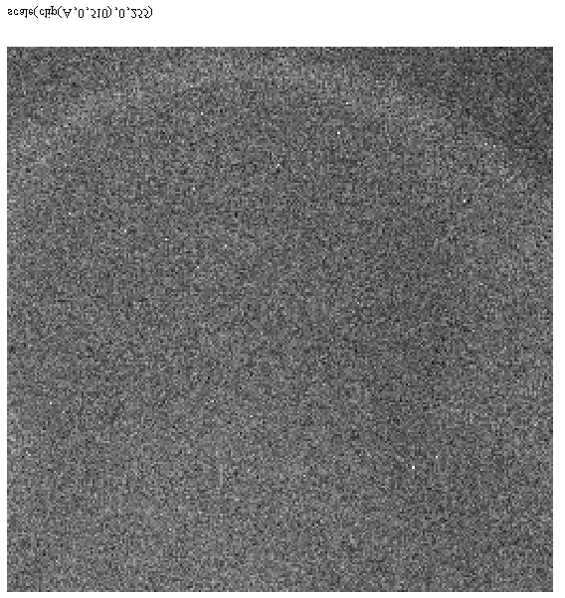
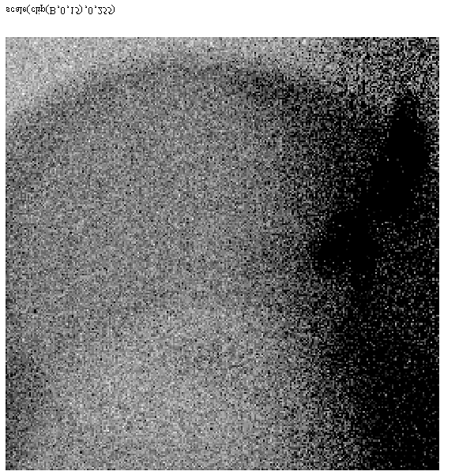
Performance after 460MRad
Threshold
Noise
Introduction to Medipix3
Radiation Damage
Design Issues
Yield artifact
460MRad Irradiation
3MRad Irradiation
σ=1.72 ke⁻
µ=9.3 ke⁻
σ=12.9 e⁻
µ=71.6 e⁻
Threshold can be re-tuned using 5 bit equalisation

Slide 15
Performance after 460MRad
Introduction to Medipix3
Radiation Damage
Row[0:255]
Yield artifact
Design Issues
460MRad Irradiation
3MRad Irradiation
Qin=2ke⁻
After 460MRad there is essentially no gain variation observed

Slide 16
DAC Measurement
PMOS DAC
Band Gap
NMOS DAC (Preamp)
Introduction to Medipix3
Radiation Damage
Accumulated dose of 396 Mrad
Accumulated dose of 396 Mrad
Design Issues
Accumulated dose of 396 Mrad
460MRad Irradiation
33mV
3MRad Irradiation
9mV

Slide 17
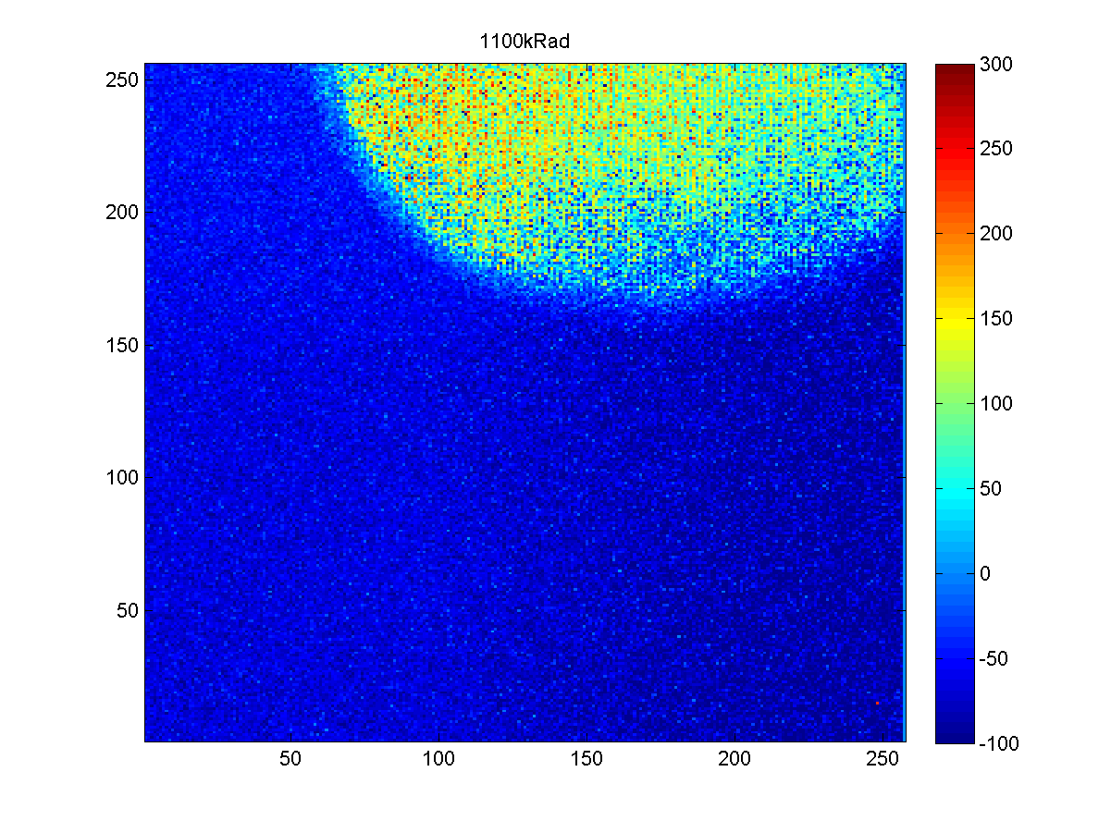
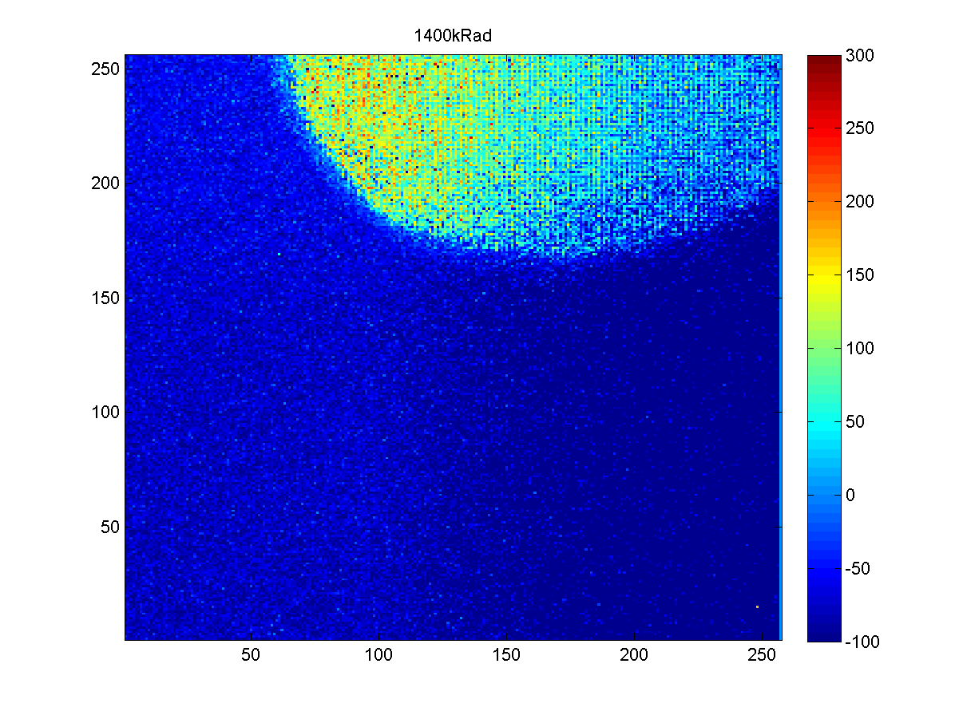
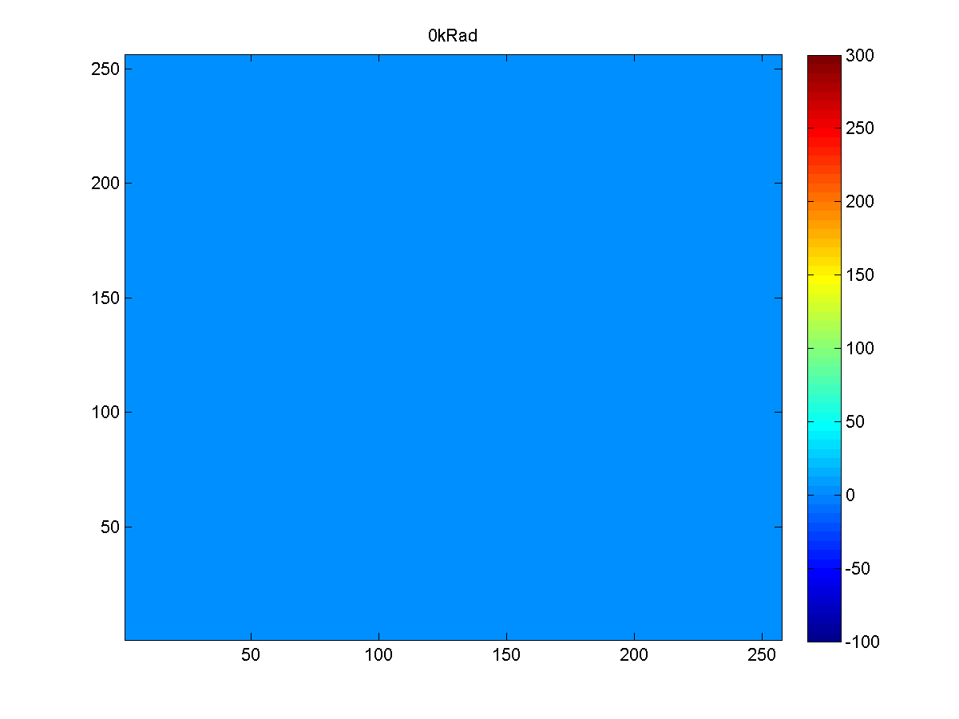
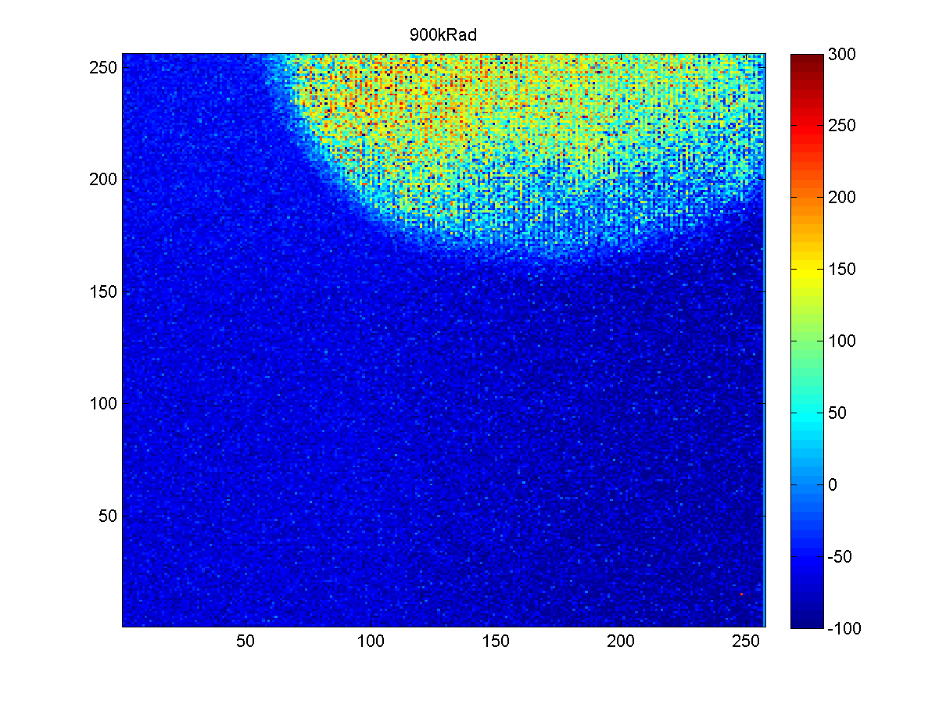
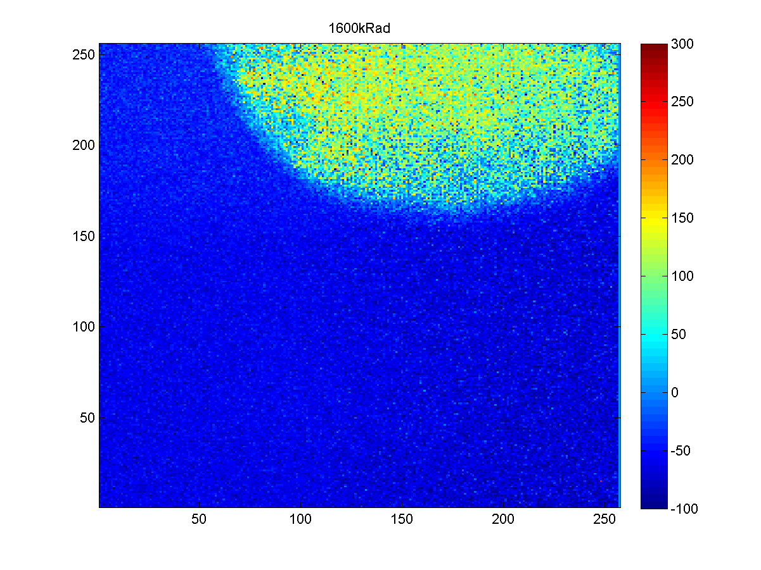
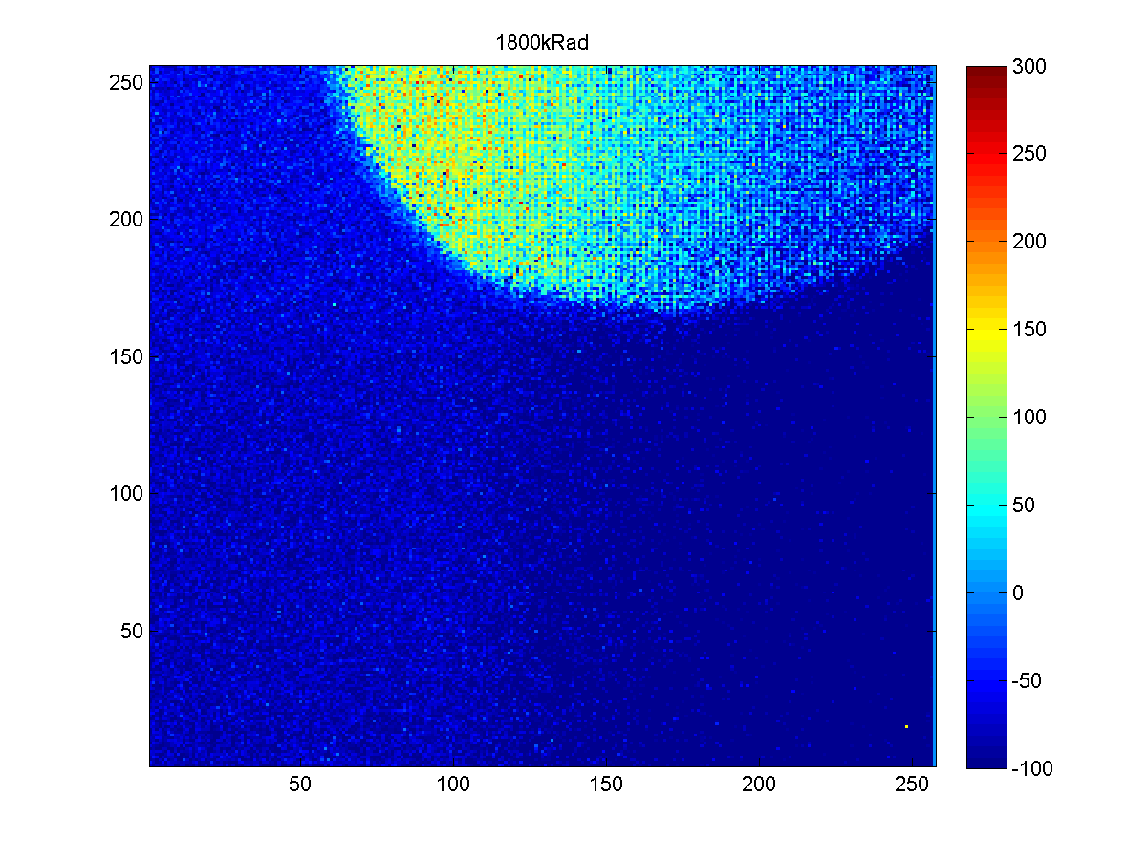
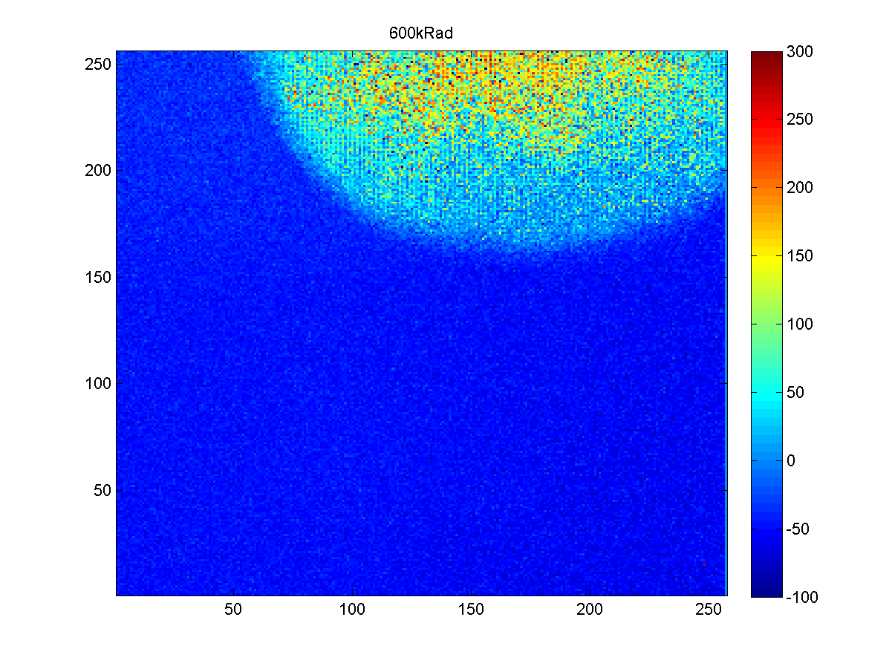
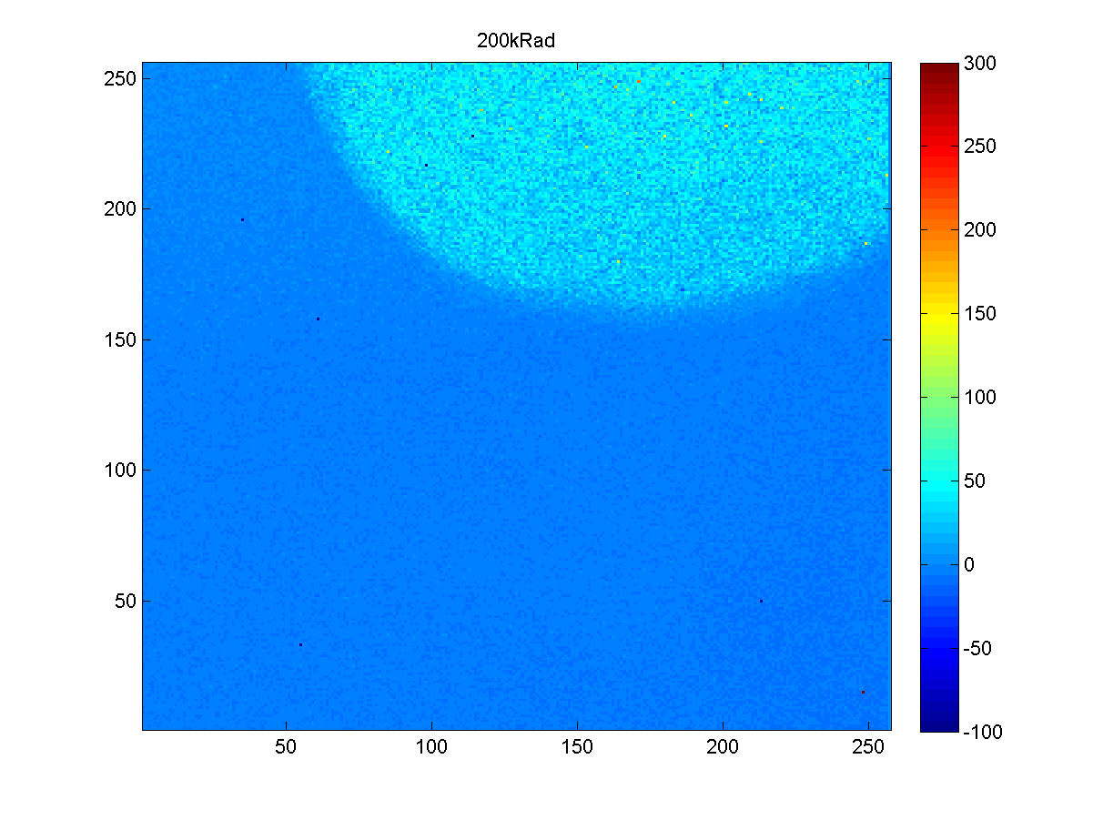
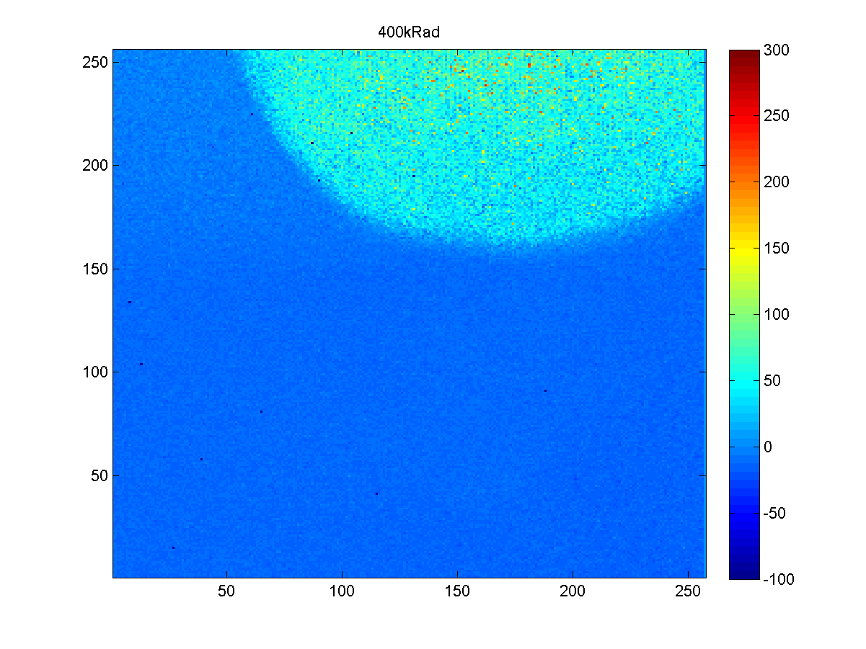
3MRad irradiation
Worst effect at 3MRad, After this the effect of further radiation is much less.
Irradiated a small area of the chip up to 3Mrad to try and keep Cas DAC working by only damaging a limited number of pixels
Introduction to Medipix3
3 MRad
Radiation Damage
Design Issues
The main effect observed is the shift in the threshold and amplifier response caused by the DAC moving…
The front end leaves its normal operating point at nominal bias conditions at 1500krad, although it remains possible to read out the chip up to 3Mrad. The front end can be recovered by increasing the value of the IKRUM DAC.
460MRad Irradiation
3MRad Irradiation

Slide 18
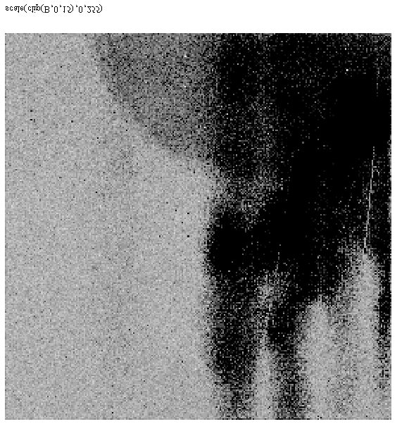
3MRad Noise and Gain Result
Introduction to Medipix3
Radiation Damage
Row[0:255]
Yield artifact
Design Issues
460MRad Irradiation
3MRad Irradiation
In this worst case situation the noise is still less than 100e⁻ and the gain variation is still minimal
Qin=2ke⁻

Slide 19
Next Steps
Repeat 400MRad measurement with bare chips and full sensors, recovering performance at each point to take measurements.
Begin hadronic measurements rather than x-rays, possibly in collaboration with LHCb upgrade projects.
Measurements with different sensors eg 3D or diamond
Next wafer production to fix Cas DAC issue by eliminating the (unneeded) leaky NMOS
Introduction to Medipix3
Radiation Damage
Design Issues
460MRad Irradiation
3MRad Irradiation

Slide 20
Conclusions
Medipix3 has been operated successfully after an exposure to a very large x-ray dose.
This is very encouraging for readout chips in SLHC trackers and other high radiation environments.
Confirmation in a full chip that 130nm is intrinsically more radiation tolerant than 250nm.
You still need to bear radiation damage in mind when designing chips to avoid unexpected problems.
Thank you for your attention.
Introduction to Medipix3
Radiation Damage
Design Issues
460MRad Irradiation
3MRad Irradiation

Slide 21
Backup Slides
This page has been left intentionally blank

Slide 22
460MRad Threshold variation
Row[0:255]
After annealing we see ~20 THL DAC steps variation (<1ke⁻) between areas non irradiated and areas irradiated at 60, 400 and 460 Mrad.
This variation can be corrected by the threshold equalization procedure (5 bits)

Slide 23
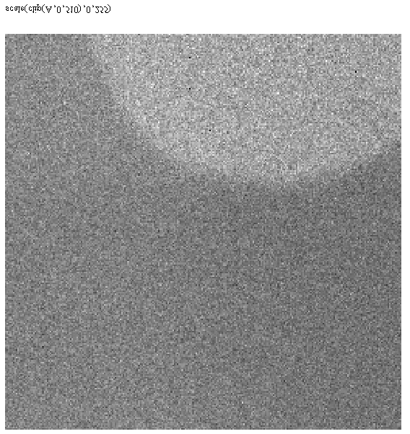
General behavior after 3 Mrad
Threshold
Noise
Yield artifact

Slide 24
THL Shift at 3MRad
Row[0:255]
Main contributor is the protection diode. In order to minimize the pixel to pixel threshold variation Ikrum is set to 16nA which indicated that the leakage of this diode at 3Mrad is ~5 to 10 nA.
This is the worst radiation operation point.

Slide 25
Difference in CAS DAC range
Good chip (F7) shows CAS DAC dynamic ranger larger than other chips → Less ids transistor leakage in analog switches?

