Slide 1
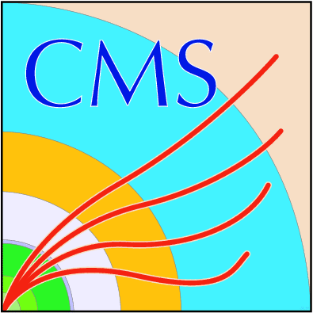
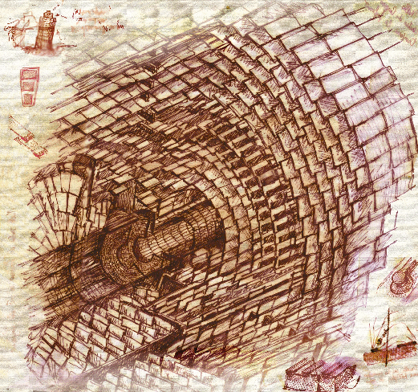

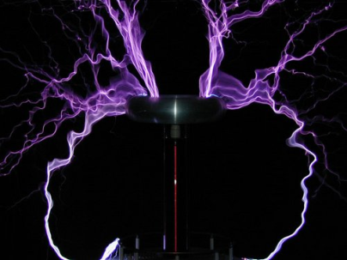
Experimental Studies Towards a
DC-DC Conversion Powering Scheme
for the CMS Silicon Strip Tracker at SLHC
Lutz Feld, Rüdiger Jussen, Waclaw Karpinski,
Katja Klein, Jennifer Merz, Jan Sammet
1. Physikalisches Institut B
RWTH Aachen University
Topical Workshop on Electronics for Particle Physics
Paris, September 23rd, 2009

Slide 2
Outline
SLHC and the CMS tracker upgrade
Buck converter development at RWTH Aachen
  Effect on material budget
  System tests
  Efficiency
  EMC
Filtering
  LDO regulators
  π-filters
Noise susceptibility
Integration into the CMS tracker
Summary

Slide 3
SLHC & the CMS Tracker Upgrade
 | LHC | SLHC Phase-1 | SLHC Phase-2
Luminosity | 10³⁴cm⁻²s⁻¹ | 2 x 10³⁴cm⁻²s⁻¹ | 10³⁵cm⁻²s⁻¹
Particles in tracker | ~ 1 000 | ~ 2 000 | ~ 15 000 – 20 000 depending on scenario
Start-up | 2009 = t₀ | t₀ + 4-5 years | t₀ + 10 years
Severe consequences for CMS and its Silicon Strip Tracker, e.g.:
Higher granularity needed ⇒ strip length decreases from 10-20cm to 2.5-5cm
Track information must be used in the level-1 trigger to preserve 100kHz trigger rate
⇒ pixellated layers with complex, fast digital electronics and high power consumption
Smaller feature size FE-electronics: 250nm → 130nm or below
⇒ saves power, but leads to larger currents for same power consumption
Preserve (improve?) detector quality ⇒ decrease material budget inside tracker (cables!)
Services – including power cables – to the tracker cannot be exchanged
A new, different Tracker will be built. Its power consumption might be high.

Slide 4
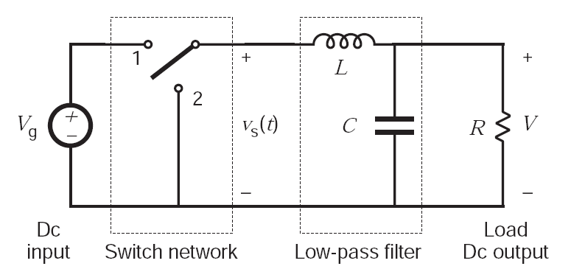
DC-DC Conversion for the Tracker Upgrade
A novel powering scheme will be needed ⇒ review process to narrow down options.
The CMS tracker has chosen DC-DC conversion as baseline solution, and
maintains Serial Powering as back-up. Reverting to back-up must remain possible.
DC-DC Converter
DC-DC Converter
Conversion ratio r = 2 - 10
r = V_{in}/V_{out} = I_{out}/I_{in}
V_{in} (e.g. 10V)
Cable loss red. by 1/r²
V_{out} (e.g. 1.2V)
“Buck converter“: few components, efficiency ~ 80%, high currents, high r
Ferrites saturate for B > ~2T
⇒ air-core inductor needed
bulky
Switching noise
radiates noise
HV-tolerant
semi-conductor
technology needed
radiation-hardness
(22cm & 3000fb⁻¹:
Fluence ~ 10¹⁵/cm²
Dose ~ 1MGy)
Efficiency
Material budget
Space constraints

Slide 5
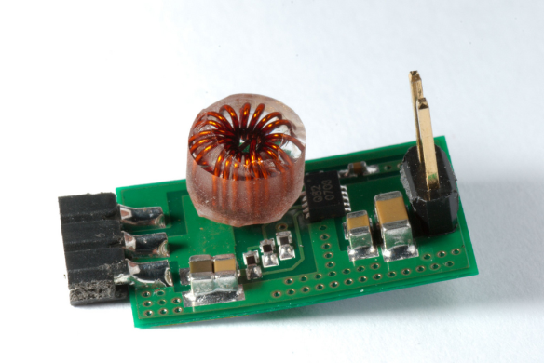
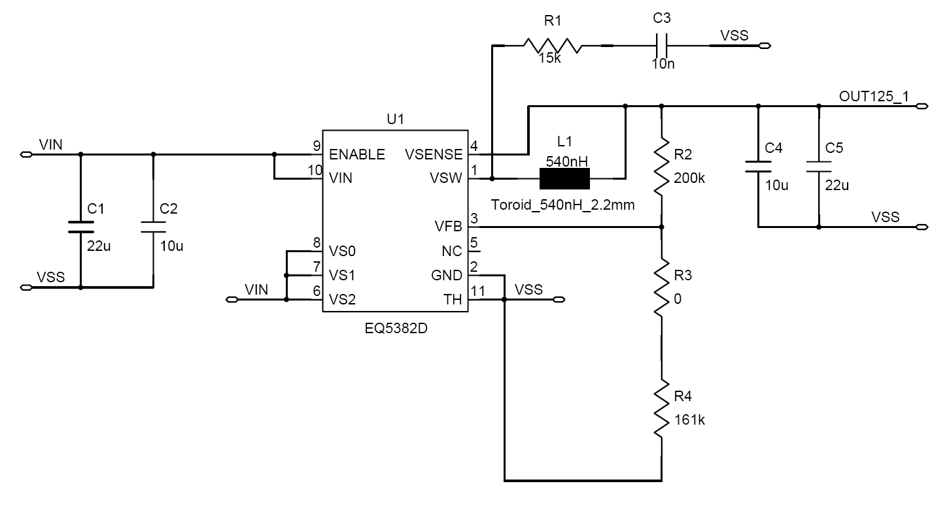
Aachen DC-DC Converters
Idea of Aachen R&D: develop buck converters with commercial non-radiation-hard
chips; optimize for low mass, low space, low noise; and study in system test
PCB:
2 copper layers a 35μm
FR4, 200µm
V = 2.3cm² x 10mm
m = 1.0g
12mm
19mm
Chip: Enpirion EQ5382D
V_{in} = 2.4-5.5V(rec.)/7.0V(max.)
I_{out} ≤ 0.8A
f_{s} ≈ 4MHz
Air-core inductor:
Custom-made toroid, ∅ ≈ 6mm
L = 200nH or 600nH
Input/output filters
Snubber to reduce ringing

Slide 6
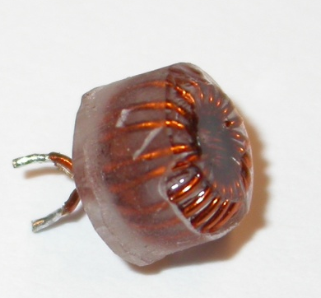
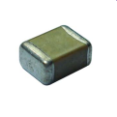
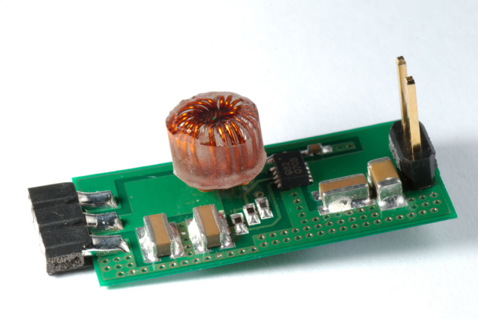
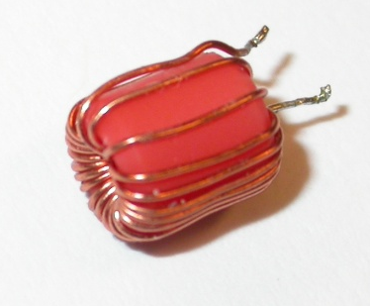
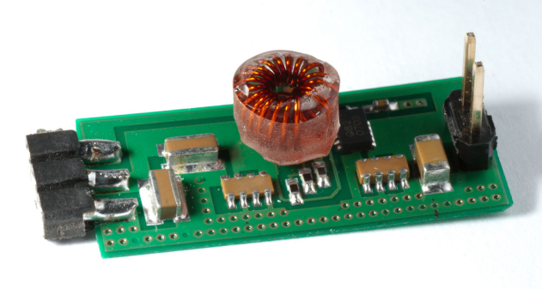

Aachen DC-DC Converter Variants
Three different filter capacitors:
Two different air-core toroids:
custom-made, small, low mass
AC2-StandardC:
Standard caps;
in: 22μF || 10μF;
out: 22μF || 10μF
4mm
“Tiny Toroid“
L = 200nH
R_{DC} = 40-50mΩ
m = 0.2g
6mm
19mm
AC2-ReverseC:
3 caps a 10μF in reverse geometry
for low ESL
“Mini Toroid“
L = 600nH
R_{DC} = 80-100mΩ
m = 0.3g
6mm
25mm
7mm
AC2-IDC:
2 Inter-Digitated
Caps with 8 legs for low ESL (<100pH)
in:1μF, out: 2.2μF
27mm

Slide 7
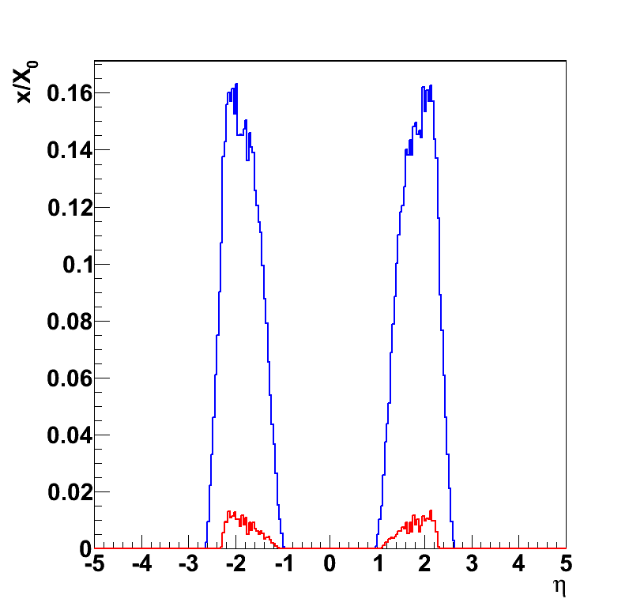
Effect on Material Budget (MB)
Motivation for new powering schemes is to save material inside the tracker
⇒ contribution of converter should be as small as possible
MB of all End Cap
- silicon strip modules
- DC-DC converters
Simulation with CMS software based
on GEANT4 (CMSSW)
1 AC2-StandardC converter per Tracker
End Cap module, located on FE-hybrid
Current tracker layout
X₀ = radiation length
x/X₀ = fraction of radiation length
Pseudo rapidity η = −ln(tan(θ/2))
η = 0
η = 2.5
Beam pipe
Contribution from DC-DC converters
~10% of current strip modules

Slide 8
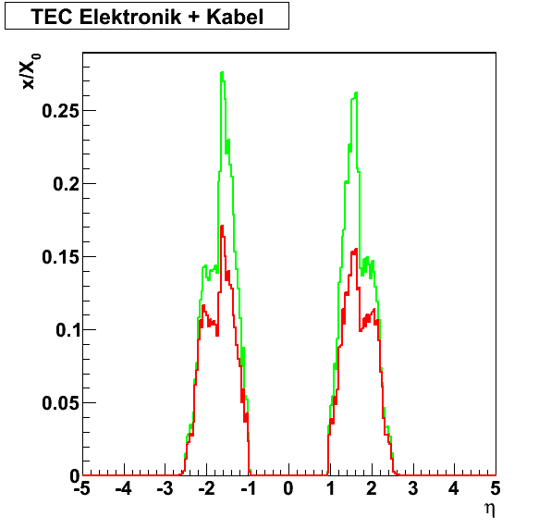
Effect on Material Budget
Lower currents with DC-DC converters ⇒ saves copper in cables & motherboards
Electronics & cables
Old layout
DC-DC conv.
- 30.9%
Assumptions:
conversion ratio = 8
80% converter efficiency
Cables:
calculate new conductor cross-section from
todays‘ maximal allowed voltage drop
between power supply and silicon module
Motherboards:
allow for 3% of module power to be lost in
motherboards;
calculate width of traces for each module
Within the applied model, we can save 30.9% in “Electronics & cables“
and 8.0% for total Tracker End Caps!
Total savings for Serial Powering similar: 7.5%.

Slide 9
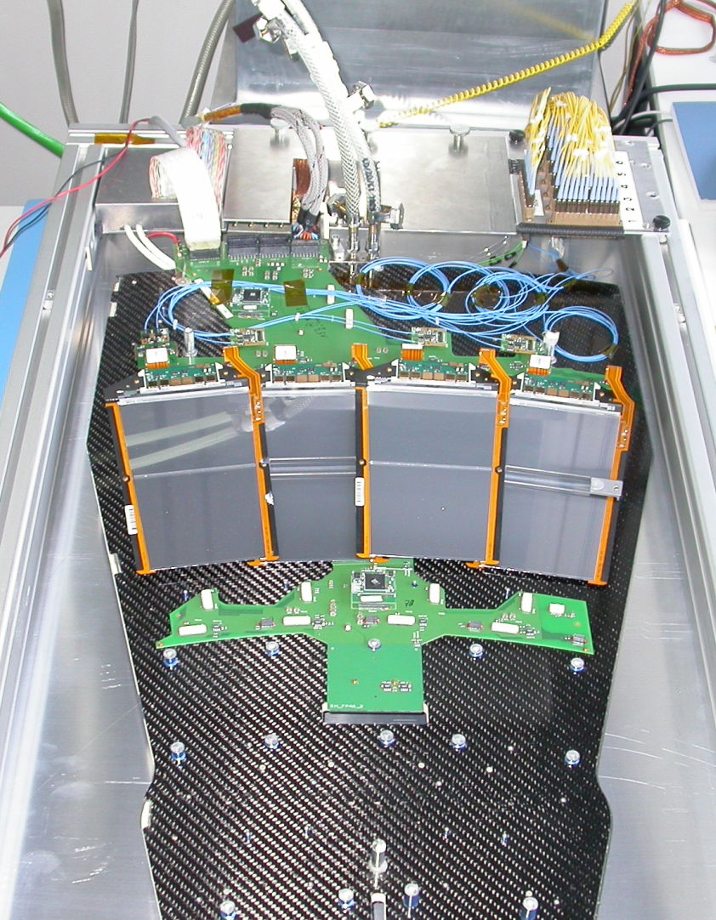
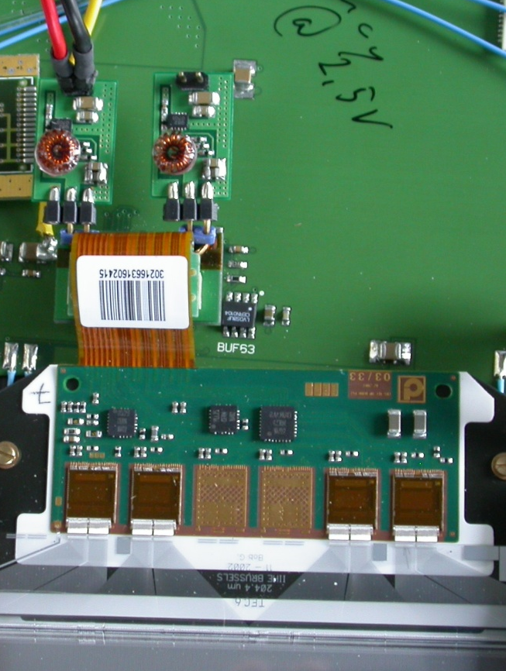
System Test Set-Up
SLHC readout chips and module prototypes not available before 2010/1011
We believe a lot can be learned from current CMS tracker hardware
TEC petal
APV25 readout chip:
0.25 µm CMOS
128 channels
- analogue readout
- per channel: pre-amp.,
CR-RC shaper, pipeline
- τ = 50ns
- 1.25V & 2.50V supply
- I₂₅₀ = 0.12A, I₁₂₅ = 0.06A
Ring 6 modules
6.4
6.3
6.2
6.1
Motherboard
Two DC-DC converters per module
Integrated via additional adapter
V_{in} from external power supply

Slide 10
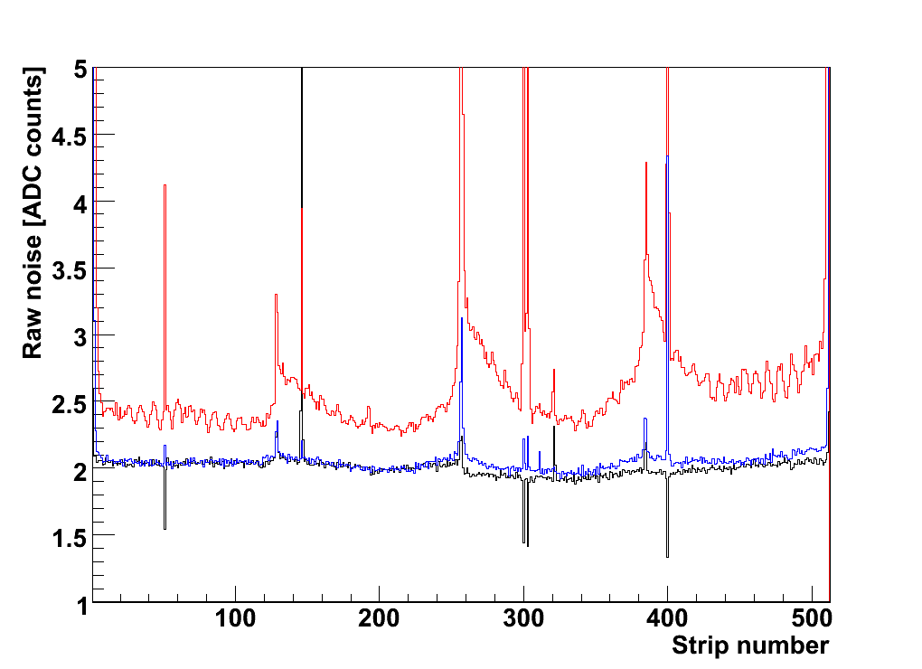
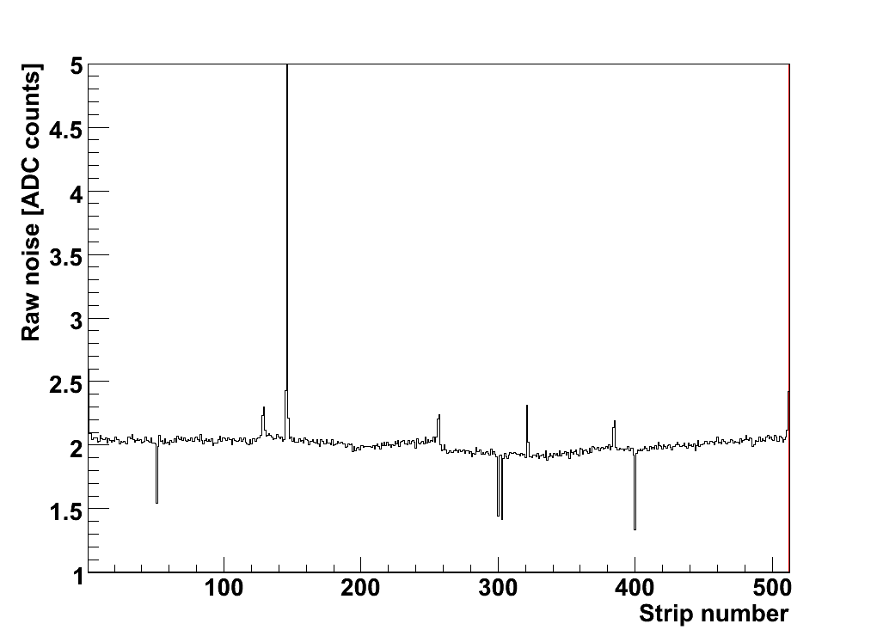
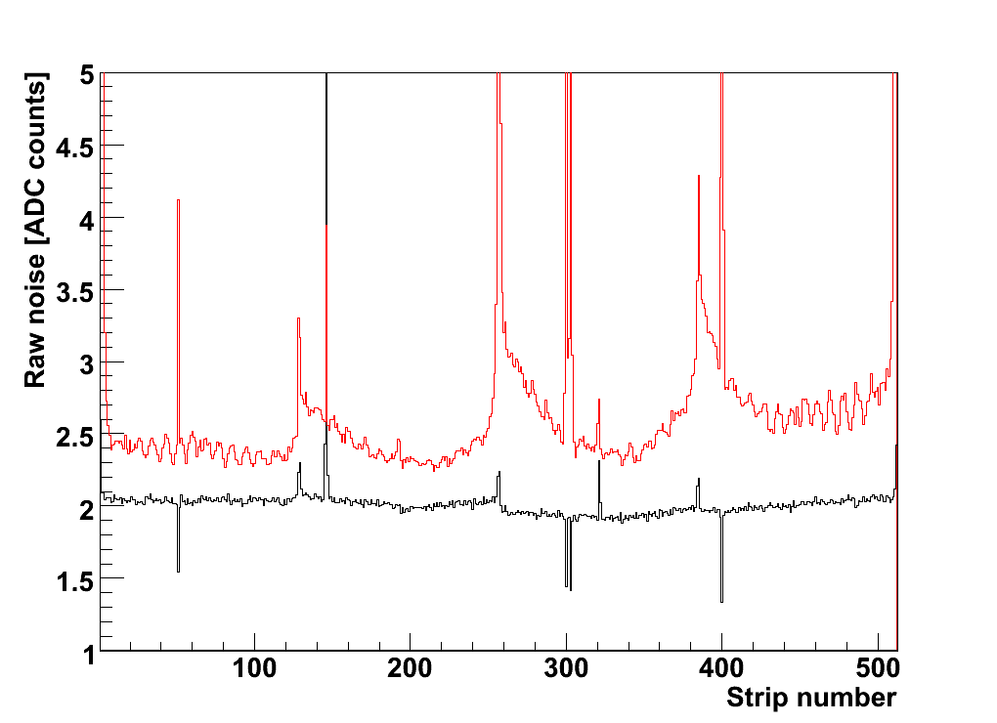
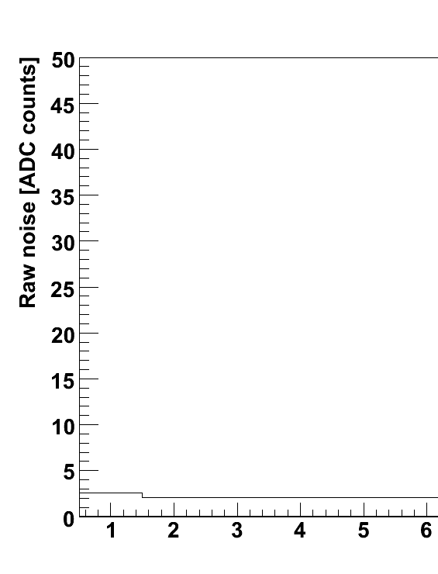
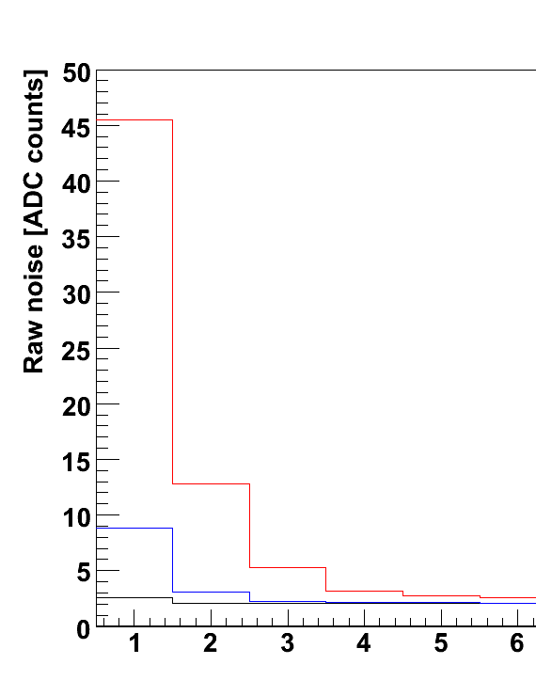
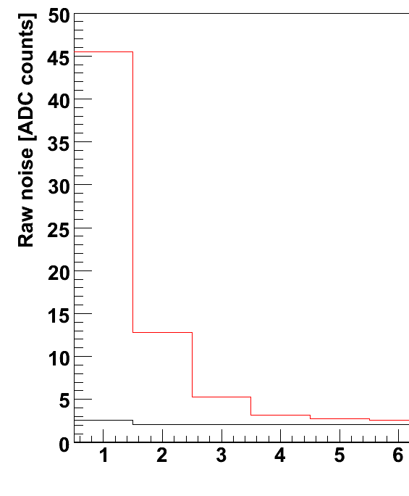
Silicon Strip Module Noise
Zoom onto edge channels
--- Conventional powering
--- DC-DC converter (AC1, 2008)
--- DC-DC converter (AC2, 2009)
--- Conventional powering
--- DC-DC converter (AC1, 2008)
--- Conventional
powering
--- DC-DC converter
(AC1, 2008)
Conventional
powering
--- Conventional
powering
--- DC-DC converter
(AC1, 2008)
--- DC-DC converter
(AC2, 2009)
Conventional
powering
{
1 APV = 128 strips
Raw noise: RMS of fluctuation around pedestal value
Edge channels are particularly sensitive (explanation in back-up slides)
Large increase with previous generation of boards (AC1), in particular on edge strips;
both conductive (ripple) and radiative (inductor) contributions (TWEPP08)

Slide 11
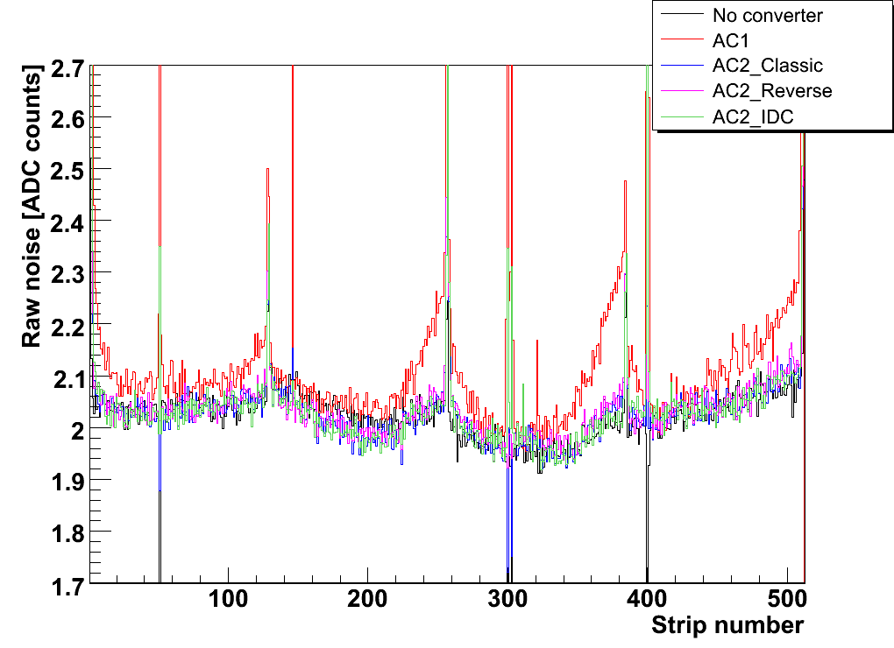
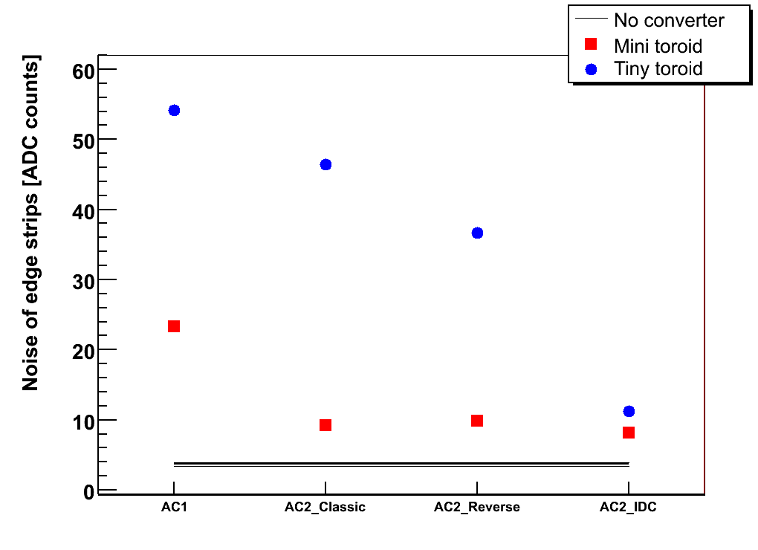
Noise of Aachen Buck Converters
--- No converter
--- AC1 with AC2 mounting
--- AC2-StandardC
--- AC2-ReverseC
--- AC2-IDC
Sensitive variable chosen for
all following comparisons:
⎯ No converter
Mini Toroid, 600nH
• Tiny Toroid, 200nH
Diff. PCB length
compensated with
addit. connectors
Lower noise than with AC1 boards
Mini Toroid shows lower noise and
5-30% higher efficiency (ΔI_{L} = V_{L} ⋅ t_{on} / L)
IDCs offer good filtering performance
Long-term reproducibility
AC1
AC2 mounting
AC2-Stand.C
AC2-Rev.C
AC2-IDC

Slide 12
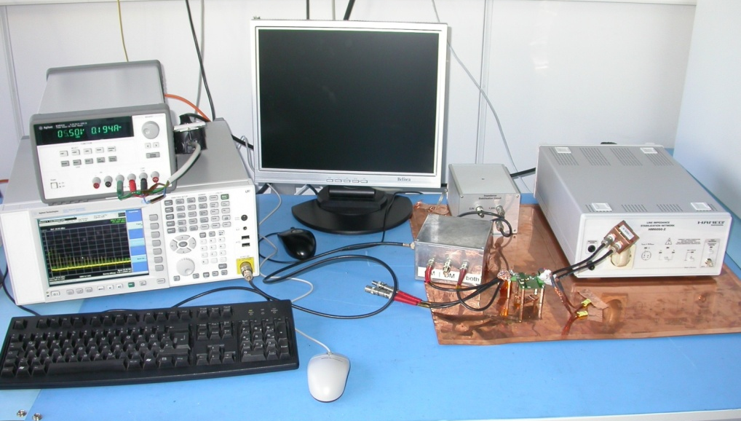
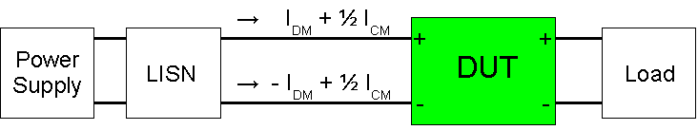
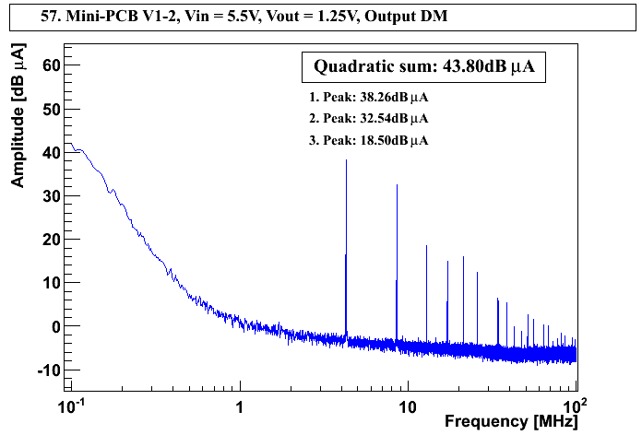
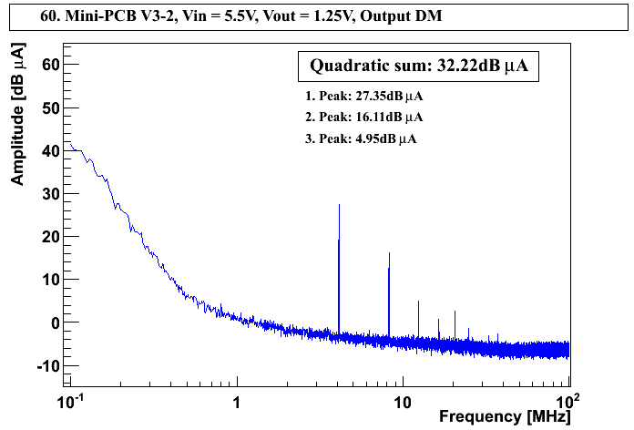
Converter Noise Spectra (EMC Test)
Load
LISN = Line Impedance
Stabilization Network
Spectrum
Analyzer
AC2-Stand.C
Tiny Toroid
DM output
5.5Vin, 1.25Vout
AC2-IDC
Tiny Toroid
DM output
5.5Vin, 1.25Vout

Slide 13
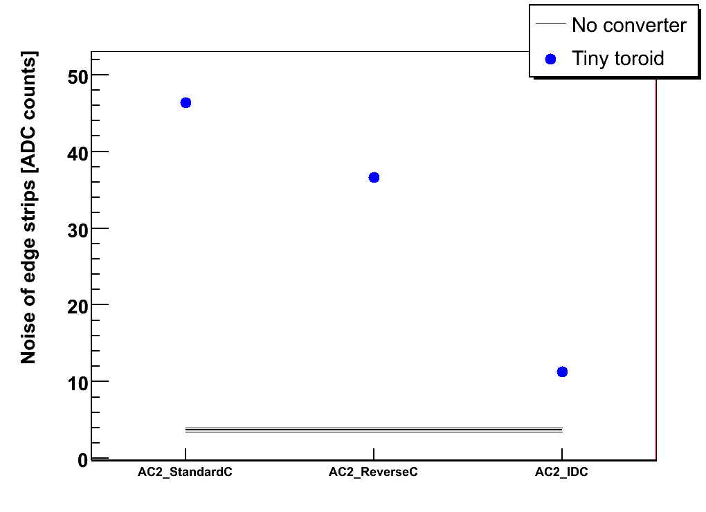
Converter Noise Spectra (EMC Test)
Quadratic sum of noise peaks [dBµA]
⎯ No converter
• Tiny toroid
Differential Mode
Common Mode
StandardC
ReverseC
IDC
AC2-IDC board has lowest DM noise ⇒ consistent with system test results
Current CMS strip modules are sensitive mostly to DM noise

Slide 14
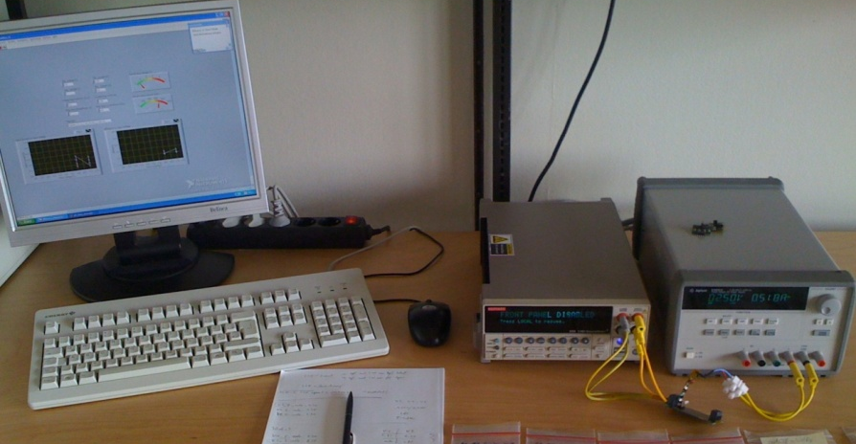
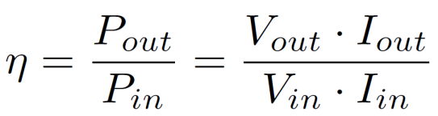
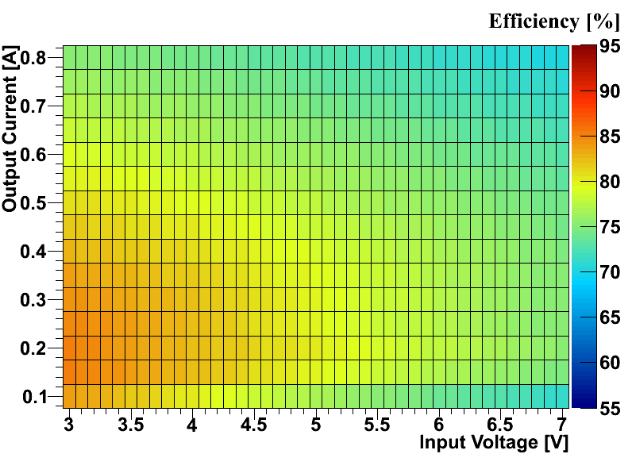
Efficiency
Load
PS
PC with LabVIEW
AC2-StandardC, V_{out} = 1.3V
Efficiency is 75-85% for V_{out} = 1.3V
and Mini Toroid
For smaller conversion ratio (V_{out} = 2.5V),
efficiency is up to 15% higher
Difference between cap. types < 1%

Slide 15
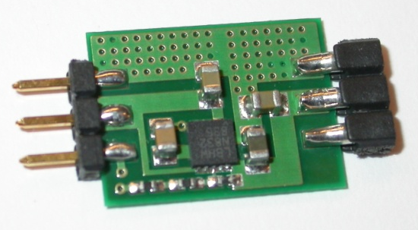
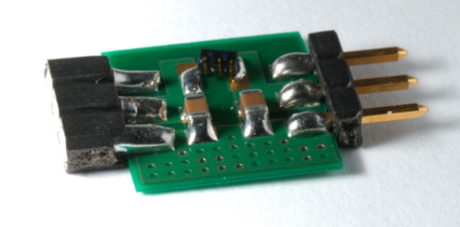
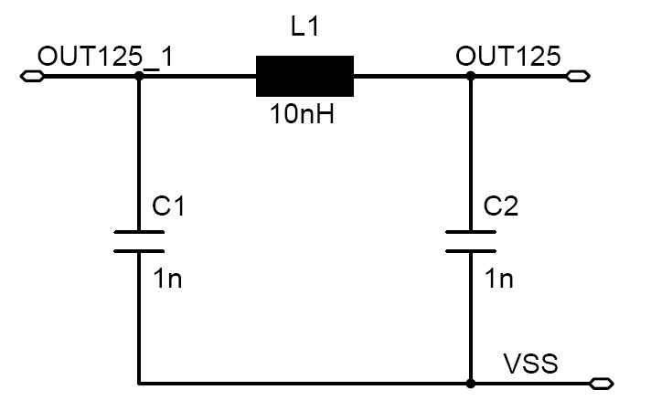
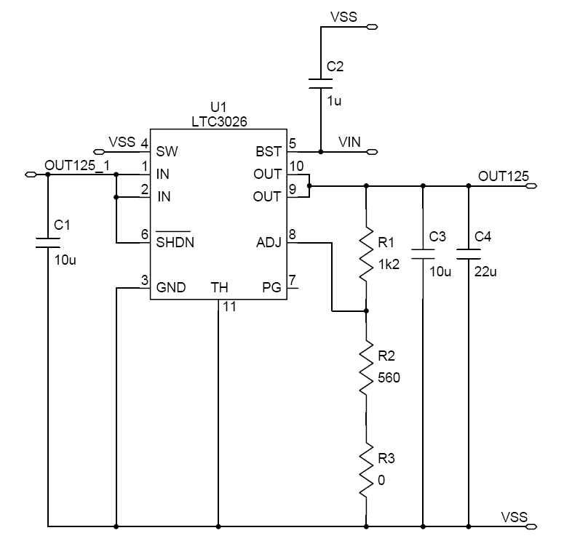
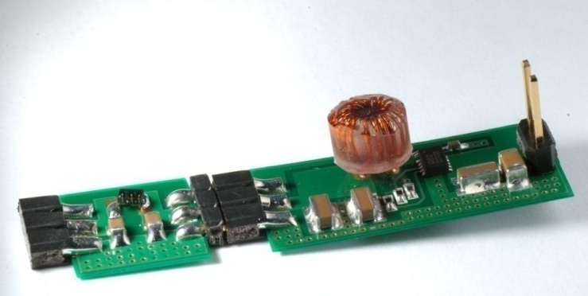
Filters: LDO and π-filter
LDO regulators can act as effective DM filters
Passive π-filters (much simpler)
LDO-StandardC board
with Linear Technology
LDO LTC3026
L1 = 2.5nH (R_{DC} ≤ 5mΩ)
C1 = C2
All converter boards can be
combined with all filters
Filter 1:
C = 22µF f_{cut} ≈1MHz
Filter 2:
C = 2.2µF f_{cut} ≈ 3MHz

Slide 16
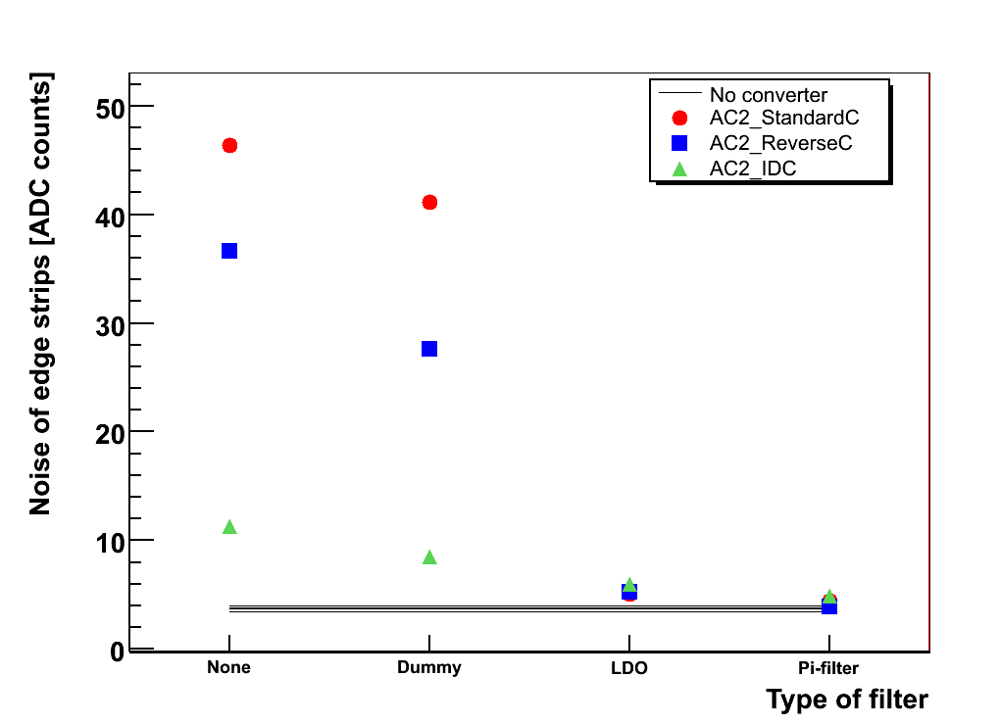
Filters: LDO and π-filter
⎯ No converter
• AC2-StandardC
AC2-ReverseC
AC2-IDC
Quadratic sum of noise peaks [dBμA]
Differential Mode
Common Mode
None
Dummy
(not equipped)
LDO
π-filter 1
Type of filter
Passive π-filters are as effective as LDO regulator
Efficiency loss with π-filter < 1%; with LDO up to 7%
π-filter is preferred

Slide 17
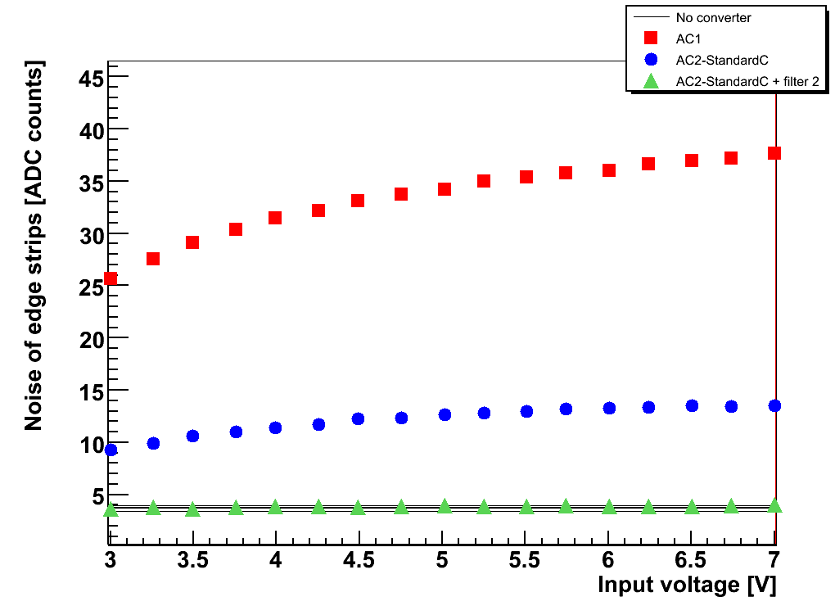
Noise vs. Conversion Ratio
No converter
AC1 (2008)
• AC2-StandardC with Mini Toroid
AC2-StandardC with Mini Toroid + filter 2
Noise of AC1 converter increased with conversion ratio r = V_{in} / V_{out}
AC2-StandardC with Mini Toroid and π-filter exhibits no significant additional
noise for all accessible conversion ratios

Slide 18
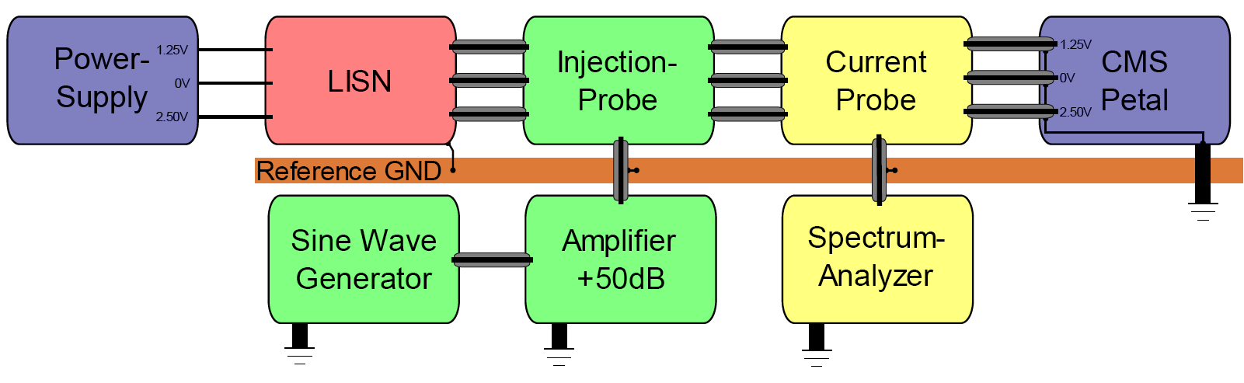
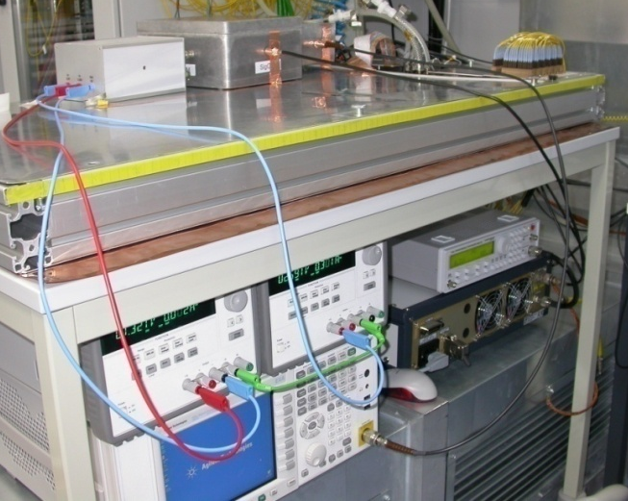
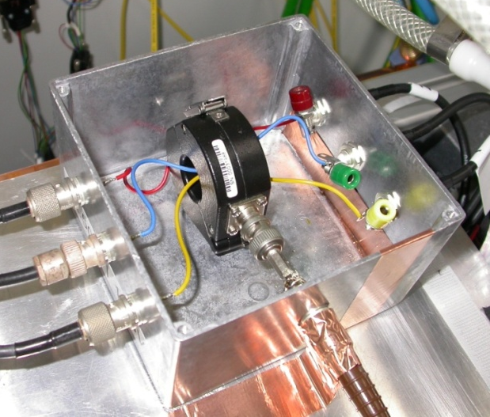
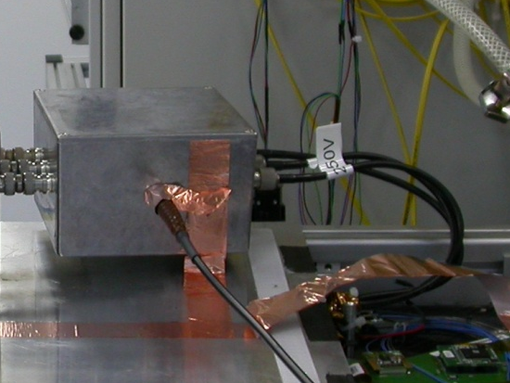
Noise Susceptibility
Goal: identify particularly critical bandwidth(s) for converter switching frequency
Bulk current injection (BCI) method used
A noise current of 70dBμA (I_{eff} = 3.16mA) is injected into the power lines
  Differential Mode (DM) and Common Mode (CM) on 2.5V and 1.25V
CMS
Module

Slide 19
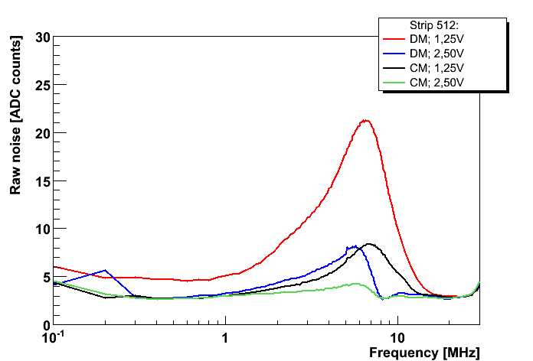
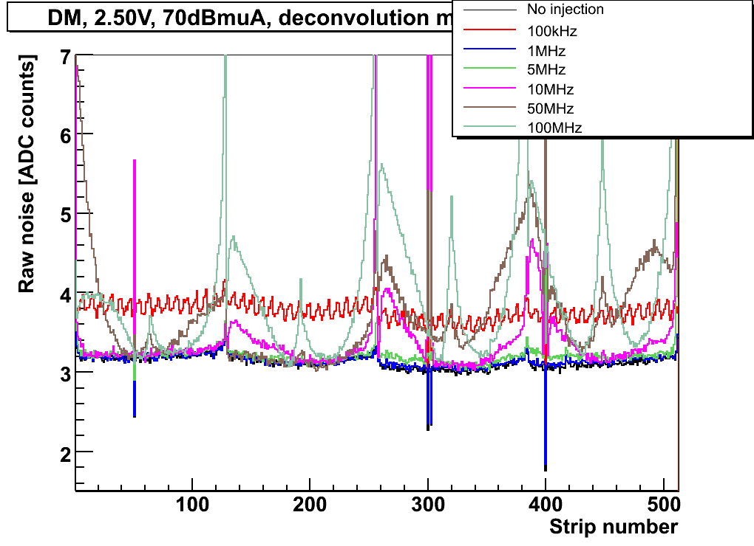
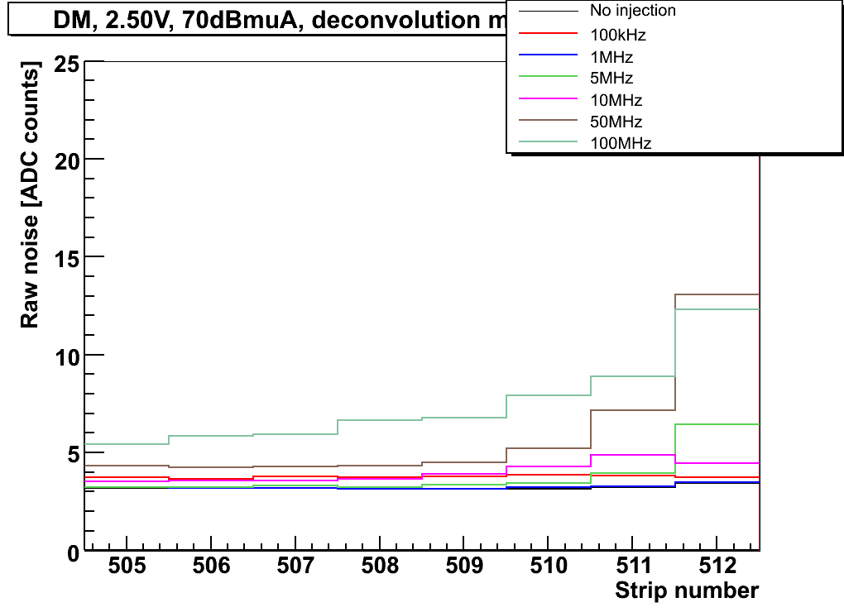
Noise Susceptibility of Current Strip Modules
Noise
distributions
Step width:
0.1MHz for 100kHz-10MHz,
1.0MHz for 10MHz-30MHz,
2.5MHz for 30MHz-100MHz
Edge strip
noise
Plot vs. f
Peak at 6-8MHz, well above future switching frequency (3.2MHz exp. from shaping time)
Higher susceptibility for DM and 1.25V = pre-amplifier reference voltage
Set-up will be valuable to characterize future module prototypes

Slide 20
Implementation into CMS Tracker
Pixels at Phase-1:
Pixel detector will grow: 3 → 4 barrel layers, 2 x 2 → 2 x 3 forward disks
More read-out chips per cable and PS ⇒ massive upgrade of PS would be needed
Buck converters with conv. ratio ~ 2 could be combined with light PS upgrade
  Integration onto pixel supply tube (η ≈ 4)
  ⇒ material budget, size, radiation of coil ~ uncritical
  On-chip linear regulators ⇒ some ripple tolerable
Outer Tracker at Phase-2:
Layout under study, but both for tracking & trigger layers DC-DC conv. are foreseen
Trigger layers might need several Amps per module and high conversion ratio
Silicon modules optimized for low mass ⇒ tight space constraints
Separate power boards, integrated onto module periphery or support structure
We will develop/test boards, based on ASICs of CERN group, for both projects.

Slide 21
Summary
Buck converters based on commercial non-radiation-hard chips have
been developed that add very little noise into the current tracker system
Small, low-mass 600nH air-core toroids with low R_{DC} have been fabricated
π-filters reduce the noise to the level of conventional powering with < 1%
efficiency loss, and are preferred over LDOs
The Material Budget corresponds to 10% of the MB of a current strip module
With buck converters close to the modules (conv. ratio = 8, efficiency = 80%),
~ 8% of the total TEC material budget could be saved
The CMS tracker plans to implement buck converters in the pixel system
at phase-1 and in the outer tracker at phase-2
RWTH Aachen group will now move on to study the integration of custom
radiation-hard converters

Slide 22
Back-up Slides

Slide 23
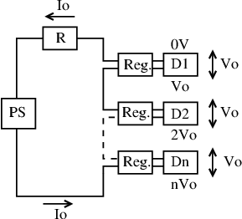
Comparison: MB for Serial Powering
Implementation of SP (inspired by ATLAS talks):
All 17-28 modules of Tracker End Cap substructure
(petal) powered in series
Additional components per module:
chip (~SPI), Kapton, bypass transistor,
6 capacitors and 3 resistors/chip for AC-coupling
Power loss in motherboards ≤ 3%
Cable cross-sections calculated as before
Savings | SP | DC-DC
Power cables | -72.4% | -64.8%
Motherboards | -39.8% | -52.2%
Electronics & cables | -29.0% | -30.9%
Total TEC | -7.5% | -8.0%
⇒ Similar savings for Serial Powering and DC-DC conversion

Slide 24
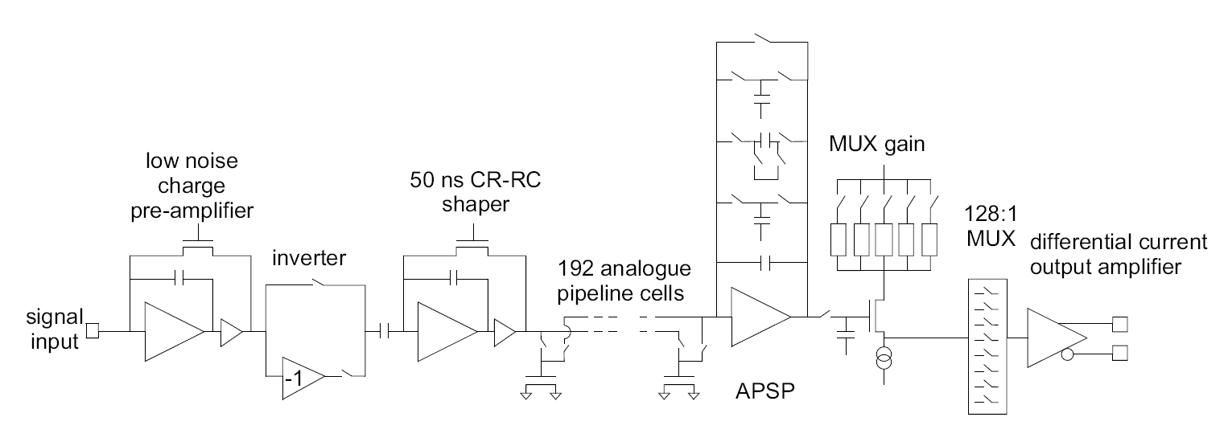
The APV25
f = 1/(2π⋅50nsec)
= 3.2MHz

Slide 25
On-Chip Common Mode Subtraction
128 APV inverter stages powered from 2.5V via common resistor (historical reasons)
⇒ mean common mode (CM) of all 128 channels is effectively subtracted on-chip
Works fine for regular channels which see mean CM
CM appears on open channels which see less CM than regular channels
CM imperfectly subtracted for channels with increased noise, i.e. edge channels
pre-amplifier
inverter
V250
V250
R (external)
V125
v_{CM}
strip
v_{IN}+v_{CM}
v_{OUT} = -v_{IN}
VSS
Node is common to
all 128 inverters in chip

Slide 26
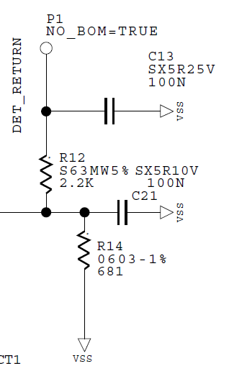
Module Edge Strips
APV25 pre-amplifier
V250
V125
strip
bias ring
VSS=GND
[Mark Raymond]
Edge strips are capacitively coupled to bias ring
Bias ring is AC coupled to ground
Pre-amplifier is referenced to 1.25V
If V125 is noisy, pre-amp reference voltage
fluctuates against input
This leads to increased noise on edge channels
[Hybrid]

Slide 27
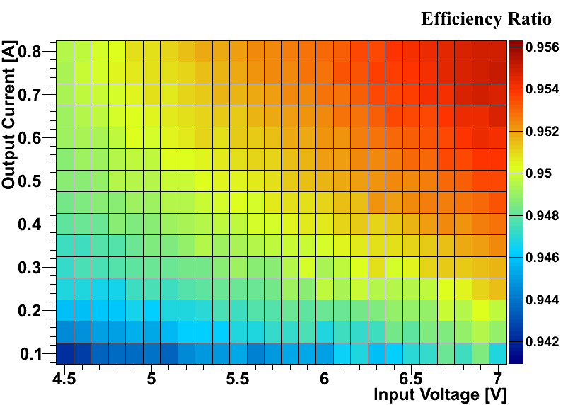
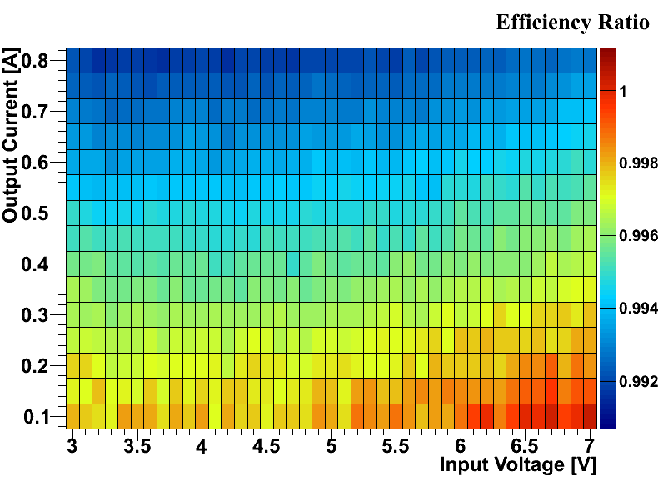
π-Filters vs. LDO: What about Efficiency?
Efficiency with LDO (filter) / efficiency without LDO (filter)
was measured for all board types, filters and V_{out} = 1.25V and 2.50V;
e.g. AC2_StandardC, 1.25V:
LDO filter
π-filter 2
Losses of up to 7% observed with LDO regulator (50mV dropout)
Losses with our π-filters stay below 1%
π-filter clearly preferred

