Slide 1
Design Considerations for an Upgraded Track-Finding Processor in the Level-1 Endcap Muon Trigger of CMS for SLHC operations
D. Acosta, M. Fisher, I. Furic, J. Gartner, G.P. Di Giovanni, A. Hammar, K. Kotov, A. Madorsky, D. Wang
University of Florida/Physics, POB 118440, Gainesville, FL, USA, 32611
L. Uvarov
Petersburg Nuclear Physics Institute, Gatchina, Russia
M. Matveev, P. Padley
Rice University, MS 61, 6100 Main Street, Houston, TX, USA, 77005

Slide 2
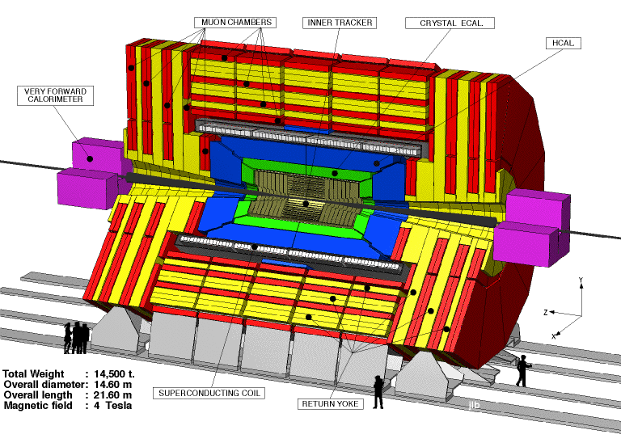
CMS Endcap Muon System
φ
θ, η
Notes:
CMS cutout

Slide 3
CMS Endcap Muon System
Notes:
CMS cutout with Endcaps glowing

Slide 4
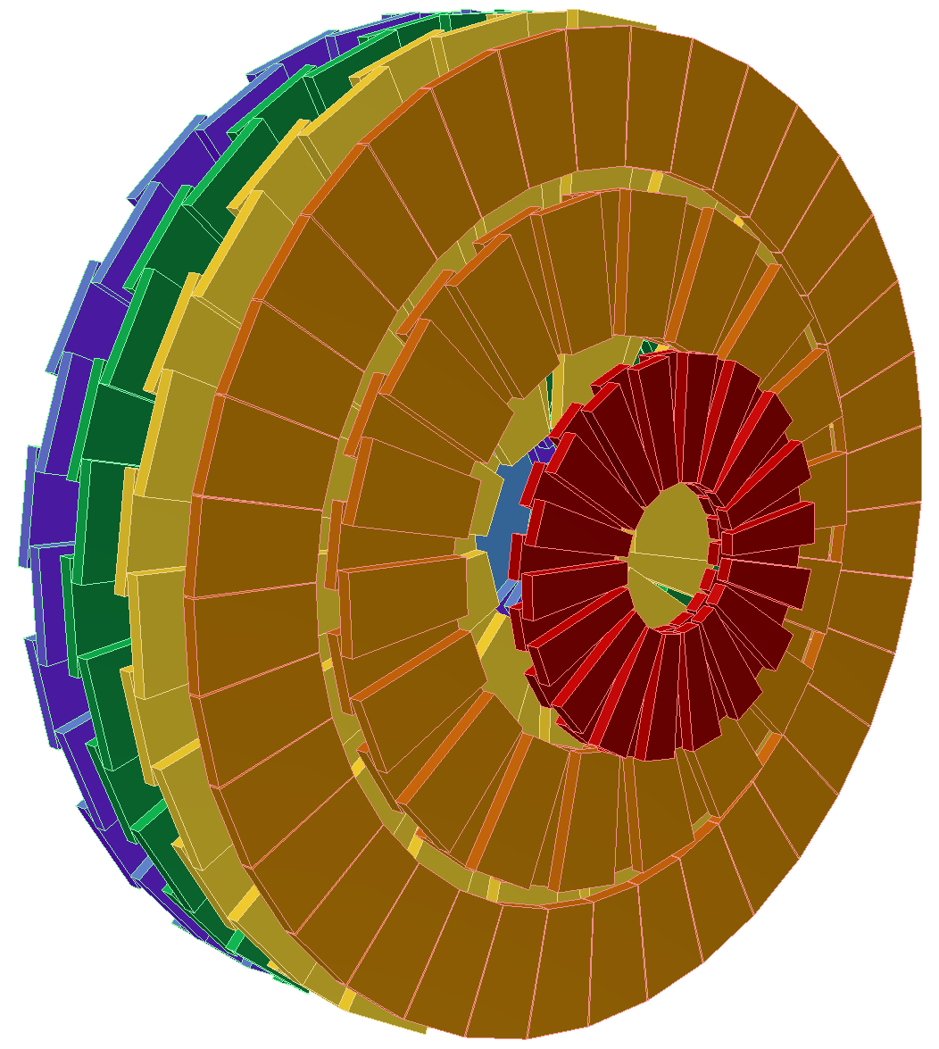
CMS Endcap Muon Trigger
Trigger sector 60˚
Each of two Endcaps is split into 6 sectors, 60° each
Each sector is served by one Sector Processor (SP)
Total 12 SPs in the entire system
CMS trigger requires us to identify distinct muons
Each SP can build up to 3 muon tracks per BX
Notes:
Brief introduction

Slide 5
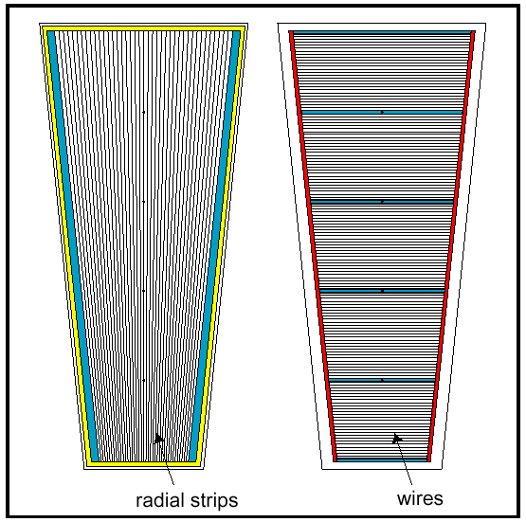
Cathode Strip Chamber
CMS Endcap uses Cathode Strip Chambers (CSC)
6 layers
  Strips in φ direction
  Wires in θ direction

Slide 6
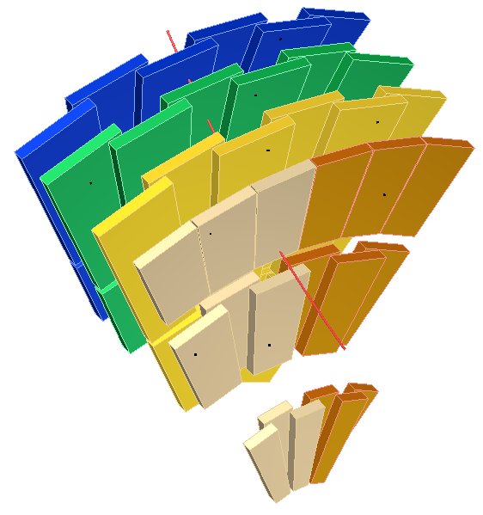
Present CSC Muon Trigger structure
Trigger information
Wiregroup patterns
(detected by on-chamber
ALCT board)
Strip hits
Trigger primitives
2 per chamber
18 per station
90 total
Muon Endcap
Trigger sector (60°)
Stations
ME4
ME3
ME2
Trigger Motherboards
(UCLA)
One per chamber
Strip pattern detection
Trigger primitive building
background
Port Cards
(Rice)
One per station
1/6 filtering
Track
Fibers
(~100 m)
Station
ME1b
3 (best) primitives
per station
15 total
Station
ME1a
Sector Processor (UF)
Complete 3-D tracks assembled from
primitives
Up to 3 tracks per BX
Notes:
Current trigger structure explanation, with emphasis on Port Card as trigger primitive filter

Slide 7
Problems and solutions
Current design is totally adequate for LHC luminosity
  2 LCTs (di-muon signal) + 1 (background) = 3 LCTs per Port Card per BX
With luminosity upgrade, we expect ~7 LCTs per Port Card per BX.
  Preliminary simulated data, no measurements so far
  Reality could be worse
Port Card becomes a bottleneck
Solution:
  Keep 2 Trigger Primitives per chamber
  Bring all LCTs to SP (18 per Port Card per BX), no filtering
    May keep the filtering option in Port Cards, in case it’s needed
See this talk by Darin Acosta for explanation of above numbers
  Based on simulations performed by A. Safonov and V. Khotilovich (TAMU)
Notes:
Explanation of Port Card as choking point for upgraded luminosity, proposed solution

Slide 8
CSC Trigger upgrade
Trigger information
Wiregroup patterns
(detected by on-chamber
ALCT board)
Strip hits
Trigger primitives
2 per chamber
18 per station
90 total
Muon Endcap
Trigger sector (60°)
Trigger Motherboards
(UCLA)
One per chamber
Strip pattern detection
Trigger primitive building
Upgraded
Port Cards
(Rice)
One per station
1/6 filtering
Fibers
(~100 m)
18 primitives
per station
90 total
Upgraded
Sector Processor (UF)
Complete 3-D tracks assembled from
primitives
Up to 3 tracks per BX
Notes:
Diagram of upgraded system showing Portcard with no filtering, much larger SP brain.

Slide 9
Port Card upgrade
Cost:
  Port Card replacement system-wide (60 pcs)
  Faster serial links PortCard → SP
    Currently used: 1.6 Gbps
    Available now: 10+ Gbps
    Link speed increase by a factor of 6.25 or more
      10+Gbps links will be run asynchronously to reach full speed
  Required bandwidth increase (in terms of trig. primitives): 18 / 3 = 6
  Looks like we don’t need additional fibers ☺
    However, may need to replace them all
    Another option: parallel multichannel serial links
Notes:
Cost of Port card and link upgrade

Slide 10
SP upgrade
SP logic structure
Conversion of trigger primitives to
coordinates
BX adjustment to 2nd trig. primitive
Pt, φ, η calculation
Multiple Bunch Crossing Analysis
Extrapolation units
Main upgrade targets
Track assembly
Sorting, ghost cancellation

Slide 11
Trig. Primitives → Coordinates
Wiregroup pattern
φ
Strip pattern
LUT
η
Chamber ID
Currently performed in large 2-stage LUTs
Unacceptable for upgrade – too much memory
  4MB per trig. primitive
  6 times more trig. primitives in upgraded design
  Need ~400 MB per SP

Slide 12
Trig. Primitives → Coordinates
For upgrade:
  Make conversion inside FPGA
  Combine LUTs and logic to reduce memory size
  We receive Trig. Primitives from all chambers
    no need to analyze Chamber ID
    saves precious LUT input bits
  Use different angular coordinates – φ with half-strip resolution and θ
    Why θ ?
      Allows for uniform angular extrapolation windows, no need to adjust them depending on θ
    Why φ with half-strip resolution?
      Makes conversion easier, for 80-strip 10° chambers (ME1/2, ME2/2, ME3/2, ME4/2) as easy as one addition with fixed value.
      Easier to handle in FPGA

Slide 13

Wiregroup → θ
θ₁
8-bit
Wiregroup
5 to 7-bit
θ
8-bit
Wiregroup
6-bit
+
LUT
32 to 128 cells
LUT
θ₂
8-bit
+
Strip₁
6-bit
θ conversion
all chambers except ME1/1
θ corrections
4-bit
LUT
WG MSB
2-bit
Strip₂
6-bit
WG₁ θ₁
WG₁ θ₂
LUT
WG MSB
2-bit
WG₂ θ₁
WG₂ θ₂
ME1/1 θ conversion
θ corrected and duplicated ☹ because of wire tilt (if chamber has 2 trig. primitives)

Slide 14
Strip → φ
Half-Strip
7 or 8-bit
φ in sector
10-bit
×F
+
Initial φ
10-bit (fixed)
corrected
φ in sector
12-bit
CLCT pattern 4-bit
φ correction
2-bit
LUT
Chamber | Strip angle | F
ME1/2, ME2/2, ME3/2, ME4/2 | 0.1333° | 1 (no multiplication)
ME2/1, ME3/1, ME4/1 | 0.2666° | 2 (shift)
ME1/1a | 0.2222° | 1.667
ME1/1b | 0.1695° | 1.272
ME1/3 | 0.1233° | 0.925
Use built-in multiplier or LUT. “F” factor depends on chamber type

Slide 15
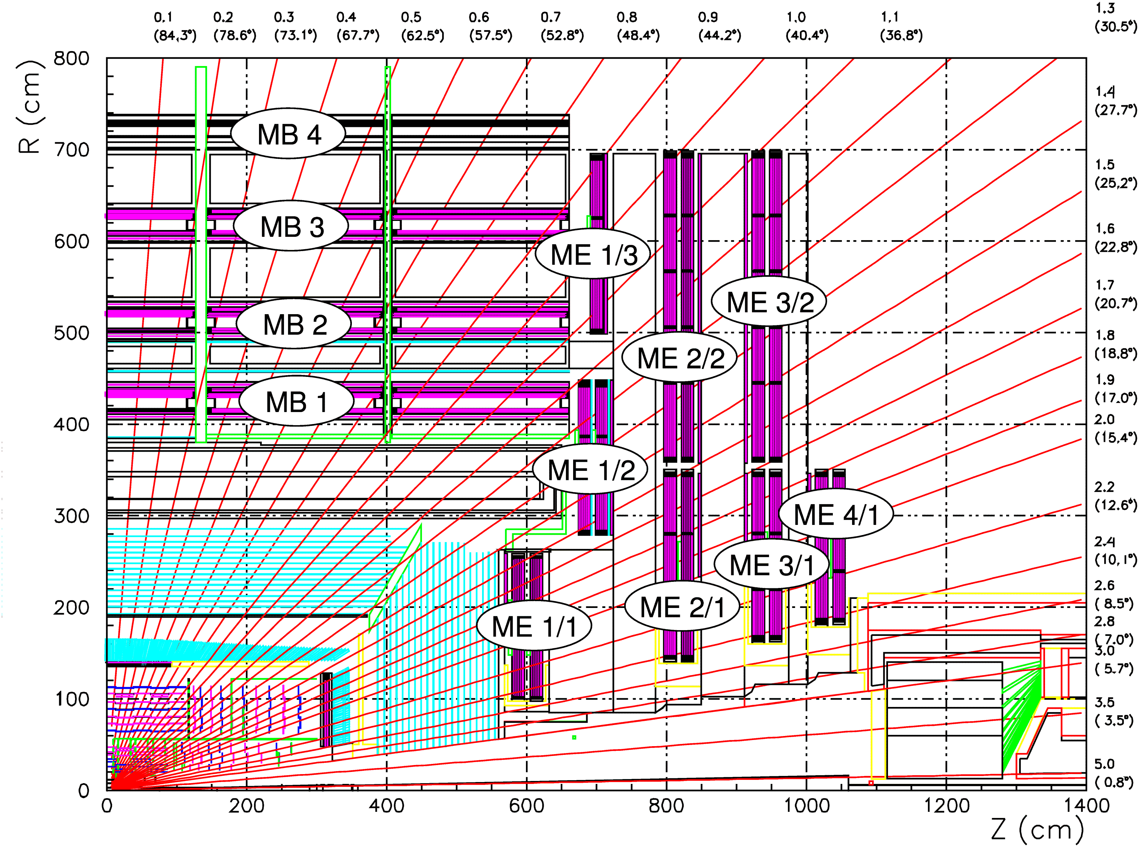
Geometry constraints for track building
Consider only physically allowed chamber combinations from one disk to the next in track extrapolations and in track assembly to reduce logic resources
Not all combinations need testing due to
  Limited bending in magnetic field (<10°) in φ
  Chamber coverage structure in θ view
η(θ)

Slide 16
Geometry constraints for track building
ME1→ME2
Total: 52 paths
ME1→ME3
Total: 58 paths
- means path to chamber directly behind

Slide 17
Geometry constraints for track building
ME1→ME4
Total: 42 paths
ME2→ME3, ME2→ME4, ME3→ME4
Total: 33 paths
- means path to chamber directly behind

Slide 18
Extrapolation units
What does extrapolation unit do?
  Compares trigger primitives from 2 stations (chamber layers)
  Checks that they are within certain “window” relative to each other
    |φ_{A} – φ_{B}| < max Δφ
    |θ_{A} – θ_{B}| < max Δθ
Window
Trig. primitive from
Station A
Trig. primitive from
Station B

Slide 19
Number of extrapolations
more θ EUs because of ME1/1 θ duplication
2002 SP design has 63 extrapolations (φ and η)
Upgraded design is ~18 times larger
Current FPGAs are 3 times larger than in 2002
Need additional factor of ~6 increase by SLHC Phase 1 upgrade – or several FPGAs
Try all wire-strip combinations for each CSC, to account for “ghosts”
  Currently done only for station 1
Extrapolation | φ EU | θ EU
ME1→ME2 | 208 | 248
ME1→ME3 | 232 | 336
ME1→ME4 | 168 | 272
ME2→ME3 | 132 | 132
ME2→ME4 | 132 | 132
ME3→ME4 | 132 | 132
ME1→MB1 | 32 ? | 0
ME2→MB1 | 32 ? | 0
Total | 1068 | 1252

Slide 20
Track Assembly Units
What does Track Assembly Unit do?
  Analyzes extrapolation results
  Attempts to build the best track from available trigger primitives

Slide 21
Track Assembly Units
Implementation:
  Find best extrapolations
    minimum φ difference between primitives
    valid θ extrapolations
  Make track out of corresponding segments
  Need to do that for each trig. primitive in key stations
Number of trigger primitives received from key stations
Key station | Current design | Upgraded design
ME2 | 3 | 18
ME3 | 3 | 18
ME4 | 3 | 18
ME2 in DT overlap | 3 | 12
Total | 12 | 66

Slide 22
Sorting and Ghost Cancellation
Purpose:
  Select 3 best tracks out of all track candidates
  Remove “ghosts” – multiple track candidates created by the same physical track
Implementation:
  Compare each candidate with all others
Problem:
  Sorting and Ghost Cancellation is already the largest part of SP design
  Logic size grows as square of the number of track candidates
  Need ~30 times more logic than current design
  May not be able to afford this even with FPGAs available at the time of upgrade!

Slide 23
Halo track detection
Same as collision tracks, except:
  Convert Wiregroup to Radius
  Perform Radius extrapolations instead of θ
  Different Geometry constraints
  Fewer Extrapolation paths

Slide 24
Pattern-based detection
Investigating another approach:
  Pattern-based detection
  Separately in φ and θ
  Once the patterns are detected, merge them into complete 3-D tracks
Benefits:
  Logic size reduction
  Certain processing steps become “natural”, logic for them is greatly simplified or removed
    Multiple Bunch Crossing Analysis
    Ghost Cancellation
ME
1234
Station
32
16
8
4
2
1
1
1
2
4
8
16
32
Number of Strips ORed
One of the patterns
Possible φ pattern envelope structure

Slide 25
CSC + Tracker = Better Trigger
Investigating challenges of matching CSC triggers with Tracker
Should be able to reach better rate reduction by:
  Using Tracker to confirm CSC trigger candidates
  Track fit improvement

Slide 26
Conclusions
Importing all trigger primitives from all chambers:
  Promising but not certain
  May need to return to filtering in Port Cards
    Need at least 7 trig. primitives per sector
Under investigation:
  Pattern detection approach
  CSC →Tracker matching

