Slide 1
Demonstration of Wire Scanners Logs Analysis Application
BI Seminar 22.02.2015
Aleksander Cudny
Emiliano Piselli
Ismael Posada Trobo IT-OIS-WLS
Guillaume Baud

Slide 2
Goals:
Easier access to logging database than trough Timber application
Wire Scanner customs settings
Static set of variables designated to Wire Scanners
Easy manipulation of charts
CSV and PNG data download
Plot of numeric values in respect of timestamps
Possibility of bunch-by-bunch plot for SPS/LHC
Possible Gaussian fitting to acquired profiles
Introduced scan quality factor

Slide 3
Current set of variables
Vectonumeric values: Data IN/OUT Position IN/OUT Resistance IN/OUT Current IN/OUT Position Probed (only for the LHC) PROJ_BUNCH IN/OUT (only for the SPS) Bunch selection (for the SPS and the LHC) | Numeric values: Selected filter Gain POT_READ Number of bunches Calculated values: Sigma IN/OUT Scan quality

Slide 4
General system architecture
Website
AFS Server
Database
Site resources (htmls, images etc.)
Python script
3.
Java .jar
4.
Python listener
1.
PHP script for data download
2.
5.
Login specifications
6.
Output CSV files

Slide 5
Website address – valid CERN account is required
www.cern.ch/bws-web

Slide 6
Online presentation

Slide 7
Thank you for your attention

Slide 8
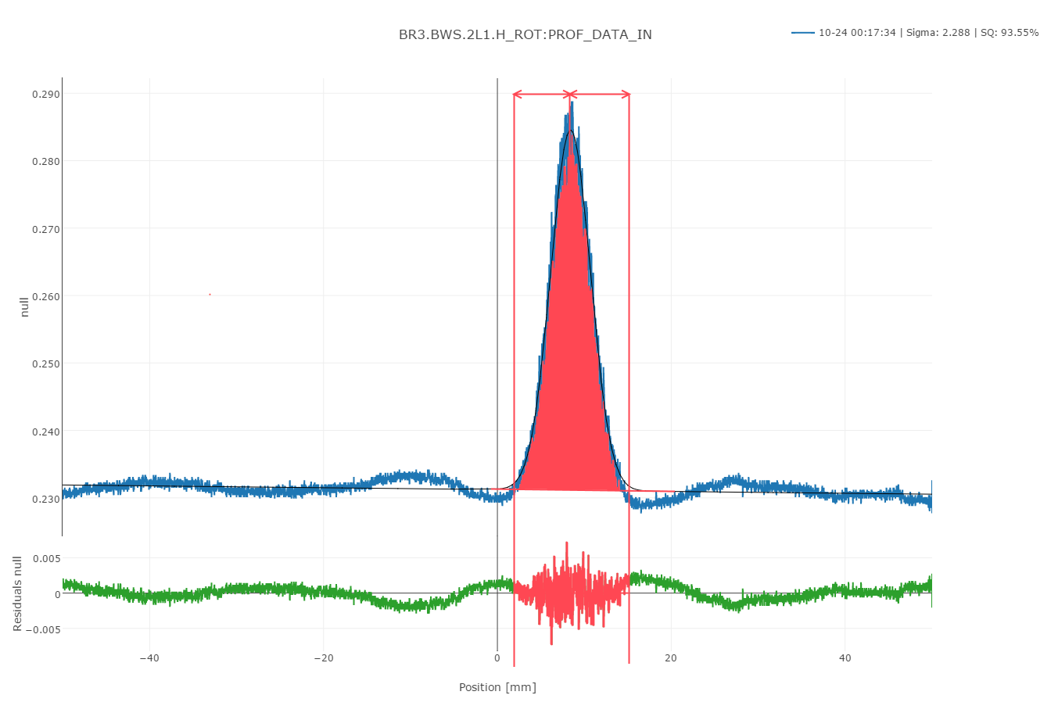
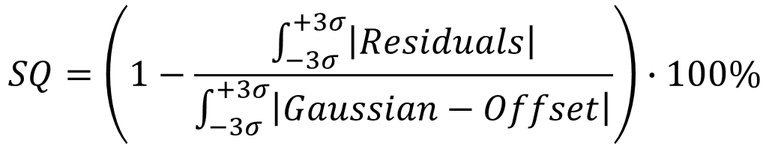
Scan quality
$$SQ=\left(1−\frac{\int_{−3σ}^{+3σ}{\left|Residuals\right|}}{\int_{−3σ}^{+3σ}{\left|Gaussian−Offset\right|}}\right)∙100\%$$
Formula
+3σ
-3σ
Example

Slide 9
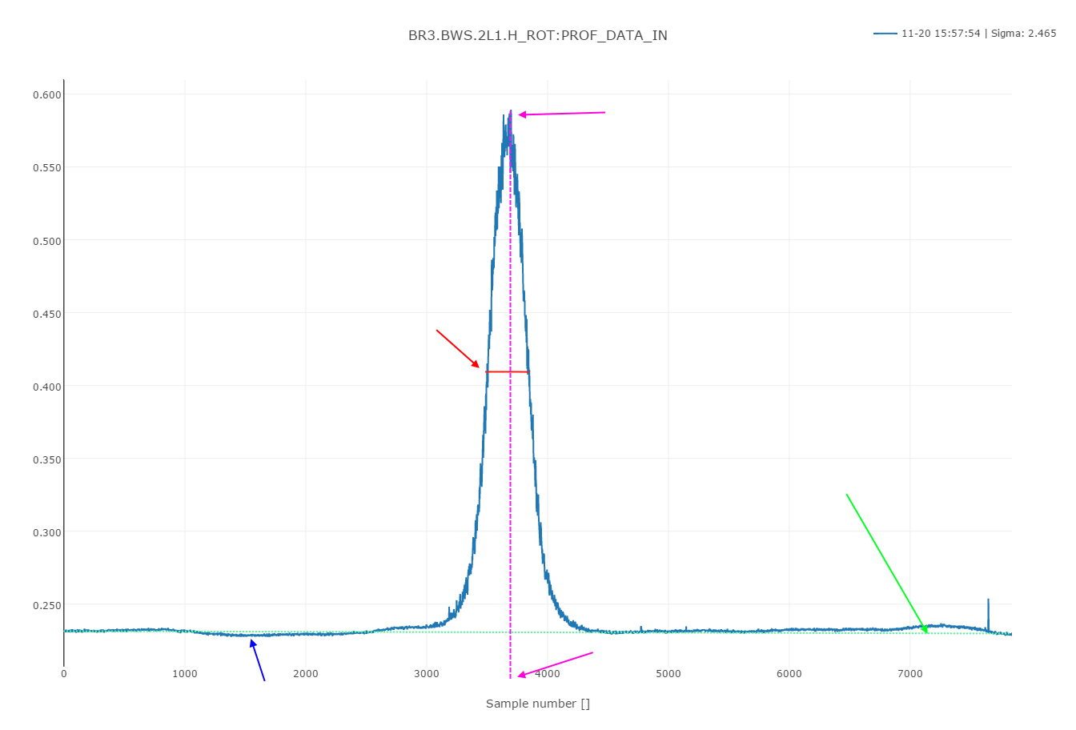
Initial fit values
Max value = Initial amplitude
Profile width in the middle = Initial σ
Slope between first and last points= Initial slope
Position of max value = Initial µ
Minimum value = Initial offset

