Slide 1
ACAT 2016 Survey Results
G. Watts (UW/Seattle)
ACAT 2017/Seattle

Slide 2
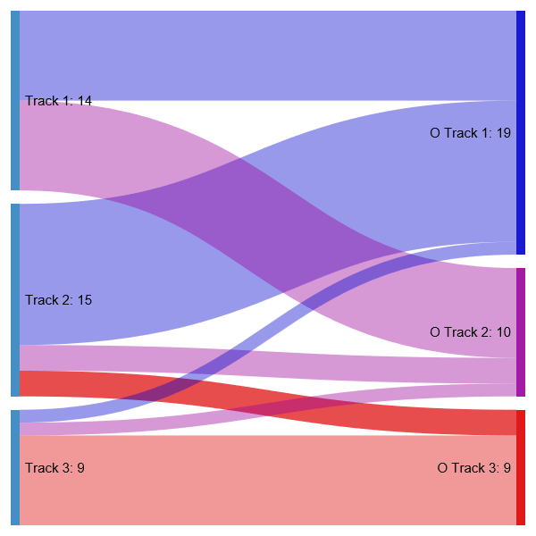
The Survey
30 people responded
Raw responses can be found in gdrive
Note the first response was a bogus one from me testing the system!
How did people migrate between tracks?
Clear split between T3 and T1 and T2, as we have always suspected…

Slide 3
Non-Favorite Track Plenaries
Again, note the isolation…
Split the results by favorite track…

Slide 4
How to improve the usefulness of the plenaries… Some ideas
Focus on technique, not problems
Level-set Track 3 speakers so they are more understandable
Group plenary sessions by topic
Modern software/programming techniques
Cool new techniques get airtime, but reasons against them do not
Organized Discussions
Mutli-track plenaries

Slide 5
Our other basic questions
Discussions with Experts…

Slide 6
Basic Components of ACAT
Didn’t have them and people are still relatively interested…
Of course, we didn’t have them this time… and attendance will always be small…

Slide 7
Posters
Not as much support as I would have thought…

Slide 8
Social Program
Support is pretty similar…

Slide 9
Industry
Not well liked…

Slide 10
Possible Topics
These will get added to the idea list file
LSST
Genomics
Computer Vision
Memory Management
Caching
Machine Learning
The explosion of programming tools
Tracking strategies
TMVA
“Cycles of lectures” on well established items
Computing in particle physics (??)
Pattern recognition
Beam Line/Light Source problems
Fields beyond HEP with important computational problems
Concurrent frameworks
Parallel Computing, Xeon Phi2, etc.
GPU applications
Latest experiments and details of technical aspects or analyses
Impacts of Tech changes over the next 5 years
Anything
More industry talks
HPC
Modern techniques for computational and theoretical physics
g-2, some of the theory behind the calculations
Modern IT outside of HEP

Slide 11
Industry Talks and Booths
People from the C++ committee
Wolfram
Maple
Cloud computing and related companies
Google
Amazon
Juniper
Facebook
Future prospects (5-10 year wait range)
Microsoft
ML group
FPGA group
Yandex
CUDA

Slide 12
Possible Improvements
More physicist and librarian interactions. Perhaps if it were required?
Special dedicated time for a poster session
End of Conference Track Summary talks should also contain a review of the plenary sessions for that track.
More posters (thanks for getting the key for me).

