Slide 1
Discussion on UT assembling, testing and installation
May 17, 2016
Burkhard Schmidt

Slide 2
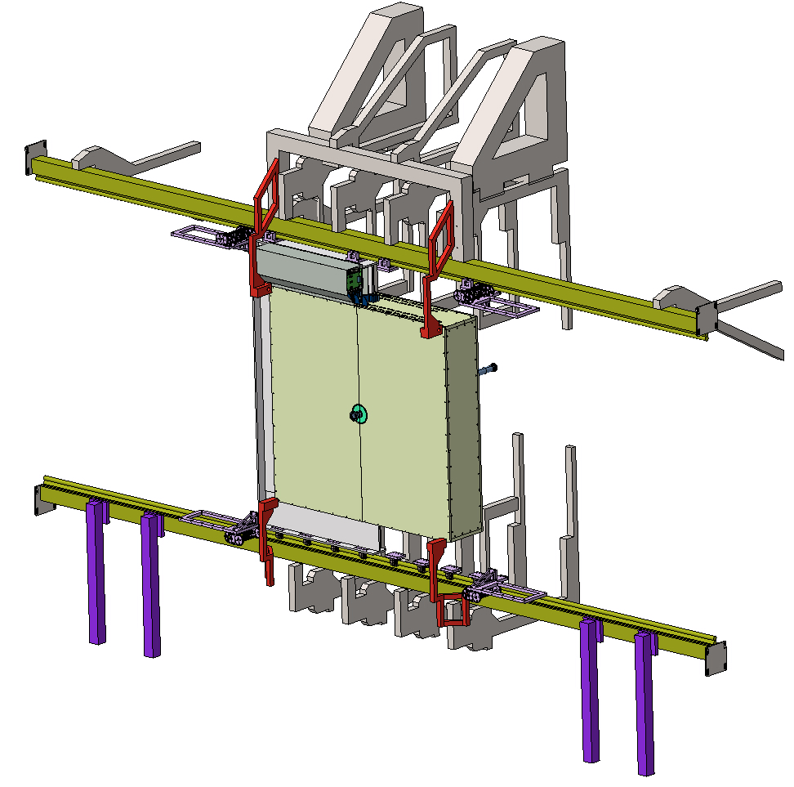
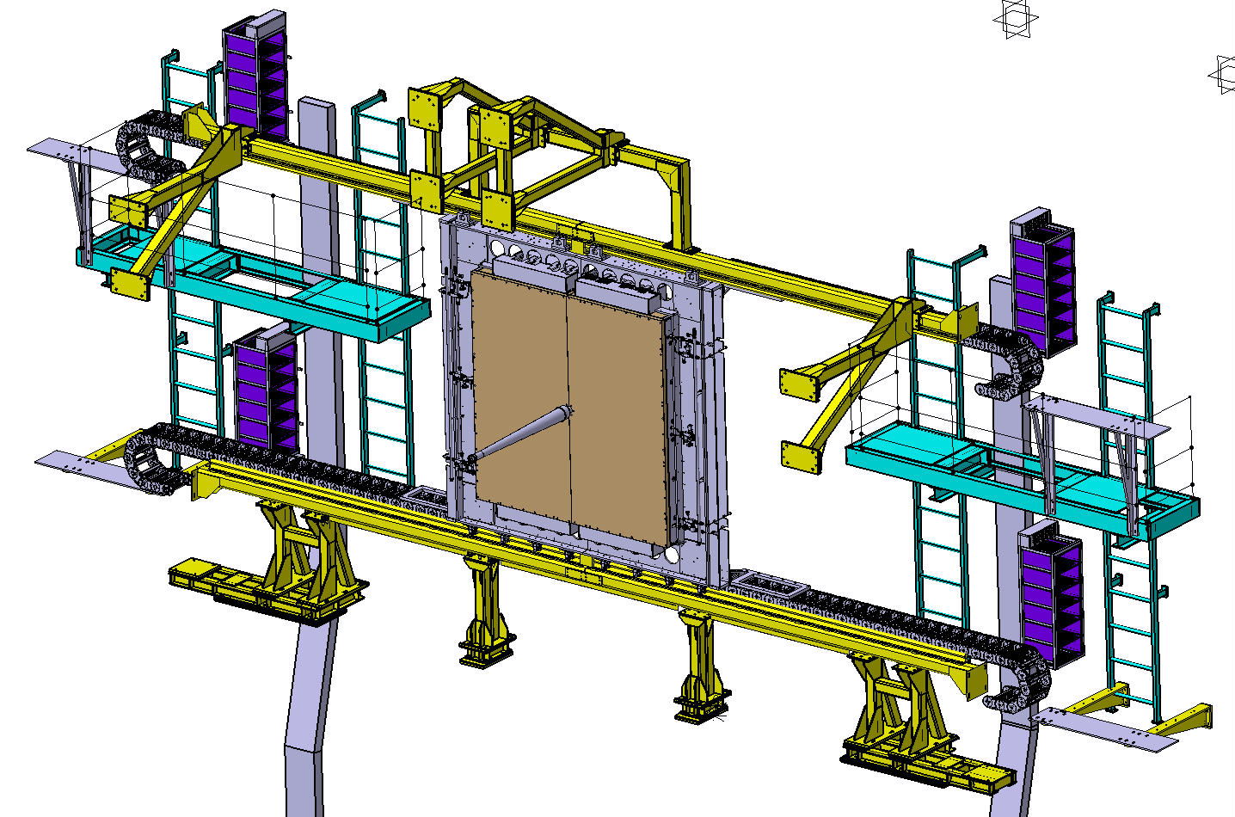
UT installation, based on TT layout
The yellow parts will be re-used for UT (other items only as they seem useful)
The sequence would be as follows:
  Put the infrastructure on the C-side (racks, chain, services etc.) in place
  Install the C-side detector box
  Install the A-side detector box
  Install/connect the infrastructure on the A-side
  The beam-pipe and the interface to the UT-box should be mounted only at the end
A small crane is available in this detector area
View from the VELO downstream
2760mm
A-side
C-side

Slide 3
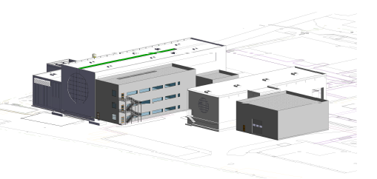
New assembly hall at Point 8
C
New LHCb Assembly Hall & Storage - roughly 485 m² – crane 30 t
The UT group we request about 80m² of assembly space in this hall.
  About half of it should be equipped with a clean room.
In addition, space of about 20m² needs to be foreseen for a cooling plant, needed to carry out the required detector tests at room temperature (<20ºC)
C

Slide 4
UT Maintenance
Some considerations:
  Maintenance will be done in the cavern; it is NOT foreseen to bring the detector halves to the surface.
  The detector will be carefully moved to the ‘maintenance position’.
  All interventions, be it on the staves, the flex cables and other connections, or the PEPI electronics, will be carried out in this location.
  The appropriate measure will have to be agreed upon.
    This might include a sort of tent for work on staves with ‘semi-clean room’ conditions etc.

Slide 5
UT Assembly & Testing Plan
Tentative stave assembly procedure:
  Fully-populated staves shipped to CERN
  Box half with frame and cooling manifold assembled and ready, has removable cover panels on open sides and dry air flush
  Add single stave at a time, connect pigtail, connect cooling, mount to frame, power up, cool down, and read out in order to qualify stave for operation
  Test stave (see below)
  Add second stave, using same procedure, test
  Repeat for all staves in four half-planes, working from beampipe region outward, populating planes U,V,X,X in order
  Ideally, test everything possible before lowering half-UT into pit
Proposed DAQ assembly:
  DCBs will be housed in crates above the detector box.
  They should be considered as part of the detector halves assembled on the surface
Installation of LV and HV distribution:
  LV and HV modules will be in the racks on the side of the detector or further away on the ‘balcony’ and installed independent on the detector halves
  Some LV and HV will be needed on the surface for testing
  Use some modules first there before installation in the cavern

Slide 6
Backup

Slide 7
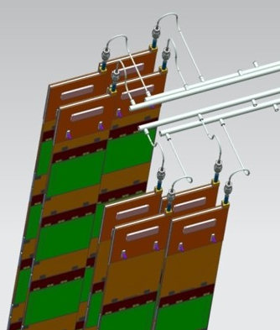
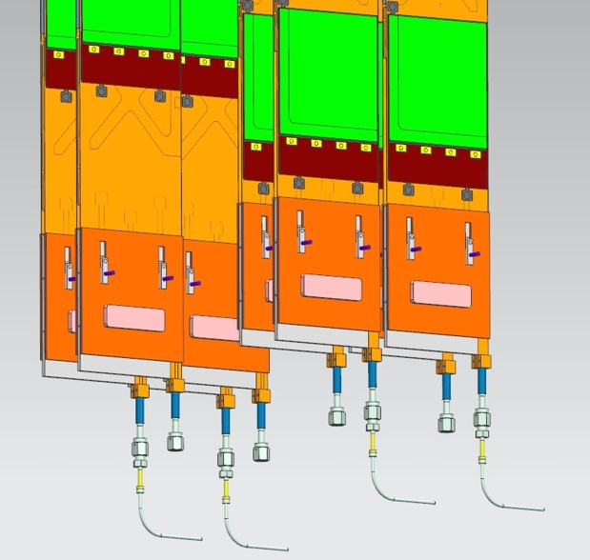
UT cooling needs during assembly & testing
The staves will be installed 1 by 1
  About 53-75 W per stave, depending on position in the detector
  after each stave assembly, a cooling cycle will be performed for tests
  16+16 staves in ‘a’ layers and 18+18 staves in ‘b’ layers;
  68 staves in total; 34 staves per detector box
Each box has 4 manifolds (for the inlet)
  2 manifolds per LUCASZ loop; about 850 W per manifold
  The whole detector half/box need to be tested at the end

Slide 8
Performance parameters for a C0₂ plant on the surface for assembling and commissioning
Parameters | unit | CMS | LHCb
Cooling loop max flow | g/s | 14 | 10
Total plant flow | g/s | max. 20 | 20
Min evaporating T | ºC | -25 | -25
Max evaporating T | ºC | +15 | +15
Number of cooling loops | # | 2 | 2
Max Δp across cooling loop | bar | <20 | <20
Cooling loop max power | W | 810 | 850
Plant max power | W | 1500 | 1500
Transfer line length | m | 18 | 15
Joint development with CMS

