Slide 1
The UT Electronics Slice Test Plan
& Preparation At Syracuse
Jianchun Wang
INFN Milano LHCb UT Workshop
May 17-19, 2016

Slide 2
Motivation of Electronics Slice Test
The UT electronics slice test system is crucial in validating the whole readout scheme, testing and optimizing design of major components.
We want to test functionalities of individual components and measure their performance when signal and LV/HV powers are routed according to the baseline design of the UT readout system.
Individual studies include:
  Check the data integrity in the system, measure signal to noise ratio with baseline configuration.
  Study power connection, grounding & shielding schemes, measure signal coupling, noise pickup with different configurations.
  Check digital signal quality in the flex cables, pigtails, & optical fibers by measuring eye diagram and bit error rate.
  Test ECS protocol and determine: whether the single-ended I²C works with the expected voltage drop; whether it introduces large noise to the signal; & whether an alternative protocol is needed.

Slide 3
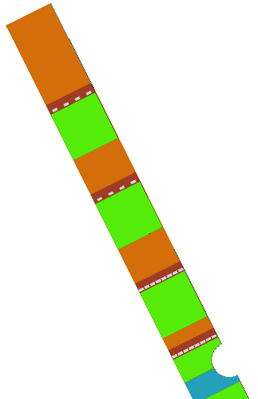
Major Components of The Readout System
Prototype
USB-to-I²C adapter
MiniDAQAMC40
Regulators
VLDB
MCB
SOL40
PC
DCB
TELL40
COMET
(with USB,
or GBTx DB)
Pigtail
Prototype
Test board
(SALT8, SALT128)
8xSALT8Prototype Hybrid
Prototypes
Flex Cable
Hybrid Flex
Si Sensor
SALT ASICs
SALT8a/b,
SALT128
CapArray,
Half-A sensor
CF sheet,
Prototype
Bare stave

Slide 4
Prototypes & Substitutes
Final |  | Substitutes & Prototypes
Sensor |  | CapArray | Half-A
SALT |  | SALT8a | SALT8b | SALT128
Hybrid |  | SALT8 Testboard | SALT128 Testboard | Hybrid_8x8
Stiffener
Wirebonds |  | 4-ASIC Ada | 8-ASIC Ada
Flex cable |  | Prototype_1 | Prototype_2 | Prototype_3
Pigtail |  | MegArray2ERF8 | MegAda | Prototype
Backplane |  |  |  | Prototype
MCB | ECS | VLDB | I2C Adapter
 | TFC
 |  |  | COMET with USB interface | COMET + GBTx DB
DCB
Opt. Fiber |  | Sample
TELL40 |  | MiniDAQ1 / AMC40 |  | MiniDAQ2 / PCIe40
SOL40
Bare Stave |  | CF sheet | Prototype
LV Regulator |  | Prototype
Use components as close to the final design as possible for realistic tests.
Green color components are available, yellow components are to be produced.

Slide 5
Components of Phase I Slice Test
Final |  | Substitutes & Prototypes
Sensor |  | CapArray | Half-A
SALT |  | SALT8a | SALT8b | SALT128
Hybrid |  | SALT8 Testboard | SALT128 Testboard | Hybrid_8x8
Stiffener
Wirebonds |  | 4-ASIC Ada | 8-ASIC Ada
Flex cable |  | Prototype_1 | Prototype_2 | Prototype_3
Pigtail |  | MegArray2ERF8 | MegAda | Prototype
Backplane |  |  |  | Prototype
MCB | ECS | VLDB | I2C Adapter
 | TFC
 |  |  | COMET with USB interface | COMET + GBTx DB
DCB
Opt. Fiber |  | Sample
TELL40 |  | MiniDAQ1 |  | MiniDAQ2
SOL40
Bare Stave |  | CF sheet | Prototype
LV Regulator |  | Prototype
MegAda board is now available. We will start phase I slice test right after this workshop.

Slide 6
Objectives of Phase I Slice Test
In phase I slice test we want to
  Validate signal integrity with a few differential lines.
  Investigate effects of I²C cross talk.
  Investigate effects of digital analog cross talk.
  Study general noise immunity.
Now we have all major components. Phase I test will start right after this workshop.
If components for phase II are available, some phase I tests may be done directly on the phase II setup.

Slide 7
Components of Phase II Slice Test
Final |  | Substitutes & Prototypes
Sensor |  | CapArray | Half-A
SALT |  | SALT8a | SALT8b | SALT128
Hybrid |  | SALT8 Testboard | SALT128 Testboard | Hybrid_8x8
Stiffener |  |  |  | Prototype
Wirebonds |  | 4-ASIC-Ada | 8-ASIC Ada
Flex cable |  | Prototype_1 | Prototype_2 | Prototype_3
Pigtail |  | MegArray2ERF8 | MegAda | Prototype
Backplane |  |  |  | Prototype
MCB | ECS | VLDB | I2C Adapter
 | TFC
 |  |  | COMET with USB interface | COMET + GBTx DB
DCB
Opt. Fiber |  | Sample
TELL40 |  | MiniDAQ1 |  | MiniDAQ2
SOL40
Bare Stave |  | CF sheet | Prototype
LV Regulator |  | Prototype
A prototype hybrid of 8 SALT8b ASICs to replace the SALT8 testboard.
A COMET board that has GBTx DB + a USB-I²C adapter to replace VLDB.
We may use prototype bare stave instead of a CF sheet.

Slide 8
Goals of Phase II Slice Test
In phase II test we want to
  Reproduce tests in phase I with a more realistic setup.
  Validate the COMET board, especially since it has a fresh implementation of GBTx, & VTRx communication.
  Test HV distribution system.
  Generate a realistic voltage drop between the COMET & the FE hybrid to determine if the I²C communication works.
  Study signal interference between ASICs.
Majority of phase I & II tests need to be done before the electronics review on July 1st. There is ~ 1 month left for component production, system setup & test.

Slide 9
Slice Test Phase 3+
We will update the slice test plan after phase II basing on how prototype components progress.
With SALT128 we want to study noise performance, power consumption, channel coupling, …
Prototype pigtail cable & back plane will be added to the system for signal quality & noise performance measurements etc.
Use more than one hybrid to measure inter-hybrid interference, and maybe also between 2 sides of stave.
…

Slide 10
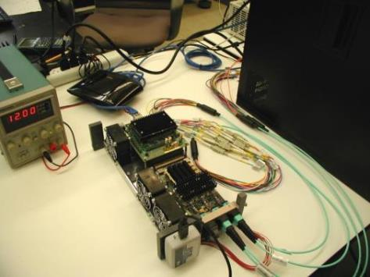
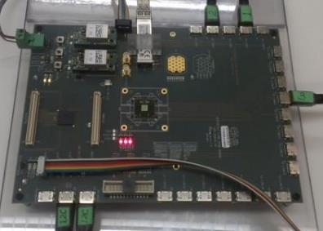
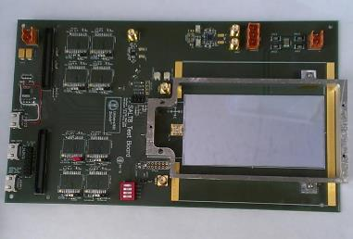
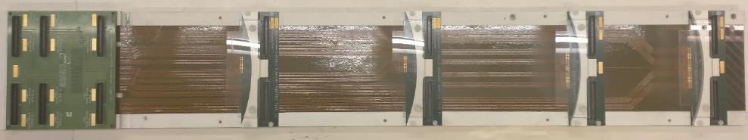
Phase I Slice Test Setup @ Syracuse
GBT frame data
(TFC/ECS & event)
MiniDAQ
I²C signal to
config GBTx
Linux PC
VLDB
CCPC
I²C signal to
config SALT8
GBTx
AMC40
SCA
LV
E-link data
320 Mbps
SALT8 TB
½ A sensor
MegAda
SALT8b
Available
now
Bonding
Adapter
Flex Cable Assembly

Slide 11
Status of Other Major Components
Status of major components to be added in the phase II slice test and tests later are presented at this workshop
  COMET with GBTx daughter card (by Will Parker).
  Hybrid of 8 SALT8 & new flex cable (by Mauro Citterio)
  SALT128 (by Marek Idzik, Krzysztof Swientek, Tomasz Fiutowski)
  SALT128 test board (by Carlos Abellan Beteta)
  Pigtail cable (by Maria Del Pilar Peco Regales)
  Prototype bare stave (by Ray Mountain)
Other components:
  MegAda: It is available now. I will bring 1 or 2 back to Syracuse.
  MiniDAQ2: One system is purchased for UMD, available this summer.
  LV regulator: We have one prototype from Brian Hamilton.

Slide 12
The DAQ System
The Linux PC
  PVSS control panels sends out configuration data to CCPC via an 1 Gbps Ethernet cable.
  A process running on PC reads event data in MEP from AMC40 via a 10 Gbps optical line, saves data in files for further analysis, or has real time analysis to avoid huge data files.
  Quartus loads firmware to AMC40 FPGA via a USB-to-jtag connection.
  Configures GBTx on VLDB via USB-to-I²C adapter.
CCPC on the MiniDAQ system
  Access register of FPGA on AMC40, write or read back register values of configuration.
AMC40 on the MiniDAQ system
  A special firmware is implemented to combine TFC/ECS & event data in 1 pair of optical fibers, to & from VLDB separately.
  The GBT frame to VLDB consists of GBTx config (IC), SALT8 config (EC), & TFC.
  The GBT frame from VLDB contains data from all input e-ports on VLDB & IC/EC read back.
  AMC40 generates MEP from VLDB GBT frame data and sends to PC via a 10 Gbps optical.
On VLDB
  GBTx is configured from the USB-to-I²C adapter, or from IC data.
  GBT-SCA communicates to GBTx of EC data & relay in I²C protocol with SALT8.
  E-ports operate at 320 Mbps, send TFC/CLK to SALT8, & receive event packets.

Slide 13
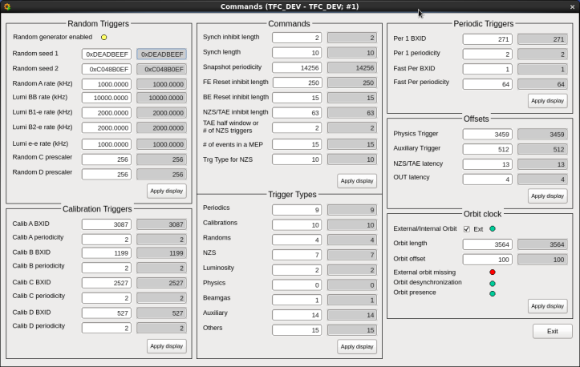
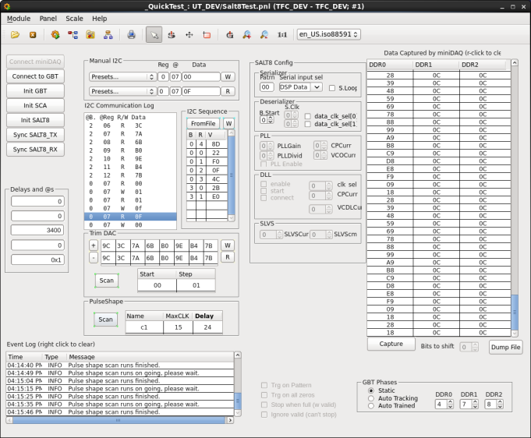
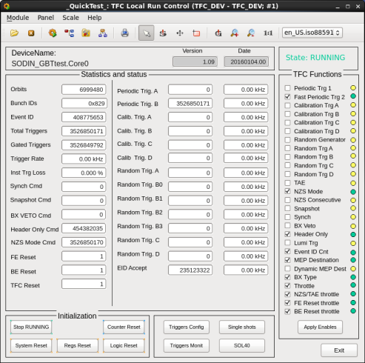
PVSS Control Panels
8-bit TFC for UT
Calib, Synch, Snapshot, BxVeto, NZS, HeaderOnly, FEReset, BXReset
TFC control panels by Federico Alessio
SALT8 test control panel started by Carlos Abellan

Slide 14
Measure System Performance
Besides of validating the readout chain, we also want to measure the system performance in analog domain and digital domain.
Static measurements of LV voltage drop & power consumption.
Noise of individual channels & common mode for high frequency effects. Some effects may also show up in the coupling of adjacent channels.
We can measure bit error rate (BER) of the digital signal to check the quality of overall communication.
We can also measure eye diagrams in individual components.

Slide 15
Requirements of BER Measurement Method
  The bit error rate (BER) measurement program runs on the Linux PC. It has following requirements:
  The program analyzes the MEP data at real time to avoid saving huge files, as the data rate per ASIC is ~ 0.12 GByte/s. We need to run in hours to measure the very small BER value.
  The analysis algorithm has to be simple & fast, since events come in at 40 MHz rate. For a 3.2 GHz CPU, there is only 80 cycles per event.
  It needs an accurate determination on whether or not the data received at the end of readout chain is exactly what was sent out from the head.

Slide 16
Bit Error Rate Measurement
In a first attempt we configure SALT8b to send out Synch package for every clock cycle, and check only Bxid[3:0].
The BER is expected to be very small. So from previous events we determine what Bxid[3:0] should be in the current event.
Bxid[3:0] signal may be affected by Bxid[11:8], Patt[11], Patt[8], & Patt[7:4].
Bxid[11:8] can have all different values, independent of Bxid[3:0] value. We can set Patt[11], Patt[8], & Patt[7:4] to different values in different runs.
Thus we can measure the true BER, check bits at a rate of 5.76×10¹¹ bits per hour.
In a slice system without flex cable, with timing optimized, we measured the BER of the system to be 0.
Eport 0 (8-bit) |  | Eport 1 (8-bit) |  | Eport 2 (8-bit)
12-bit BXID |  |  | Synch pattern
Bxid[11:8] | Bxid[7:4] | Bxid[3:0] | Patt[11:8] | Patt[7:4] | Patt[3:0]

Slide 17
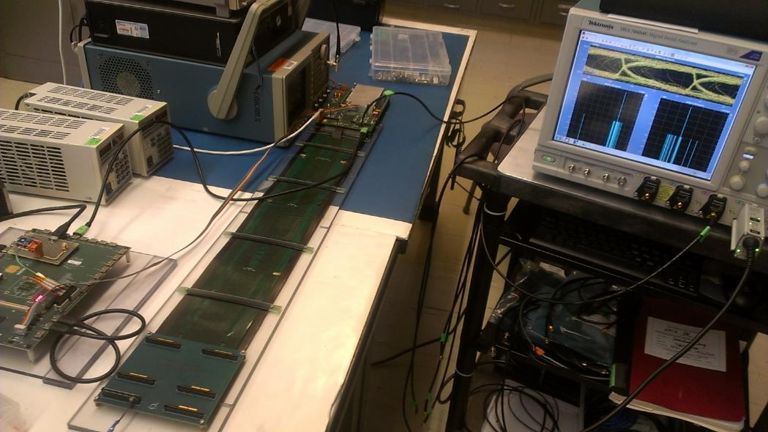
Eye Diagram Setup
SALT8b Testboard modified for eye diagram test
Tektronix DSA 70404C
Tektronix P7504 LVDS probe
A ERM8 connector with a modified micro-coax soldering tip

Slide 18
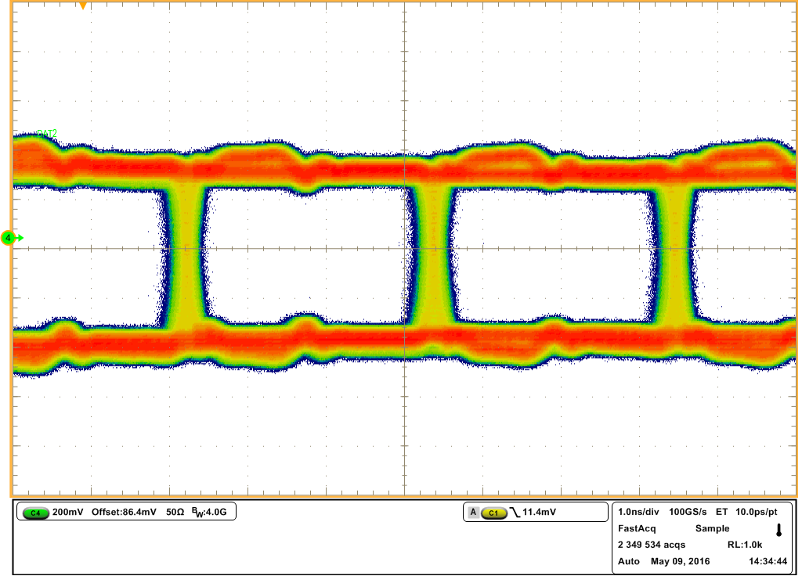
Eye Diagram @ SALT8b TB (I)
3.1 ns for
320 Mbps
Reflection due to impedance mismatch
Triggered by
master clock.
0 & 1 are
well separated.
Fast 0→1 & 1→0 transition.
Small jitter.
Relatively open eye diagram

Slide 19
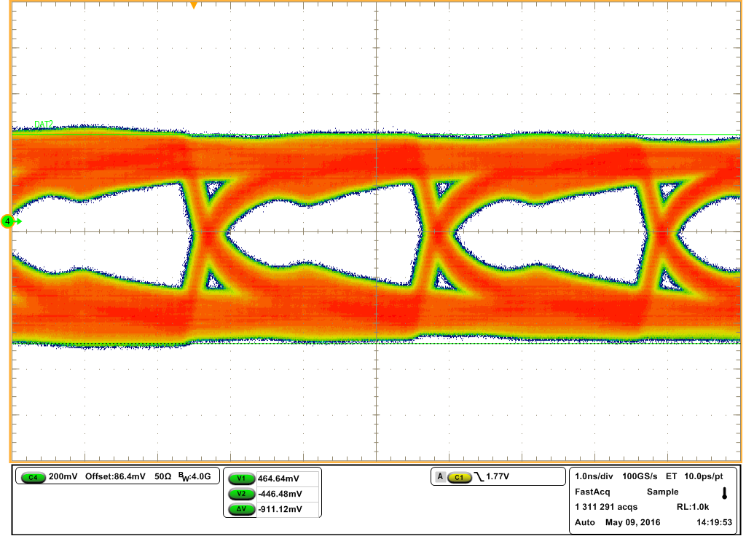
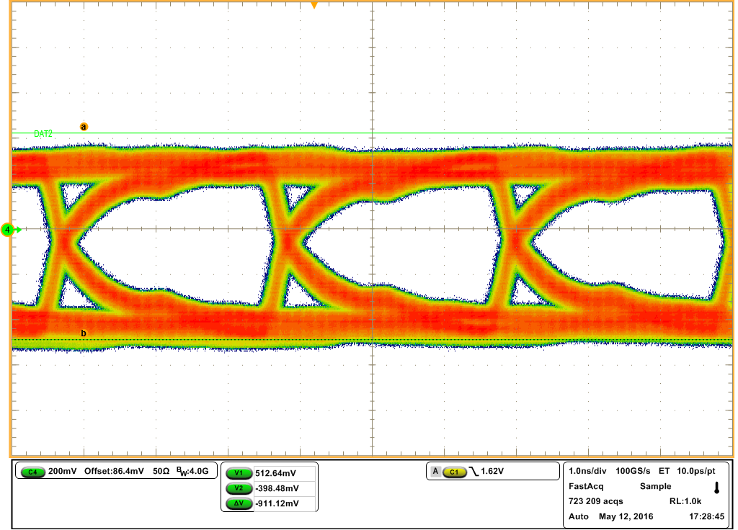
Eye Diagram At The End of Flex Cable
Plots taken by Nathan Jurik
Rev2 flex cable
Rev1 flex cable
Rev2 seems worse than rev1, maybe due to the impedance issue in the new Flex cable.

Slide 20
Summary
We have staged slice test plans to validate the read out chain and optimize individual components.
The system setup depends strongly on the available components.
We plan to study the noise performance, bit error rate, eye diagrams to provide quantitative & qualitative measurements of the readout system.
Phase I test that was aiming for this workshop is behind plan. We hope phase I & phase II tests can be ready for the electronics review on July 1st at Syracuse.

