Slide 1
HPC Programs and Needs @ Philips Research
Sven Prevrhal
Philips Research Hamburg
April 14, 2016 for the 7th INFIERI workshop

Slide 2

2
Philips Research Hamburg, DI Confidential

Slide 3

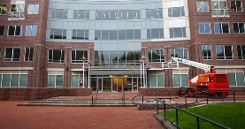
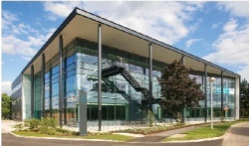
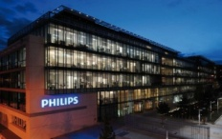
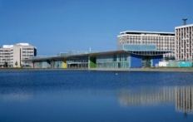
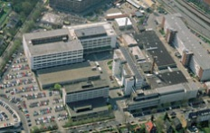
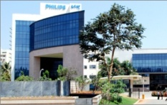
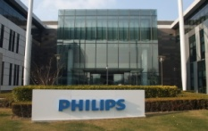
Philips Research
Philips Research Hamburg
100 Employees
Innovation Areas:
Diagnostic Imaging
Image-guided Intervention and Therapy
Clinical Decision Support
Professional Imaging Services
Boston / MIT
Clinical Research
Healthcare
Lighting
Cambridge
Home & Oral
Healthcare
Paris
Healthcare
Eindhoven
Healthcare
Lighting
Lifestyle
Hamburg
Healthcare
Bangalore
Emerging Markets
Healthcare
Lighting
Shanghai
Emerging Markets
Healthcare
Lighting, Lifestyle
3
Philips Research / Digital Imaging
Notes:
A lot to be proud of and Right competencies on board with a global footprint

Slide 4
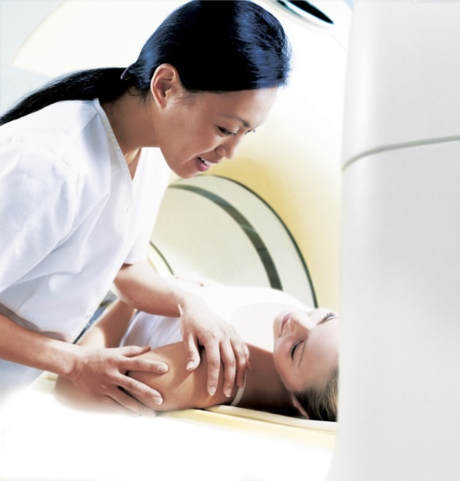
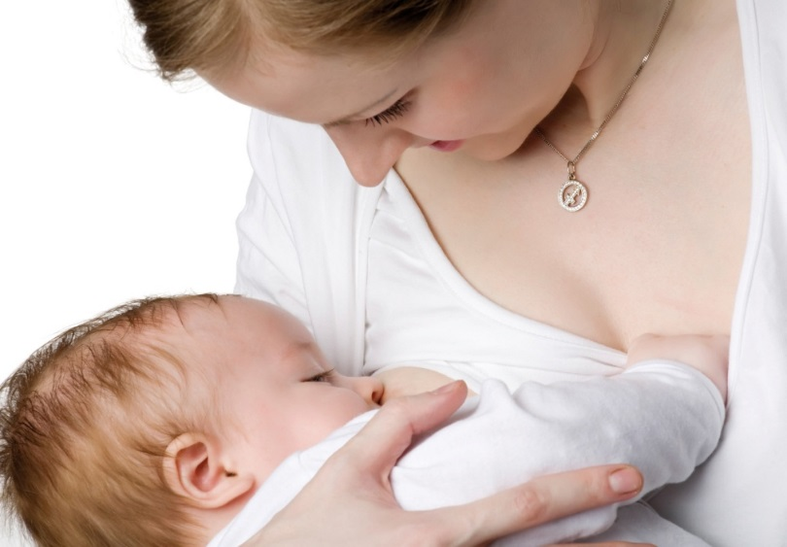
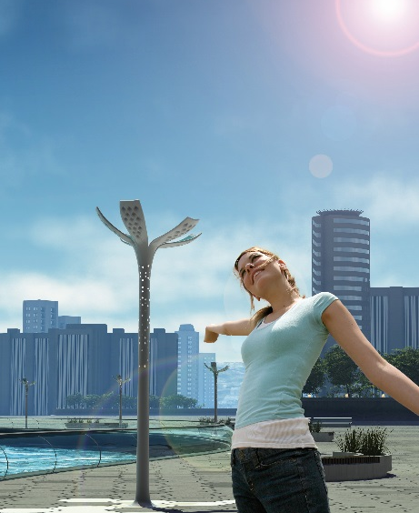
Philips Research Innovation Areas and Topics
Healthcare
Diagnostic imaging
Image-guided intervention & therapy
Patient care
Clinical decision support
Home and personal healthcare
Healing environments and services
Consumer Lifestyle
Healthy life
Personal care
Home living
Interactive living
Lighting
LED conversion and systems
Advanced light delivery
Light and energy management
Lighting services
Light for Health and well-being
4
Philips Research / Digital Imaging
4

Slide 5
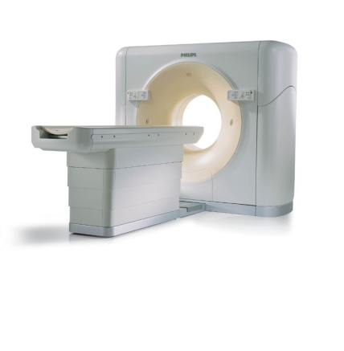
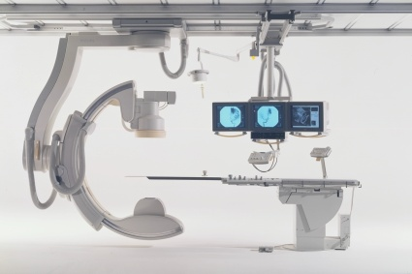
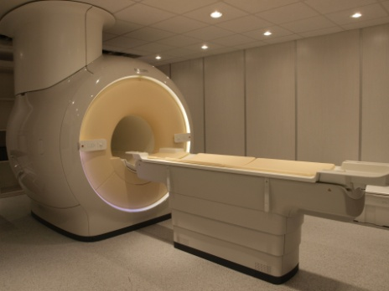
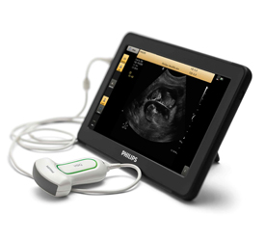
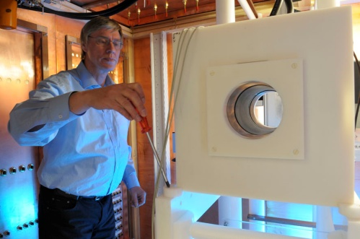
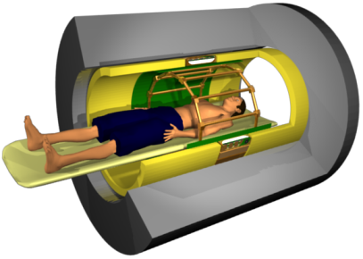
Diagnostic Imaging
Diagnostic
X-ray Imaging
Computed Tomography
Magnetic Resonance
Ultrasound
Magnetic Particle
Imaging
Hybrid
Tomographic Imaging
5
Philips Research / Digital Imaging

Slide 6
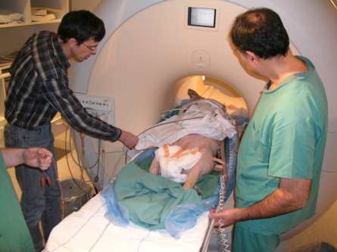
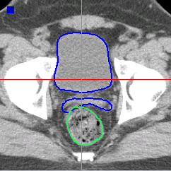
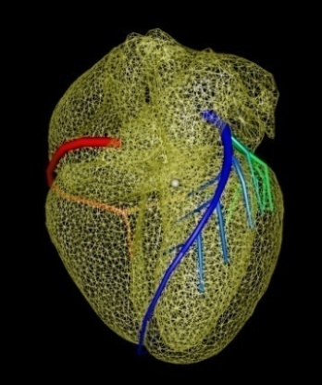
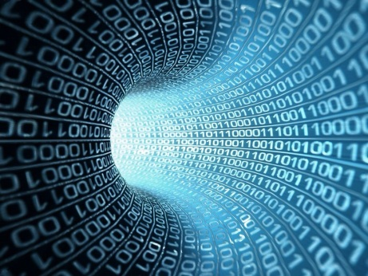
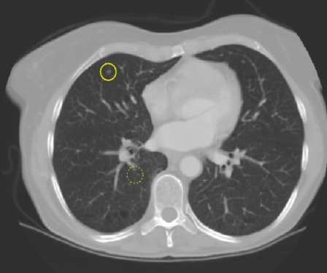
IGIT, CDS
Image-guided
Intervention & Therapy
Radiation Oncology
Image Registration /
Segmentation / Fusion
Professional
Imaging Services
Computer Aided Detection /
Clinical Decision Support
Modeling
6
Philips Research / Digital Imaging

Slide 7






Key Contacts with Universities / Institutes
Univ / Institute Content
Kings College London Interventional MR, MR EP, qMRI
NIH, Bethesda MR Quantification
Johns Hopkins, Baltimore Interventional X-ray
Charité/DHZ Berlin Cardiac MR, MPI, CDS for Dementia
U o Wash., Seattle Cardiac MR, CAD/CDS for Dementia
Univ. Bonn MR Methodology, Quantification
UKE Hamburg MPI, Oncology CDS
Univ. Utrecht MR-RT
Univ. of Leiden MR Methodology
Univ. Magdeburg Interventional MR
Univ. of Kyushu qMRI
Univ. of Lübeck MPI, MR Methodology
Univ. Clinic Munich Spectral CT, Phase Contrast CT
7

Slide 8
Massive Parallel Computing For PET Reconstruction
Sven Prevrhal
Philips Research Hamburg

Slide 9
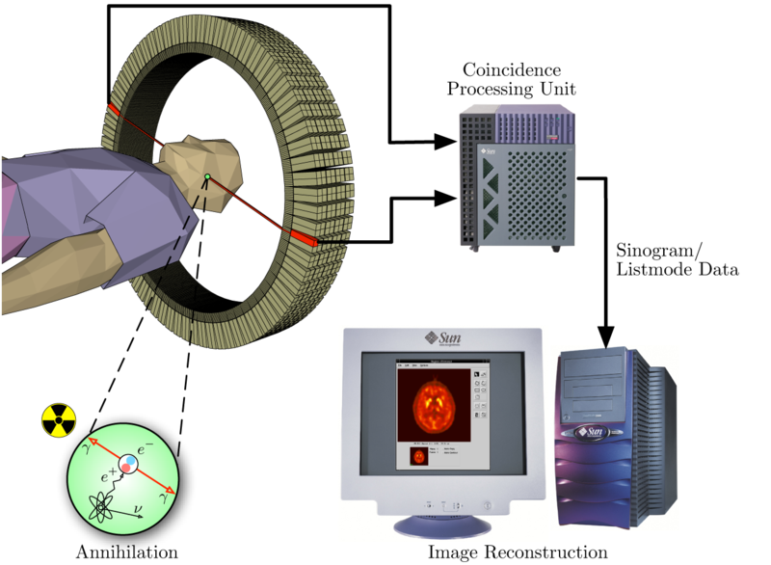
PET- Positron Emission Tomography
Detector Ring
456 13 212 18
012 15 134 08
213 05 024 02
Preprocessing
064 23 434 12
456 13 212 18
012 15 134 08
213 05 024 02
List of Events
064 23 434 12
Annihilation events
Image Reconstruction
Philips Research / Digital Imaging

Slide 10
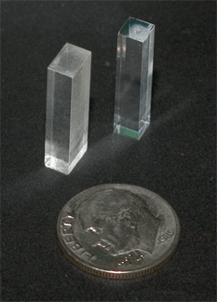
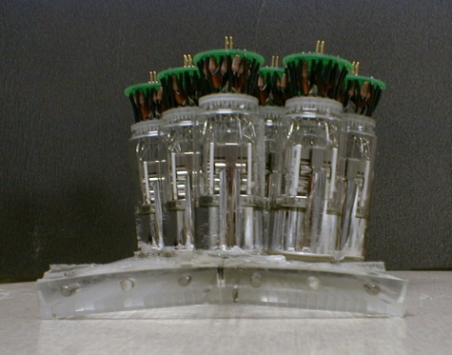
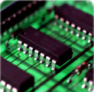
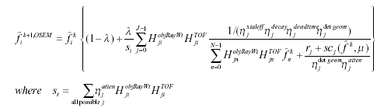
PET Instrumentation
Scintillator
PMTs, DMPs
Detector
Electronics
Recon
Philips Research / Digital Imaging

Slide 11
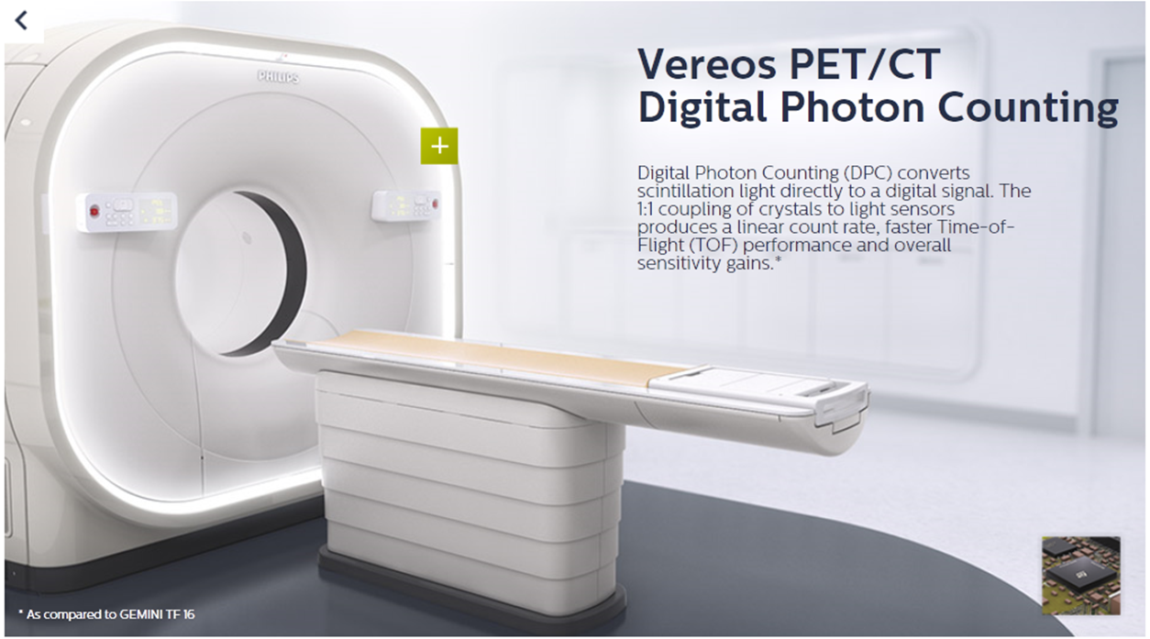
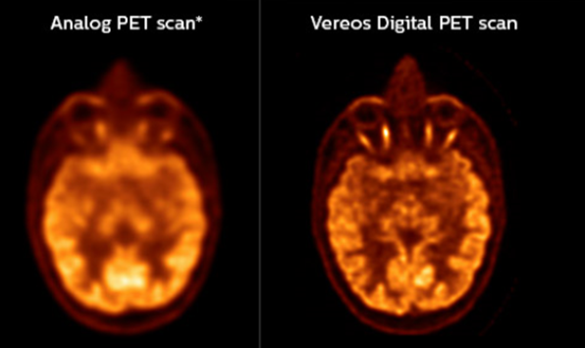
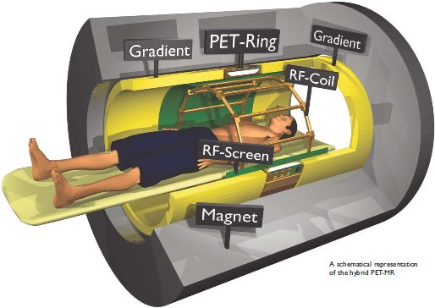
PET imaging: Imaging and recent developments
Philips Research / Digital Imaging

Slide 12
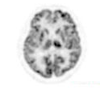
PET Image Reconstruction
Into this:
How to turn this:
456 13 212 18 1.2
012 15 134 08 0.8
213 05 024 02 1.4
064 23 434 12 0.6
456 13 212 18 -0.1
012 15 134 0. .4
213 05 024 02
List of Events
064 23 434 12
OSEM
List-Mode
Iterative
Ordered-Subsets Expectation-Maximization Reconstruction
Philips Research / Digital Imaging

Slide 13
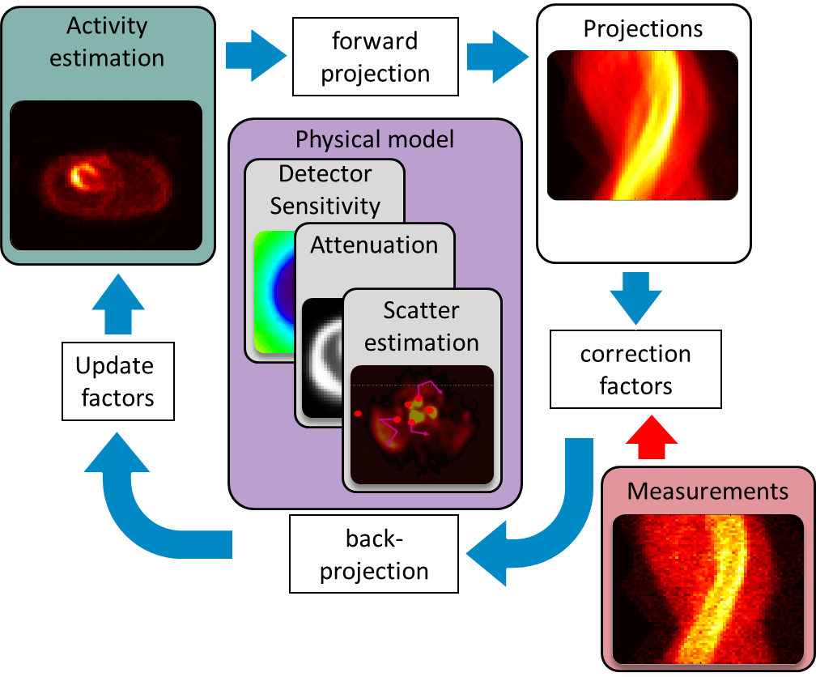
PET reconstruction: From events to images
Reconstruction estimates tracer distribution by optimizing conditional likelihood:
Physical model considers:
  Detector setup and geometry
  Attenuation and scatter in the patient
Iterative Algorithm for likelihood optimization
L (tracer distribution | meas., physical model)
Philips Research / Digital Imaging
Notes:
Reconstruction considers the statistical nature of measured data

Slide 14

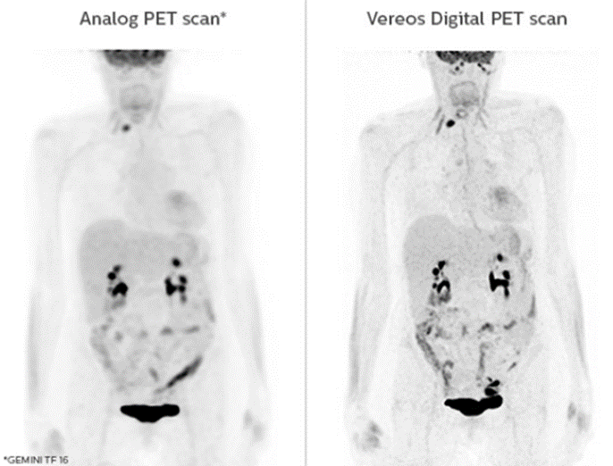
PET reconstruction: Why hurry?
  Computational time constrains by clinical workflow
  Real-Time reconstruction to
    Guide patient positioning
    Early detection of imaging issues (e.g. spilled activity)
    Establish feedback loops (image guided therapy)
Philips Research / Digital Imaging
Notes:
Reconstruction considers the statistical nature of measured data

Slide 15
Accelerators in medical imaging
GPGPUs are used in several imaging modalities and tasks (¹Cui et al.)
  Image registration
  Segmentation
  Filtering
  PET/SPECT/CT reconstruction (FBP, MLEM )
  MR-reconstruction
PET recon on Xeon Phi with motion correction (²Ryder et al.)
  Focus on time averaged sensitivity map calculation
  and list-mode MLEM recon motion
  Found about 0.66 the performance of a dual CPU server
  Use Workstation with Xeon Phi accelerator instead of high performance server
¹ Cui, J.; Pratx, G.; Prevrhal, S. & Levin, C.S. Fully 3D List-Mode Time-of-Flight PET Image Reconstruction on GPUs Using CUDA, Medical Physics Vol. 38, pp. 6775-6786
² Ryder, W. J., et al. "List-mode PET image reconstruction for motion correction using the Intel XEON PHI co-processor."
SPIE Medical Imaging. International Society for Optics and Photonics, 2014.
Philips Research / Digital Imaging
Notes:
Clock speed and single thread performance limited, -> multi-core
List-mode PET image reconstruction for motion correction using the Intel XEON PHI co-processor 1.67 slower than on server

Slide 16
Breakdowns of the speedup
GPGPU
Philips Research / Digital Imaging

Slide 17


Credits
Thomas Dey
Pedro Rodriguez
Andreas Göddeke
Thomas Köhler
Dirk Schäfer
Research and Engineering
Some of the research leading to these results has received funding from the People Programme (Marie Curie Actions) of the European Union’s Seventh Framework Programme FP7/2007-2013/ under REA grant agreement n° [317446] INFIERI "INtelligent Fast Interconnected and Efficient Devices for Frontier Exploitation in Research and Industry''
Philips Research / Digital Imaging
Notes:
Fully 3D erwähnen

Slide 18
HPC in CT and Cone-Beam CT
Thomas Köhler
Philips Research Hamburg

Slide 19
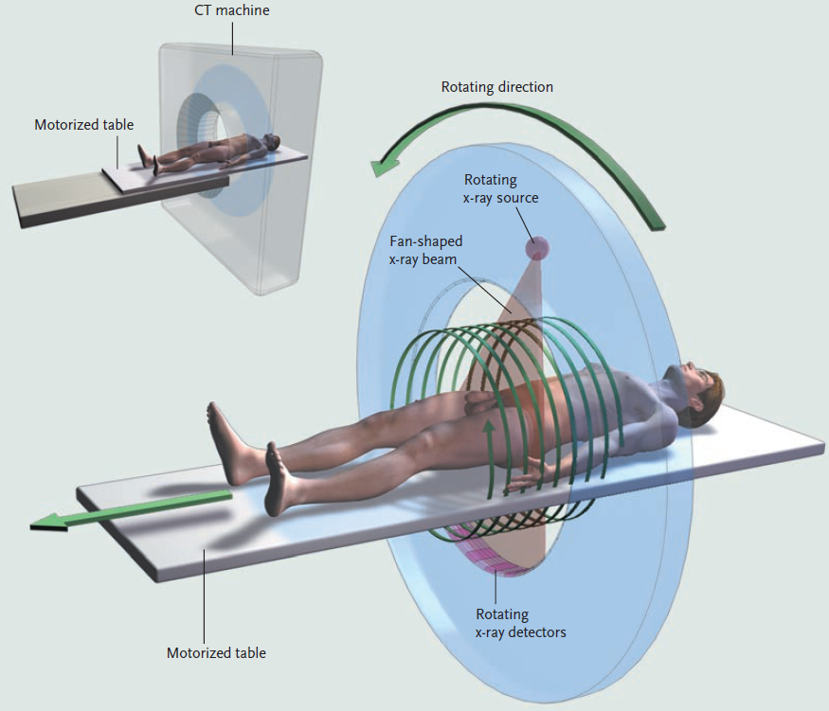

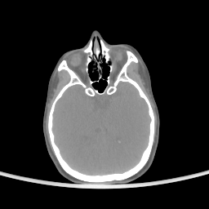
X-Ray Computed Tomography
reconstruction
2
October 11, 2014 Philips Research / Digital Imaging

Slide 20
Reconstruction as Large-Scale Optimization Problem
image
typical 0.5 Giga-Samples
projection data
typical 2 Giga-Samples
Regularization
parameter
Likelihood of image
“data term”
required accurate modeling of data acquisition
Roughness penalty
“model term”
Philips Research / Digital Imaging

Slide 21
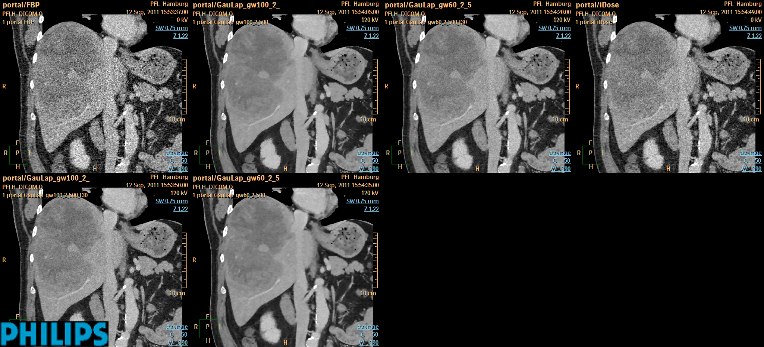
Example Reconstruction – Conventional CT
analytic reconstruction
maximum likelihood reconstruction
Philips Research / Digital Imaging

Slide 22
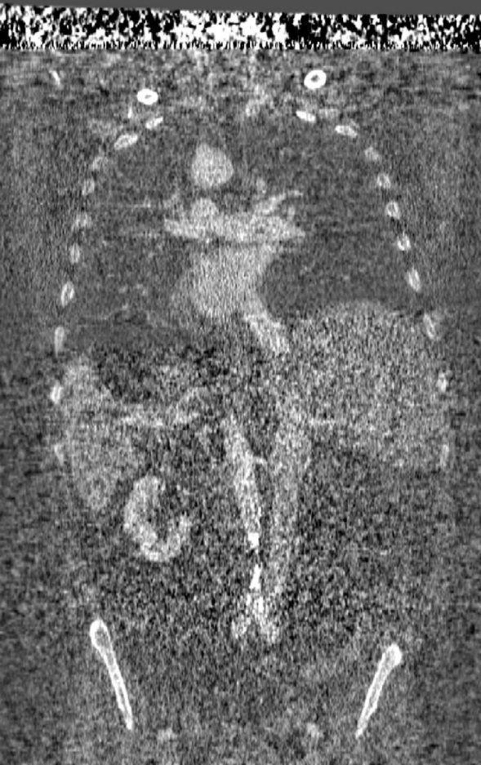
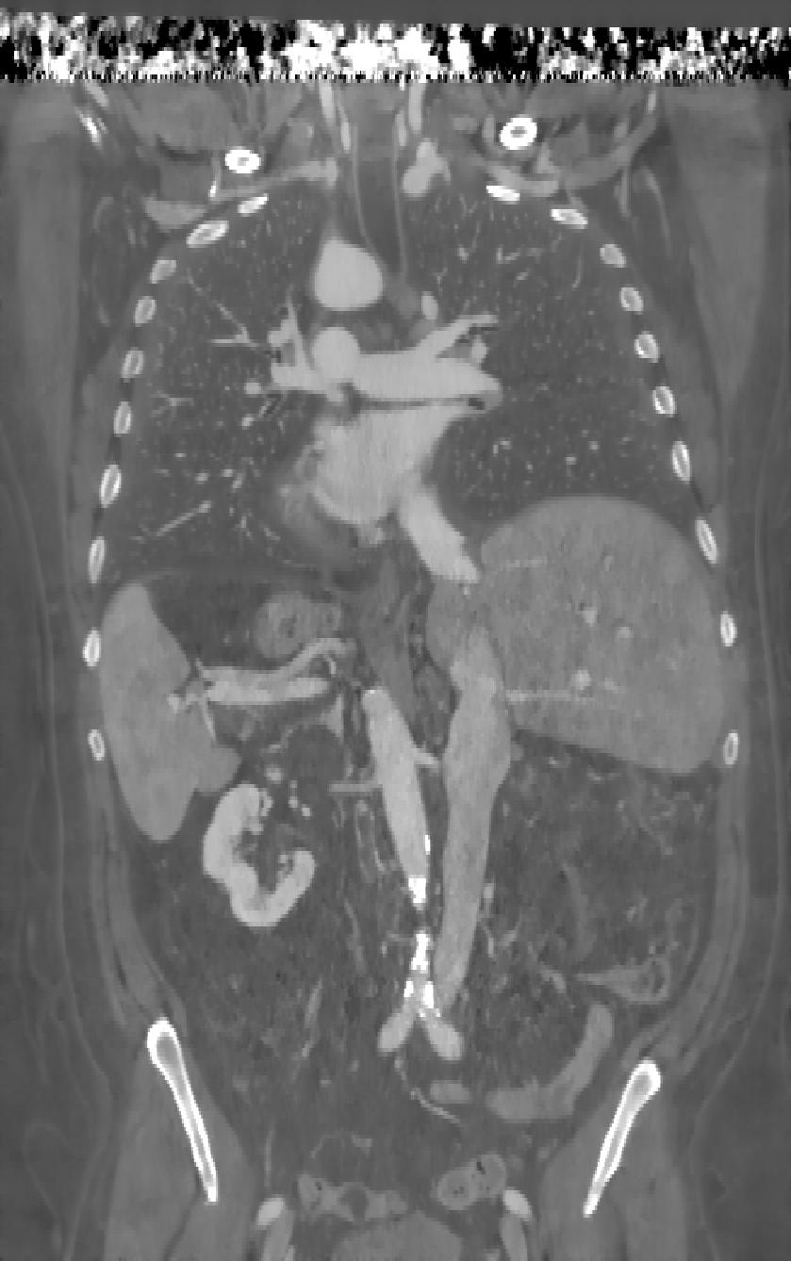
New Trend – Dual Energy CT
  input data size doubles
output data size doubles
physics to be modeled is more complicated
=> high performance computing required
Photo
analytic
reconstruction
Photo
maximum
likelihood
reconstruction

Slide 23
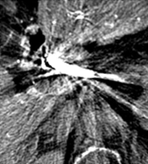
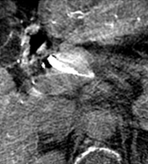
Motion and metal: Two problems in Computed tomography
Existing multi-pass algorithm addressing both problems simultaneously.
Implemented on multi-threaded CPU.
Acceleration on GPU needed.
Interesting problem, because not all processing steps can be translated directly to massively parallel processing.
Philips Research / Digital Imaging

