Slide 1
WP8: Outreach and Dissemination
Status Report
Franco Ligabue
Scuola Normale Superiore and INFN, Pisa

Slide 2
what is new since october
site improvements & updates
brochure(s)!
playlists created on Youtube public channel
EU fellows videoclip contest: 2nd round
outreach events during the present Workshop (Thanks to LIP)

Slide 3
site improvements
Dissemination
Landscape page refurbished http://infieri-network.eu/content/dissemination
other new pages
  http://infieri-network.eu/content/key-numbers
    open issues:
        KEEP INFO UPDATED

Slide 4
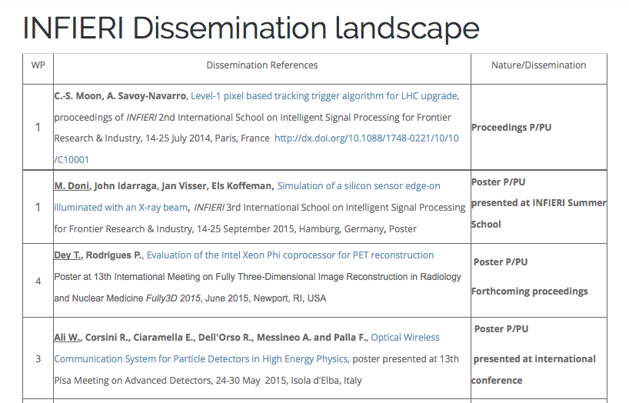
Obsolete

Slide 5
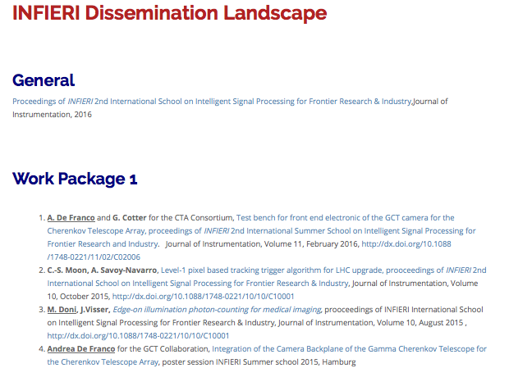
New Version

Slide 6
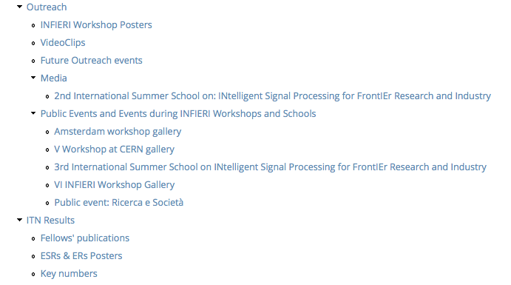
site improvements
New

Slide 7


Slide 8
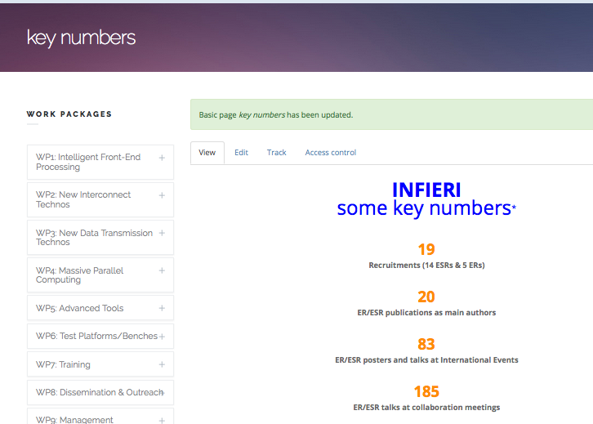

Slide 9
HABEMVS BROCHVRAM
brochure finally completed!! presented at the third year report last month
longer than the 8 a4 pages foreseen in last july’s design (having in mind a paper handout version)
therefore:
2 brochure versions:
  shorter, less technical, mainly for printout
  longer version (12 pages)
both versions should be published in 7 languages
  some translated versions already available
  the others need to be prepared
still room for some fine corrections/updates

Slide 10
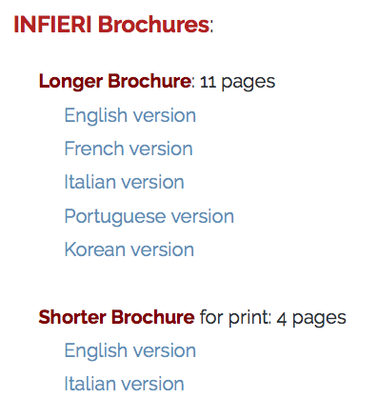

Slide 11
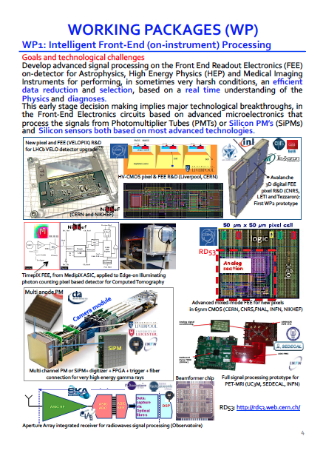
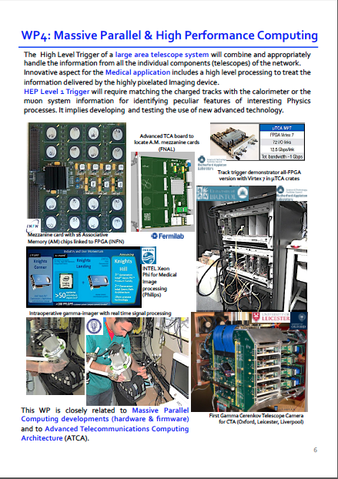
long brochure
12 pages
get your printed copy!
page 4
page 6

Slide 12
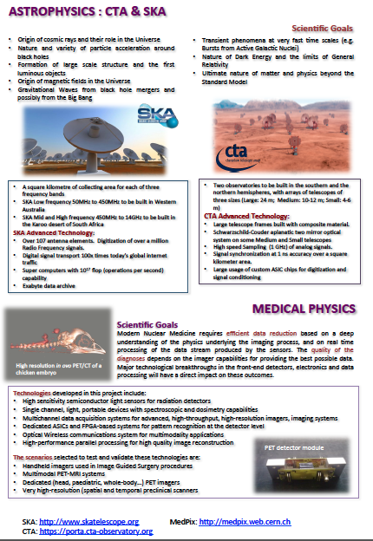
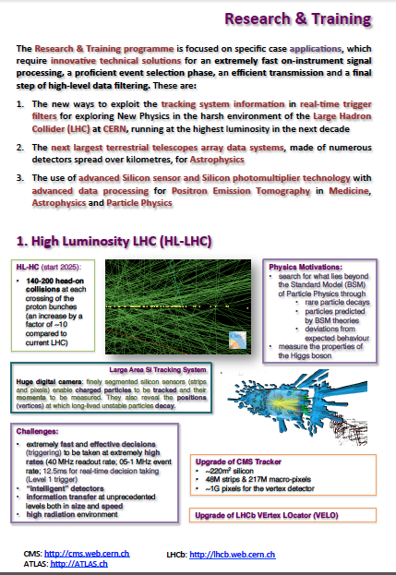


short brochure
4 pages
printable on a single A3 sheet

Slide 13
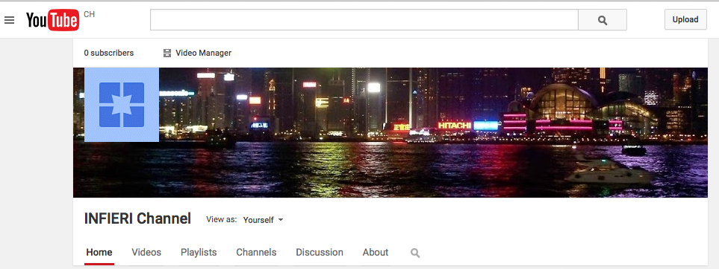
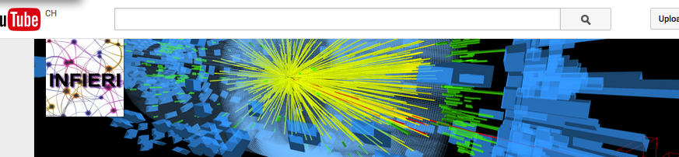
YouTube channels
private channel (used for students video upload)
public channel: public students videos uploaded
playlists with links to other videos of interest

Slide 14
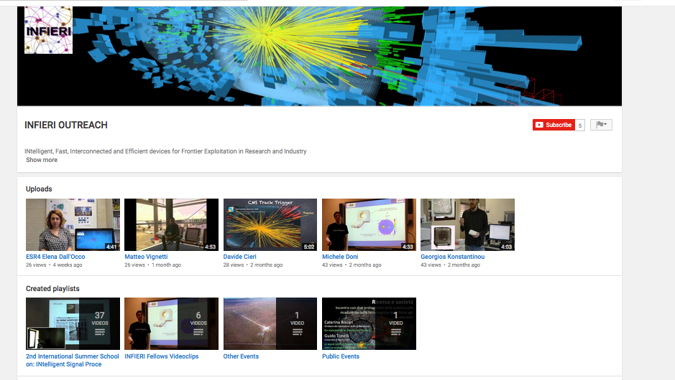
public YouTube channel

Slide 15
1° Videoclip Contest
very nice clips produced for the first round, I hope all of you have seen them
some uploaded on public youtube channel
online poll created
  not too many votes: 21
  we have a winner!

Slide 16
2° Videoclip Contest
second round of clips will be shown on friday (last session). PLEASE ATTEND!!!
please upload your videos on the “private” channel https://www.youtube.com/channel/UCDFk_Qg-WNR4LzhbhaEVD2A (only 6 new videos as of tuesday morning)
at the end of the projections the winner of the first contest will be announced and awarded the Oscar a wonderful prize!

Slide 17
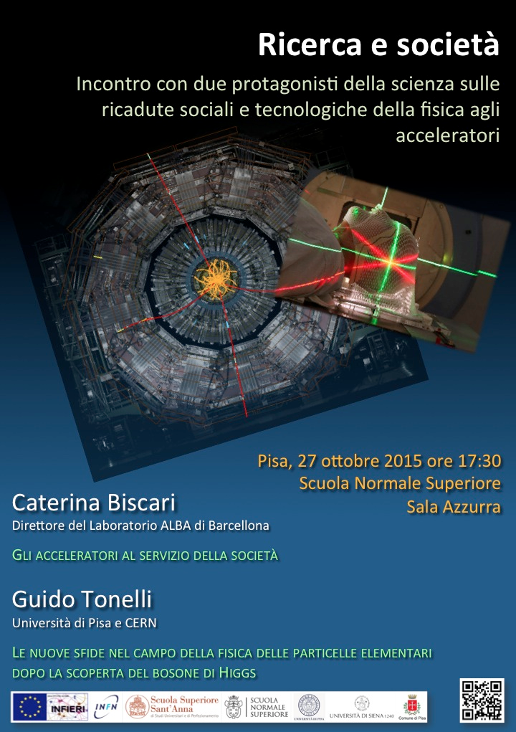
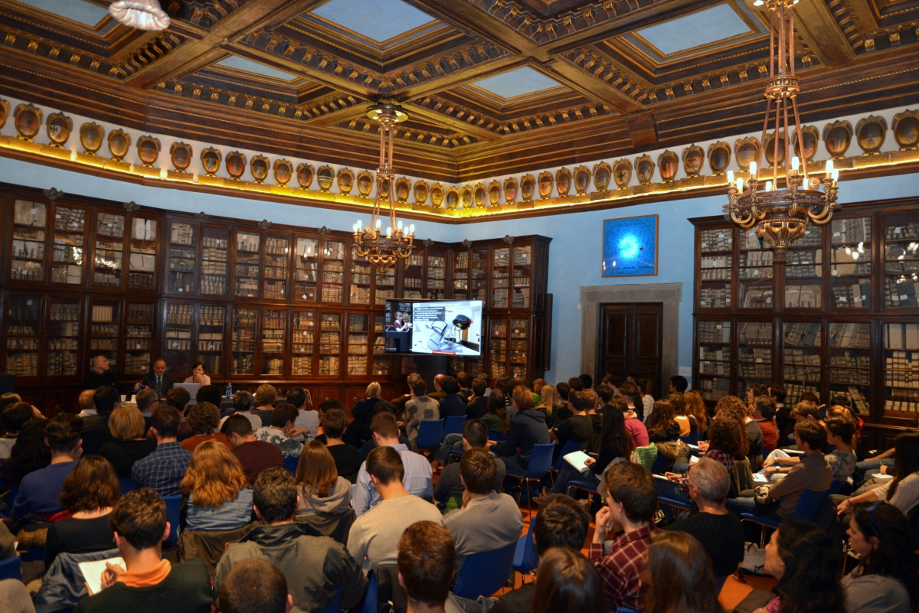
recent public events
Public event during the Pisa workshop was a big success
complete video footage available online

Slide 18
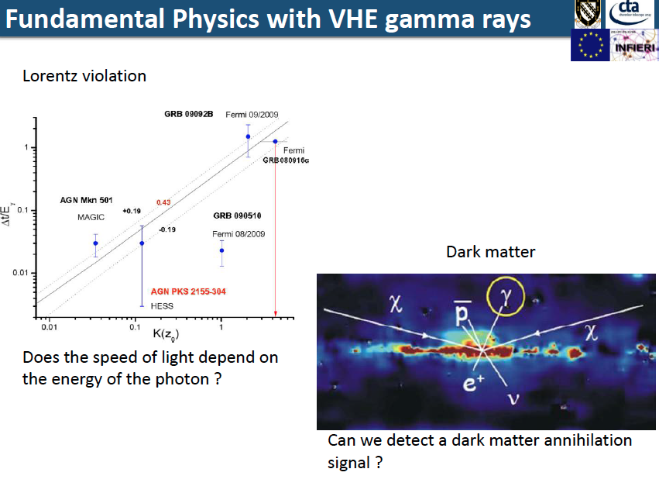
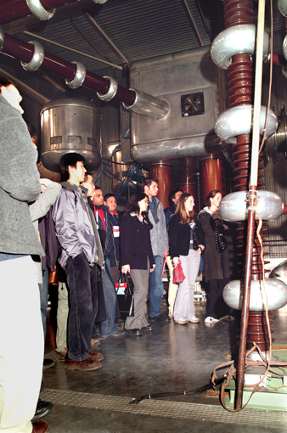
recent public events
other additions to outreach page:
  Public talk by A.De Franco @ Exeter College
  participation in Particle Physics Masterclass (targeting high-school students) by L.Calligaris

Slide 19
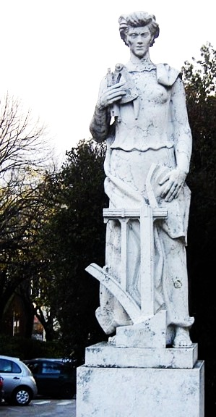
outreach event during the present workshop
Technologies from Particle Physics and Society
The event targets high school students and teachers.
Presentations are in Portuguese.
Venue: Instituto Superior Técnico, Anfiteatro do Complexo Interdisciplinar
Technologies developed for accelerators and used in other fields
Paulo Gomes
Particle physics as a pioneer in many of the key technologies
used in society
Clara Gaspar
How particle detectors are used in diagnostics
José Carlos Silva
Notes:
6 classi di V liceo scientifico per un totale di 150 studenti + 10 docenti

Slide 20
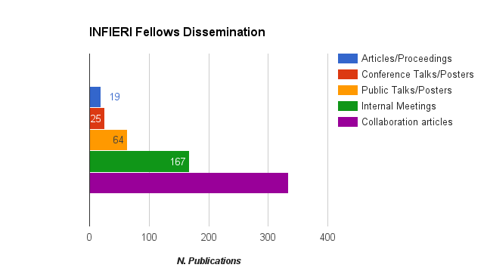
Dissemination figures update
table updated by Davide Cieri, Daniele Vadruccio

Slide 21
WP8 deliverables
Task 8.1: Dissemination
Within the ITN:
The ESRs and ERs will give oral presentations of their work to the whole network at the biannual ITN Workshops that also include a poster session and a few invited talks. Dedicated Web-pages in the INFIERI Website will be prepared for each ITN workshop with the program and the slides accessible to all the partners.
Internal INFIERI Notes on the work performed by ITN collaborators and especially ESRs and ERs will be reviewed by the Editing Board and made available on the INFIERI Website to all the partners.
The ESRs and ERs will present their work in different international conferences/workshop, such as: IEEE NSS MIC, SPIE, TWEPP, WITT, TIPP, etc.
The project results will be published in international peer review journals like: Transactions on Nuclear Science (TNS); Nuclear Instruments and Methods (NIM); Journal of Instrumentation (JINST); Proceedings of important International Events; Journal of Astrophysics; Physics Review Letters, etc.
The project results will be presented in general meetings of the large international collaborations in Astrophysics, HEP and Medical Physics and reported in Internal Notes with large diffusion in these large international collaborations.
The Media ITN annual series of courses (66 hours per year) will be accessible to the general public through DVD’s produced by the ITN.

Slide 22
WP8 deliverables
Task 8.2: Outreach
• Design and implement a web page that will be widely advertised on all partner websites;
• Publication of a project brochure oriented towards the general public and scientists from other domains (translated in different languages);
• Publication of articles presenting the project in information bulletins of the participating parties.
• Participation in Marie Curie Open Days organized by the partner institutes.
• Participation in regular public events, public exhibitions, science centers and public fairs organized by the host institutes like for instance: Fêtes de la science (in France and at CERN), Settimana della cultura scientifica e technologica (Italy) as well as in the similar events in UK, Spain, Netherlands and Portugal.
• Regular seminars reporting on the project progress in the ESR/ER’s home university/institute (act as “Marie-Curie Ambassadors”);
• Production of a video clip showing the project’s ESRs during the annual meeting (interview of each ESR, short presentation of their lab), production of a DVD;
• Organization of social events for all participating students in each host institute, celebration of major project milestones.
• Guided tours;
• Demonstration prototypes, bench top experiments.

Slide 23
pending issues
longstanding problem of updating dissemination pages
  Google Drive Repository proposal seems not to have proved so feasible/popular/successful
  Therefore: WP coordinators and single members are WARMLY invited to
  browse the pages and check for missing items, especially those concerning them of course (that should be easier)
  send REGULARLY (on a monthly basis) the updates to myself, Davide Cieri and Daniele Vadruccio (for the fellows material).

Slide 24
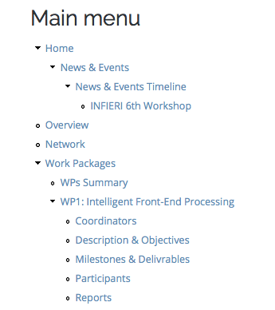
pending issues
  WP coordinators/webmasters are also invited to check and update the pages related to their WP.
  Many are obsolete.

