Slide 1
First VideoClip Contest
Franco Ligabue
Scuola Normale Superiore and INFN, Pisa

Slide 2
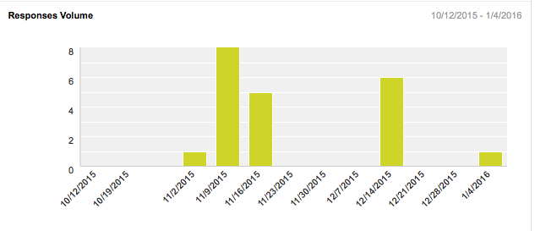
poll was launched after last workshop in pisa: rank the clips from top favourite to less favourite
21 people voted

Slide 3
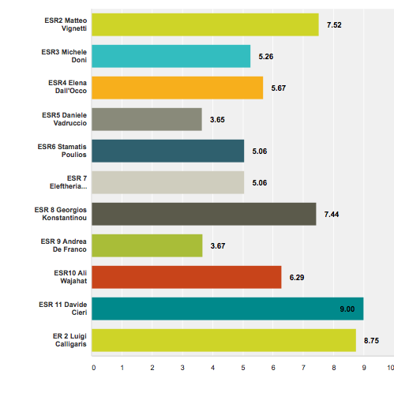
results
weighted average

Slide 4

results
3° best score
Matteo Vignetti
score: 7.52

Slide 5
results
2° best score
Luigi Calligaris
score: 8.75

Slide 6
results
best score
Davide Cieri
score: 9:00

Slide 7

Congratulations
to Davide!

Slide 8
Stay tuned for possible second round of the contest!

