Slide 1
ECal Optimization for High Energy Photons
N. Nikiforou

Slide 2
Possible Models
Calculations from geometry xml file using excel
 | # Layers | Absorber Thickness [mm] | Si [mm] | Other (gaps, etc) [mm] | Absorber Thickness [X0] | Si+Other Thickness [mm] | Si+Other Thickness [X0] | Total Thickness [mm] | Total Thickness [X0] | Calorimeter Thickness [mm] | Calorimeter Depth [X0]
CLIC_o2_v04 (current) | 17 | 2.4 | 0.5 | 1.5 | 0.65 | 2 | 0.06 | 74.8 | 12.01 | 129.2 | 22.85
 | 8 | 4.8 | 0.5 | 1.5 | 1.30 | 2 | 0.06 | 54.4 | 10.84
CLICdet_20_10 (original CLIC_ILD) | 20 | 2 | 0.5 | 1.5 | 0.54 | 2 | 0.06 | 80 | 11.96 | 140 | 23.35
 | 10 | 4 | 0.5 | 1.5 | 1.08 | 2 | 0.06 | 60 | 11.39
CLICdet_30_10 (possible high granularity option) | 30 | 1.5 | 0.5 | 1.5 | 0.41 | 2 | 0.06 | 105 | 13.89 | 155 | 22.58
 | 10 | 3 | 0.5 | 1.5 | 0.81 | 2 | 0.06 | 50 | 8.68
CLICdet_40 (possible high granularity option) | 40 | 1.9 | 0.5 | 1.5 | 0.51 | 2 | 0.06 | 156 | 22.85 | 156 | 22.85
 | 0 | 0 | 0 | 0 | 0.00 | 0 | 0.00 | 0 | 0.00
Note: we can “easily” accommodate an ECal thickness up to 159 mm (thickness of envelope) in our models without increasing detector size

Slide 3
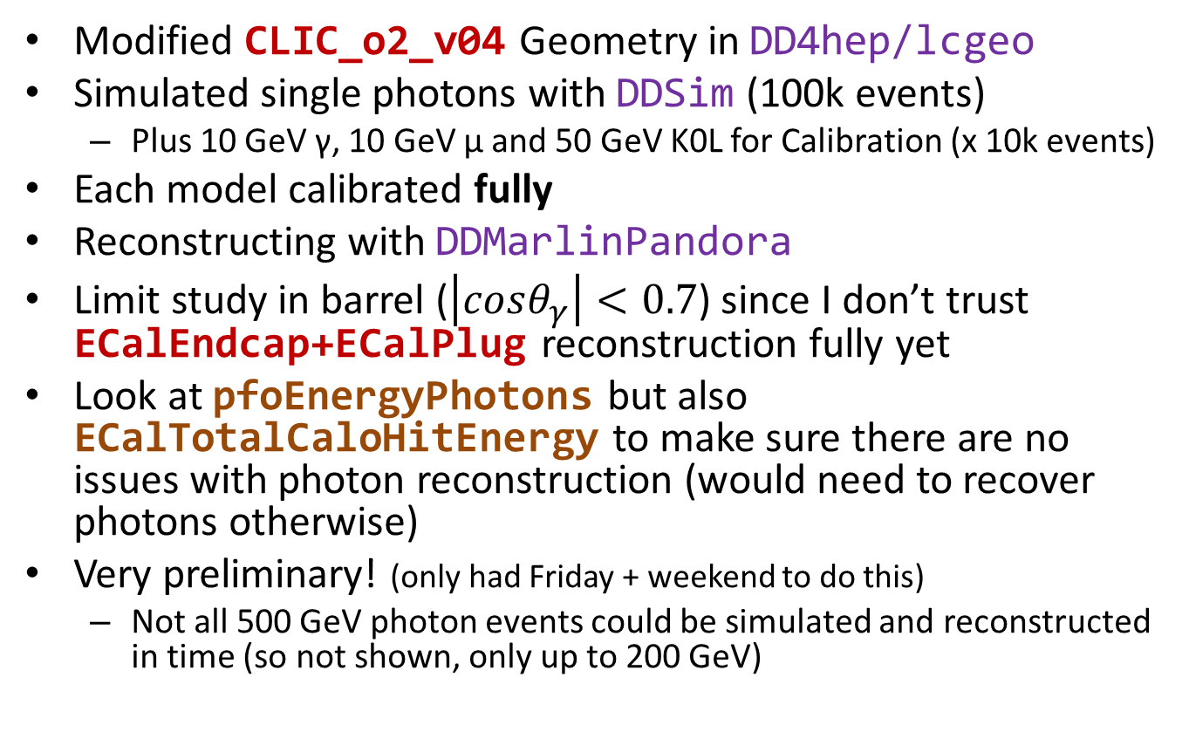
Full Simulation Study
Modified CLIC_o2_v04 Geometry in DD4hep/lcgeo
Simulated single photons with DDSim (100k events)
  Plus 10 GeV γ, 10 GeV μ and 50 GeV Κ0L for Calibration (x 10k events)
Each model calibrated fully
Reconstructing with DDMarlinPandora
Limit study in barrel ($\left|cosθ_{γ}\right|<0.7$) since I don’t trust ECalEndcap+ECalPlug reconstruction fully yet
Look at pfoEnergyPhotons but also ECalTotalCaloHitEnergy to make sure there are no issues with photon reconstruction (would need to recover photons otherwise)
Very preliminary! (only had Friday + weekend to do this)
  Not all 500 GeV photon events could be simulated and reconstructed in time (so not shown, only up to 200 GeV)

Slide 4
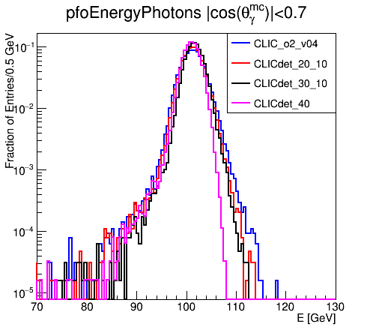
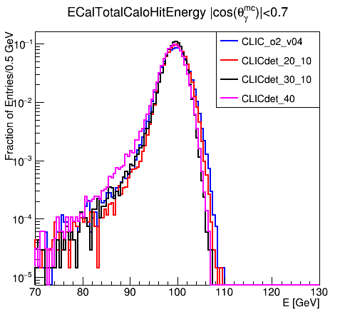
100 GeV Photons
Notice that this has significant underflows! ~6-7% -> Implicitly “bad” events where photons are badly reconstructed are ignored
Underflows <0.1%
Model/ Energy | Total γ PFO Energy |  | Total ECal Energy (no γ reco)
 | Mean [GeV] | Sigma [GeV] | Mean [GeV] | Sigma [GeV]
CLIC_o2_v04_100GeV | 101.33 | 2.25 | 99.55 | 2.33
CLICdet20_10_100GeV | 101.32 | 2.04 | 99.72 | 2.05
CLICdet30_10_100GeV | 101.67 | 1.74 | 99.49 | 1.82
CLICdet40_100GeV | 101.07 | 1.65 | 99.17 | 2.04

Slide 5
PFO Photon Energy σ(Ε)/E vs E

Slide 6
Total ECal Energy σ(Ε)/E vs E

Slide 7
Conclusions?
A closer look is needed
If model has to be frozen, I would propose we go with 30 layers (20+10)
One can notice that the performance changes when more energetic showers penetrate more the back layers with coarser sampling

