Slide 1
Scintillator module mechanics
Baby MIND Collaboration Meeting
E. Noah
19 April 2016

Slide 2
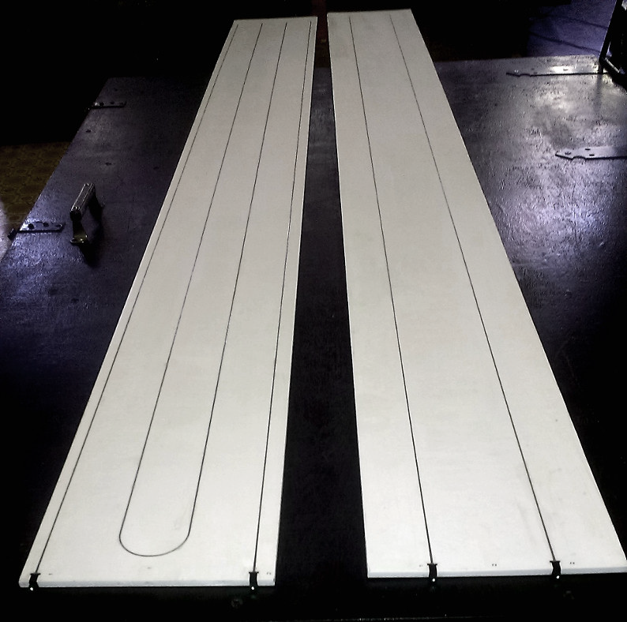
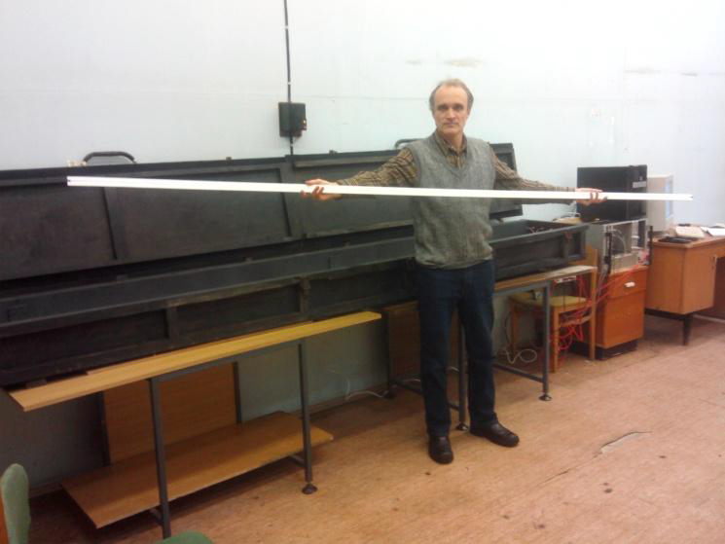
Two bar types
Horizontal bars:
  3000 mm x 31 mm x 7.5 mm
Vertical bars:
  1950 mm x 210 mm x 7.5 mm

Slide 3
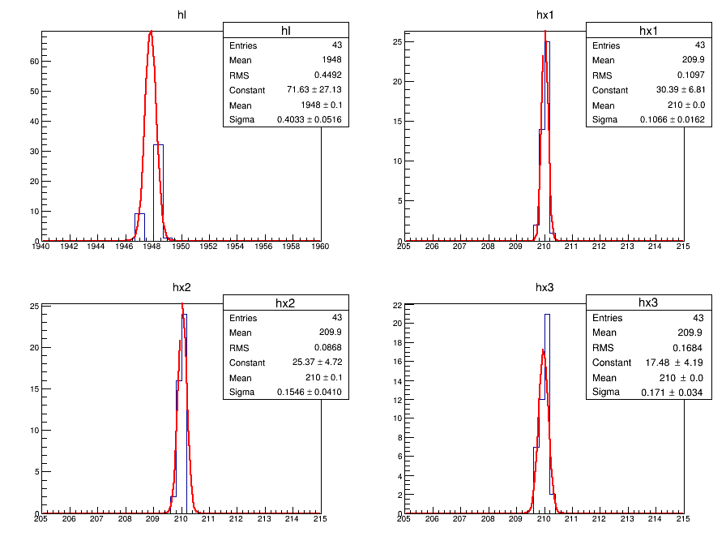
Vertical bar dimensions

Slide 4
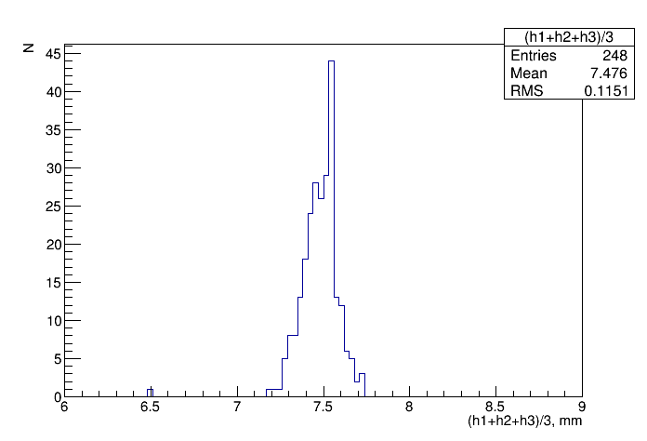
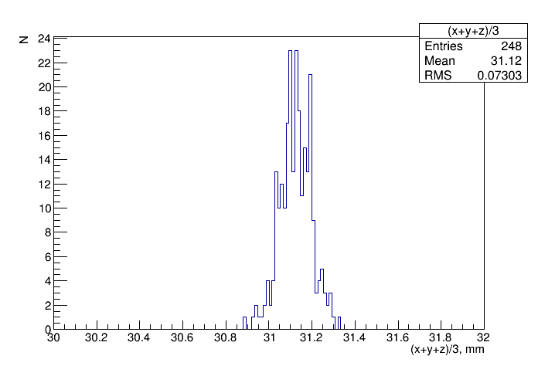
Horizontal bar dimensions

Slide 5
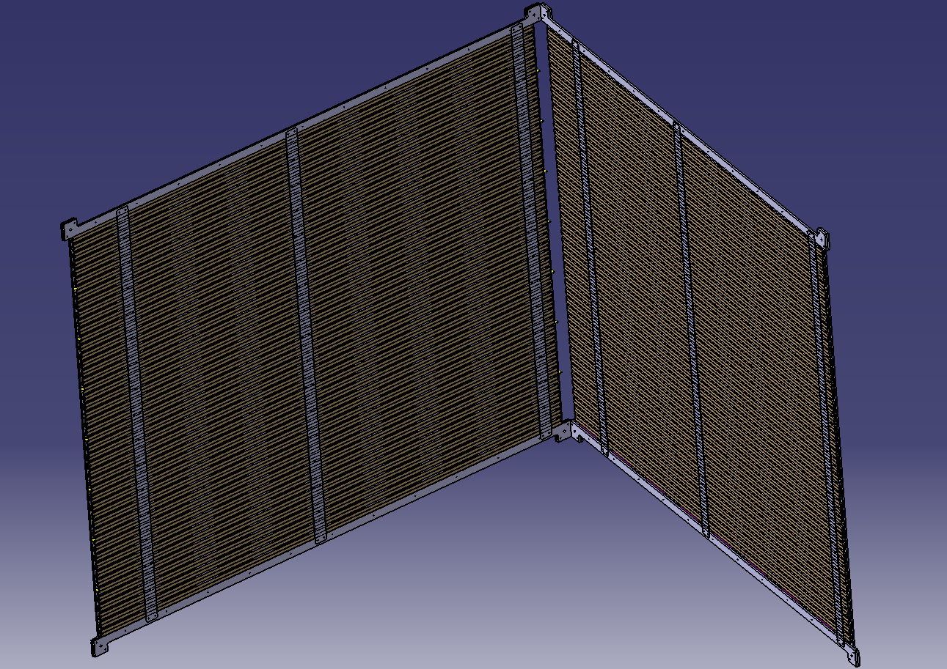
Two half-modules: open

Slide 6
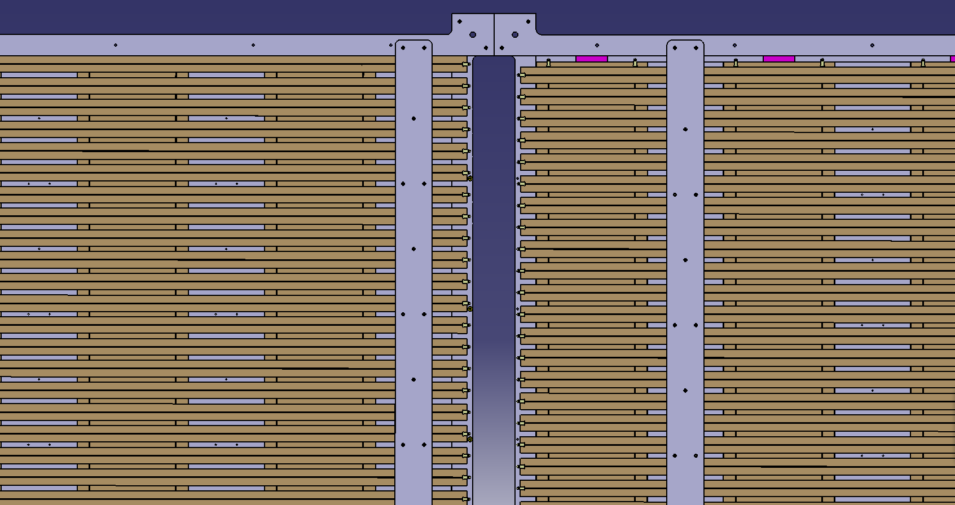
Two half-modules: open

Slide 7
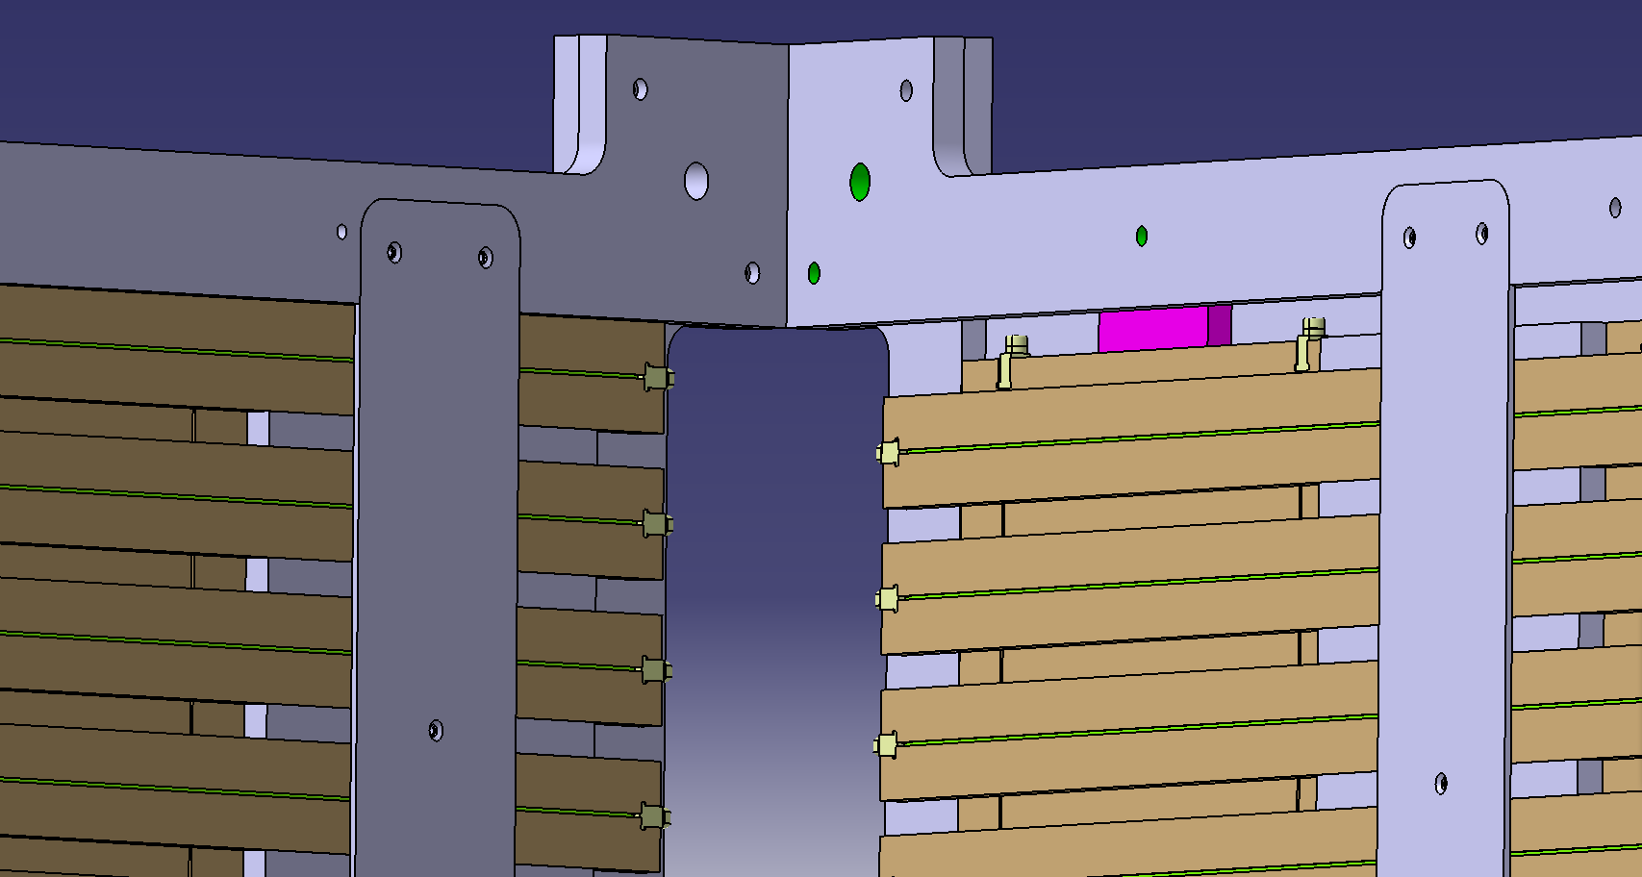
Two half-modules: open

Slide 8
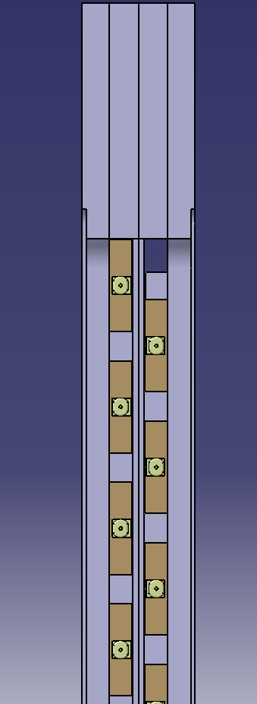
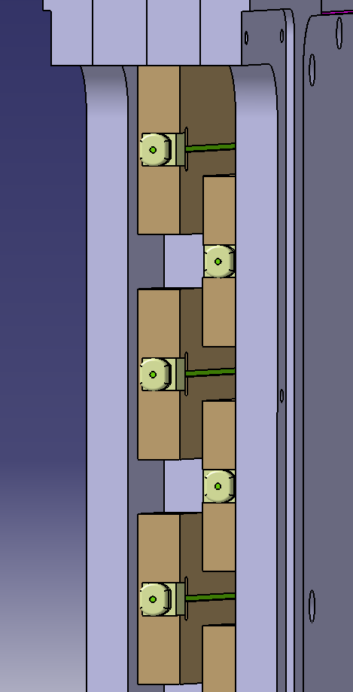
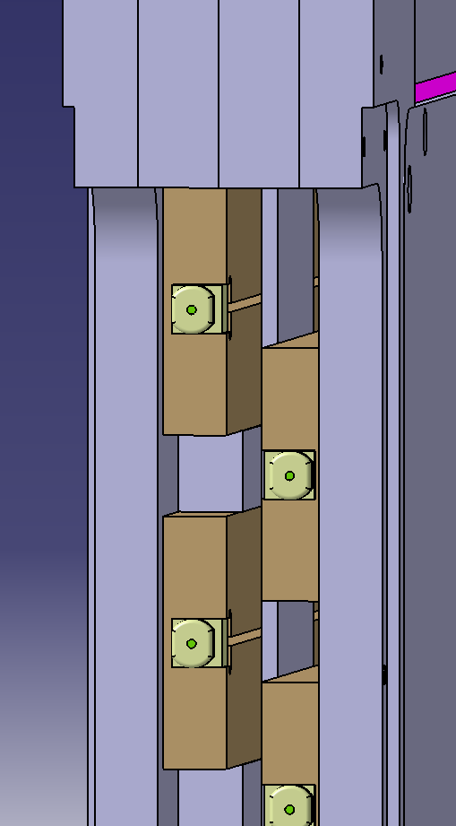
Side view of horizontal bars

Slide 9
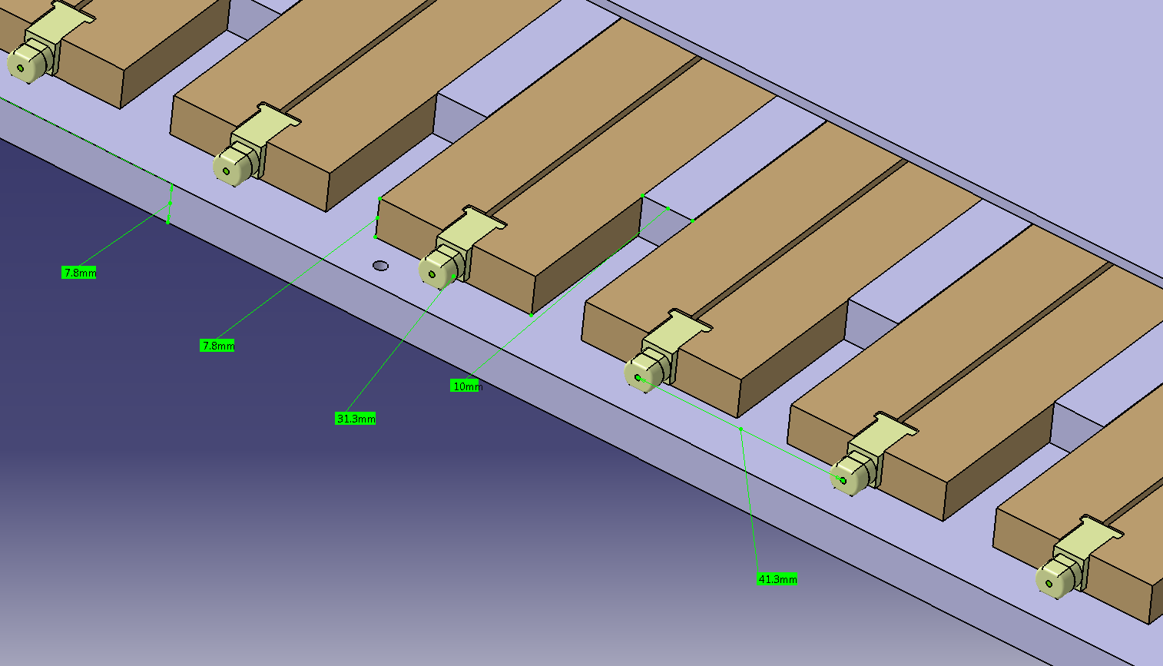
Positioning of Horizontal bars

Slide 10
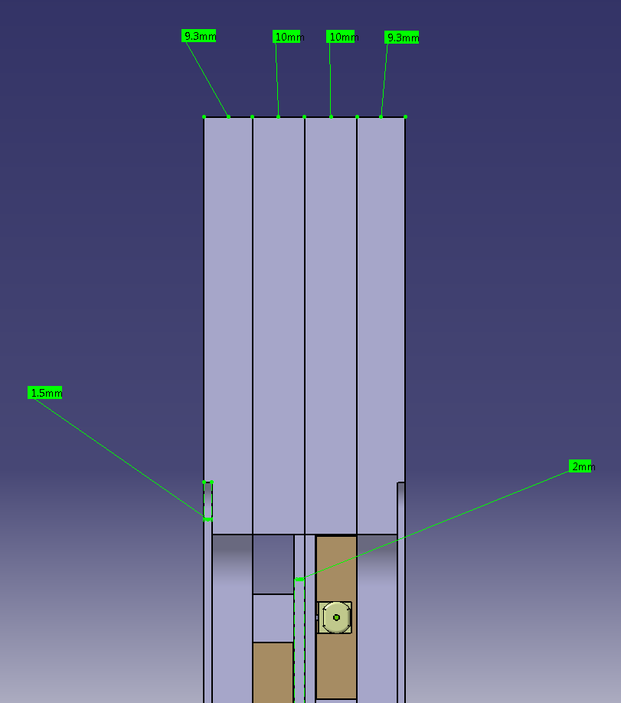
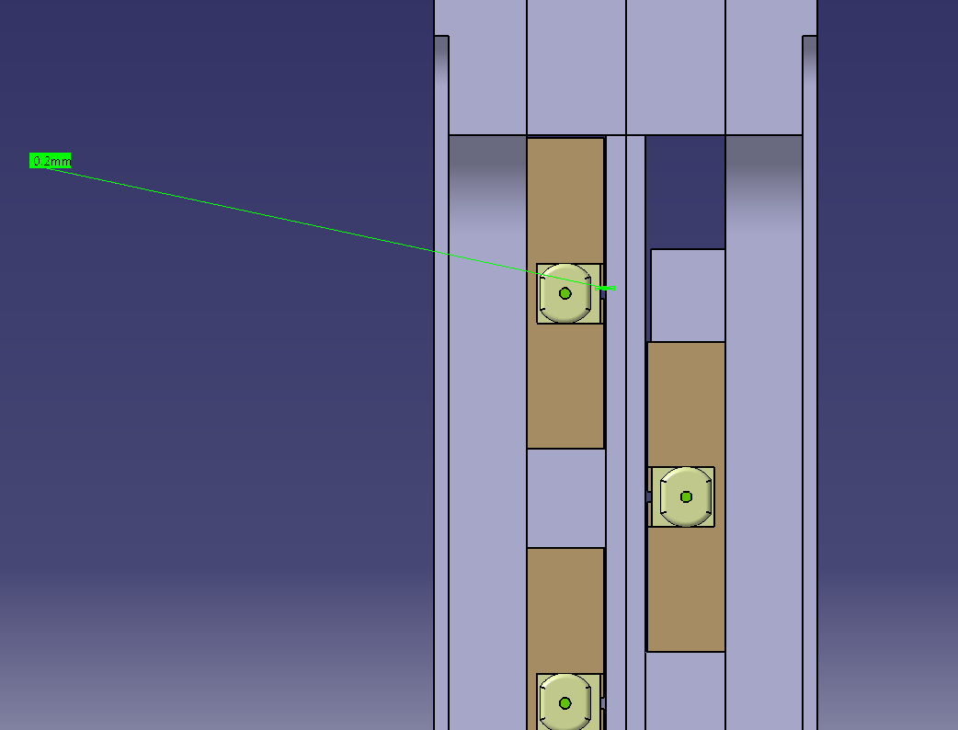
Thickness of modules
200 μm gap between sci. and al.

Slide 11
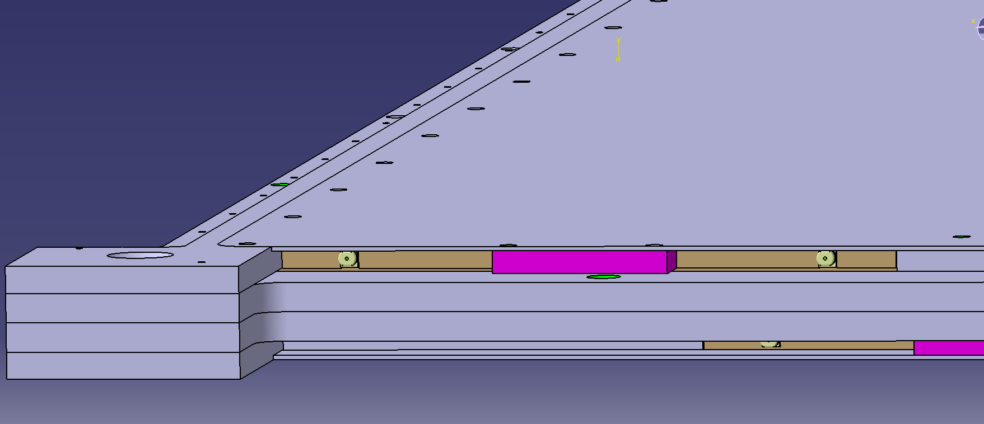
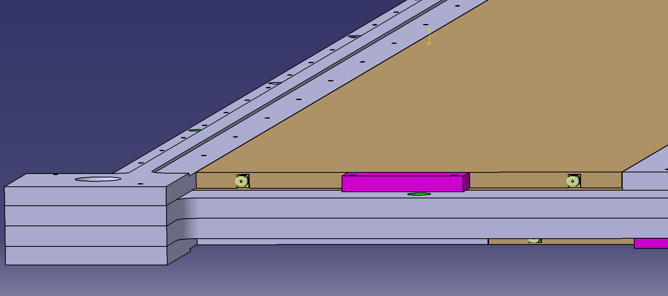
Vertical bars in module

Slide 12
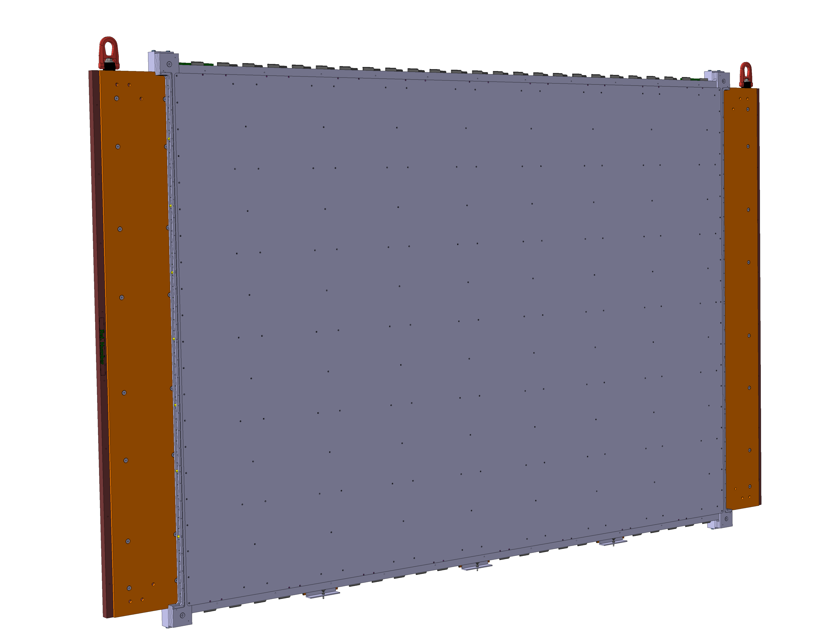
Integration on magnet

Slide 13
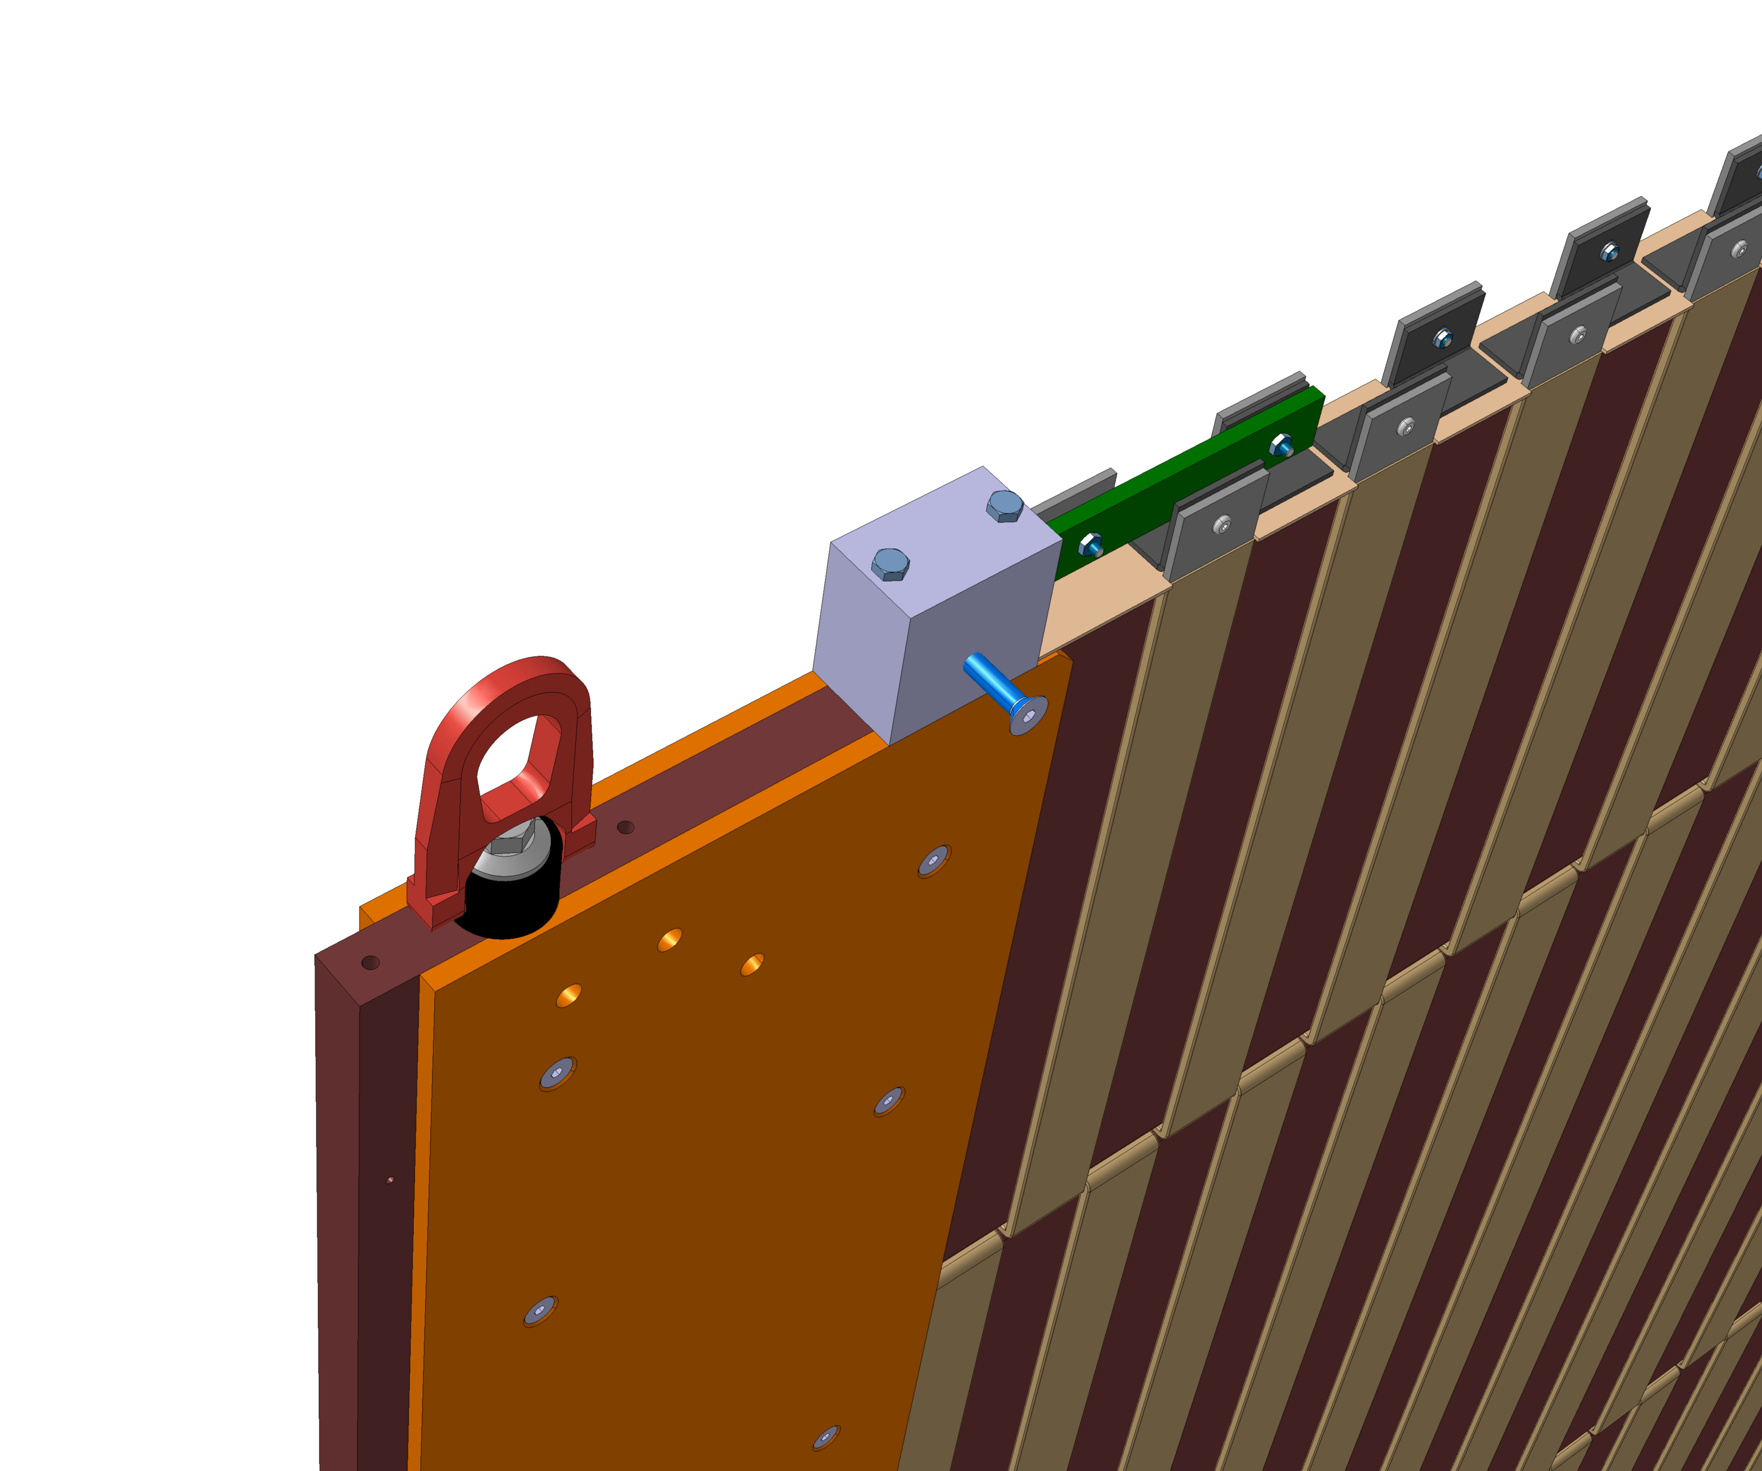
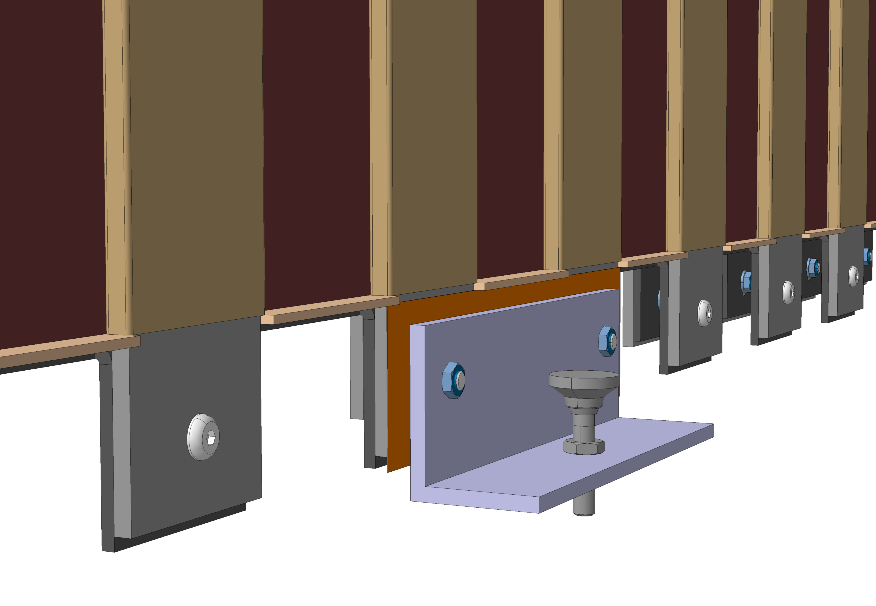
Detector integration on magnet

Slide 14
Costing of mechanics for sci. modules
First costing in February 2016 on basis of fairly complex machining: Per module: Total: 11’600.-CHF
  Frame (x8 bars): 8’500.-CHF
  Sheets (x2): 1’500.-CHF
  MPPC cover and cable trays: 1’500.-CHF
  Various: 100.-CHF
Re-designed to lower machining costs: updated costing on the way.

Slide 15
Schedule for scintillator modules
URGENT!! Find assembly zone May 2016.
  encouraging discussions with I. Mardirossian
  we meet 21/04/2016.
Freeze (tweak) mechanical design early May 2016.
Material procurement in June-July 2016.
First Baby MIND module assembled August 2016.
Steady assembly at rate of 2 per week from November 2016 to February 2017.

Slide 16
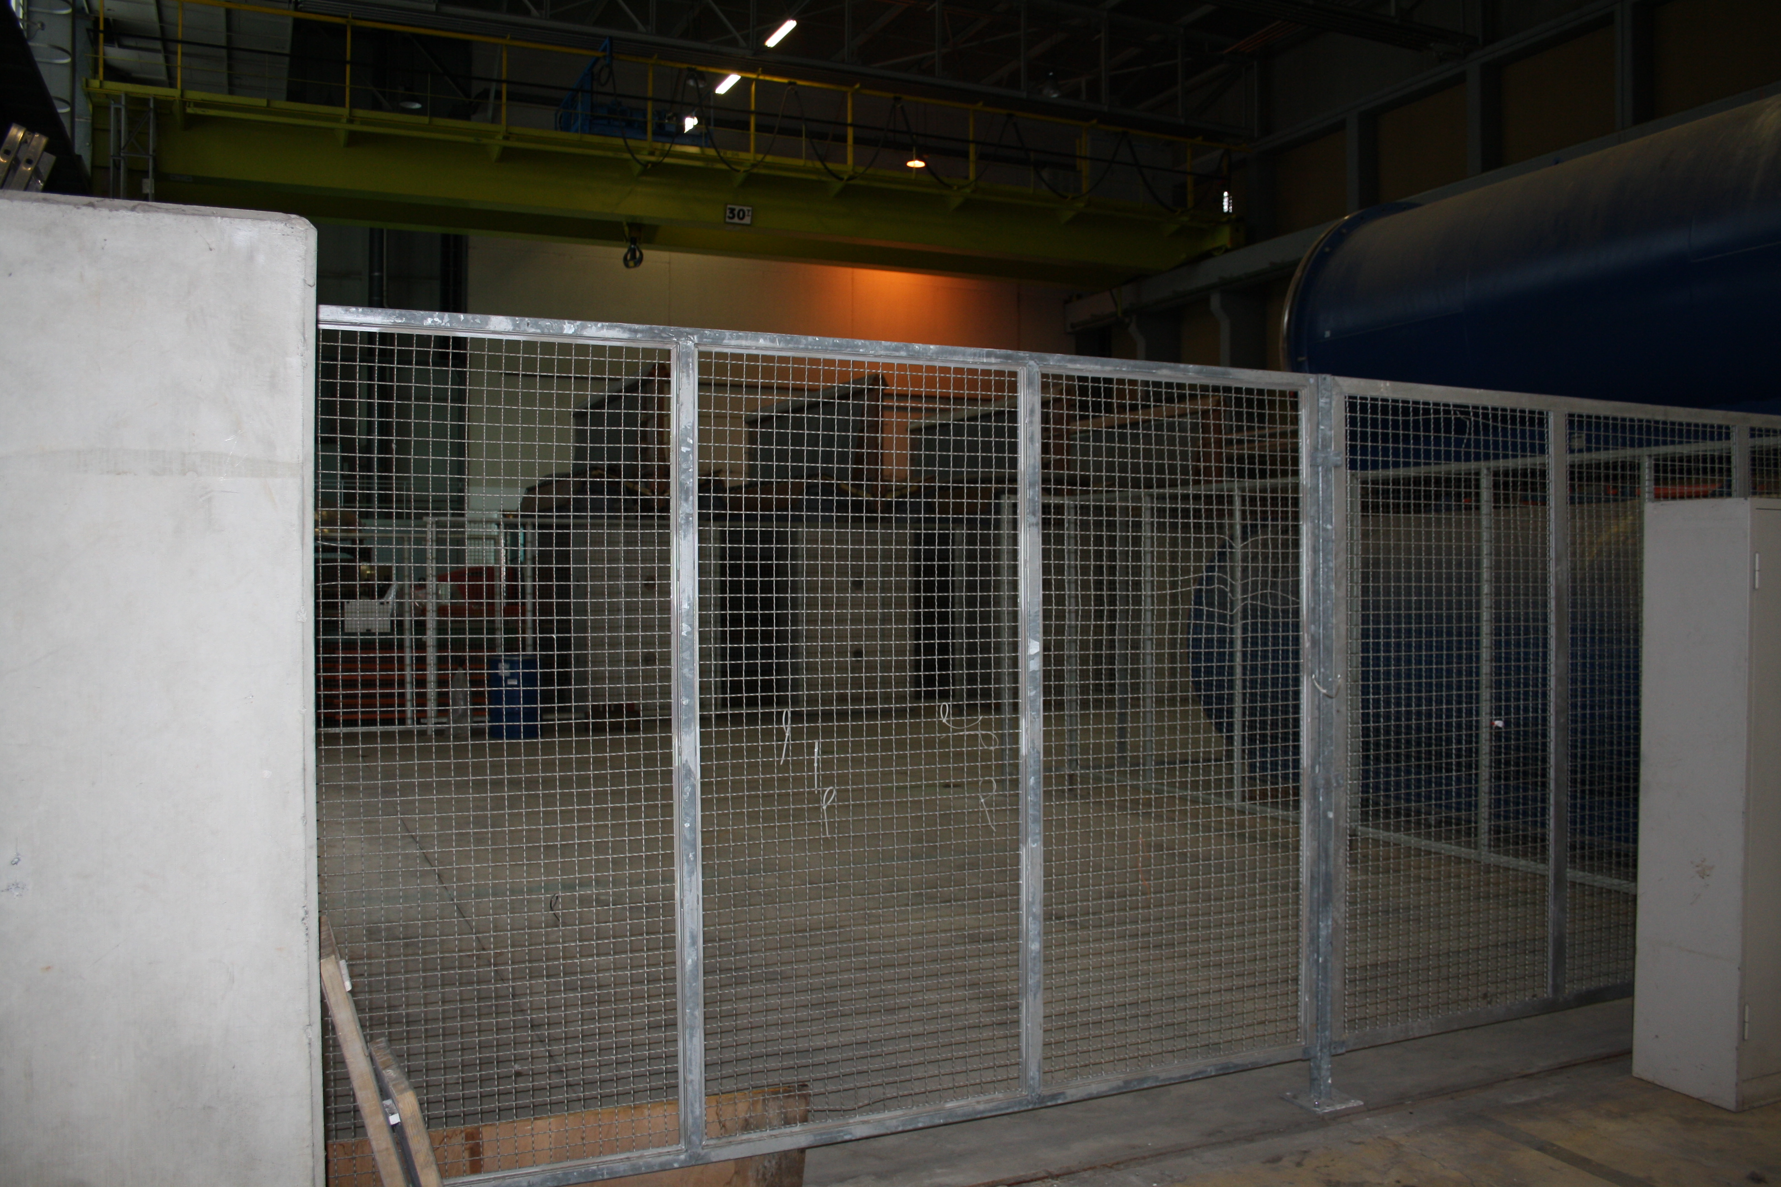
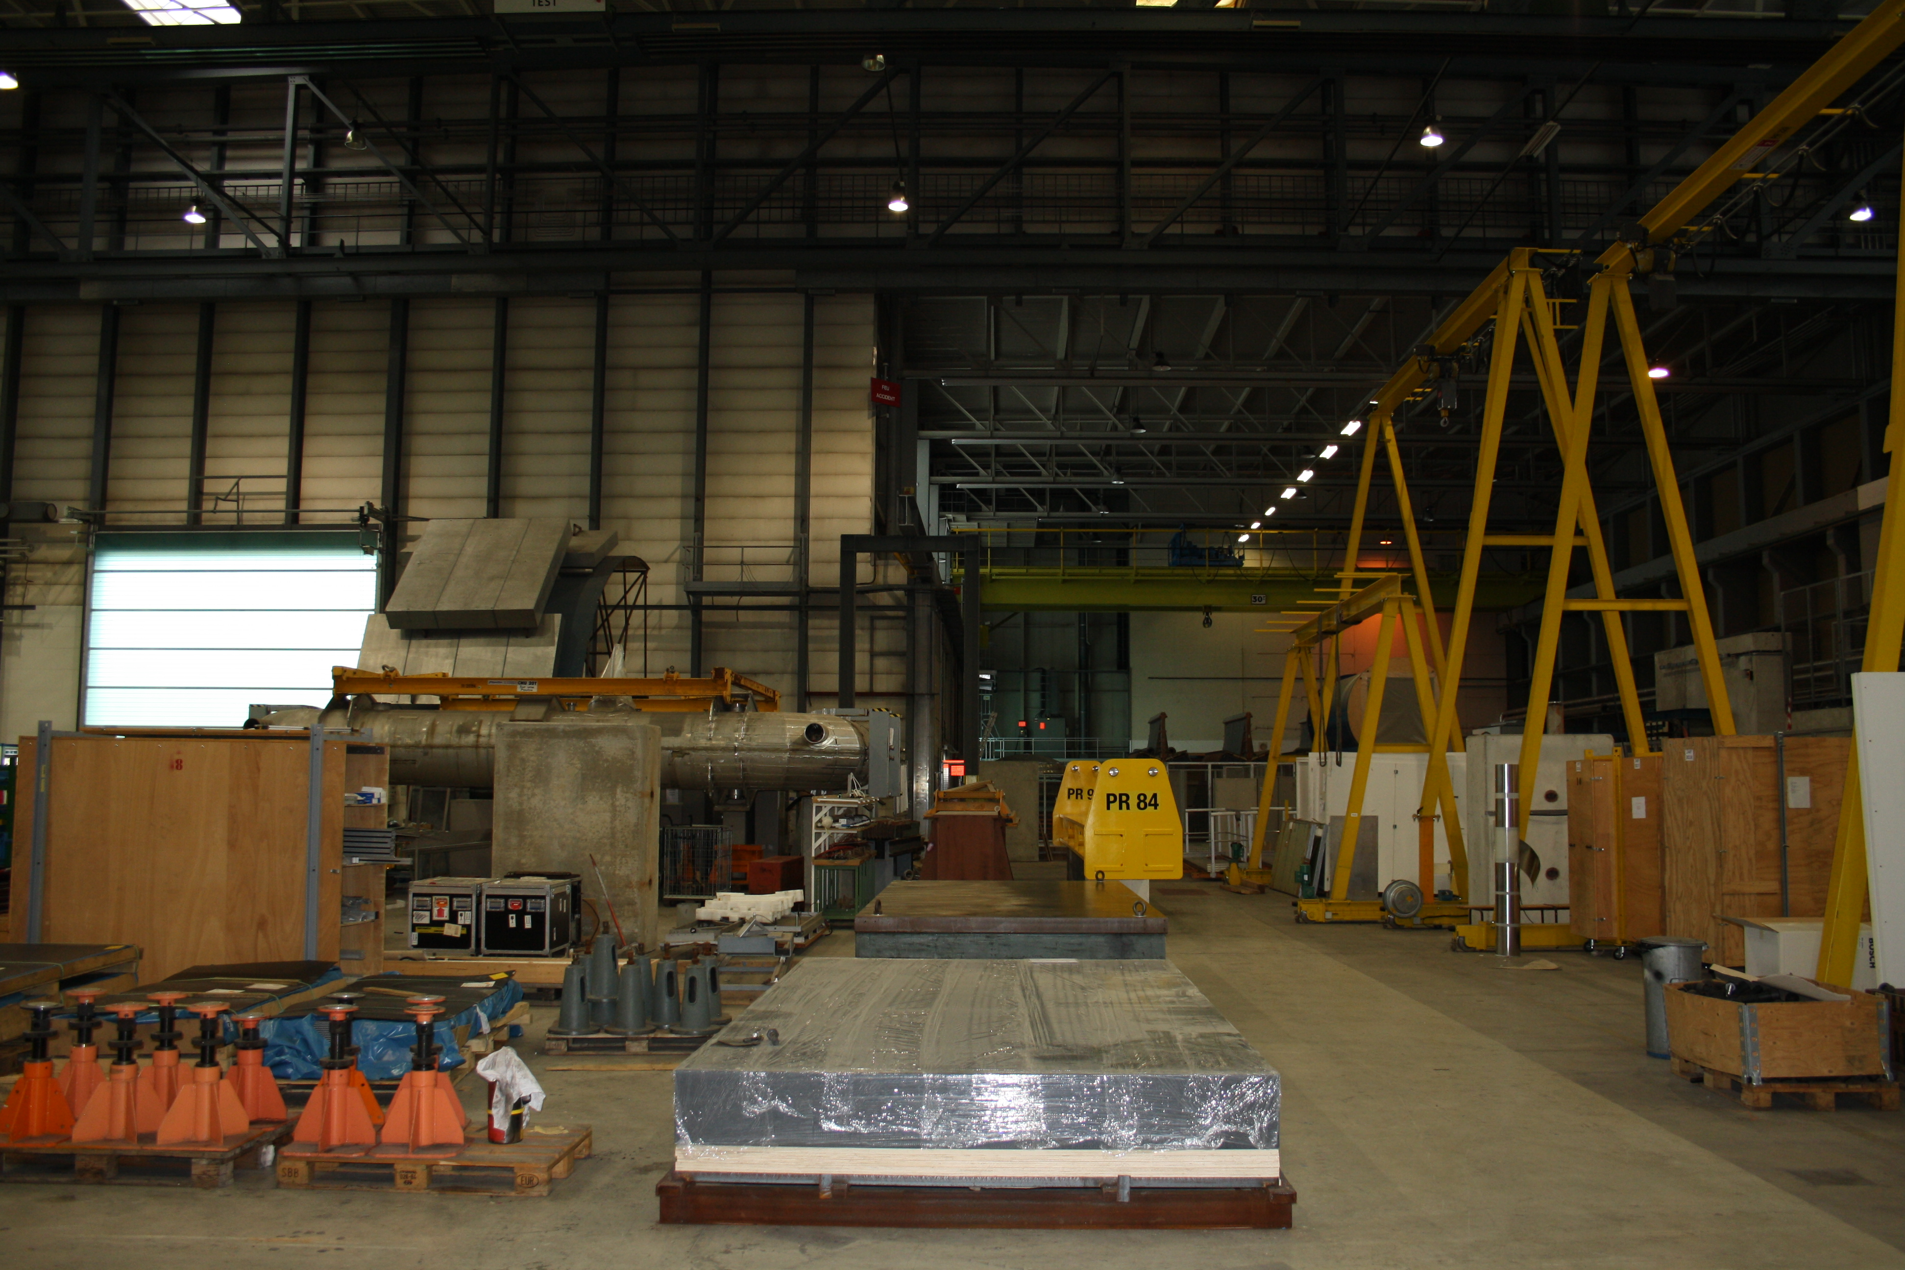
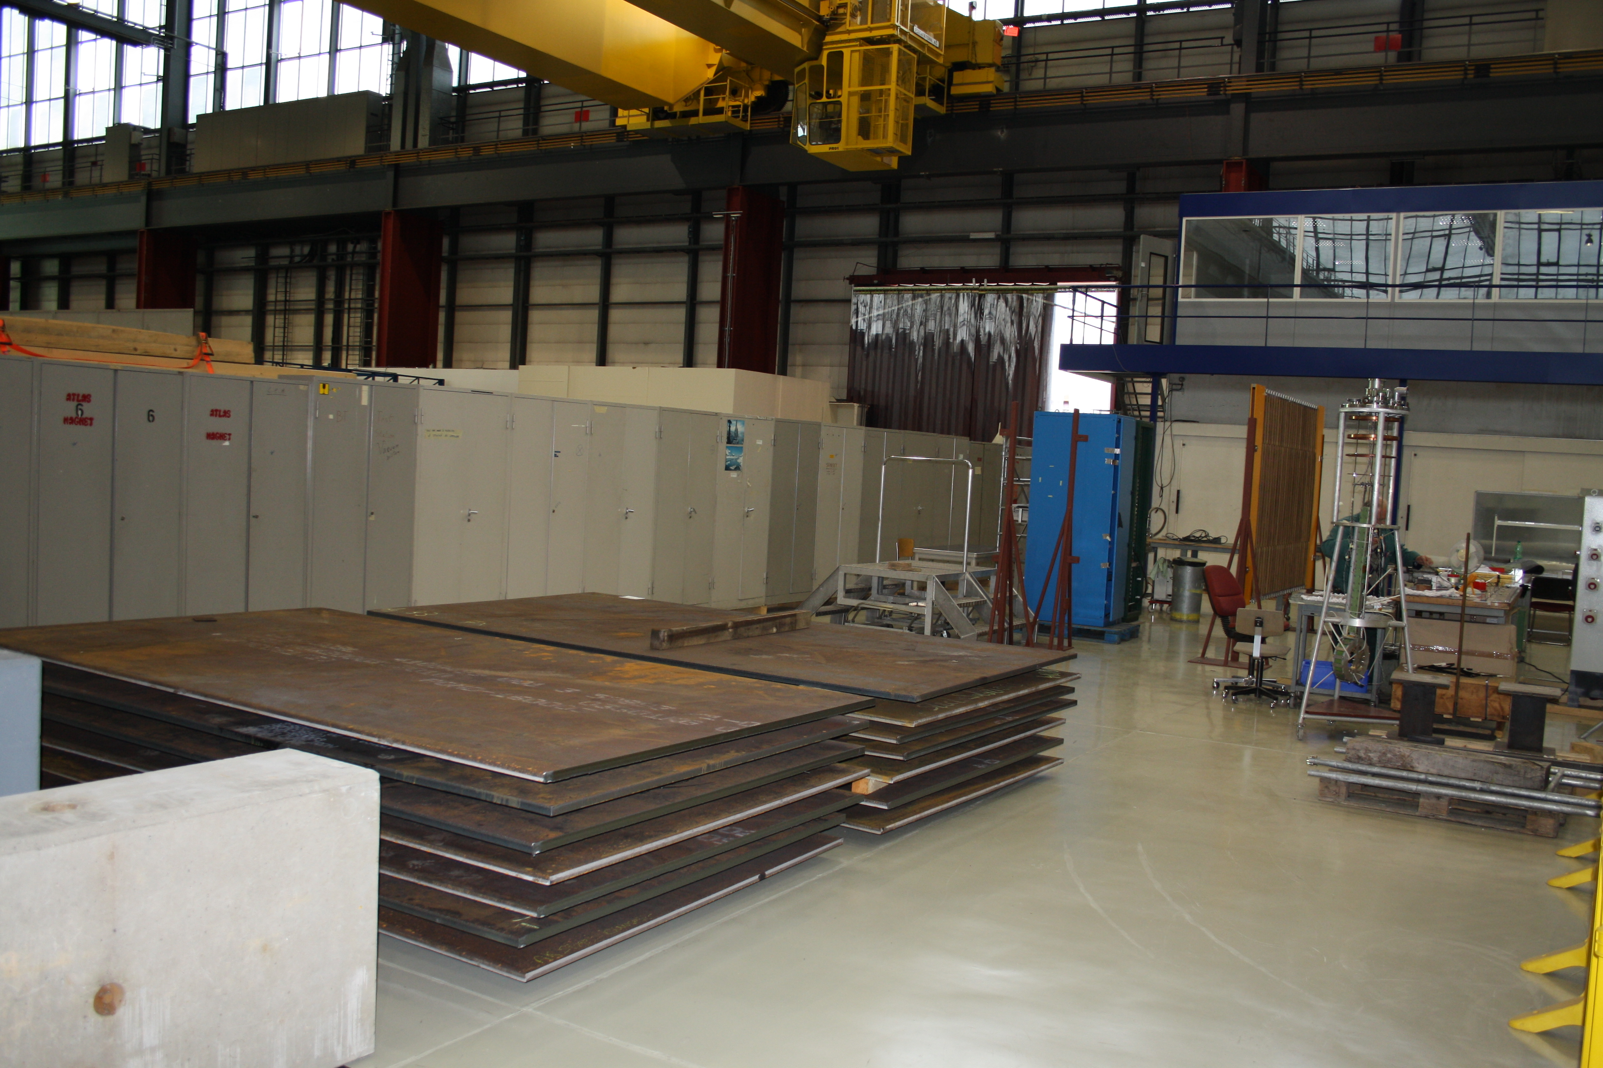
Potential assembly zone in bldg 180

