Slide 1
LED driver design
Georgi M. MITEV
Bulgarian academy of sciences
20.04.2016
Baby MIND Collaboration Meeting #1

Slide 2
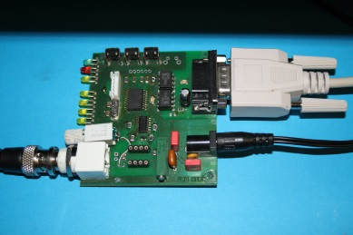
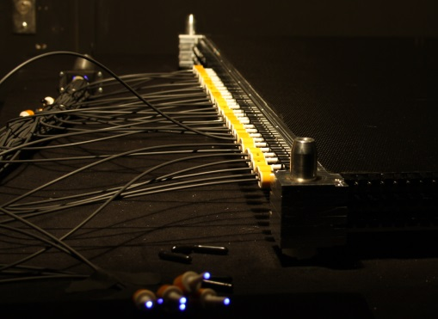
Initial LED driver design and use
Single channel design
Onboard LED
Adapted to work on external LED
Side effects
RS-232
interface
MCU
timing
Manual control and mode display
LED driver
amplitude
20.04.2016
Baby MIND Collaboration Meeting #1

Slide 3
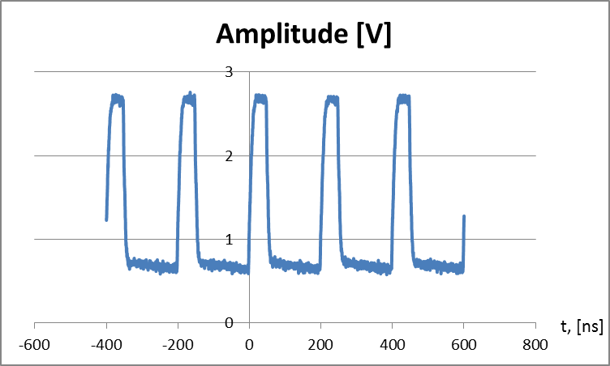
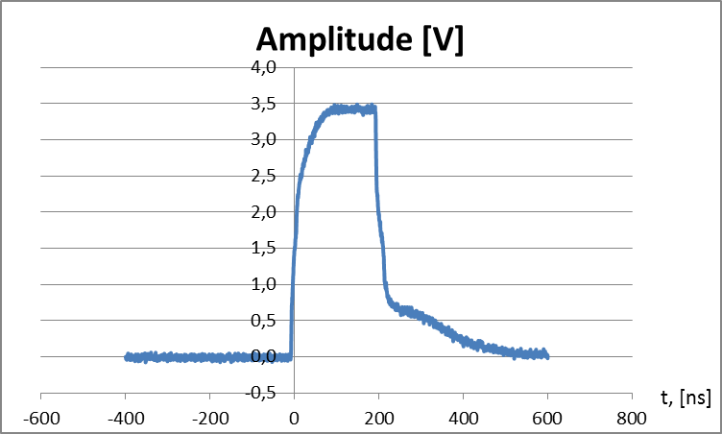
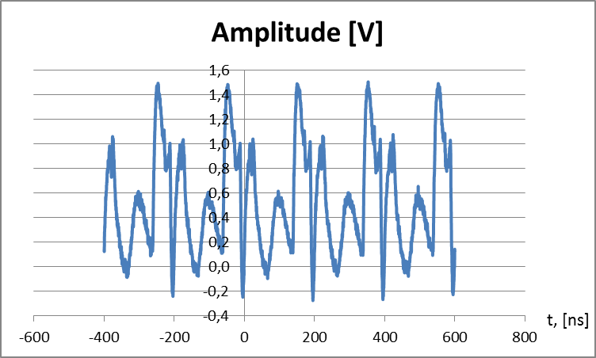
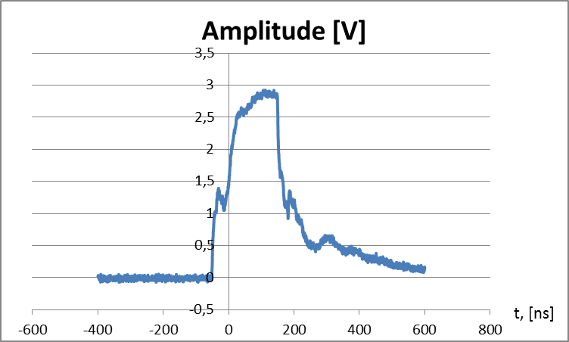
Pulse Shape
50 ns pulse
200 ns pulse
50 ns pulse, fed to LEDs over 2m coax
200 ns pulse, fed to LEDs over 2m coax
20.04.2016
Baby MIND Collaboration Meeting #1

Slide 4
LED driver upgrade proposition
Modular system with common pulse timing
Shorter pulse length
Better pulse shape
Multiple wavelengths
Separate diode amplitude control
Oscilloscope
Optical Pulse Control unit
LED tube + optics
Optical fiber bundle
3- channel amplitude control unit
. . . . .
Onboard USB & WiFi to RS-232 bridges
Master
timing control unit
Optical fiber bundle
timing
3- channel amplitude control unit
Amplitude control bus I²C
20.04.2016
Baby MIND Collaboration Meeting #1

