Slide 1
Trigger system for beam test
Mefodev, E. Noah
April 20, 2016

Slide 2
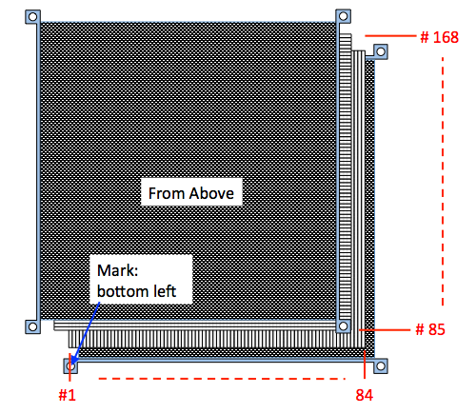
Layout
Several layouts possible:
  Can change within one beam test campaign
  ... or between June/July campaigns
  Single end readout vs double end readout
Example analog signal and tracking test:
  single end readout
  20 channels vertical
  20 channels horizontal
  10 modules
Example timing test:
  double end readout
  beam incident on 3 positions
  20 channels vertical
  20 channels horizontal
  5 modules

Slide 3
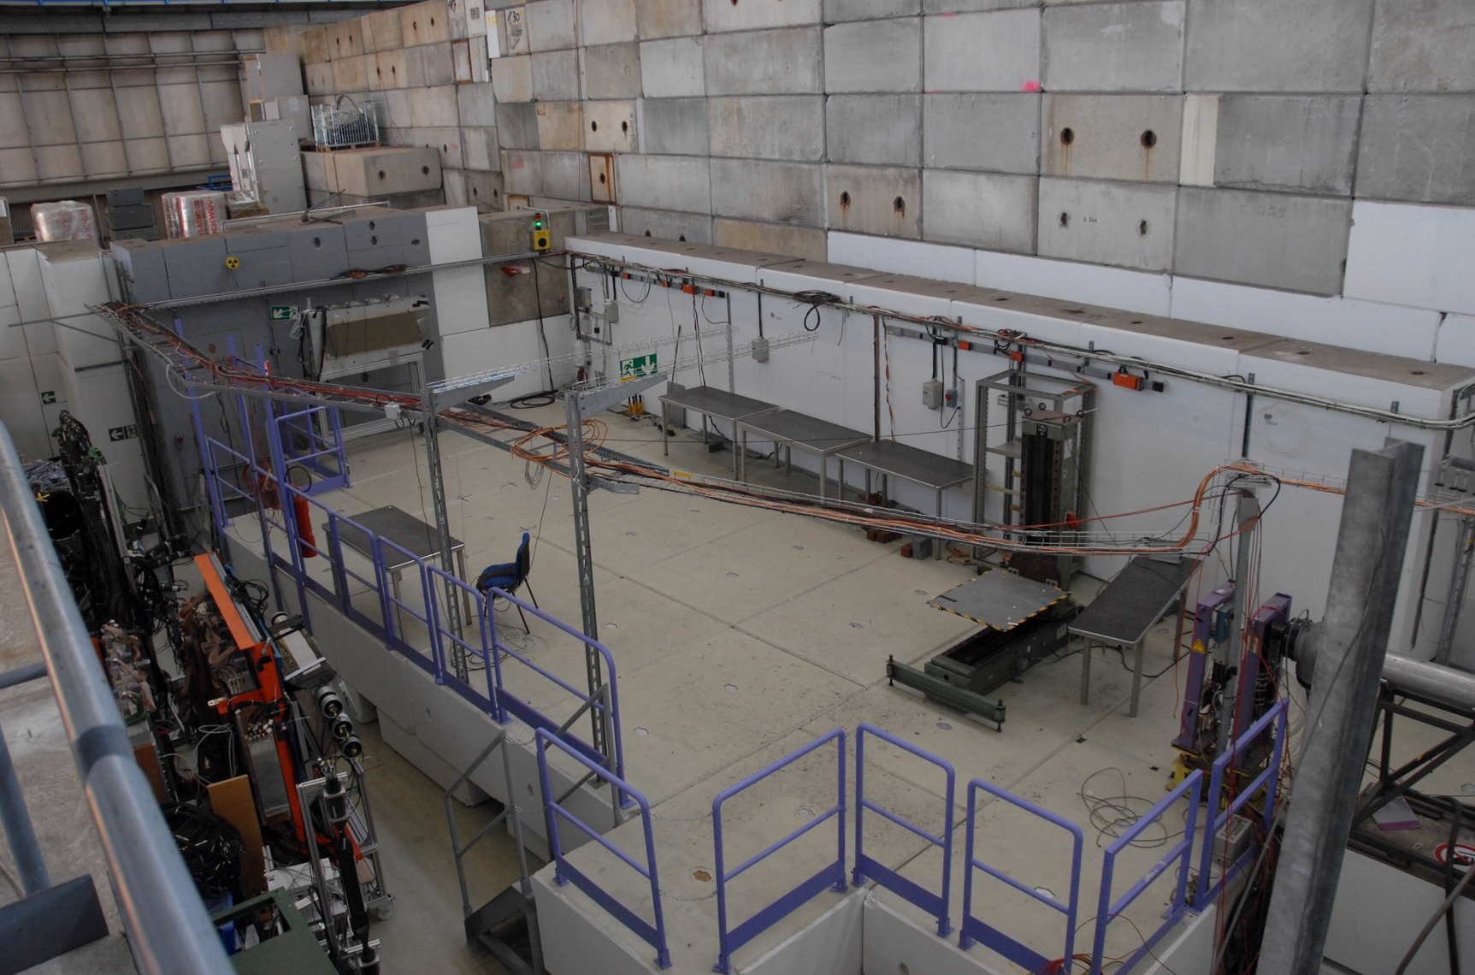
T9 experimental area

Slide 4
1 variant: internal trigger.
Example analog signal and tracking test:
  single end readout
  20 channels vertical
  20 channels horizontal
  10 modules
Beam

Slide 5
  2 variant: external trigger with 2 beam counters.
Example analog signal and tracking test:
  single end readout
  20 channels vertical
  20 channels horizontal
  10 modules
  2 beam counters
Beam
  2 beam counters

Slide 6
3 variant: external trigger with 2 extra modules.
Example analog signal and tracking test:
  single end readout
  20 channels vertical
  20 channels horizontal
  12 modules
  adder
2 extra modules
Beam

Slide 7
  2 variant: external trigger with 2 beam counters.
Example analog signal and tracking test:
  single end readout
  20 channels vertical
  20 channels horizontal
  10 modules
  2 beam counters
Beam
  2 beam counters

Slide 8
What we need to the 2 variant:
  2 extra beam counters (Support mechanics to hold triggers between modules)
    1st dimension depends of beam size;
    2nd 20x20 cm²
  2 PMTs;
  High-power supply for trigger PMTs;
  Trigger channel on each CITIROC;
  Generator with tracking threshold (NIM signal)
  Capacitors system to provide trigger signal to CITIROC;
  Cover all modules from light;
  Program to calculate SiPMs gain automatically.

Slide 9
What we need to know before beam:
PMTs specification;
Beam size;
Test NIM signal with capacitors system;
Trigger counters specification (time resolution);

