Slide 1
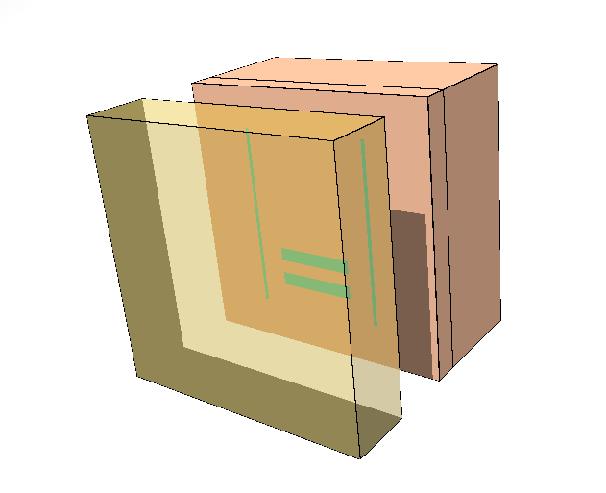
RadFET dose response in the CHARM mixed-field: FLUKA MC simulations
Matteo Marzo (EN-STI-FDA)
Markus Brugger, Rubén Garcia Alia (EN-EA)
Acknowledgements: Stefano Bonaldo, Salvatore Danzeca (EN-STI-ECE), Adam Thornton (EN-EA)

Slide 2
Overview
Present mismatch between experimental and FLUKA simulated doses
A second step simulation: RadFET geometry and new simulations settings
Updated scenario
Conclusions

Slide 3
Overview
Present mismatch between experimental and FLUKA simulated doses
A second step simulation: RadFET geometry and new simulations settings
Updated scenario
Conclusions

Slide 4
CHARM test-facility in FLUKA
Cu target and no shielding configuration
Postion 1 is taken as reference and positions 3, 10, 13 will be studied as well

Slide 5
1st step simulations settings
Entire CHARM geometry implemented in FLUKA: no shielding and Cu target configuration studied
Particles shower coming from the interaction between 24GeV protons beam and Cu target as source term
NEWDEFA defaults in FLUKA for transport and production of particles (given the large geometry of the facility, using higher thresholds allows us to save CPU time):
  Thresholds for Monte Carlo particles transport set at 10MeV (i.e. particles having energy lower than 10MeV deposit their energy on spot, without being transported and without originating other particles, once interacting with matter)
  Thresholds for Monte Carlo transport of neutrons set at 1E-5 eV
  Delta ray production thresholds set at 1MeV
Air rack 20x20x20 cm3 sensitive volume

Slide 6
Measured VS simulated doses: present scenario
Position | Experimental dose | 1st step dose | % difference
1 | 0.776 ± 23% | 1.102 | 30%
3 | 1.510 ± 23% | 2.281 | 34%
10 | 1.550 ± 29% | 2.401 | 35%
13 | 3.420 ± 28% | 4.510 | 25%
Doses are expressed in 1e-14 Gy/pot
The differences between measured (average) and simulated doses are 25-35% for the cases of study (rack positions 1, 3, 10, 13)
Further investigations needed to find the source of this mismatch

Slide 7
Overview
Present mismatch between experimental and FLUKA simulated doses
A second step simulation: RadFET geometry and new simulations settings
Updated scenario
Conclusions

Slide 8
2nd step simulations settings
RadFET geometry implemented in FLUKA: kovar lid, Silicon die and substrate and Silicon dioxide gate oxide
A beam having the same surface as the RadFET and carrying information about particles spectra chosen as source term (mixed-field is in good approximation radial at the racks positions)
RadFET gate oxide as sensitive volume
Silicon Dioxide gate
Silicon SUBSTRATE
Kovar LID
Silicon DIE
Beam direction

Slide 9
1st vs 2nd step validation: air rack and NEWDEFA defaults settings
First of all we tried to reproduce the 1st step dose simulated on the air rack, for the position 1, using the same geometry of the rack and the same simulations settings (NEWDEFA), but changing the source term:
  1st step → particles shower coming from the beam-target interaction (CHARM geometry)
  2nd step → mixed field given by using a beam carrying all the spectra (external subroutine)
By simply enlarging from 20x20 cm^2 to 50x50 cm^2 the beam surface we got a dose in perfect agreement with the previous one, even if we introduced the approximation of the beam
The dose we got is 1.101e-14 Gy/pot, against 1.102e-14 Gy/pot in the previous step of simulation (all the 2nd step simulated dose values presented have uncertainties of the 2-5% )

Slide 10
A new defaults: PRECISIO
PRECISIO defaults in FLUKA for transport and production of particles:
  Thresholds for Monte Carlo particles transport set at 100keV
  Thresholds for Monte Carlo transport of neutrons set at 1E-5 eV
  Delta ray production thresholds set at 100keV
In addition, EMF-CUT and DELTARAY cards have been used to further lower the energy thresholds for transport and production of electrons, positrons and photons and delta ray produced by muons and charged hadrons to 1keV
On the other hand, PART-TH card have been employed to lower energy transport cut-offs for protons, pions, muons, kaons and alpha particles to 1keV
Setting very low thresholds for the simulations is not an issue in terms of CPU time now, since the size of our geometry is of the same order of magnitude as the beam surface.

Slide 11
Air rack and RadFET: PRECISIO vs NEWDEFA
We then simulated the dose in the air rack and the SiO2 gate oxide of the RadFET by using both NEWDEFA (with thresholds lowered at 1MeV) and PRECISO (with thresholds lowered at 1keV) defaults settings: this is an important overview of what a first change in thresholds should determine, after the validation
Volume | Dose NEWDEFA 1MeV | Dose PRECISIO 1keV | % differ.
Air rack | 1.101 | 0.840 | 24%
Gate Oxide (lid ON) | 0.895 | 0.757 | 15%
Doses are expressed in 1e-14 Gy/pot
In the frame of NEWDEFA, the dose scored in the SiO2 gate oxide of the RadFET (kovar lid ON) is the 20% lower than the dose scored in the air rack
Scoring dose in the SiO2 gate oxide of the RadFET (kovar lid ON), using NEWDEFA or PRECISIO makes a difference of the 15%
The dose scored in the RadFET (kovar lid ON) with precisio is the 30% lower than the one scored in the air rack using NEWDEFA!

Slide 12
PRECISIO deafults: from 1MeV to 1keV thresholds
Energy thresholds | Dose at the Gate oxide
1MeV | 0.895
100keV | 0.768
10keV | 0.787
1keV | 0.757
Doses are expressed in 1e-14 Gy/pot
Having found a 15% difference between the dose scored with PRECISIO and 1MeV and the one obtained from PRECISIO and 1keV, we want to see what happens in between
The major change, in the frame of simulations with PRECISIO settings, is between 1MeV and 100keV
We decide to consider PRECISIO + energy thresholds at 1keV as the most suitable setting for production and transport of particles during the Monte Carlo simulations

Slide 13
Input spectra energy cut: 1MeV and 100keV spectra
Gate oxide thickness | Dose if 1MeV input | Dose if 100keV input | % differ.
400nm | 0.757 | 0.820 | 8%
100nm | 0.719 | 0.816 | 12%
Doses are expressed in 1e-14 Gy/pot
It’s clearly visible that the gate oxide thickness does not make a significant difference (between 100nm and 400nm): we chose a 400nm thick oxides
A further difference in terms of deposited dose can be found, if input spectra cut at 1MeV or 100keV are used: this is of the order of 10%
We decide to use input spectra at 100keV, to take advantage of the 1MeV → 100keV energy range additional information

Slide 14
Summary (1)
Overview of the simulations for the rack position 1
Simulation stage | Dose | % change
1st step: air rack | 1.102
2nd step: RadFET gate oxide, NEWDEFA (1MeV), input spectra at 1MeV | 0.895 | -20%
2nd step: RadFET gate oxide, PRECISIO (1keV), Input spectra at 1MeV | 0.757 | -15%
2nd step: RadFET gate oxide, PRECISIO (1keV), Input spectra at 100keV | 0.820 | +10%
Doses are expressed in 1e-14 Gy/pot

Slide 15
Summary (2)
Ideally starting from 1.102e-14 Gy/pot in the air rack in postion 1, obtained with NEWDEFA defaults:
Dose decreases of the 20% if we score it in the RadFET (kovar lid ON) gate oxide (0.895e-14 Gy/pot )
A further decrease of the 15% is detected if PRECISIO defaults + 1keV thresholds is used (0.757e-14 Gy/pot )
An increase of the 10% is found if we use the same setting as the previous point, but changing the input spectra energy thresholds from 1MeV to 100keV (0.820e-14 Gy/pot )
The total cumulative effect of the change of the discussed parameters is of the order of the 25%, from 1.101e-14 Gy/pot to 0.820e-14 Gy/pot! This goes in the direction of the experimental measurements.

Slide 16
Overview
Present mismatch between experimental and FLUKA simulated doses
A second step simulation: RadFET geometry and new simulations settings
Updated scenario
Conclusions

Slide 17
Measured VS simulated doses: updated scenario
Position | Experimental dose | 1st step dose | % difference wrt experim. | 2nd step dose | % difference wrt experim.
1 | 0.776 ± 23% | 1.102 | 30% | 0.820 | 5%
3 | 1.510 ± 23% | 2.281 | 34% | 1.740 | 13%
10 | 1.550 ± 29% | 2.401 | 35% | 1.900 | 18%
13 | 3.420 ± 28% | 4.510 | 25% | 3.610 | 5%
Doses are expressed in 1e-14 Gy/pot
The % differences between measured (average) and simulated doses are definitely decreasing going in the direction of the experimental results

Slide 18
Overview
Present mismatch between experimental and FLUKA simulated doses
A second step simulation: RadFET geometry and new simulations settings
Updated scenario
Conclusions

Slide 19
Conclusions
This study showed how:
Using a detailed geometry of the RadFET in kovar lid configuration
Scoring dose in the 400nm gate oxide in SiO2
Using source spectra cut at 100keV
Setting energy thresholds for transport and production of particles at 1keV plus PRECISIO defaults in FLUKA
Led to a reduction of the previously calculated doses in different postions at CHARM of the order of 20-30% in the direction of the experimental results.
The next step of our work is to calculate particles contribution (in terms of dose) to the total dose deposited on the gate oxide of the RadFET, to see how each particle of the mixed field contributes to energy deposition.

Slide 20
Many thanks!

